Slide 1
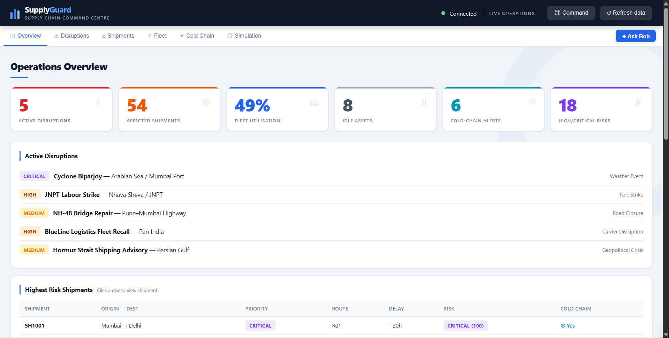
SUPPLY CHAIN COMMAND CENTRE
SupplyGuard
Live visibility into disruptions, shipment risk, fleet use and cold-chain integrity, with what-if simulation.
Notes:
SupplyGuard is a supply chain command centre. This deck walks through the platform screen by screen: overview, disruptions, shipments, cold chain and simulation.

Slide 2
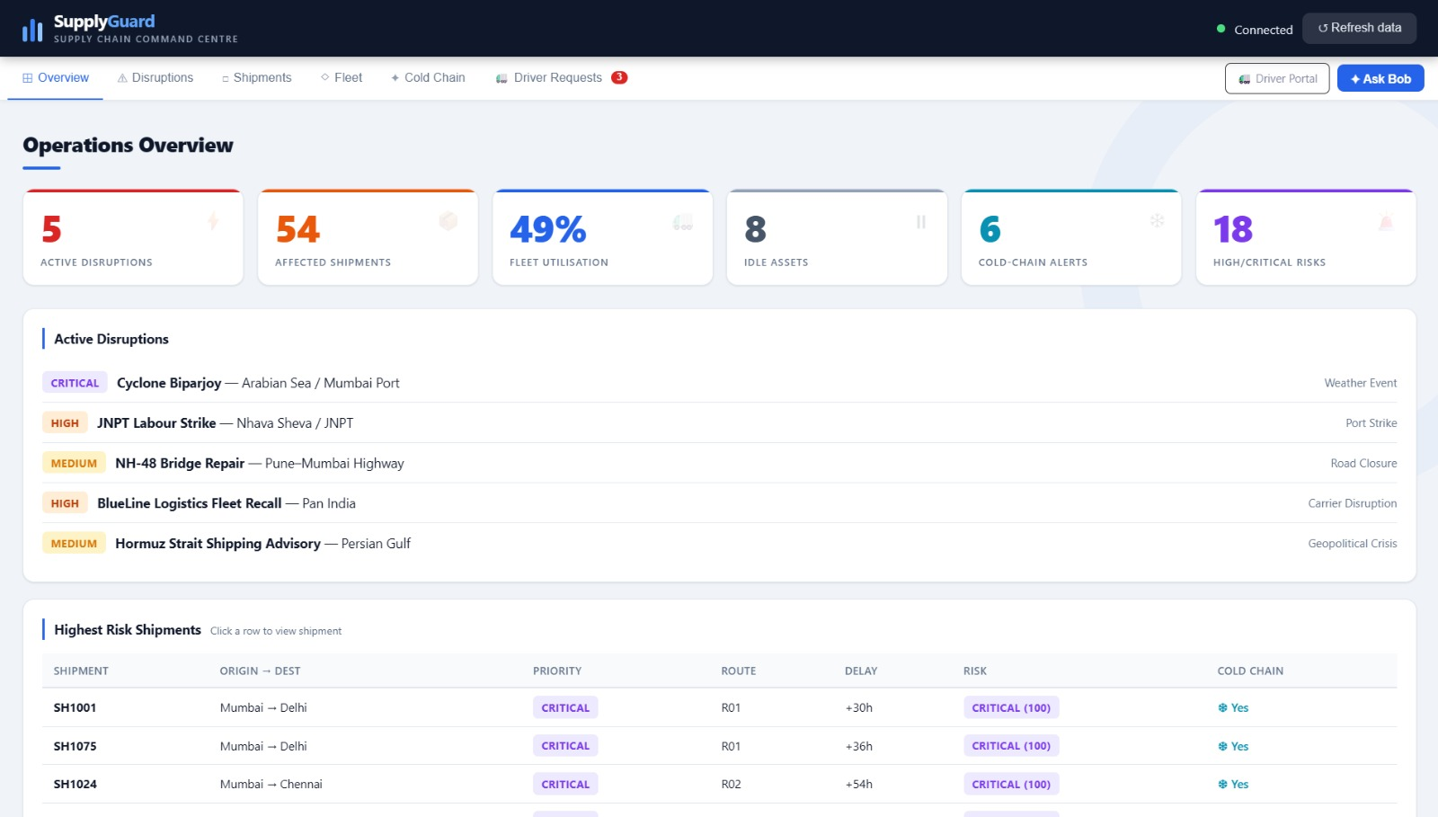
Operations overview
One screen for the health of the network
5
54
ACTIVE DISRUPTIONS
AFFECTED SHIPMENTS
49%
8
FLEET UTILISATION
IDLE ASSETS
6
18
COLD-CHAIN ALERTS
HIGH / CRITICAL RISKS
The overview pairs six headline KPIs with the active disruption list and the highest-risk shipments (for example SH1001, Mumbai to Delhi, cold chain, risk 100).
Notes:
Headline numbers: 5 active disruptions, 54 affected shipments, 49% fleet utilisation, 8 idle assets, 6 cold-chain alerts and 18 high or critical risks. Rows in the highest-risk table are clickable.

Slide 3
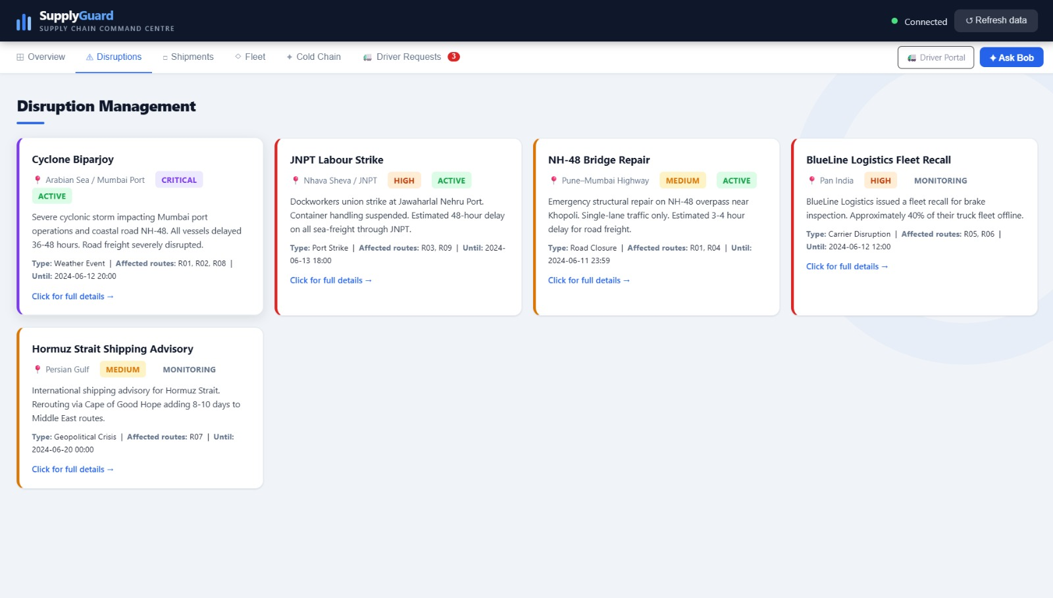
Disruption management
Five live events, ranked by severity
Cyclone Biparjoy
CRITICAL
Arabian Sea / Mumbai Port
JNPT Labour Strike
HIGH
Nhava Sheva / JNPT
BlueLine Logistics Fleet Recall
HIGH
Pan India
NH-48 Bridge Repair
MEDIUM
Pune–Mumbai Highway
Hormuz Strait Shipping Advisory
Each card shows type, affected routes, expiry and status (Active or Monitoring). Cyclone Biparjoy delays all vessels by 36 to 48 hours and severely disrupts road freight; the JNPT strike halts container handling.
MEDIUM
Persian Gulf
Notes:
Cyclone Biparjoy and the JNPT strike are Active; BlueLine fleet recall (about 40% of trucks offline) and the Hormuz advisory (8 to 10 extra days via Cape of Good Hope) are in Monitoring.

Slide 4
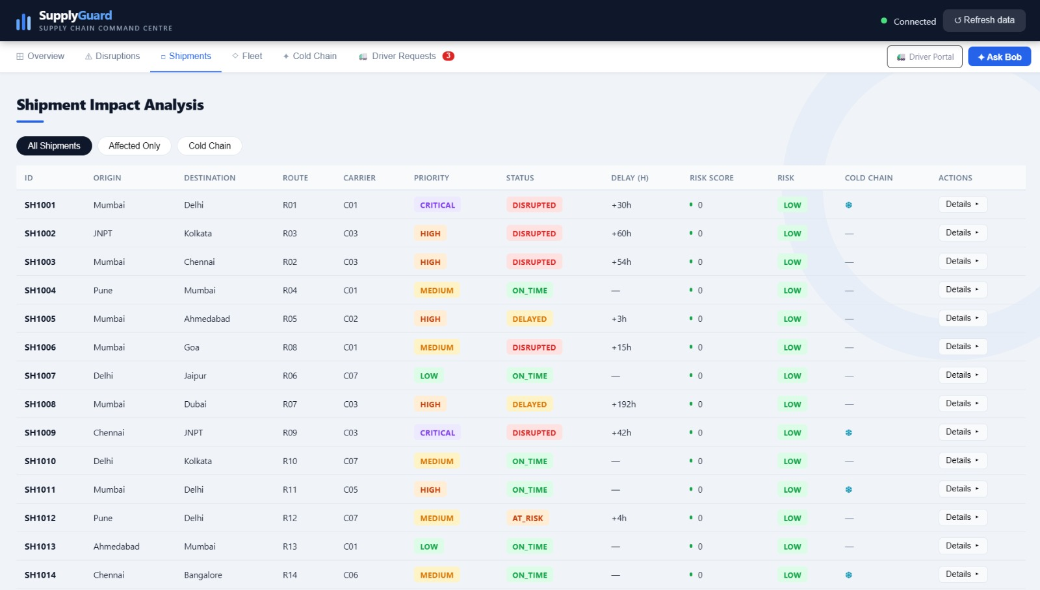
Shipment impact analysis
Every shipment with status, delay and risk in one table
Three views
All Shipments, Affected Only and Cold Chain filters
Rich columns
Route, carrier, priority, status, delay (h), risk score and cold-chain flag
Drill down
Sortable columns and a Details action on every row
Notes:
Status values include ON_TIME, AT_RISK and DISRUPTED. Cold-chain shipments carry a snowflake marker.

Slide 5
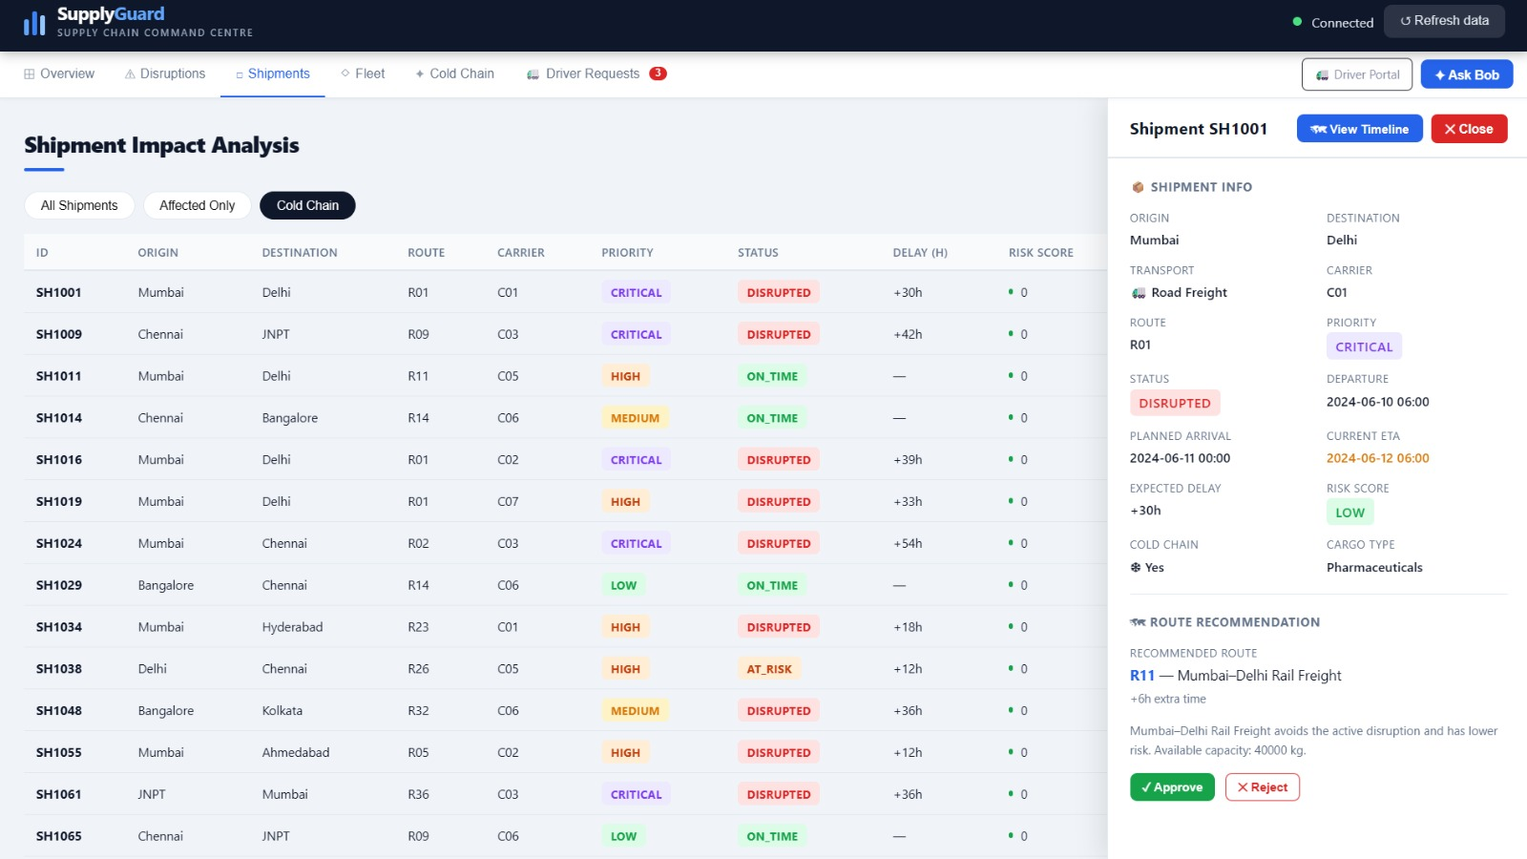
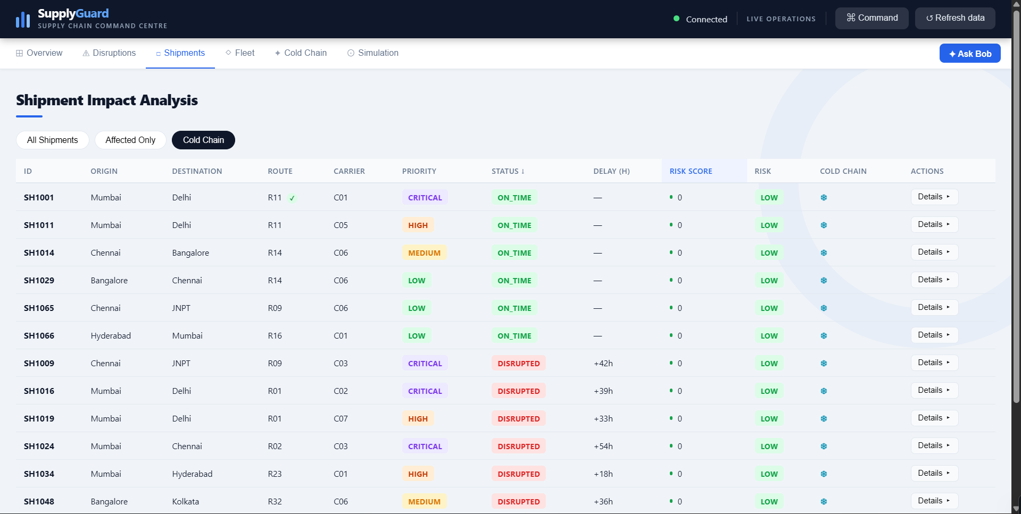
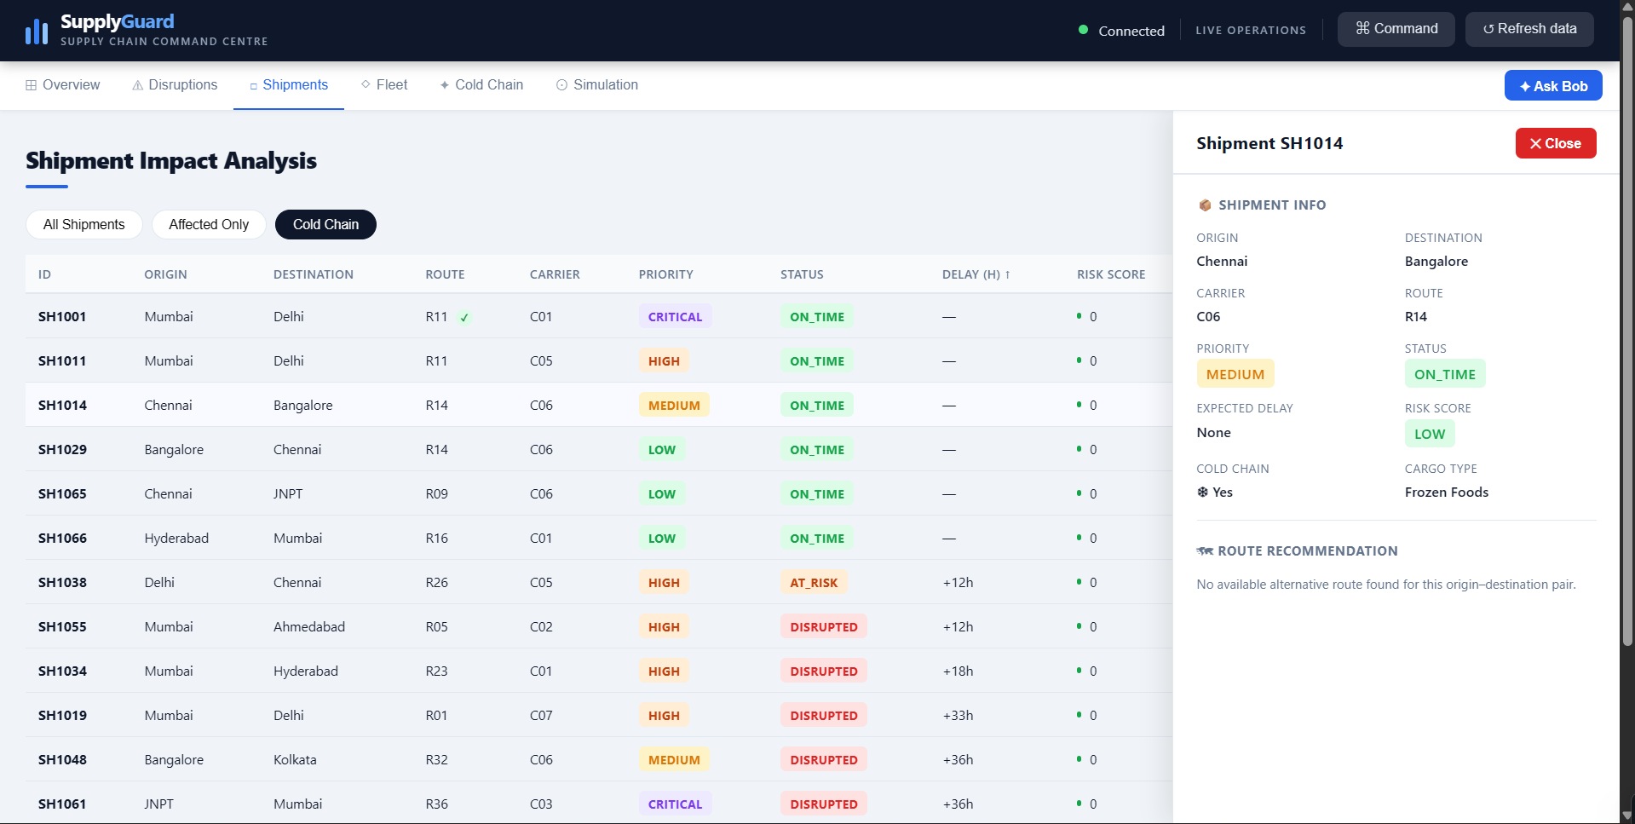
Drilling into cold-chain shipments
Filter the table, then open a shipment for its detail and route advice
Cold Chain filter
Shipment detail panel
Reefer loads sorted by status, so disrupted ones surface fast, such as SH1009 (+42h) and SH1024 (+54h).
SH1014, Chennai to Bangalore, frozen foods: on time with low risk. The route recommendation reports no alternative route for this pair.
Notes:
The side panel shows origin, destination, carrier, route, priority, status, expected delay, risk score, cold-chain flag and cargo type, plus a route recommendation.

Slide 6
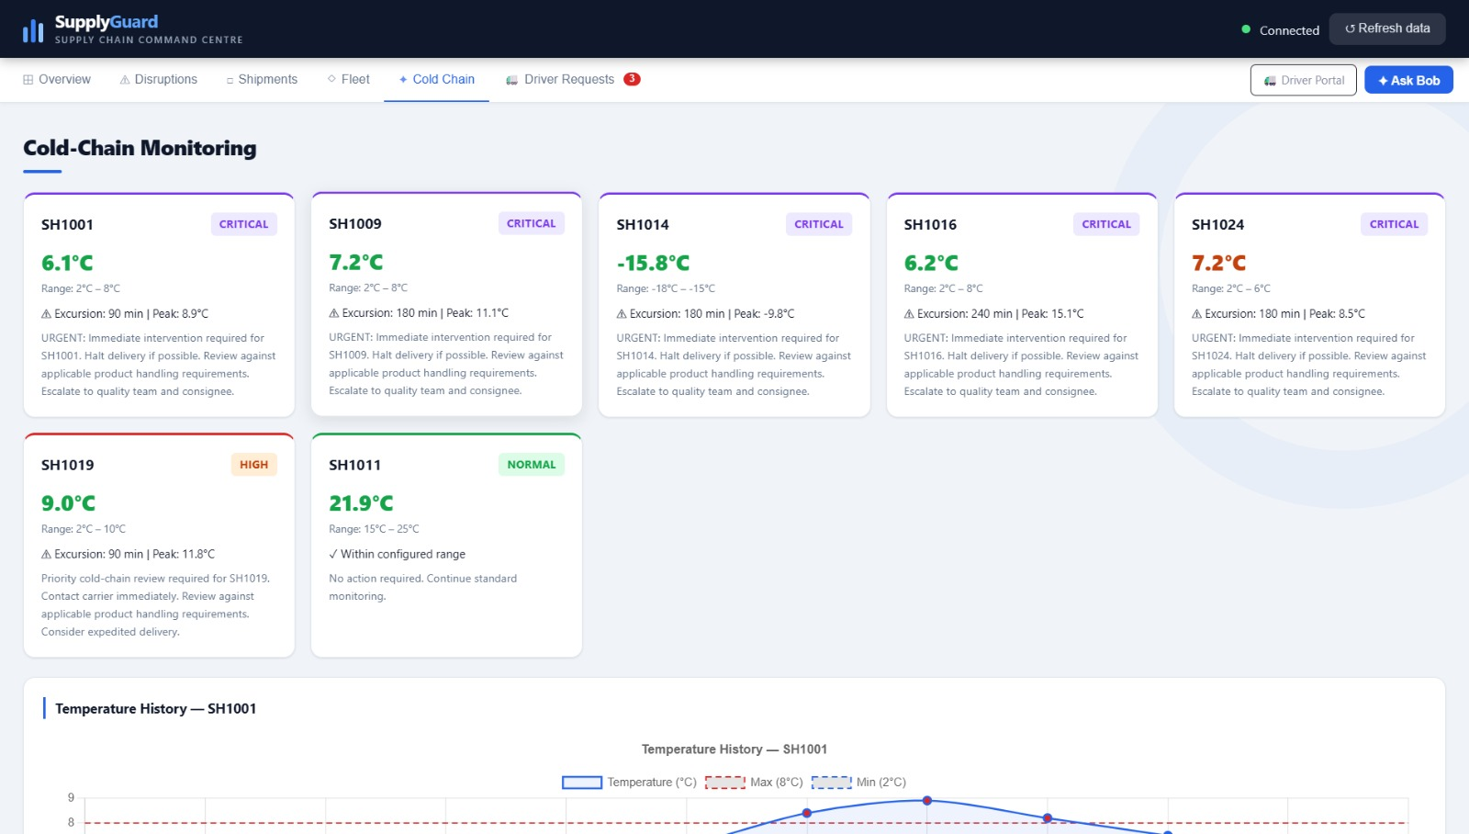
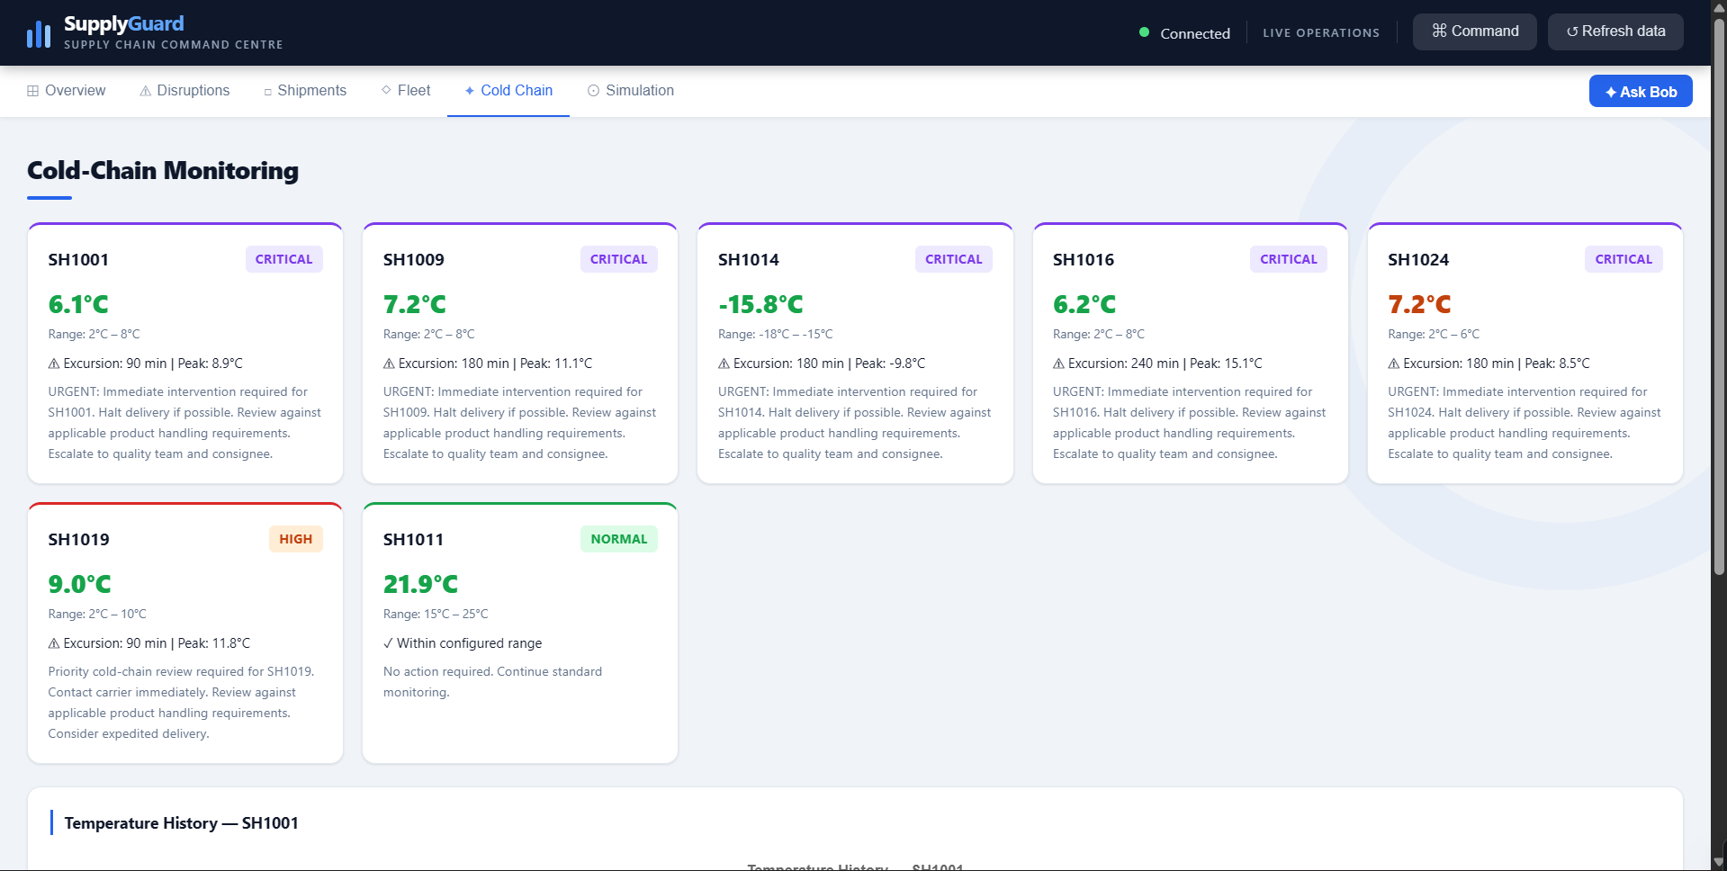
Cold-chain monitoring
Temperature excursions tracked per shipment against its allowed range
5
1
1
CRITICAL
HIGH
NORMAL
Recommended actions
Critical: halt delivery if possible, review against handling requirements, escalate to quality and consignee
High: contact carrier and consider expedited delivery
Each card shows the current temperature, permitted range, excursion length and peak, for example SH1016: 240 min, peak 15.1°C.
Notes:
Ranges differ by product: SH1014 is frozen (-18 to -15°C), SH1011 ambient (15 to 25°C), others 2 to 8°C or similar.

Slide 7
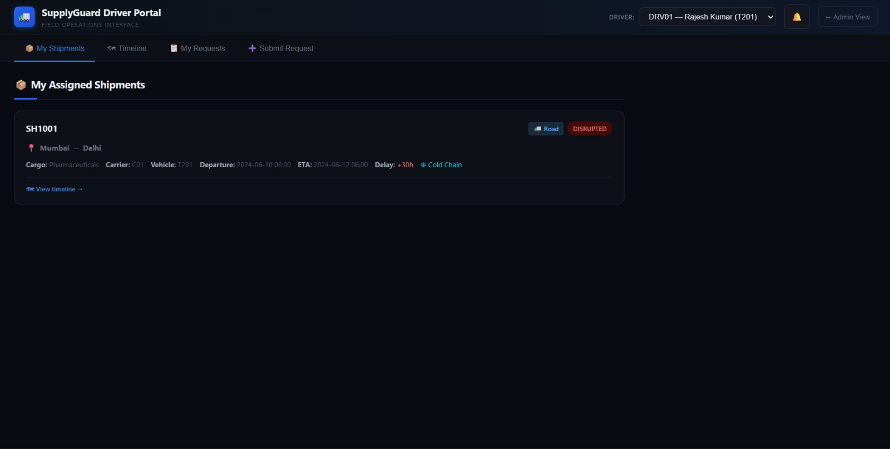
Driver Portal
Driver can submit the request for route change.
Notes:
Ranges differ by product: SH1014 is frozen (-18 to -15°C), SH1011 ambient (15 to 25°C), others 2 to 8°C or similar.

Slide 8
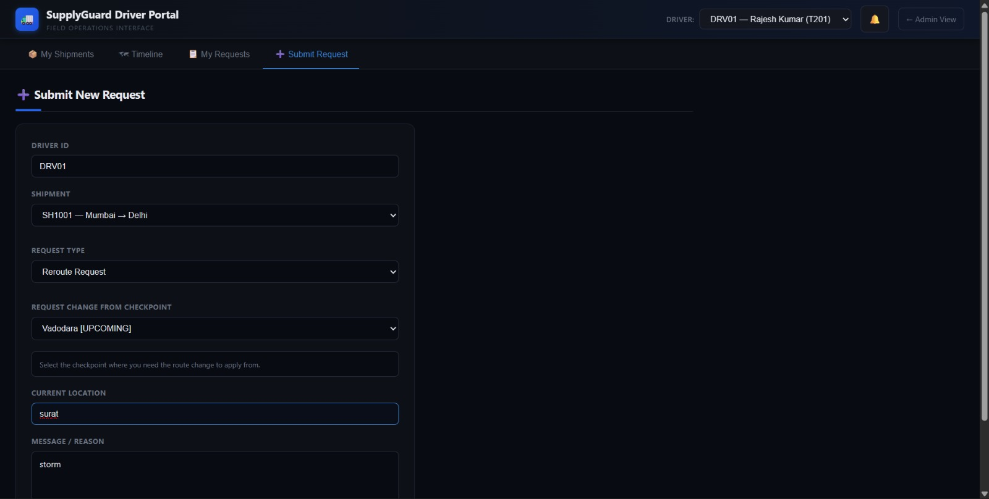
Driver Portal
Driver can submit the request for route change.
Notes:
Ranges differ by product: SH1014 is frozen (-18 to -15°C), SH1011 ambient (15 to 25°C), others 2 to 8°C or similar.

Slide 9
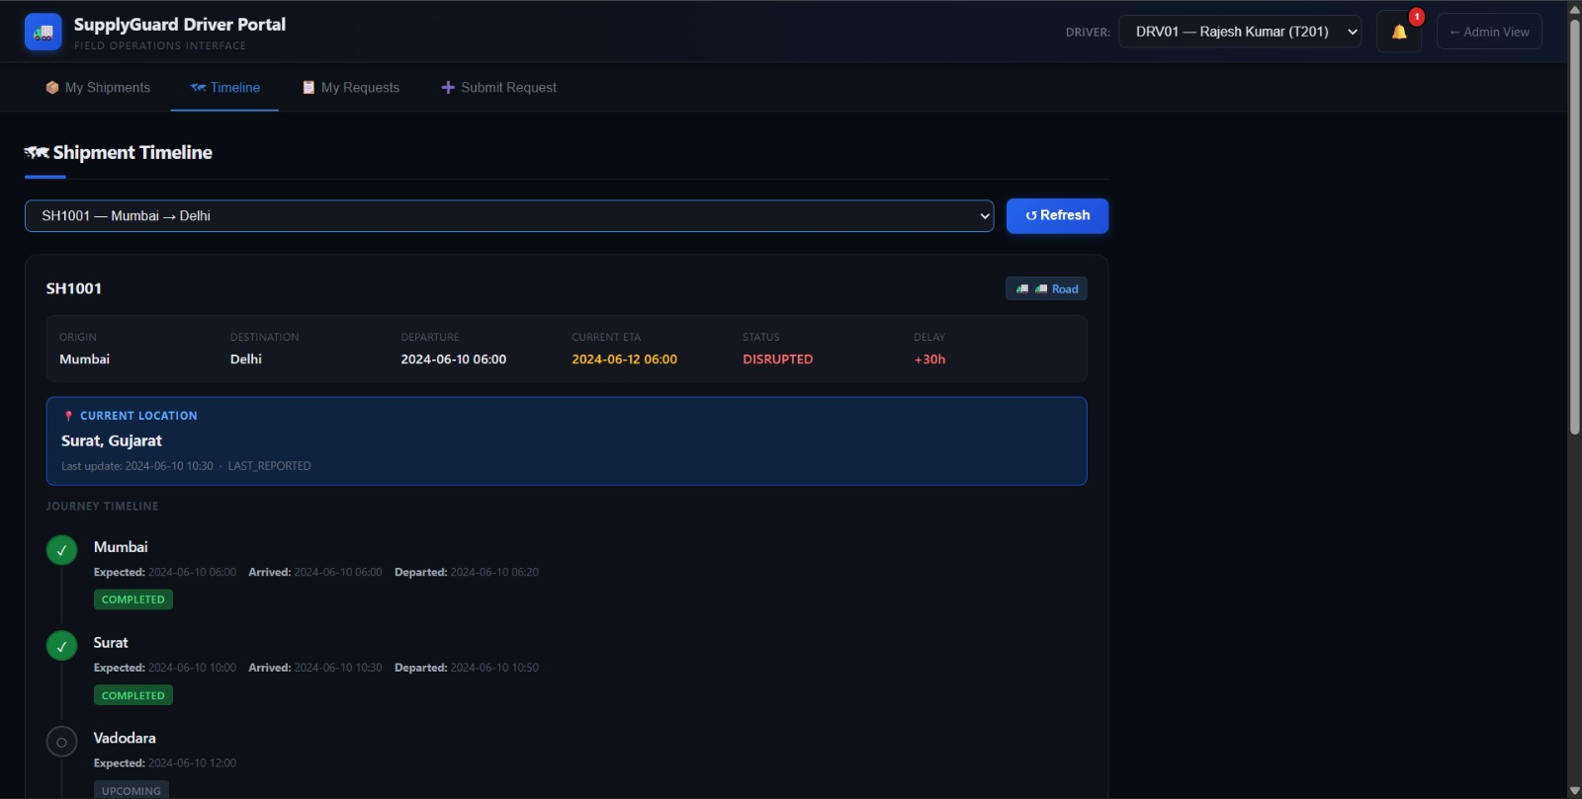
Driver Portal
Driver can also view his Progress in the timeline.
Notes:
Ranges differ by product: SH1014 is frozen (-18 to -15°C), SH1011 ambient (15 to 25°C), others 2 to 8°C or similar.

