Slide 1



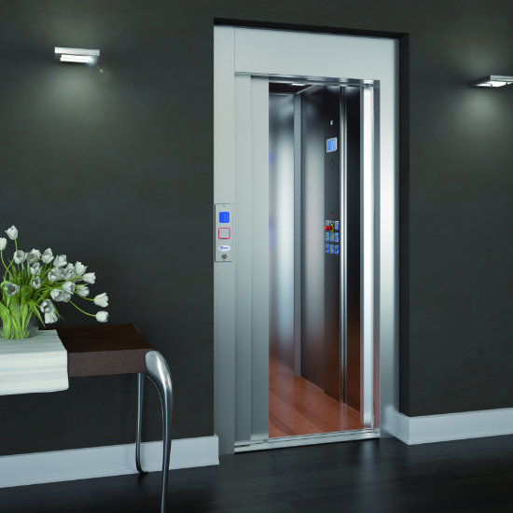
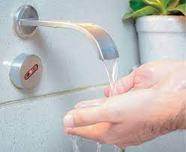
Sensor
Devices
Submitted by : Submitted to :
Bhawana Dr. Alekha Kumar Mishra
2021PGCACA011

Slide 2
Points to be discussed… What are SENSOR DEVICES ? Why SENSOR DEVICES ? Real World Examples Different types of sensors… How sensors work ? How can you say a sensor is good or bad ?

Slide 3
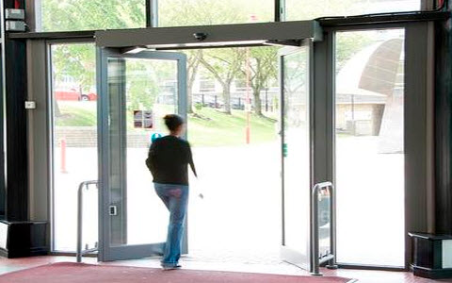
In malls,
Doors will automatically open as a person go towards the door.
How?

Slide 4


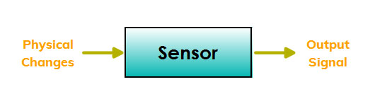
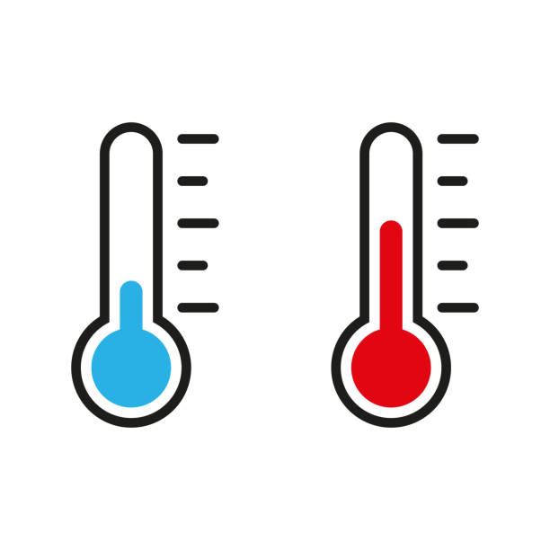

WHAT IS A SENSOR DEVICE?
A sensor is a device that detects events or changes in its environment and provides output(signal) with respect to that input.
Physical Changes / Inputs
Now Let’s Discuss sensors types …..

Slide 5
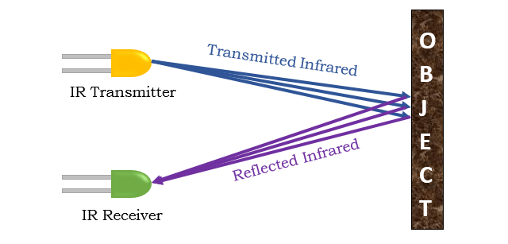
Infrared Sensors – Detect presence of object.
Working
Examples

Slide 6
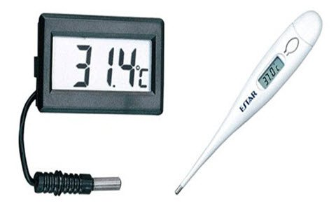
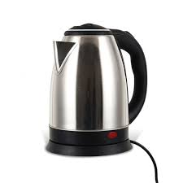
Temperature Sensor : Measures the change in temperature.
Uses the convertor for converting the
measured temperature to electrical signals.
E
X
A
M
P
L
E
S
Based on voltage, it consists of 2 metal rods which generates voltage. If the voltage reduces, temperature also reduces and hence the deviation in temperature takes place.

Slide 7
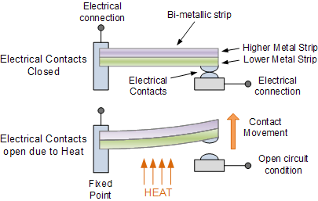
How does a electric kettle know when to switch off ?
Based on thermostat which consists of 2 mettalic strips and when steam comes in contact or we can say it’s heated up, metallic strip bends and breaks the circuit.
It automatically turns off when it reaches it’s boiling point.
Bi-mettalic thermostat

Slide 8
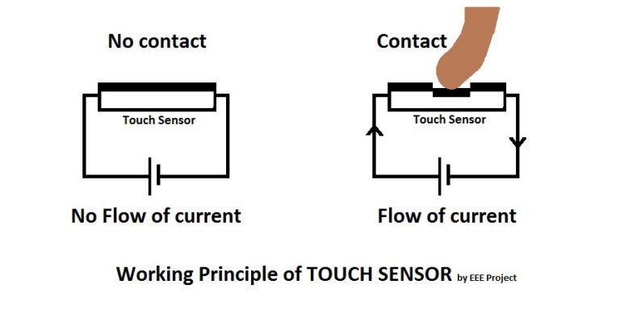
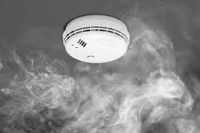
Smoke Sensor
Detects gases like LPG, Carbon Dioxide, etc.
Touch Sensor
Detects when
any object
come in
contact.

Slide 9
Sensor’s Quality
A good sensor should be
Sensitive to the measured property.
Insensitive to any other property likely to be encountered while measurement.
Does not influence the measured property.

Slide 10
Why Sensor Devices ?
It improved everyday life of human being.
To Performs Tasks automatically.
To make things much easier beyond our imagination.
Using Sensors, technology is expanding day by day.
Thankyou!!!

