Slide 1



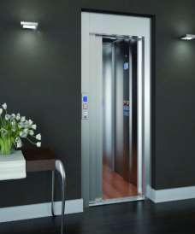


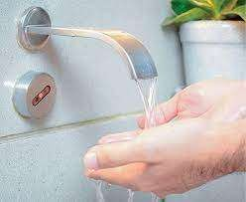


Submitted by : Bhawana 2021PGCACA011
Submitted to :
Dr. Alekha Kumar Mishra

Slide 2






Points to be discussed…
What are SENSOR DEVICES ?
Why SENSOR DEVICES ?
Real World Examples How sensors work ?
How can you say a sensor is good or bad ? Different types of sensors…

Slide 3
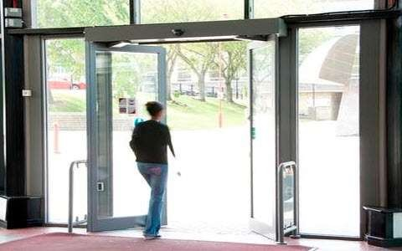
In malls, Doors will automatic ally open as a person go towards the door.
How?

Slide 4


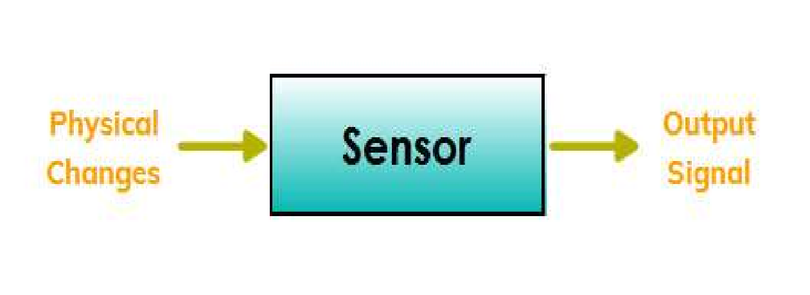


WHAT IS A SENSOR DEVICE?
▶ A sensor is a device that detects events or changes in its environment and provides
output(signal) with respect to that input.
Physical Changes / Inputs
Now Let’s Discuss sensors types …..

Slide 5
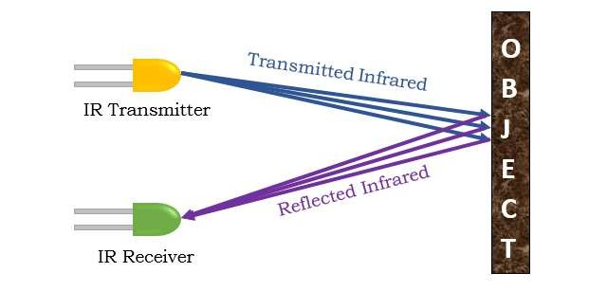
Infrared Sensors – Detect presence of object.
Working
Examples

Slide 6
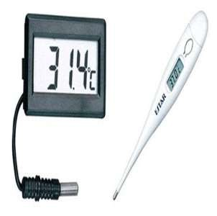
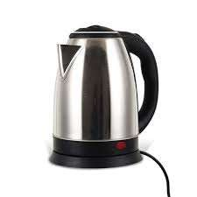
Temperature Sensor : Measures the change in temperature.
Uses the convertor for converting the measured temperature to electrical signals.
E X A M P L E S
Based on voltage, it consists of 2 metal rods which generates voltage. If the voltage reduces,
temperature also reduces and hence the deviation in temperature takes place.

Slide 7
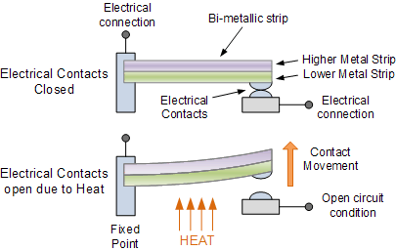
How does a electric kettle know when to switch off ?
Bi-mettalic thermostat
Based on thermostat which consists of 2 mettalic strips and when steam comes in contact or we can say it’s heated up, metallic strip bends and breaks the circuit.
It automatically turns off when it reaches it’s boiling point.

Slide 8
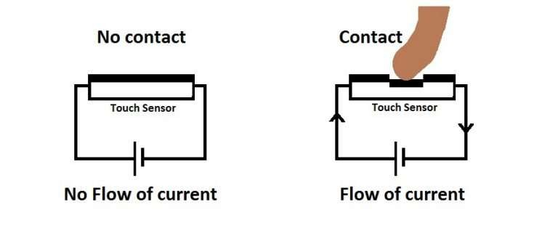
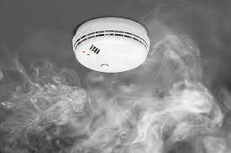
Smoke Sensor
Detects gases like LPG, Carbon
Dioxide, etc.
Touch Sensor
Detects when any object come in contact.

Slide 9
Sensor’s Quality
A good sensor should be
Sensitive to the measured property.
Insensitive to any other property likely to be encountered while measurement.
Does not influence the measured property.

Slide 10


Why Sensor Devices ?
▶ It improved everyday life of human being.
▶ To Performs Tasks automatically.
▶ To make things much easier beyond our imagination.
Using Sensors, technology is expanding day by day.

