Slide 1
Fraudulent Claim Detection
Assignment Submission
By
Bhawani Shankar Mahapatra
Biniyam Belayneh Demisse

Slide 2
Problem Statement
Global Insure faces significant financial losses due to fraudulent claims.
Manual inspection is time-consuming and inefficient.
Fraudulent claims are often detected too late.
Goal: Use data-driven insights to classify claims early.

Slide 3
Business Objective
Build a predictive model to classify claims as fraudulent or legitimate.
Use historical claim details and customer profiles.
Features: Claim amount, customer profile, claim type.
Minimize financial losses and optimize claim handling.

Slide 4
Data Preparation
Dataset: 1000 records, 40 columns.
Libraries: pandas, seaborn, matplotlib, scikit-learn.
Steps: Import, clean, split into train & validation sets.

Slide 5
Data Cleaning
Handled null values (authorities_contacted, _c39 dropped).
Removed high-cardinality identifiers (policy_number, incident_location).
Corrected invalid values (age, umbrella_limit, etc.).
Fixed data types for dates.

Slide 6
EDA Findings
Univariate: Age, premiums normal; claims skewed.
Correlation: Strong overlap in claim amount features.
Class imbalance: Fraudulent ~25%, Non-fraud ~75%.
Bivariate: Incident type, severity, and occupation key predictors.

Slide 7
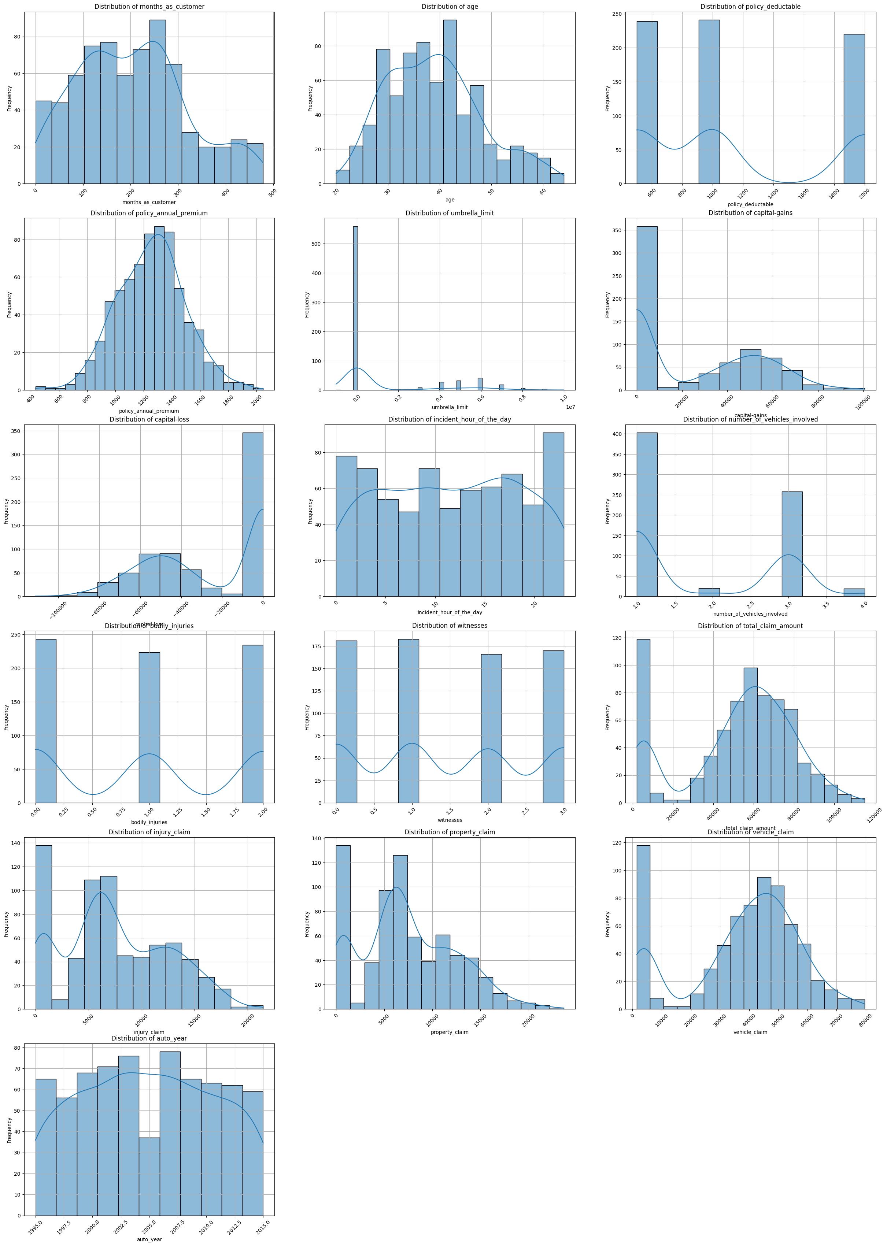
EDA On Training Data

Slide 8
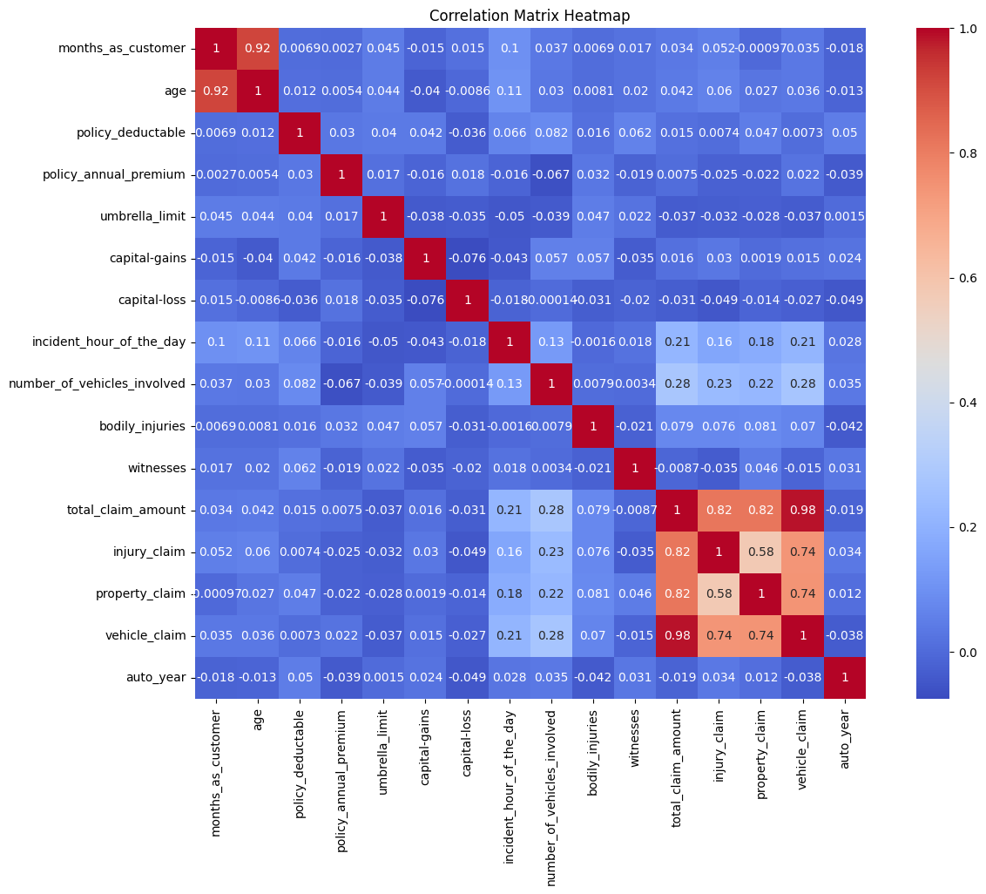
EDA Correlation Analysis
Correlation Insights
Age ↔ Months_as_customer: Highly correlated (0.92) → redundancy risk
Claim amounts (total, injury, property, vehicle) → strongly correlated
Most other variables = weak correlations (independent predictors)
Unique contributors: policy_deductible, umbrella_limit, incident_hour
Action: Handle multicollinearity (feature selection/dimensionality reduction)

Slide 9
Feature Engineering
Applied resampling (RandomOverSampler).
Created new features (policy age, vehicle age, ratios).
Grouped rare categories & dropped redundant columns.
Dummy encoding + feature scaling applied.

Slide 10
Model Building
Logistic Regression: RFECV feature selection, optimal cutoff=0.6.
Random Forest: Feature importance used, hyperparameter tuning.
Both models trained & validated with strong accuracy.

Slide 11
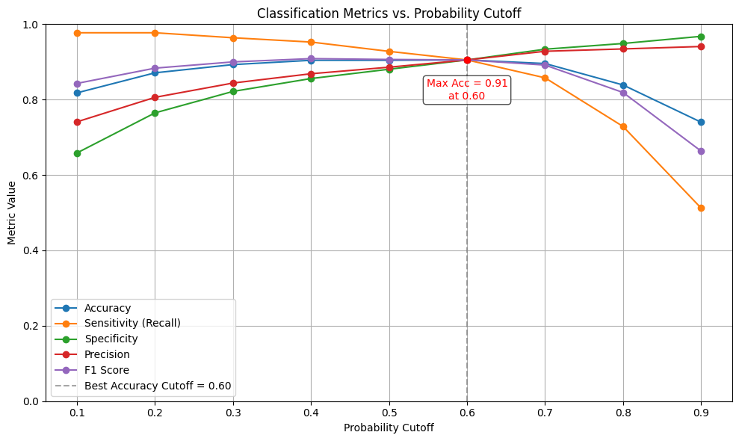
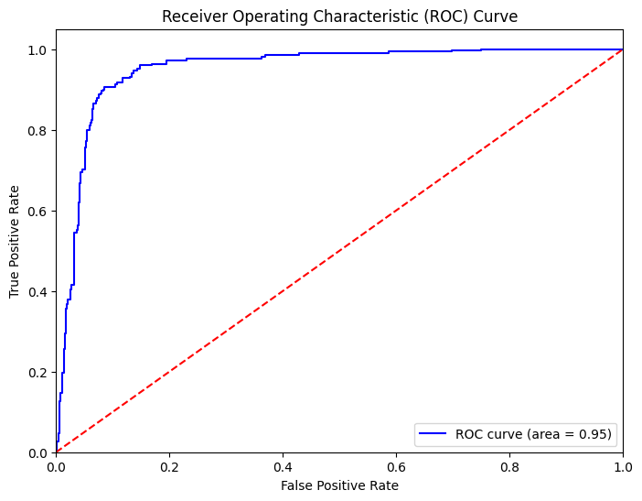
Model Building-Logistics Regression
True Negatives: 477
False Positives: 50
False Negatives: 50
True Positives: 477
Sensitivity (Recall): 0.9051
Specificity: 0.9051
Precision: 0.9051
Recall: 0.9051
F1 Score: 0.9051

Slide 12
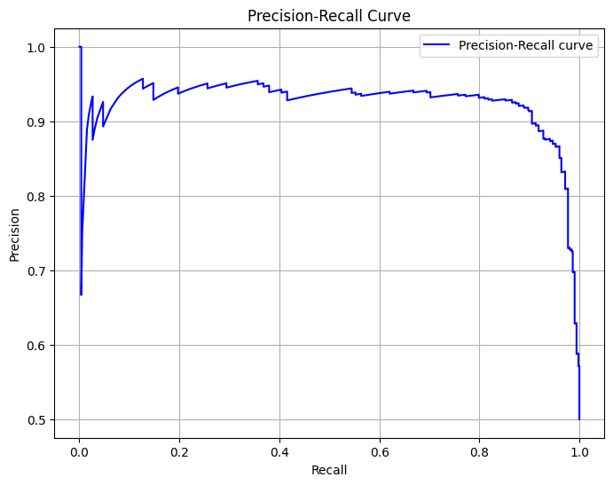
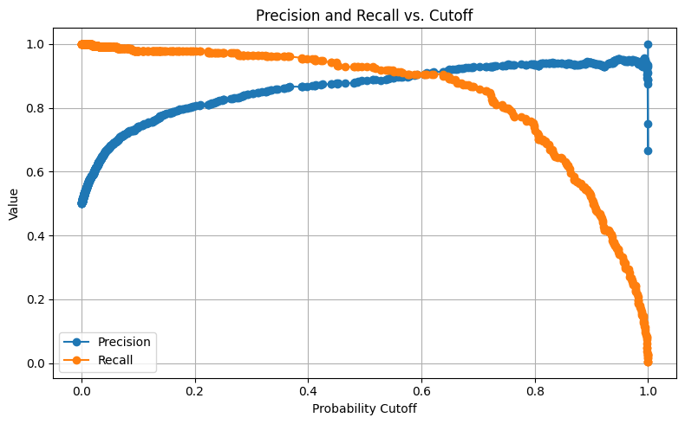
Model Building-Logistics Regression
True Negatives: 477
False Positives: 50
False Negatives: 50
True Positives: 477
Sensitivity (Recall): 0.9051
Specificity: 0.9051
Precision: 0.9051
Recall: 0.9051
F1 Score: 0.9051

Slide 13
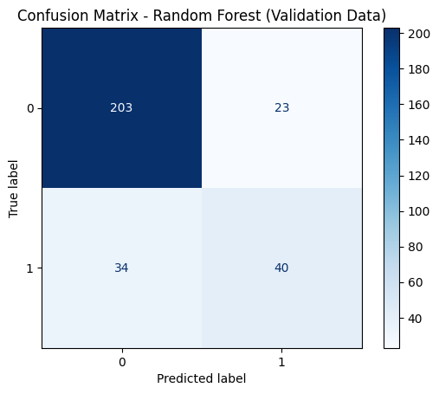
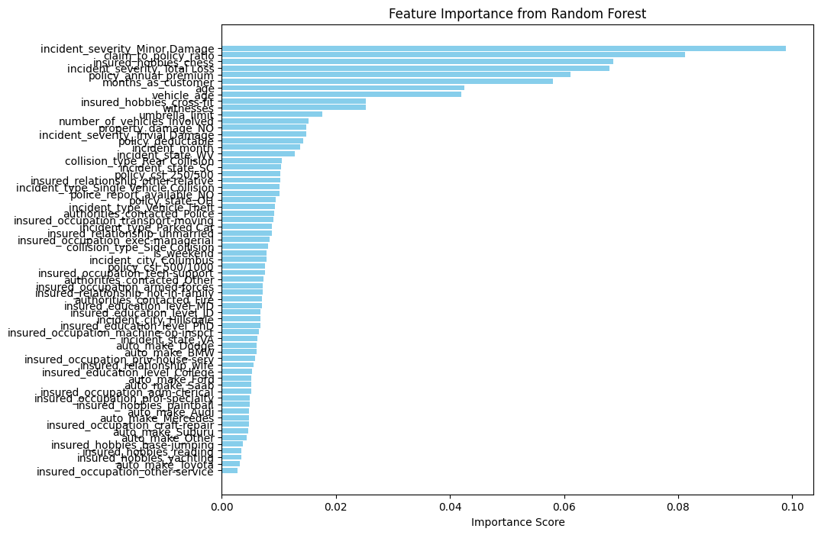
Model Building-Random Forest
True Negatives: 203
False Positives: 23
False Negatives: 34
True Positives: 40
Sensitivity (Recall): 0.5405
Specificity: 0.8982
Precision: 0.6349
Recall: 0.5405
F1 Score: 0.5839

Slide 14
Model Evaluation
Logistic Regression performed better at fraud detection.
Metric(Validation) | Logistic Regression | Random Forest
Accuracy | 83.4% | 81.0%
Sensitivity(Recall) | 66.2% | 54.1%
Specificity | 89.4% | 89.9%
Precision | 67.1% | 54.1%
F1-Score | 66.7% | 58.4%

Slide 15
Conclusion & Recommendations
Logistic Regression preferred for fraud detection.
Random Forest useful as secondary model.
Recommendations:
- Deploy Logistic Regression as primary tool.
- Regularly retrain models with updated data.
- Explore ensemble methods for improved detection.

