Slide 1

FlipFIT
Your Fitness Journey Starts Here

Slide 2
THE ASK - WHERE WE STARTED?
The ask of this project is to expand Flipkart into the fitness industry
enhance user convenience
strengthen gym partnerships
streamline slot management
real-time booking capabilities

Slide 3
Framework for 6 days
DAY 1 | Day 2 | Day 3 | Day 4 | Day 5 | Day 6
Introduction to UML Artifacts | Introduction to Git and GitHub | Classes vs Interfaces & I/0 in Java | Database Schema Design & DAO Layer Implementation | JDBC, Exception Handling & Validator | Dropwizard Framework

Slide 4
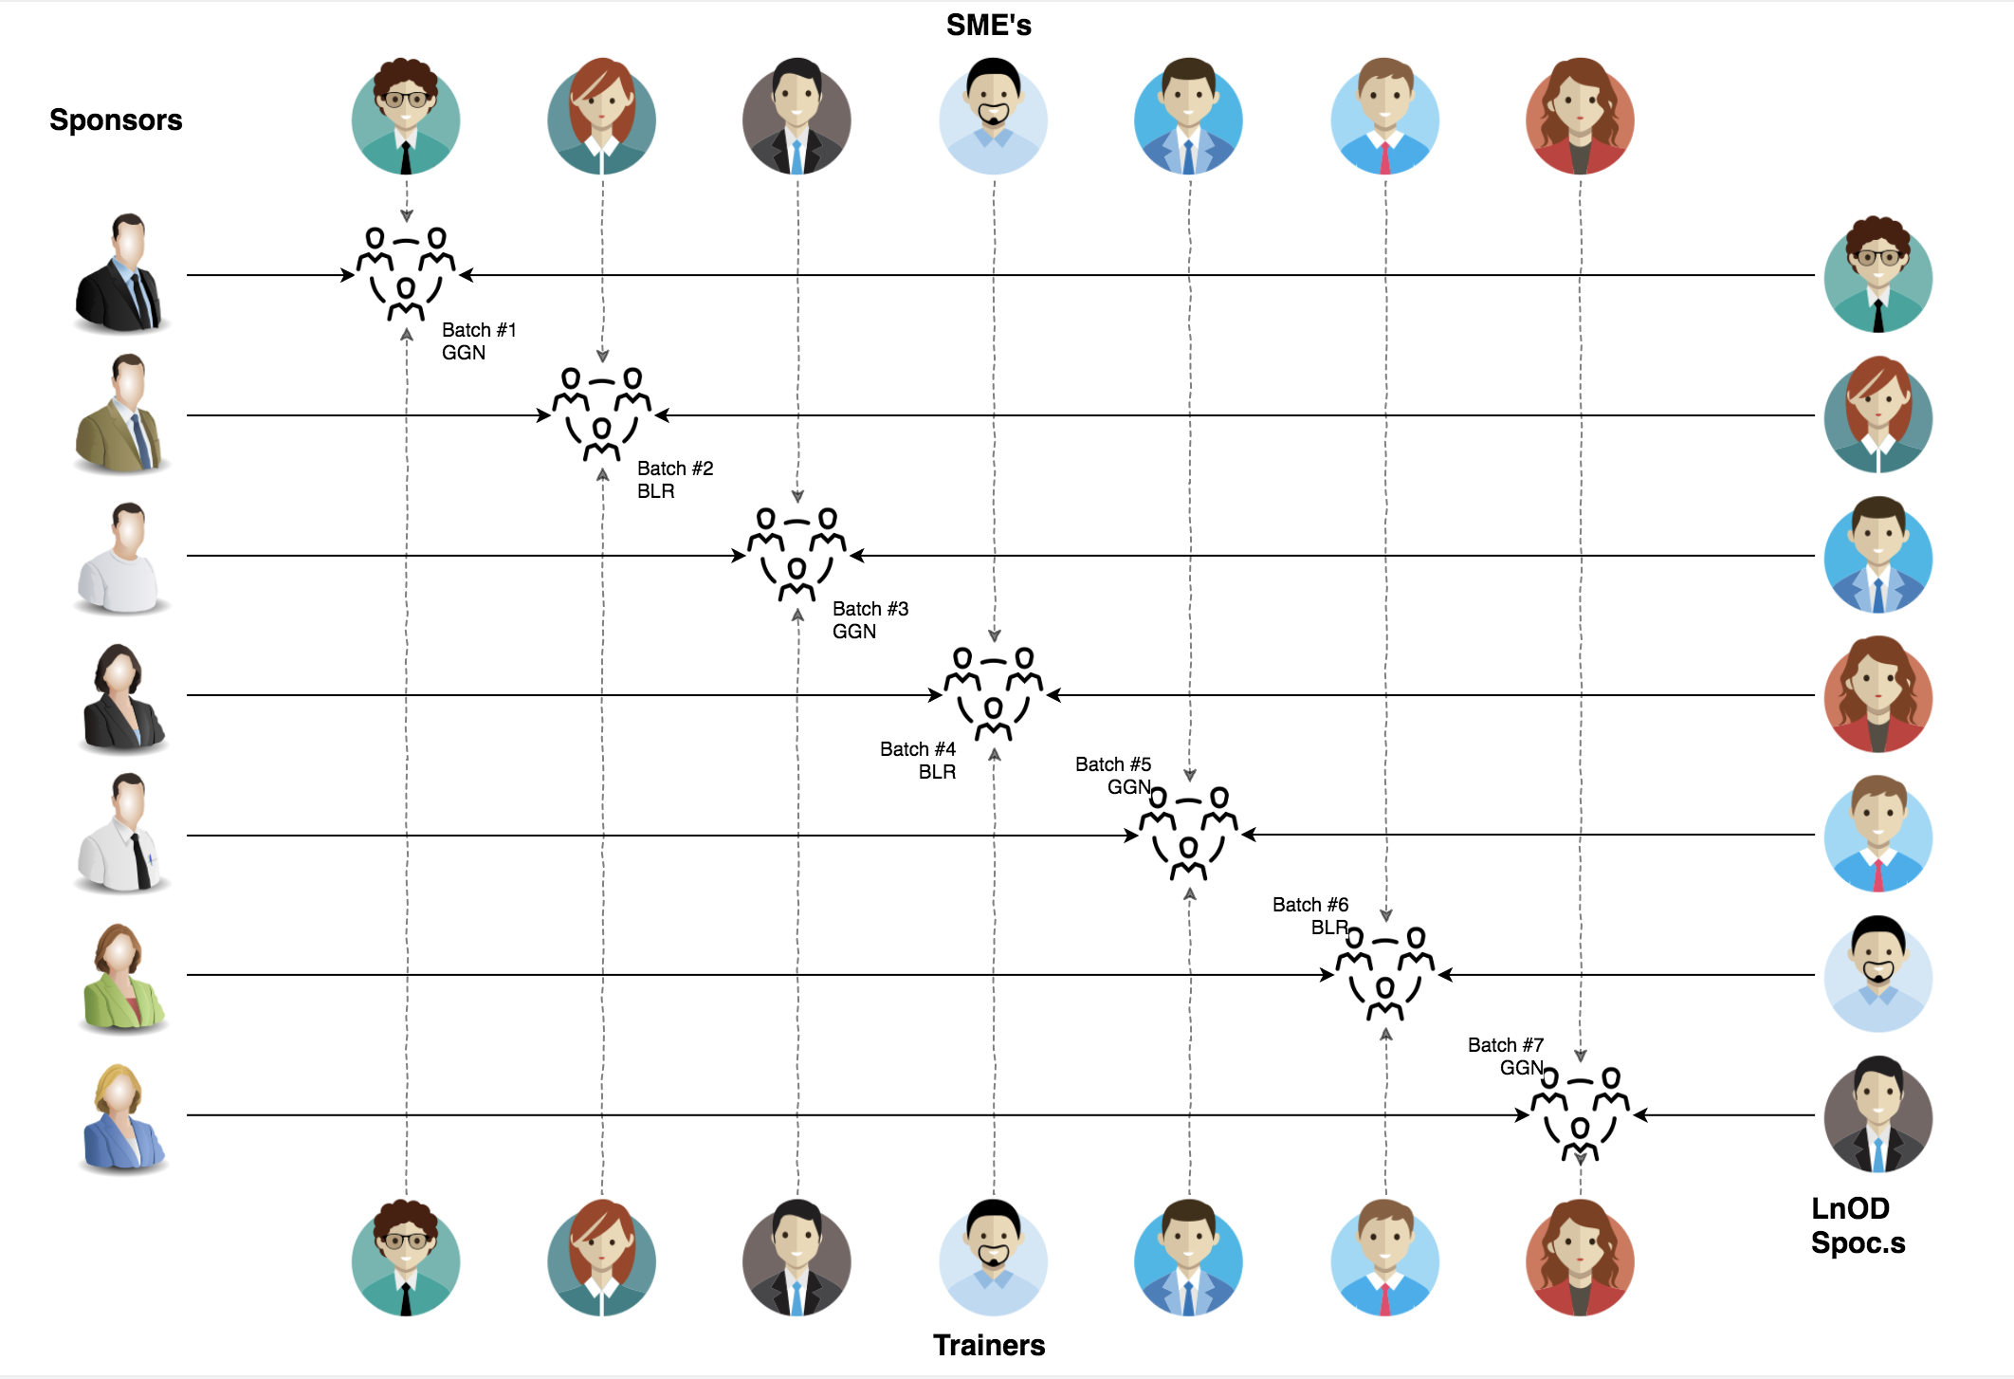
StakeHOlders
1. Sponsor
- Flipkart
2. SME’s
- Amit Balyan
3. Co-ordinators
-Anushka khanna
-Sharath ramesha

Slide 5
6 DAYS OF TRAINING + PROJECT DEMO
6 DAYS
144 HOURS
8640 MINUTES
518400 SECONDS
LIMITLESS KNOWLEDGE

Slide 6
Team Structure
Bhawarth Garg
(Team Leader)
Darshana Durgamahanty
Bhavya Marya
Ujjval Saini
Ranjan Kumar
Manisha Koranga

Slide 7
TABLE Of contents
01
02
03
04
05
06
Project Goals
Engineering Practices
Tech Stack
Development
Challenges & Learnings
Demo

Slide 8
01
ProJECT Goals

Slide 9

OUR VISION
The goal is to create and deploy a FlipFit Gym application using Java tools, enabling users to register, check the availability of slots, and book workout sessions at different gym centers across Bangalore.

Slide 10
02
Engineering Practices

Slide 11
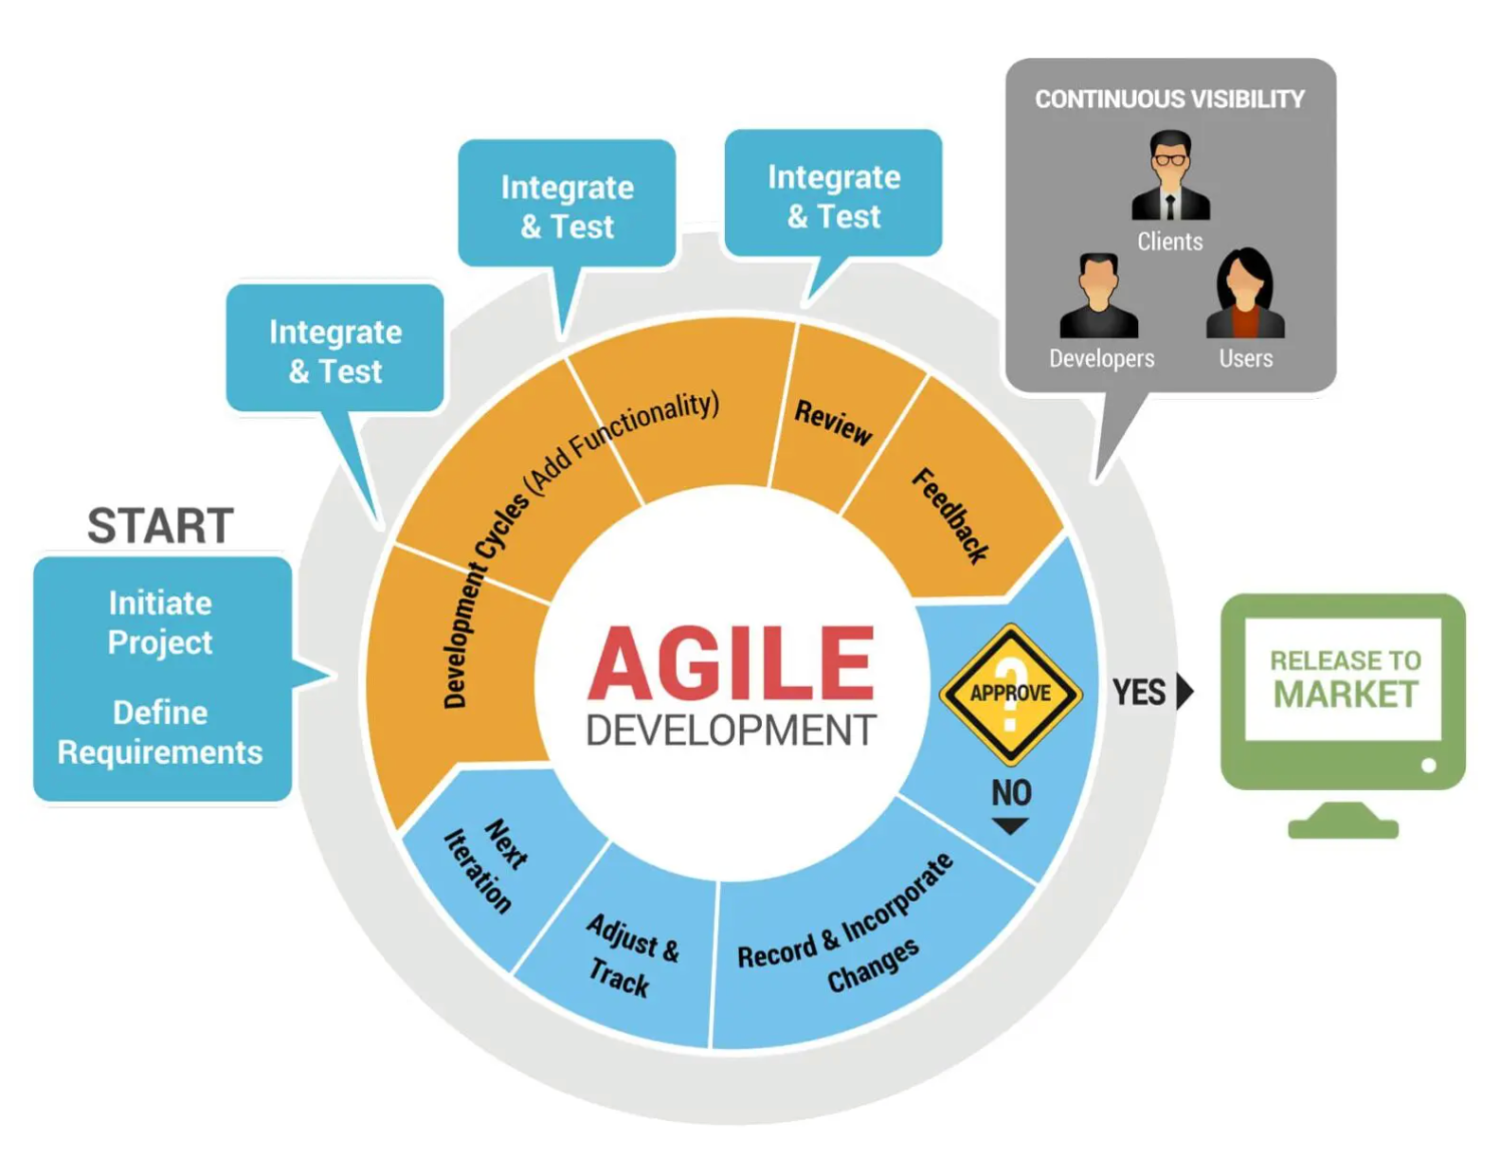
Deploy

Slide 12
03
Tech Stack

Slide 13








BACKEND
SCM
DATABASE
API TESTING
FRAMEWORK
IDE

Slide 14
04
Development

Slide 15
Bean
Custom Exceptions
Normal Exceptions
BUSINESS LAYER
(Processes business logic & interacts with DAO Layer)
processes request
DAO LAYER
(Performs database - CRUD operations)
CLIENT LAYER
data result
Initiates requests
Prepares response
Returns data
Data operations
Validated request
DropWizard
(REST Controller)
routes requests
DropWizard (Validator)
(Validates data)
DATABASE
(Stores and retrieves data)
Sends response
(outcome of the request)

Slide 16
05
Challenges & Learnings

Slide 17
Challenges
SQL Workbench Setup: Overcame initial setup challenges and mastered schema design.
DAO & Business Logic: Ensured efficient DAO operations and robust business logic.
Dropwizard Integration: Struggled with learning and integrating Dropwizard.
Learnings
Tech Stack Proficiency: Mastered Git, Java, MySQL, Dropwizard,Postman.
Best Practices: Adopted Agile methods and rigorous code reviews.
Troubleshooting: Developed strong debugging and problem-solving skills.
Teamwork: Fostered collaboration through regular communication.

Slide 18
06
DEMO

Slide 19




THANK YOU!
Do you have any questions?

