Slide 1

Uber Supply – Demand Gap
Bhawesh Gehlot
Machine Learning

Slide 2
BUSSINESS OBJECTIVE
To identify the root cause of problems of
cancellation of request and non availability of
cabs and recommend suggestions to tackle the
problem

Slide 3
Data used for analysis
=> The data used is only to and fro airport
=> The span of the data is of 5 days
Data collection and cleaning
Identifying the data quality issues and clean the data
Format date and time variables
Extract new variables required for analysis

Slide 4
Datasets Content
6 attributes provided in the csv file are:-
1) Request id- Id of the request made Unique in nature
2) Pickup point- Location from where the request is being made.
3) Driver id- Unique id of the driver.
4) Status – Status of request i.e whether its been completed, cancelled or the cab is not available.
5) Request timestamp- Date and time of the request
6) Drop timestamp- Date and time of completion of request

Slide 5
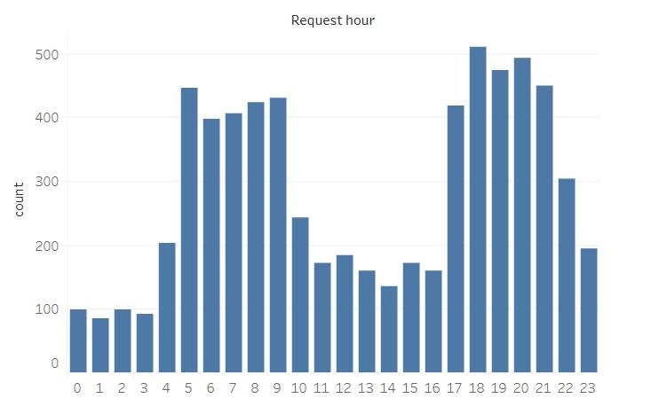
Primary analysis
The plots between frequency of requests and hour tells us that maximum request are been made in morning and evening from 5 am - 10 am and from 5 pm - 10 pm

Slide 6
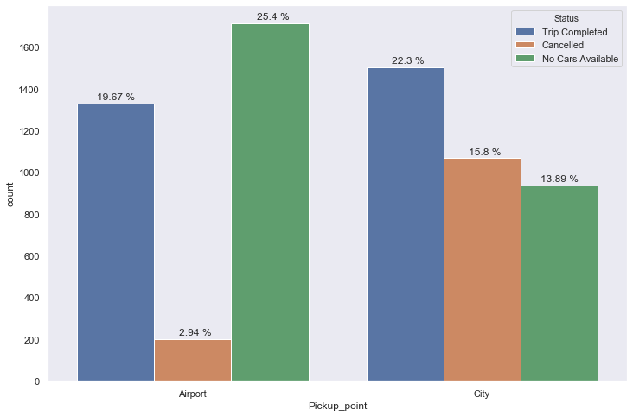
The plot showing the requests from airport-city and city-airport

Slide 7
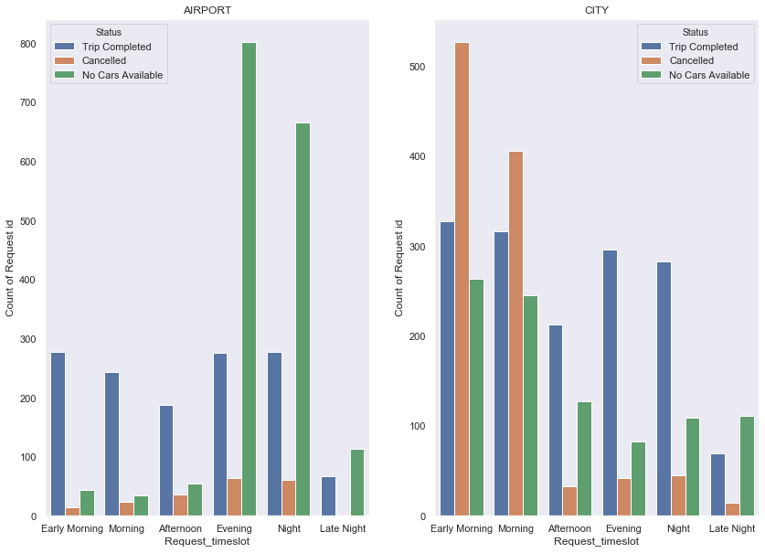
From the plot we can make out that in the morning time many requests that are being cancelled or the cars are unavailable for the customer from city and the same scenario occurs for the airport in evening

Slide 8
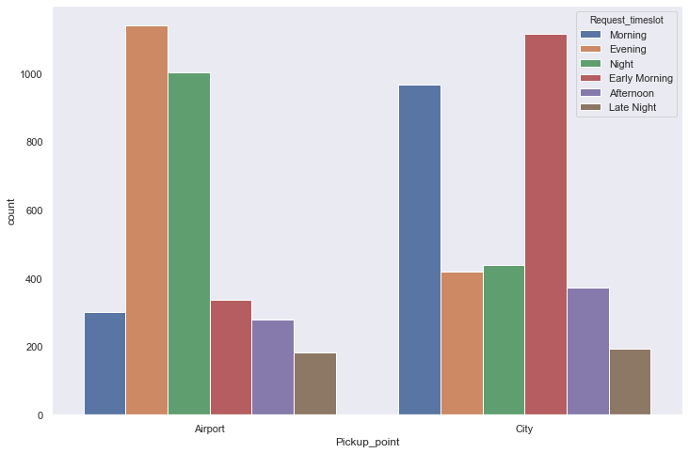
From the plot it can be viewed that while in the morning maximum requests are being completed while at evening and night large no of requests show no cars available.

Slide 9
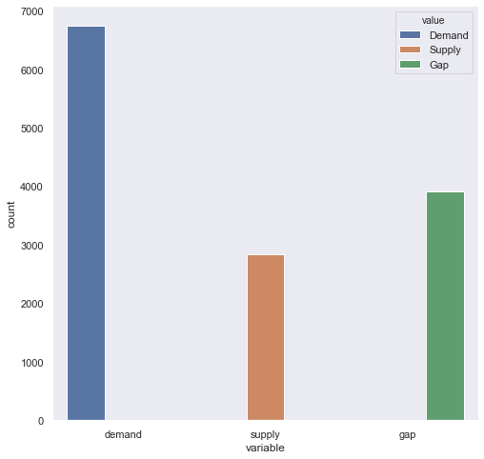
From the graph it is evident that the main problem occurs in the morning and evening timeslots where there’s a big gap between demand and supply

Slide 10
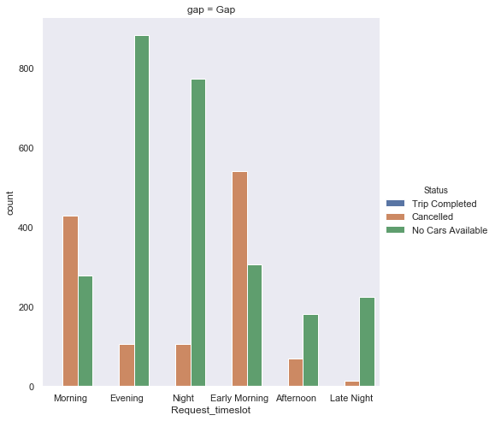
When the supply ,demand and gap between them is plotted for each timeslot for requests being made in City, we can make out that large number of requests that are made in the morning are going unmet, there is large gap between supply and demand which has to be brought down

Slide 11
Analyzing the solution and presenting the solution
1) The main problematic timeslots which are creating problems are morning, evening and night.
2) Maximum requests that are being made in city in morning go unmet and there’s a big gap between supply and demand.
3) For the requests that are being made in evening and at night in airport ,a large gap persists between supply and demand

Slide 12
Recommendations to
narrow the gap
1) Encourage pooling of customers going from city to airport ,this will create a bigger income for the driver and hence he won’t cancel the requests.
2) Incentivize the drivers going for morning drive from city to airport.
3) Recruit more drivers who live near the airport ,so they don’t have to travel long distance for the ride, and hence they won’t cancel.
4) Permit the drivers to leave the airport area without any passenger if it is taking too long and give him some compensatory allowance for this, in this way he won’t cancel the requests in future because he will be knowing that he wont lose money even if it takes a long time for any request.

Slide 13
Analysis Conclusion
- The supply demand gap for cab requests from airport to city is more during evening and night hours, maximizing at 6:00 PM
- The supply demand gap for cab requests from city to airport is more during early morning and morning hours, maximizing at 8:00 AM
- Most severe supply demand gap is for trip from airport to city between 6:00 PM to 9:00 PM, maximizing at 6:00 PM

Slide 14
Thank You

