Slide 1
CLASSICMODELS
2004 Sales Performance & Growth Analysis
Where revenue comes from, when it spikes, and which products and
markets actually drive the business — built in MySQL and Power BI
Bhawna Kumari | Data Analyst Portfolio Project

Slide 2
01
Business
Context
When in the year does revenue actually spike — and why?
1
2
Which specific products and markets drive results?
ClassicModels is a retailer of scale-model cars, planes, ships, and trains, selling to customers worldwide.
3
How concentrated is revenue in a few products or accounts?
This analysis focuses on 2004 — the business's strongest year on record — to understand what drove performance and where the risk is concentrated.
ClassicModels Sales Analysis — 2004 Performance Review
Bhawna Kumari

Slide 3
Approach
From transactional records to an interactive dashboard
1
2
3
MySQL
Power BI + DAX
Business Analysis
Modeled an 8-table relational schema — customers, orders, order details, payments, products — and wrote 33+ queries covering joins, CTEs, and window functions.
Built an interactive dashboard with year-slicers, DAX measures for revenue and AOV, and drill-downs by product, country, and customer.
Investigated seasonality, product concentration, and customer concentration to turn dashboard numbers into decisions.
ClassicModels Sales Analysis — 2004 Performance Review
Bhawna Kumari

Slide 4
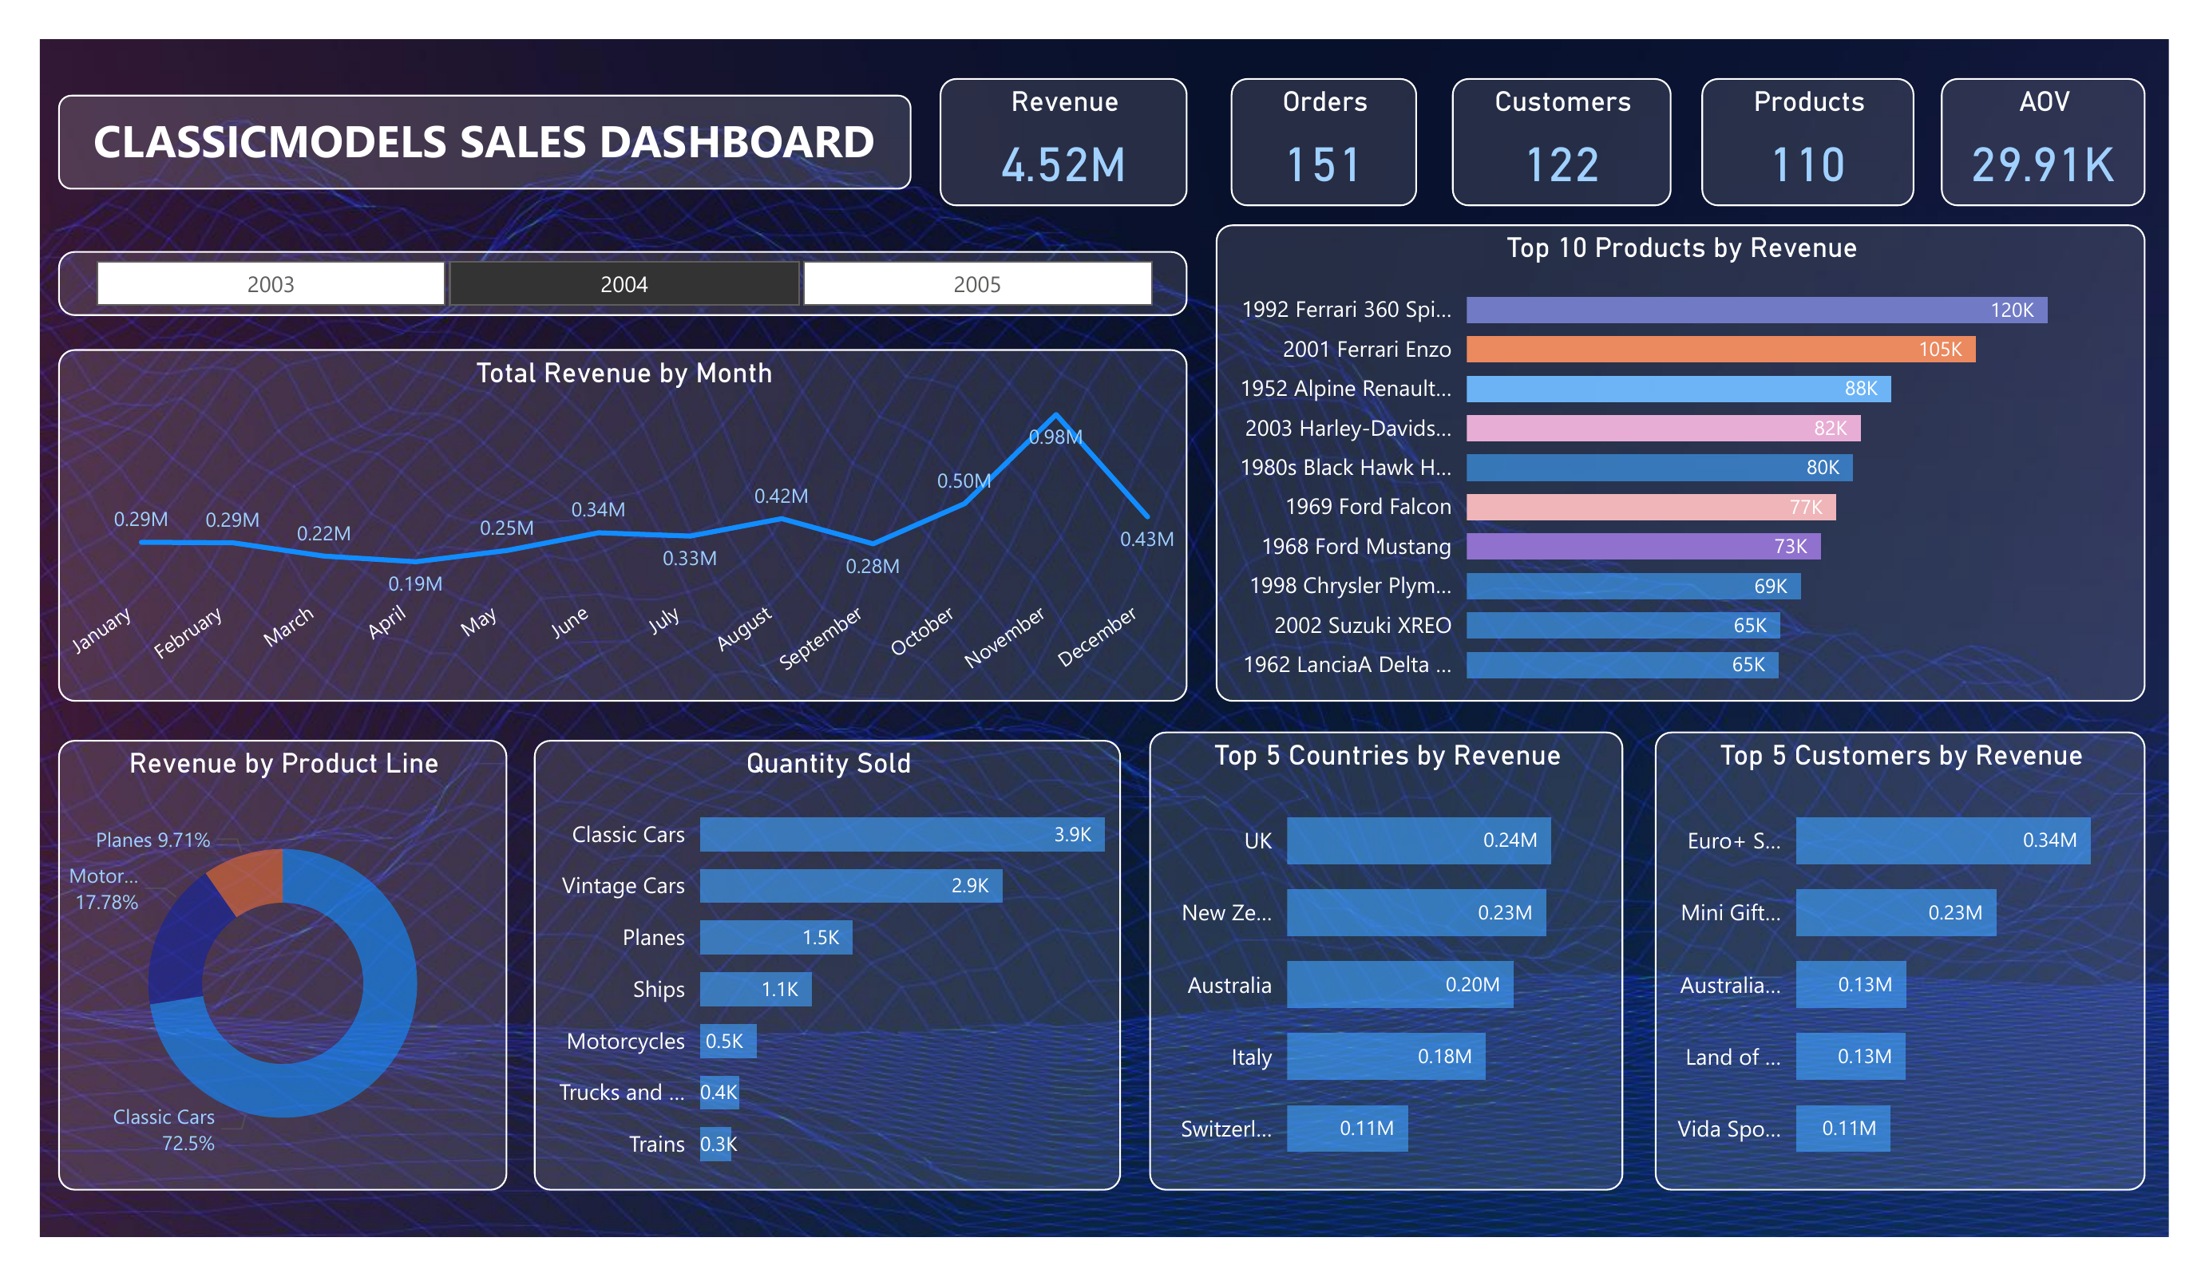
The Dashboard
Interactive Power BI report — year slicer, revenue trend, product and geography breakdowns
ClassicModels Sales Analysis — 2004 Performance Review
Bhawna Kumari

Slide 5
2004 At a Glance
$4.52M
151
$29.91K
122 / 110
Revenue
Orders
Avg. order value
Customers / Products
Figures reflect 2004, the company's strongest year in the dataset
ClassicModels Sales Analysis — 2004 Performance Review
Bhawna Kumari

Slide 6
November Alone Generated 22% of the Year's Revenue
Monthly revenue, 2004 ($ millions)
Revenue nearly doubles from October ($0.50M) to November ($0.98M) before falling back in December — a pre-holiday ordering spike consistent with a gift/collectibles business, and April is the year's low point ($0.19M).
ClassicModels Sales Analysis — 2004 Performance Review
Bhawna Kumari

Slide 7
Two Ferrari Models Alone Generated $225K
Top 10 products by revenue, 2004 ($ thousands)
ClassicModels Sales Analysis — 2004 Performance Review
Bhawna Kumari

Slide 8
Revenue Is Concentrated — in One Product Line and a Few Accounts
Product Line
Geography
Top Customers
The UK leads, and the USA — despite having the largest customer count — doesn't crack the top 5.
Just 5 of 122 customers (4%) generated ~21% of 2004 revenue.
Classic Cars alone drove 72.5% of 2004 revenue — heavy reliance on a single line.
ClassicModels Sales Analysis — 2004 Performance Review
Bhawna Kumari

Slide 9
Business Recommendations
Plan inventory around the November spike
1
With revenue nearly doubling in November, stock and staffing should ramp ahead of Q4 rather than reactively — protecting fulfillment during the year's most critical month.
Diversify beyond Classic Cars
2
At 72.5% of revenue, the Classic Cars line represents concentration risk. Cross-selling Motorcycles and Planes to existing Classic Car buyers is a natural next step.
Protect and grow key accounts, and re-engage the USA
3
The top 5 customers already drive ~21% of revenue — dedicated account management protects that base, while the USA's absence from the top 5 (despite having the most customers) signals an untapped growth market.
ClassicModels Sales Analysis — 2004 Performance Review
Bhawna Kumari

Slide 10
Tools & Skills
1
2
3
4
MySQL
Power BI
DAX
Business Analysis
8-table schema, joins, CTEs, and window functions across orders and payments
Interactive dashboard with year slicers, drill-downs, and KPI cards
Custom measures for revenue, AOV, and product/geo breakdowns
Seasonality, concentration risk, and market-gap insight
ClassicModels Sales Analysis — 2004 Performance Review
Bhawna Kumari

Slide 11
Let's Connect
Full SQL scripts, dashboard file, and write-up available on GitHub
Bhawna Kumari | Aspiring Data Analyst | SQL • Power BI • Python

