Slide 1
CLASSICMODELS
2004 Sales Performance & Growth Analysis
Where revenue comes from, when it spikes, and which products and markets actually drive the business — built in MySQL and Power BI
Bhawna Kumari | Data Analyst Portfolio Project

Slide 2
Business Context
ClassicModels is a retailer of scale-model cars, planes, ships, and trains, selling to customers worldwide. This analysis focuses on 2004 — the business's strongest year on record — to understand what drove performance and where the risk is concentrated.
1
When in the year does revenue actually spike — and why?
2
Which specific products and markets drive results?
3
How concentrated is revenue in a few products or accounts?
ClassicModels Sales Analysis — 2004 Performance Review
Bhawna Kumari

Slide 3
Approach
From transactional records to an interactive dashboard
1
2
3
MySQL
Power BI + DAX
Business Analysis
Modeled an 8-table relational schema and wrote 20+ queries using CTEs, ROW_NUMBER() and LAG() window functions, and CASE-based logic for segmentation and trend analysis.
Built an interactive dashboard with year-slicers, DAX measures for revenue and AOV, and drilldowns by product, country, and customer.
Segmented customers by value, tracked spending trends order-over-order, and turned dashboard numbers into concrete recommendations.
ClassicModels Sales Analysis — 2004 Performance Review
Bhawna Kumari

Slide 4
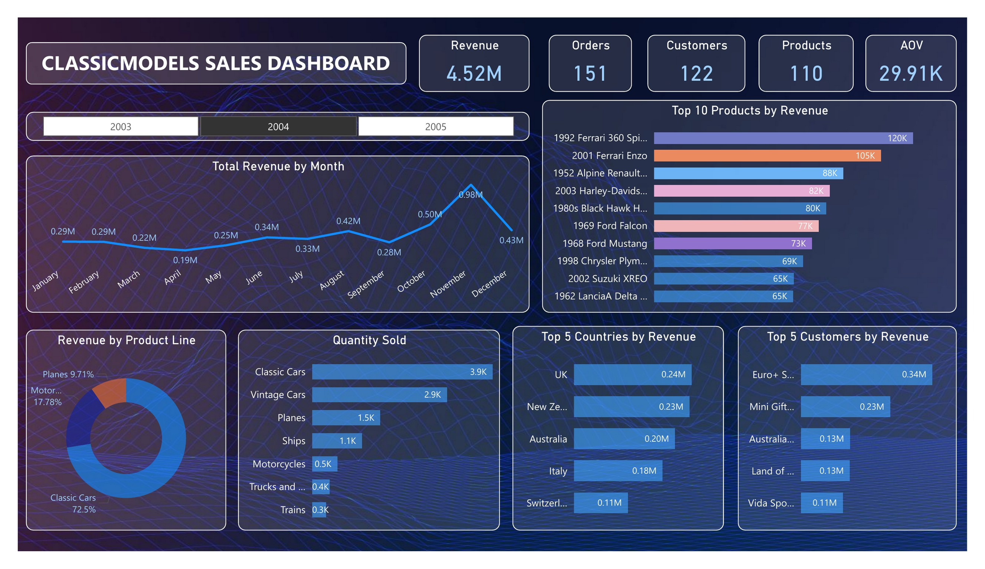
The Dashboard
What it does
Live year slicer — 2003, 2004, 2005
12 visuals: revenue trend, top products, product line mix, and geography
Built with Power Query transformations and DAX measures
KPI cards and charts update instantly when the year filter changes
ClassicModels Sales Analysis — 2004 Performance Review
Bhawna Kumari

Slide 5
2004 At a Glance
$4.52M
151
$29.91K
122 / 110
Revenue
Orders
Avg. order value
Customers / Products
Figures reflect 2004, the company's strongest year in the dataset
ClassicModels Sales Analysis — 2004 Performance Review
Bhawna Kumari

Slide 6
November Alone Generated 22% of the Year's Revenue
Monthly revenue, 2004 ($ millions)
Revenue nearly doubles from October ($0.50M) to November ($0.98M) before falling back in December — a pre-holiday ordering spike consistent with a gift/collectibles business, and April is the year's low point ($0.19M).
ClassicModels Sales Analysis — 2004 Performance Review
Bhawna Kumari

Slide 7
Two Ferrari Models Alone Generated $225K
Top 10 products by revenue, 2004 ($ thousands)
ClassicModels Sales Analysis — 2004 Performance Review
Bhawna Kumari

Slide 8
Revenue Is Concentrated in One Product Line
72.5%
of 2004 revenue came from Classic Cars alone
Classic Cars alone drove 72.5% of 2004 revenue — heavy reliance on a single line.
ClassicModels Sales Analysis — 2004 Performance Review
Bhawna Kumari

Slide 9
The UK Leads — and a Few Accounts Drive Outsized Revenue
Top 5 Countries by Revenue
Top 5 Customers by Revenue
The UK leads, and the USA — despite having the largest customer count — doesn't crack the top 5.
Just 5 of 122 customers (4%) generated ~21% of 2004 revenue.
ClassicModels Sales Analysis — 2004 Performance Review
Bhawna Kumari

Slide 10
A Quarter of Customers Drive Nearly Half of Revenue
Customer segmentation by total payments received, 2003–05
G
S
B
Gold
Silver
Bronze
25 customers (26%)
53 customers (54%)
20 customers (20%)
$4.18M — 47% of revenue
$3.96M — 45% of revenue
$0.71M — 8% of revenue
Gold-tier customers are just over a quarter of the base but generate nearly half of all revenue — a strong case for a dedicated key-account program rather than treating every customer the same.
ClassicModels Sales Analysis — 2004 Performance Review
Bhawna Kumari

Slide 11
Business Recommendations
1
Plan inventory around the November spike
With revenue nearly doubling in November, stock and staffing should ramp ahead of Q4 rather than reactively — protecting fulfillment during the year's most critical month.
2
Diversify beyond Classic Cars
At 72.5% of revenue, the Classic Cars line represents concentration risk. Cross-selling Motorcycles and Planes to existing Classic Car buyers is a natural next step.
3
Protect and grow key accounts, and re-engage the USA
The top 5 customers already drive ~21% of revenue — dedicated account management protects that base, while the USA's absence from the top 5 (despite having the most customers) signals an untapped growth market.
ClassicModels Sales Analysis — 2004 Performance Review
Bhawna Kumari

Slide 12
Tools & Skills
1
MySQL
2
Window Functions
8-table schema, joins, CTEs, and window functions across orders and payments
ROW_NUMBER() for top customer/product rankings; LAG() for MoM and order-over-order growth
3
Customer Segmentation
4
Power BI + DAX
CASE-based Gold/Silver/Bronze tiers and above-average spend detection via CTEs
Interactive dashboard with year slicers, drill-downs, and custom revenue/AOV measures
ClassicModels Sales Analysis — 2004 Performance Review
Bhawna Kumari

Slide 13
Let's Connect
Full SQL scripts, dashboard file, and write-up available on GitHub
Bhawna Kumari | Aspiring Data Analyst | SQL • Power BI • Python

