Slide 1
CREDIT CARD
Revenue & Customer Analysis
Reconciling 10,293 customer records across MySQL and Power BI to find
where revenue concentrates — and where the business is exposed
Bhawna Kumari | Data Analyst Portfolio Project

Slide 2
01
The Business
Problem
Which card tiers and channels drive revenue?
1
2
Which customer segments and states concentrate it?
A credit card issuer needs to know exactly where its revenue comes from — by card, by customer, and by geography — before it can grow or defend it.
3
Where is the business over-exposed to a few segments?
Credit Card Revenue & Customer Analysis
Bhawna Kumari

Slide 3
Approach
From raw transaction data to a reconciled, trustworthy dashboard
1
2
3
MySQL
Power BI + DAX
Data Reconciliation
Modeled 10,293 customer records across two linked tables and wrote 12 analytical queries covering revenue, segments, and growth trends.
Built an interactive dashboard with Power Query transformations and DAX measures combining transaction, interest, and fee revenue.
Caught a revenue mismatch between SQL and Power BI, traced it to an incomplete formula and 185 unsynced rows, and resolved both.
Credit Card Revenue & Customer Analysis
Bhawna Kumari

Slide 4
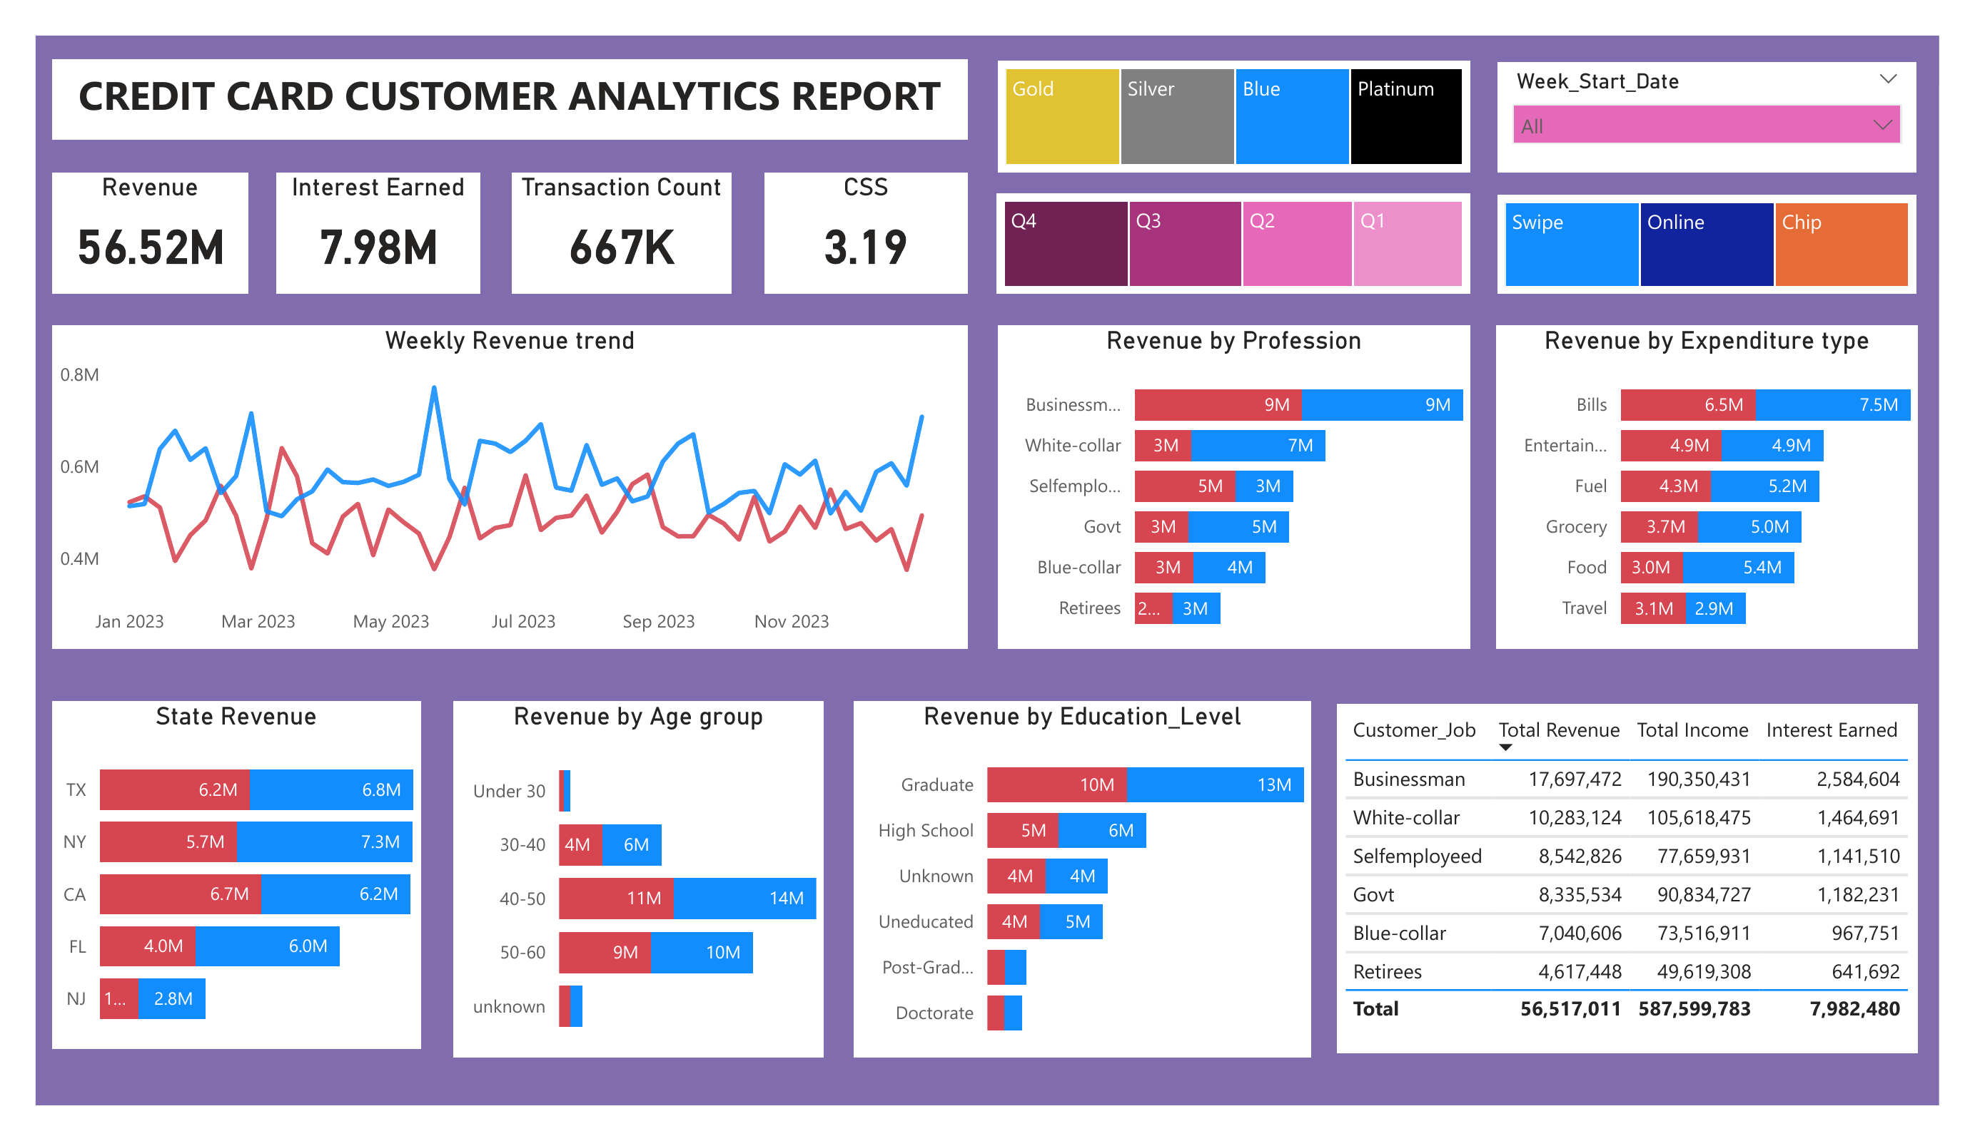
The Dashboard
What it does
Filterable by card category, quarter, and channel
12 visuals: revenue trend, profession, expenditure, education, and state breakdowns
Built with Power Query transformations and DAX measures
KPI cards and charts update instantly with each filter
Credit Card Revenue & Customer Analysis
Bhawna Kumari

Slide 5
At a Glance
$56.52M
10,293
667,234
$7.98M
Total revenue
Customers analyzed
Total transactions
Interest income
Revenue = Transaction Amount + Interest Earned + Annual Fees • Customer Satisfaction 3.19 / 5
Credit Card Revenue & Customer Analysis
Bhawna Kumari

Slide 6
Blue Cards Carry 83% of All Revenue
Revenue by card category ($ millions)
Why it matters
Blue-tier cards generate $47.19M — 83% of total revenue — not because they're premium, but because they're the most widely held. Silver, Gold, and Platinum together contribute under 17%, pointing to a large pool of Blue customers who haven't been upgraded.
Credit Card Revenue & Customer Analysis
Bhawna Kumari

Slide 7
Businessmen and the 40–59 Age Band Drive Two-Thirds of Revenue
Revenue by profession and age group ($ millions)
Credit Card Revenue & Customer Analysis
Bhawna Kumari

Slide 8
Revenue Is Concentrated — in 5 States and 2 Channels
Top States by Revenue
Revenue by Channel
These 5 states alone account for ~94% of total revenue — the rest of the country contributes barely 6%.
Online transactions generate just 6% of revenue — far behind Swipe (63%) and Chip (31%), despite being the lowest-friction channel to grow.
Credit Card Revenue & Customer Analysis
Bhawna Kumari

Slide 9
Business Recommendations
Upgrade the Blue base
1
With 83% of revenue concentrated in Blue, a targeted Silver/Gold upgrade campaign for high-spending Blue customers is the single largest growth lever available.
Diversify beyond 5 states
2
TX, NY, CA, FL, and NJ generate ~94% of revenue. Expansion marketing in underrepresented states reduces geographic concentration risk.
Grow the Online channel and lift satisfaction
3
Online contributes just 6% of revenue despite being the cheapest channel to scale, and a 3.19/5 satisfaction score alongside strong revenue signals room to improve retention before it erodes growth.
Credit Card Revenue & Customer Analysis
Bhawna Kumari

Slide 10
Tools & Skills
1
2
3
4
MySQL
Power BI
DAX
Data QA
Joins, CTEs, window functions (RANK, ROW_NUMBER, LAG) across 10K+ rows
Interactive dashboard design, drill-through, KPI cards
Custom measures combining transaction, interest, and fee revenue
Traced a $11M cross-tool discrepancy to its root cause and resolved it
Credit Card Revenue & Customer Analysis
Bhawna Kumari

Slide 11
Let's Connect
Full SQL scripts, dashboard, and write-up available on GitHub
Bhawna Kumari | Aspiring Data Analyst | SQL • Power BI • Python

