Slide 1

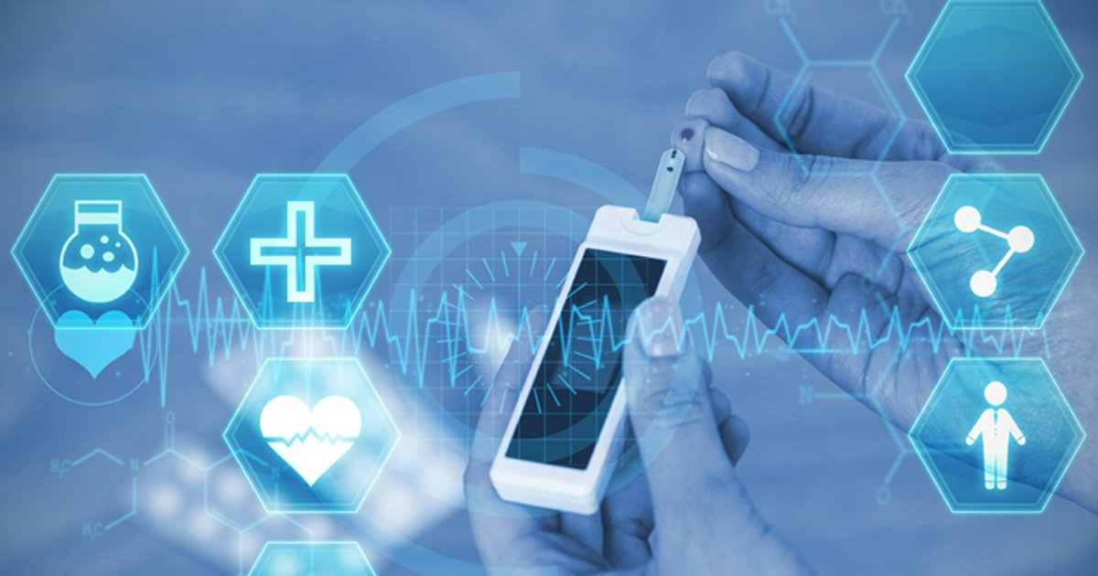
Machine Learning–Based Diagnosis of Diabetes
MINOR Project Presentation
Submitted in partial fulfillment of the requirements for the degree of
Master of Computer Applications (MCA)
Submitted by:
Aditi Das (120710242014)
Bhawna Jha (120710242032)
Academic Session: 2024–2026
Under the Guidance of:
Prof. (Dr.) Pabitra Kumar Dey
Head, Department of Computer Applications
Dr. B. C. Roy Engineering College, Durgapur
(An Autonomous Institute)

Slide 2
Project Responsibilities / Tasks
Analysis of the problem related to early diagnosis of diabetes.
Collection and study of the Pima Indians Diabetes Dataset.
Data preprocessing including handling missing and invalid values.
Implementation of machine learning algorithms using Python.
Development of an interactive web application using Streamlit.

Slide 3
What We Learned
Practical application of machine learning techniques in healthcare.
Importance of data preprocessing in medical datasets.
Model training, testing, and evaluation methodologies.
Use of Python libraries such as Pandas, NumPy, and Scikit-learn.
Deployment of machine learning models using Streamlit.

Slide 4
Key Project / Achievement
Designed and implemented an end-to-end Diabetes Prediction System.
Applied Logistic Regression and Random Forest classifiers.
Random Forest model demonstrated improved predictive performance.
Developed a user-friendly interface for real-time prediction.

Slide 5
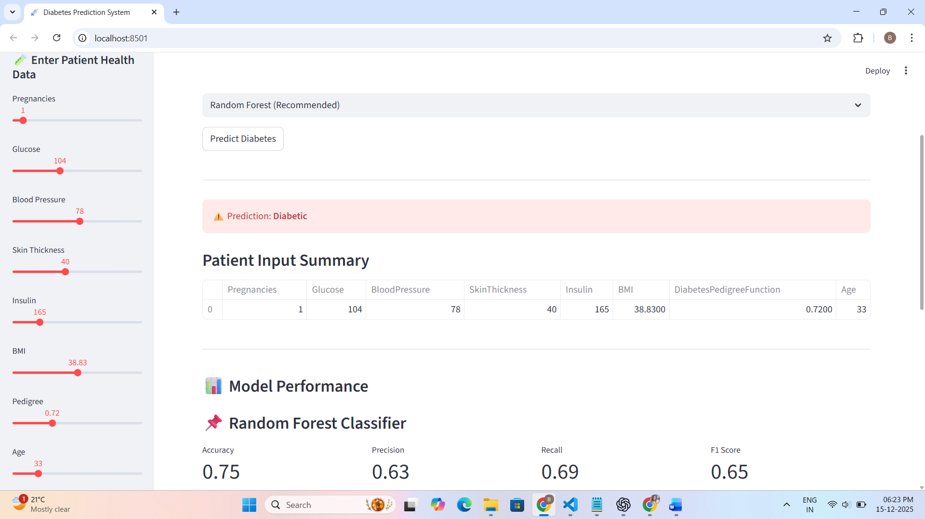
Project Output – Streamlit-Based Application

Slide 6
Challenges Faced
Presence of missing and zero values in medical data.
Selection of the most suitable machine learning model.
Handling class imbalance within the dataset.
Designing a clear and user-friendly interface.

Slide 7
How Challenges Were Overcome
Applied mean and median imputation during preprocessing.
Evaluated multiple models using standard performance metrics.
Selected Random Forest based on accuracy and reliability.
Improved user interface through iterative testing.

Slide 8
Conclusion
The project demonstrates the effectiveness of machine learning in healthcare.
The developed system provides accurate and reliable diabetes prediction.
It supports early diagnosis and decision-making.
The system enhances understanding of applied machine learning concepts.

Slide 9
Future Scope
Integration of advanced machine learning and ensemble techniques.
Use of deep learning models for improved accuracy.
Deployment as a mobile or cloud-based application.
Integration with real-time healthcare and wearable devices.

Slide 10
Acknowledgment
We sincerely thank our project guide Prof. (Dr.) Pabitra Kumar Dey for his guidance.
We are grateful to the Department Master of Computer Applications.
Thanks to Dr. B. C. Roy Engineering College for support and facilities.
We also thank our faculty members and peers for their encouragement.

Slide 11


