Slide 1
Will They Claim It?
Predictive Analysis of Insurance Data
Presented By : K Bhawana

Slide 2
Problem Statement
Risk management processes form an integral part of the insurance industry. Insurers consider every available quantifiable factor to develop profiles of high and low insurance risk for their prospective policyholders.
Level of risk determines the insurance premiums of these policies. To this end, insurers collect a vast amount of information about policyholders and insured objects.

Slide 3
Machine Learning Steps
1.Data Pre-Processing & Exploratory Data Analysis
2.Feature Transformation
3.Model Creation
4.Ensemble Method
Increasingly, statistical methods and tools based on data mining techniques are being used to determine insurance policy risk levels.
We discuss the use of predictive analytics for assessing insurance risk in the following sections.

Slide 4
Raw Dataset
Dataset:
The data consists of records of roughly 52000 instances and 11 features.
There are 10 independent variables and 1 target that describes whether the insurances will be claimed or not.
Target: Claim Status (Claim)
Name of agency (Agency)
Type of travel insurance agencies (Agency.Type)
Distribution channel of travel insurance agencies (Distribution.Channel)
Name of the travel insurance products (Product.Name)
Duration of travel (Duration)
Destination of travel (Destination)
Amount of sales of travel insurance policies (Net.Sales)
The commission received for travel insurance agency (Commission)
Age of insured (Age)
The identification record of every observation (ID)

Slide 5
Data Pre-Processing
Data pre-processing is a major task in any machine learning model, without pre-processing the model will not give good results as desired.
Why ?:
First and foremost thing is to verify that is there a missing value in dataset, if yes we had to impute the value for missing.
Outlier detection.
Duplicate Data Detection
Scaling the numeric data to standardize.

Slide 6
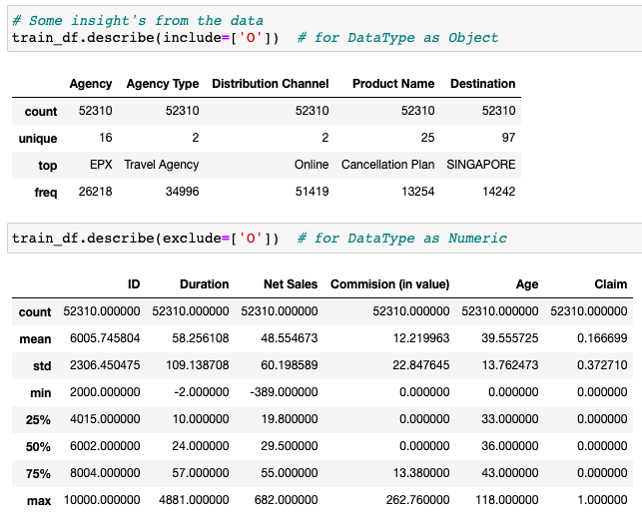
Exploratory Data Analysis (EDA)
EDA helps gaining the better insight about data.
As we can see our dataset contains both text and numerical features
Exploratory Data Analysis
(EDA)

Slide 7
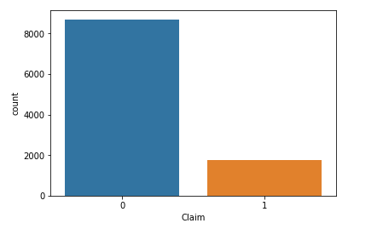
Distribution of class variable in our dataset
Observation: As we can see our data is highly imbalanced

Slide 8
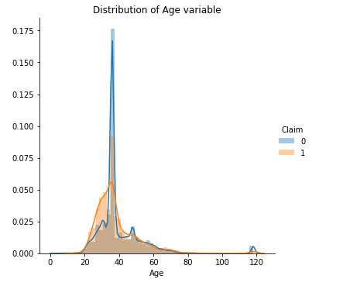
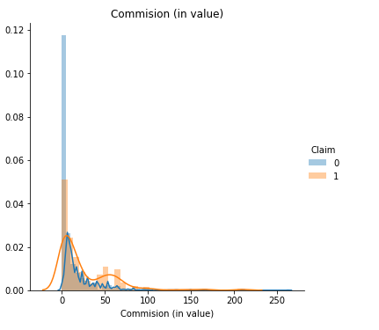
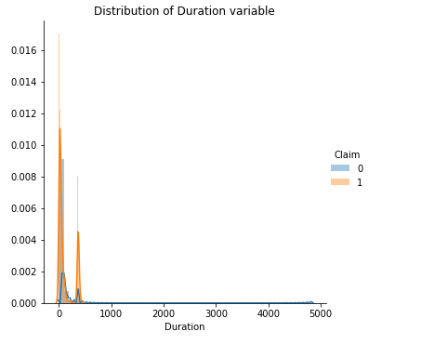
Exploratory Data Analysis (EDA)
Distribution of numerical features :
As we can see our data is overlapping and is not linearly separable
Univariate Analysis of features

Slide 9
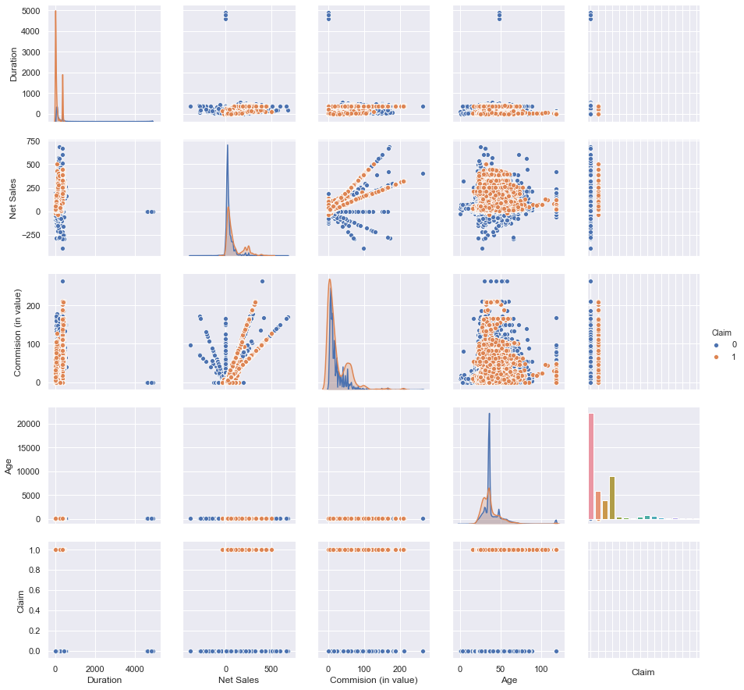
Bivariate Analysis

Slide 10
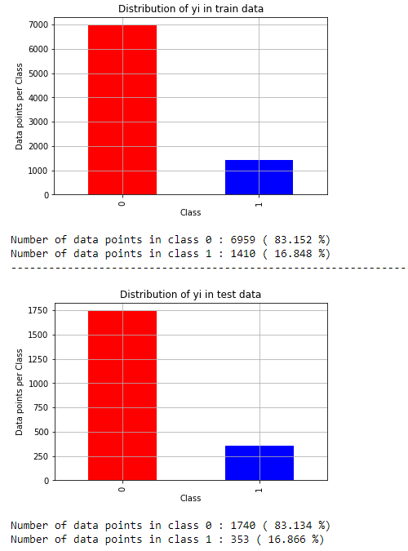
Distribution of true label after splitting the data
Now splitting the data into train and test set for modelling:
As we can see train and test split has same amount of data which is good for modelling

Slide 11
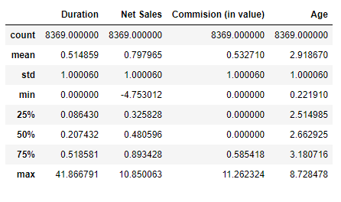
Features Pre-Processing
Features are transformed into :-
One Hot Encoding of text data
Standardization of numerical data
After Standardization our data looks centred around mean

Slide 12
Machine Learning Models
Total 6 models are used with hyperparameter tuning :
KNN
Logistic Regression
Decision Tree
Random Forest
Gradient Boosting Decision Tree (using XGBOOST)
Stacking Classifier

Slide 13
Model Matrix with One-Hot Encoding and Standard Scale
Classification Models | Best Hyper-parameter | Train ROC AUC | Test ROC AUC | Precision
 |  |  |  | 0 | 1
KNN (Brute Force) | K = 11 | 0.92 | 0.87 | 0.89 | 0.57
Logistic Regression(L2) | C=10 | 0.86 | 0.85 | 0.95 | 0.42
Decision Tree | Depth = 160 Sample Split = 80 | 0.93 | 0.85 | 0.95 | 0.41
Random Forest | Depth = 190 n_estimators = 190 | 0.96 | 0.90 | 0.94 | 0.54
GBDT(XGBoost) | Depth = 140 n_estimators = 90 | 0.99 | 0.92 | 0.92 | 0.72
Stacking Classifier | Using all models | 0.99 | 0.88 | 0.93 | 0.71

Slide 14
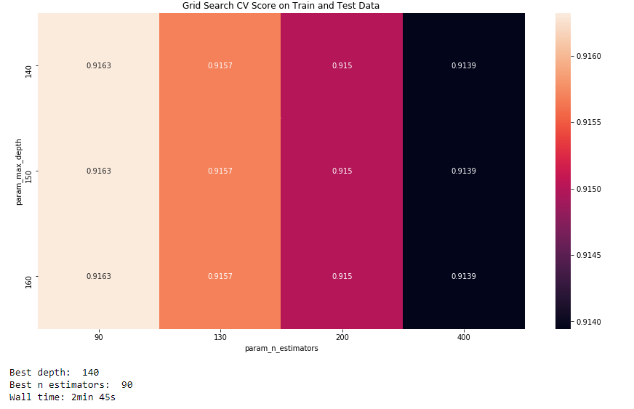
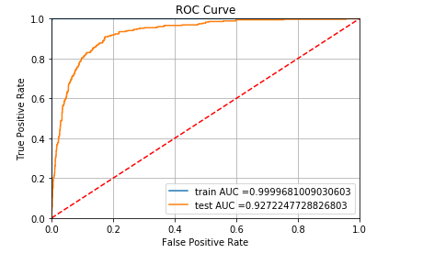
Conclusion:
As we can see XGBOOST is our best model lets visualize its ROC AUC
One Hot Encoding + Standard Scale​

Slide 15
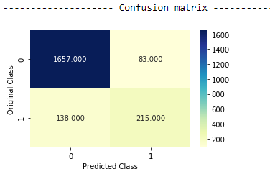
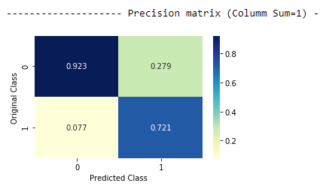
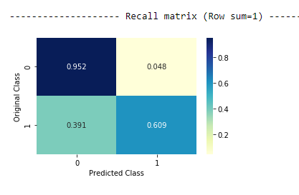
Confusion ,Precision and Recall Matrix of XGBOOST MODEL

Slide 16
Key Points and Future Scope
XGBOOST is our best model but it was suffering in our class 1 datapoints
We can improve our model with more data
We can use feature selection and try to minimizing the overfitting of models

Slide 17
Will Machine Learning help?
To improve operational efficiency from claim registration to settlement.
Enhancing the customer experience while reducing the claims settlement time.
These insights can help a carrier save millions of dollars in claim costs through proactive management, fast settlement, targeted investigations and better case management.
In doing so, insurance companies can also reduce costs and generate substantial business growth.

Slide 18
Thank you!!!

