Slide 1
Calculator+ Unified Smart Calculation System
A Multi-Mode Desktop Application using Python
“One Tool, All Calculations”
Presented by: Bhawna Chouhan
Date: April 2026

Slide 2
The Problem
Users rely on multiple tools for different calculations
Switching between applications is time-consuming and inefficient
No integration of advanced features
No single platform provides a complete calculation solution
“There is no unified solution for all calculation needs.”

Slide 3
The Solution
Developed Calculator+ as a unified platform
Combine multiple calculation tools
Includes Basic, Scientific, and Programmer modes
Designed for efficiency and ease of use
Calculator+ Structure:
Basic Calculator
Scientific Calculator
Programmer Calculator
“All Calculations. One Smart System.”

Slide 4
System Overview
Three main modules:
Basic
Scientific
Programmer
Each module handles specific calculations
“A modular design ensures flexibility and scalability.”
Calculator+
Basic Module
Scientific Module
Programmer Module

Slide 5
Technology Stack
Python - Core programming language
Tkinter - GUI framework
Math Module - Performs scientific calculations
Datetime Module – History tracking
Desktop Application - Runs on a local system
“Built using Python with a focus on simplicity and functionality.”

Slide 6
Key Features
Multi-mode calculator (Basic, Scientific, Programmer)
User-friendly interface with clean design
Supports advanced scientific operations
Programmer tools (Binary, Hex, Octal conversions)
Bitwise operations (AND, OR, XOR, Shift)
Calculation history with 24-hour tracking
ASCII conversion functionality
Fibonacci series generator
“A powerful all-in-one calculation system.”

Slide 7
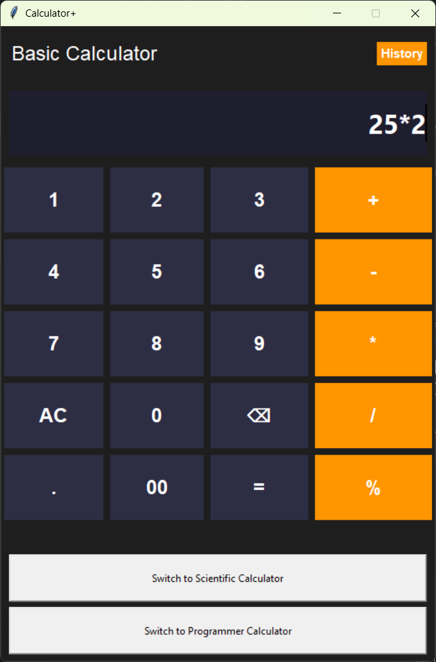
Basic Calculator Module
Performs basic arithmetic operations
Supports addition, multiplication, division
Clean and user-friendly interface
Fast and accurate calculations
Basic Application Interface

Slide 8
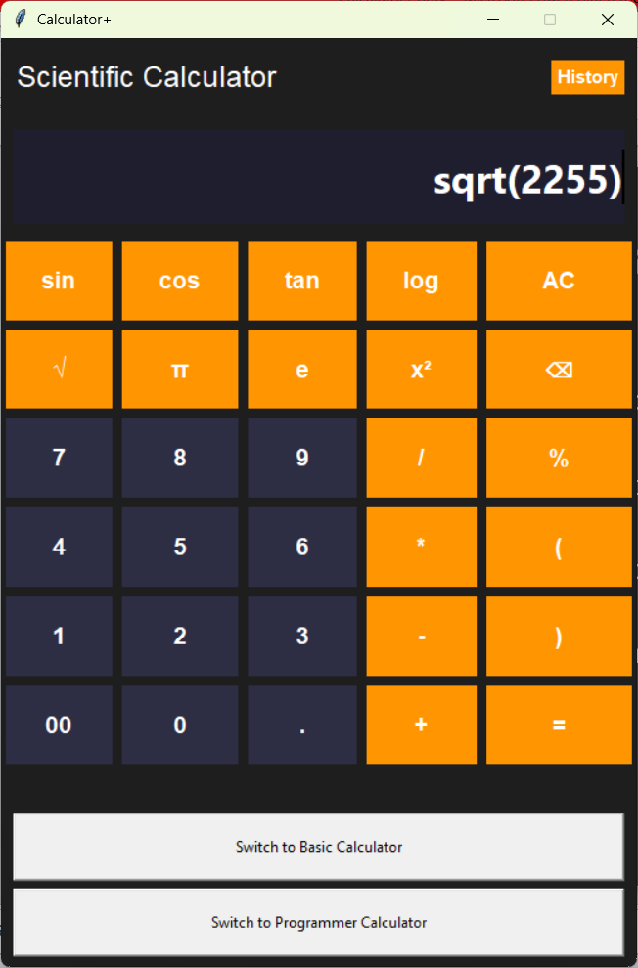
Scientific Calculator Module
Advanced mathematical operations
Trigonometric functions
Logarithmic & exponential functions
Square root, power, and factorial
Designed for complex calculations
“Advanced calculations made simple.”
Scientific Calculator UI

Slide 9
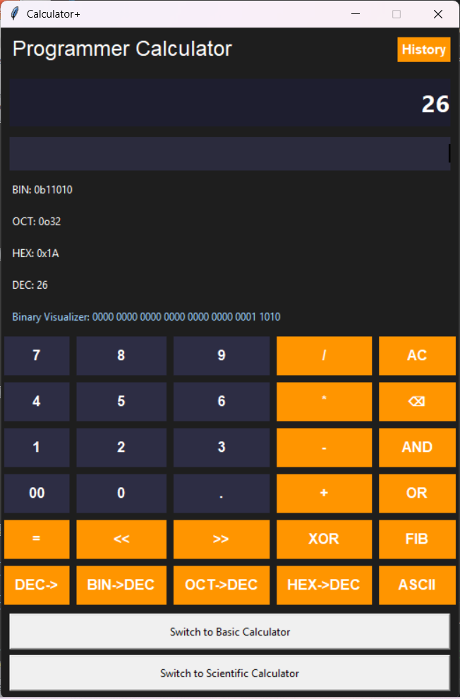
Programmer Calculator Module
Number system conversions
(Binary, Octal, Hex )
Bitwise operations
( AND, OR, XOR, Shift )
Efficient for low-level computations
Debugging and development friendly
Designed for programmers
“Simplifying complex binary calculations for developers.”
Programmer Calculator UI

Slide 10
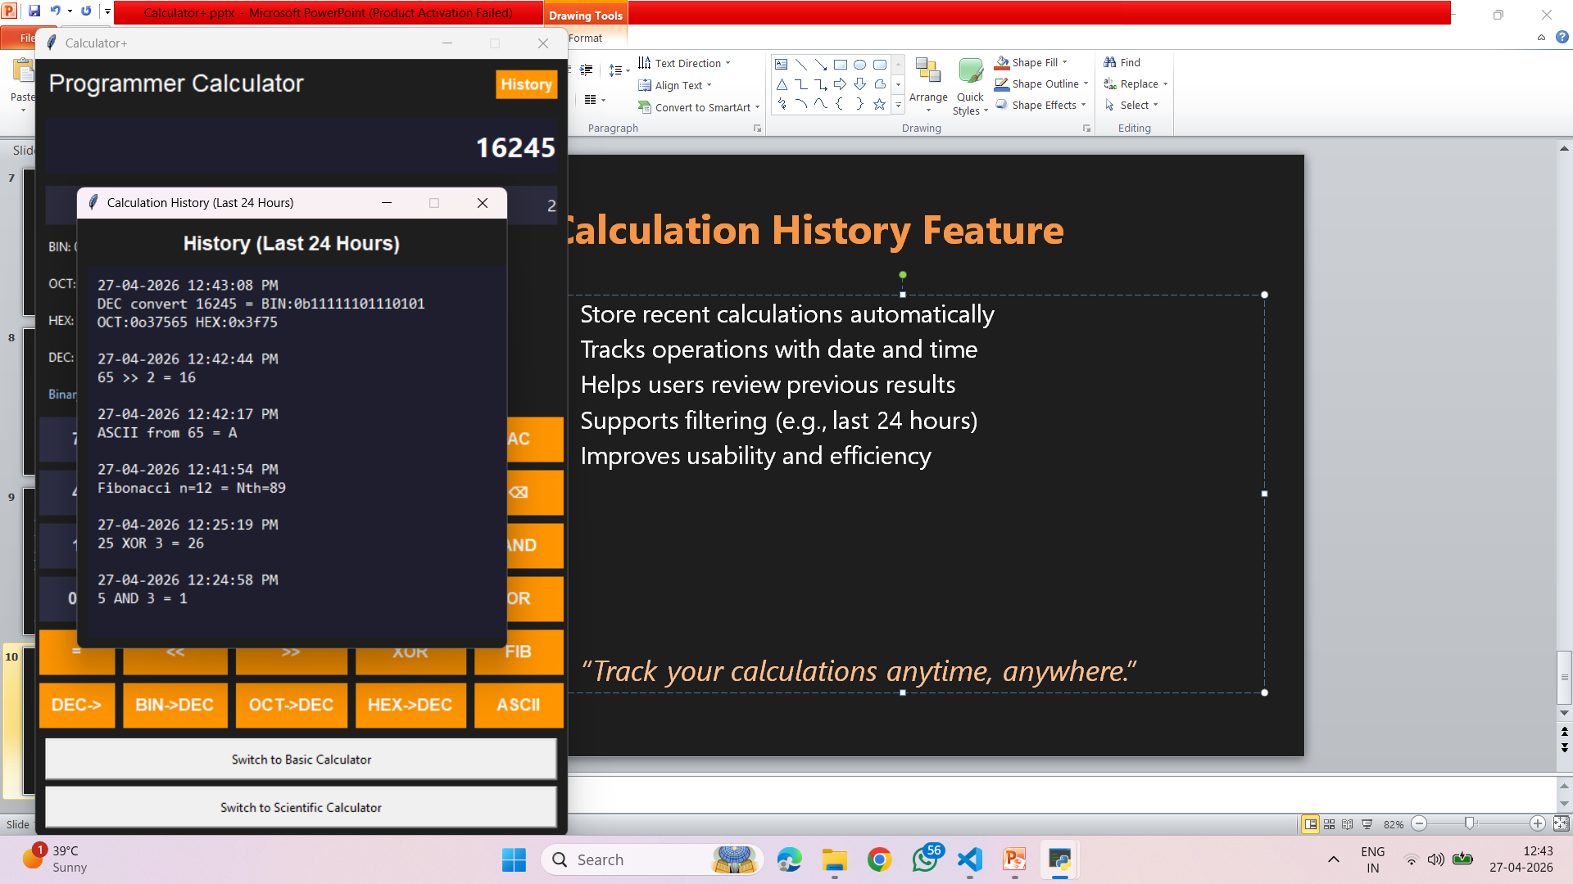
Calculation History Feature
Store recent calculations automatically
Tracks operations with date and time
Helps users review previous results
Supports filtering (e.g., last 24 hours)
Improves usability and efficiency
“Track your calculations anytime, anywhere.”

Slide 11
Conclusion
Developed an all-in-one calculator system
Integrates Basic, Scientific, and programmer modules
Provides fast, accurate, and user-friendly calculations
Reduces dependency on multiple tools
Built with a modular and scalable design
”A smart and efficient solution for all calculation needs.”

Slide 12
Thank you

