Slide 1
NEXTHIKES IT SOLUTIONS • DATA SCIENCE & AI INTERNSHIP
Disaster Tweet Classification
Using Natural Language Processing
An end-to-end NLP system for emergency monitoring - from data audit and exploratory analysis through text preprocessing, feature engineering, sentiment analysis, classical machine learning, DistilBERT fine-tuning, and Streamlit deployment.
Final model: Calibrated LinearSVC (tuned) • Accuracy 78.8% • F1 0.743
Prepared by Bhawna Chouhan | Project 7 | Final Submission | October 2026

Slide 2
The Problem & Objectives
Why keyword matching fails
• Twitter is often faster than official channels during an emergency.
• But disaster vocabulary is also everyday exaggeration vocabulary:
  – "Forest fire near La Ronge Sask. Canada" → REAL disaster
  – "that exam absolutely destroyed me" → NOT a disaster
  – "My new song is FIRE" → NOT a disaster
• Searching for the word 'fire' flags all three. The real task is CONTEXTUAL UNDERSTANDING, not keyword lookup.
• Objective: classify 1 = disaster-related, 0 = non-disaster — and judge it on operational metrics, because the two error types differ:
  – False negative = a real emergency missed (dangerous)
  – False positive = a false alarm (causes alarm fatigue)
• Full lifecycle: Audit → EDA → Preprocessing → Keywords → Features → Sentiment → Vectorization → Split → Models → DistilBERT → Evaluation → App.

Slide 3
Dataset & Data-Quality Audit
Every figure verified from the file itself
Check | Value | Why it matters
Rows × columns | 7,613 × 5 | Brief claimed 10,000 — the supplied file is what we use
Missing 'keyword' | 61 (0.8%) | Nearly complete; curated metadata
Missing 'location' | 2,534 (33.3%) | Unvalidated free text — excluded from the model
Duplicate IDs | 0 | Row identity is clean
Duplicate tweet text | 110 | Removed BEFORE splitting to prevent leakage
Contradictory labels | 18 texts | Humans disagreed — sets a realistic accuracy ceiling
Non-disaster (0) | 4,342 (57.0%) | Majority class → 57% accuracy baseline
Disaster (1) | 3,271 (43.0%) | Mild imbalance → accuracy alone is misleading
The project statement describes 10,000 tweets; the supplied dataset contains 7,613. The supplied data was used as-is — no rows were synthesised. After removing duplicates and contradictions, 7,485 rows were modelled.

Slide 4
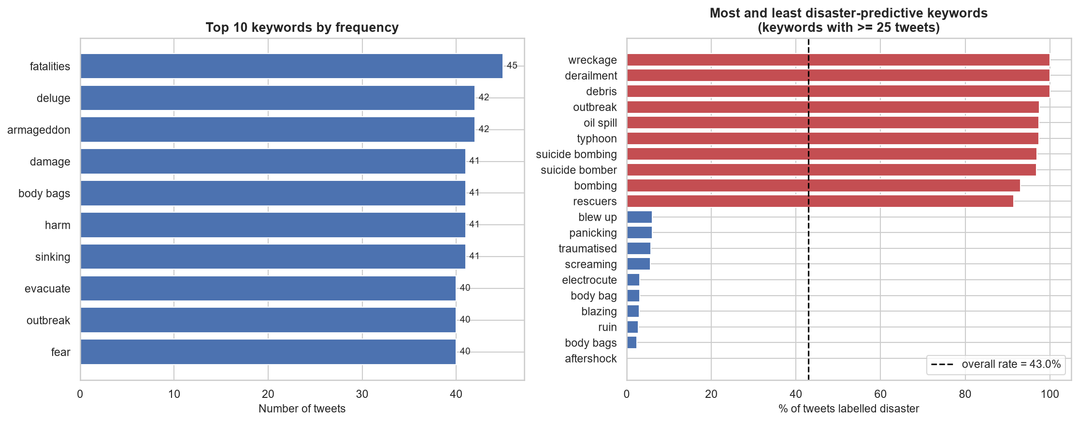
Keyword Analysis
The curated keyword separates the classes — but not the way you would expect
The 'keyword' column separates classes strongly (~8% to ~95% disaster rate). But the pattern is NOT 'dramatic word = disaster': 'blazing', 'ruin' and 'aftershock' are mostly figurative, while 'wreckage' and 'derailment' are almost always literal. Excluded from the model anyway — it is dataset metadata a live user never supplies.

Slide 5
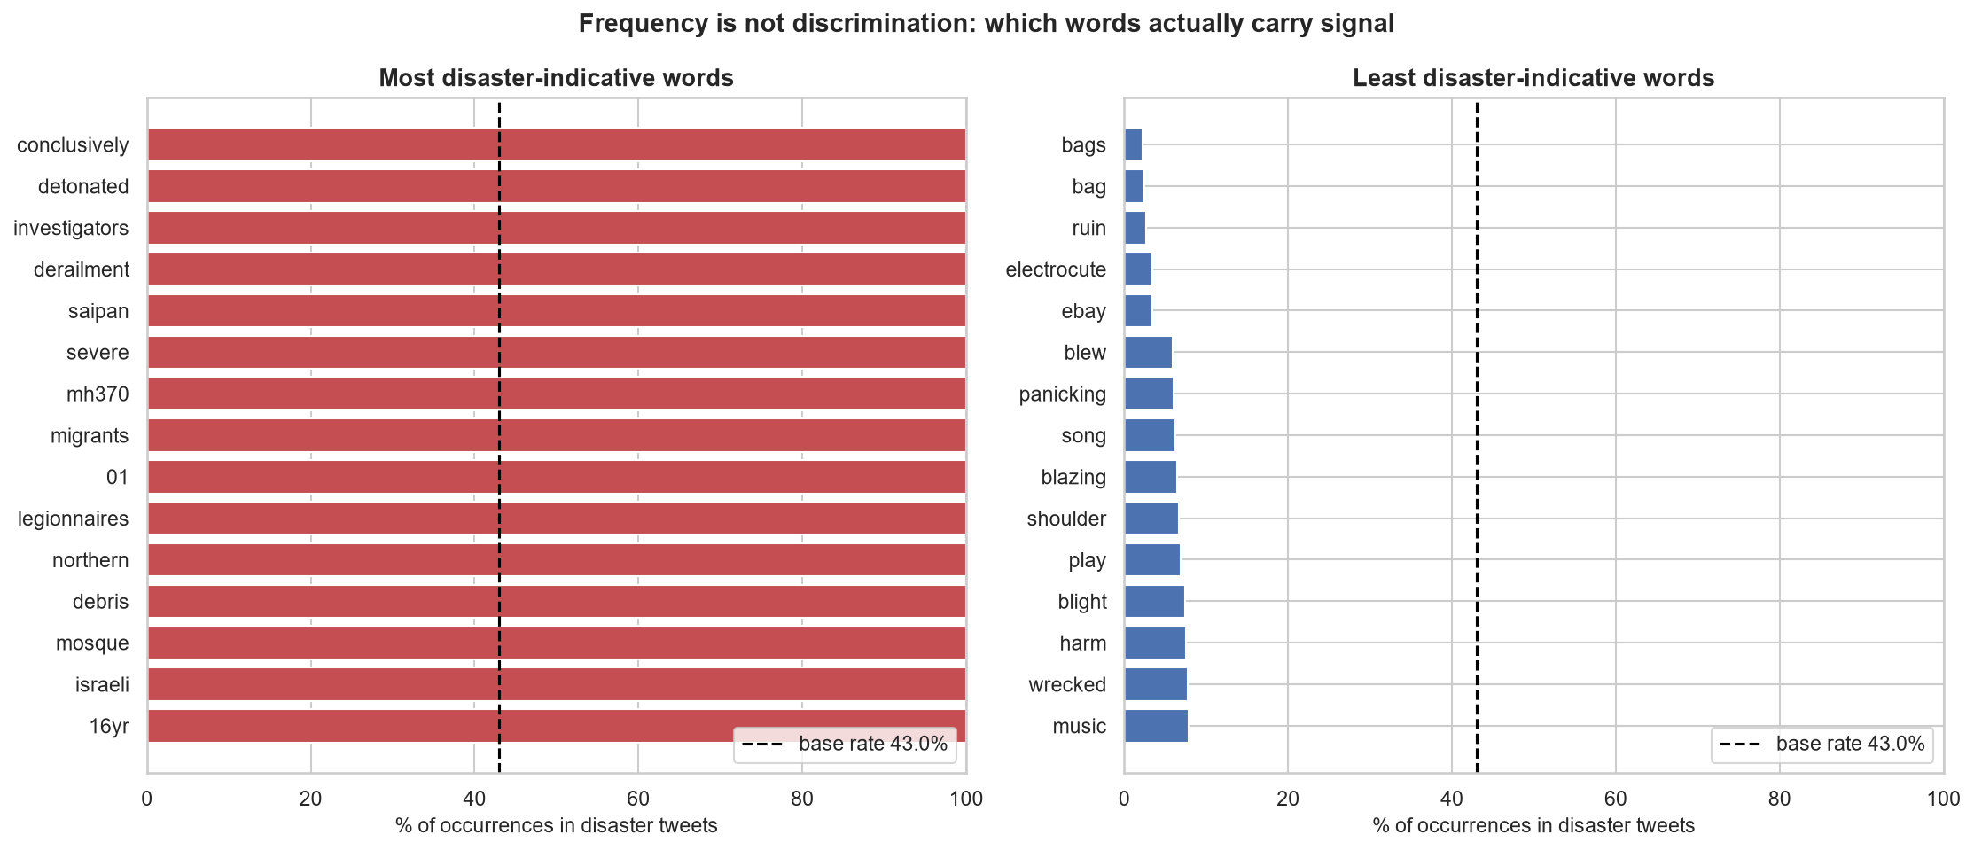
Frequency Is Not Discrimination
A common word is not necessarily a useful one
Hundreds of NON-disaster tweets contain 'fire', 'destroyed' or 'crash' — the concrete reason keyword matching cannot solve this task. Note that 'wreck' and 'destroyed' sit near the ambiguous middle, because those are the words English speakers most often use figuratively.

Slide 6
Text Preprocessing
Cleaning that preserves meaning
• Preprocessing TRANSFORMS text; feature engineering MEASURES it. Different jobs.
• URLs → 'urltoken', @mentions → 'usertoken' (the fact of a link is signal).
• Hashtag words KEPT and CamelCase split: #CaliforniaWildfire → california wildfire.
• Numbers KEPT: '13,000 evacuated', 'M5.8 earthquake' are meaningful.
• NEGATION DELIBERATELY PRESERVED — the most deliberate decision here:
  – standard cleaning: "There is no flooding" → "flooding" ✗ inverted
  – our cleaning: "There is no flooding" → "no flooding" ✓ correct
• Necessary — but NOT sufficient. Slide 13 shows the model still misreads it.
• One implementation, imported by notebook AND app — they cannot drift apart.

Slide 7
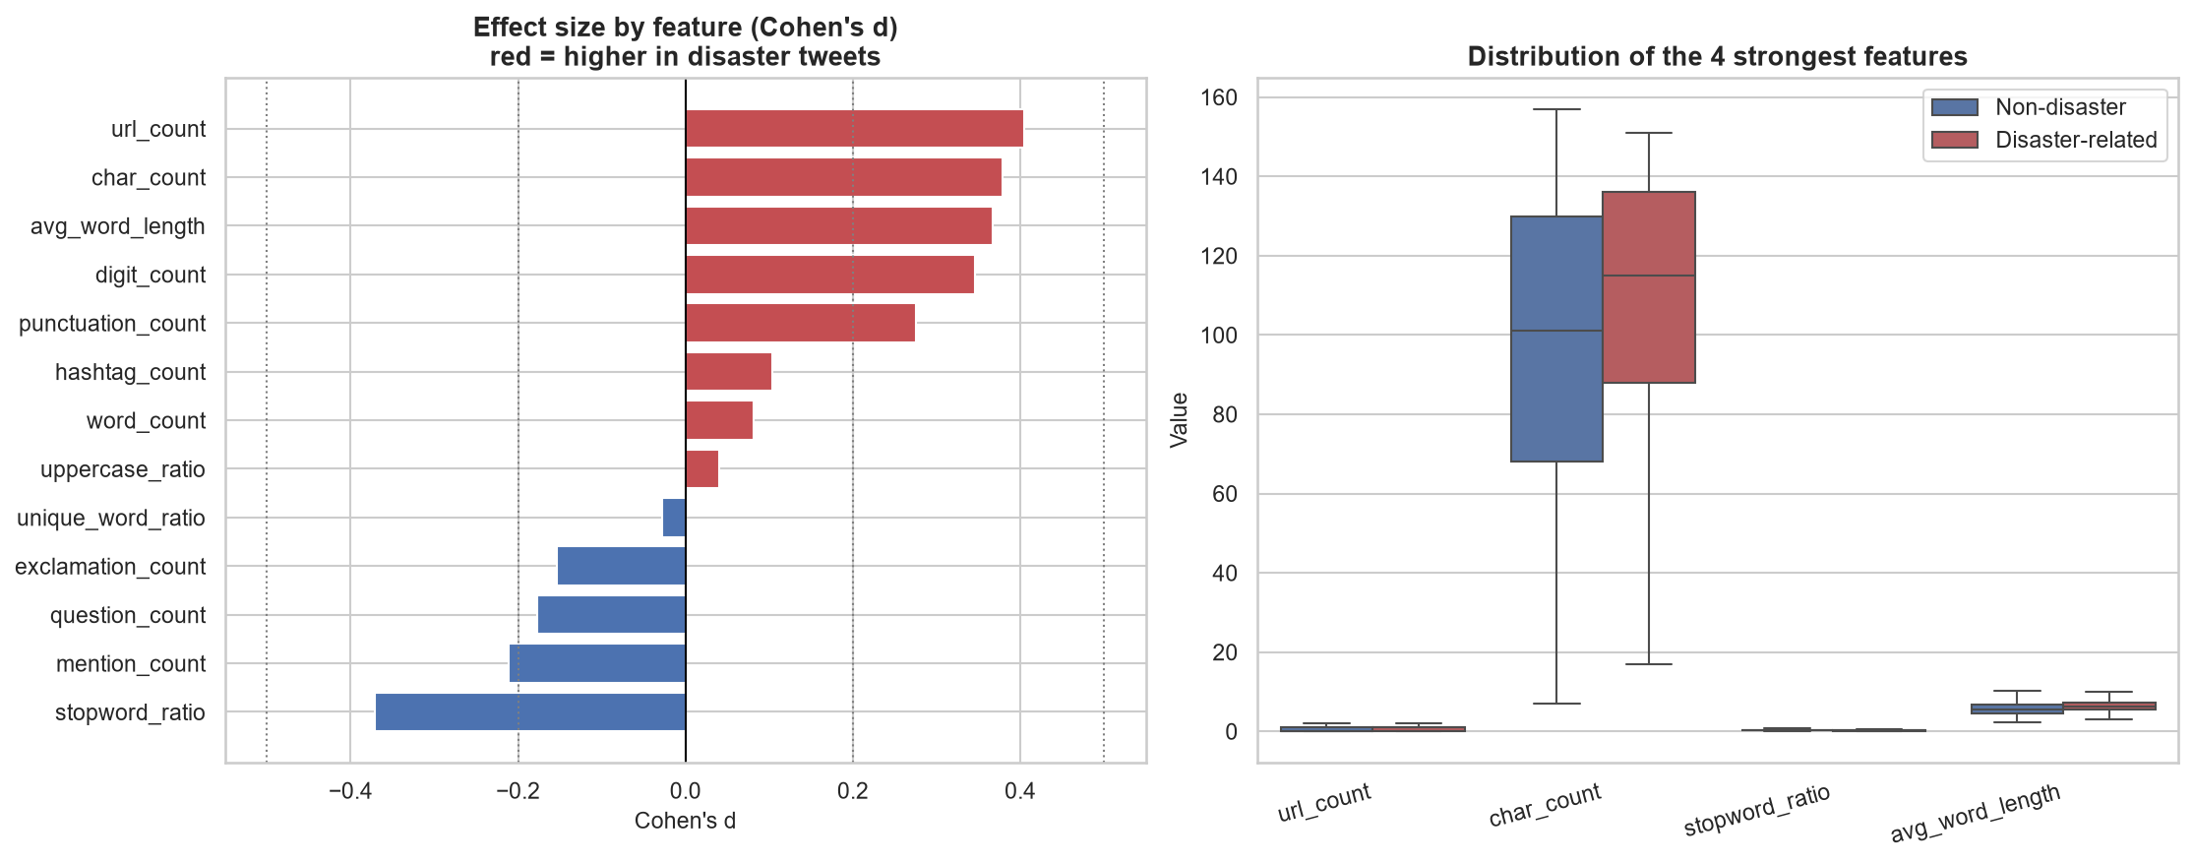
Feature Engineering
13 numeric features measured from the raw tweet
Strongest signals: url_count (disaster tweets link to news) and mention_count (non-disaster tweets are conversational). Even these are only small effects — an honest finding, reported rather than oversold. 'keyword' and 'location' were deliberately EXCLUDED: they are dataset metadata a live user would not supply.

Slide 8
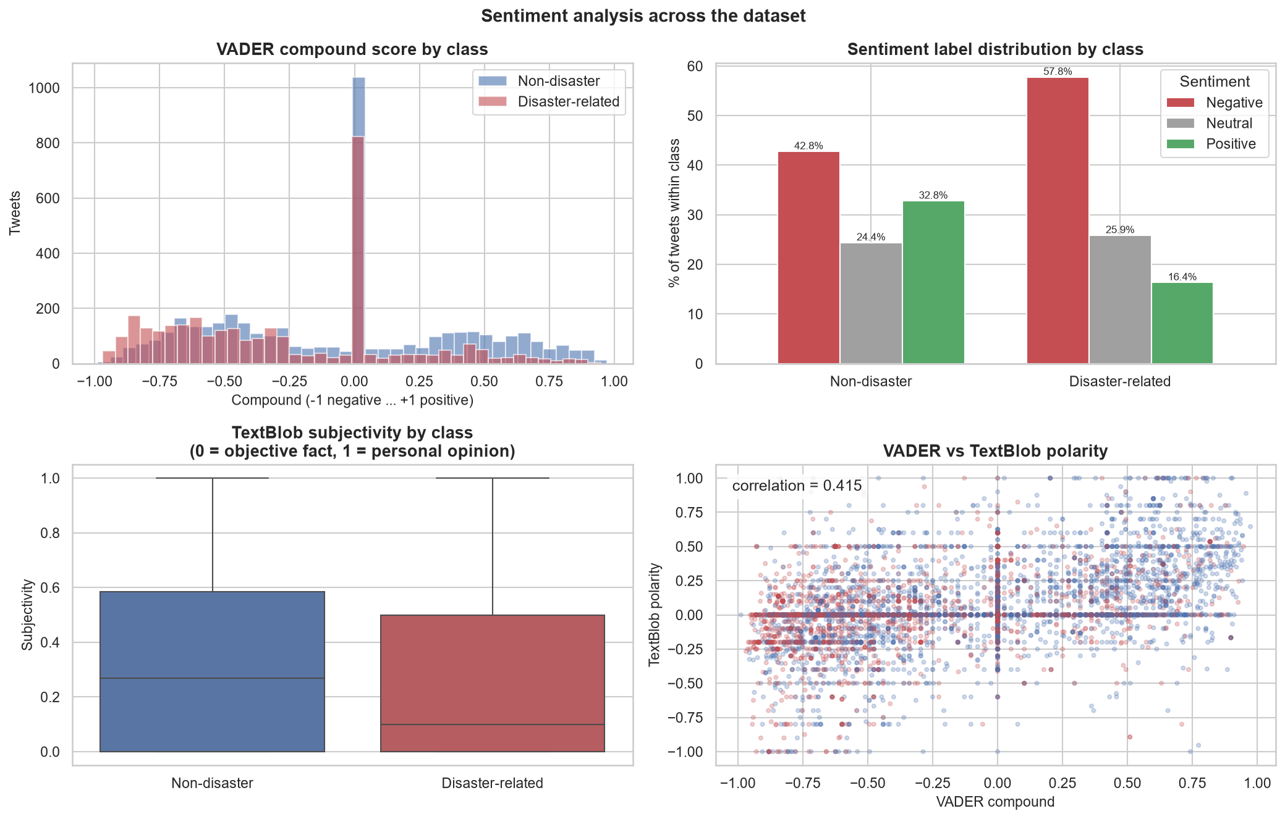
Sentiment Analysis
Implemented with VADER + TextBlob — and measured
Disaster tweets are more negative and more objective. But sentiment answers a DIFFERENT question: a factual disaster report reads neutral, while 'this traffic is killing me' reads strongly negative. A sentiment-only rule performs WORSE than guessing the majority class — so it is a supporting signal only.

Slide 9
Vectorization & Embeddings
Five distinct concepts — and none of them is label encoding
Approach | What it produces | Context-aware? | Used here
Tokenization | Text → list of tokens | n/a | Yes
Bag of Words | Sparse term counts | No | Yes
TF-IDF | Counts weighted by rarity | No | Yes — final model
Word2Vec | 100-dim dense word vectors | No | Yes (trained on corpus)
DistilBERT | 768-dim contextual vectors | Yes | Yes — fine-tuned
• Vectorization is NOT label encoding — words are not ordered categories.
• Word2Vec trained on our own corpus: no 822 MB GloVe download needed.
• Static embeddings give 'fire' ONE vector — but our whole task is that 'forest fire' and 'song is fire' differ. Hence DistilBERT.

Slide 10
Model Comparison
All models on the same untouched test set
Model | Accuracy | Precision | Recall | F1 | Macro-F1
DistilBERT (fine-tuned) | 0.8303 | 0.8380 | 0.7461 | 0.7894 | 0.8237
Calibrated LinearSVC (tuned) | 0.7882 | 0.7697 | 0.7179 | 0.7429 | 0.7814
Linear SVC (tuned) | 0.7896 | 0.7770 | 0.7100 | 0.7420 | 0.7822
LogReg + engineered features | 0.7882 | 0.7945 | 0.6787 | 0.7320 | 0.7785
Logistic Regression (TF-IDF) | 0.7882 | 0.7967 | 0.6755 | 0.7311 | 0.7782
LinearSVC + engineered features | 0.7876 | 0.7974 | 0.6724 | 0.7296 | 0.7773
Linear SVC (TF-IDF + stemming) | 0.7836 | 0.7865 | 0.6755 | 0.7268 | 0.7738
Random Forest (TF-IDF + SVD) | 0.7575 | 0.7996 | 0.5752 | 0.6691 | 0.7389
KNN (TF-IDF + SVD) [demo] | 0.7448 | 0.7667 | 0.5768 | 0.6583 | 0.7273
Baseline (majority class) | 0.5738 | 0.0000 | 0.0000 | 0.0000 | 0.3646
Linear models dominate on sparse text. Random Forest and KNN underperform — confirming that tree and distance models are a poor fit for high-dimensional text, with evidence rather than assertion.

Slide 11
DistilBERT — Actually Fine-Tuned
The advanced comparison
• 6 transformer layers, ~66M parameters, distilled from BERT-base.
• Self-attention makes each word's vector depend on its SENTENCE — exactly what this task needs.
• Model card reviewed: intended for fine-tuning; documented risks include biased predictions and English-only support.
• A sentiment checkpoint would be the WRONG choice — different question. We fine-tuned the BASE checkpoint on our own labels.
• Trained for real: 2 epochs, lr=3e-05, batch=32, on CPU — 15.0 minutes.
• Result: accuracy 0.8303, F1 0.7894.
• NOT deployed: ~255 MB exceeds GitHub's 100 MB file limit.
These are real numbers from a real training run, not quoted figures.

Slide 12
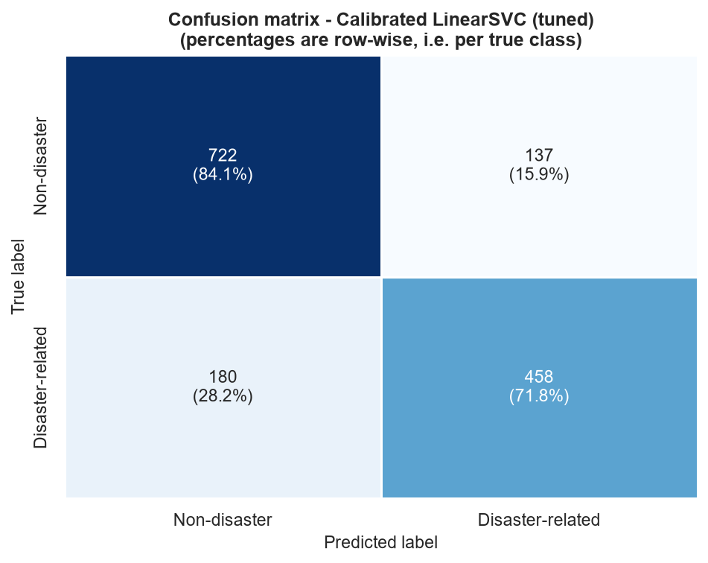
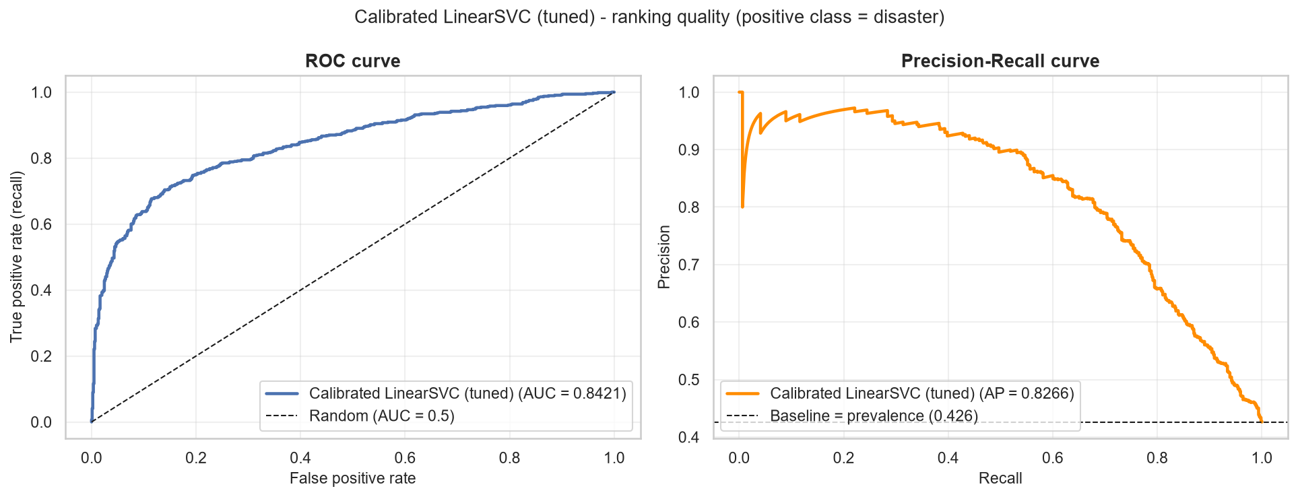
Evaluation & Error Analysis
Calibrated LinearSVC (tuned)
Of 638 real disasters in the test set, the model found 458 (71.8%) and missed 180. Of its 595 alerts, 77.0% were correct. ROC-AUC 0.8421.

Slide 13
The Negation Finding
The most instructive result — and it did not go as predicted
Probe tweet | Deployed model | DistilBERT
"This traffic is killing me..." | WRONG (0.701) | correct (0.381)
"There is no flooding in our area..." | WRONG (0.854) | WRONG (0.915)
"The fire alarm was a false alarm..." | WRONG (0.819) | WRONG (0.550)
• Hypothesis: self-attention should let 'no' modify 'flooding', fixing negation.
• What DistilBERT DID fix — figurative language. 'Traffic is killing me' goes from a confident wrong answer to a correct one.
• What it did NOT fix — negation. Both models still call 'no flooding' a disaster, and DistilBERT does so MORE confidently.
• Why: the training data, not the architecture. Disaster words appear in ~3,000 tweets, almost all genuine reports; negated statements are rare, so both models learn an overwhelming 'flooding ⇒ disaster' prior.
• Preprocessing DOES preserve the 'no' — preserving the token was necessary but not sufficient.
• Reported as a real limitation in the notebook, README and the app's own UI.

Slide 14
Final Model & Streamlit Application
Chosen on evidence — then actually shipped
Criterion | Value
Test F1 (disaster) | 0.7429
Macro-F1 | 0.7814
ROC-AUC | 0.8421
Cross-validated F1 | 0.7611 ± 0.0162
Artifact size | 1.05 MB
Inference speed | sub-millisecond per tweet
Probability output | Calibrated probability
• Selected: Calibrated LinearSVC (tuned) — fits GitHub and Streamlit Cloud, calibrated, and linear enough to explain.
• DistilBERT reported but not deployed (~244× larger, 159× slower).
• THE APP — https://project7digo-6nxbuqxvpnitprohz9cjts.streamlit.app/
  – Branded dark UI: About Me / About the Project / Project Overview panels
  – Paste a tweet → colour-coded verdict + calibrated confidence
  – Tabs: how the model read the tweet, and sentiment shown SEPARATELY
  – Model-comparison panel: deployed model vs fine-tuned DistilBERT
  – Every figure read live from model_metadata.json — never hardcoded
  – Example tweets: literal / figurative / negation / ambiguous
  – Validation, friendly errors, no tracebacks; negation weakness stated

Slide 15
Conclusions, Limitations & Future Scope
• Delivered a working classifier at 78.8% accuracy / 0.743 F1 on held-out data, plus a working Streamlit app (verified locally; deployment-ready but not publicly hosted).
• Honest findings worth stating:
  – Preprocessing choices moved the score less than cross-validation noise
  – Engineered features and sentiment added little over text alone
  – 'keyword' was excluded despite being predictive — it would not exist live
  – Negation defeats BOTH models — a data problem, not an architecture one
• Limitations: negated statements misclassified; English only; 2015-era vocabulary; classifies language, not facts; no disaster-type label exists; sarcasm is hard.
• Human annotators disagreed on 18 texts — ~100% accuracy would indicate leakage.
• Future, in priority order: (1) augment training data with negated examples, (2) train DistilBERT longer, (3) modern labelled data, (4) DistilBERT behind an API, (5) explainability, (6) threshold tuned to an operational cost balance.

