Slide 1

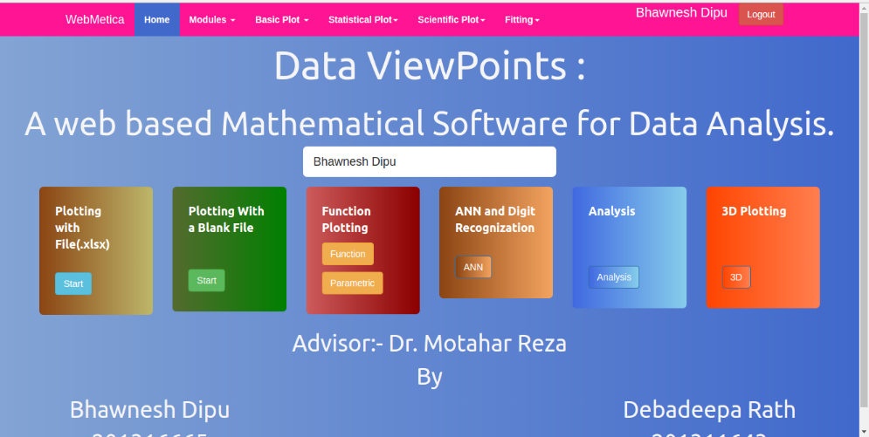
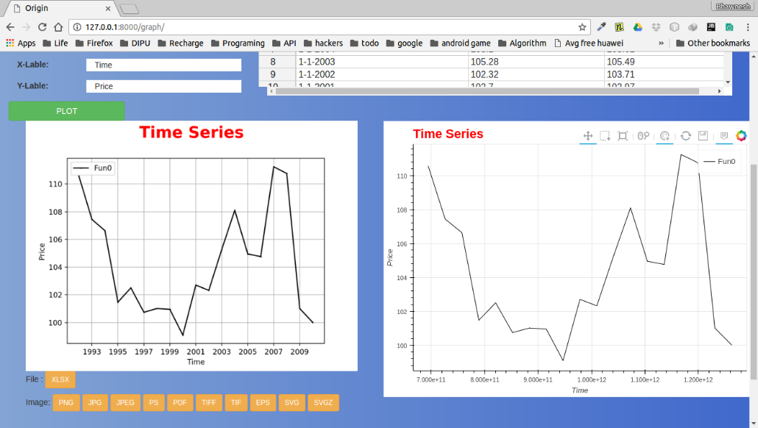
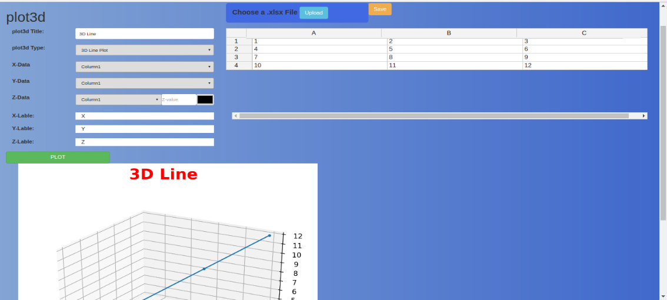
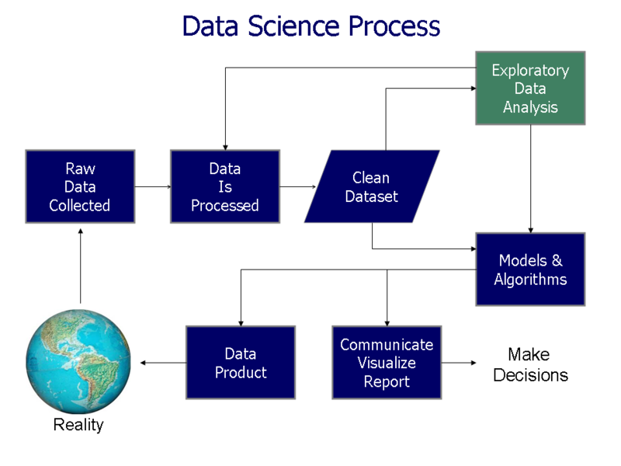
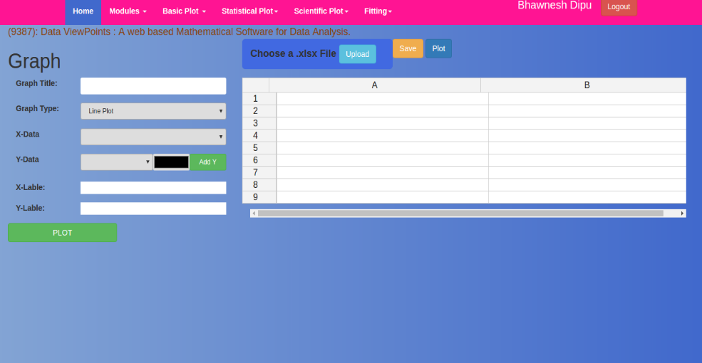
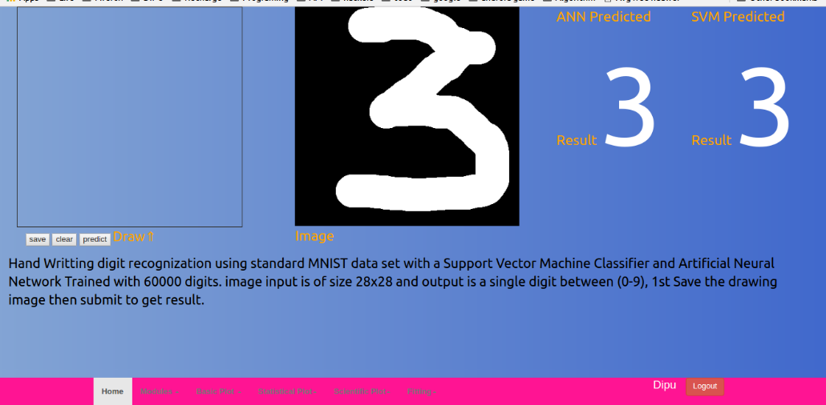
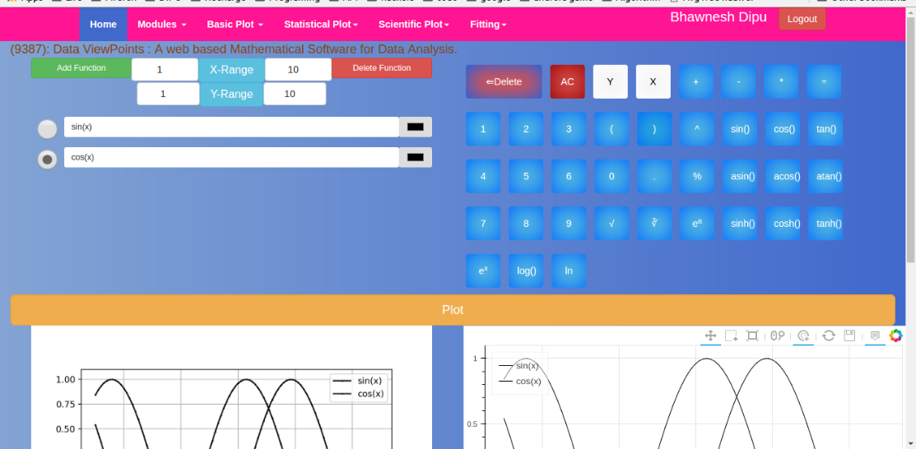
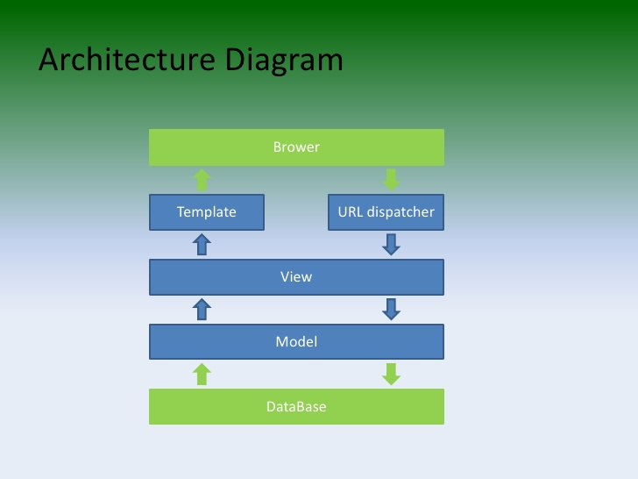
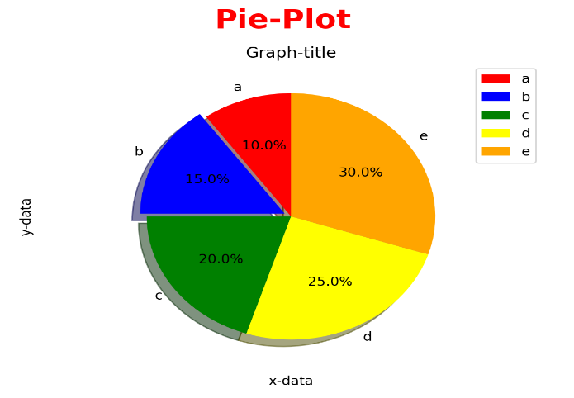
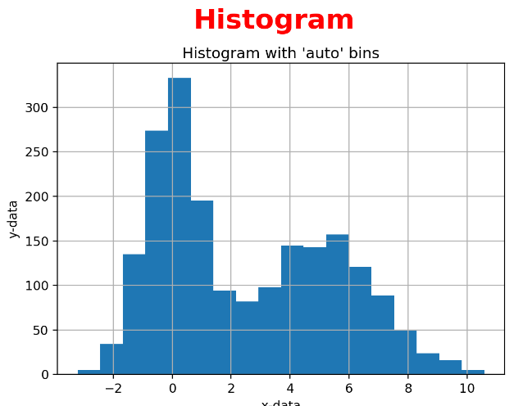
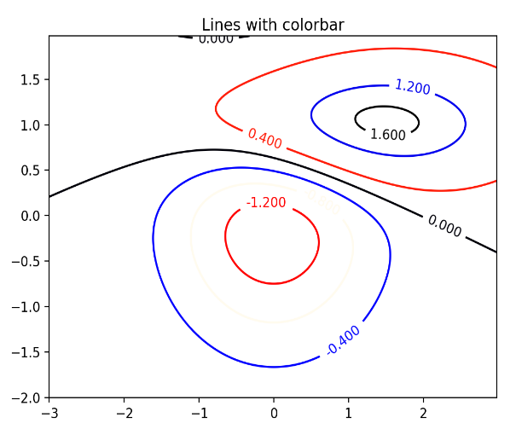
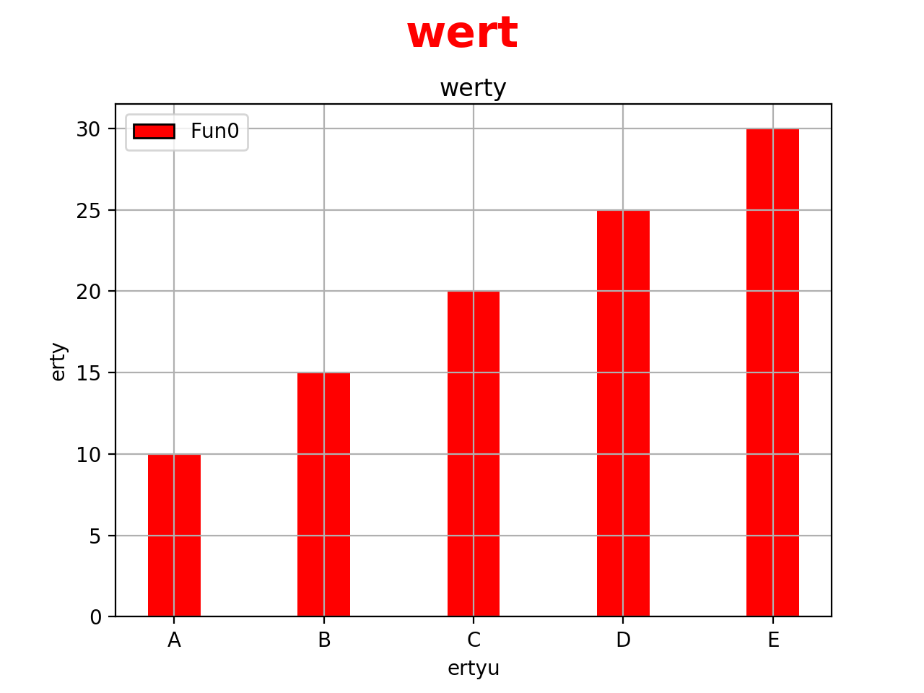
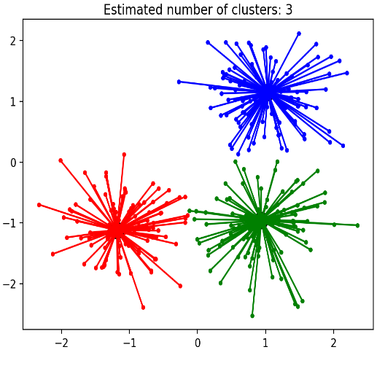
Data Viewpoints : A Web Based Mathematical Analysis Software
Project id:9387
Bhawnesh Dipu CSE201316665
Debadeepa Rath CSE201311643
Introduction
Aim
Method
Conclusion
Data visualization is the presentation of data in a pictorial or graphical format. It enables decision makers to see analytics presented visually, so they can grasp difficult concepts or identify new patterns.
The way the human brain processes information, using charts or graphs to visualize large amounts of complex data is easier than poring over spreadsheets or reports.
Data visualization is a quick, easy way to convey concepts in a universal manner
Data visualization can also:
Identify areas that need attention or improvement.
Clarify which factors influence customer behavior.
Help us to understand which products to place where.
Predict sales volumes.
Data visualization is one of the steps in analyzing data and presenting it to users.
The web based visualization tool aims to provide visualization of data in different ways .
It gives user the flexibility to visualize the data with a web based user interactive page.
The user has the flexibility to create artificial neural network to train and predict the data
The following method is adopted for the online optimization tool hosted from cloud instance –
Users need to select the type of graph they want to solve such as line,scatter,function,3D etc.
Based on the selection, a webpage asking for all the details related to that problem will appear.
Users can either fill in the details or upload a excel sheet corresponding to their graph .
Click on the Plot button . The details is transferred to the Dango server.
The graph is generated . If any error, then it is displayed
The focus is largely on standard line, bar, and pie charts over other types of data visualizations.
Academic audiences are the most common target audience
There appears to be a lack of understanding about how to tailor design choices to ensure that visualizations are communicating a more focused and compelling message
It is significantly faster to analyze information in graphical format
Even extensive amounts of complicated data start to make sense when presented graphically.
Challenges
Understanding the data
Understanding what user want to see
Understanding the format of visualization and its strengths and limitations
Development
The web based tool is developed using the django web framework using python as a backend language with its different packages used for full filling the different need of user.

