Slide 1




GloBox Food and Drink Banner A/B Test
Analysis and Report
By
Bradley Hazelton

Slide 2
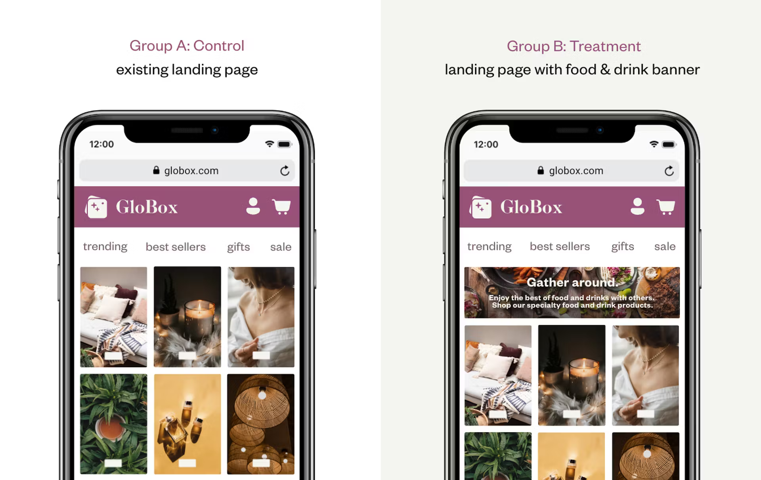
Introduction
The A/B test was conducted to evaluate the impact of a new food and drink banner on user behavior on the GloBox mobile website.
GloBox's food and drink offerings have grown tremendously in the last few months. The new banner was introduced to bring awareness to this product category with the aim of increasing revenue.
The new banner was expected to enhance user engagement and encourage more purchases by highlighting the variety of food and drink offerings available.

Slide 3
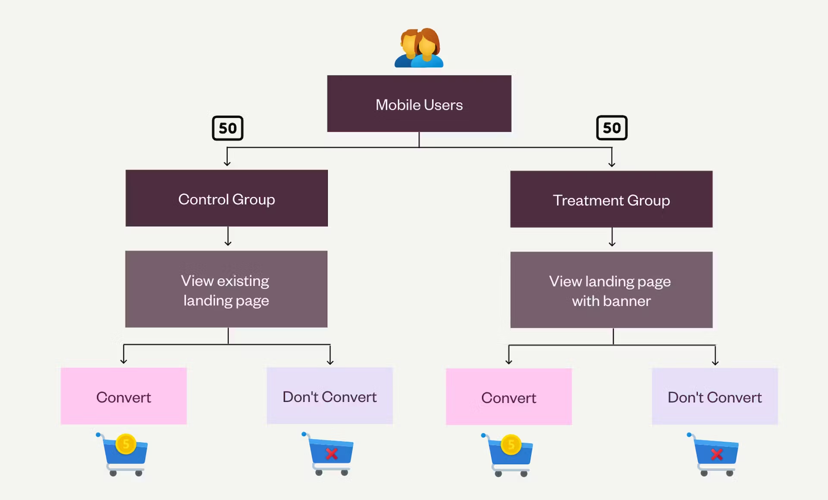
Test Design and Key Metrics
Test Design: Users visiting the site during the test period were randomly assigned to the control or test group. The control group saw the original site and the test group saw the food and drink banner.
Test Duration: The test was conducted over a period of 12 days, from January 26 to February 6.
Primary Metrics: The primary metrics of interest for the test were the conversion rate and the average amount spent per user. The conversion rate was defined as the proportion of users who made a purchase during their visit or subsequent visits to the site. The average amount spent was calculated as the total amount spent divided by the number of users.
Data Collected: The dataset used for the analysis includes data on approximately 49,000 users who visited the site during the test period. The data collected was the group they were assigned to, whether they made a purchase or not, the amount they spent, and other user characteristics such as gender, device, and country of residence.

Slide 4
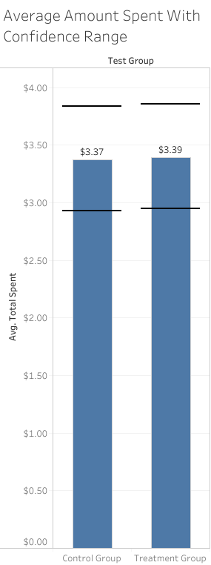
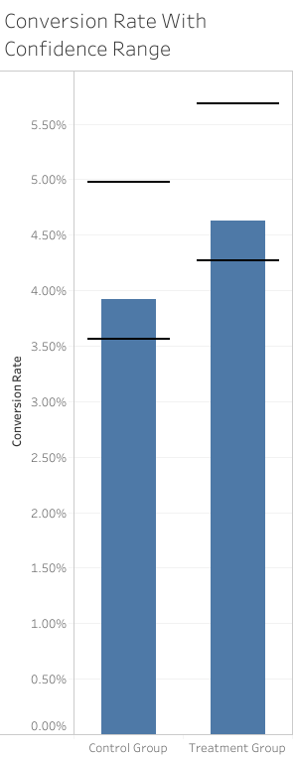
Data Overview and User Characteristics
Total Users: There were 48,943 total users in the A/B test with 24,343 in the Control group and 24,600 in the Test group.
Conversion Rates: The Control group had a conversion rate of 3.923% while the Test group had a conversion rate of 4.630%.
Average Spend: The average spent in the Control group was $3.37 and was $3.39 in the Test group.

Slide 5
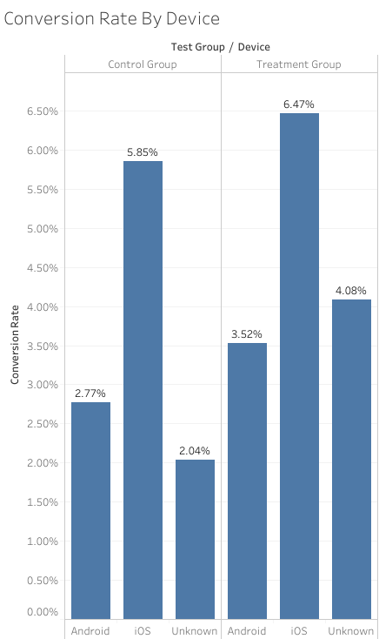
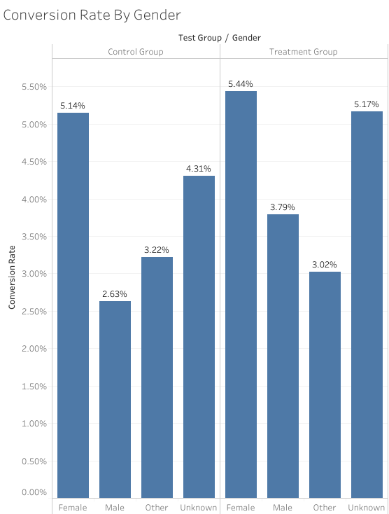
User Characteristics - Gender and Device
Gender Distribution: The gender distribution was approximately equal with slightly more females in the Control group (10,069 vs 10,054) and slightly more males in the Test group (10,235 vs 10,061). There were also 1,669 users of ‘Other’ gender and 6,855 users with unknown gender.
Device Usage: There were approximately 5,900 more Android users than iOS users in each group, with Android holding approximately 62% of the devices.

Slide 6
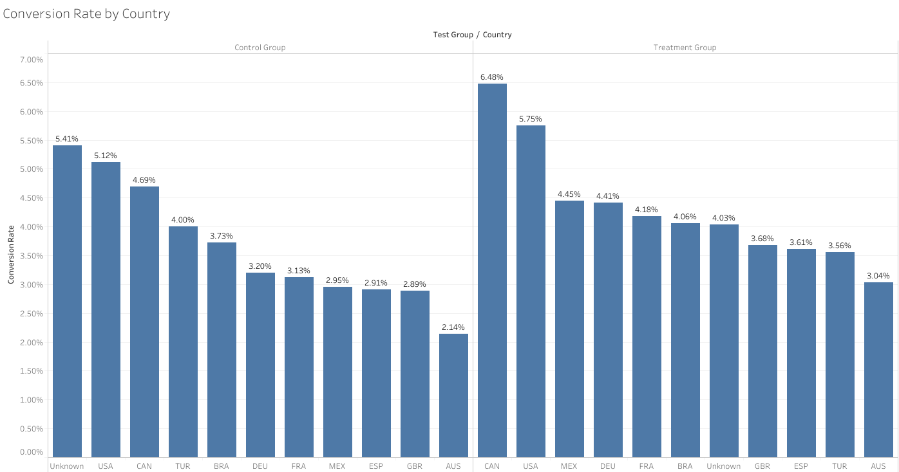
Country Analysis
USA: 7,309 users in the control group and 7,463 users in the test group.
Brazil: 4,805 users in the control group and 4,629 users in the test group.
Mexico: 2,815 users in the control group and 2,923 users in the test group.
Germany: 1,906 users in the control group and 1,948 users in the test group.
For the remaining countries please reference the written report.

Slide 7

Conclusions and Recommendations
The A/B test showed a statistically significant difference in conversion rate between the control and test group, suggesting that the new banner had a positive impact on user behavior.
The test group outperformed the control group by approximately 12.47% in terms of conversion rate.
While there was no significant difference in the average amount spent per user between the two groups, the increase in the number of users making a purchase in the test group implies a potential for increased revenue.
Based on these findings, we recommend launching the new banner for all users.
Further research could focus on exploring the observed gender differences in more detail.

Slide 8

Future Work
Further Testing: Explore why the new banner was more effective for certain user groups. This could provide insights for more targeted marketing strategies.
Design Improvements: Test other design or user experience elements to improve conversion. This could include changes to the layout, color scheme, or other elements of the site.
Product Analysis: Explore what products are commonly purchased together. This could improve our suggested add-on algorithm and potentially increase the average spend per user.
Expand Testing: Continue the A/B test but expand the test populations to approximately 121,000 based on the ideal sample size analysis. This will provide more robust results and increase the confidence in the findings.

Slide 9

Questions & Discussion

Slide 10



Thank you for your time and attention. I look forward to hearing your thoughts and answering any questions you may have.

