Slide 1
Modelling the volatility surface OF various S&P500 Options

Slide 2
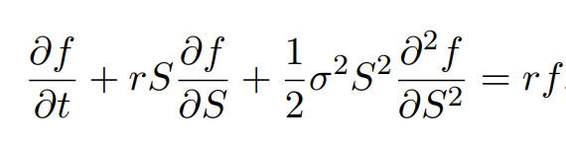
The Black Scholes Equation
The Black Scholes Equation was derived in 1973 giving the price of a European-style call option f as a function of:
S, the current spot price of the underlying
r, the current risk-free rate
σ, the volatility of the underlying asset
And time t
Of all of these inputs, only the volatility σ is unknown at any given time

Slide 3
The Black Scholes Equation - Assumptions
Markets are efficient (i.e. market movements cannot be predicted)
No transaction costs
The returns on the underlying are normally distributed
Etc…
However, the most important of these is:
The risk-free rate and volatility of the underlying are known and constant
This assumption has been shown to be false

Slide 4
Implied Volatility
If the price of the options is known, all other inputs (except the volatility) are already known
This means that, given the price of an option, we can figure out the volatility used to calculate the price of the options
This is called the implied volatility

Slide 5
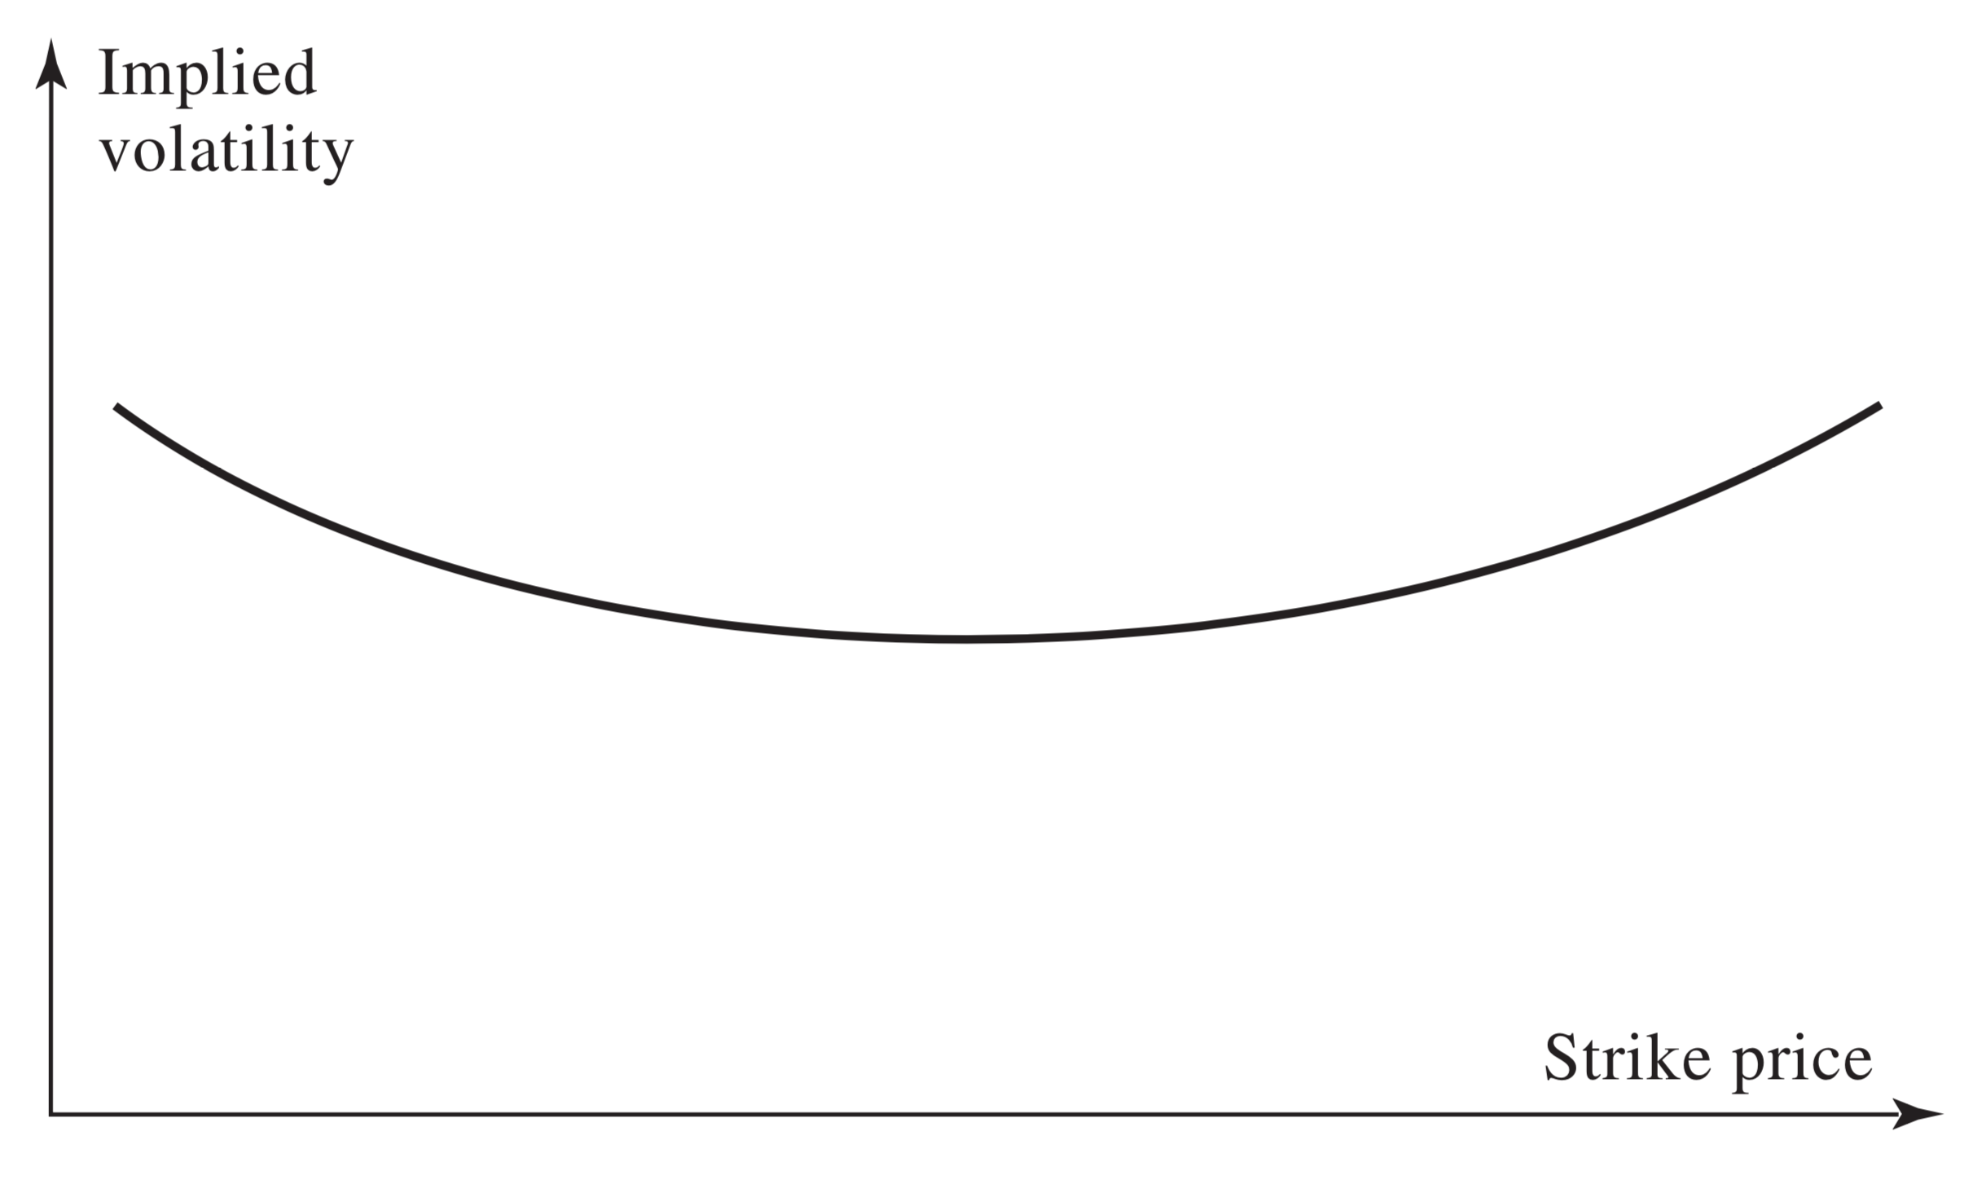
The Volatility Smile
We map out the implied volatility of several options relative to their strike price
According to Black Scholes, this volatility should be a constant regardless of strike price or maturity
However, we see this is not the case
This is what we call the “volatility smile”

Slide 6
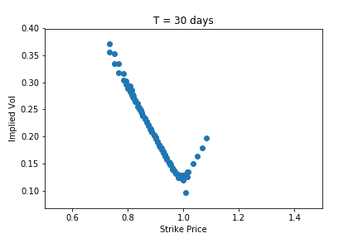
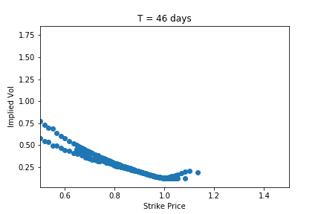
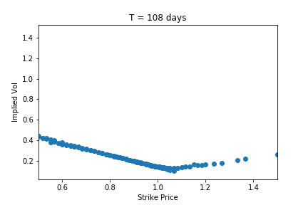
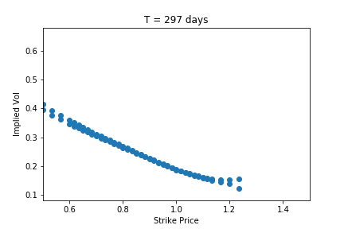
Volatility Smile Shortcomings
Using historical options data, we created several plots but also varied the time to expiration
The “volatility smile” is not enough to explain variation in implied volatility
We can use a 3D plot called a volatility surface to model the variation of the implied volatility

Slide 7
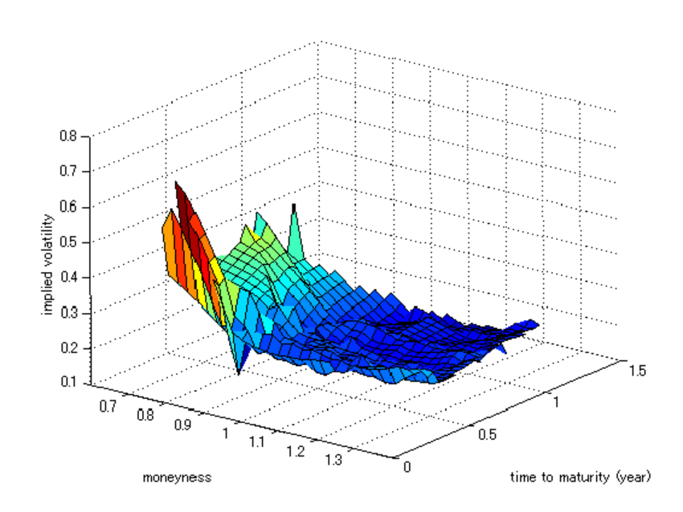
Volatility Surface - Example
This is an example of a volatility surface generated for the Nikkei options market
This plot shows the varying shape of the volatility surface based on the strike price and time to maturity
Our goal will be to model the volatility surface of the S&P500 options market

Slide 8
Data
We use historical options market data from September 2012 (OptionMetrics)
We look at both European-style call and put options for the S&P500 index
First we filter out all options with expiry shorter than 10 days because of the volatility of these option themselves
We also filter out options with expiry greater than 500 days due to the lack of liquidity
We take into consideration ONLY out-the-money options
We assume a spot price of $1500 and risk-free rate of 2% for simplicity

Slide 9
Methods – PCA & RBF Networks
We will run Principal Component Analysis on our dataset in order to measure how much of the variation in implied volatility we can capture with our data
We will use radial basis function networks to approximate the volatility surface
We chose radial basis functions because of their ability to theoretically approximate any function in the functional space as a linear combination
The goal now becomes to find the appropriate weightings w_{i} and basis functions φ_{i}
This can be achieved by training a radial basis function network with our existing data

