Slide 1
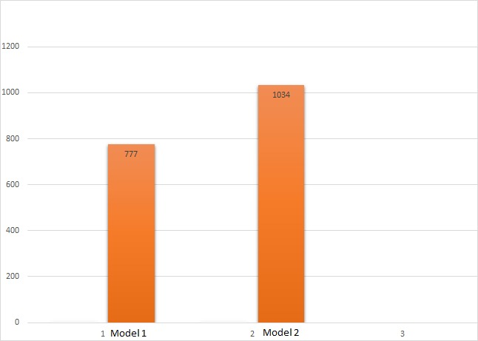
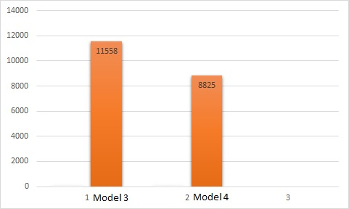
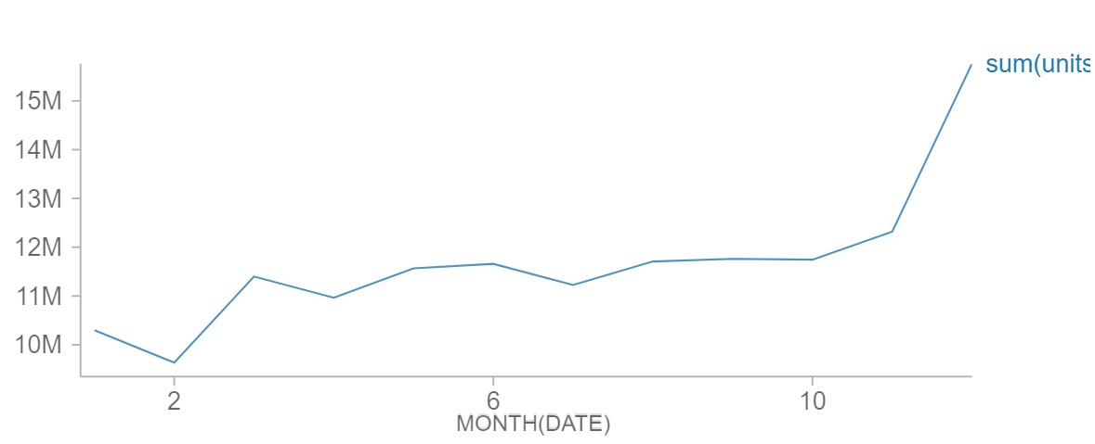
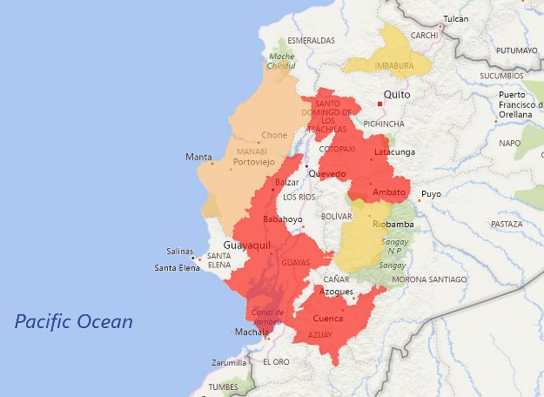
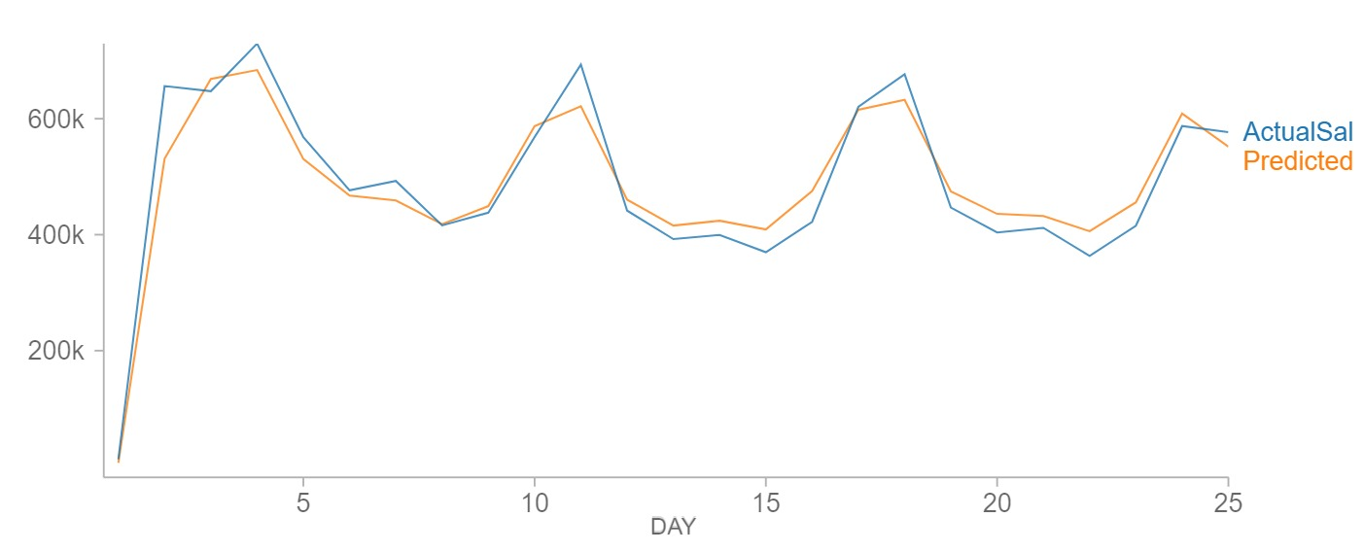
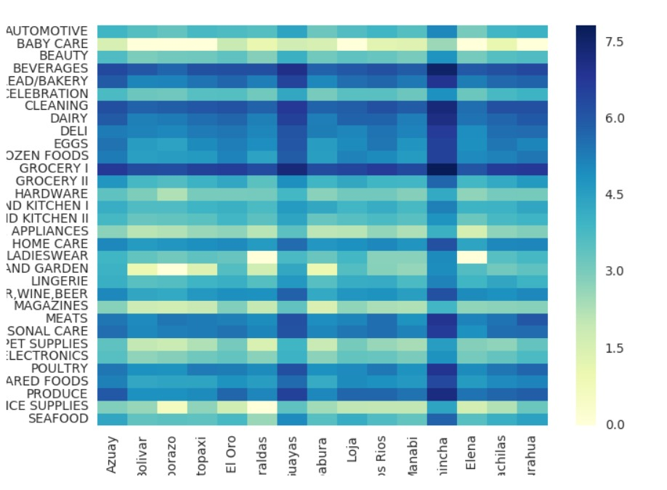
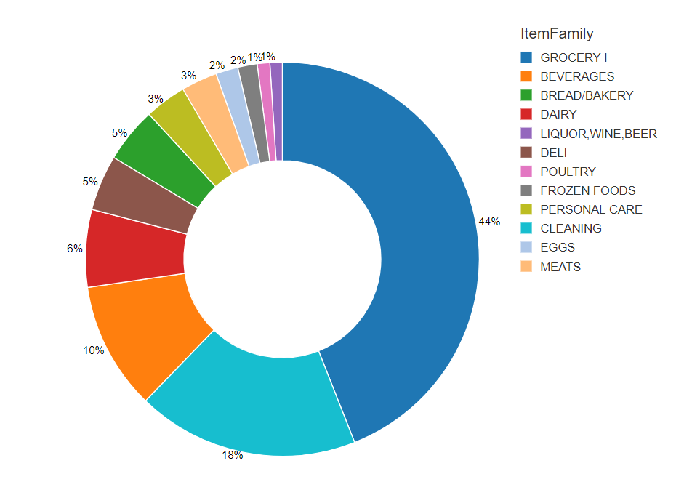
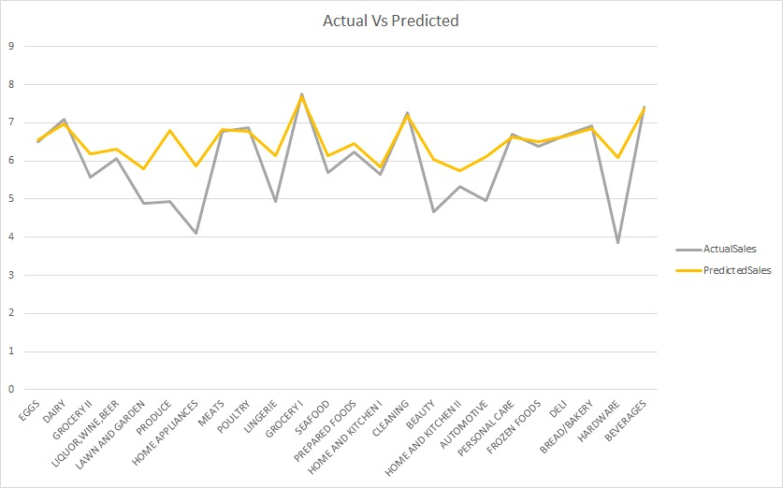
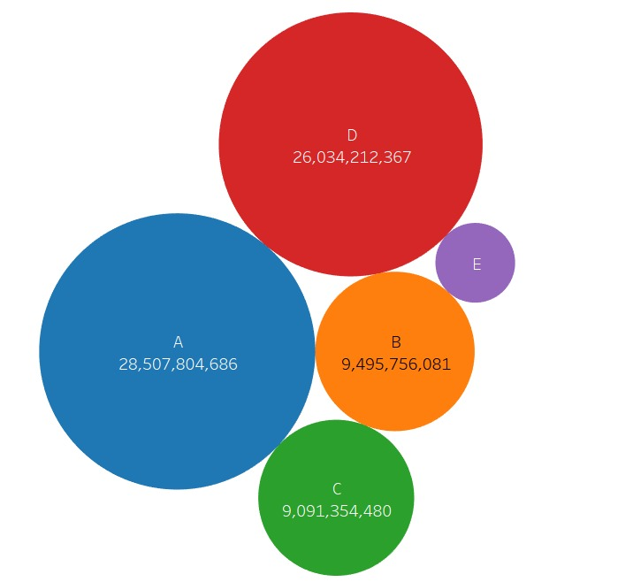
Sales forecasting for large Grocery chains
Akshit Salian
Bhaumik Doshi
Palak Nyati
Radhika Bhange
Problems and Objectives
Model Description
Prediction Inference
Problem Statement
Brick-and-mortar grocery stores are always in a sweet spot with purchasing and sales forecasting. Predict a little over, and grocers are stuck with overstocked, perishable goods. Guess a little under, and popular items quickly sell out, leaving money on the table and customers fuming.
The problem becomes more complex as retailers add new locations with unique needs, new products, ever transitioning seasonal tastes, and unpredictable product marketing.
Corporación Favorita, a large Ecuadorian-based grocery retailer, knows this all too well. They operate hundreds of supermarkets, with over 200,000 different products on their shelves.
Objectives
Comparing various models in order to accurately predict the right model to predict sales.
Model 1: Linear Regression using Store State, Item Family, Month, Day, Day of week, Cluster of stores, Type of store (Predicting sales for state)
Model 2: Random Forest Regressor using Store State, Item Family, Month, Day, Day of week, Cluster of stores, Type of store (Predicting sales for state)
Model 3: Linear Regression using Store State, Item Family, Month, Day, Day of week, Cluster of stores, Type of store (Predicting sales for Store ID)
Model 4: Random Forest Regressor using Store State, Item Family, Month, Day, Day of week, Cluster of stores, Type of store (Predicting sales for Store ID)
Data Description and Processing
Model Comparison Metrics
The Data consists of thousands of items sold at different Favorita stores located in Ecuador. The training data includes dates, store and item information, whether that item was being promoted, as well as the unit sales
The total data consisted of 40 million rows on which we performed exploratory data analysis and feature engineering to feed it into the respective models
An indexer was used to convert the categorical data into numeric data which was then used in OneHotEncoder
Data Partition
Training Data: 60% of total data
Validation Data: 30% of total data
Testing Data: 10% of total data
Generalization Performance Measure
RMSE: 777 (Model 1)
RMSE: 1034 (Model 2)
RMSE: 11558 (Model 3)
RMSE: 8825 (Model 4)
RMSE of Model 1 and Model 2 based on States
Exploratory data analysis
Prediction Performance
RMSE of Model 3 and Model 4 based on Stores
Conclusion
Based on the RMSE values we came to the following conclusions
State wise modelling: Linear Regression has a better value than Random Forest Regression
Store wise modelling: Random Forest Regression has a better value Linear Regression
Actual Sale Vs. Predicted Sale for the month of January
Future Scope
With more processing power, one will be able to process and predict sales for individual items.
Features like public holidays and festivals will help the models to predict holiday shopping behavior.
Adding number of features would maintain the learning capacity of our models thus resulting in better performance.
Acknowledgement
Actual Sales Vs. Predicted Sales per item family
We would like to thank Prof. Daniel Acuna and Tong Zeng for guiding us and keeping us abreast with the latest knowledge and technologies.

