Slide 1
How Weather Affects
Public Transport in Dublin
A Data-Driven Analysis Using Real Datasets
Programming for Data Analytics — CA2
Bahadir Demir

Slide 2
What We'll Cover
01
Project Overview
What this project is about and why it matters
02
Datasets
11 real datasets from Met Éireann and CSO
03
Dublin's Weather Profile
Understanding the city's climate patterns
04
Transport Trends
How Dubliners use buses and trams
05
Weather × Transport
Correlation analysis and statistical tests
06
Peak Hours & Seasons
When and how travel patterns shift
07
Key Findings
What the data tells us

Slide 3
Project Overview
11
Real Datasets
What are we trying to find out?
This project analyses how weather conditions — rain, temperature, wind, and sunshine — affect the number of people using public transport in Dublin.
We use real, publicly available data to find patterns and correlations that could help transport planners make better decisions.
700K+
Data Rows
80+
Years of Weather
3
Transport Modes

Slide 4
Our Data Sources
Weather Data — Met Éireann
Transport Data — CSO / TII
Hourly — 700K rows (temp, rain, humidity, wind, visibility)
Weekly passenger journeys (2019–2023) — Bus, Rail
Daily — 30K rows (1942–2026, rain, max/min temp, sunshine)
Dublin Bus monthly passengers (2014–2024)
Monthly — 1K rows (averages per month since 1941)
Luas monthly, hourly %, day-of-week flow
Bus city routes & fleet data
Source: data.gov.ie — Creative Commons 4.0
Source: data.gov.ie — Creative Commons 4.0

Slide 5
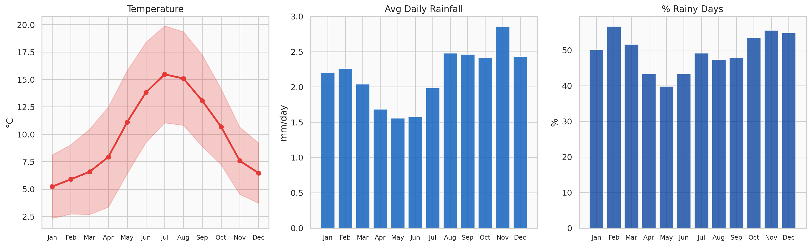
Dublin's Weather Profile
Monthly averages from 2014–2025 — Temperature, Rainfall, and Rainy Day frequency
Dublin averages around 750mm of rain per year, with 55–65% of days being rainy — weather is a constant factor in travel decisions.

Slide 6
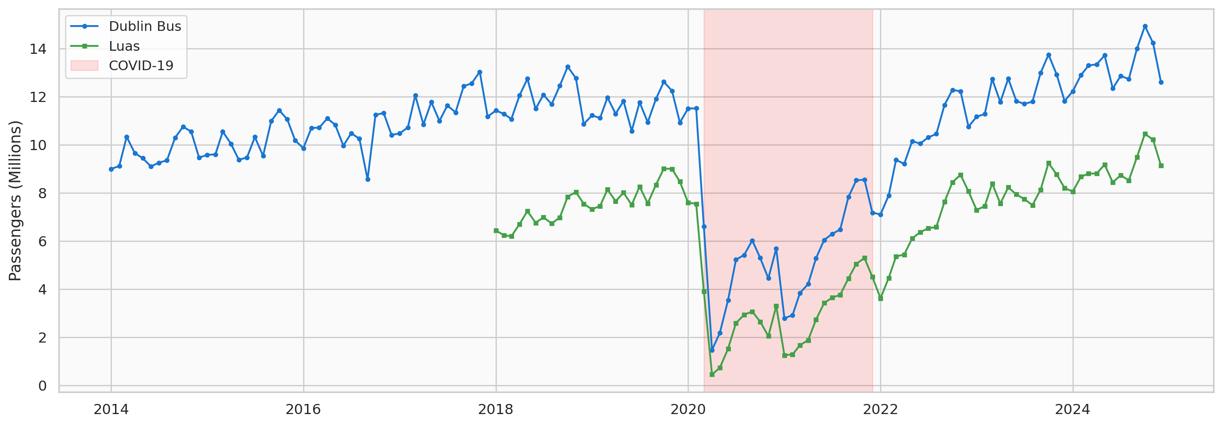
Transport Usage Over Time
Monthly passenger numbers for Dublin Bus and Luas (2014–2024)
COVID-19 caused a dramatic drop in 2020. Bus ridership fell ~55%, Luas ~60%. Recovery is ongoing but not yet at pre-pandemic levels.

Slide 7
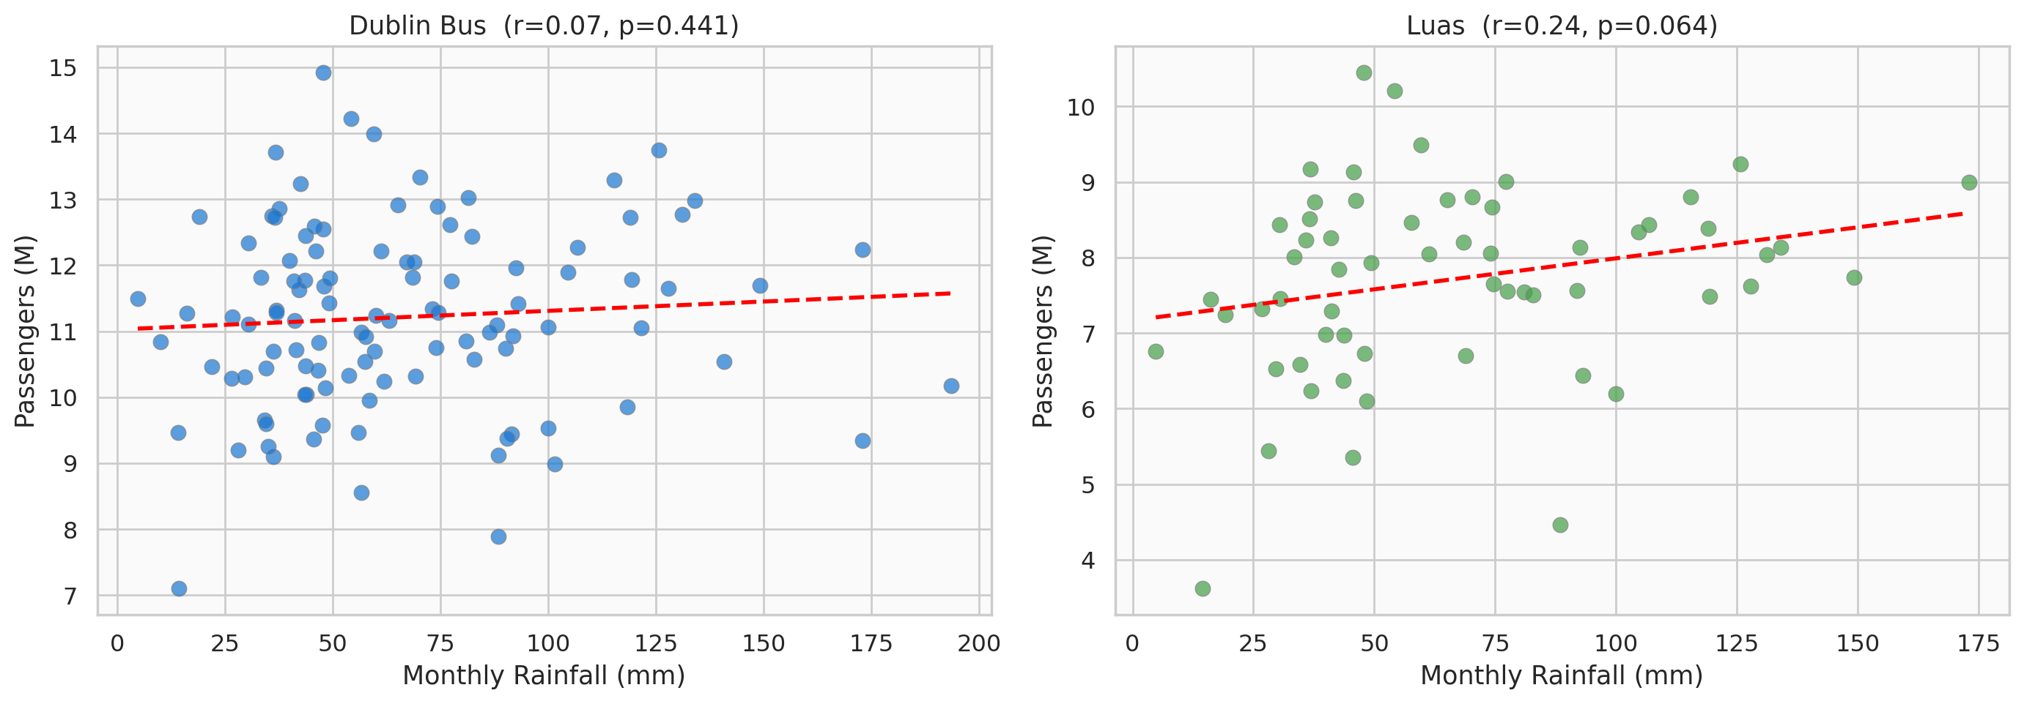
Does Rain Increase Ridership?
Monthly rainfall vs passenger numbers (COVID years excluded)
The red trend line and correlation coefficient (r) show the direction and strength of the relationship. A negative r means rainier months tend to have fewer passengers — possibly because people stay home more.

Slide 8
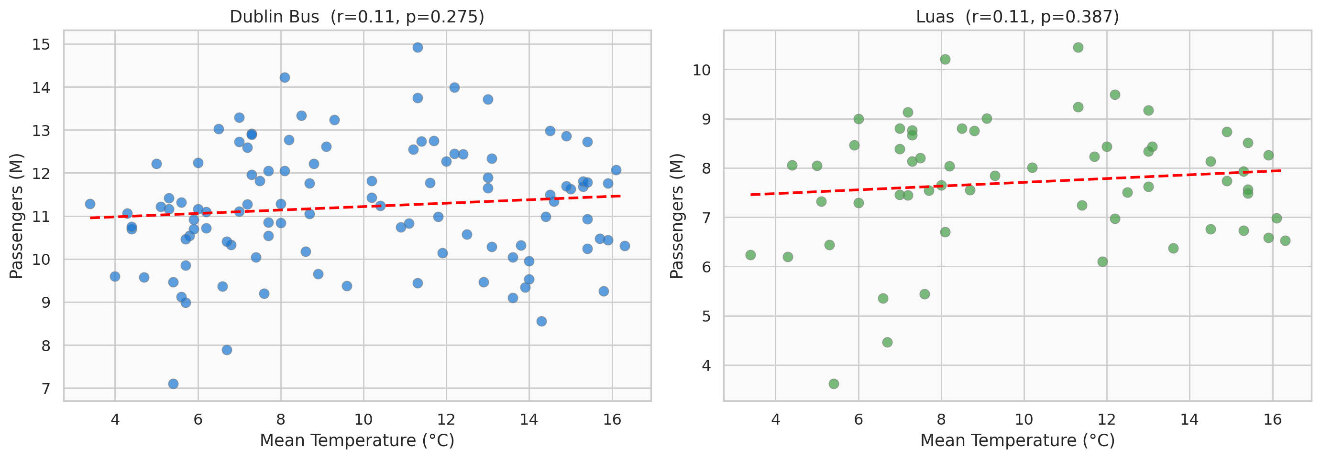
Temperature & Transport
Mean temperature vs passenger numbers (COVID years excluded)
Warmer months may see lower ridership because more people walk or cycle. Cooler months drive commuters toward buses and trams.

Slide 9
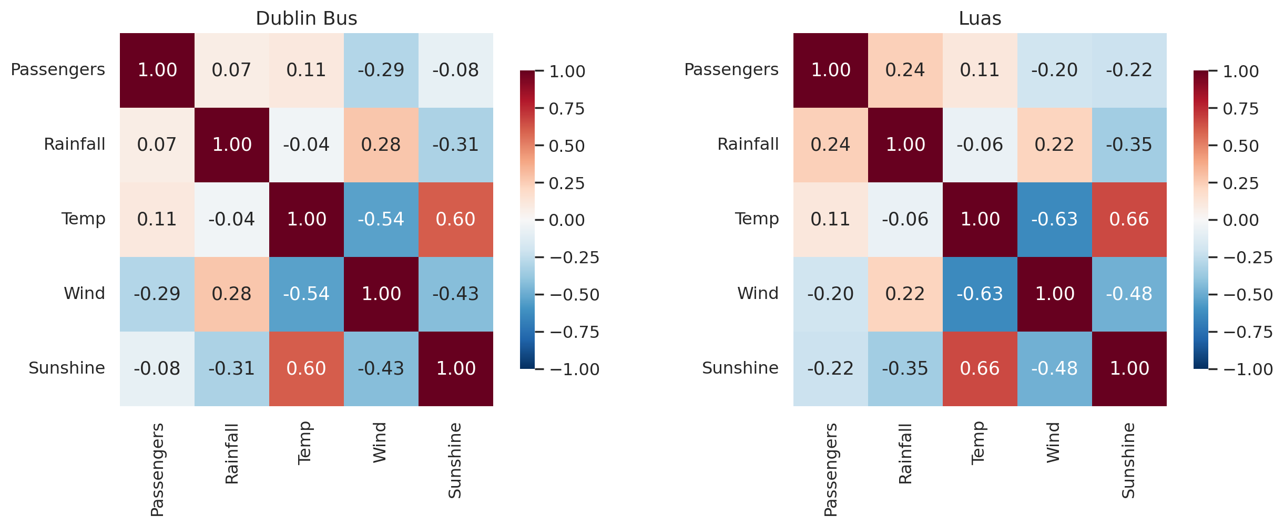
Correlation Heatmaps
How strongly is each weather variable linked to passenger numbers? (Red = positive, Blue = negative)
Values close to +1 or -1 show strong relationships. Values near 0 show weak or no relationship.

Slide 10
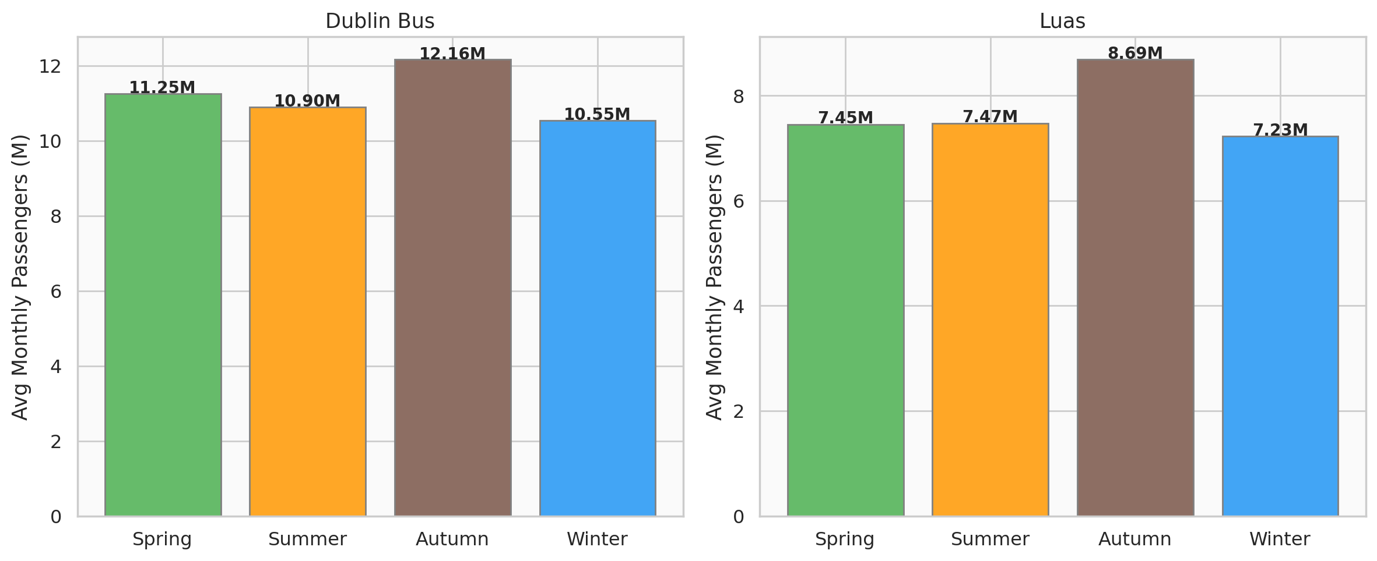
Seasonal Patterns
Average monthly passengers by season — Spring, Summer, Autumn, Winter
Autumn and Spring tend to have the highest ridership (school and work terms), while Summer drops — even though the weather is better, people use alternative transport or go on holiday.

Slide 11
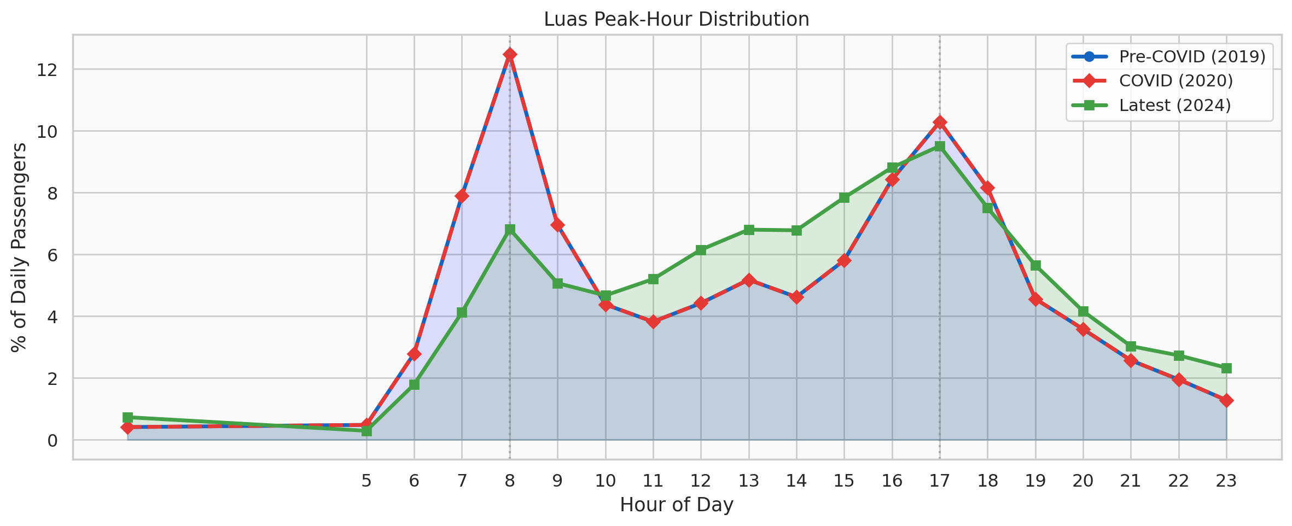
Peak-Hour Behaviour
Luas hourly passenger distribution — Pre-COVID, During, and Post-COVID
Clear morning (8–9 AM) and evening (5–6 PM) peaks. COVID flattened these peaks, and recovery shows a shift toward more distributed travel.

Slide 12
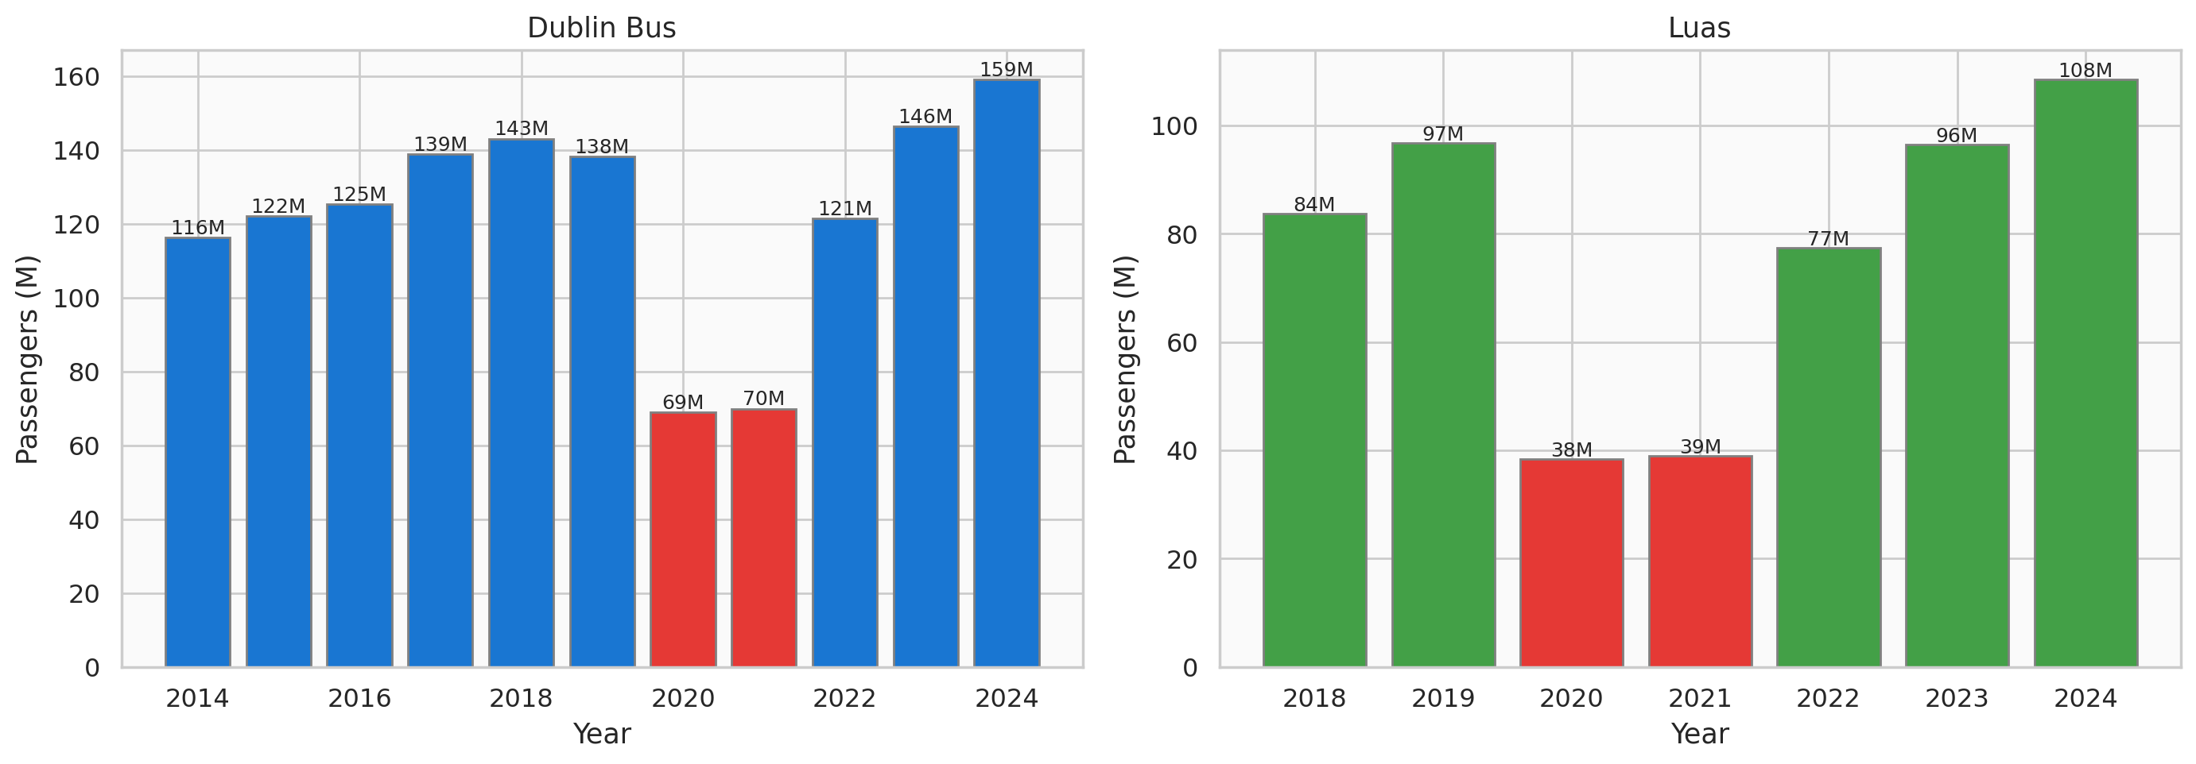
COVID-19 Impact & Recovery
~55% drop Dublin Bus in 2020
~60% drop Luas in 2020

Slide 13
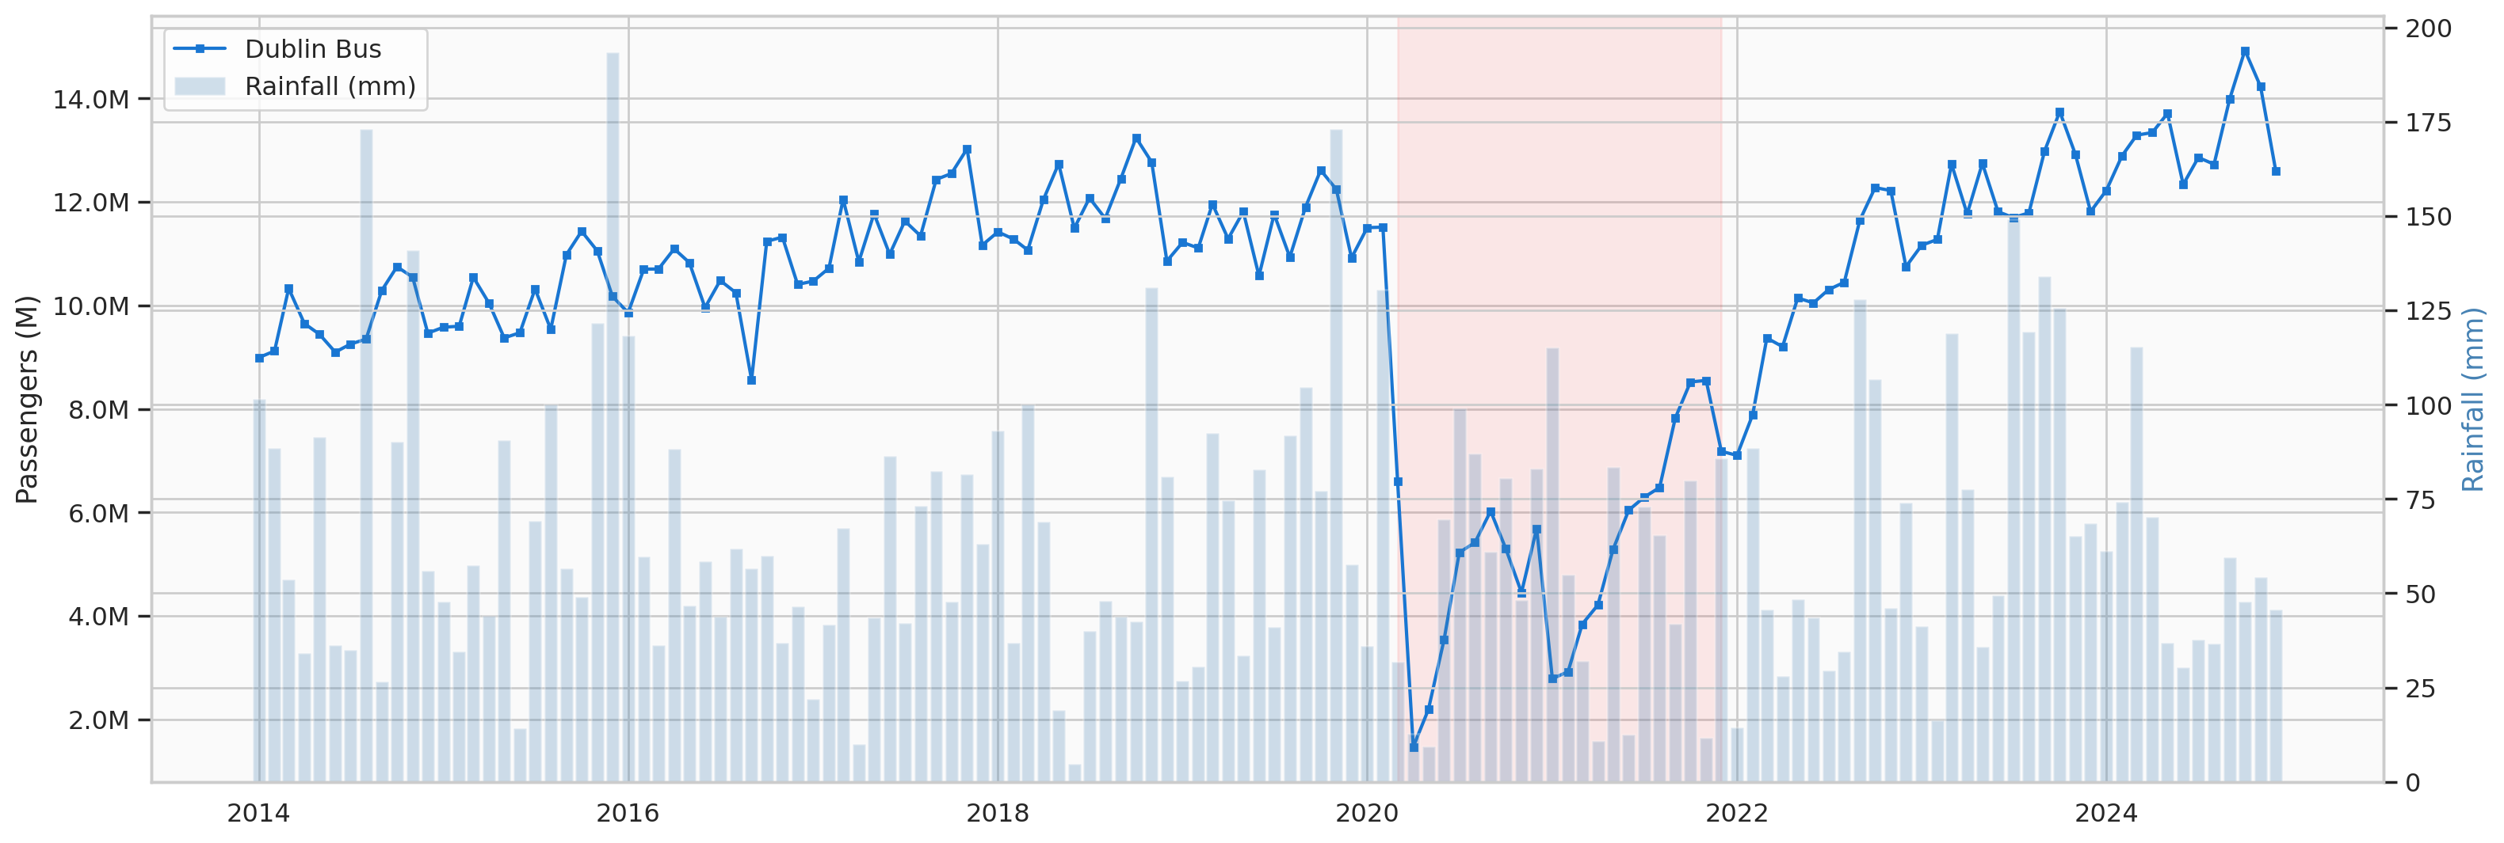
Transport & Weather Combined
Dublin Bus passengers overlaid with monthly rainfall — do they move together?
The blue bars show rainfall rising and falling while the passenger line follows its own seasonal rhythm — weather is one factor among many.

Slide 14
Key Findings
1
Rainfall has a measurable link to ridership
Wetter months show a correlation with transport usage — but it's not always positive. Heavy rain may keep people at home.
2
Temperature shapes seasonal cycles
Cooler months see higher ridership; warmer months see a dip as people switch to walking, cycling, or holidays.
3
COVID reshaped travel patterns
The pandemic caused a 55–60% drop. Even after recovery, peak-hour patterns have shifted toward flatter, more distributed travel.
4
Weather is one factor among many
School terms, work patterns, and events also drive ridership. Weather effects are real but moderate — not the dominant factor.

Slide 15
Conclusion
Weather plays a real but moderate role in Dublin's public transport patterns. This analysis — using 11 datasets and 700K+ data points — shows that transport planners can use weather forecasts to better anticipate demand changes and improve service allocation.
Data Sources: Met Éireann (CC-BY 4.0) • Central Statistics Office • Transport Infrastructure Ireland
Thank You

