Slide 1









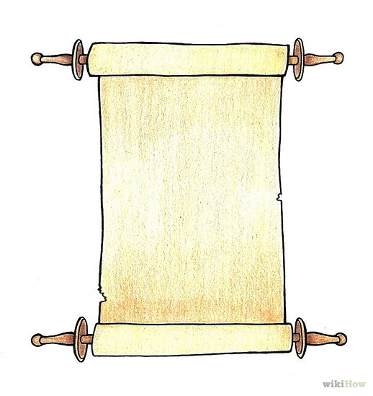

Hospitals, Universities, Federal Institutes
Clinical Genetic Testing Labs
Research + clinical samples
# variants
detectable variants
10^{2 to 3}
A
G
# samples
Research
participant repository (e.g. dbGap)
B
H
Clinical sample repository (e.g. ILDB)
10^{2 to 3}
Function
Literature
C
Associated Variants
(with relevant metadata)
Domain
Other
Crowd curation
by domain experts + Review
D
10^{1 to 2}
Pre-existing Knowledge
Curation
Process
ACMG AMP
+ ClinGen
E
10^{1 to 2}
ClinVar /
ClinGenKB
Standardized interpretation guidelines
New samples
(research + clinical)
novel variants
F
# variants
Time (in days)
# samples
Notes:
Figure 2. This info-graphic shows our new, proposed workflow for genomic data through all the entities relevant to disease-related genomic analysis. (A, G) Research participant samples are deposited separately as before, but the ILDB resource now allows clinical testing labs to deposit their patient samples (those with appropriate consent) and be included in the process from the start. The combination of patient and participant records will provide increased statistical power to detect disease associated genomic variation – as evidenced by the chart to the top-right corner. (B, H) While incorporation of research samples into analysis stays unchanged, appropriate processes to hide/transform the relevant fields in patient data need to be developed. Subsequent downstream analysis will be restricted to “variant” and “gene” level information, with curators having no access to patient-specific phenotype or health data (C, D) The ClinGen crowd curation infrastructure (phone-app, web-interface) will bring together teams of domain experts for scalable interpretation of the much larger pool of associated variants. The curation and triage process for each disease domain will adhere to common standards, and remove lab-specific biases in interpretation. (E, F) Variant interpretations will be deposited in the new ClinGenKB repository, with any additional patient records, research samples or associated variants being iterated through the entire process (A through F), as before.

