Slide 1
Alzheimer U01 Data Analysis Framework
Cory Funk
Ben Heavner
Nathan Price
U01 monthly meeting
Feb 24, 2015

Slide 2
Overview of the data
Tau and APP mouse models
APPPS1 forebrain @ 3, 9, 12, 20 months; controls 9
TgCRND8 forebrain @ 3, 6, 12, 20 months (+ age-matched controls)
Homozygous P301L tau (MAPT) mice (JNPL3 strain) spinal cord @ 2, 6, 12 months w/ controls from Swiss Webster NTG
rTg4510 forebrain @ 2.5, 4.5, 6 months
Preliminary Human samples
Temporal cortex
AD (96 samples)
PSP (96 samples)
Primary U01 samples
Uploaded to S3, no present description in Synapse

Slide 3
First priority: generating lists of DEGs
Starting with the TAU and JNPL3 mice, perform PCA (or MDS) to identify outliers
Evaluate clustering
Calculate differential gene expression for pairwise comparisons in each mouse strain
Identify which pairwise comparisons make sense
PCA
Alignment
(SNAPR)
Sorted BAM
file
Normalized
Read counts
List of
DEGs

Slide 4
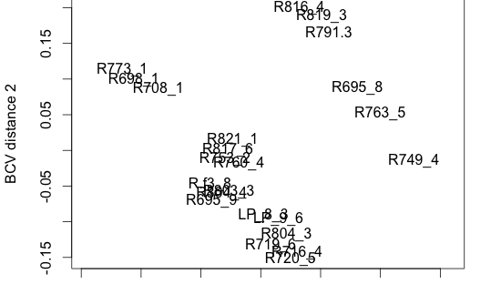
MDS plot of rTg4510 forebrain RNAseq data
+F4.5
-F2.5
-F4.5
+F6
+F6
+F4.5
+M6
-M6
-F2.5
+M2.5
-F6
-F6
-M6
+M6
+M4.5
+M6
-M4.5
-M4.5
-M4.5
-M2.5
-M2.5
-M2.5

Slide 5
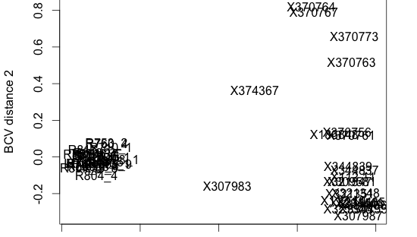
MDS plot of rTg4510 and JNPL3 RNAseq data
JNPL3
rTg

Slide 6
Creation of variant files
Processing time is significant, but can be done on a local machine (takes a bit more time)
Is there interest in doing joint variant calling? This would be for the RNA samples
VCF
Alignment
(SNAPR)
Sorted BAM
file
eGWAS
eQTL
Joint
VCF?

Slide 7
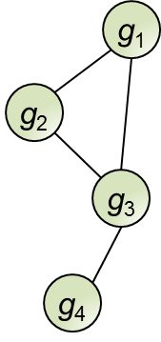

Identify changes in networks (DIRAC)
Highest Expression
Lowest Expression
Measures how network orderings differ within and between disease states
Alignment
(SNAPR)
Sorted BAM
file
Normalized
Read counts
DIRAC
GSEA
Network Analysis
Classification

Slide 8
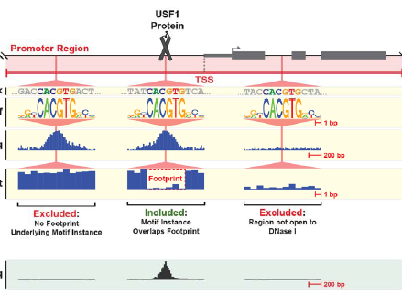
Identifying Transcriptional Regulatory Networks (TRNs)
Attempt to learn what transcription factors contribute to changes in gene expression through correlation with transcription factor expression
Constrain the search space in the promoter by ENCODE data (DNAse hypersensitivity regions) coupled with binding motifs
TRN
Normalized
Read counts
(TFs and targets)
Coordinates for
Binding motifs
Alignment
(SNAPR)
Sorted BAM
file

Slide 9
Characterizing differences in isoform expression and other novel discoveries
Isolator
normalization
Guided Transcript
Assembly
Alternate
BAM file
Differential Isoform
Expression
Normalized
Read counts

Slide 10
RNA editing
RNA editing is highest in the brain; AMPA receptors among best characterized targets
We’ve found editing to be 5x higher in the cerebellum
RNA editing has been shown to change in several neurological disorders including AZ
ADAR (responsible for editing) has an interferon-inducible isoform
Alignment
(SNAPR)
Sorted BAM
file
Dynamic trimming
of reads
Conservative
VCF
Strand
assignment
Edit calls
(Kruskal-Wallis)

