Slide 1

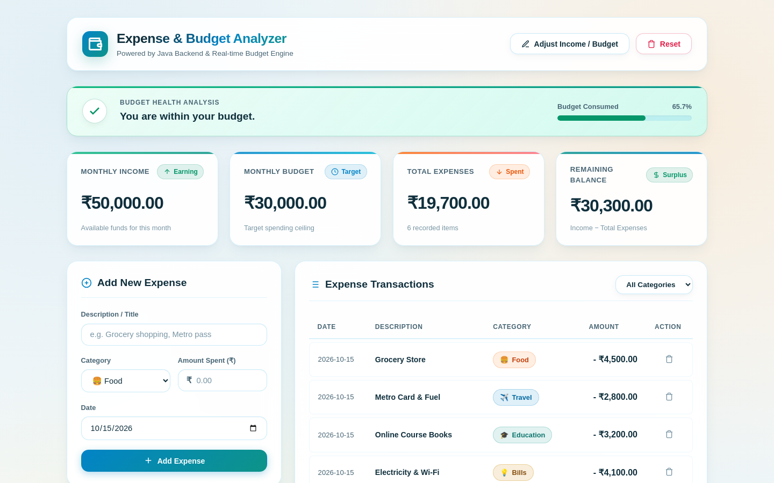
Monthly Expense & Budget Analyzer
Name | Roll no
Sandeep | 2620090082
Sai Dhruva | 2620080118
Bhargav Sri Datta | 2620090060
Under Guidance:
G. Mamatha

Slide 2
Abstract
2
modes: console app and web dashboard
The Monthly Expense & Budget Analyzer is a Java application that lets a user record monthly income, set a spending budget, log categorised expenses and instantly see whether they are within budget.
It is delivered in two modes: a Scanner-based console program, and a web dashboard served by a lightweight built-in Java HTTP server with a REST API and an HTML, CSS and JavaScript front end.
The whole system uses only the Java standard library and brings together all six course outcomes in one working product.
7
expense categories tracked
0
external libraries, Java SE only

Slide 3
Java Basics & Control Flow
CO1
MonthlyExpenseAnalyzer.java (console mode)
Implementation
MonthlyExpenseAnalyzer.java (excerpt)
Variables and primitive types (double, int, String) hold income, budget and expense count
Arithmetic operators compute total expenses and the remaining balance
Relational operators with an if / else-if / else ladder decide the budget status
Scanner reads user input; printf formats output in ₹ with two decimals
double remainingBalance = monthlyIncome - totalExpenses;
String budgetStatus;
if (totalExpenses < monthlyBudget) {
budgetStatus = "You are within your budget.";
} else if (totalExpenses == monthlyBudget) {
budgetStatus = "You have reached your budget limit.";
} else {
budgetStatus = "Warning! You have exceeded your budget.";
}
Data types
Operators
if-else
Scanner

Slide 4
Arrays, Loops & Strings
CO2
MonthlyExpenseAnalyzer.java and Server.java
Implementation
MonthlyExpenseAnalyzer.java / Server.java (excerpt)
Parallel arrays categories[] and amounts[] are sized at run time from the expense count
for loops read each expense and accumulate the total
String handling: printf alignment (%-15s), concatenation, and escapeJson() built on replace()
A fixed String[] of seven categories seeds the category totals
String[] categories = new String[numberOfExpenses];
double[] amounts = new double[numberOfExpenses];
for (int i = 0; i < numberOfExpenses; i++) {
categories[i] = scanner.next();
amounts[i] = scanner.nextDouble();
totalExpenses = totalExpenses + amounts[i];
}
String[] allCategories = {"Food", "Travel", "Education",
"Shopping", "Entertainment", "Bills", "Other"};
Arrays
for loop
Strings
printf

Slide 5
Classes, Objects & Encapsulation
CO3
Server.java: the Expense class and shared state
Implementation
Server.java (excerpt)
The Expense class models one record: id, title, category, amount and date
A parameterised constructor builds each object; every expense is an object kept in a list
Private static fields hold shared state (income and budget)
Nested classes group related code: Expense and six handler classes live inside Server
private static double monthlyIncome = 50000.0;
private static double monthlyBudget = 30000.0;
static class Expense {
int id; String title; String category;
double amount; String date;
public Expense(int id, String title, String category,
double amount, String date) {
this.id = id; this.title = title;
this.category = category; this.amount = amount;
this.date = date;
}
}
Class
Object
Constructor
this
static

Slide 6
Interfaces & Polymorphism
CO4
Server.java: HttpHandler implementations
Implementation
Server.java (excerpt)
Six classes implement the HttpHandler interface, each with its own handle() method
@Override gives runtime polymorphism: the server calls handle() on whichever object matches the URL
Programming to an interface keeps routing separate from request logic
Shared helpers (sendJsonResponse, addCorsHeaders) avoid repeated code
server.createContext("/api/data", new DataHandler());
server.createContext("/api/budget", new BudgetHandler());
server.createContext("/", new StaticFileHandler());
static class BudgetHandler implements HttpHandler {
@Override
public void handle(HttpExchange exchange)
throws IOException {
addCorsHeaders(exchange);
...
}
}
Interface
implements
@Override
Polymorphism

Slide 7
Exceptions & Thread Safety
CO5
Server.java: request handlers
Implementation
Server.java (excerpt)
try / catch on NumberFormatException turns bad numeric input into a clean 400 response
Validation rejects non-positive amounts before any data changes
throws IOException is declared on handlers and I/O helpers
synchronized blocks and AtomicInteger keep the shared list and IDs safe across threads
try {
double amount = Double.parseDouble(amountStr);
if (amount <= 0) {
sendJsonResponse(exchange, 400, "{\"success\":false, ...}");
return;
}
synchronized (expenses) {
newExpense = new Expense(
idGenerator.getAndIncrement(),
title, category, amount, date);
expenses.add(0, newExpense);
}
} catch (NumberFormatException ignored) {}
try-catch
throws
synchronized
AtomicInteger

Slide 8
Collections, File I/O & Networking
CO6
Server.java: data store, static files and HTTP server
Implementation
Server.java (excerpt)
Generic collections: List<Expense> store, LinkedHashMap<String, Double> category totals
A lambda with removeIf() deletes an expense by id
File I/O: Files.readAllBytes serves the HTML, CSS and JS from /public
Networking: HttpServer on port 8080 exposes a REST API with JSON responses
private static final List<Expense> expenses =
new ArrayList<>();
Map<String, Double> categoryMap = new LinkedHashMap<>();
expenses.removeIf(e -> e.id == id);
byte[] bytes = Files.readAllBytes(file.toPath());
HttpServer server =
HttpServer.create(new InetSocketAddress(PORT), 0);
server.start();
Generics
Lambda
File I/O
HttpServer

Slide 9
Final Integrated Project
Web Dashboard
Java Server
In-memory Store
HTML · CSS · JavaScript
Forms, tables, charts and live budget banner
Server.java on port 8080
6 handlers · REST API · JSON
CO3 · CO4 · CO5 · CO6
List<Expense>, income, budget
Category totals computed per request
CO3 · CO6
HTTP / JSON
reads / writes
Console Application
One Budget Rule, Two Modes
MonthlyExpenseAnalyzer.java
Scanner input → arrays → if-else → printf report
CO1 · CO2
Expenses < budget: within budget
Expenses = budget: limit reached
Expenses > budget: exceeded
The same logic runs in the console and on the server

Slide 10
Features & REST API
Set income & budget
Adjust both from one dialog
Endpoint | Method | Purpose
/api/data | GET | Totals, categories, status, list
/api/income | POST | Update monthly income
/api/budget | POST | Update monthly budget
/api/expense | POST / DELETE | Add or remove an expense
/api/reset | POST | Clear all data
/ | GET | Serve the dashboard files
1
2
Log expenses
Title, category, amount and date, validated on the server
3
Live budget health
Within, reached or exceeded, with a progress bar
4
Category breakdown
Seven categories with share of total spend
5
Filter & delete
Filter the table by category; remove any entry

Slide 11
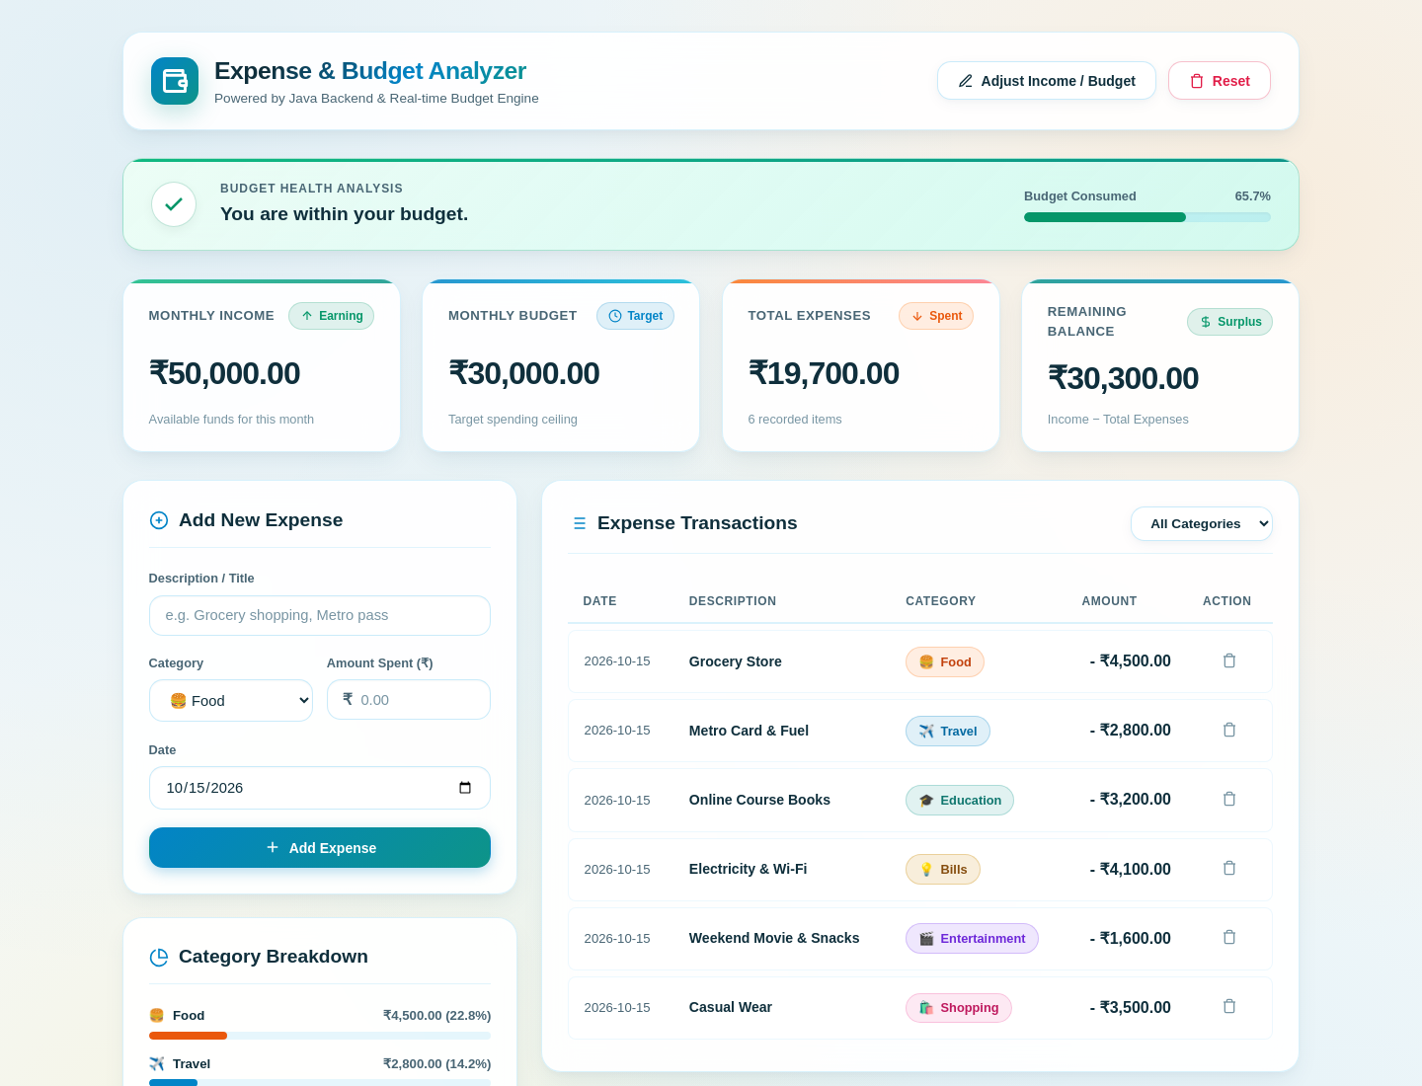
Execution & Output
Console mode: java MonthlyExpenseAnalyzer
=============================================
MONTHLY EXPENSE & BUDGET ANALYZER
=============================================
Enter your Monthly Income (₹): 50000
Enter your Monthly Budget (₹): 30000
How many expenses would you like to enter? 6
[Expense #1]
Enter Category: Food
Enter Amount Spent (₹): 4500
... 5 more expenses entered ...
=============================================
SUMMARY REPORT
=============================================
Monthly Income : ₹50,000.00
Monthly Budget : ₹30,000.00
Total Expenses : ₹19,700.00
Remaining Balance: ₹30,300.00
Budget Status : You are within your budget.
=============================================
--- Expense Itemization ---
1. Food : ₹4,500.00
2. Travel : ₹2,800.00
3. Education : ₹3,200.00
4. Bills : ₹4,100.00
5. Entertainment : ₹1,600.00
6. Shopping : ₹3,500.00
Web mode: java Server → http://localhost:8080 (sample data)

Slide 12
GitHub Repository:
GitHub link:

