Slide 1
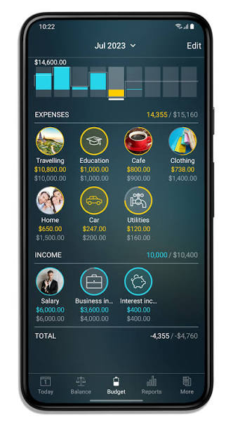
MONTHLY EXPENSE
& BUDGET ANALYZER
BUDGET
SAVED
₹10,000
₹6,000
SPENT
₹4,000
Track spending • Monitor budgets • Make smarter decisions
Monthly overview
EXPENSE TRACKING
BUDGET CONTROL
JAVA CONCEPTS
A practical Java application for understanding monthly spending and remaining budget.

Slide 2
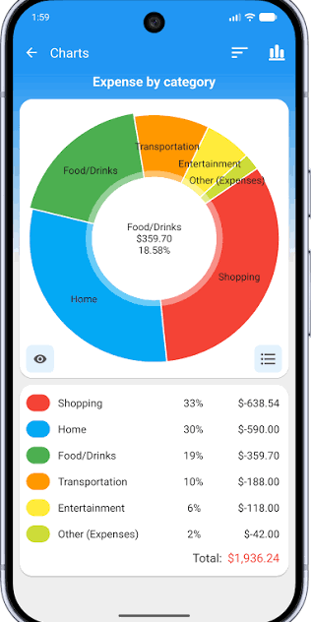
Introduction & Objectives
Introduction:
  A Java-based project for managing monthly expenses.
  Helps users calculate total spending and remaining budget.
Objectives:
  Allow the user to enter monthly income and budget.
  Calculate total expenses.
  Track remaining budget.
  Check whether the budget is exceeded.
  Java concepts : Variables, Scanner, Operator, and if-else condition.
Monthly Expense & Budget Analyzer | 2/12
Monthly Expense & Budget Analyzer | 2/12

Slide 3
CO1 – Datatypes, Variables & Operators
TOPICS: Variables, Datatypes and Operators
Store budget and expenses using the double datatype.
Use arithmetic operators for calculations.
Formula:
remaining Budget = Budget − Total Expenses
Monthly Expense & Budget Analyzer | 3/12
Monthly Expense & Budget Analyzer | 3/12

Slide 4
CO1 – Code Implementation
double budget = 10000;
double food = 2500;
double travel = 1500;
double total = food + travel;
double remaining = budget - total;
double stores expense values.
+ calculates the total.
− calculates the remaining budget.
Monthly Expense & Budget Analyzer | 4/12

Slide 5

CO2 – Conditional Statements & Loops
TOPICS: if-else and for loop
A loop accepts multiple expenses.
if-else checks whether the budget is exceeded.
Conditional statement:
if (total > budget) {
System.out.println("Budget Exceeded");
} else {
System.out.println("Budget Within Limit");
}
Monthly Expense & Budget Analyzer | 5/12
Monthly Expense & Budget Analyzer | 5/12

Slide 6
CO3 – Methods & Arrays
Topics: Methods, 1D Arrays and 2D Arrays
Methods calculate total expenses.
1D arrays store expense values.
2D arrays store monthly expense data.
double[] expenses = {2500, 1500, 1000};
Monthly Expense & Budget Analyzer | 6/12
Monthly Expense & Budget Analyzer | 6/12

Slide 7
CO3 – Code & Combined Project
static double calculateTotal(double[] expenses) {
double total = 0;
for (int i = 0; i < expenses.length; i++) {
total += expenses[i];
}
return total;
}
CO1: Variables and operators
CO2: Conditions and loops
CO3: Methods and arrays
All concepts combine into one project.
Monthly Expense & Budget Analyzer | 7/12
Monthly Expense & Budget Analyzer | 7/12

Slide 8
CO4 – Objects & OOP Concepts
TOPICS: Classes, Objects and OOP Principles
• A class defines the data and behaviour of an expense.
• Objects represent expenses such as Food or Travel.
• Encapsulation keeps data and methods together.
• Inheritance, polymorphism and abstraction support reusable design.
Key idea: private fields are accessed through methods.
class Expense {
private String category;
private double amount;
Expense(String category, double amount) {
this.category = category;
this.amount = amount;
}
double getAmount() { return amount; }
String getCategory() { return category; }
}
Monthly Expense & Budget Analyzer | 8/12

Slide 9
CO5 – Strings & File Handling
TOPICS: Strings & File Handling
• Strings store category names and descriptions.
• String methods can validate or format input.
• File handling saves expense details for later use.
• Files can be read back to display saved records.
FileWriter writes data; IOException handles writing errors.
String category = "Food";
double amount = 2500.0;
String record = category + "," + amount;
try (FileWriter writer =
new FileWriter("expenses.txt", true)) {
writer.write(record + System.lineSeparator());
} catch (IOException e) {
System.out.println("Unable to save expense");
}
Monthly Expense & Budget Analyzer | 9/12

Slide 10
CO6 – Collections & Streams
TOPICS: Collections & Stream API
• ArrayList stores a flexible list of expense amounts or objects.
• Collections help manage multiple records.
• Streams process data without manual loops.
• Filtering and summing help analyze spending.
mapToDouble() supports numeric calculations; sum() returns total spending.
ArrayList<Double> expenses = new ArrayList<>();
expenses.add(2500.0);
expenses.add(1500.0);
expenses.add(1000.0);
double total = expenses.stream()
.mapToDouble(Double::doubleValue)
.sum();
System.out.println("Total: " + total);
Monthly Expense & Budget Analyzer | 10/12

Slide 11
Conclusion
The Monthly Expense & Budget Analyzer demonstrates Java concepts through a practical application.
CO1: Data types, variables and operators calculate totals and balances.
CO2: Conditions and loops support repeated entry and budget checks.
CO3: Methods and arrays organize and calculate expense data.
CO4: Classes and objects model expenses using OOP principles.
CO5: Strings and file handling format and save expense records.
CO6: Collections and streams manage and process expense data.
Together, these concepts create a structured and extensible expense-management project.
THANK YOU!
Monthly Expense & Budget Analyzer | 11/12
Monthly Expense & Budget Analyzer | 11/12

Slide 12
GitHub Repository
Repository Link:h
Monthly Expense & Budget Analyzer | 12/12

