Slide 1


A
Major Project
On
Spammer Detection and Fake User Identification on Social Networks
Under the Guidance
of
RANJITH REDDY K
(Assistant Professor)
By
CHOUHAN BHEEM SINGH (197R1A05K2)
DEVENDER DONADULA (197R1A05K5)
MUCHARLA VAMSHIDHAR REDDY (197R1A05N1)

Slide 2
ABSTRACT
Social networking sites engage millions of users around the world. The users interactions with these social sites, such as Twitter and Facebook have a tremendous impact and occasionally undesirable repercussions for daily life.
The prominent social networking sites have turned into a target platform for the spammers to disperse a huge amount of irrelevant and deleterious information. Twitter, for example, has become one of the most extravagantly used platforms of all times and therefore allows an unreasonable amount of spam.
Fake users send undesired tweets to users to promote services or websites that not only affect legitimate users but also disrupt resource consumption.

Slide 3
ABSTRACT
Moreover, the possibility of expanding invalid information to users through fake identities has increased that results in the unrolling of harmful content. Recently, the detection of spammers and identification of fake users on Twitter has become a common area of research in contemporary online social Networks (OSNs).
Here we perform a review of techniques used for detecting spammers on Twitter. Moreover, a taxonomy of the Twitter spam detection approaches is presented that classifies the techniques based on their ability to detect: (i) fake content, (ii) spam based on URL, (iii) spam in trending topics, and (iv) fake users. The presented techniques are also compared based on various features, such as user features, content features, graph features, structure features, and time features. We are hopeful that this will be a useful resource for everyone to find the highlights of recent developments in Twitter spam detection on a single platform.

Slide 4
EXISTING SYSTEM
In today’s online social networks there have been a lot of fake profiles, online impersonation, etc. To date no one has come with a feasible solution to these problems. Manually detecting these fake and spam accounts would require a lot of human effort and time. Thus we are always in need of better methods which require less effort and time.
So we are intend to give a framework with which the automatic detection of fake profiles and spammers can be done so that the social life of people become secured and by using this automatic detection technique we can make it easier for the sites to manage the huge number of profiles, which can’t be done manually. Decision trees, Logistics regression and support vector machine algorithms are used presently.

Slide 5
DISADVANTAGES
Decision tree is Less effective in predicting the outcome of a continuous variable.
Logistic regression may not be accurate if the sample size is too small.
Support vector algorithm does not execute very well when the data set has more sound i.e. target classes are overlapping.

Slide 6
PROPOSED SYSTEM
We are describing a concept to detect spam tweets and fake user account from online social network called twitter. To perform detection, we are using twitter dataset and 4 different techniques called Fake Content, Spam URL Detection, Spam Trending Topic and Fake User Identification.
Using above 4 techniques we can identify whether tweet is normal or spam and then using Random Forest data Mining algorithm we will train above dataset to classify number of spam and nonspam tweets or fake or non-fake accounts. For each technique we are using different Random Forest classifier.

Slide 7
ADVANTAGES
Here we include comparison of various previous methodologies proposed using different datasets and with different characteristics and accomplishments.
Tested with real time data.

Slide 8
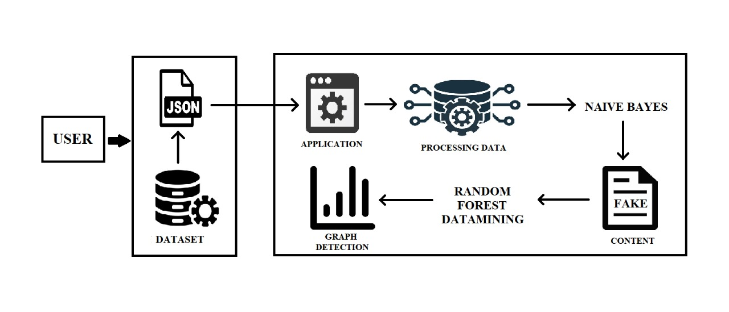
ARCHITECTURE

Slide 9
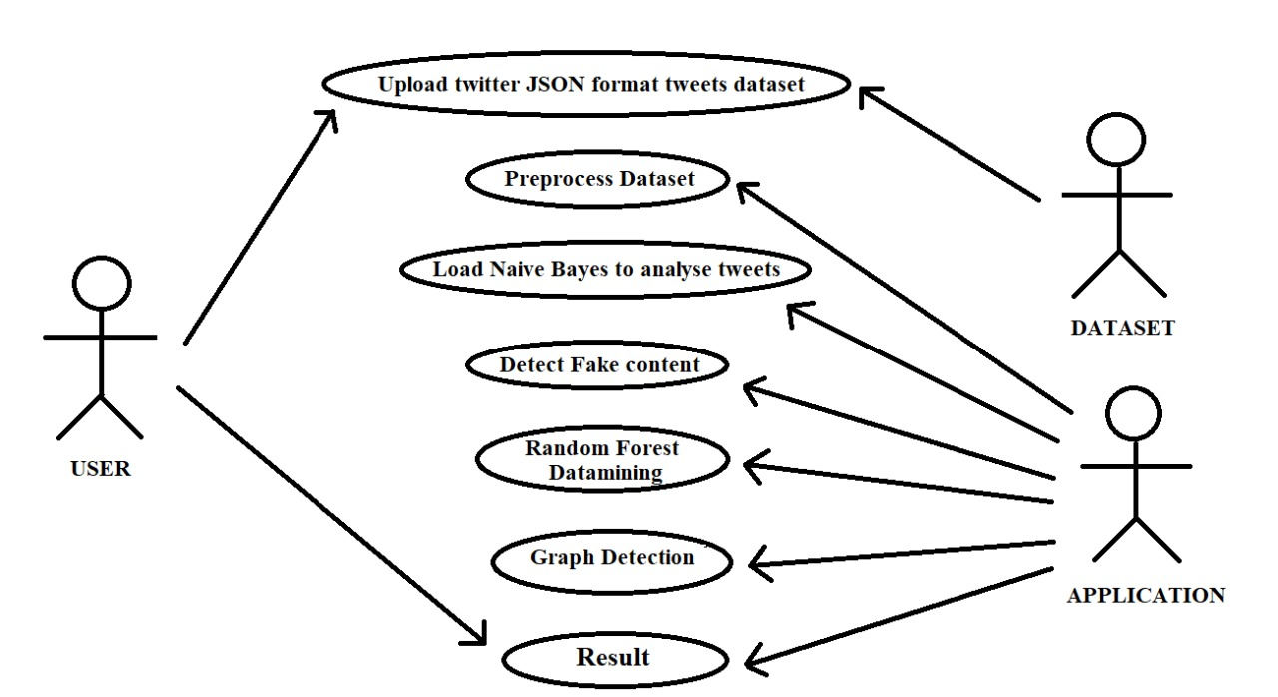
USE CASE DIAGRAM

Slide 10
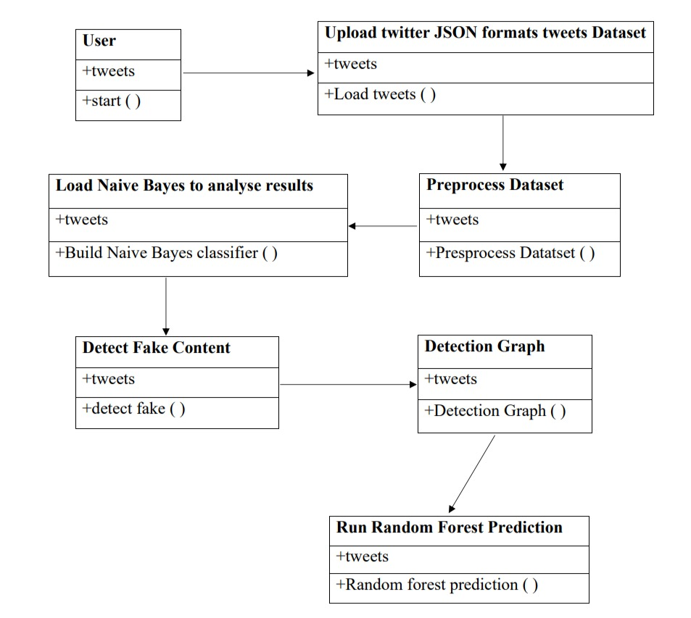
CLASS DIAGRAM

Slide 11
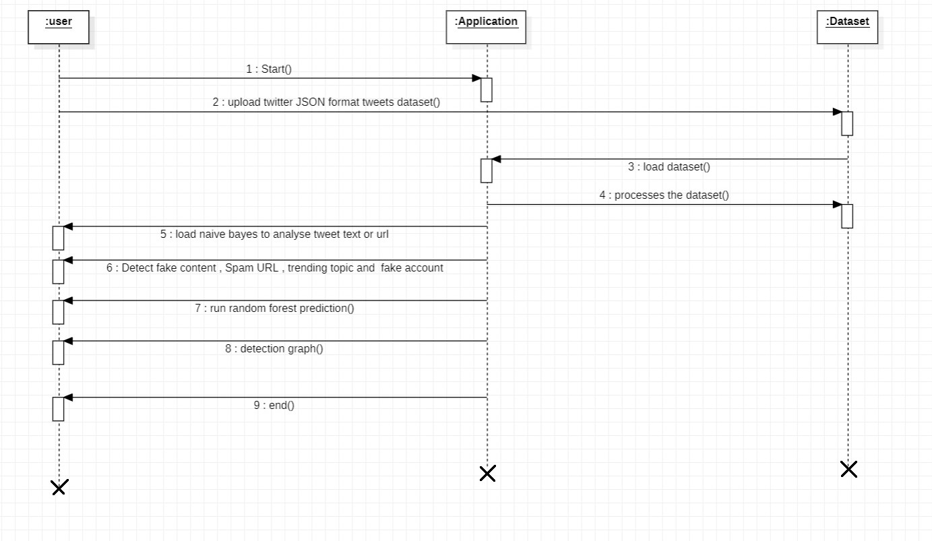
SEQUENCE DIAGARM

Slide 12
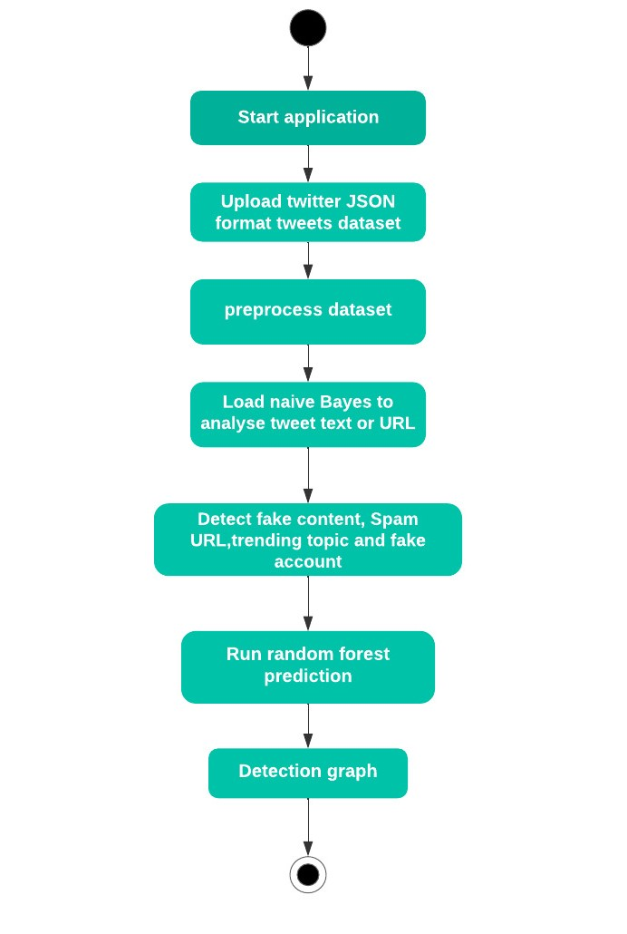
ACTIVITY DIAGRAM

Slide 13
REQUIREMENTS
HARDWARE REQUIREMENTS:
System : Pentium IV 2.4 GHz and Higher
Hard Disk : 4 GB.
Ram : 512 Mb and higher

Slide 14
REQUIREMENTS
SOFTWARE REQUIREMENTS:
Operating System : Windows
Coding Language : Python 3.7

Slide 15
IMPLEMENTATION
SAMPLE CODE
IMPORT STATEMENTS
from tkinter import messagebox
from tkinter import *
from tkinter import simpledialog
import tkinter
from tkinter import filedialog
import matplotlib.pyplot as plt
from tkinter.filedialog import askopenfilename
import numpy as np
import pandas as pd

Slide 16
MAIN PROGRAM
main = tkinter.Tk()
main.title("Spammer detection and Fake user identification on social networks") #designing main screen
main.geometry("1300x1200")
global filename
global classifier
global cvv
global total,fake_acc,spam_acc
def process_text(text):
nopunc = [char for char in text if char not in string.punctuation]
nopunc = ''.join(nopunc)
clean_words = [word for word in nopunc.split() if word.lower() not in
stopwords.words('english')]
return clean_words

Slide 17
#function to upload tweeter profile
def upload():
global filename
filename = filedialog.askdirectory(initialdir=".")
pathlabel.config(text=filename)
text.delete('1.0', END)
text.insert(END,filename+" loaded\n");
def naiveBayes():
global classifier
global cvv
text.delete('1.0', END)

Slide 18
#extract features from tweets
def fakeDetection():
global total,fake_acc,spam_acc
total = 0
fake_acc = 0
spam_acc = 0
text.delete('1.0', END)
dataset = 'Favourites,Retweets,Following,Followers,Reputation,Hashtag,Fake,class\n'
for root, dirs, files in os.walk(filename):
for fdata in files:
with open(root+"/"+fdata, "r") as file:

Slide 19
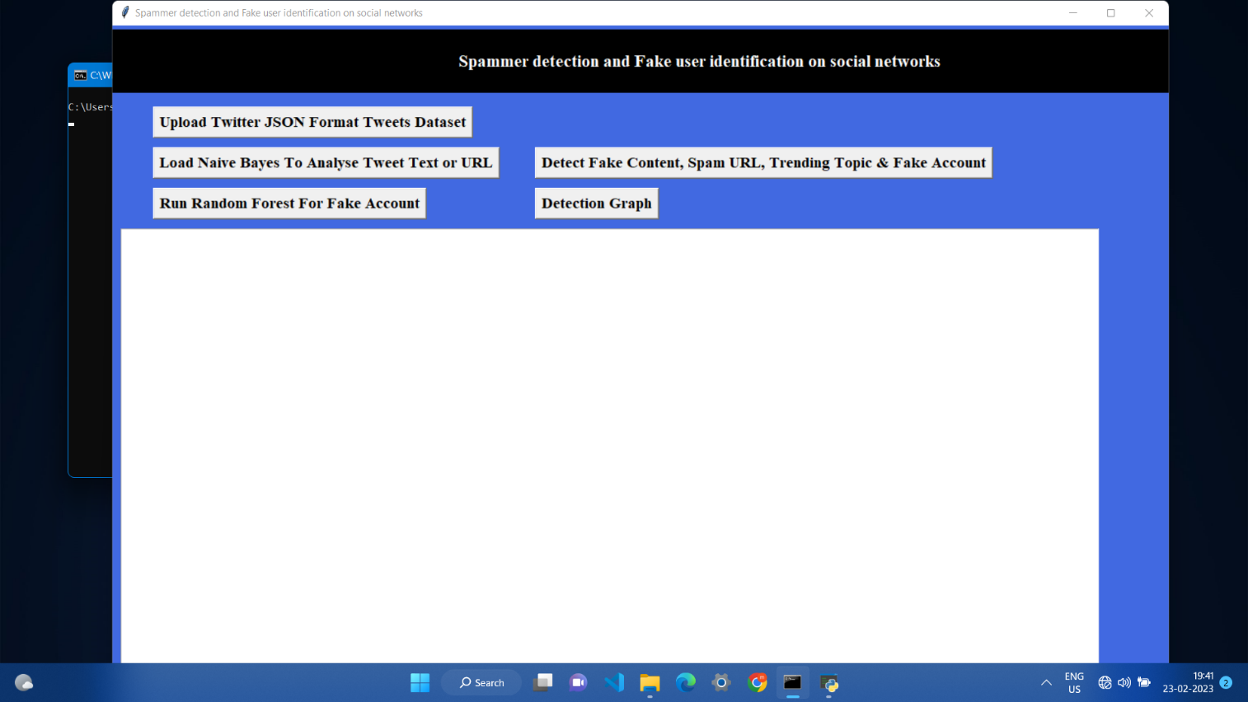
RESULTS
User Interface of the Application

Slide 20
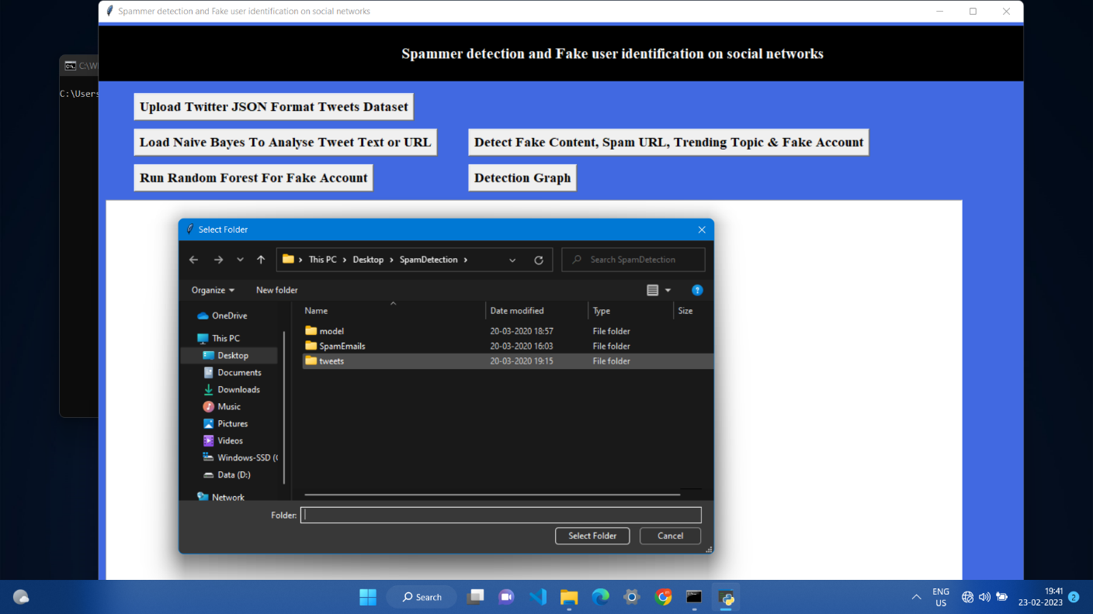
Uploading tweets Dataset

Slide 21
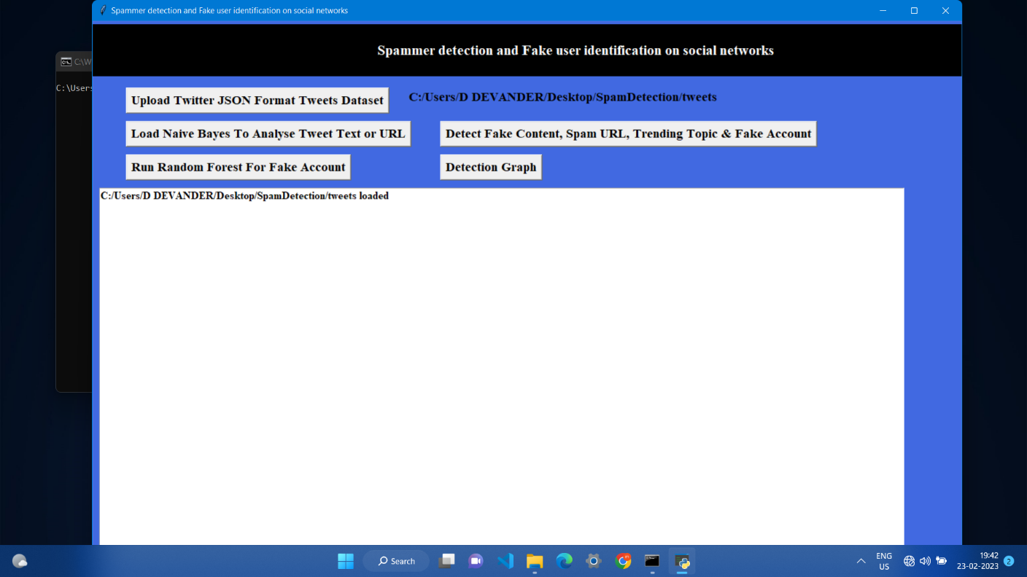
Loading Naïve Bayes

Slide 22

Tweets are loaded into Application

Slide 23
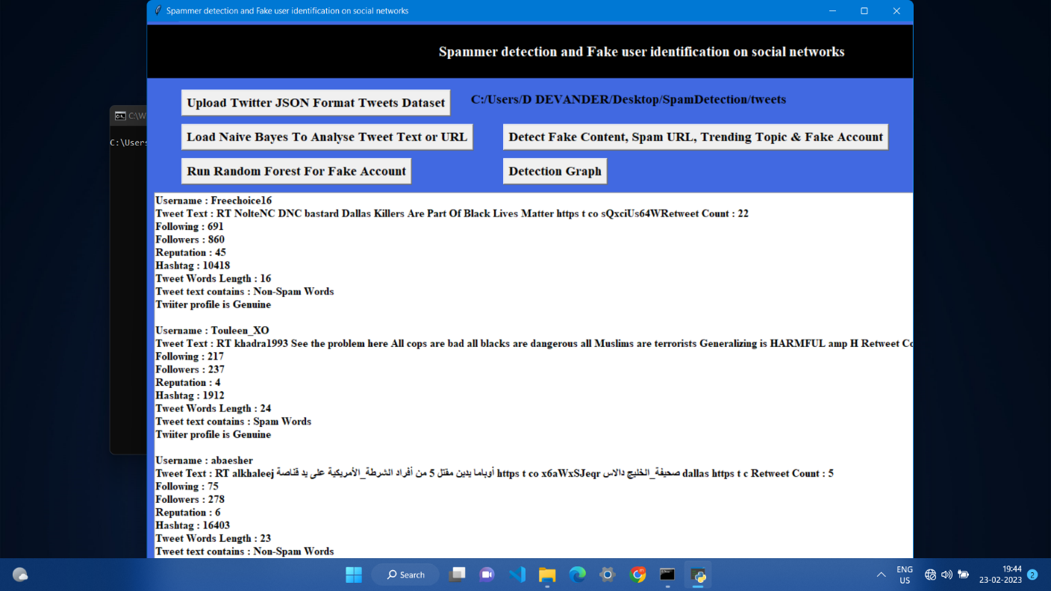
Detecting Fake Content

Slide 24
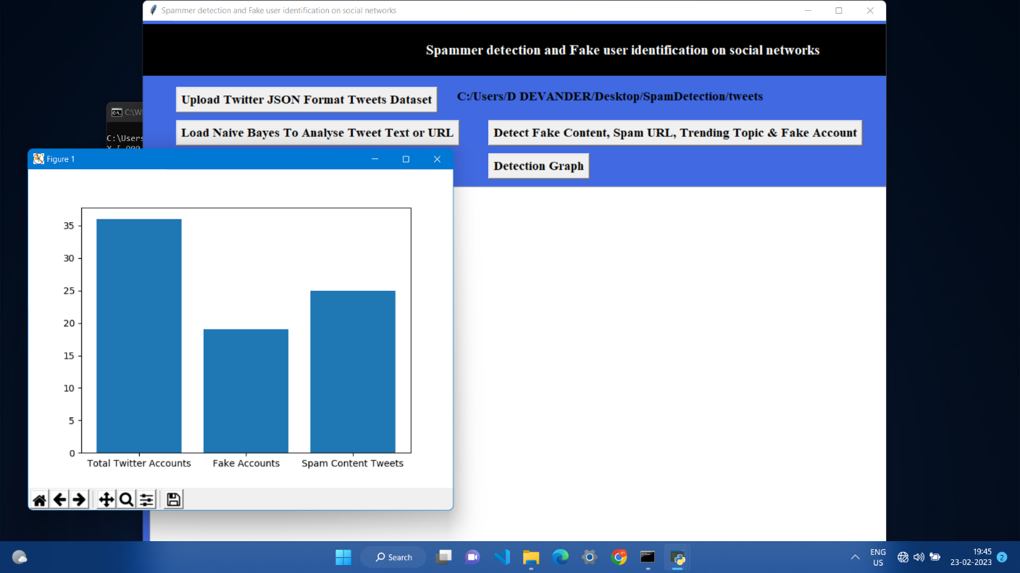
Graph Detection

Slide 25
NOVELTY
Manually detecting these fake and spam accounts would require a lot of human effort and time. Thus we are always in need of better methods which require less effort and time. So we are intend to give a framework with which the automatic detection of fake profiles and spammers can be done so that the social life of people become secured and by using this automatic detection technique we can make it easier for the sites to manage the huge number of profiles, which can’t be done manually. Recently, the detection of spammers and identification of fake users on Twitter has become a common area of research in contemporary online social Networks (OSNs). Here we perform a review of techniques used for detecting spammers on Twitter.

Slide 26
CONCLUSION
Using above techniques, we can detect whether tweets contains normal message or spam message. By detecting and removing such spam messages help social networks in gaining good reputation in the market. If social networks did not remove spam messages then its popularity will be decreases. Now a days all users are heavily dependent on social networks to get current news and business and relatives information and thus protecting it from spammer help it to gain reputation.

Slide 27
BIBLIOGRAPHY
REFERENCES
Programming Python, Mark Lutz
Head First Python, Paul Barry
Core Python Programming, R. Nageswara Rao
Learning with Python, Allen B. Downey
.B. Erçahin, Ö. Aktaş, D. Kilinç, and C. Akyol, ‘‘Twitter fake account detection,’’ in Proc. Int. Conf. Computer. Sci. Eng. (UBMK), Oct. 2017, pp. 388–392.
F. Benevenuto, G. Magno, T. Rodrigues, and V. Almeida, ‘‘Detecting spammers on Twitter,’’ in Proc. Collaboration, Electron. Messaging, AntiAbuse Spam Conf. (CEAS), vol. 6, Jul. 2010, p. 12.
. S. Gharge, and M. Chavan, ‘‘An integrated approach for malicious tweets detection using NLP,’’ in Proc. Int. Conf. Inventive Commun. Computer. Technol. (ICICCT), Mar. 2017, pp. 435–438.

Slide 28
Thank you

