Slide 1
IBM University Engagement Project Submission
“Exploring the Power of Agentic AI with IBM Granite and IBM Bob”

Slide 2

Project Tile – Smart Nutrition Agent
Domain of Project – Education
Student Name | Recent Passport Photo | Email ID | Mobile number [WhatsApp]
G.Bheemesh |  | 23r11a0560@gcet.edu.in | 6309523648
Recommended font style and size: Font Style: Arial Font Size (Heading): 28
Font Size (Content): 20

Slide 3
Problem Statement -
Problem Statement : AI-Powered Nutrition Advisor Agent
The Challenge
Good nutrition is the foundation of health, yet individuals and families consistently struggle with diet planning, portion control, calorie awareness, and making informed food choices. In a country like India, where cuisine is deeply diverse and culturally rooted, generic nutrition tools fail to account for regional food habits, traditional ingredients, and varying dietary preferences such as vegetarian, vegan, Jain, or diabetic-friendly diets. Additionally, busy lifestyles leave people with little time to research balanced meals, calculate macronutrients, or plan weekly menus for the entire family. Without personalized, accessible, and culturally relevant guidance, people unknowingly consume imbalanced diets — leading to lifestyle diseases such as obesity, Type 2 diabetes, hypertension, and malnutrition. This highlights the urgent need for an AI-powered nutrition system that understands individual health profiles and delivers actionable, personalized dietary recommendations..
The Objective
Personalized Nutrition Planning — Generate customized daily and weekly meal plans based on the user's age, weight, height, health goals, dietary preferences, and medical conditions.
Calorie & Macro Analysis — Analyse the nutritional content of any meal or food item, providing accurate calorie counts, macronutrient breakdowns (protein, carbohydrates, fats, fibre), and key micronutrient insights.
BMI & Health Assessment — Calculate Body Mass Index (BMI), Basal Metabolic Rate (BMR), and Total Daily Energy Expenditure (TDEE) to help users understand their current health status and set realistic goals.
Conversational AI Coaching — Deliver real-time, context-aware nutrition advice through a conversational chat interface powered by IBM Watsonx.ai Granite models, enabling users to ask questions naturally and receive expert-level responses instantly.

Slide 4
Proposed Solution -
The proposed solution is a multi-agent AI-powered Smart Nutrition Agent built using IBM Bob, IBM watsonx.ai, and Granite Models to provide personalized, real-time nutrition guidance and health recommendations. The system addresses challenges in diet planning, calorie awareness, nutrition analysis, and preventive healthcare through an intelligent, modular architecture.
At its core, the solution uses a Retrieval-Augmented Generation (RAG) pipeline to fetch accurate nutritional information from trusted sources such as USDA, FSSAI, WHO, and Indian Food Composition (IFCT) datasets. This data is embedded and stored in a vector database, enabling the system to retrieve and summarize nutritional information including calories, macronutrients, micronutrients, and health benefits using Granite models.
The system consists of four key agents:
Nutrition Analysis Agent retrieves and summarizes nutritional information using RAG and provides calorie, macronutrient (protein, carbohydrates, fats, fibre), and micronutrient analysis for food items and meals.
Personalized Diet Recommendation Agent generates customized daily and weekly meal plans based on user inputs such as age, height, weight, BMI, BMR, TDEE, dietary preferences, fitness goals, and medical conditions.
Indian Food Intelligence Agent recommends culturally relevant meal plans using traditional Indian foods, regional cuisines, and health-beneficial spices while supporting vegetarian, vegan, Jain, diabetic-friendly, and other dietary preferences.
Health Assessment & Family Nutrition Agent calculates BMI, BMR, and TDEE, provides preventive health recommendations, and generates personalized nutrition plans for multiple family members, including children, adults, and elderly individuals. The solution includes a user-friendly dashboard (built with Streamlit or React) that visualizes daily calorie intake, macronutrient distribution, BMI, BMR, TDEE, meal plans, nutrition history, and progress toward individual health goals.

Slide 5
Technology Used
IBM watsonx.ai (Granite Model) – For natural language understanding, nutrition reasoning, personalized meal recommendations, and conversational AI.
Python – Core programming language used to develop the backend.
Flask – Lightweight backend framework for building REST APIs and handling user requests.
IBM watsonx.ai Python SDK – Connects the Flask backend with IBM watsonx.ai Granite models.
HTML, CSS, Bootstrap & JavaScript – For developing a responsive and user-friendly web interface.
Flask Sessions – Maintains user conversation history and session management.
Python-dotenv (.env) – Securely stores and manages API keys and configuration details.
Docker & Gunicorn/Waitress – For application deployment and scalable production hosting.
IBM Cloud – Provides secure, reliable, and scalable cloud infrastructure for deploying the Smart Nutrition Agent.

Slide 6

Role of Agentic AI in the solution
Agentic AI enables the Smart Nutrition Agent to operate as an intelligent system of specialized AI agents that work together to provide personalized nutrition guidance instead of responding with a single generic answer.
Nutrition Analysis Agent – Analyzes food items and meals to provide calorie, macronutrient, and micronutrient information.
Personalized Diet Recommendation Agent – Creates customized meal plans based on the user's age, height, weight, health goals, dietary preferences, and medical conditions.
Indian Food Intelligence Agent – Recommends culturally relevant Indian meals, regional cuisines, and suitable alternatives based on dietary restrictions.
Health Assessment & Family Nutrition Agent – Calculates BMI, BMR, and TDEE, assesses overall health, and generates personalized nutrition plans for multiple family members.
Collaborative Decision Making – The agents communicate and share information to generate accurate, context-aware, and personalized nutrition recommendations.
Autonomous Task Execution – Each agent independently performs its assigned task while contributing to a complete end-to-end nutrition advisory solution, improving accuracy, efficiency, and user experience.

Slide 7
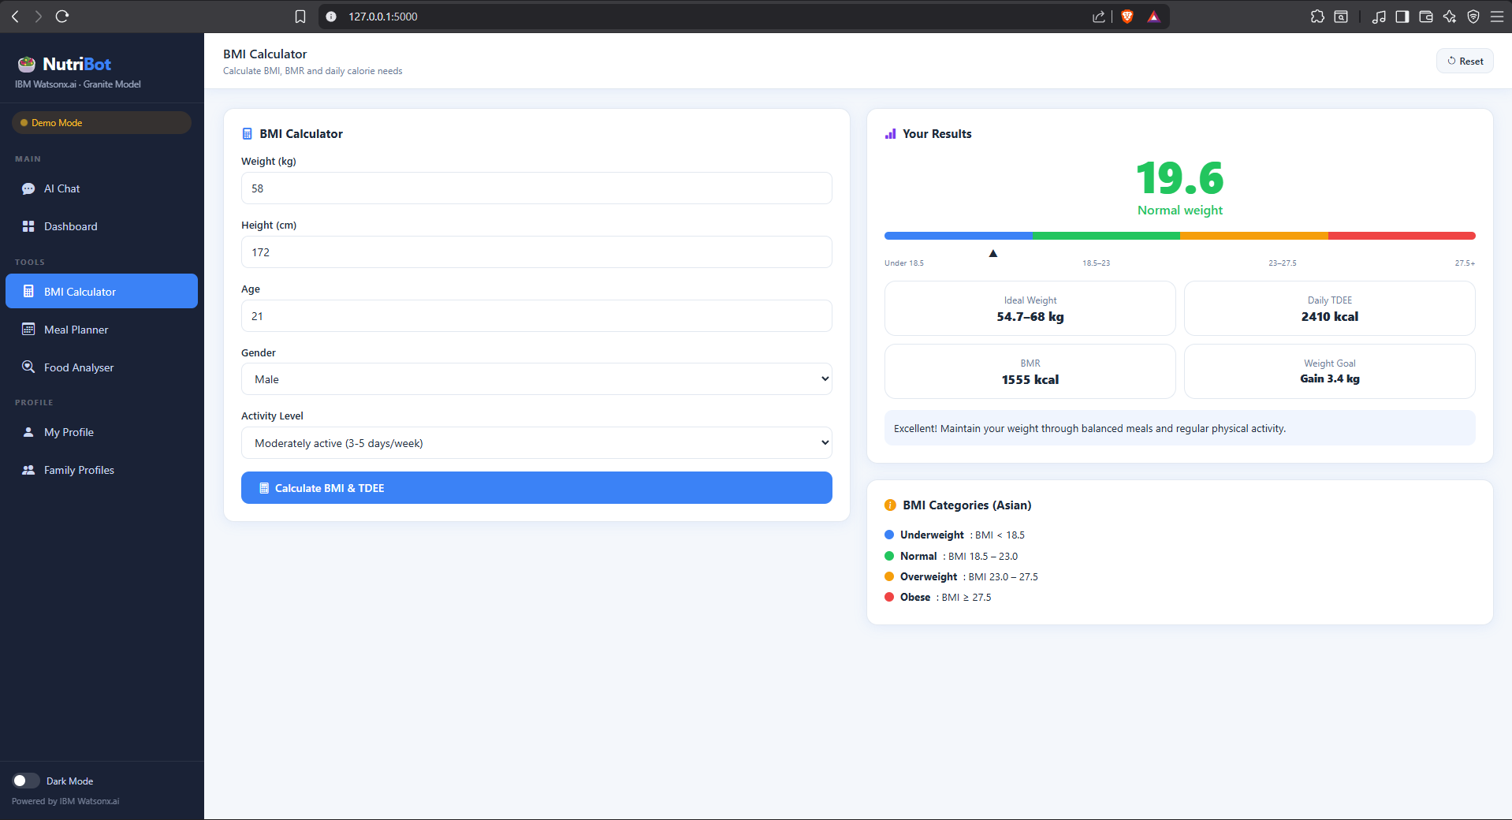
IBM Bob output screen:
·
·
·

Slide 8
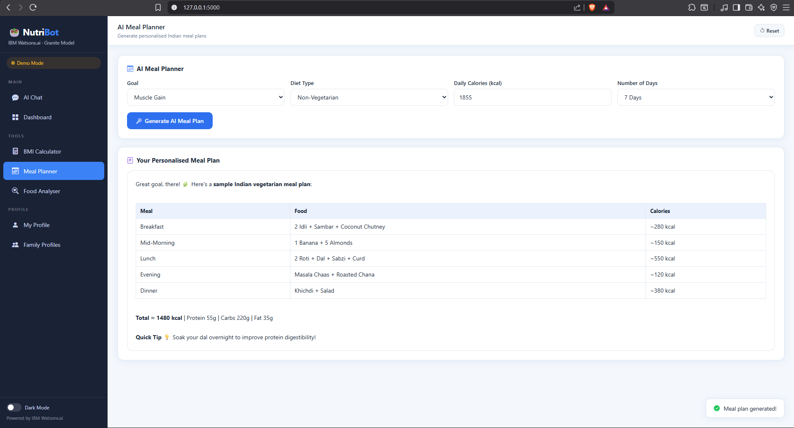
IBM Bob output screen:
·
·
·

Slide 9
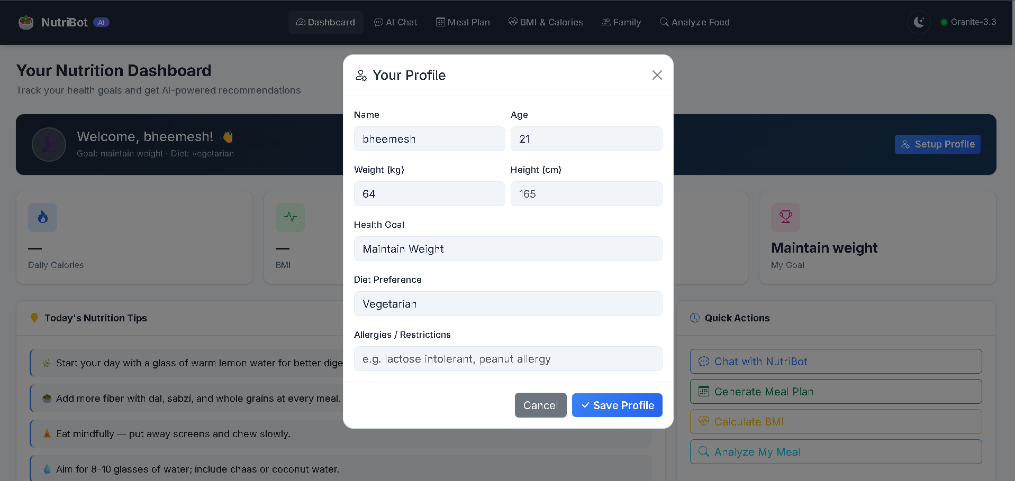
IBM Bob output screen:
·
·
·

Slide 10
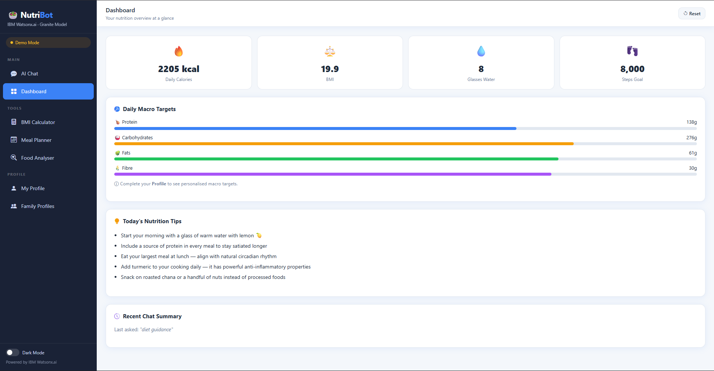
IBM Bob output screen:
·
·
·

Slide 11
Novelty and Uniqueness
Multi-Agent AI Architecture – Uses specialized AI agents for nutrition analysis, meal planning, Indian food recommendations, and health assessment, enabling more accurate and personalized guidance than a single chatbot.
Personalized Nutrition Planning – Generates meal plans based on age, height, weight, BMI, BMR, TDEE, health goals, dietary preferences, and medical conditions.
Indian Food Intelligence – Recommends culturally relevant Indian meals, regional cuisines, and traditional ingredients instead of relying only on Western food databases.
Family-Based Nutrition Support – Supports nutrition planning for multiple family members, including children, adults, and elderly individuals, within a single platform.
Real-Time Conversational AI – Powered by IBM watsonx.ai Granite models, allowing users to ask nutrition-related questions in natural language and receive instant, personalized responses.
Health-Focused Recommendations – Combines nutrition analysis with BMI, BMR, and TDEE calculations to provide preventive healthcare and wellness guidance rather than only calorie tracking.
Scalable and Secure AI Solution – Built on IBM technologies, making the system reliable, scalable, and suitable for real-world healthcare and wellness applications.

Slide 12
Git Hub Link
· Please create public github repository (Enable Add README button while creating repository) with format –
Please test and Paste the working Github URL –
Make sure you have Uploaded following three files into your github repository 1) All Agent relevant files of IBM Cloud , 2) yourproblemstatement.pdf file 3) your projectpresntation.pptx file 4)any other files
·
·
·

Slide 13
Future Scope
AI Image-Based Food Recognition – Detect food items from images and automatically estimate calories and nutritional values. Wearable & Health Device Integration – Connect with smartwatches and fitness trackers to use real-time health data for personalized recommendations. Voice-Based Nutrition Assistant – Enable users to interact with the nutrition agent using voice commands in multiple languages. IoT Integration – Connect with smart kitchen appliances and health monitoring devices to provide intelligent meal planning and dietary suggestions. Disease-Specific Nutrition Support – Expand recommendations for conditions such as diabetes, hypertension, obesity, kidney disease, and heart disease. Multilingual Support – Support regional Indian languages to make the application accessible to a wider population.
·
·
·

Slide 14
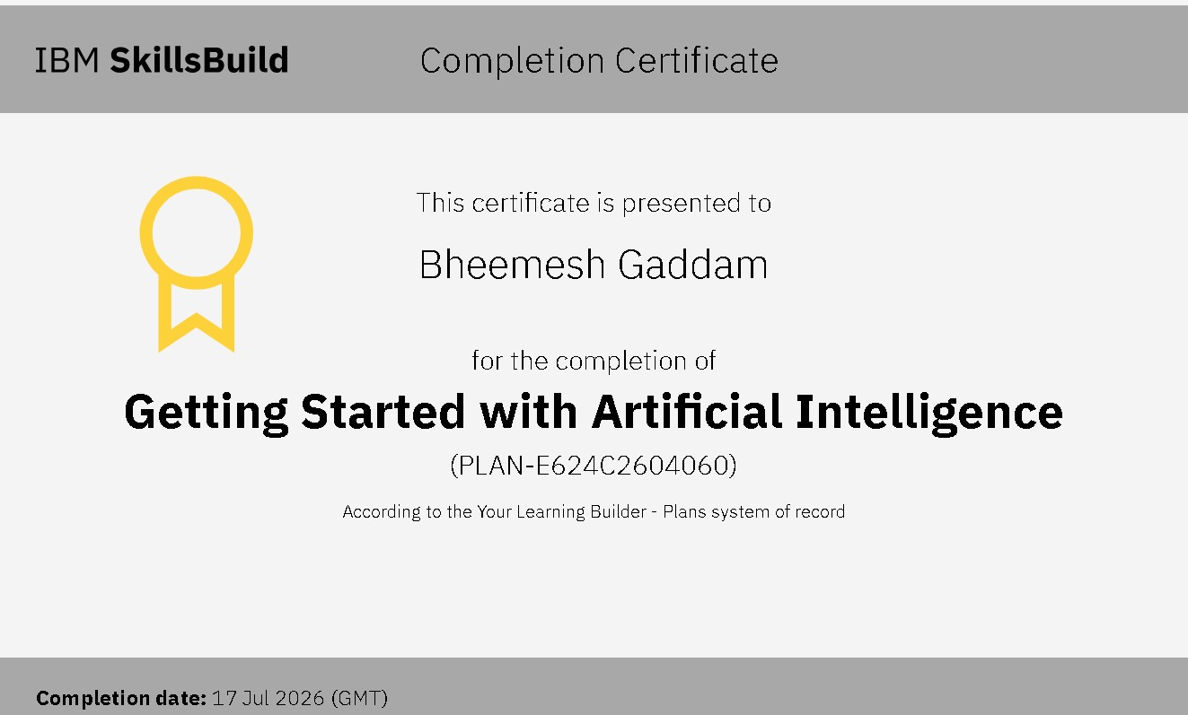
Certificates Earned:
Please add your credly certificate

Slide 15
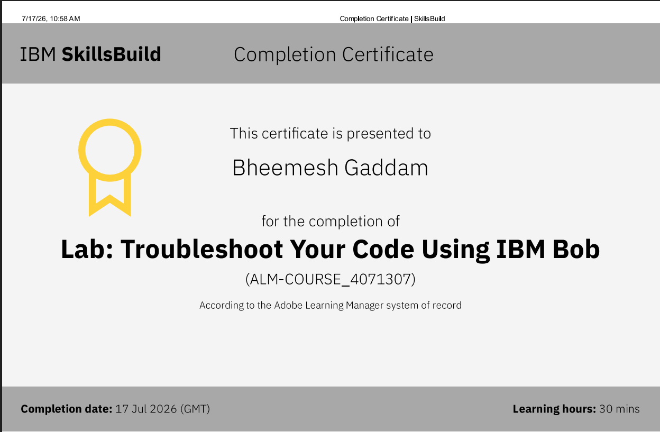
Certificates Earned:​
Add your IBM BOB Certificate

Slide 16


