Slide 1
AI-Powered
QA Lifecycle Automation
How an AI agent replaces manual steps in testing — from ticket discovery to test execution
Notes:
Welcome. This is a 5-min overview of how we use AI to automate manual QA steps — from finding tickets in Jira to running tests and posting results back automatically. No deep technical background needed.

Slide 2
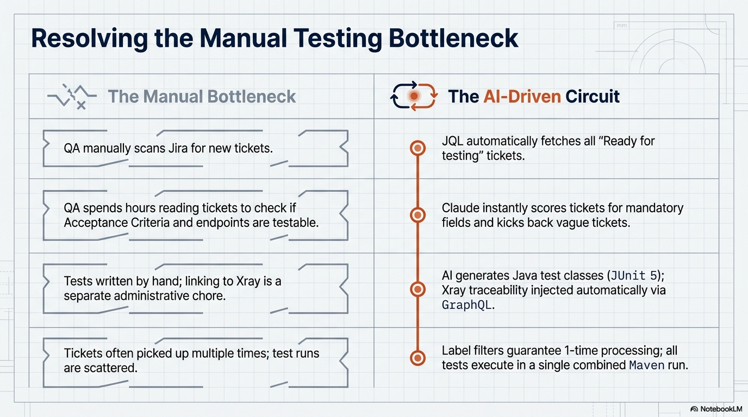

Slide 3
