Slide 1
Vehicle CO₂ Emission Prediction
using Elastic Net Regression
S. Bheeshma
2520030528

Slide 2
Introduction
2
A vehicle’s CO₂ emissions depend on technical factors such as engine size, number of cylinders, fuel type and fuel consumption rate.
Estimating this by hand is hard, time-consuming and often inaccurate, especially when many factors interact together.
We use Machine Learning to learn patterns directly from real vehicle data and predict CO₂ emissions accurately and consistently.
Model used: Elastic Net Regression, which combines Ridge (L2) and Lasso (L1) penalties to handle correlated features and reduce overfitting.

Slide 3
Problem Statement
3
CO₂ emissions depend on multiple interacting factors — engine size, fuel type, transmission and fuel consumption — making the relationship complex.
It is hard to estimate emissions manually using so many factors together, and manual methods do not scale well to thousands of vehicles.
Goal:
Build a Machine Learning model that predicts a vehicle’s CO₂ emissions (g/km) from its features, giving reliable estimates without physical emission testing.

Slide 4
Objectives
4
Collect a real-world vehicle dataset containing technical specifications and emission values.
Clean and prepare the data by handling missing values, duplicates and irrelevant columns.
Build an Elastic Net Regression model that balances Ridge and Lasso regularization for stable, generalizable predictions.
Check model accuracy using MAE, RMSE and R² to see how closely predictions match actual emissions.
Predict CO₂ emissions (g/km) for any vehicle based on its engine, fuel and transmission characteristics.

Slide 5
Dataset Overview
5
Dataset: Vehicle CO₂ Emission Dataset, compiled from real vehicle specification and emissions records.
7,385 rows and 12 columns, giving a reasonably large sample for training and testing.
Includes Engine Size, Cylinders, Fuel Type, Fuel Consumption (city, highway, combined), Transmission and Vehicle Class.
Target: CO₂ Emissions (g/km) — a continuous number, which makes this a Regression problem rather than classification.

Slide 6
Step 1 Load Dataset & Import Libraries
6
import pandas as pd
import numpy as np
import matplotlib.pyplot as plt
import seaborn as sns
from sklearn.linear_model import ElasticNet
from sklearn.preprocessing import StandardScaler
Library | Purpose
Pandas | Load and manipulate the dataset
NumPy | Numerical calculations
Matplotlib | Create graphs and visualizations
Seaborn | Create statistical visualizations
Scikit-learn | Build the Elastic Net Regression model

Slide 7
Loading the Dataset
7
Loading the Dataset
Check Dataset Size
from google.colab import files
upload = files.upload()
print("Rows:", df.shape[0])
print("Columns:", df.shape[1])
Display the Dataset
Rows: 7,385
Columns: 12
df.head()
Check Column Names
This displays the first 5 rows of the dataset.
print(df.columns.tolist())

Slide 8
Step 2 Data Understanding
8
Check Statistical Summary
Check Missing & Duplicate Values
df.describe()
df.isnull().sum()
df.duplicated().sum()
Count
Mean
Standard deviation
Minimum
Maximum
Quartiles
Understand the Target Variable
df["CO2 Emissions"].describe()
Since CO₂ Emissions is continuous, we review its distribution — range, spread and skewness — rather than class counts, to understand the target before modeling.

Slide 9
Step 3 Data Cleaning
9
Remove Irrelevant Columns
Encoding & Scaling
columns_to_drop = [
"Make",
"Model"
]
df = pd.get_dummies(df, columns=
["Fuel Type","Vehicle Class","Transmission"])
scaler = StandardScaler()
df[num_cols] = scaler.fit_transform(df[num_cols])
Make and Model are identifiers rather than measurable properties, so they don’t provide useful predictive information for CO₂ emission prediction.
Categorical features (Fuel Type, Vehicle Class, Transmission) are One-Hot Encoded to avoid implying false ordinal relationships; numerical features are standardized with StandardScaler so all features contribute on the same scale.

Slide 10
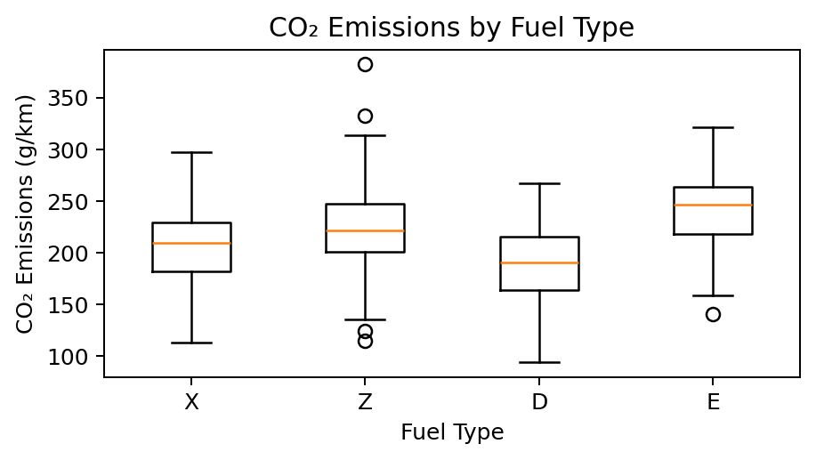
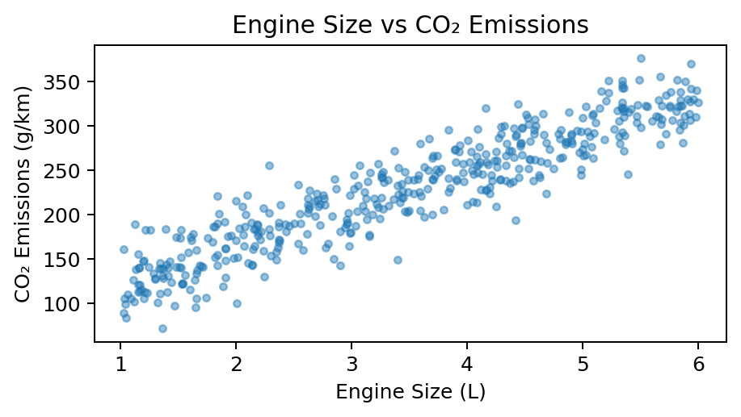
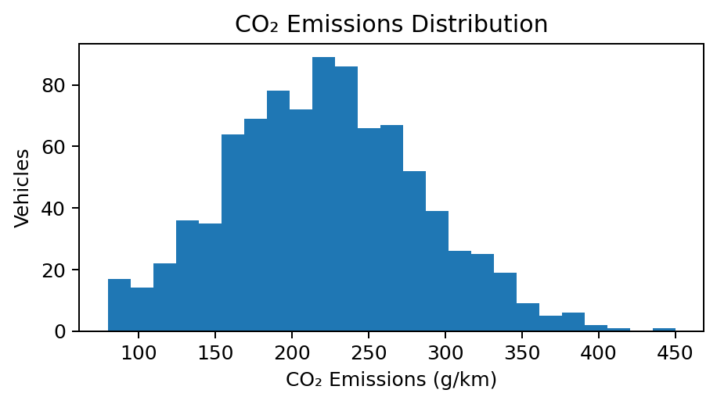
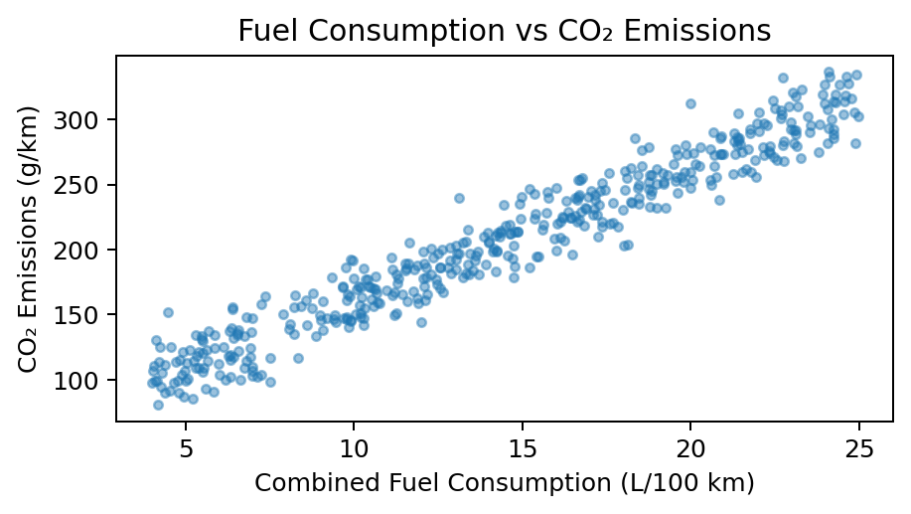
Step 4 EDA
10
To understand the distribution of CO₂ Emissions.
CO₂ Emissions vs Fuel Type
plt.figure(figsize=(6,4))
sns.histplot(data=df, x="CO2 Emissions")
plt.title("CO2 Emissions Distribution")
plt.show()
plt.figure(figsize=(8,5))
sns.boxplot(data=df, x="Fuel Type", y="CO2 Emissions")
plt.title("Emissions by Fuel Type")
plt.show()
We analyze whether CO₂ emissions differ based on:
Engine size and cylinders
Fuel type
Transmission type
Fuel consumption patterns

Slide 11
Model, Evaluation & Correlation Heatmap
11
Correlation Heatmap
Elastic Net Regression — Evaluation Results
numeric_cols = df.select_dtypes(include=np.number).columns
correlation = df[numeric_cols].corr()
sns.heatmap(correlation, annot=True, cmap="coolwarm")
plt.show()
Metric | Result
MAE | 4.76
RMSE | 7.08
R² Score | 0.9854
Studies relationships among Engine Size, Fuel Consumption and CO₂ Emissions.
Trained on 80% / tested on 20% of the data (5,908 train, 1,477 test records).
Thank You

