Slide 1
QA TDD
… do you test already … or do you develop now?

Slide 2
… last comment from a developer…
… just before production.
I have looked everything very clear. I‘m sure: There aren‘t any fails.
After start, thery was a fail at just his added position.

Slide 3
… a developer with compiler-DNA…
I looked into the code. Line 5 will give a compiler error.
The param value isn‘t correct.
… answer from the project manager:
Did you know?: JAVA-Compiler don‘t cost anything.

Slide 4
… developer after a little refactoring and a fail after life
We looked into that part twice times. We ment that ist was correct what we did.
But by the way: The code was very complex.
… answer from the projectmanager:
Complex? Yes!
But before you changed it the code was correct!!!

Slide 5
… after a configuration change for a software release …
Oh oh …
Now, more than 20 tests will change to red, and I have to change the expected results.
… answer:
??? (without any word)

Slide 6
… just before delivery …
We have this ugly quality guard, that we won‘t deliver software with red tests. Please, look at the red tests. It should be a good and quickly way, looking the real result (the red tests logs it) and put it into the requested result.
… weeks later after delivery:
Uups!
This feature doesn‘t work correct. Does ist ever work correct?

Slide 7
… just before change a XML-fragment …
We change that shorten. There isn‘t any reason for a fail. If we don‘t do it, we have to wait for 3 hours.
… after delivery. The requested labels couldn‘t print, because the xml-fragment wasn‘t correct.
… for 3 hours, because there wasn‘t any possibility for re-delivery.
… costs: 1000EUR per minute

Slide 8

Content
Theory
Practice

Slide 9
Agenda
Basics
Tests, why tests, kind of tests
How to test
First action with TDD
What is TDD
Steps in TDD
Target with TDD

Slide 10
Basics and deep dive into tests

Slide 11
Term: Quality
Many people many definitions

Slide 12
Term: Quality
Many people many definitions
Easy learning
Extendible
Robustness
Efficient
Correctness
Easy using
Portable
Timeliness
Security
Effictive
Reusable
Improved

Slide 13
Term: Quality
Many people many definitions
Easy learning
Extendible
Robustness
Efficient
Correctness
Easy using
Portable
Timeliness
Security
Effictive
Reusable
Improved

Slide 14
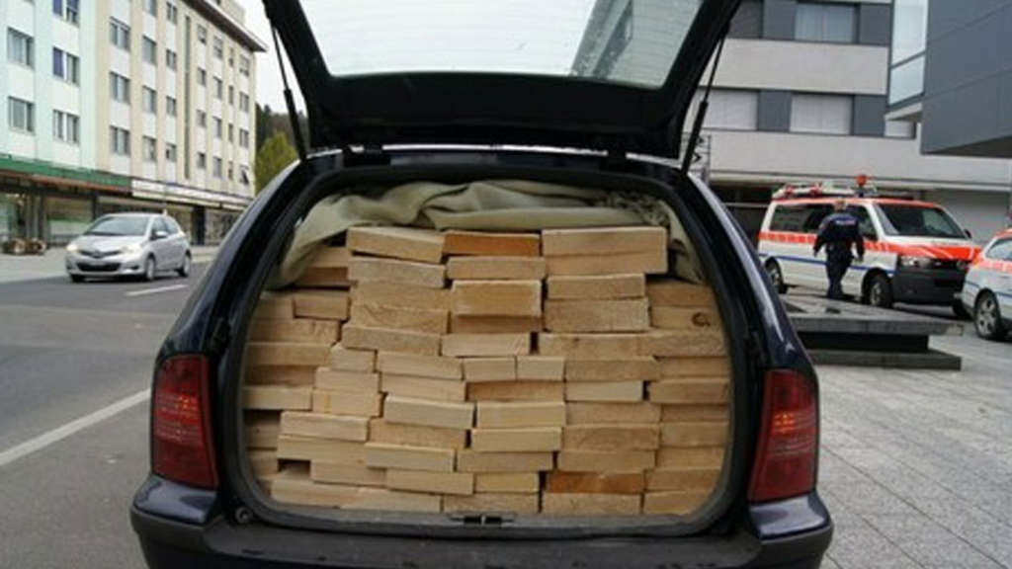

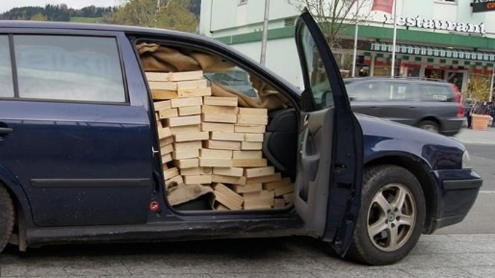
Quality: Reusable

Slide 15
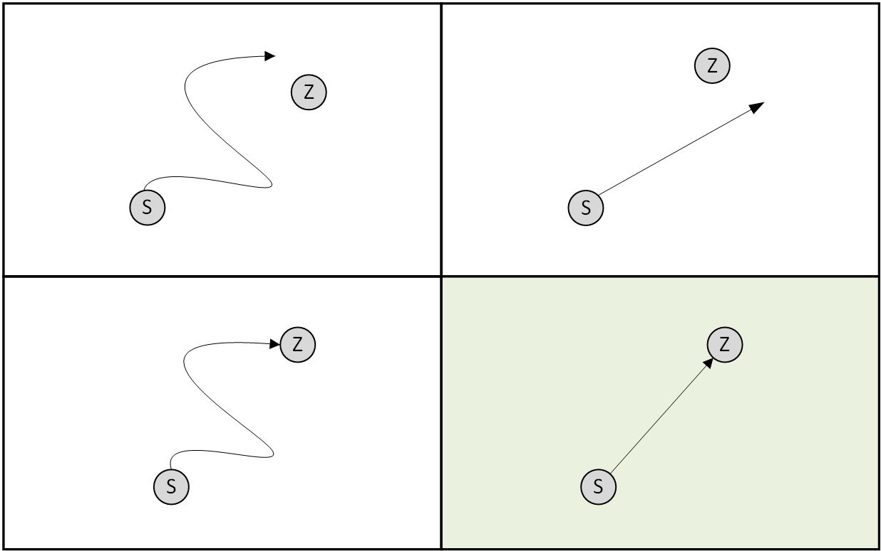
Quality: Effective and efficient
Not efficient
efficient
Not effective
From an email:
AW:AW:RE:REASON: AW:AW:AW:RE:RE:RE: Reply:RE:RE:RE:RE:RE:AW:AW:Answer: RE:AW:RE:AE:AW:RE:Reasons, why we don‘t work efficient
effective

Slide 16
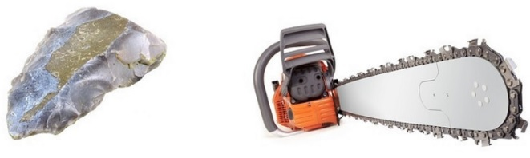


Quality: effective and efficient

Slide 17
Quality: a numeric definition
Result
Effectiveness
=
Goal
Result
Efficiency
=
Effort

Slide 18
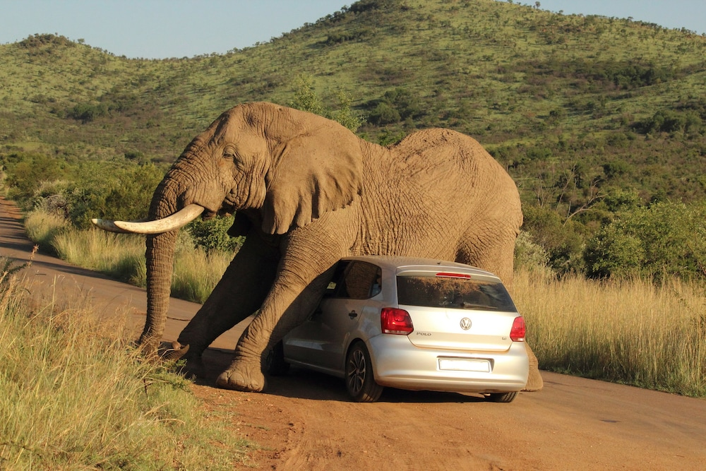
Quality: Robustness

Slide 19
Quality: Reliability
t
0
Performing quality aspects for a specified period of time

Slide 20
Quality: Reliability
t
0
Performing quality aspects for a specified period of time
Intended function specific period of time specified condtions Probability Satisfactory
Notes:
Satisfactory: perform according to a specification, with an acceptable degree of compliance
Probability: the likelihood of mission success

Slide 21
Quality: in one sentence
Quality is the absence of
deficits
Bugs

Slide 22
Quality: IEEE
Mistakes
Faults
Failures

Slide 23
Faults in Software: Reasons (1)
In large system, no one understand the complete algorithm
complexity of the code
Complexity of the business
Unpredictable behavior in some situations

Slide 24
Faults in Software: Reasons (2)
Unclear requirements
Design errors
Architecture errors
No understanding design
No understanding architecture
Implementation errors
Wrong assumptions

Slide 25
Fails in Software
Failure
Error
Fault

Slide 26
Fails in Software
Fault
Mistake in programm/function
Function double(3) results in 9 (because the developer paste a „*“ instead of „+“)
In the start-phase of the flight the software interpreted a faulty signal and pushed the plane nose down
The programm should works fine until some calls/times …
Call double(2) results in correct number.
If the sensor works fine, the software works fine.

Slide 27
Fails in Software
Fault
Mistake in programm/function
Function double(3) results in 9 (because the developer paste a „*“ instead of „+“)
In the start-phase of the flight the software interpreted a faulty signal and pushed the plane nose down
The programm should works fine until some calls/times …
Error
Activated Fault
Failure
Deviation in system behaviour
Bug
Deviation in system behaviour

Slide 28
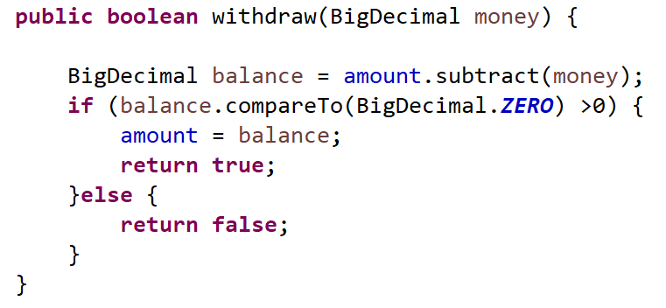
Fault, Error, Failure

Slide 29
Fault, Error, Failure
FAULT: withdraw isn‘t possible if balance is zero.
ERROR: Call the function with amount-value, other calls proceed well
FAILURE: customer tries to transfer his complete credit to other bank account

Slide 30
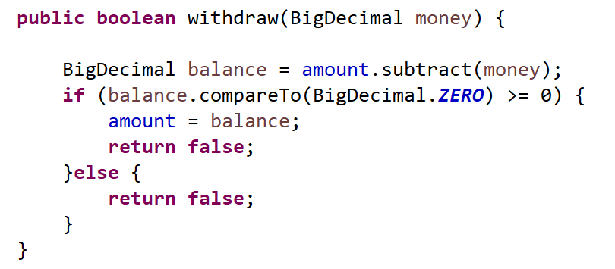
Fault, Error, Failure

Slide 31
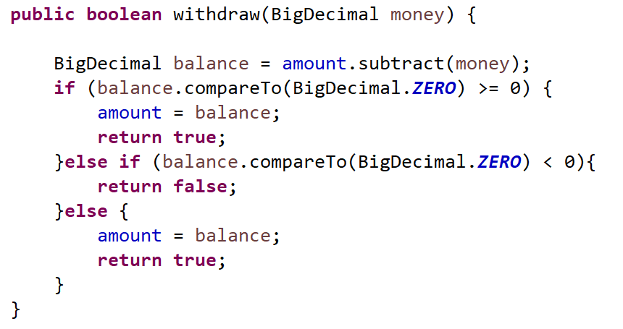
Fault, Error, Failure

Slide 32
result from
caused by
Failure
Error
Fault
Needs an event of execution
Needs a special use
Defect
Found Error in Developing/Test-Phase (by developer, tester, …)
Bug
Found Error after delivery (by customer, user)

Slide 33
Test-Level
acceptance
system
integration
unit
User-End-Test
Developer checks test

Slide 34
Test-Level
acceptance
system
integration
unit
Costs of remedying a failure
Time of determination a failure

Slide 35
QA: Tests
With tests you trie to make a fail.
Or in other words: Testing can only show the precence of errors, never their absence. {Dijkstra, 1930-2002}

Slide 36
Aspects for tests
A test is made for finding bugs
Only a test, that previously failed is a good hint about the reliability for the test or the tested unit
Testing stops a identification of bugs
Correction is „debugging“

Slide 37

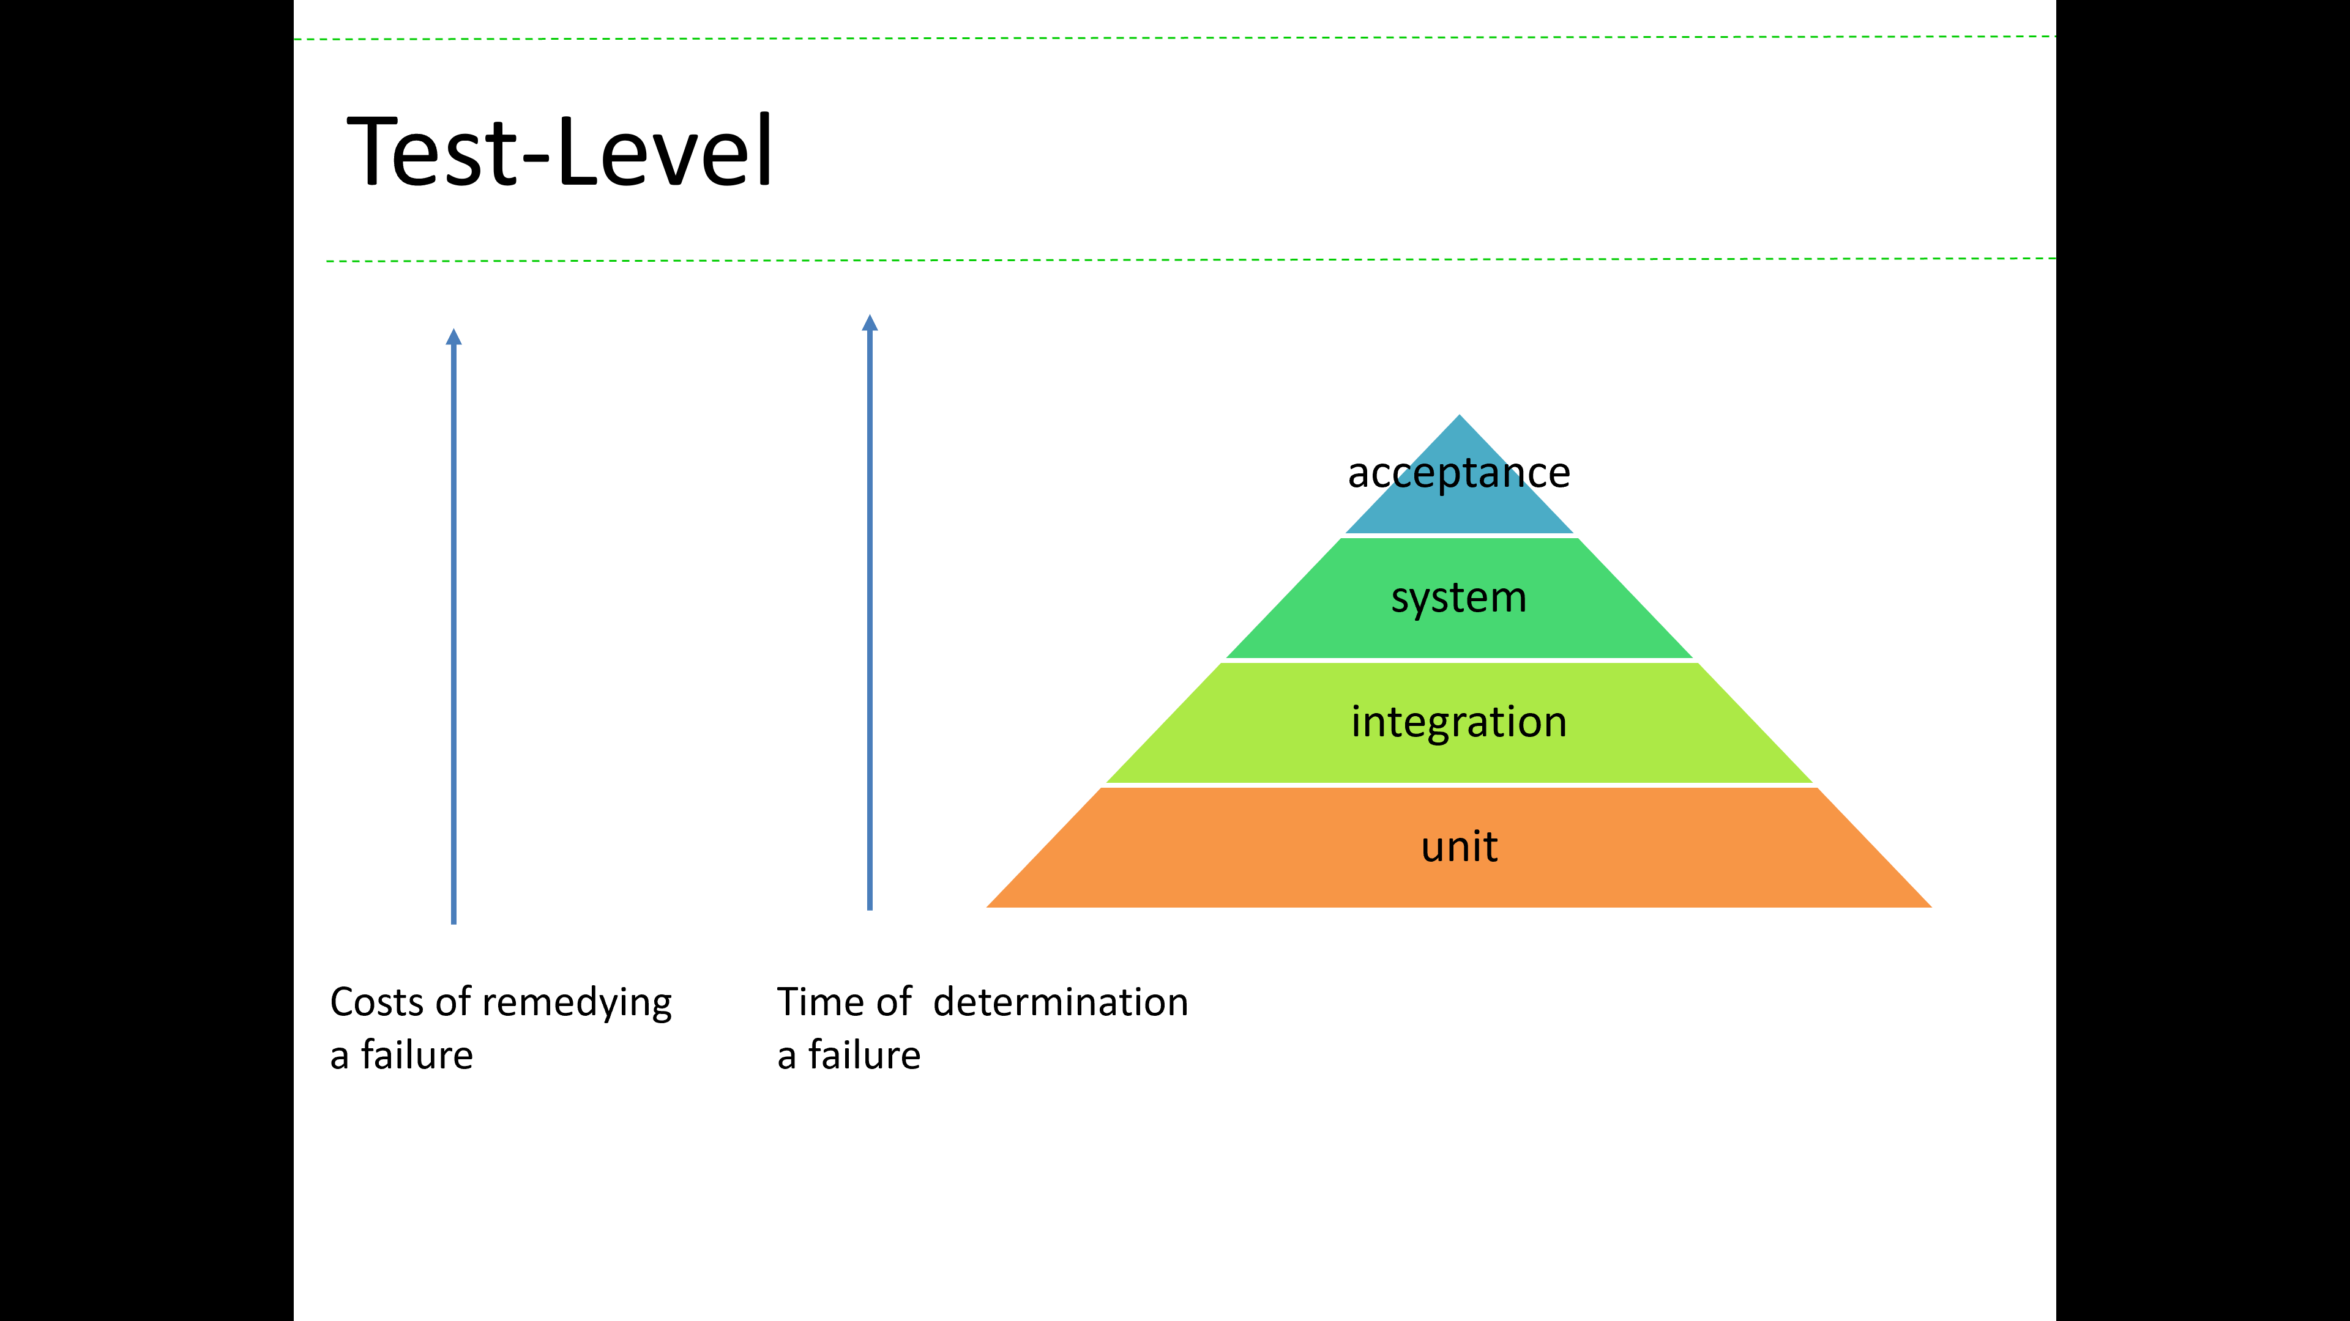
Cutback
Quality
Absence of deficits
Absence of bugs
Typical software Quality terms
Robustness
Efficience
Effectife
Reliability

Slide 38
Cutback
Errors in software
Requirements
Unclear
Complex
incomplete
Design
Error
Not understand
Architecture
Error
No understand
Code
Complex
Errors
Unpredictable behaviour sometime
QA (quality assurance)
Defining quality guards
Ensure, that the product meets these guards
Improving over the lifecycle
Making tests
Try to make fails
Ensuring the correctness of the software
Testing can only show the precence of errors, never their absence.

Slide 39
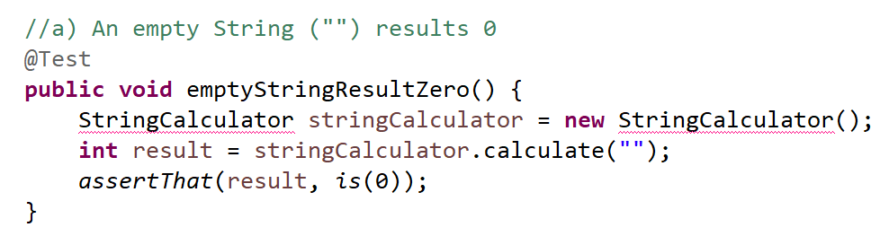
Go forward in making test for demonstrating a correct requirement
Simple step.
Make a fail test
Note: The test must be fixed with short code changes
This test failed:
- It gets an compile error
But, during writing a test you think about:
Name of the class
Name of the method
Input of the method
Output of the method

Slide 40
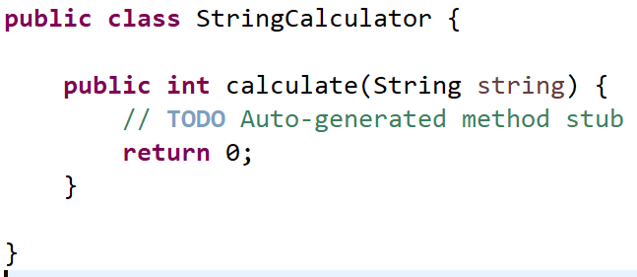
Go forward in making test for demonstrating a correct requirement
Simple step.
Make a fail test
Note: The test must be fixed with short code changes
Solve the test in the easiest way you can.

Slide 41
Go forward in making test for demonstrating a correct requirement
NOTE: The only one task here was to make a function which returns 0 by an empty string.
That the function do return 0 by all other input too doesn‘t matter.
Thats not part of the current task.
Stay by your task.
There are many other (additional) tasks defining the complete behaviour of the calculator.
Simple step.
Make a fail test
Note: The test must be fixed with short code changes
Solve the test in the easiest way you can.

Slide 42
Quality meets Project live
scope
stable
quality
unstable
time
cost
Notes:
Here you see the parameter of a classical project management.
Time, Cost and Scope are relevant factors; everybody knows that these threee factors manipulate each other.
And, typically time and cost are unstable factors and the scope is seen as a stable scope.
Thats a big problem in an agile world.
Because agile teams do something like sprints in timeboxing. So the are very fix in time and typically fixed in cost. But the scope a a variable thing.
And quality in this picture is more a dream. But quality has to get in focus.

Slide 43
Quality meets Project live
scope
scope
stable
quality
unstable
time
cost
time
quality
Notes:
Here you see the parameter of a classical project management.
Time, Cost and Scope are relevant factors; everybody knows that these threee factors manipulate each other.
And, typically time and cost are unstable factors and the scope is seen as a stable scope.
Thats a big problem in an agile world.
Because agile teams do something like sprints in timeboxing. So the are very fix in time and typically fixed in cost. But the scope a a variable thing.
And quality in this picture is more a dream. But quality has to get in focus.

Slide 44
Quality meets Project live
Releasable product
stable
unstable
quality
Basic conditions
{Agile triangle, Jim Highsmith}
Notes:
So this picture is likely better for managing projects.
Quality is a main point and it is defined as fix.
That doesn‘t mean, that there is no discussion allowed. But typicalle the discussion about quality start long time before a project.

Slide 45
Quality meets Project live
scope
time
cost
stable
quality
quality
unstable
time
cost
scope
Notes:
Here you see the parameter of a classical project management.
Time, Cost and Scope are relevant factors; everybody knows that these threee factors manipulate each other.
And, typically time and cost are unstable factors and the scope is seen as a stable scope.
Thats a big problem in an agile world.
Because agile teams do something like sprints in timeboxing. So the are very fix in time and typically fixed in cost. But the scope a a variable thing.
And quality in this picture is more a dream. But quality has to get in focus.

Slide 46
Quality meets Project live
scope
time
quality
stable
unstable
time
quality
scope
Typical agile view
Notes:
Here you see the parameter of a classical project management.
Time, Cost and Scope are relevant factors; everybody knows that these threee factors manipulate each other.
And, typically time and cost are unstable factors and the scope is seen as a stable scope.
Thats a big problem in an agile world.
Because agile teams do something like sprints in timeboxing. So the are very fix in time and typically fixed in cost. But the scope a a variable thing.
And quality in this picture is more a dream. But quality has to get in focus.

Slide 47
Verification and Validation
Verification
Validation
Determine if the artifact (result of a development phase) establishes the requirements before creation
Confirm that a product meets customers expectation(s)
Confirm that a product meets its attended use

Slide 48
Verification and Validation
Verification
Validation
Determine if the artifact (result of a development phase) establishes the requirements before creation
Confirm that a product meets customers expectation(s)
Confirm that a product meets its attended use
Focused on: the development
Focused on: the (final) product

Slide 49
QA: Quality Assurance
Define quality objectives
Define processes for meeting the defines objectives
Improve the quality objectives over the time

Slide 50
Term: Quality assurance (QA)
Activities
Defining quality guards
Ensure, that the product meets the guards
Improve them over the lifecycle

Slide 51
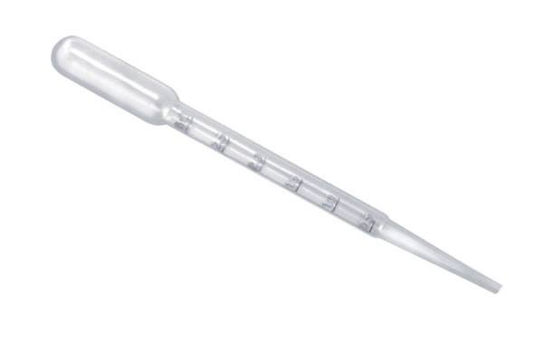
Testscope: Unit-Test
Tests a module/class or methode/function
Class1
Class2
Class2 dosomething()
Database

Slide 52
Testscope: Integrationtest
Tests a subsystem
Class1
Class2
Class2 dosomething()
Database

Slide 53
Testscope: Integrationtest
Tests a subsystem
Class1
Class2
Class2 dosomething()
Database

Slide 54
Testscope: Systemtest
Tests an integrated application, typically parameterized typically with deployment and platform characteristics
Class1
Class2
Class2 dosomething()
Database

Slide 55
Impact for test-level
Start very early with testing
Integrate testing in your development process

Slide 56
Types of tests
Start very early with testing
Integrate testing in your development process
Make it allone
Unit-Tests Integration-Tests
Make it together
Pair-programming
Code-review
Crowd developing
Crowd architecture

Slide 57
Where can tests help you
Akzeptanz
System
Integration
Unit
Have you made a testable application
Indication for good architecture
Indication for good design
Indication for no fails
Indication for no technical depts
Please note:
An application lives.
You have to tell the same questions time for time.
Be never full satisfied.
Know that current satisfaction is only for the moment.
Do not go ahead too much.
There is no sence for develop requirement you dont know. Reality will win and overtake.

Slide 58
Where can tests help you
Akzeptanz
System
Integration
Unit
Do you know the Beatles?
Do you know John Lennon?
Quote:
Live is what happens while you plan your live.
Don‘t care about the problems will come tomorrow ;)
But be ready to manage the future problems. So you can solve them in a very light way.
Notes:
It‘s one of my basic principels

Slide 59
This side is free for technical reason

Slide 60
Test-Level, JUnit
Akzeptanz
System
Integration
Unit
Unit-tests check a special method/function of a component
Unit-tests check …
… the implementation of a method/function
… the logic of a method/function
TestClass
SUT
DOC
testmethod
Methode
method
Methode
method
DOC
Methode
Methode
method
Notes:
Daran denken, dass beteiligte Klassen auch eine Datenbankabstraktion sein können.

Slide 61
Examples wrong created tests
Test fails and proceeds accidental
After changing configuration the test fails
Test fails according events, e.g. time
One or more tests fail if they proceed in other order
Notes:
Roter Test nach Konfigurationswechsel: Führt im schlimmsten Fall dazu dass das erwartete Ergebnis kurzerhand ohne nachdenken vom aktuellen Testergebnis abgeschrieben wird. Nach dem Motto, nach der Konfiguration gibt es einen Assert, dass nun 3 erwartet wird obwohl 5 geliefert wird. Dann tauschen wir kurzerhand die drei gegen 5 aus und alles passt.

Slide 62
Hotspots in UnitTests
Tests check more as one thing
E.g. SUT does more than one thing
Tests pass on concrete order only
Tests take too much time
Tests need database
Tests need complete environment
Notes:
Ein wesentlicher Erfolgsfaktor für Entwicklertests auf der untersten Ebene ist möglichst häufige Ausführung. Kein Entwickler möchte auf sein Ergebnis eine Minute warten. Konsequenz ist, dass viel u

Slide 63
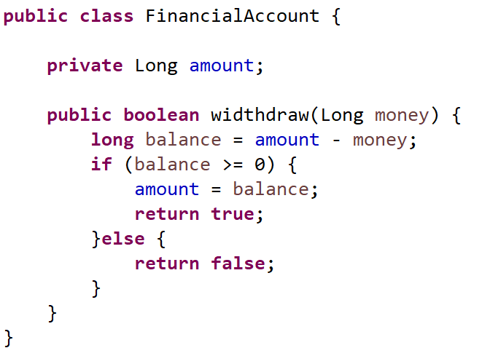
How to find good inputs
Problem
Testing with all inputs isn‘t possible. BUT: We need realistic inputs

Slide 64
Finding input: partition testing, equivalence class
Devide complete possible input into parts (partitions) with equal types. Take some inputs of every partition
A2
A3
A4
A1
Hope
If the test passes for one input-value of a partition, it will passes for all other values of that partition
If the test fails for one input-value of a partition, it will fails for all other values of that partition
Notes:
The opposite ist correct to. If one fails other fails, if one passes other passes.
Do you know the slogan: If you know one … you know all.
Its a typical OO-pattern. You want to class oder subclass them.

Slide 65
Partition: Strategies
Boundaries (MAX_LONG, …)
Max possible amount
Value „above“ boundaries (look „without any sence“)
Values at the center of the range
Well known relevant values (could be zero)
Values without any sence
Values which must trigger an error/exception
null
Zero-length array
Not (completly) initialized value
Notes:
Many errors occur on/near boundaries >>> select values at the edge

Slide 66
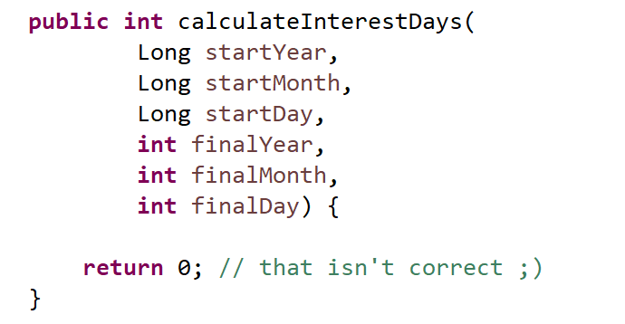
Partition: Example

Slide 67
Partition: Example
Month: 1, 12, 6 -1, 13, MAX_LONG null

Slide 68
Partition: Example
Month: 1, 12, 6 -1, 13, MAX_LONG null
Year: 0, 2000, 9999 2100, -9999 2020 (leap year) 2021 (non leap year)

Slide 69
Partition: Example
Month: 1, 12, 6 -1, 13, MAX_LONG null
Year: 0, 2000, 9999 2100, -9999 2020 (leap year) 2021 (non leap year) null
day: 1, 15, 31 -1, 0, 32, MAX_LONG null

Slide 70
Partition: Example
Month: 1, 12, 6 -1, 13, MAX_LONG null
Year: 0, 2000, 9999 2100, -9999 2020 (leap year) 2021 (non leap year) null
day: 1, 15, 31 -1, 0, 32, MAX_LONG null
combinations: Month 1, day 0, 15, 31, 32 Month 2, day 0, 14, 28
Leap year, Month 2, day 28, 29
Non Leap year, Month 2, day 28, 29
Same Day >>> Month 1, Day 1, Year 2100 second value equal

Slide 71
Structure for test: „Triple A“-Pattern
Arrange the preconditions
Act on the test object
Assert the results
Given a precondition
When a thing happens
Then a result should be observable

Slide 72
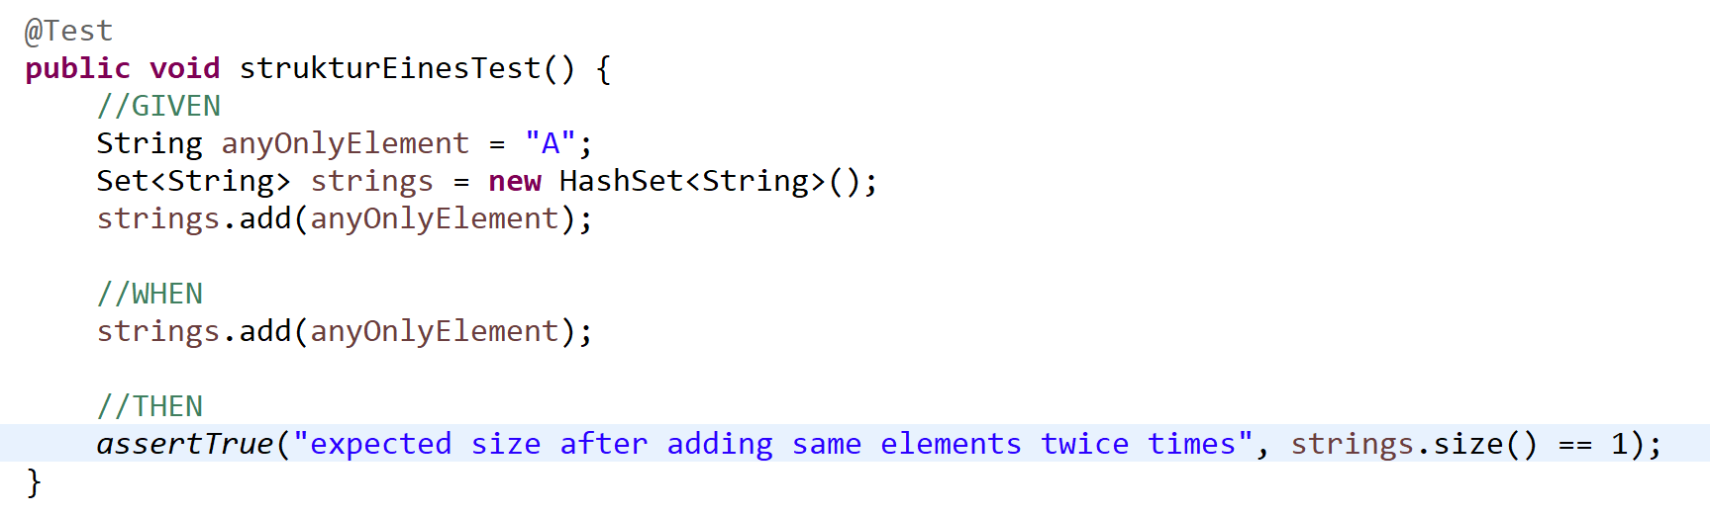
teststructure: „Triple A“-Pattern
Arrange the preconditions
Act on the test object
Assert the results
Given a precondition
When a thing happens
Then a result should be observable

Slide 73
Cutback 1
Quality
Absence of deficits
Absence of bugs
Typical software Quality terms
Robustness
Efficience
Effectife
Reliability

Slide 74
Cutback 2
Errors in software
Requirements
Unclear
Complex
incomplete
Design
Error
Not understand
Architecture
Error
No understand
Code
Complex
Errors
Unpredictable behaviour sometime
QA (quality assurance)
Defining quality guards
Ensure, that the product meets these guards
Improving over the lifecycle
Making tests
Try to make fails
Ensuring the correctness of the software
Testing can only show the precence of errors, never their absence.

Slide 75
Cutback 3
Focus for unit-tests
Subject under test (SUT)
Only the class / method / function
Rules for unit-tests
Test only one thing in one test
Tests must be undependent
Think about good names

Slide 76
Cutback 4
Structure in tests
Triple „A“-pattern
(Arrange) GIVEN a
(Act) WHEN a
(Assert) THEN a
Input-values for tests
Find partitions of equals values
Null-value
Zero (0)
Boundaries
Above boundaries
More inputs: equal inputs

Slide 77
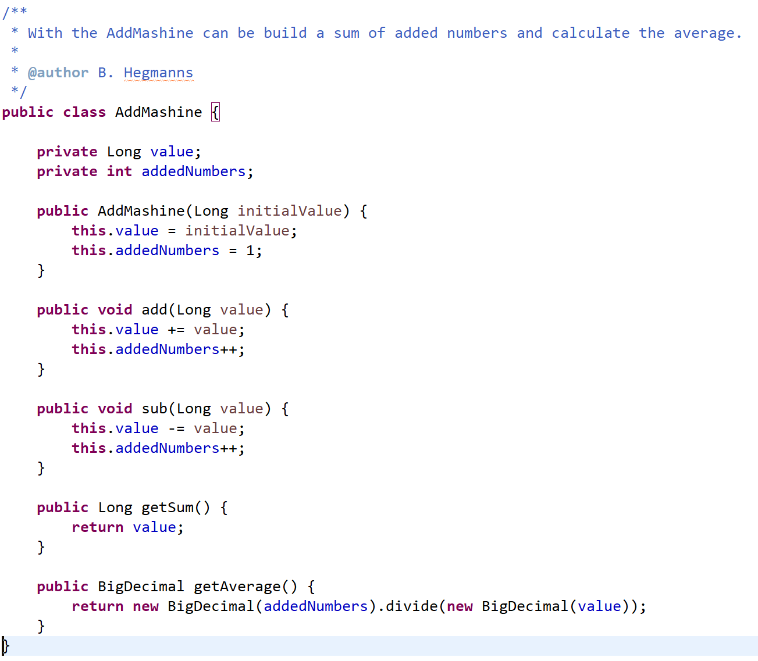
Tests: what are possible tests? How many tests are recommendable?
de.hegmanns.tdd.task04.AddMaschine
Notes:
Vollständige Induktion

Slide 78
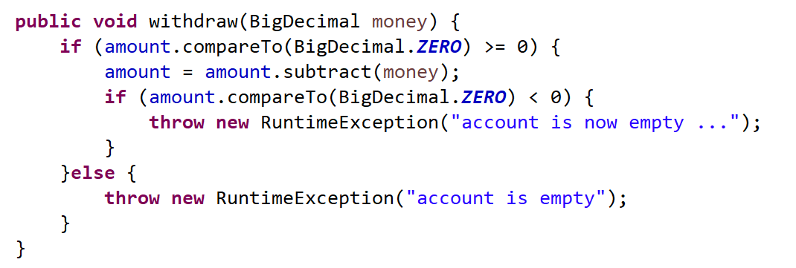
Coverage

Slide 79
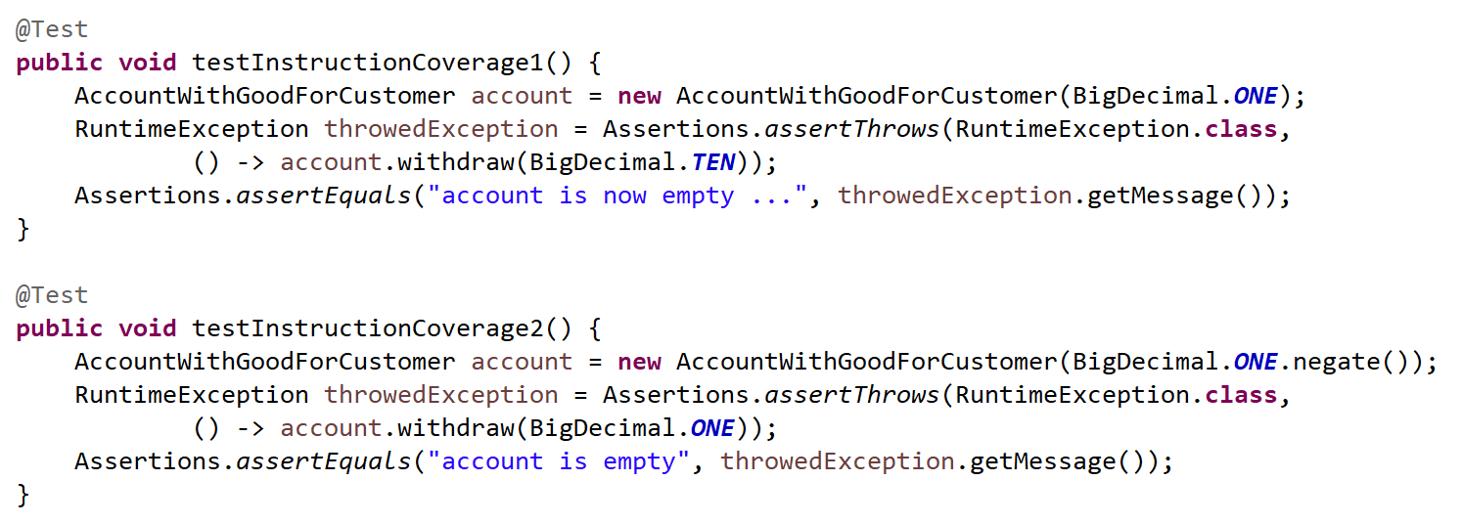
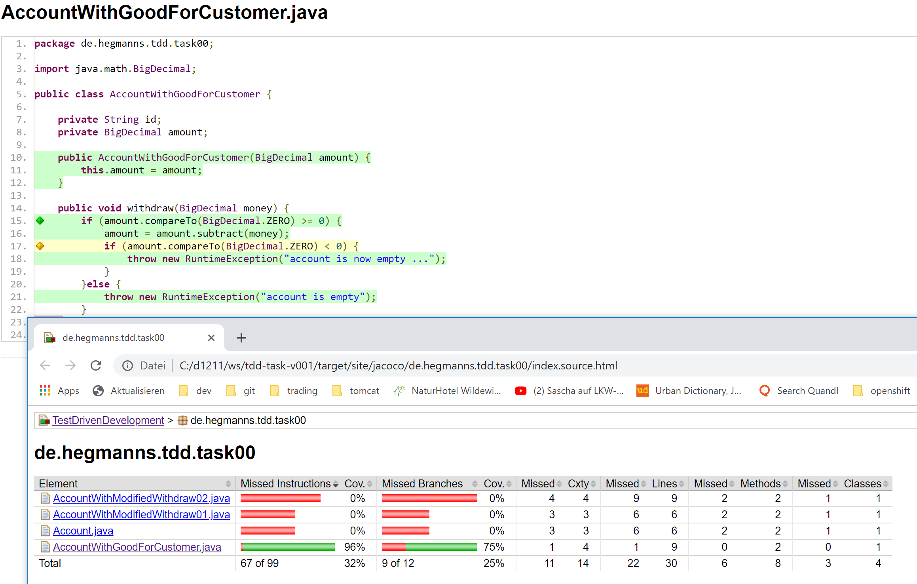
Coverage: statement

Slide 80
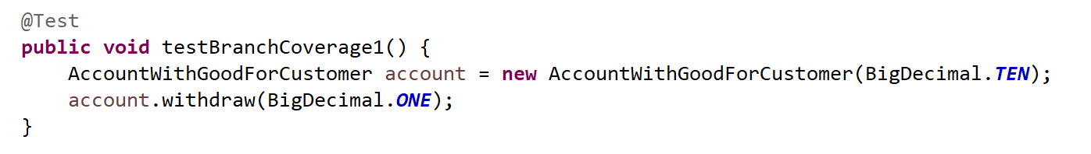
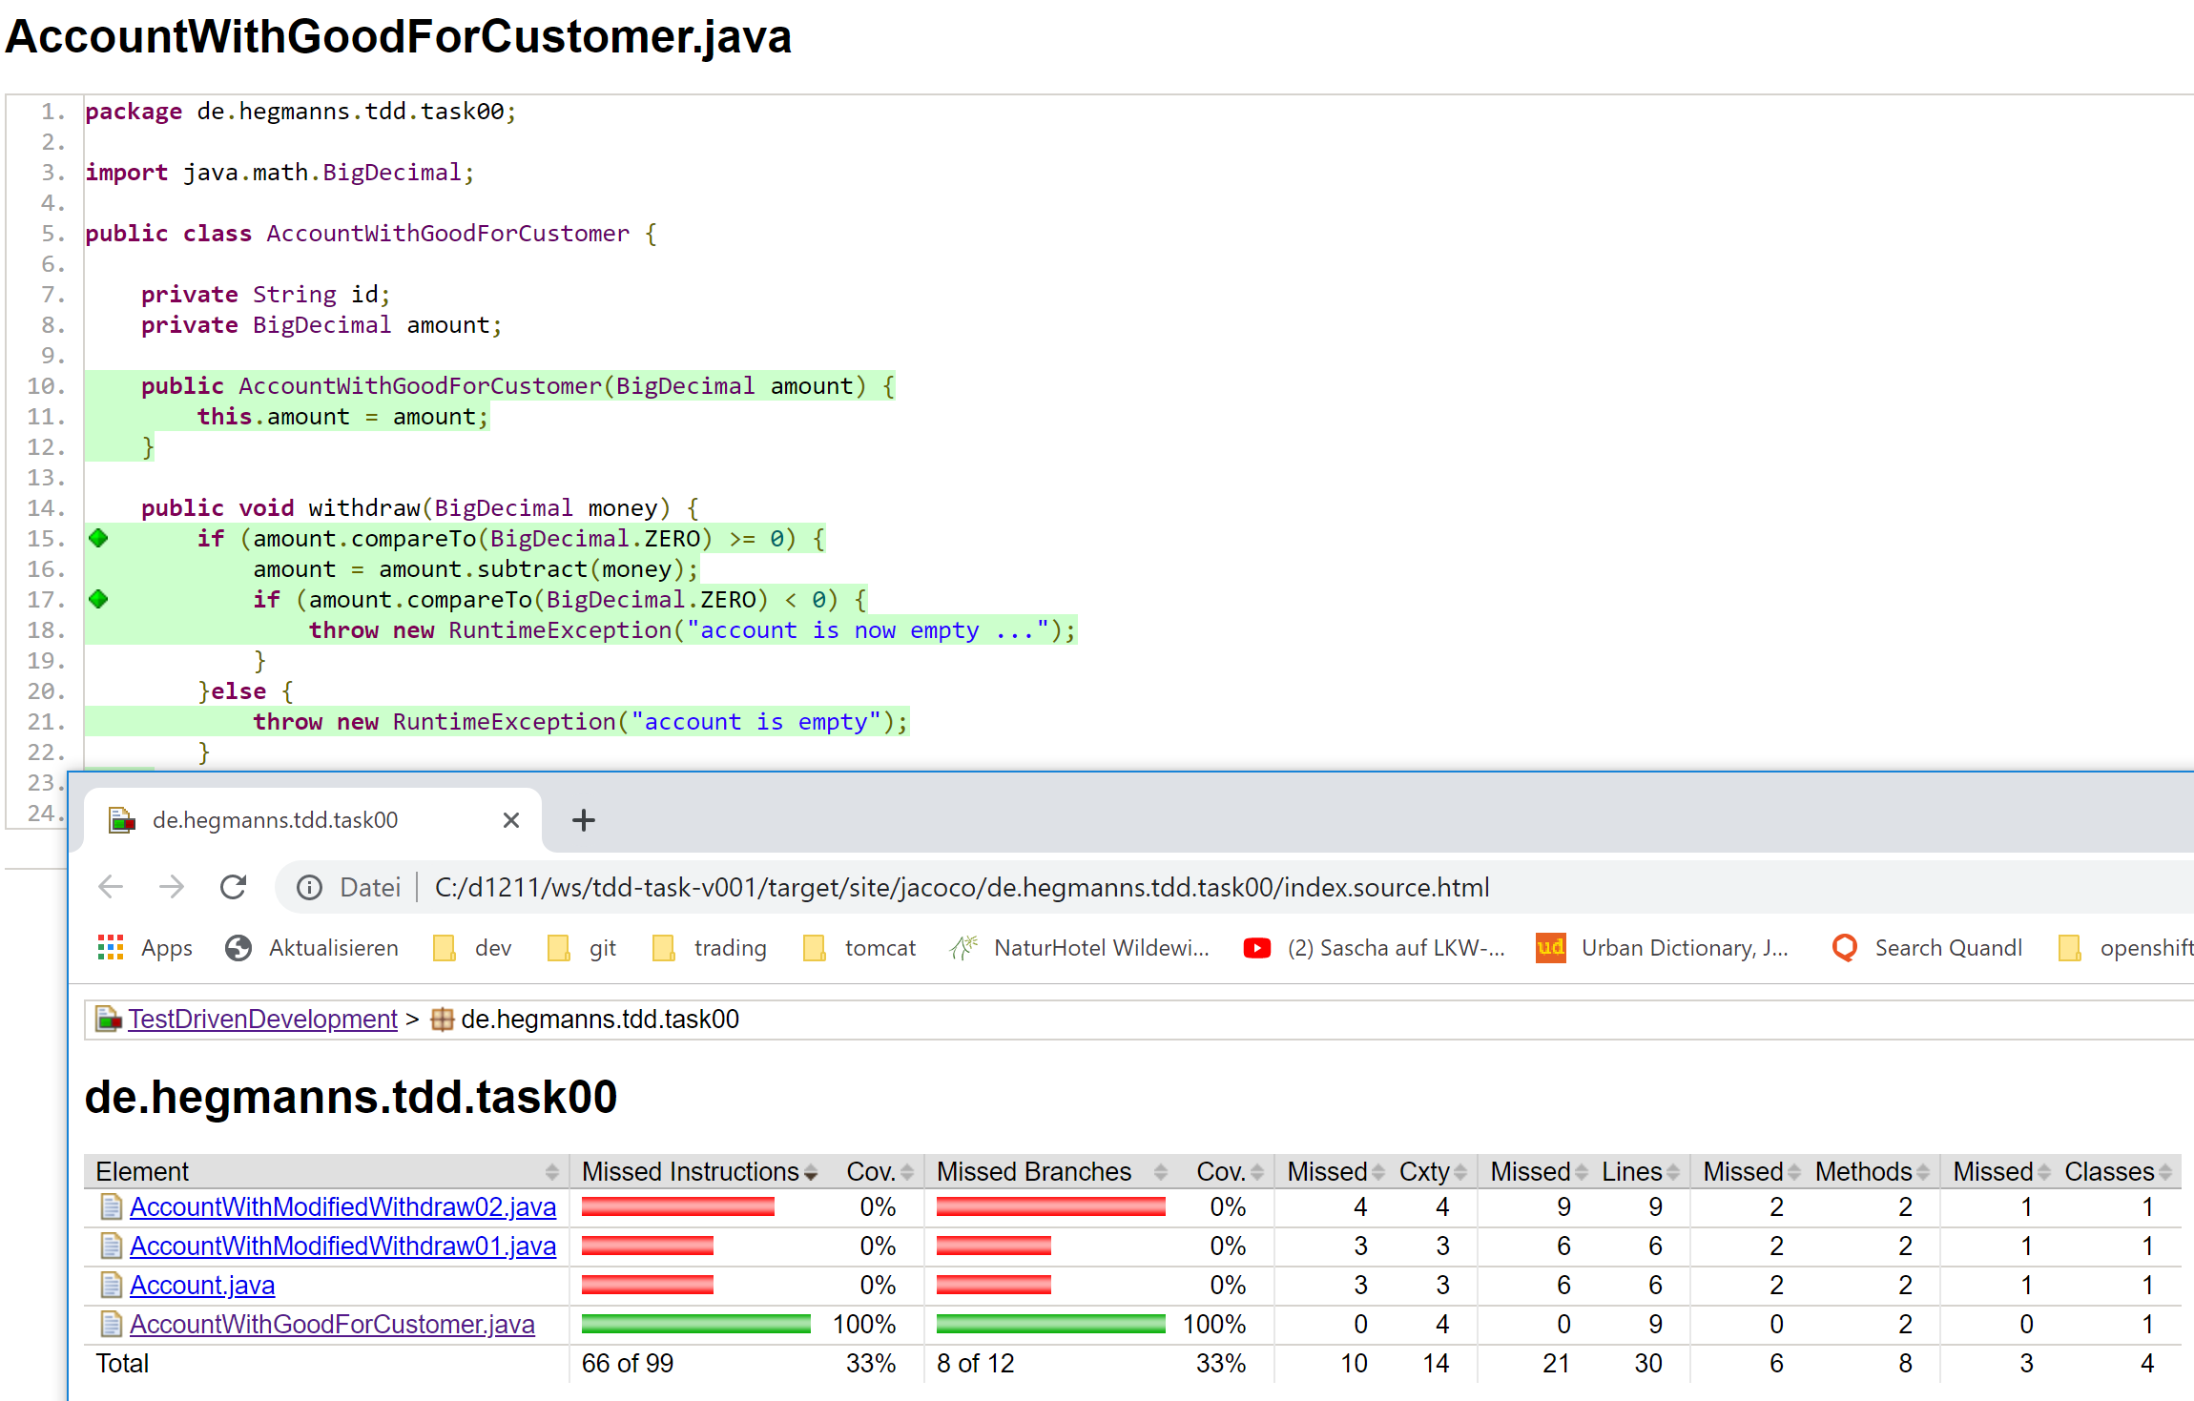
Coverage: branch and path

Slide 81
Some words of coverage metric
100% coverage says nothing
Are all important boundaries tested?
Are all related partitions considered?
A lazy and good developer can make 100% coverage in an easy way …
Impact for a good quality statement
Combine test with code revision / pair programming
Define quality guard, like „a commit may not decrease coverage“

Slide 82
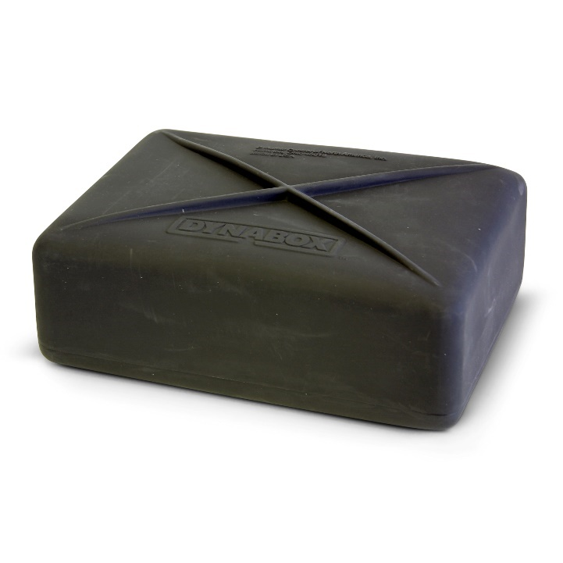
Black-box tests
Oriented on behave without focus on implementation
Check output by given input
Based on specification

Slide 83
White-box tests
Oriented in structure / implementation
Needs programmcode / plan / activity-plan
Based on source code

Slide 84
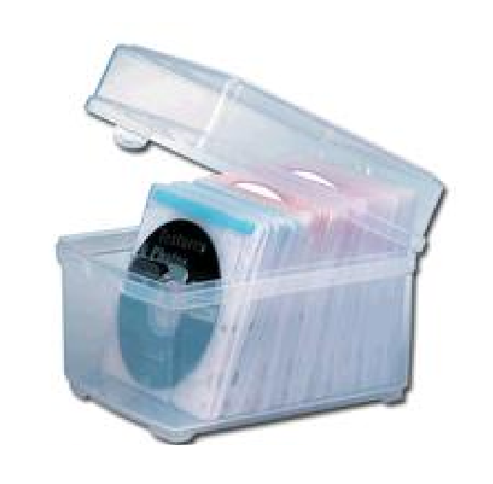
White-box tests
Oriented in structure / implementation
Needs programmcode / plan / activity-plan
Based on source code
Covers the code-specification
More fitting picture for white box test …

Slide 85
Black box test: methods
Functional test
Smoke test
Sanity test
Regression test
User acceptance test
Integration test
Non-functional test
Usability test
Load test
Performance test
Stress test
Scalability test
Compatibility test
Notes:
If we take an Example to test our car or bike, we always drive it to make sure that it doesn’t behave in an unusual way. See? We already have done black box testing.

Slide 86
white box test: methods
Basis path test
Data flow test
Path test
Loop test
Notes:
If we take an Example to test our car or bike, we always drive it to make sure that it doesn’t behave in an unusual way. See? We already have done black box testing.

Slide 87
JUNIT 4 / 5

Slide 88
Junit 4
A unit-test framework for java
Monolithic
You can combine junit with other techniques
Spring
Java/Jacarta EE
Extendible
… with limits

Slide 89
Junit 5
A unit-test framework for java
Modularized
Extendible
Compatible with junit4
Based on JAVA 8

Slide 90
JUNIT5 dependencies
<junit.jupiter.version>5.3.0</junit.jupiter.version>
<dependency>
<groupId>org.junit.jupiter</groupId>
<artifactId>junit-jupiter-api</artifactId>
<version>${junit.jupiter.version}</version>
<scope>test</scope>
</dependency>
<dependency>
<groupId>org.junit.jupiter</groupId>
<artifactId>junit-jupiter-engine</artifactId>
<version>${junit.jupiter.version}</version>
<scope>test</scope>
</dependency>

Slide 91
JUNIT5: parameterized tests
<junit.jupiter.version>5.3.0</junit.jupiter.version>
<dependency>
<groupId>org.junit.jupiter</groupId>
<artifactId>junit-jupiter-params</artifactId>
<version>${junit.jupiter.version}</version>
<scope>test</scope>
</dependency>

Slide 92
JUnit5-Architektur
JUnit4-Tests
JUnit5-Tests
Other Tests
Vintage
Jupiter
3d party
Platform
Tools

Slide 93
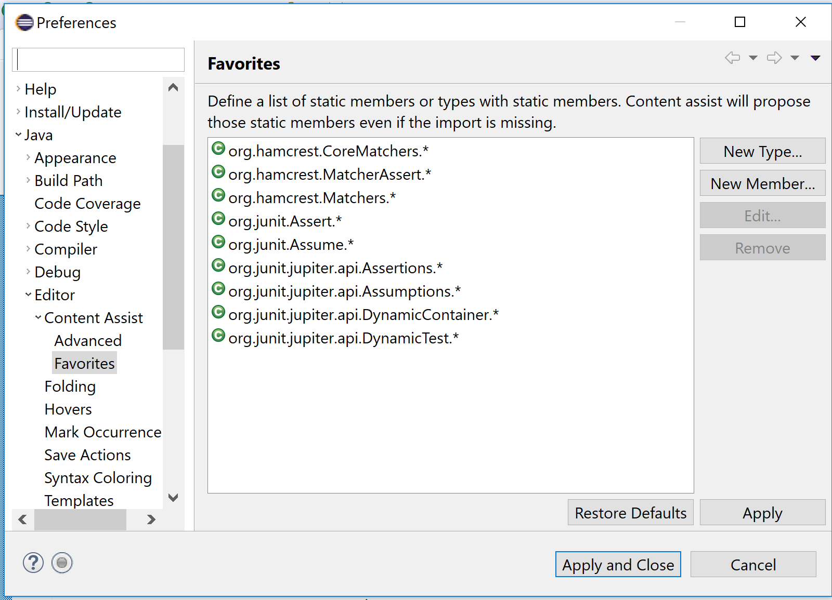
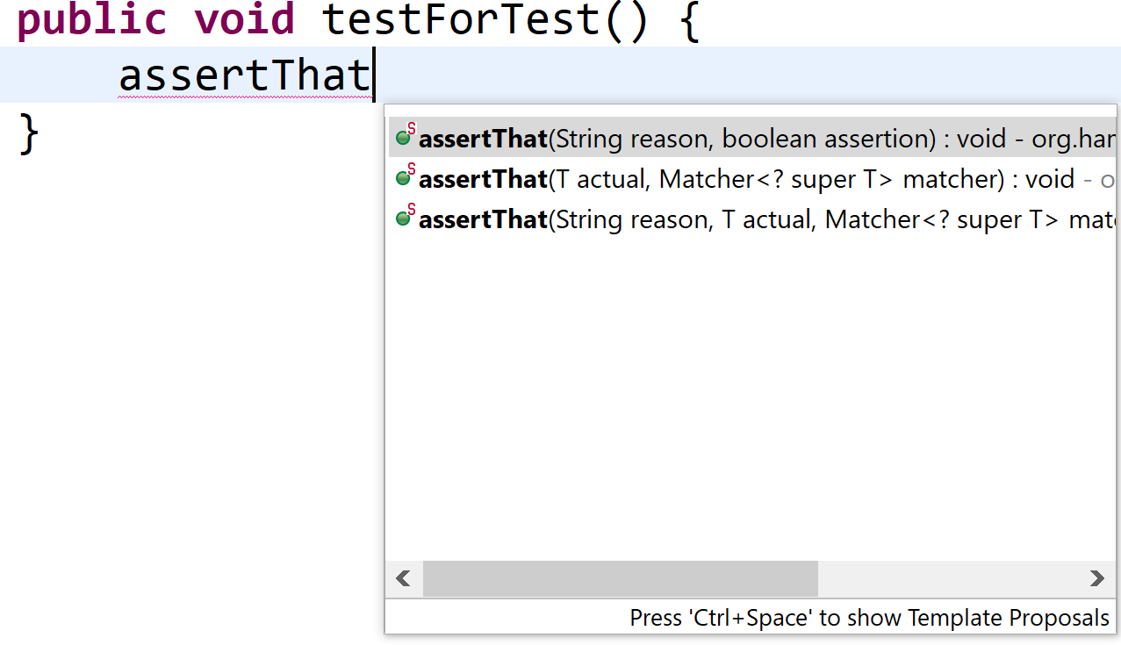
Auto-Import in Eclipse

Slide 94
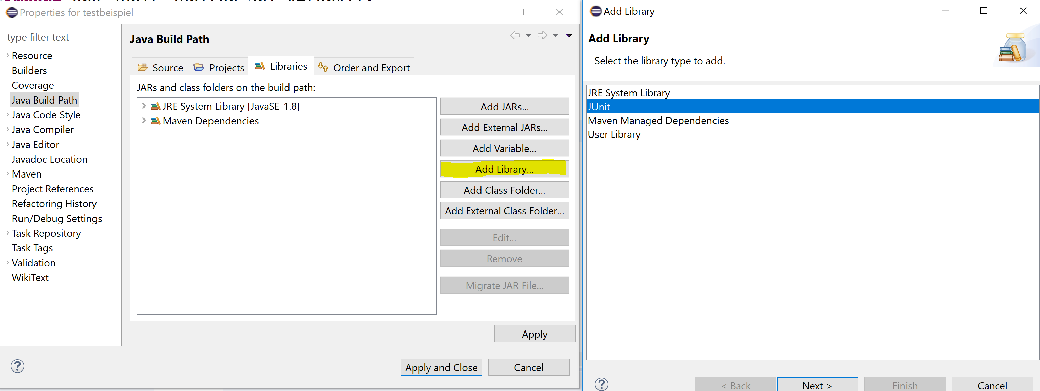
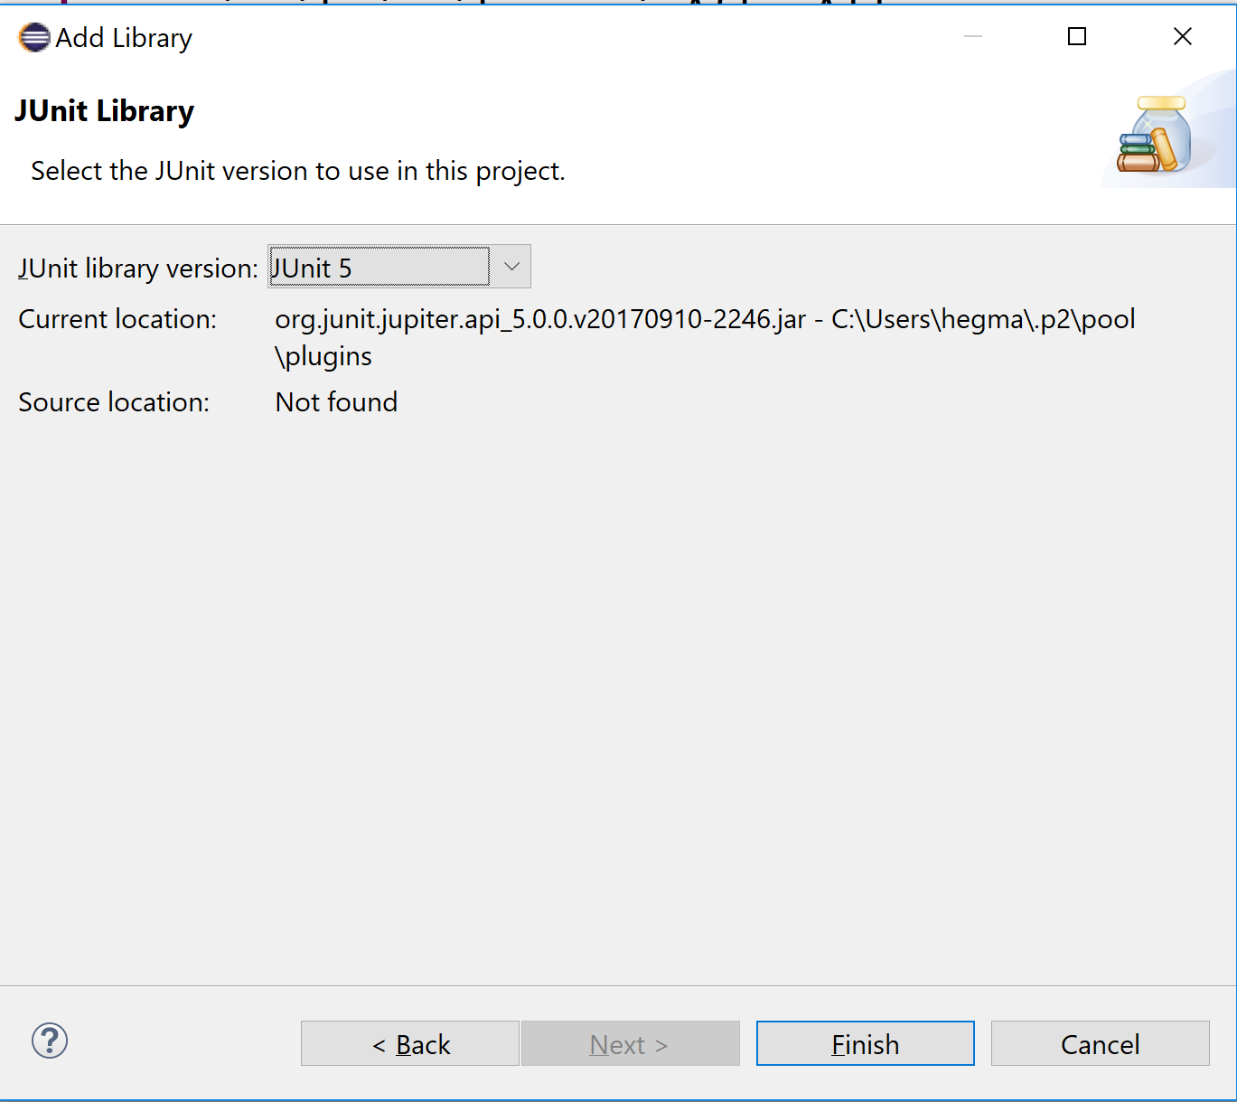
JUnit5-Launcher (in new Eclipse-versions)

Slide 95
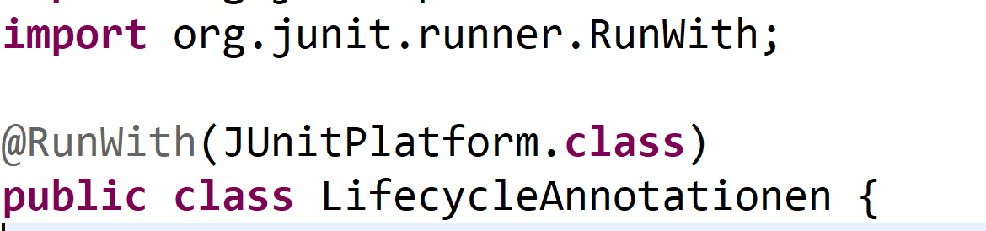
Using JUnit4-Launcher (for older Eclipse-Versionen bzw. Launcher)

Slide 96
HELPFUL für TDD: Shortcut
In focus of TDD:
Quick retest
Code and test
Well used shortcut „Ctrl+F11“ (Relaunch last Run)

Slide 97
What make junit4 / 5
See a class as a test
Condition: At least one method is annotated with „Test“
Junit 4: org.junit.Test
Junit 5: org.junit.jupiter.api.Test
All with @Test annotated methods are proceeded by the test runner
Als procceded tests are shown in the test runner windows

Slide 98
Typical challenge in junit
Comparing with expected value
Result of a method-call with expected result
A method-call changed properties of an object
A method-call throws an exception
A method-cal creates an event

Slide 99
Assertions / Checks
By using junit 5: „org.junit.jupiter.Assertions“
Very large
Third-Party: hamcrest
Talking syntax
Typesafe
Typesafe assertions
Extendible

Slide 100
JUnit5-Assertions
org.junit.jupiter.api.Assertions
May assert-methods
AND-link of asserts:
Assertions.assertAll(…..)

Slide 101
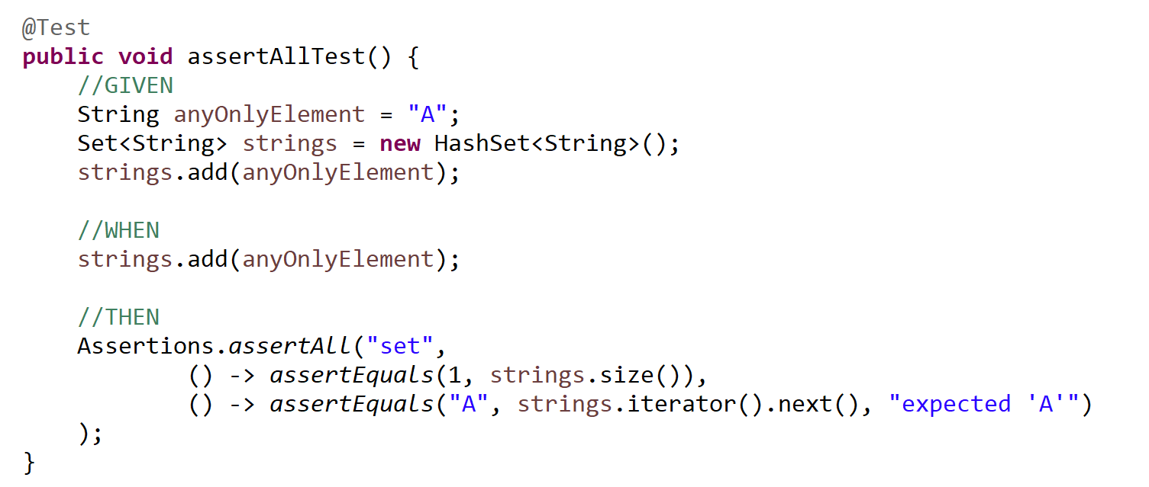
Assertions.assertAll

Slide 102
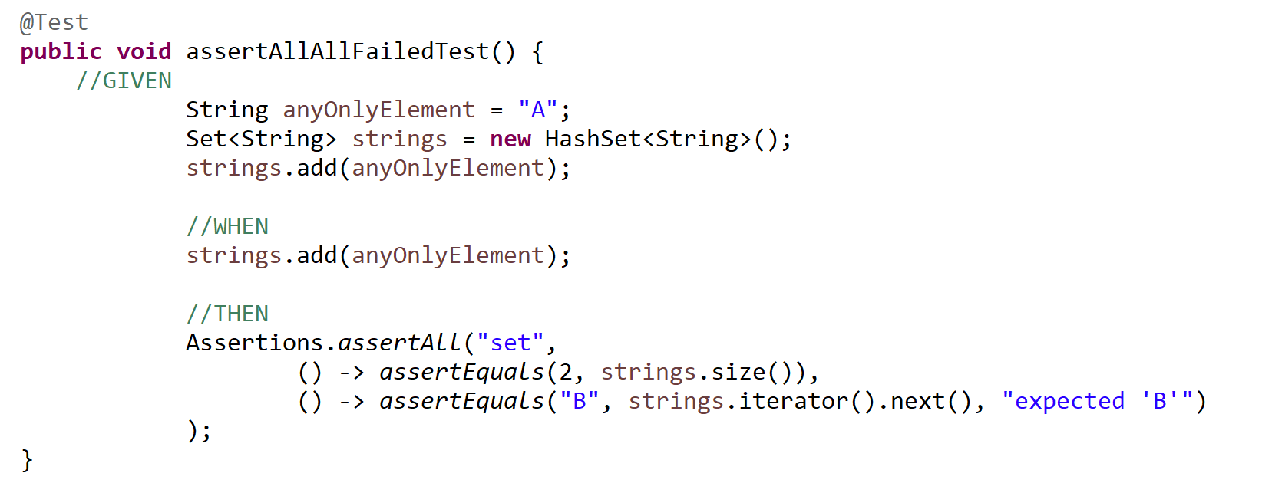
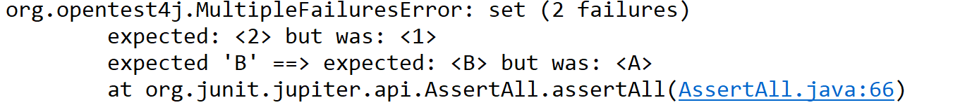
Assertions.assertAll: more asserts

Slide 103
Assertions.assertAll: more assert
Be carefull mit testing more than one assert in one test(method).
One test(method) should only test ONE aspect.
Sometimes it is a good idea testing more than one aspect.
note

Slide 104
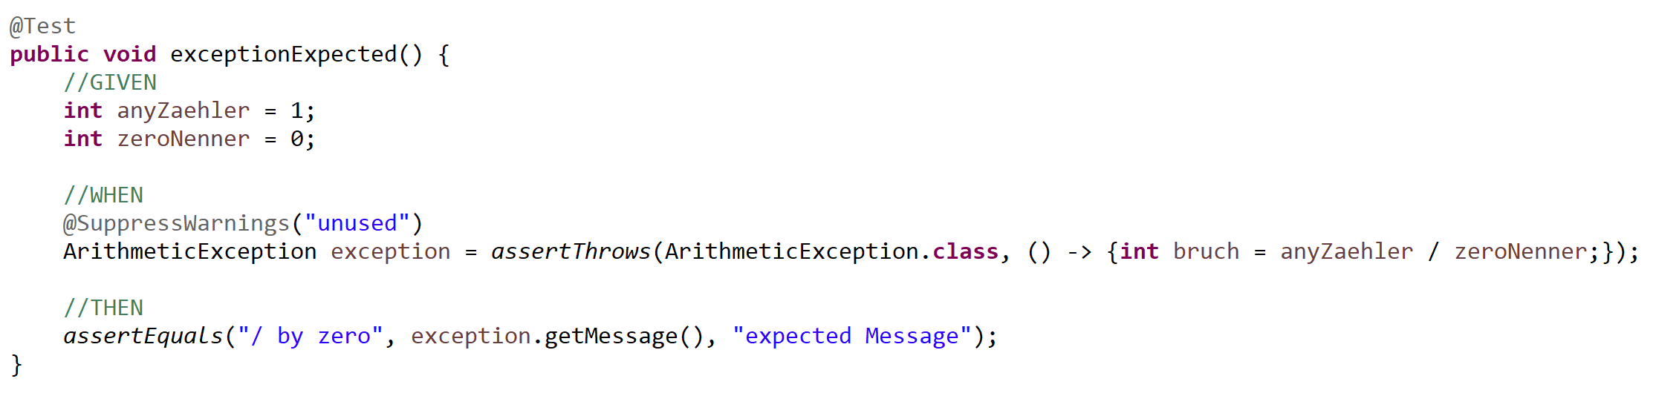
Assertions.assertThrows
Expected Exception
… and you can use it

Slide 105
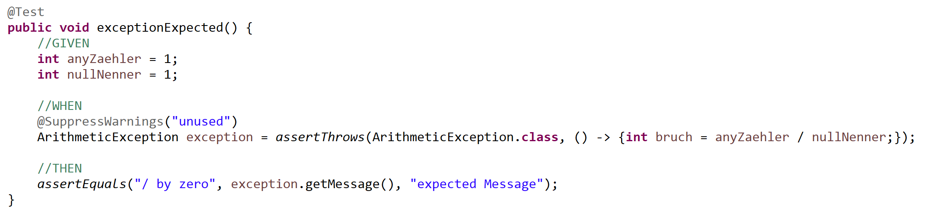
Assertions.assertThrows

Slide 106
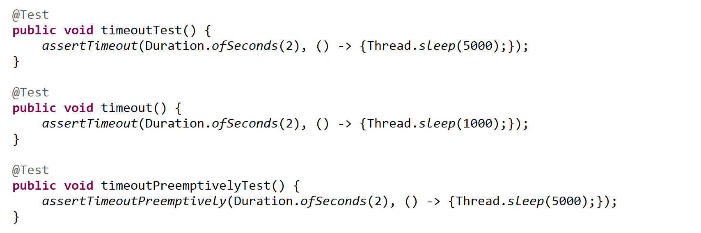
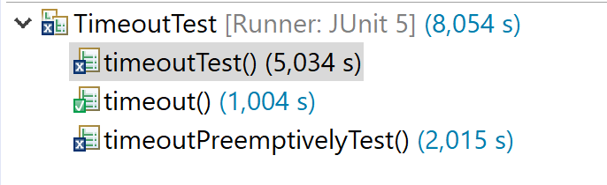
Assertions.assertTimeout
Max proceed time
With waiting (assertTimeout)
Without waiting (assertTimeoutPreemptively)

Slide 107
Unit-tests
Unit-Test tests a concrete object/method
Well known as „SUBJECT UNDER TEST“ (SUT)
Rules for unit-test
Only test the SUBJECT UNDER TEST (not other objects)
Only test one thing (output, …) (make more tests)
Do not test with environment
Do not test with database

Slide 108
Good name inside unit-test
Name should describe the use-case
No continuing numbers
No fantasy names
Use possible width
Length of names
Width of monitor
Test-classes and methods must not satisfy codestyle rules (PMD)

Slide 109
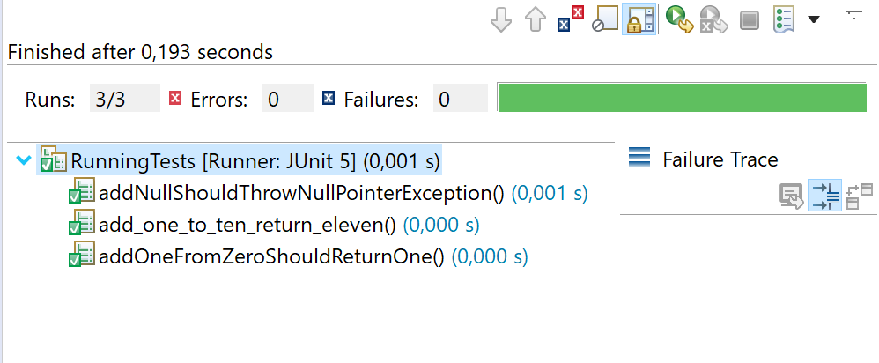
Good name inside unit-test
Examples
public void addOneFromZeroShouldReturnOne() public void addNullShouldThrowNullPointerException() public void add_one_to_ten_return_eleven()

Slide 110
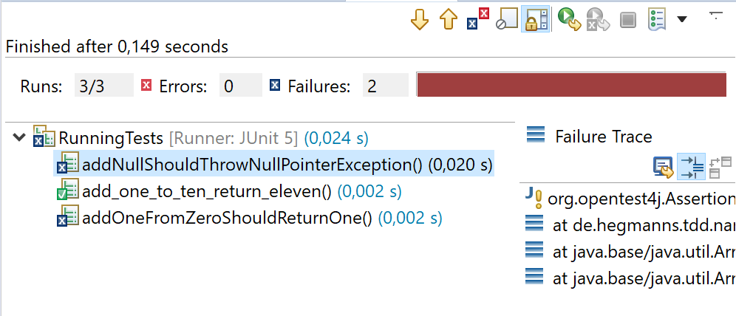
Good name inside unit-test
Examples
public void addOneFromZeroShouldReturnOne() public void addNullShouldThrowNullPointerException() public void add_one_to_ten_return_eleven()

Slide 111
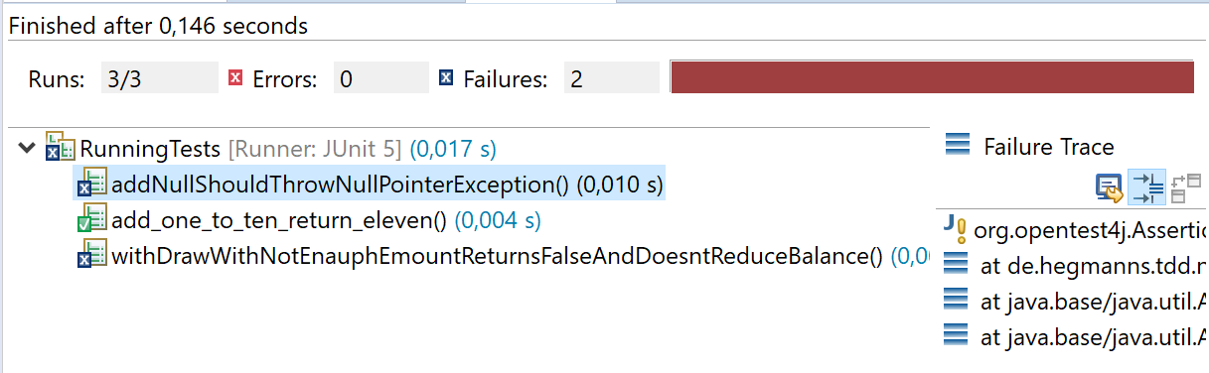
Unit-test idea: look the test-result und you know all
Looking into the test or stack-trace wastes time.

Slide 112
Typical work in a junit test
Call a method
Fetch the result
compare the fetched result with your expectation
Note
Before your call should be some preparations necesary (create instance, …)

Slide 113
Benefits of unit-tests
Precondition for refactoring
You must have sufficient tests
You may not have any red test
Your classes are testable
Its a sign of good design
Martin Fowler:
If you want to refactor , the essential precondition is having solid tests.

Slide 114
maintainable software with unittest
No untestet code
Clean architecture
Clean design
No redudancy
Precondition for refactoring

Slide 115
From problem/use-case to solution with unit-test
No solution on stock
No solution for future (and unknown) problems
No code on stock
You do only just necessary

Slide 116
Rules for developing
You make a blind flight without unit-test
New features
bugfix
refactoring
Make a RED test. Note: Without red test no change
Make changes
Check test for green.

Slide 117
TDD
Test Driven Design
An agile developing method
For quick results
For good results
Means: simple, clear
For testet results
Means: bug free

Slide 118
TDD-activities
Add a test
pass
Execute test
pass
fail
fail
Make code-changes

Slide 119
TDD process
Building the complete feature/requirement in very small steps
Plan the steps
Work the TDD-Lifecycle for every small step
Note
If you are working on a step and your test passes. Then the step is done.
If you are working on a step and you recognize heavy test-scenario. Think about refactoring. (but only for green test)

Slide 120
Cutback 1
Quality
Absence of deficits
Absence of bugs
Typical software Quality terms
Robustness
Efficience
Effectife
Reliability

Slide 121
Cutback 2
Errors in software
Requirements
Unclear
Complex
incomplete
Design
Error
Not understand
Architecture
Error
No understand
Code
Complex
Errors
Unpredictable behaviour sometime
QA (quality assurance)
Defining quality guards
Ensure, that the product meets these guards
Improving over the lifecycle
Making tests
Try to make fails
Ensuring the correctness of the software
Testing can only show the precence of errors, never their absence.

Slide 122
Cutback 3
Focus for unit-tests
Subject under test (SUT)
Only the class / method / function
Rules for unit-tests
Test only one thing in one test
Tests must be undependent
Think about good names

Slide 123
Cutback 4
Structure in tests
Triple „A“-pattern
(Arrange) GIVEN a
(Act) WHEN a
(Assert) THEN a
Input-values for tests
Find partitions of equals values
Null-value
Zero (0)
Boundaries
Above boundaries
More inputs: equal inputs

Slide 124
Cutback 5
Everytime make one red test at least
If you have to fix a bug
If you habe to add a new feature
Integrate making better code (refactoring)
Only when ALL tests are green

Slide 125
Cutback 6
TDD-Process
Add a test
Execute the test
Change code for solving test
Execute ALL tests
If other tests fail
Check of the inputs and expectations of these tests are still correct
Check if further changes are needed in code

Slide 126
Cutback 7
Advantages of TDD
Everything is tested (high coverage)
Simple solution for your problem
Easy design
Easy integration of redesign

Slide 127
TDD-step example
The password-checker only accepts passwords between 5 and 10 characters (inclusive)
What are good tests?
(Remember equivalence classes)

Slide 128
Testing more than one class
Junit-test may only test one method
You do not know what fails if fail
But sometime, a method needs some other objects …
If you tests all objects, results depend from the result those objects

Slide 129
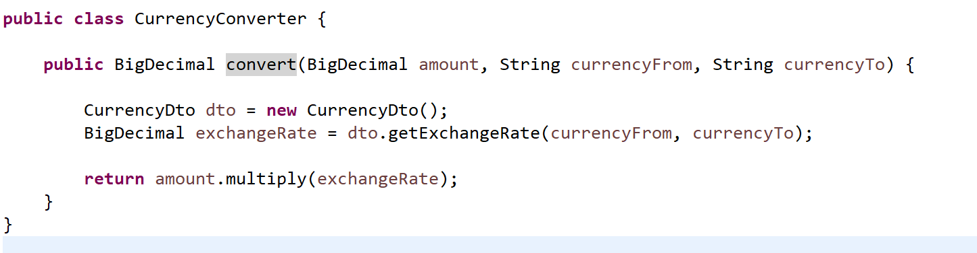
More Objects: Example
Result depends vom current rate
You do not know the current result (without looking for current rate)
You have to change the expected result in tests

Slide 130
Testing more than one class
Junit-test may only test one method
You do not know what fails if fail
But sometime, a method needs some other objects
Refactoring
Use defined objects with defined results (proxy-objects)

Slide 131
Proxy-Objects or Mocks
A Proxy-Object is a deputy for an other object with defined behave.
You make your tests predictable
A special DTO not connected with database or internet result the same result for every call. E.g. exchange rate ONE every time.

Slide 132
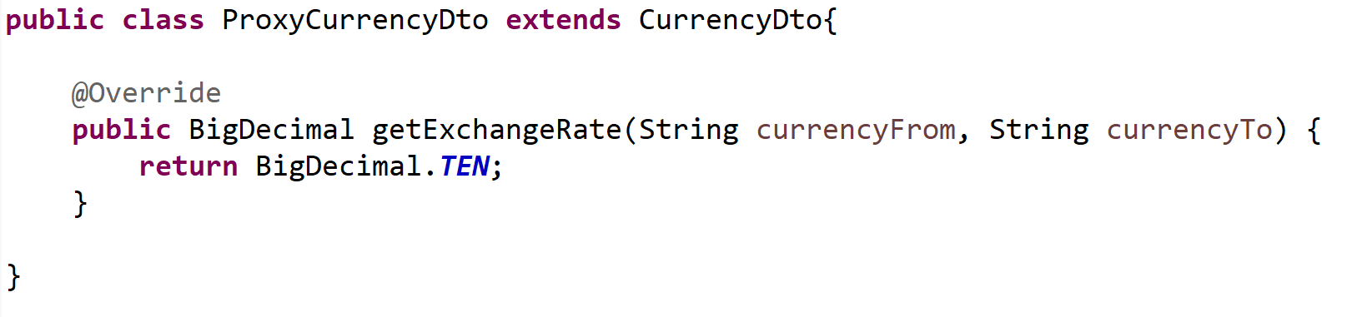
creating and using proxy objects
For integration the proxy you need to refactor the CurrencyConverter class

Slide 133
Benefits for using proxies
You test only your SUT
You get a good design
You use delegating
You use polymorphy

Slide 134
Mock
Self created proxies
For easy output easy to build
For complex and changing output complex
solution
Mock-Frameworks (mockito, easymock) Proxy objects with integrated logic
The logic can be called in various situations
Predefining output for the same proxy/mock
Predefining behave for the came proxy (e.g. throwing exception)

Slide 135
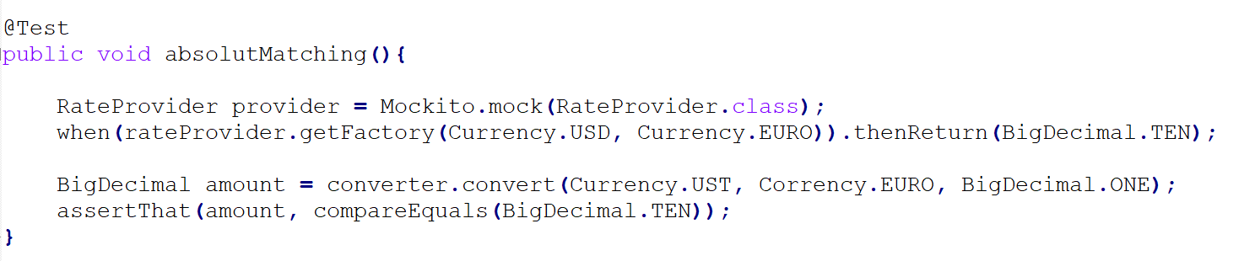
Mock example

Slide 136
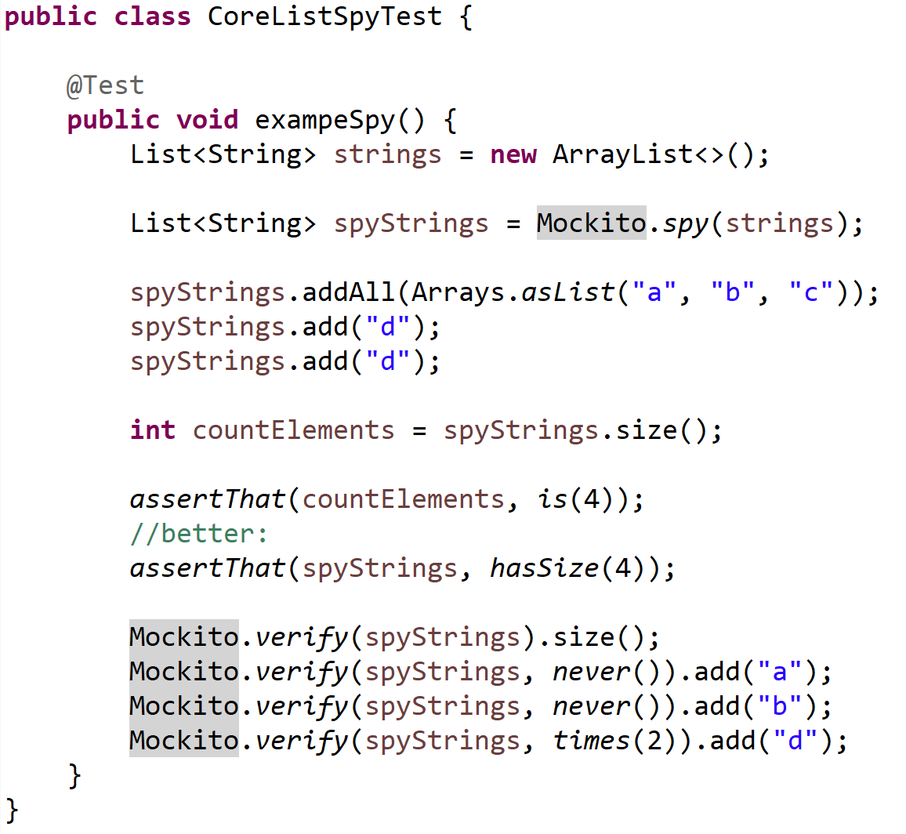
Mock: other features
Mock checks execution
Mock checks order of execution

