Slide 1

CSC415 Operating System Principles
Introduction
Professor Hao Yue
Fall 2017

Slide 2

Outline
What is OS
Computer System Organization
OS Structure
OS Operation and System Calls
Process Management
Memory Management
Storage Management

Slide 3
What Is an OS
Four components of computer system
Hardware: provides basic computing resources
E.g., CPU, memory, I/O devices
Operating System
System Programs: application-independent programs which manage the operation of the computer
E.g., compilers, assembler, command interpreter
Application Programs: define the ways in which resources are used to solve users’ computing problems
Application Programs
System Programs
OS
Hardware

Slide 4
What Is an OS
Two Functions:
OS as an extended machine
Hide the complexity of hardware and present an extended machine that is easier to use
OS as a resource allocator
Efficiently and fairly allocate resources among the programs competing for them
Notes:
Basic commands such as read and write may require 13 parameters, which specify the address of the disk block to be read, the number of sectors, the recording mode, etc. The return value consists of 23 status and error fields. It is clear that programmers do not want to handle such details. What they want is a simple, high-level abstraction to deal with. In the case of disks, a typical abstraction would be the disk contains a collection of named files. Each file can be opened for reading and writing, and closed. OS hides the truth about the hardware from the programmer and presents a simple interface for programmer and user. (top-down view)
(Bottom-up view): modern computers have resources such as processors, memories, disks, etc. single-user case and multi-user case

Slide 5
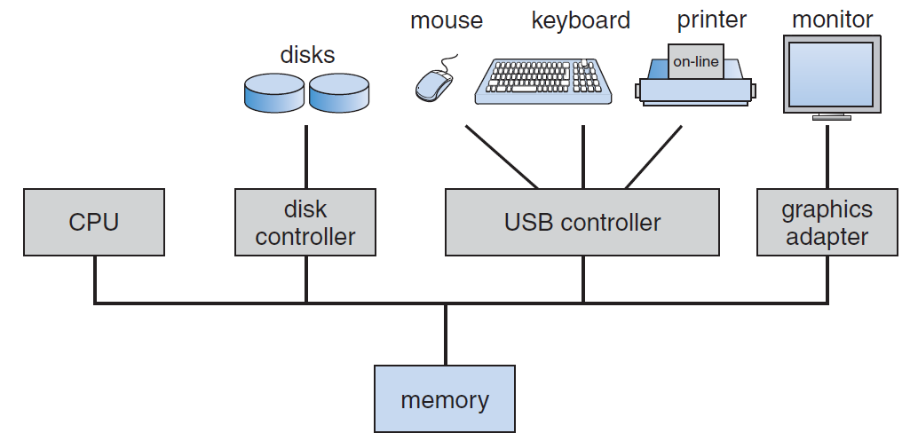
Computer System Organization
A modern computer system
Consists of one or more CPUs and a number of device controllers connected through a common bus that can access shared memory
CPUs and device controllers can execute in parallel and compete for memory cycles

Slide 6
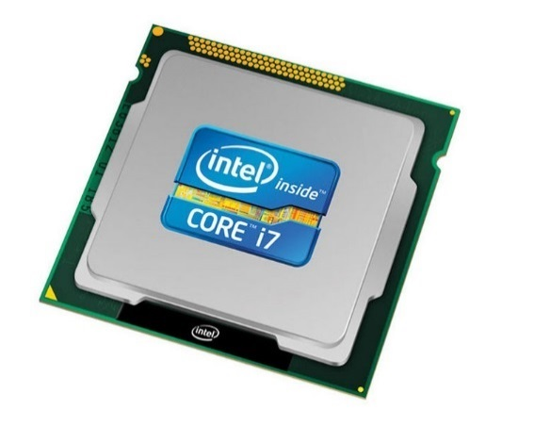
Single-Processor Systems
Single-Processor Systems
One main CPU capable of executing a general-purpose instruction set, including user programs
Can also have special-purpose processors, e.g., device controllers, which run a limited instruction set and do not run user programs

Slide 7
Multi-Processor Systems
Multi-Processor Systems
Have two or more general-purpose processors in close communication, sharing the computer bus and other resources
Advantages:
Increased throughput: Get more work done in less time
Economy of scale: Cost less than equivalent multiple single-processor systems
Increased reliability: Slow down rather than died
Multicore: multiple computing cores on a single chip
In 2010, Intel unveiled 48-core processor for cloud computing
Notes:
More efficient than multiple chips with single core because on-chip communication is faster than between-chip communication.

Slide 8
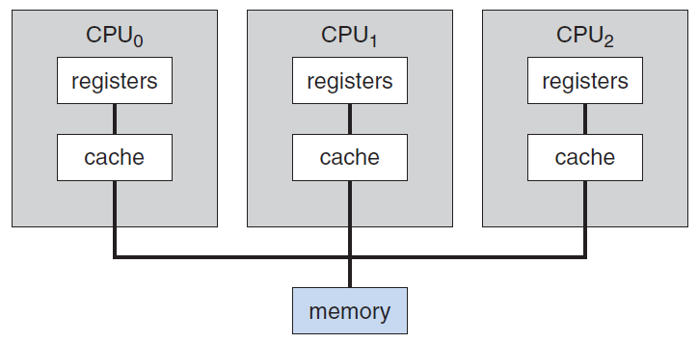
Multi-Processor Systems
Two kinds of Multi-Processor Systems
Asymmetric multiprocessing
A boss processor controls the system. It schedules and allocates tasks to work processors
Symmetric multiprocessing (SMP)
Processors share all tasks within the OS
Notes:
Capitalism socialism

Slide 9
Clustered Systems
Clustered Systems
Consists of two or more individual systems. Each of them can be a single-processor system or a multi-processor system
Clustered computers share storage and are connected via a fast network
Provide high-availability service: service will continue even if one or more systems in the cluster fail
Provide high-performance computing

Slide 10
Storage Structure
Main Memory
Only large storage media that the CPU can directly access
Provide an array of bytes. Each one has its own address.
Volatile device that loses its content when power is turned off
Secondary Storage
An extension of main memory to hold large volume of data permanently
E.g., magnetic disk
Other storage systems
E.g., cache, magnetic tapes, etc.

Slide 11
I/O Structure
A computer system consists of CPUs and device controllers that are connected through a common bus
Each device controller is in charge of a specific type of device. It also maintains some local buffer storage.
The device controller moves data between the controlled devices and its local buffer
CPU moves data between the main memory and local buffer of device controller

Slide 12
OS Structure
Multiprogramming
Observation: a single program cannot keep either the CPU or the I/O devices busy at all times
In a multiprogramming system, OS keeps several jobs in memory simultaneously. When a job has to wait for I/O operation, the CPU switches to and run another job
Increase CPU utilization
Involve CPU scheduling, memory management, etc.

Slide 13
OS Structure
Dual-Mode of OS
Goal: distinguish between the execution of OS code and user code
Two modes: user mode and kernel mode
Mode bit is used to indicate the current mode
Dual-mode protects OS from errant users
Some machine instructions are designated as privileged instructions, which are only allowed to be executed in kernel mode
When a system call is invoked, the mode changes to kernel mode; when it is finished, the mode returns to user mode

Slide 14
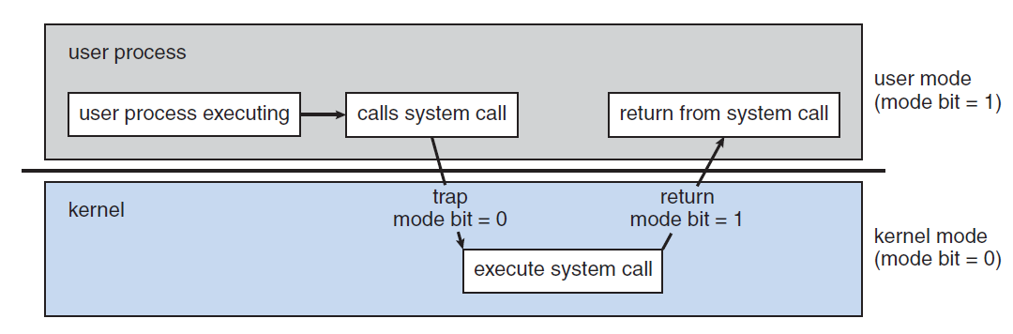
OS Structure
Dual-Mode of OS
Goal: distinguish between the execution of OS code and user code
Two modes: user mode and kernel mode
Dual-mode protects OS from errant users
When a system call is invoked, the mode changes to kernel mode; when it is finished, the mode returns to user mode

Slide 15
OS Services
Services for the user
User interface (UI)
Command-line interface: text commands and a method for entering them are used
Batch interface: commands and directives to control those commands are entered into files, and those files are executed
Graphical user interface (GUI): a window system with a pointing device to direct I/O, choose from menu, and make selections
Program execution: load a program into memory, run the program, and end its execution

Slide 16
OS Services
File-system manipulation: read and write files and directories, create and delete them, search them, list file information, etc.
Communications: processes exchange information with each other
Services for ensuring efficiency of the system
Resource allocation: allocate resources to jobs running at the same time
Accounting: track usage statistics
Protection and security

Slide 17
System Calls
System calls provide an interface to the services of OS
Example: write a program to read data from one file and copy them to another file
Obtain the names of the input file and output file
Write a prompting message on the screen and then read from the keyboard
Open the input file and create the output file
Additional system calls to handle error conditions. E.g., the input file does not exist, the output file already exists, etc.
Read data from the input file and writes to the output file
Additional system calls to handle error conditions. E.g., hardware failure in read, no enough space to write data, etc.
Close both files, write a message to console, and terminate normally

Slide 18
System Calls
Most of time use API rather than direct system calls
System calls are often more detailed and difficult to work with than the API available to an application programmer
Three most common APIs
Win32 API for Windows
POSIX API for POSIX-based systems (e.g., UNIX, Linux, and Mac OS X)
Java API for Java virtual machine

Slide 19
System Calls
Process control
Create and terminate process, load and execute a program, end and abort, lock shared data, etc.
E.g., fork(), exit(), wait()
File management
Create and delete files and directories, open and close files, read from and write to files, determine and reset file attributes, etc.
E.g., read(), write(), open(), close()

Slide 20
System Calls
Device management
Request and release devices, read and write, determine and reset device attributes, etc.
E.g., read (), write()
I/O devices and files are similar and many OS use the same set of system calls on both of them
Information maintenance
Transfer information between a user program and OS, like time and date, debugging information, process information, etc.
E.g., getpid(), time(), dump()

Slide 21
System Calls
Communication
Two models for Inter-Process Communications: message-passing model and shared-memory model
Create and terminate communication connections, read and write messages, create and access shared memory, etc.
Protection
Access control to resources

Slide 22
System Calls
Example: read()
#include <unistd.h>
ssize_t read(int fd, void *buf, size_t count)
Read up to count bytes from the file with the descriptor fd into the buffer starting at buf
On a successful read, the number of bytes read is returned. A return value of 0 indicate end of file. If an error occurs, read() returns -1.

Slide 23
System Calls
Example: write()
#include <unistd.h>
ssize_t write(int fd, const void *buf, size_t count)
Write up to count bytes to the file with the descriptor fd from the buffer starting at buf
fd = 1 for standard out
On a successful write, the number of bytes written is returned. A return value of 0 indicate nothing is written. If an error occurs, write() returns -1.

