Slide 1
Announcement
The deadline of Coding Assignment 2 is extended to the end of today
Notes:
Jetlag

Slide 2

Last Time
Inter-Process Communication
Shared memory
Message passing

Slide 3

CSC415 Operating System Principles
Threads
Professor Hao Yue
Fall 2017

Slide 4

Outline
Motivation
Multicore Programming
Thread Libraries

Slide 5
Motivation
A thread is a basic unit of CPU utilization
Consist of a thread ID, a program counter, a register set, and a stack
Share code section, data section, and resources with other threads in the same processes
Most modern applications are multithreaded
E.g., word processor, Web browser, …
Most OS kernel are also multithreaded
Process creation is more time consuming and resource intensive than thread creation
Notes:
An application may perform several similar task. E.g., web server accepts client requests. It can serve multiple clients at the same time. Traditional method: when the server receives a request, it creates a separate process to service the request. Process creation is time consuming and resource intensive. More efficient way is to use threads.
Most applications running on modern computers are multithreaded. A word processor may have a thread for displaying graphics, another thread for responding to keystroke from user, third thread for performing spelling and grammar checking in the background. It is more efficient to use one process that contains multiple threads.

Slide 6
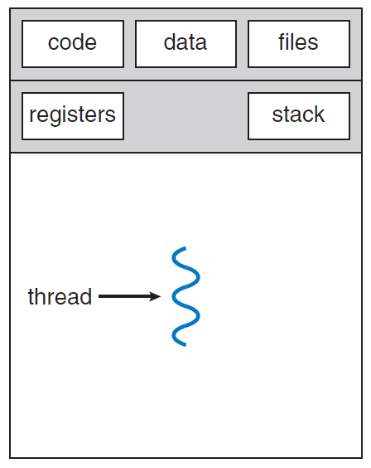
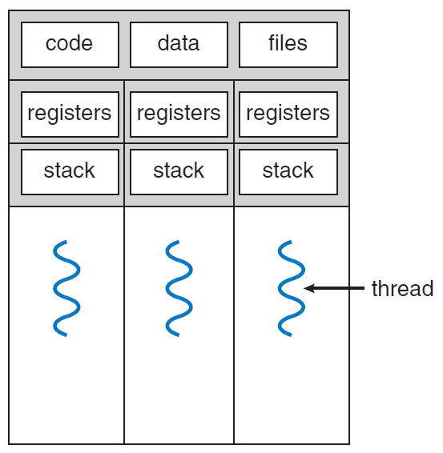
Motivation
A thread is a basic unit of CPU utilization
Single-threaded Process
Multithreaded Process

Slide 7
Motivation
Benefits
Responsiveness
Multithreading allows a program to continue running even if part of it is blocked or performing a time-consuming operation
Resource sharing
Threads share memory and resources by default, which is easier than shared memory and message passing
Economy
It is more economical to create and context-switch threads than processes
Scalability
Threads can be running in parallel in multi-processor architecture
Notes:
If a user clicks a button to run a time-consuming operation, a single-threaded application would be unresponsive until it has completed. In contrast, it is responsive in multi-threaded process.

Slide 8
Multicore Programming
Multithreaded programming provides a mechanism for more efficient use of multiple computing cores
Concurrency: all the tasks can make progress
A system with a single computing core can achieve concurrency, where the execution of threads is interleaved over time
Parallelism: more than one task can be performed simultaneously
A system with multiple computing core can achieve parallelism, where threads run over different cores at the same time
Data Parallelism: distribute subsets of the same data across multiple computing cores and perform the same operation on each core
Task Parallelism: distribute tasks across multiple computing cores. Each thread is performing a unique operation
Notes:
One process can be running on any processor at any instant. Many processes may be ready and waiting.

Slide 9
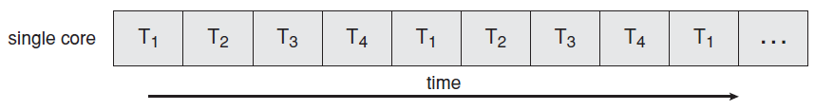
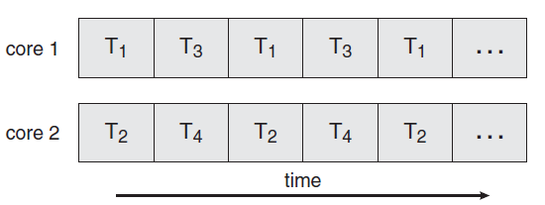
Multicore Programming
Concurrent execution on a single-core system
Parallel execution on a multi-core system

Slide 10
Thread Libraries
A thread library provides the programmer with an API for creating and managing threads
Three main thread libraries
POSIX Pthreads
Windows
Java

Slide 11
Pthreads
Pthreads refers to the POSIX standard defining an API for thread creation and synchronization
Common in UNIX-based OS (Linux, Mac OS X, Solaris)
Asynchronous threading
Once the parent creates a child thread, both of them execute concurrently
Synchronous threading
When the parent creates one or more children threads, it must wait for all its children to terminate before it resumes
Once each child thread finishes its work, it terminates and joins with its parent (also called fork-join)

Slide 12
Pthreads
Example: design a multithreaded program to calculate the summation of numbers from 0 to a non-negative integer in a separate thread

Slide 13
Pthreads
#include <pthread.h>
#include <stdio.h>
int sum; /* this data is shared by the thread(s) */
void *runner(void *param); /* threads call this function */
int main(int argc, char *argv[])
{
pthread_t tid; /* the thread identifier */ pthread_attr_t attr; /* set of thread attributes */
if(argc != 2) { fprintf(stderr,"usage: a.out <integer value>\n");
return -1;
}

Slide 14
Pthreads
Global variables (i.e., data declared outside of any function) are shared among all threads belonging to the same process

Slide 15
Pthreads
#include <pthread.h>
#include <stdio.h>
int sum; /* this data is shared by the thread(s) */
void *runner(void *param); /* threads call this function */
int main(int argc, char *argv[])
{
pthread_t tid; /* the thread identifier */ pthread_attr_t attr; /* set of thread attributes */
if(argc != 2) { fprintf(stderr,"usage: a.out <integer value>\n");
return -1;
}

Slide 16
Pthreads
Global variables (i.e., data declared outside of any function) are shared among all threads belonging to the same process
pthread_t: data type for thread identifier
pthread_attr_t: data type for thread attribute

Slide 17
Pthreads
if(atoi(argv[1]) < 0) { fprintf(stderr,"%d must be >= 0\n",atoi(argv[1]));
return -1;
}
/* get the default attributes */ pthread_attr_init(&attr); /* create the thread */ pthread_create(&tid, &attr, runner, argv[1]);
/* wait for the thread to exit */
pthread_join(tid, NULL);
printf("sum = %d\n",sum);
}

Slide 18
Pthreads
pthread_attr_init(): initialize an thread attribute object with default attribute values
pthread_attr_init(pthread_attr_t *attribute)

Slide 19
Pthreads
if(atoi(argv[1]) < 0) { fprintf(stderr,"%d must be >= 0\n",atoi(argv[1]));
return -1;
}
/* get the default attributes */ pthread_attr_init(&attr); /* create the thread */ pthread_create(&tid, &attr, runner, argv[1]);
/* wait for the thread to exit */
pthread_join(tid, NULL);
printf("sum = %d\n",sum);
}

Slide 20
Pthreads
pthread_attr_init(): initializes an thread attribute object with default attribute values
pthread_attr_init(pthread_attr_t *attribute)
pthread_create(): create a new thread in the calling process. The new thread starts by invoking start_routine(); arg is passed as the sole argument to start_routine().
int pthread_create(pthread_t *thread, pthread_attr_t &attribute, void *(*start_routine)(void *), void *arg)

Slide 21
Pthreads
if(atoi(argv[1]) < 0) { fprintf(stderr,"%d must be >= 0\n",atoi(argv[1]));
return -1;
}
/* get the default attributes */ pthread_attr_init(&attr); /* create the thread */ pthread_create(&tid, &attr, runner, argv[1]);
/* wait for the thread to exit */
pthread_join(tid, NULL);
printf("sum = %d\n",sum);
}

Slide 22
Pthreads
pthread_attr_init(): initializes an thread attribute object with default attribute values
pthread_attr_init(pthread_attr_t *attribute)
pthread_create(): create a new thread in the calling process. The new thread starts by invoking start_routine(); arg is passed as the sole argument to start_routine().
int pthread_create(pthread_t *thread, pthread_attr_t &attribute, void *(*start_routine)(void *), void *arg)
pthread_join(): wait for the child thread to terminate and join
int pthread_join(pthread_t thread, void **retval)
Note: usually use NULL for retval

Slide 23
Pthreads
if(atoi(argv[1]) < 0) { fprintf(stderr,"%d must be >= 0\n",atoi(argv[1]));
return -1;
}
/* get the default attributes */ pthread_attr_init(&attr); /* create the thread */ pthread_create(&tid, &attr, runner, argv[1]);
/* wait for the thread to exit */
pthread_join(tid, NULL);
printf("sum = %d\n",sum);
}

Slide 24
Pthreads
/* The thread will begin control in this function */
void *runner(void *param) {
int i, upper = atoi(param);
sum = 0;
for (i = 1; i <= upper; i++)
sum += i;
pthread_exit(0);
}

Slide 25
Pthreads
pthread_exit(): terminate the calling thread
pthread_exit(0)

