Slide 1
Water Treatment GUI
Brandon Helmericks and Hannah tsunemori

Slide 2
Overall Project
Designed for the Alaska Water and Sewer Challenge
Dotson Labs is creating an automated system
In-house plumbing without community infrastructure
Minimize water that must be hauled into and out of the home
Cost effective and sustainable in rural Alaska
Second generation prototype of system
More information at: reusewaterak.com

Slide 3
The Interface
The Water Treatment GUI
User interaction with the overall project
Allows for easy maintenance
Displays relevant information about system

Slide 4
Users
Dotson Labs:
The team designing the Water Treatment Project
Homeowners:
The basic users who need to operate the system
Advanced Users:
The users who need to diagnose and maintain the system

Slide 5
Requirements
Easily adapted by Dotson Labs
Display and store relevant information
Interaction with the system through Arduino Mega
Use provided hardware

Slide 6
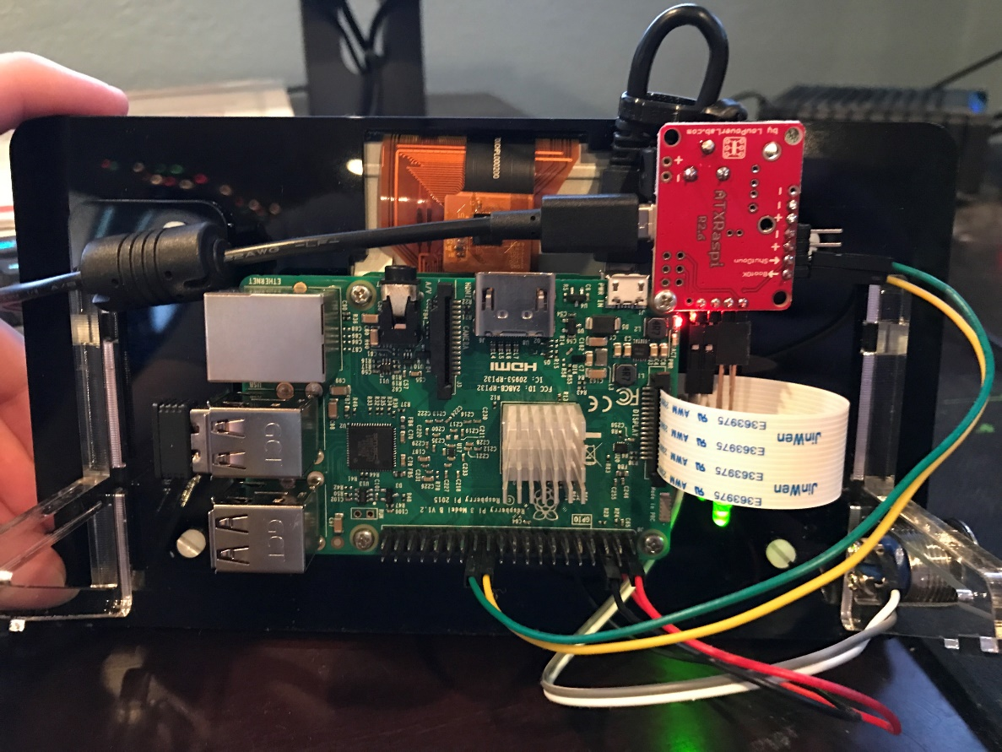
Hardware
Raspberry Pi 3 Model B
Element14 7” Touchscreen Display
ATXRaspi Power Controller
SD Card

Slide 7
Software
Must be well commented
Easy to adjust and modify
Written in Python
Run on Raspbian v8.0
Reads information from Arduino Mega
Creates files and displays from data
Sends controls to the Arduino Mega
Monitors system status

Slide 8
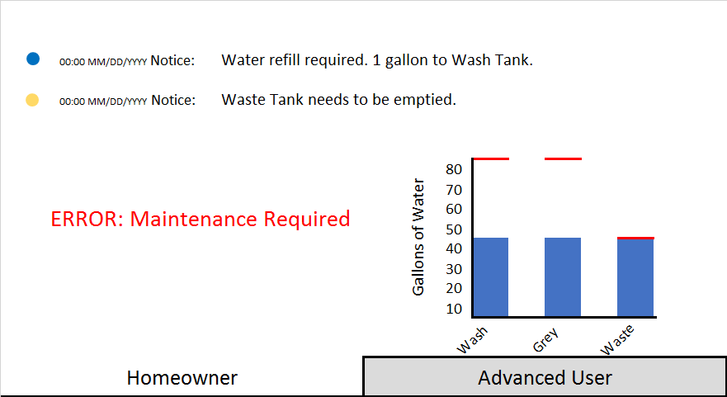
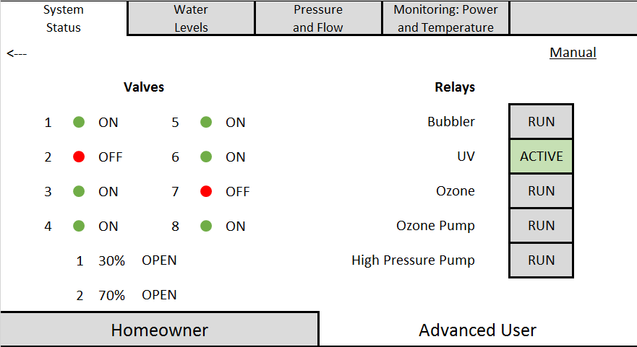
Display Layout
Home Owner View
Advanced user view

Slide 9
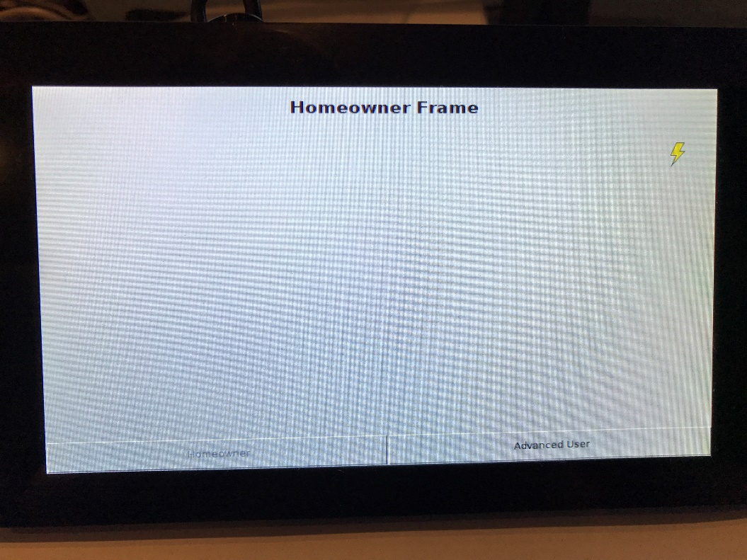
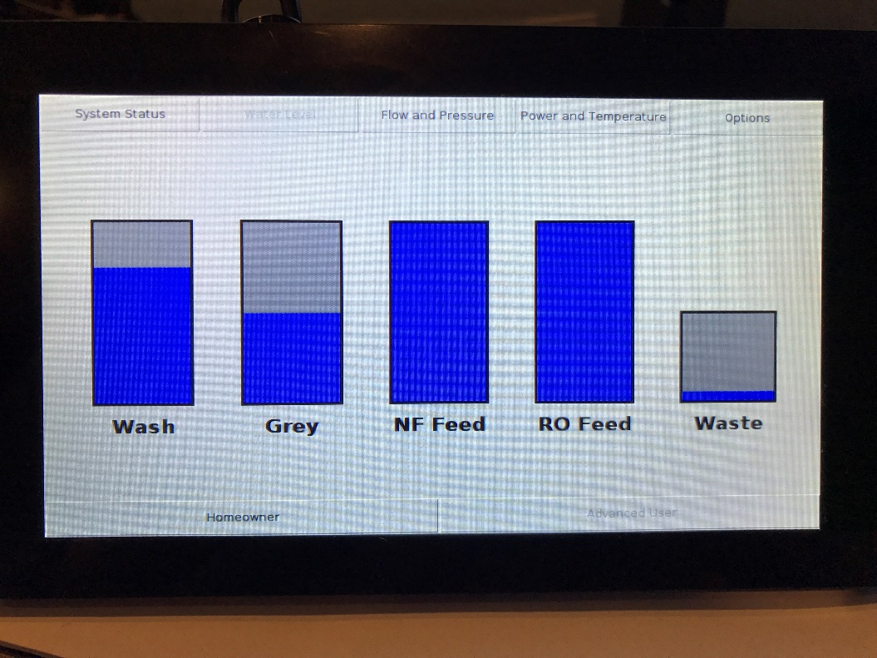
Prototype
HOME OWNER VIEW
ADVANCED USER VIEW

Slide 10
Consulting
Requested by client
Includes for work towards version 2.0
Recording and display of usage history
Displaying expected life of components
Includes modifying current Dotson Labs code

Slide 11
Thank you
FAQ:
Q: How do you interact with the system?
A: All interactions with the system are done through the Arduino Mega.
Q: How are you programming the Arduino Mega?
A: The Arduino Mega has already been programmed by Dotson Labs
Q: Is consulting necessary?
A: Yes, consulting is necessary. The code written by Dotson Labs may need to be modified to produce desired usable outputs.

