Slide 1
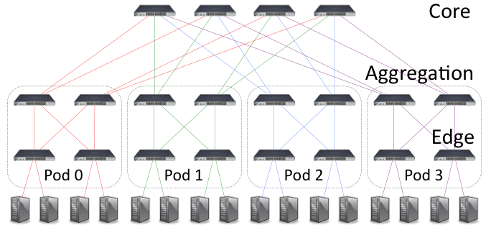
k=4 IP and Virtual Port numbering, 1-indexed
(same pattern applies to k=6)
(4,1,1)
(4,1,2)
(4,2,1)
(4,2,2)
1
2
3
4
3
1
3
1
1
1
3
3
(0,2,1)
(0,3,1)
(1,k/2,1)
(1,k/2+1,1)
2
4
2
4
2
4
2
4
1
3
1
3
1
3
1
3
(0,0,1)
(0,1,1)
(1,0,1)
(1,1,1)
2
4
2
4
2
4
2
4
(0,0,2)
(0,0,3)
(0,1,2)
(0,1,3)
(1,0,2)
(1,0,3)
(1,1,2)
(1,1,3)
0 1 2 …
15
Host Total: k³/4
Pod Switches: (pod,switch,1), switch in [0,k]
Host Tuple(x,y,z) ←→ Host IP 10.x.y.z
Core Switches: (k,i,j), i and j in [1,k/2]
Host Tuple(x,y,z) ←→ (pod, switch, host)
Hosts: (pod,switch,host), host in [2,k/2+1]

