Slide 1






VASSIST
vassist-mu.vercel.app
VASSIST
WE + ASSIST
TEAM MEMBERS
Bhenedix Paul 23BAI1383
Yashvanth Karunakaran 23BAI1589
Deepak Ragavendra 23BRS1434

Slide 2







VASSIST
TECHSTACK
vassist-mu.vercel.app
TECH STACK
GOOGLE CONSOLE CLOUD
NEXTAUTH.JS

Slide 3

VASSIST
TECHSTACK
PROBLEM
vassist-mu.vercel.app
OBJECTIVE
VASSIST aims to provide VIT Chennai students with a centralized platform for accessing Previous Year Questions (PYQs) and study materials. By offering a user-friendly interface, easy navigation, and a collaborative approach, VASSIST ensures that students can efficiently find and share academic resources to enhance their learning experience.

Slide 4
VASSIST
TECHSTACK
OBJECTIVE
APPLICATIONS
vassist-mu.vercel.app
APPLICATIONS
Collaborative Learning Platform
Resource Repository for Faculty & Tutors
On-the-Go Access
Reduces Paper Waste
Exam Preparation

Slide 5
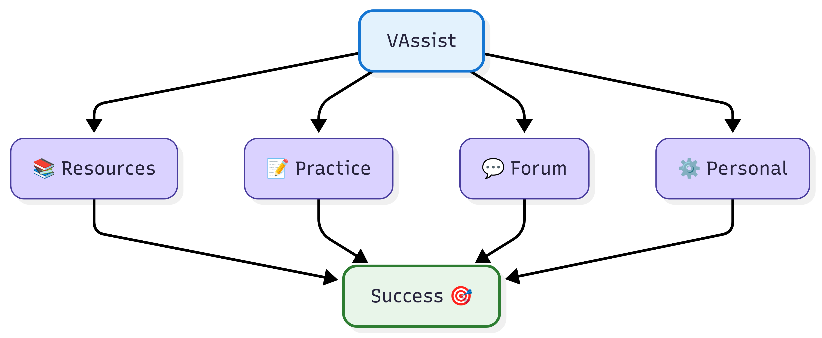
VASSIST
TECHSTACK
OBJECTIVE
FEATURES
vassist-mu.vercel.app
FEATURES

Slide 6
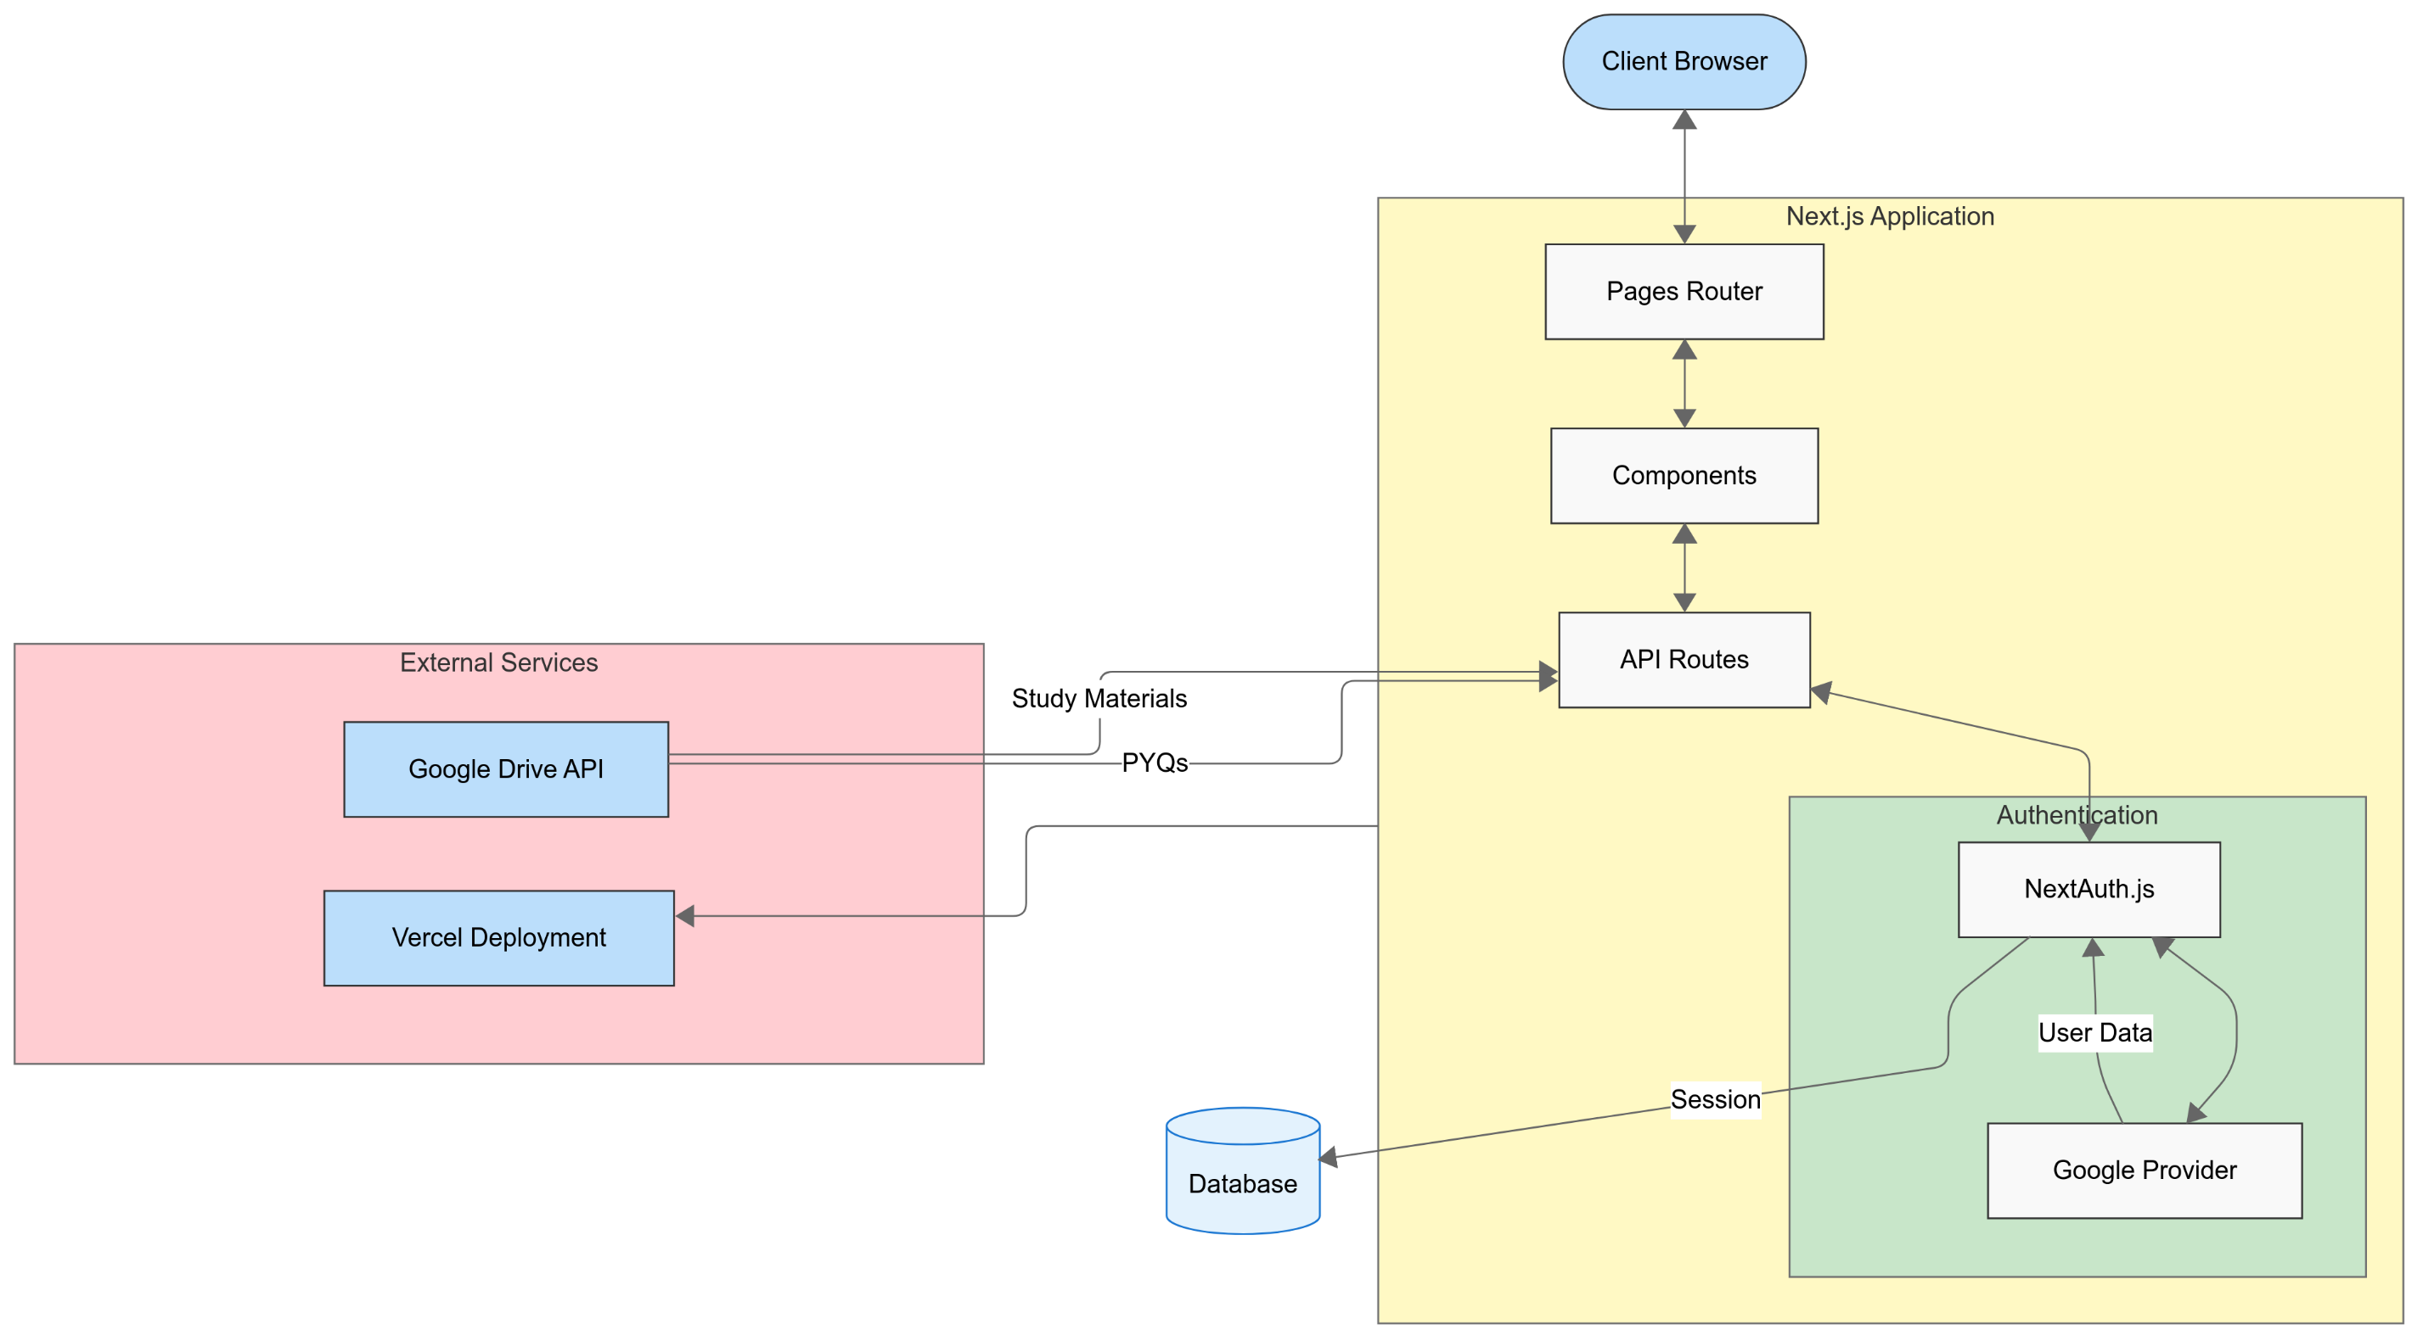
VASSIST
PROJEC PLAN
TECHSTACK
OBJECTIVE
FEATURES
vassist-mu.vercel.app
PLAN OF WORK

