Slide 1

ISTA 331 | Machine Learning
Arizona Crime Data
Benjamin Henning
Notes:
This presentation is going to be on crime data in Arizona, how it’s progressed over the last 35 years, and where it could be going in the next 15 years according a machine learning model.

Slide 2
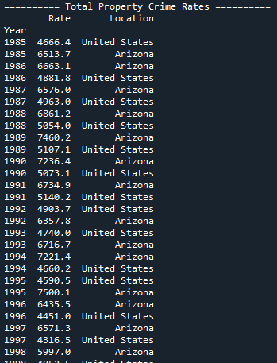
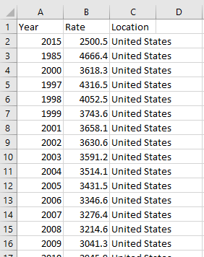
Dataset – FBI Crime Data (1985-2019)
https://crime-data-explorer.fr.cloud.gov/explorer/state/arizona/crime
total_property.csv
Notes:
My data was retrieved from the FBI database on crime data in the US.
I imported the data into my script with pandas using DataFrames and sorted them by year. I downloaded a total of 9 datasets from the FBI database, and for each one I filtered for Arizona crime data, however there is the option in my script to filter for any state or the United States at large.

Slide 3
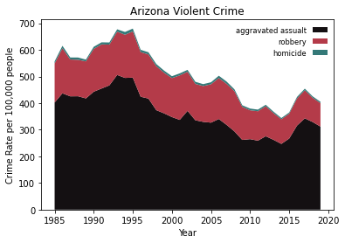
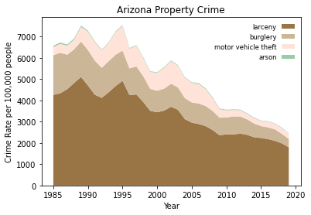
Arizona Crime Data (1985-2019) – Stackplot Visualization
Notes:
This is a stackplot visualization of the Arizona crime data from 1985 to 2019, which is as far back and as current as this database goes, and split up by crime type. I also I decided to split the data into Violent crime and property crime categories, because as you can see in the plots, the scale of property crime is much higher than the scale of violent crime. This plot is just a visualization of the current data before I applied any machine learning models.
All the plots in the project were made with matplotlib.

Slide 4
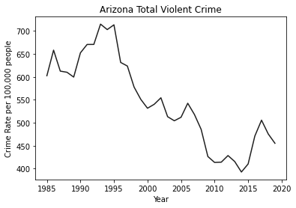
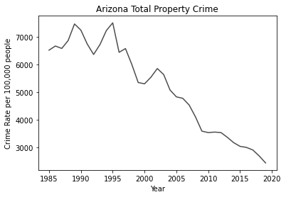
Arizona Crime Data (1985-2019) - Totals
Notes:
Here is a simple line graph visualization of the total datasets that I actually used to make my models. As you can see the data is still separated between violent crime and property crime, but the crime types have all been added up to show the total crime under the two categories. The axes here are the same as is used in the FBI database, with year on the horizontal axis and Crime Rate per 100,000 people on the vertical axis.

Slide 5
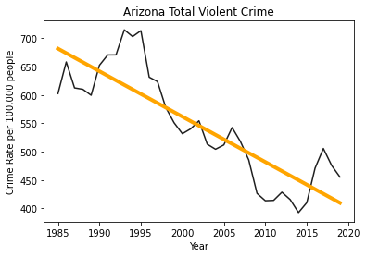
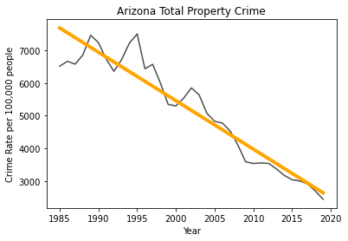
Model 1 – Simple Linear Regression using OLS
Notes:
On to the machine learning models. The first model I tried out was a simple linear regression using ordinary least squares, which was done in my script using the statsmodels package.

Slide 6
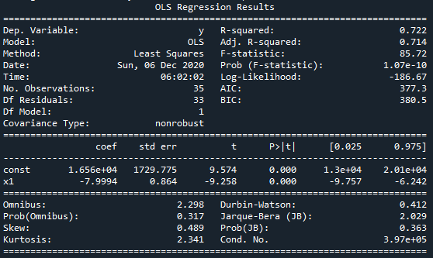
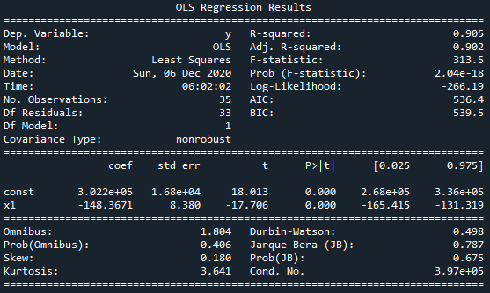
Model 1 – Simple Linear Regression using OLS
Notes:
The model for this actually fits pretty well, you can see my r-squared for the violent crime is around .72 and the r-squared for the property crime is actually above .9. So, this model fits well, however, if you remember I mentioned earlier that I want to use machine learning to predict where crime rates are heading in the future, and the problem with a linear model in this context is that we probably don’t expect something like crime rate to just be a straight line down, because eventually it would hit 0, and actually go below 0, which is not possible. A more likely scenario is that crime rates would continue to go down as the current data shows, but eventually taper off and then plateau at some point, or possibly rise depending on social and economic factors. For that reason, this model is no good, so I had to try something else.

Slide 7
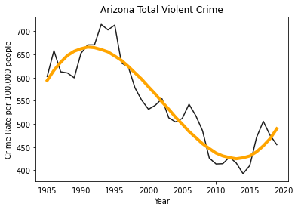
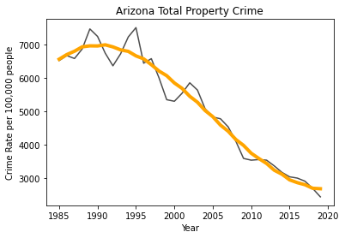
Model 2 – 5th Degree Polynomial Regression using OLS
Notes:
So, the next model I tried was a 5th degree polynomial regression using ordinary least squares.

Slide 8
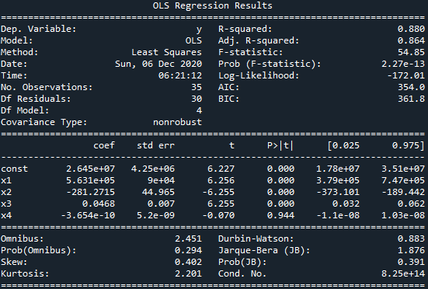
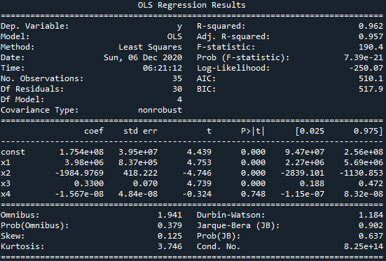
Model 2 – 5th Degree Polynomial Regression using OLS
Notes:
This model fits much better than the simple linear regression model, the error for violent crime is .88 and the property crime error is pretty good as well. However, there are two big problems with this model.
First of all, this model is way over fitted. You can see in the violent crime graph especially, that the outliers are having way too much influence on the model.
Secondly, this model just isn’t realistic, because similarly to the linear model, we can’t use it to predict how crime rates will continue in the future. As you can see, this model would predict that crime rates would skyrocket infinitely. So I had to find a better model, this one is no good either.

Slide 9
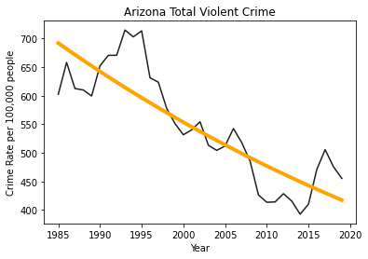
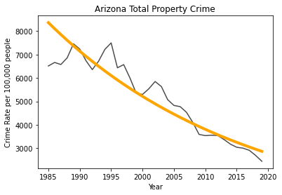
Model 3 – Log transformation of linear regression using OLS
Notes:
The model I ended up on was a simple log transformation of the linear regression model.

Slide 10
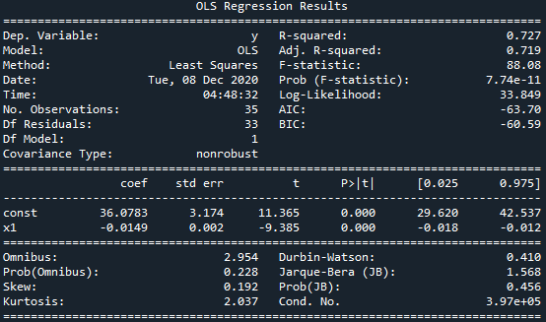
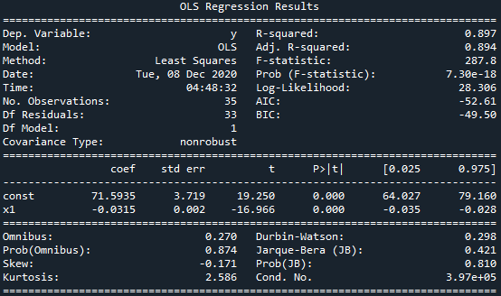
Model 3 – Log transformation of linear regression using OLS
Notes:
This model ended up being much better than my other 2 attempts, because a logarithmic model satisfies the expectation that crime rates will continue to fall, but will eventually plateau, never reaching 0. The error for this model is not as low as in the previous 2 models, but is still quite reasonable to the point where we can call this a decent fit.

Slide 11
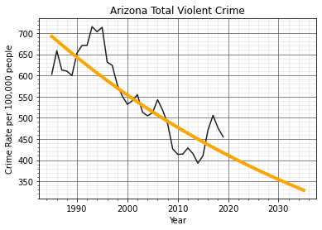
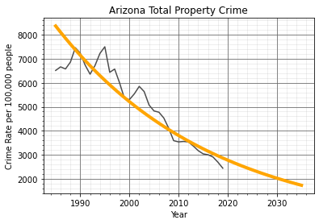


15-year predictions using the Log transformation model
17% decrease
29% decrease
40% decrease
9% decrease
15% decrease
21% decrease
Notes:
So now that I found a model that I’m happy with, I can apply it to a larger range on the horizontal axis to make predictions for Arizona crime rates in the future. For these graphs I decided to add some gridlines so you can see the values easier. I used the model to output a 5, 10 and 15 year prediction, and on the slides you can see that my model predicted a 40% decrease in violent crime and a 21% decrease in property crime by 2035. Unfortunately, I’m not sure how accurate this model will be for the very near future, because the effects of the pandemic have and will cause crime rates to spike, but once things go back to normal I expect the data to continue to trend towards my model’s predictions.

Slide 12
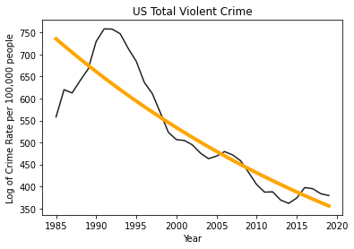
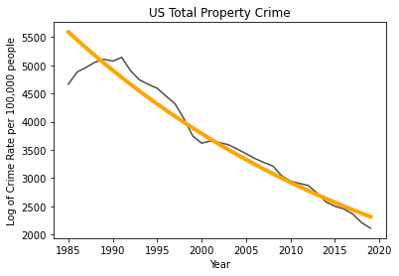
Applying the model to other datasets
Notes:
As I said in the beginning, my script allows this model to be applied to any dataset from the FBI crime database, so I tried it out on the US crime totals, and it actually fits very well, So I have confidence that the model isn’t overfitted to just the Arizona crime data, and thus could be applied to other states or in this case the US as a whole.

Slide 13
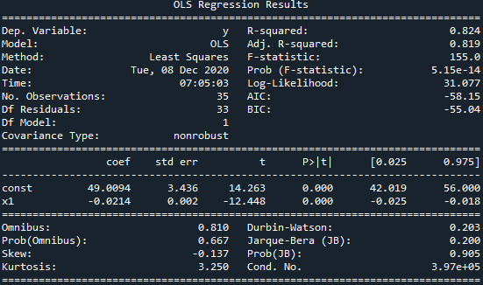
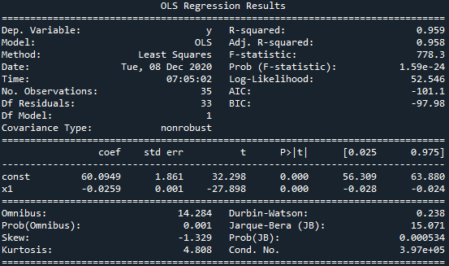
Applying the model to other datasets
Notes:
Here you can see the error for the model when applied to the US total datsets is actually quite good.

Slide 14

Q & A
Notes:
Thats all from me, hope you found my results interesting.

