Slide 1
Virtual Memory
A Biswas
Ref: Hallaron

Slide 2
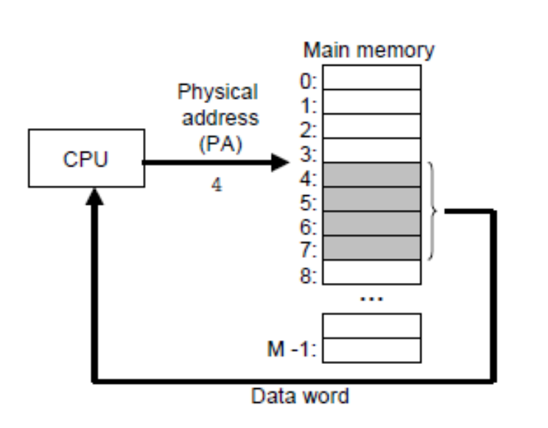
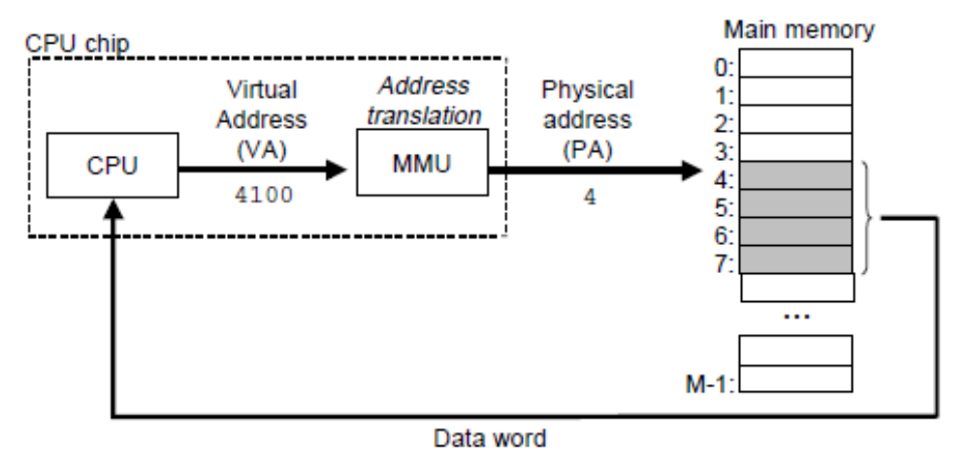
A system with physical addressing
Early PCs used physical addressing, and systems such as digital signal processors, embedded microcontrollers, and Cray supercomputers continue to do so.

Slide 3
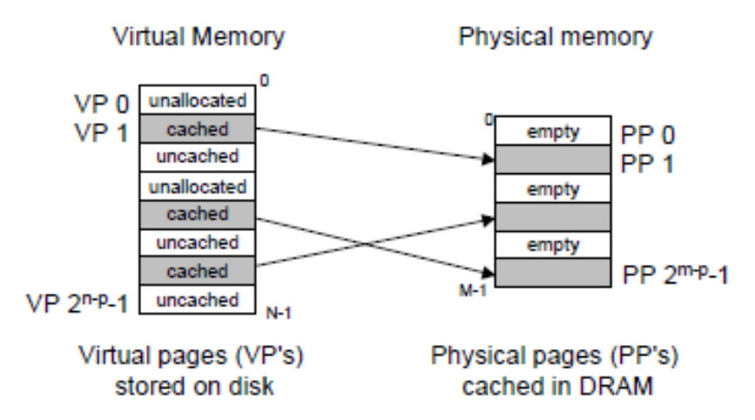
Cached: Allocated pages that are currently cached in physical memory.
Uncached: Allocated pages that are not cached in physical memory.
At any point in time, the set of virtual pages is partitioned into three disjoint subsets:
Unallocated: Pages that have not yet been allocated (or created) by the VM system. Unallocated blocks do not have any data associated with them, and thus do not occupy any space on disk.

Slide 4
DRAM is about 10 times slower than an SRAM and that disk is about 100,000 times slower than a DRAM.
Thus, misses in DRAM caches are very expensive compared to misses in SRAM caches because DRAM cache misses are served from disk, while SRAM cache misses are usually served from
DRAM-based main memory.

Slide 5
Further, the cost of reading the first byte from a disk sector is about 100,000 times slower than reading successive bytes in the sector.
Because of the large miss penalty and the expense of accessing the first byte, virtual pages tend to be large, typically four to eight KB.

Slide 6
Due to the large miss penalty, DRAM caches are fully associative, that is, any virtual page can be placed in any physical page.
The replacement policy on misses also assumes greater importance, because the penalty associated with replacing the wrong virtual page is so high.

Slide 7
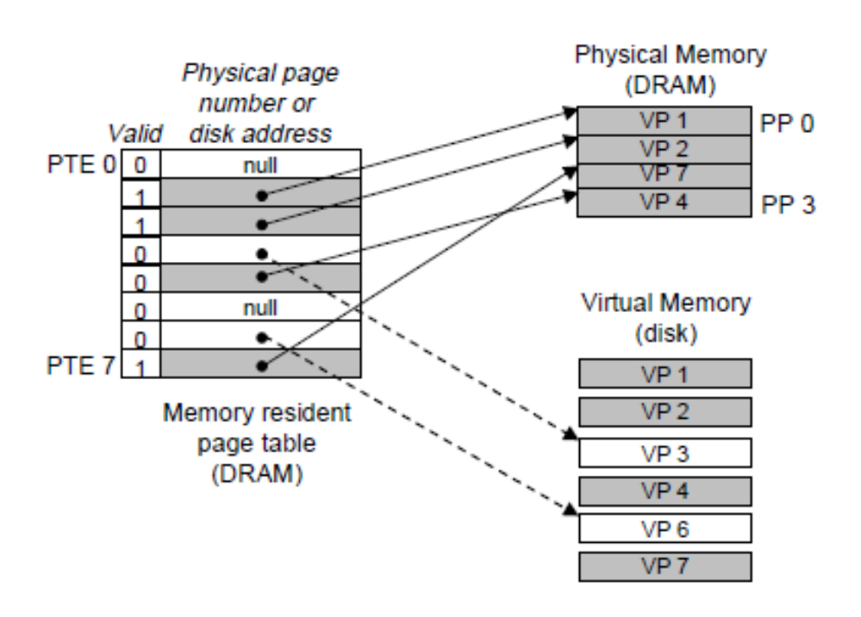
A system with 8 virtual pages and 4 physical pages.
Four virtual pages (VP 1, VP 2, VP 4, and VP 7) are currently cached in DRAM.
Two pages (VP 0 and VP 5) have not yet been allocated, and
the rest (VP 3 and VP 6) have been allocated but are not currently cached.

Slide 8
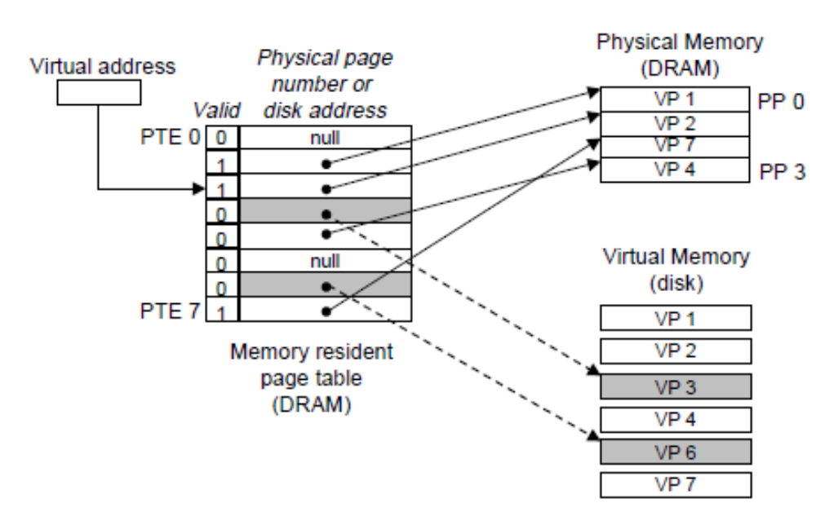
Page Hit

Slide 9
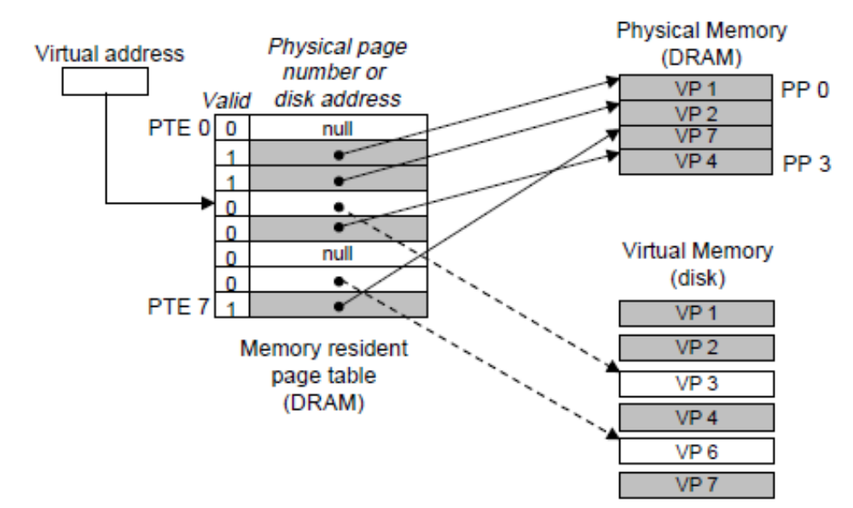
Page Fault

Slide 10
The CPU references a word in VP 3.
VP 3 is not cached in DRAM
The address translation hardware reads PTE 3 from memory, infers from the valid bit that VP 3 is not cached
It triggers a page fault exception.
The kernel copies VP 3 from disk to PP 3 in memory, updates PTE 3, and then returns.
When the handler returns, it restarts the faulting instruction, which resends the faulting virtual address to the address translation hardware.
But now, VP 3 is cached in main memory, and the page hit is handled normally by the address translation hardware.
A page fault exception handler in the kernel is invoked.
Selects a victim page, in this case VP 4 stored in PP 3.
If VP 4 has been modified, then the kernel copies it back to disk.
In either case, the kernel modifies the page table entry for VP 4 to reflect the fact that VP 4 is no longer cached in main memory.

Slide 11
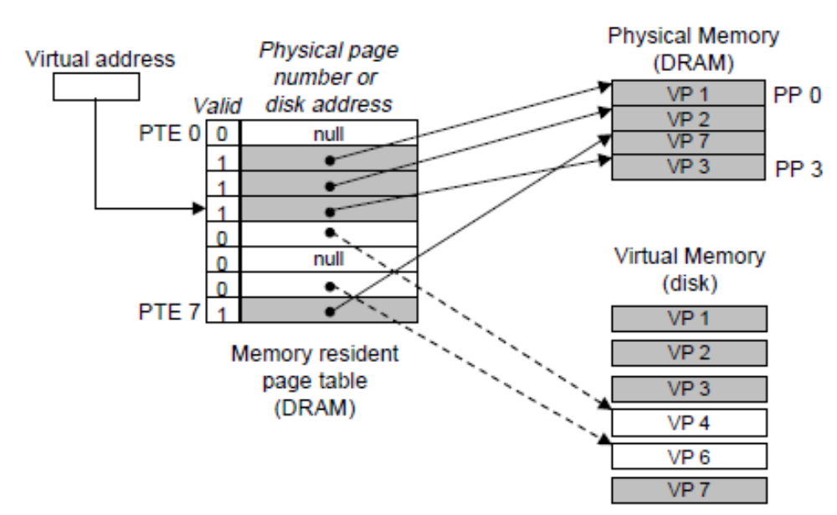
Page miss (after)

Slide 12
Is VM inefficient?
Given the large miss penalties, we worry that paging will destroy program performance.
In practice, virtual memory works pretty well because of locality.

Slide 13
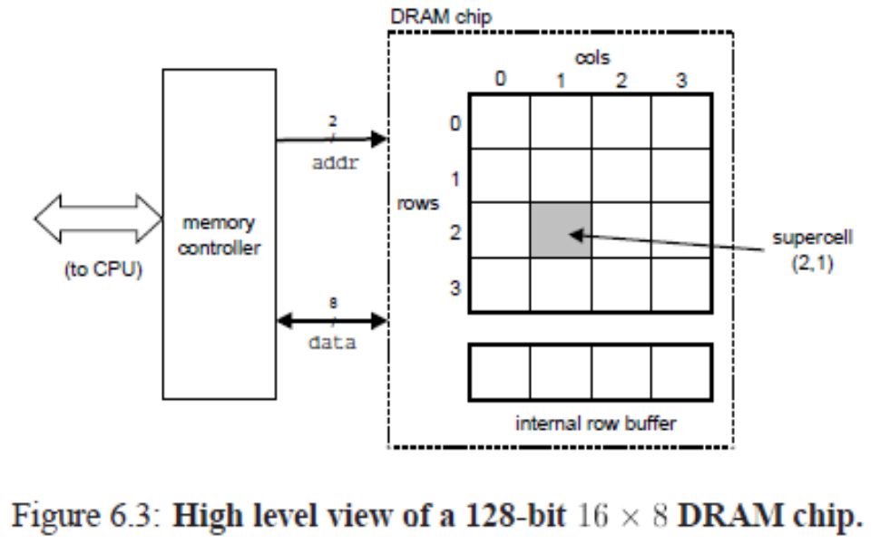
Conventional DRAMs
The cells (bits) in a DRAM chip are partitioned into d supercells, each consisting of w DRAM cells. A
d £ w DRAM stores a total of dw bits of information.
The supercells are organized as a rectangular array with r rows and c columns, where rc = d.
Each supercell has an address of the form (i; j), where i denotes the row, and j denotes the column.
16 £ 8 DRAM chip
d = 16 supercells,
w = 8 bits per supercell,
r = 4 rows, and c = 4 columns.
Information flows in and out of the chip via external connectors called pins.
Each pin carries a 1-bit signal.
8 data pins that can transfer one byte in or out of the chip, and 2 addr pins that carry 2-bit row and column supercell addresses.
Other pins with control information are not shown.

Slide 14
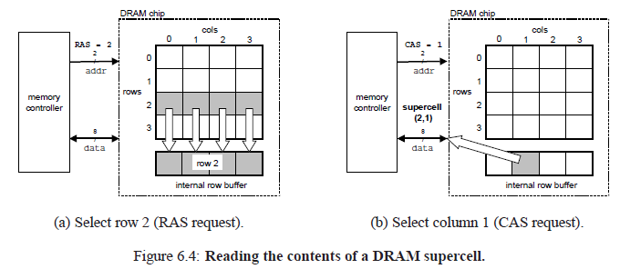
Each DRAM chip is connected to some circuitry, known as the memory controller, that can transfer w bits at a time to and from each DRAM chip.
To read the contents of supercell (i; j), the memory controller sends the row address i to the DRAM, followed by the column address j.
The DRAM responds by sending the
contents of supercell (i; j) back to the controller.
The row address i is called a RAS (Row Access Strobe) request.
The column address j is called a CAS (Column Access Strobe) request.
Notice that the RAS and
CAS requests share the same DRAM address pins.

Slide 15
Memory Modules
DRAM chips are packaged in memory modules that plug into expansion slots on the main system board (motherboard). Common packages include the 168-pin Dual Inline Memory Module (DIMM), which transfers data to and from the memory controller in 64-bit chunks, and the 72-pin Single Inline Memory Module (SIMM), which transfers data in 32-bit chunks.

Slide 16
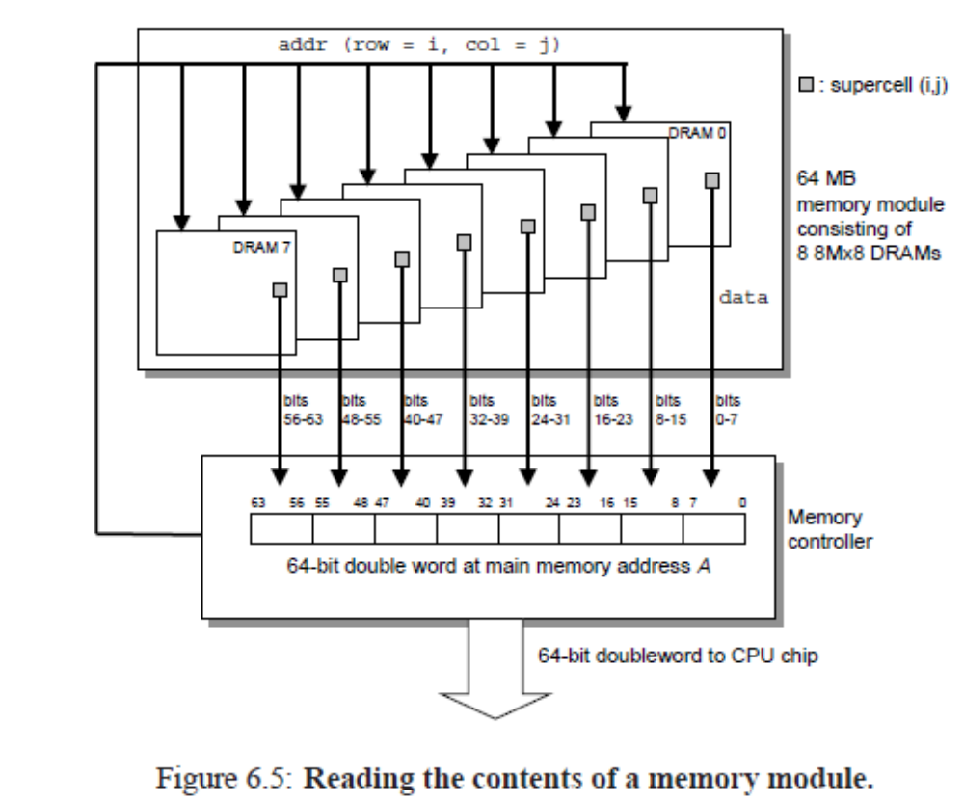

Slide 17
The example module stores a total of 64 MB (megabytes) using eight 64-Mbit 8M 8 DRAM chips, numbered 0 to 7.
Each supercell stores one byte of main memory, and each 64-bit doubleword at byte address A in main memory is represented by the eight supercells whose corresponding supercell address is (i; j).
In Figure, DRAM 0 stores the first (lower-order) byte, DRAM 1 stores the next byte, and so on.

Slide 18
Accessing Main Memory
Bus:
Data flows back and forth between the processor and the DRAM main memory over shared electrical conduits called buses.
Bus transaction:
Each transfer of data between the CPU and memory is accomplished with a series of steps called a bus transaction.
A read transaction transfers data from the main memory to the CPU.
A write transaction transfers data from the CPU to the main memory.
A bus is a collection of parallel wires that carry address, data, and control signals.
Depending on the particular bus design, data and address signals can share the same set of wires, or they can use different sets.
More than two devices can share the same bus.
The control wires carry signals that synchronize the transaction and identify what kind of transaction is currently being performed.

Slide 19
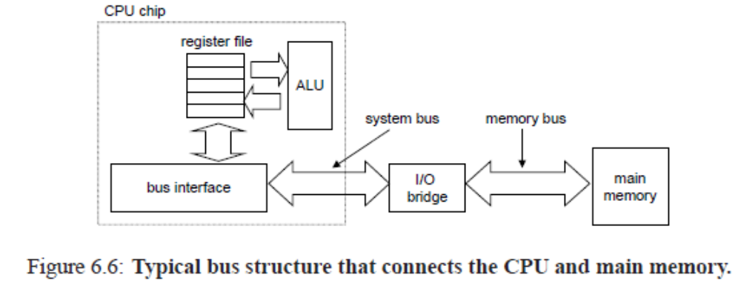
The main components are the CPU chip,a chipset that we will call an I/O bridge (which includes the memory controller), and the DRAM memory modules that comprise main memory.
These components are connected by a pair of buses: a system bus that
connects the CPU to the I/O bridge, and a memory bus that connects the I/O bridge to the main memory.

Slide 20
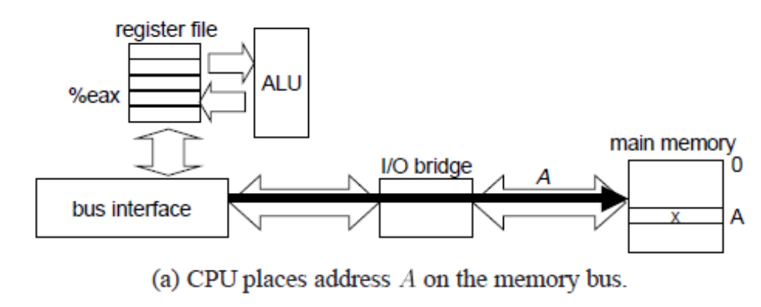

Slide 21
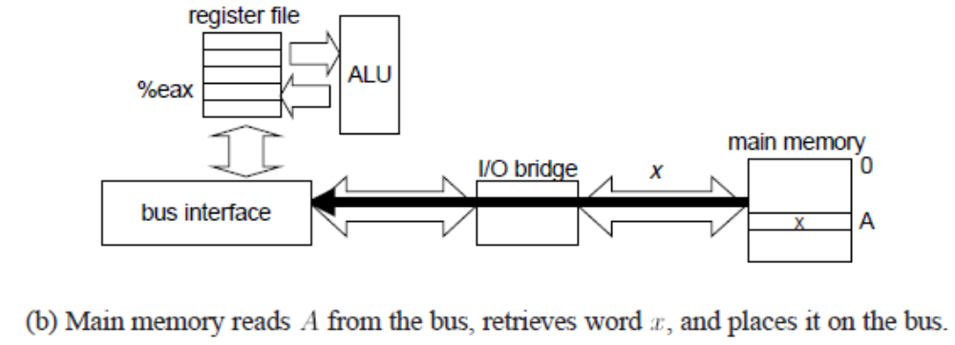

Slide 22
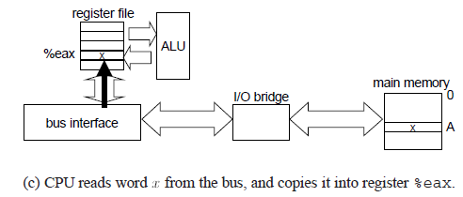

Slide 23
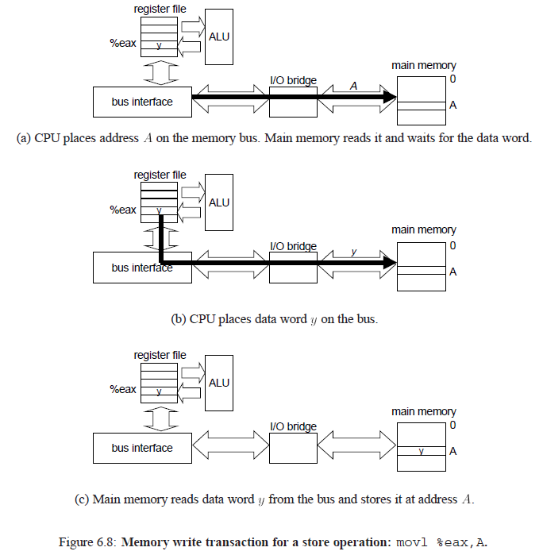

Slide 24
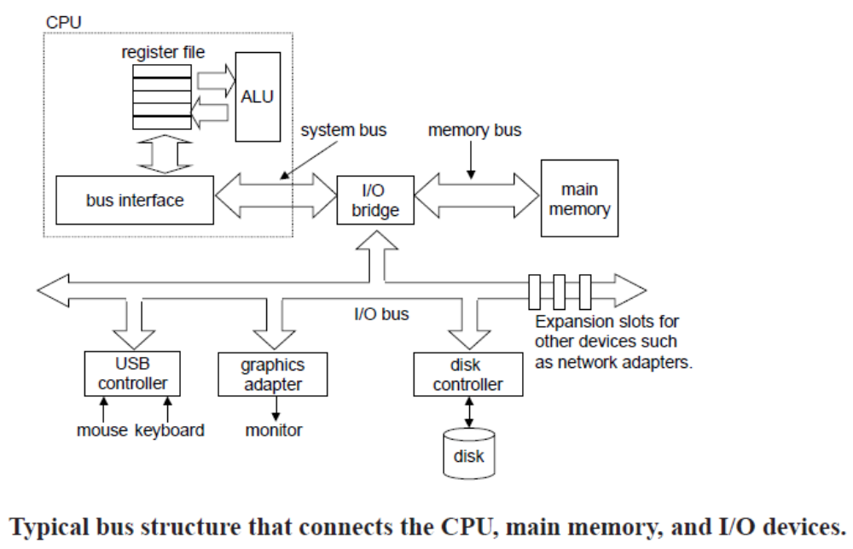

Slide 25
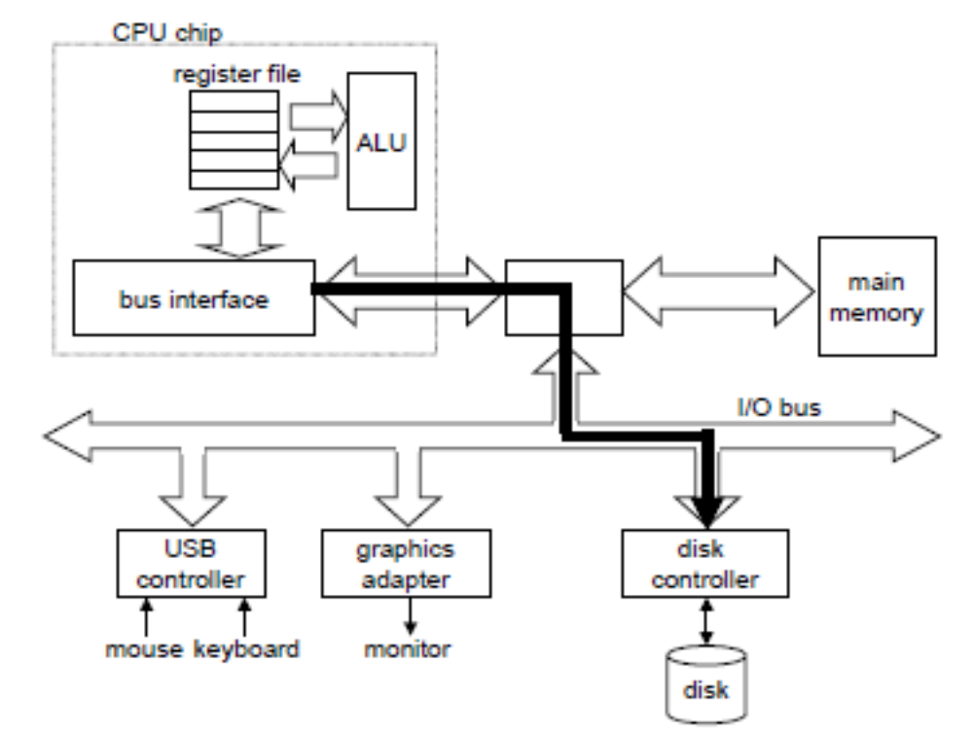
The CPU initiates a disk read by writing a command, logical block number, and destination memory address to the memory-mapped address associated with the disk.

Slide 26
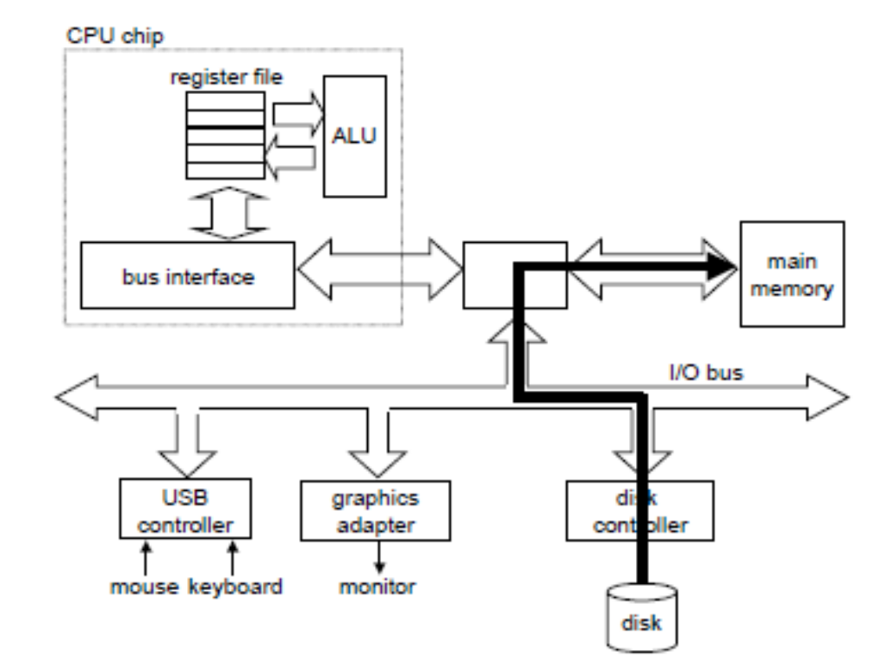
The disk controller reads the sector and performs a DMA transfer into main memory.

Slide 27
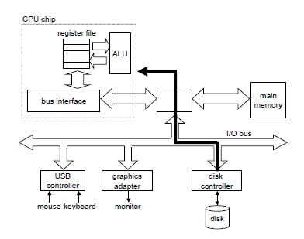
When the DMA transfer is complete, the disk controller notifies the CPU with an interrupt

Slide 28
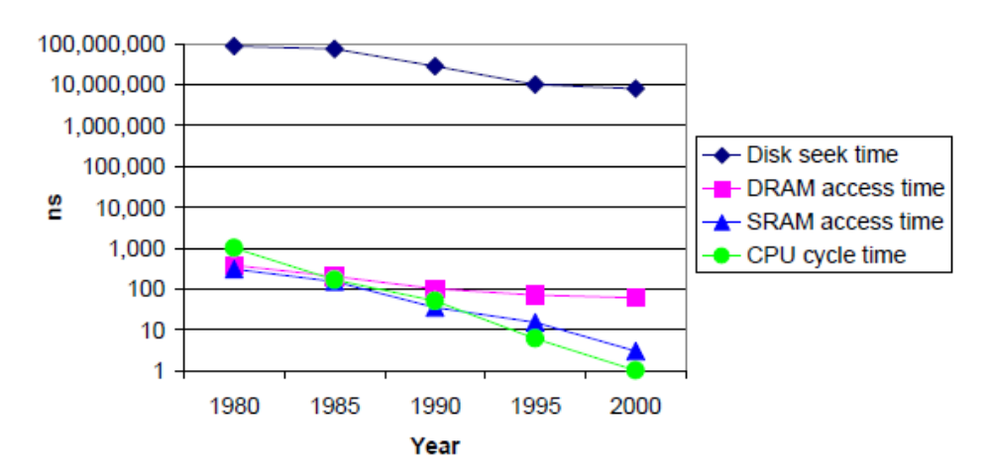
The increasing gap between DRAM, disk, and CPU speeds.

Slide 29
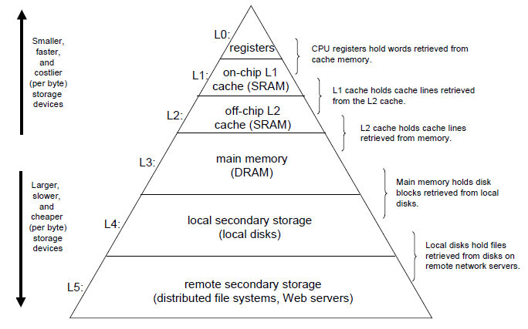

Slide 30
Locality is typically described as having two distinct forms:
temporal locality and
spatial locality.
In a program with good temporal locality, a memory location that is referenced once is likely to be referenced again multiple times in the near future.
In a program with good spatial locality, if a memory location is referenced once, then the program is likely to reference a nearby memory location in the near future.
Well-written computer programs tend to exhibit good locality.
That is, they tend to reference data items that are near other recently referenced data items, or that were recently referenced themselves.
This tendency, known as the principle of locality, is an enduring concept that has enormous impact on the design and
performance of hardware and software systems.

Slide 31
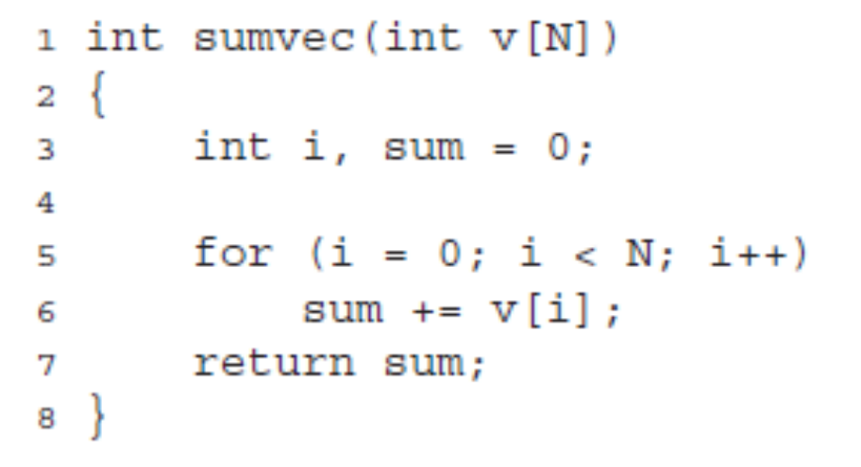
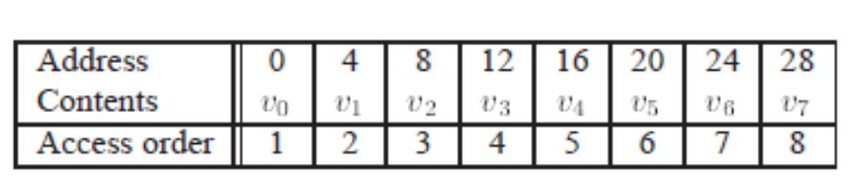
Thus, with respect to variable v, the function has good spatial locality, but poor temporal locality since each vector element is accessed exactly once.
A function such as sumvec that visits each element of a vector sequentially is said to have a stride-1 reference pattern (with respect to the element size).
Visiting every kth element of a contiguous vector is called a stride-k reference pattern.
Stride-1 reference patterns are a common and important source of spatial locality in programs.
In general, as the stride increases, the spatial locality decreases.

Slide 32
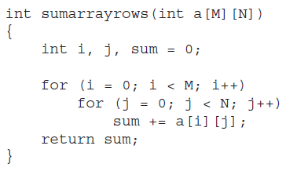
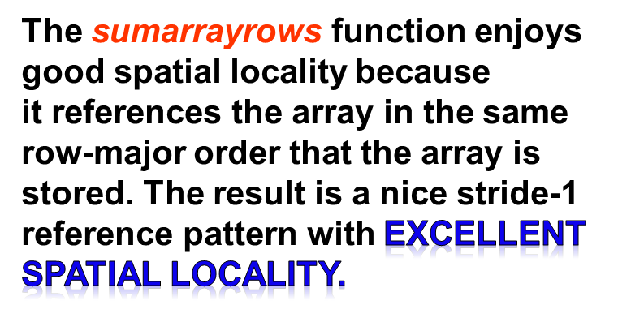
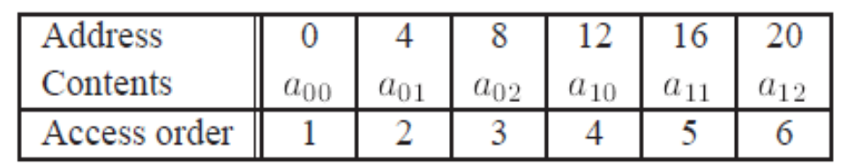
The doubly nested loop reads the elements of the array in row-major order. That is, the inner loop reads the elements of the first row, then the second row, and so on.

Slide 33
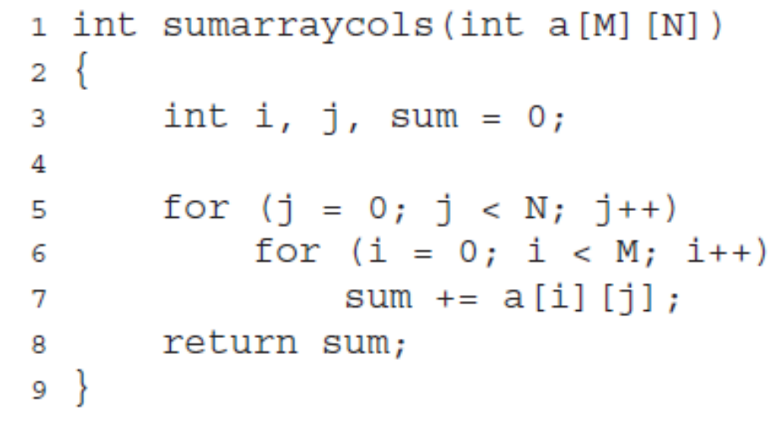

The sumarraycols function suffers from poor spatial locality because it scans the array column-wise instead of row-wise.
Since C arrays are laid out in memory row-wise, the result is a
stride-(N £ sizeof(int))
reference pattern.
The sumarraycols function above computes the same result as the sumarrayrows function. The only difference is that we have interchanged the i and j loops.

Slide 34
Locality of Instruction Fetches
Since program instructions are stored in memory and must be fetched (read) by the CPU, we can also evaluate the locality of a program with respect to its instruction fetches.
For example, the instructions in the body of the for loop are executed in sequential memory order, and thus the loop enjoys good spatial locality.
Since the loop body is executed multiple times, it also enjoys good temporal locality.
An important property of code that distinguishes it from program data is that it can not be modified at runtime.
While a program is executing, the CPU only reads its instructions from memory. The CPU never overwrites or modifies these instructions.

Slide 35
Programs that repeatedly reference the same variables enjoy good temporal locality.
For programs with stride-k reference patterns,
the smaller the stride the better the spatial locality.
Programs with stride-1 reference patterns have good spatial locality. Programs that hop around memory with large strides have poor spatial locality.
Loops have good temporal and spatial locality with respect to instruction fetches.
The smaller the loop body and the greater the number of loop iterations, the better the locality.

Slide 36
L0:
At the highest level (L0) are a small number of fast CPU registers that the CPU can access in a single clock cycle.
L1 AND L2:
Next are one or more small to moderate-sized SRAM-based cache memories
that can be accessed in a few CPU clock cycles.
Main Memory L3:
These are followed by a large DRAM-based main memory that can be accessed in tens to hundreds of clock cycles.
Disk L4:
Next are slow but enormous local disks.
L5:
Finally, some systems even include an additional level of disks on remote servers that can be accessed over a network.
For example,
distributed file systems such as the Andrew File System (AFS) or
the Network File System (NFS) allow a program to access files that are stored on remote network-connected servers.

Slide 37
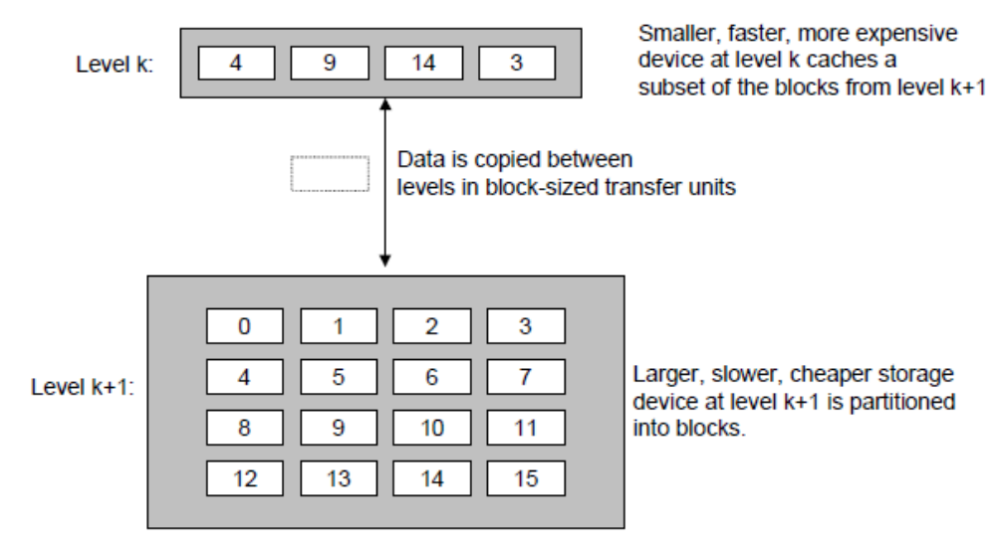
Caching in the Memory Hierarchy
The faster and smaller storage device at level k serves as a cache for the larger and slower storage device at level k + 1.

Slide 38
Data is always copied back and forth between level k and level k + 1 in block-sized transfer units.
Transfers between L1 and L0 typically use 1-word blocks.
Transfers between L2 and L1 (and L3 and L2) typically use blocks of 4 to 8 words.
And transfers between L4 and L3 use blocks with hundreds or thousands of bytes.
In general, devices lower in the hierarchy (further from the CPU) have longer access times, and thus tend to use larger block sizes in order to amortize these longer access times.

Slide 39
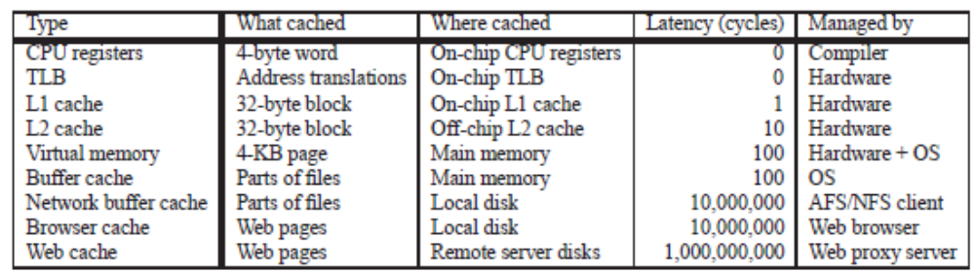

Slide 40
Cache Hits
When a program needs a particular data object d from level k + 1, it first looks for d in one of the blocks currently stored at level k. If d happens to be cached at level k, then we have what is called a cache hit.
The program reads d directly from level k, which by the nature of the memory hierarchy is faster than reading d from level k + 1.
For example, a program with good temporal locality might read a data object from block 14, resulting in a cache hit from level k.

Slide 41
Cache Misses
If, on the other hand, the data object d is not cached at level k, then we have what is called a cache miss.
When there is a miss, the cache at level k fetches the block containing d from the cache at level k + 1, possibly overwriting an existing block if the level k cache is already full. This process of overwriting an existing block is known as replacing or evicting the block.
The block that is evicted is sometimes referred to as a victim block. The decision about which block to replace is governed by the cache’s replacement policy.
For example, a cache with a random replacement policy would choose a
random victim block. A cache with a least-recently used (LRU) replacement policy would choose the block that was last accessed the furthest in the past.
After the cache at level k has fetched the block from level k + 1, the program can read d from level k as before.
For example, reading a data object from block 12 in the level k cache would result in a cache miss because block 12 is not currently stored in the level k cache.
Once it has been copied from level k + 1 to level k, block 12 will remain there in expectation of later accesses.

Slide 42
Kinds of Cache Misses
If the cache at level k is empty, then any access of any data object will miss. An empty cache is sometimes referred to as a cold cache, and misses of this kind are called compulsory misses or cold misses.
Cold misses are important because they are often transient events that might not occur in steady state, after the cache has been warmed up by repeated memory accesses.
Whenever there is a miss, the cache at level k must implement some placement policy that determines where to place the block it has retrieved from level k+1. The most flexible placement policy is to allow any block from level k + 1 to be stored in any block at level k.
For caches high in the memory hierarchy (close to the CPU) that are implemented in hardware and where speed is at a premium, this policy is usually too expensive to implement because randomly placed blocks are expensive to locate.

Slide 43
Thus, hardware caches typically implement a more restricted placement policy that restricts a particular block at level k + 1 to a small subset (sometimes a singleton) of the blocks at level k.
For example, we might decide that a block i at level k + 1 must be placed in block (i mod 4) at level k.
For example, blocks 0, 4, 8, and 12 at level k + 1 would map to block 0 at level k, blocks 1, 5, 9, and 13 would map to block 1, and so on.
Restrictive placement policies of this kind lead to a type of miss known as a conflict miss, where the cache is large enough to hold the referenced data objects, but because they map to the same cache block, the cache
keeps missing.
If the program requests block 0, then block 8, then block 0, then block 8, and so on, each of the references to these two blocks would miss in the cache at level k, even though this cache can hold a total of 4 blocks.

Slide 44
Programs often run as a sequence of phases (e.g., loops) where each phase accesses some reasonably constant
set of cache blocks.
For example, a nested loop might access the elements of the same array over and over again. This set of blocks is called the working set of the phase.
When the size of the working set
exceeds the size of the cache, the cache will experience what are known as capacity misses.
In other words, the cache is just too small to handle this particular working set.

Slide 45
Cache Management
The storage device at each level is a cache for the next lower level.
At each level, some form of logic must manage the cache.
For example,
the compiler manages the register file, the highest level of the cache hierarchy.
It decides when to issue loads when there are misses, and determines which register to store the data in.
The caches at levels L1 and L2 are managed entirely by hardware logic built into the caches.
DRAM main memory serves as a cache for data blocks stored on disk, and is managed by a combination of operating system software and address translation hardware on the CPU.
For a machine with a distributed file system such as AFS, the local disk serves as a cache that is managed by the AFS client process running on the local machine.
In most cases, caches operate automatically and do not require any specific or explicit actions from the program.

Slide 46
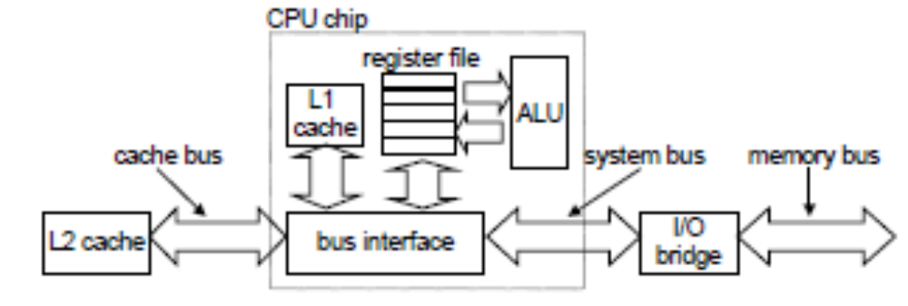

Slide 47
A computer system:
Each memory address = m bits
2^{m} unique addresses.
Cache sets (S):
The cache is organized as an array of S sets
S = 2^{s} cache sets.
Cache Lines (E):
Each set consists of E cache lines.
Cache Block (B):
Each line consists of a data block of
B = 2^{b} bytes,
Valid bit:
a valid bit that indicates whether or not the line contains meaningful information, and
Tag Bits:
t = m-(b+s) tag bits (a subset of the bits from the current block’s memory address) that uniquely identify the block stored in the cache line.

Slide 48
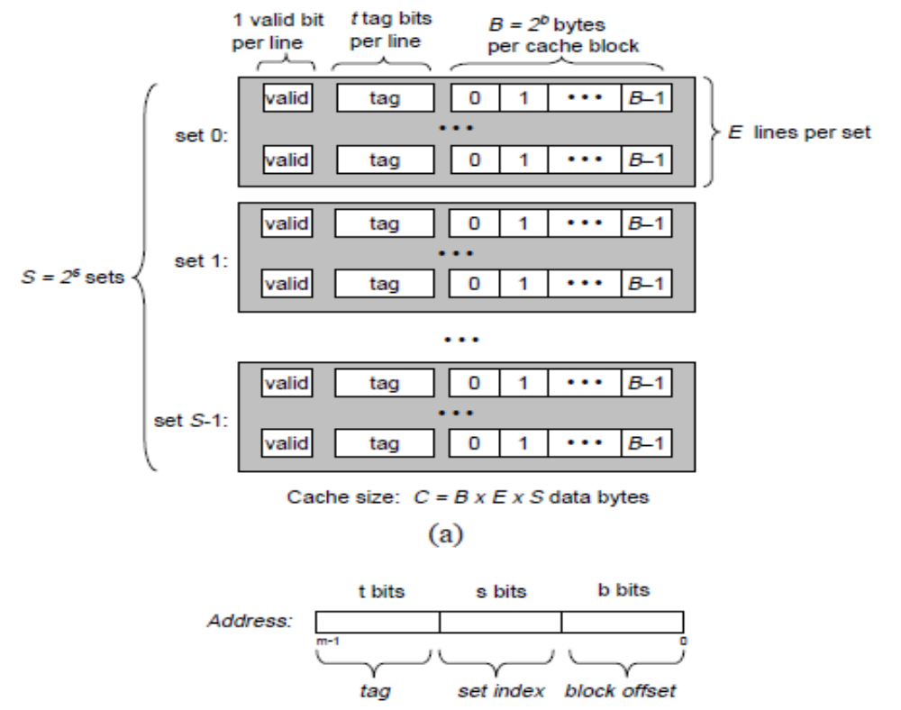
General organization of cache (S, E, B, m).
A cache is an array of sets. Each set contains one or more lines. Each line contains a valid bit, some tag bits, and a block of data.
(b) The cache organization induces a partition of the m address bits into t tag bits, s set index bits, and b block offset bits

Slide 49
In general, a cache’s organization can be characterized by the tuple
<S, E, B,m>.
The size (or capacity) of a cache, C, is stated in terms of the aggregate size of all the blocks. The tag bits and valid bit are not included.
Thus, C = S £ E £ B.
If the cache is holding a copy of the word at address A, it sends the word
immediately back to the CPU.
When the CPU is instructed by a load instruction to read a word from address A of main memory, it sends the address A to the cache.
The cache is organized so that it can find the requested word by simply inspecting the bits of the address, similar to a hash table with an extremely simple hash function.

Slide 50
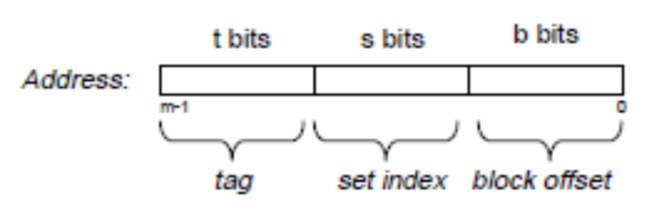
The parameters S and B induce a partitioning of the m address bits into the three fields.
Set Index Bits:
The s set index bits in A form an index into the array of S sets.
The first set is set 0, the second
set is set 1, and so on.
When interpreted as an unsigned integer, the set index bits tell us which set the word must be stored in.
Tag Bits:
Once we know which set the word must be contained in, the t tag bits in A tell us which line (if any) in the set contains the word.
A line in the set contains the word if and only if the valid bit is set and the tag bits in the line match the tag bits in the address A.
Block Offset Bits:
Once we have located the line identified by the tag in the set identified by the set index, then the b block offset bits give us the offset of the word in the B-byte data block.

Slide 51
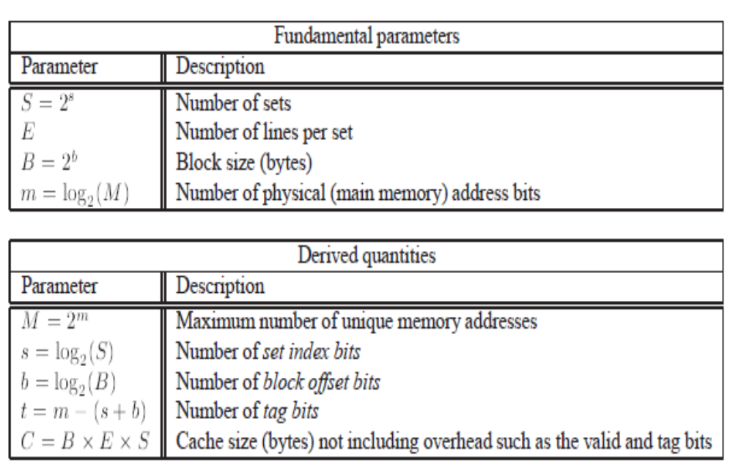

Slide 52
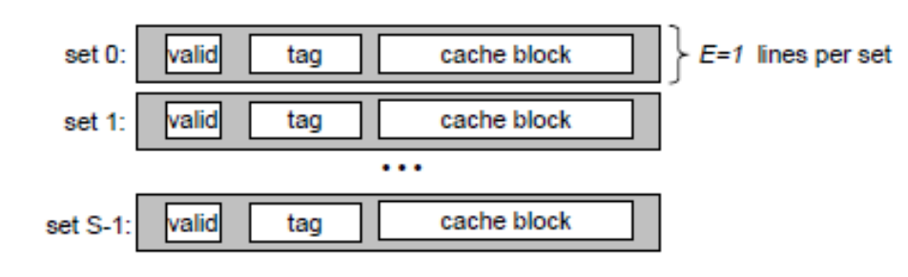
Direct-mapped Cache:
Caches are grouped into different classes based on E, the number of cache lines per set. A cache with exactly one line per set (E = 1) is known as a direct-mapped cache.

Slide 53
System:
a CPU,
a register file,
an L1 cache, and
a main memory.
CPU executes an instruction
that needs to read a memory word w,
it requests the word from the L1 cache
if
the L1 cache has a cached copy of w,
(L1 cache hit)
the cache extracts w and returns it to the CPU.
else /* cache miss*/
the CPU waits and
L1 cache requests a copy of the block
containing w from the main memory.
requested block arrives from memory,
L1 cache stores the block in one of its cache lines, extracts word w from the stored block,
and returns it to the CPU.

Slide 54
The process that a cache goes through of determining whether a request is a hit or a miss, and then extracting the requested word consists of three steps:
(1) set selection,
(2) line matching, and
(3) word extraction.

Slide 55
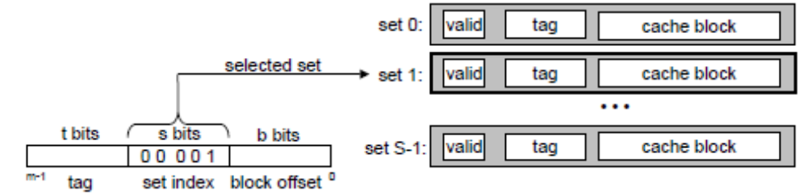
Set Selection in Direct-Mapped Caches
The cache extracts the s set index bits from the middle of the address for w.
These bits are interpreted as an unsigned integer that corresponds to a set number.
the set index bits form an index into this array.
The set index bits 00001 are interpreted as an integer index that selects set 1.

Slide 56
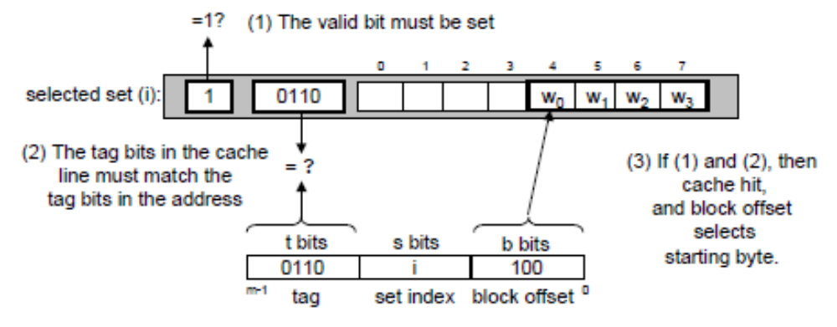
Line Matching in Direct-Mapped Caches:
Selected some set i in the previous step, next determine if a copy of the
word w is stored in one of the cache lines contained in set i.
In a direct-mapped cache, this is easy and fast
because there is exactly one line per set.
A copy of w is contained in the line if and only if
the valid bit is set and
the tag in the cache line matches the tag in the address of w.

Slide 57
There is exactly one cache line in the selected set.
The valid bit for this line is set,
so we know that the bits in the tag and block are meaningful.
Since the tag bits in the cache line match the tag bits in the address,
we know that a copy of the word we want is indeed stored in the line -- a cache hit.
On the other hand, if either the valid bit were not set or the tags did not match, then we would have had a cache miss.

Slide 58
Word Selection in Direct-Mapped Caches
a cache hit,
w is somewhere in the block.
The block offset bits of 100 indicate that the copy of w starts at byte 4 in the block. (assumed that words are 4 bytes long.)

Slide 59
Line Replacement on Misses in Direct-Mapped Caches
If the cache misses,
then it needs to retrieve the requested block from the next level in the memory hierarchy
and store the new block in one of the cache lines of the set indicated by the set index bits.
In general, if the set is full of valid cache lines, then one of the existing lines must be evicted.
For a direct-mapped cache,
where each set contains exactly one line, the replacement policy is trivial: the current line is replaced by the newly fetched line.

Slide 60
Suppose we have a direct-mapped cache where
(S, E, B, m) = (4,1,2,4)
the cache has four sets,
one line per set,
2 bytes per block, and
4-bit addresses
each word is a single byte

Slide 61
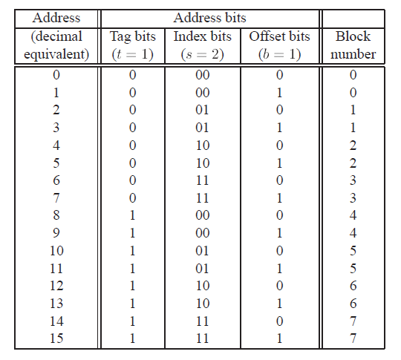
Since there are eight memory blocks but only four cache sets, multiple blocks map to the same cache set (i.e., they have the same set index).
For example, blocks 0 and 4 both map to set 0, blocks 1 and 5 both map to set 1, and so on.
The tag and index bits uniquely identifies each block in memory.
For example,
block 0 consists of addresses 0 and 1, block 1 consists of addresses 2 and 3, block 2 consists of addresses 4 and 5, and so on.
3. Blocks that map to the same cache set are uniquely identified by the tag.
For example, block 0 has a tag bit of 0 while block 4 has a tag bit of 1, block 1 has a tag bit of 0 while block 5 has a tag bit of 1.

Slide 62
Issues with writes:
Write hit:
CPU writes a word w that is already cached (a write hit).
Cache updates its copy of w,
Does it do about updating the copy of w in memory?
Write-through:
Immediately write w’s cache block to memory.
Cost:
A write transaction on the bus
with every store instruction.
Write-back
Defers the memory update.
Writes the updated block to memory only when it is evicted from the cache by the replacement algorithm.
Significantly reduces the number of bus transactions due to locality.
Additional complexity:
dirty bit:
Must maintain an additional dirty bit for each cache line that indicates whether or not the cache block has been modified.

Slide 63
Write miss:
Write-allocate:
Loads the corresponding
memory block into the cache and then updates the cache block.
Write-allocate tries to exploit
spatial locality of writes, but has the disadvantage that every miss results in a block transfer from memory to cache.
Or, No-write-allocate:
Bypasses the cache and writes the word directly to memory.
Write-through caches are typically no-write-allocate.
Write-back caches are typically write-allocate.

Slide 64
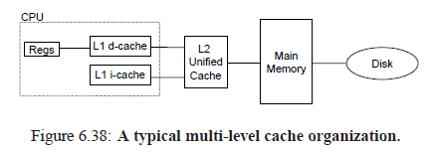
Instruction Caches and Unified Caches
i-cache:
A cache that holds instructions only is known as an i-cache.
d-cache:
A cache that holds program data only is known as a d-cache.
unified-cache:
Holds both instructions and data is known as a unified cache.
A typical desktop systems includes an L1 i-cache and an L1 d-cache on the CPU chip itself, and a separate off-chip L2 unified cache.

Slide 65
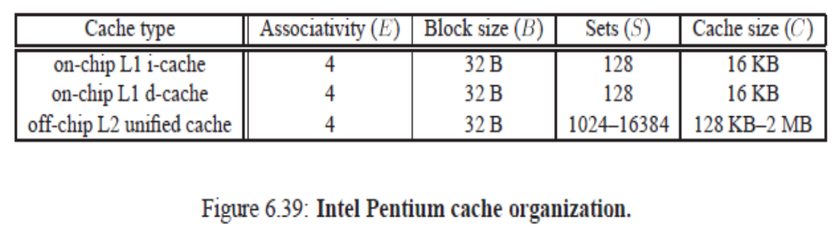
Intel Pentium Cache Organizaton:

Slide 66
Cache performance:
Miss rate.
The fraction of memory references during the execution of a program, or a part of a program, that miss.
(= # misses / # references).
Hit rate.
The fraction of memory references that hit. (=1 - miss rate).
Hit time.
The time to deliver a word in the cache to the CPU, including the time for set selection, line identification, and word selection. Hit time is typically 1 to 2 clock cycle for L1 caches.
Miss penalty.
Any additional time required because of a miss. The penalty for L1 misses served from L2 is typically 5 to 10 cycles. The penalty for L1 misses served from main memory is typically 25 to 100 cycles.

Slide 67
Impact of Cache Size
A larger cache will tend to increase the hit rate.
It is always harder to
make big memories run faster.
So larger caches tend to decrease the hit time.
Important for on-chip L1 caches - a hit time of one clock cycle.
However,
for a given cache size,
larger blocks imply a
smaller number of cache lines,
may hurt the hit rate in programs with more temporal locality than spatial locality.
Larger blocks also have a negative impact on the miss penalty, since larger blocks cause larger transfer times.
Modern systems has cache blocks that contain 4 to 8 words.
Impact of Block Size
Mixed blessing.
Larger blocks increases the hit rate by exploiting any spatial locality that might exist in a program.

Slide 68
Impact of Associativity
the parameter E, the number of cache lines per set.
Higher associativity (larger E)
- decreases the vulnerability of the cache to thrashing due to conflict misses.
Expensive to implement and hard to make fast.
More tag bits per line, additional
LRU state bits per line, and additional control logic.
Higher associativity can increase hit time, because
of the increased complexity.
Can also increase the miss penalty because of the increased complexity of
choosing a victim line.

Slide 69
The choice of associativity ultimately boils down to a trade-off between the hit time and the miss penalty.
Traditionally, high-performance systems that pushed the clock rates would opt for direct-mapped L1 caches (where the miss penalty is only a few cycles) and a small degree of associativity (say 2 to 4) for the lower levels.
In Intel Pentium systems, the L1 and L2 caches are all four-way
set associative.
In Alpha 21164 systems, the L1 instruction and data caches are direct-mapped, the L2 cache
is three-way set associative, and the L3 cache is direct-mapped.

Slide 70
Impact of Write Strategy
Write-through caches are simpler to implement and can use a write buffer that works independently of the cache to update memory.
Read misses are less expensive because they do not trigger a memory write.
Write-back caches result in fewer transfers, which allows more bandwidth to memory for I/O devices that perform DMA.
Further, reducing the number of transfers becomes increasingly
important as we move down the hierarchy and the transfer times increase.
In general, caches further down
the hierarchy are more likely to use write-back than
write-through.

Slide 72
Instruction Caches and Unified Caches
i-cache:
A cache that holds instructions only is known as an i-cache.
d-cache:
A cache that holds program data only is known as a d-cache.
unified-cache:
Holds both instructions and data is known as a unified cache.
A typical desktop systems includes an L1 i-cache and an L1 d-cache on the CPU chip itself, and a separate off-chip L2 unified cache.

Slide 73
The Memory Mountain
Read throughput:
The rate that a program reads data from the memory system.
A program reads n bytes over a period of s seconds :-
Read throughput = n/s, MB/s.

Slide 74
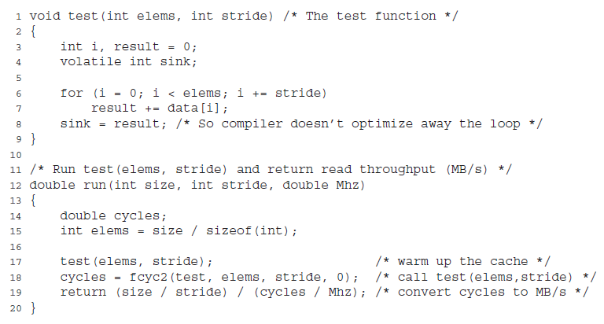
words
generates the read sequence by scanning the first elems elements of an integer array with a stride of stride
bytes
run function is a wrapper that calls the test function and returns the measured read throughput.
Functions that measure and compute read throughput.

Slide 75
size and stride arguments to the run function allow us to control the degree of locality in the resulting read sequence
Smaller size → smaller working set size → more temporal locality
Smaller stride → more spatial locality
Functions that measure and compute read throughput.

Slide 76
Memory Mountain:
If we call the run function repeatedly
with different values of size and stride, then we can recover a two-dimensional function of read bandwidth versus temporal and spatial locality called the memory mountain.

Slide 77
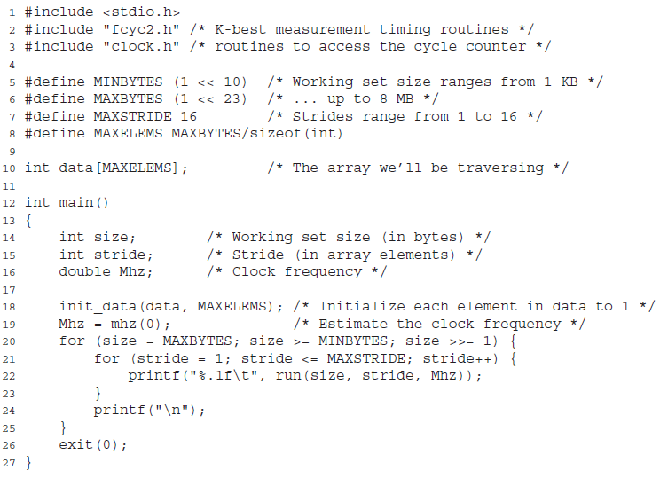

Slide 78
The mountain program calls the run function with different working set sizes and strides.
Working set sizes start at 1 KB, increasing by a factor of two, to a maximum of 8 MB. Strides range from 1 to 16.
For each combination of working set size and stride, mountain prints the read throughout, in units of MB/s. The mhz function in line 19 is a system-dependent routine that estimates the CPU clock frequency.

Slide 79
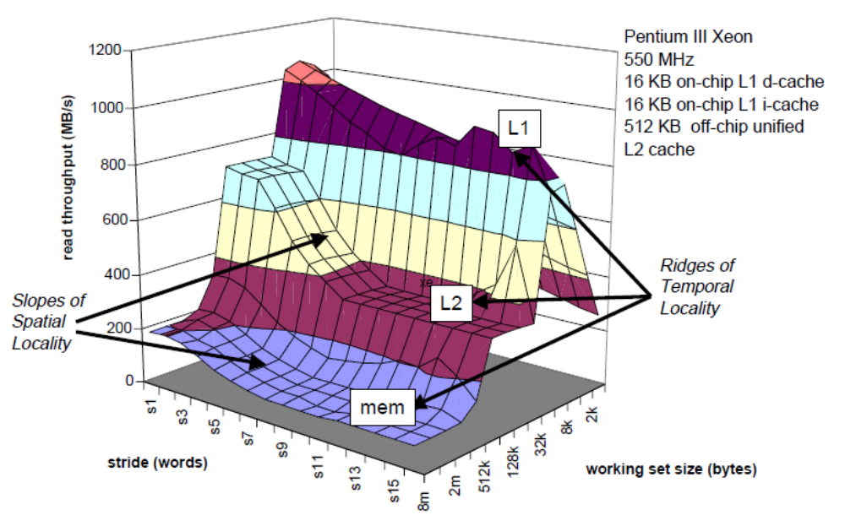
Perpendicular to the size axis are three ridges that correspond to the regions of temporal locality where the working set fits entirely in the L1 cache, the L2 cache, and main memory respectively.
The memory mountain for an Intel Pentium III Xeon system

Slide 80
Notice that there is an order of magnitude difference between the highest peak of the L1 ridge, where the CPU reads at a rate of 1 GB/s, and the lowest point of the main memory ridge, where the CPU reads at a rate of 80 MB/s.
The memory mountain for an Intel Pentium III Xeon system

Slide 81
There are two features of the L1 ridge that should be pointed out. First, for a constant stride, notice how the read throughput plummets as the working set size decreases from 16 KB to 1 KB (falling off the back side of the ridge).
The memory mountain for an Intel Pentium III Xeon system

Slide 82
Second, for a working set size of 16 KB, the peak of the L1 ridge line decreases with increasing stride. Since the L1 cache holds the entire working set, these features do not reflect the true L1 cache performance.
The memory mountain for an Intel Pentium III Xeon system

Slide 83
They are artifacts of overheads of calling the test function and setting up to execute the loop. For the small working set sizes along the L1 ridge, these overheads are not amortized, as they are with the larger working set sizes.
The memory mountain for an Intel Pentium III Xeon system

Slide 84
On the L2 and main memory ridges, there is a slope of spatial locality that falls downhill as the stride increases. This slope is steepest on the L2 ridge because of the large absolute miss penalty that the L2 cache suffers when it has to transfer blocks from main memory.
The memory mountain for an Intel Pentium III Xeon system

Slide 85
The memory mountain for an Intel Pentium III Xeon system

Slide 86
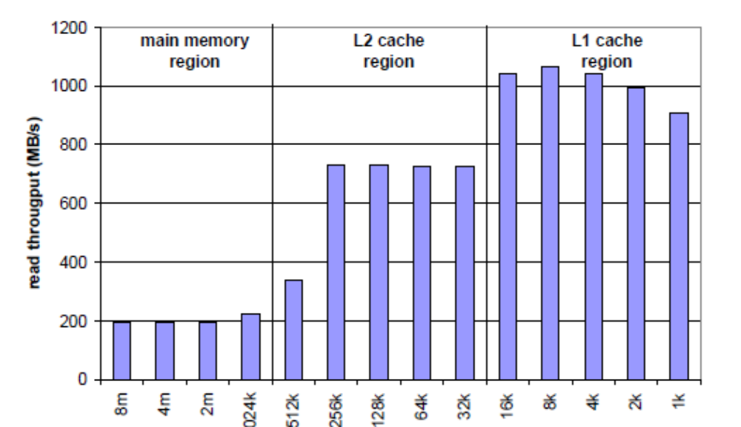
The impact of cache size and temporal locality on performance.
For sizes up to and including 16 KB, the working set fits entirely in the L1 d-cache, and thus reads are served from L1 at the peak throughput of about 1 GB/s.
For sizes up to and including 256 KB, the working set fits entirely in the unified L2 cache.
Ridges of temporal locality in the memory mountain, stride = 1.

Slide 87
Larger working set sizes are served primarily from main memory.
Ridges of temporal locality in the memory mountain, stride = 1.

Slide 88
The drop in read throughput between 256 KB and 512 KB is interesting.
Since the L2 cache is 512 KB, we might expect the drop to occur at 512 KB
instead of 256 KB. The only way to be sure is to perform a detailed cache simulation, but we suspect the reason lies in the fact that the Pentium III L2 cache is a unified cache that holds both instructions and data.
What we might be seeing is the effect of conflict misses between instructions and data in L2 that make it impossible for the entire array to fit in the L2 cache.
Ridges of temporal locality in the memory mountain, stride = 1.

Slide 89
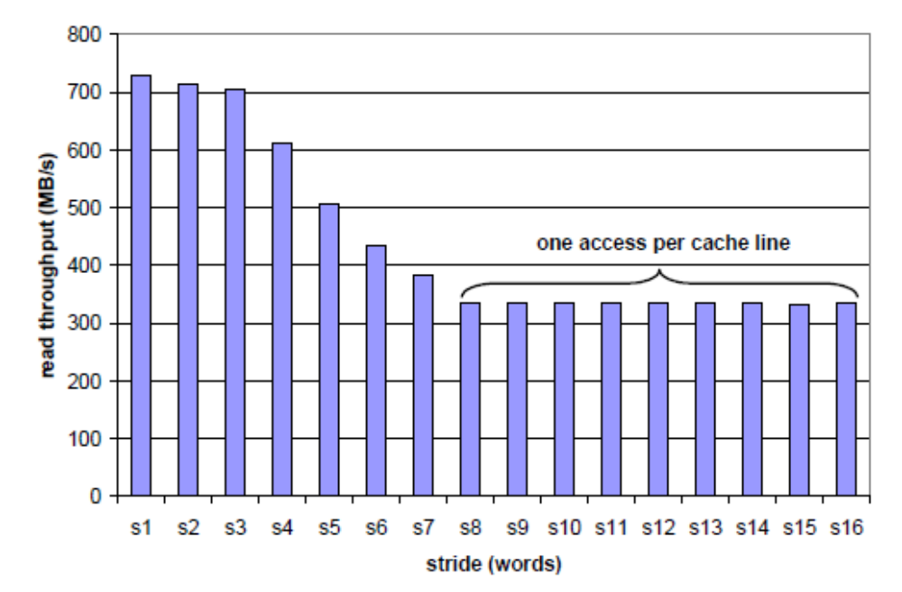
This slice cuts along the L2 ridge, where the working set fits entirely in the L2 cache, but is too large for the L1 cache.
Notice how the read throughput decreases steadily as the stride increases from 1 to 8 words. In this region of the mountain, a read miss in L1 causes a block to be transferred from L2 to L1.
This is followed by some number of hits on the block in L1, depending on the stride.
A slope of spatial locality. size=256 KB

Slide 90
As the stride increases, the ratio of L1 misses to L1 hits increases. Since misses
are served slower than hits, the read throughput decreases. Once the stride reaches 8 words, which on this system equals the block size, every read request misses in L1 and must be served from L2. Thus the read throughput for strides of at least 8 words is a constant rate determined by the rate that cache blocks can be
transferred from L2 into L1.
A slope of spatial locality. size=256 KB

