Slide 1
Operating Systems
Processes
A Biswas

Slide 2

Process Concept

Slide 3
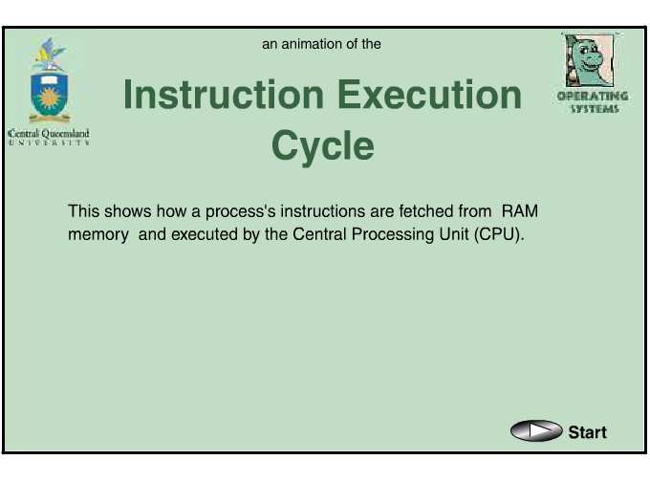
Process Concept

Slide 4
Process State
As a process executes, it changes state
  new: The process is being created
  running: Instructions are being executed
  waiting: The process is waiting for some event to occur
  ready: The process is waiting to be assigned to a processor
  terminated: The process has finished execution

Slide 5

Diagram of Process State

Slide 6
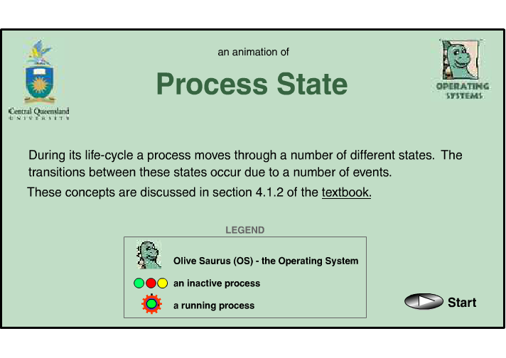
Diagram of Process State

Slide 7
Process Control Block (PCB)
Information associated with each process
Process state
Program counter
CPU registers
CPU scheduling information
Memory-management information
Accounting information
I/O status information

Slide 8

Process Control Block (PCB)

Slide 9
DATA STRUCTURE: THE PROCESS LIST
Operating systems are replete with various important data structures.
The process list is the first such structure. It is one of the simpler ones, but certainly any OS that has the ability to run multiple programs at once will have something akin to this structure in order to keep track of all the running programs in the system.
Sometimes people refer to the individual structure that stores information about a process as a Process Control Block (PCB).

Slide 10
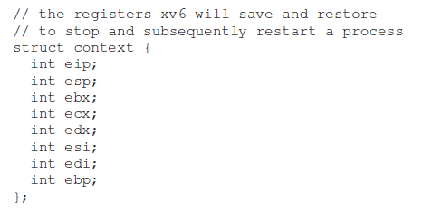


Slide 11
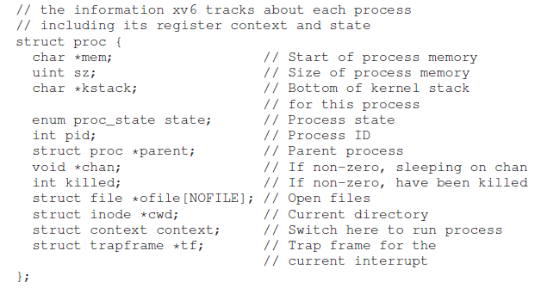

Slide 12
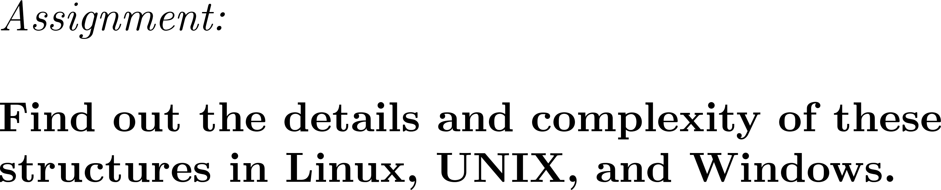

Slide 13

CPU Switch From Process to Process

Slide 14
PCBs / Process Descriptors
Process table
  The OS maintains pointers to each process’s PCB in a system-wide or per-user process table
  Allows for quick access to PCBs
  When a process is terminated, the OS removes the process from the process table and frees all of the process’s resources

Slide 15
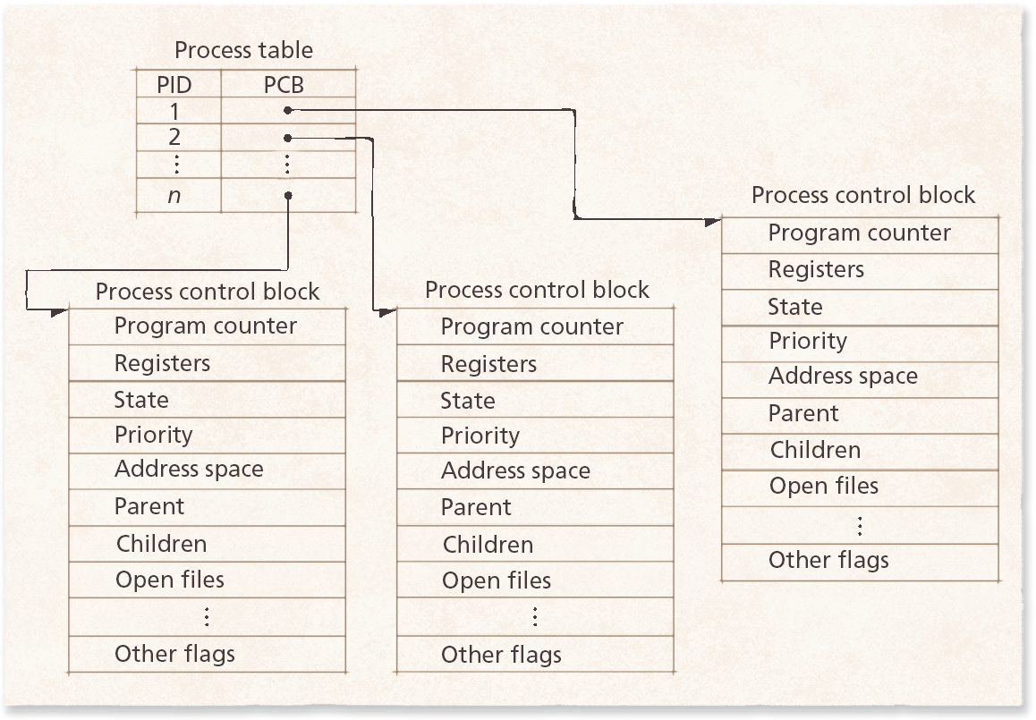
PCBs / Process Descriptors
Process table and process control blocks.

Slide 16
Process Scheduling Queues
Job queue – set of all processes in the system
Ready queue – set of all processes residing in main memory, ready and waiting to execute
Device queues – set of processes waiting for an I/O device
Processes migrate among the various queues

Slide 17

Ready Queue And Various I/O Device Queues

Slide 18

Representation of Process Scheduling

Slide 19
Schedulers
Long-term scheduler (or job scheduler) – selects which processes should be brought into the ready queue
Short-term scheduler (or CPU scheduler) – selects which process should be executed next and allocates CPU

Slide 20

Addition of Medium Term Scheduling

Slide 21
Schedulers (Cont.)
Short-term scheduler is invoked very frequently (milliseconds) ⇒ (must be fast)
Long-term scheduler is invoked very infrequently (seconds, minutes) ⇒ (may be slow)
The long-term scheduler controls the degree of multiprogramming
Processes can be described as either:
  I/O-bound process – spends more time doing I/O than computations, many short CPU bursts
  CPU-bound process – spends more time doing computations; few very long CPU bursts

Slide 22
Context Switch
When CPU switches to another process, the system must save the state of the old process and load the saved state for the new process
Context-switch time is overhead; the system does no useful work while switching
Time dependent on hardware support

Slide 23
Process Creation
Parent process create children processes, which, in turn create other processes, forming a tree of processes
Resource sharing
  Parent and children share all resources,
  Children share subset of parent’s resources, or
  Parent and child share no resources
Execution
  Parent and children execute concurrently, or
  Parent waits until children terminate

Slide 24
Process Creation (Cont.)
Address space
  Child duplicate of parent, or
  Child has a program loaded into it
UNIX examples
  fork system call creates new process
  exec system call used after a fork to replace the process’ memory space with a new program

Slide 25

Process Creation

Slide 26
fork()
The child isn’t an exact copy. Specifically, although it now has its own copy of the address space (i.e., its own private memory), its own registers, its own PC, and so forth, the value it returns to the caller of fork() is different.
Specifically, while the parent receives the PID of the newly-created child, the child is simply returned a 0. This differentiation is useful, because it is simple then to write the code that handles the two different cases.

Slide 27
C Program Forking Separate Process
int main()
{
  pid_t pid;
/* fork another process */
pid = fork();
if (pid < 0) { /* error occurred */
fprintf(stderr, "Fork Failed");
exit(-1);
}
else if (pid == 0) { /* child process */
execlp("/bin/ls", "ls", NULL);
}
else { /* parent process */
/* parent will wait for the child to complete */
wait (NULL);
printf ("Child Complete");
exit(0);
}
}

Slide 28
fork()
The output is not deterministic.
When the child process is created, there are now two active processes in the system: the parent and the child.

Slide 29
wait()
Sometimes, as it turns out, it is quite useful for
a parent to wait for a child process to finish what it has been doing.
This task is accomplished with the wait() system call. the parent process calls wait() to delay its execution until the child finishes executing.
When the child is done, wait() returns to the parent.

Slide 30
exec
However, sometimes you want to run a different program; exec() does just that.
What it does: given the name of an executable, and some arguments, it takes the code from that executable and overwrites its current code segment with it; the heap and stack and other parts of the memory space of the programme reinitialized.

Slide 31
exec
Then the OS simply runs that program, passing in any arguments as the argv of that process. Thus, it does not create a new process; rather, it transforms the currently running program into a different running program.
After the exec() in the child, it is almost as if p3.c never ran; a successful call to exec() never returns.

Slide 32
UNIX Shell
main()
{
  while(read from stdin) /* command */
  {
    if (fork()==0)
    {
      execve(command);
    }
  }
}

Slide 33

A tree of processes on a typical Solaris

Slide 34
Process Termination
Process executes last statement and asks the operating system to delete it (exit)
  Output data from child to parent (via wait)
  Process’ resources are deallocated by operating system
Parent may terminate execution of children processes (abort)
  Child has exceeded allocated resources
  Task assigned to child is no longer required
  If parent is exiting
    Some operating system do not allow child to continue if its parent terminates
      All children terminated - cascading termination

Slide 35
Book
“Advanced Programming in the UNIX Environment” W. Richard Stevens and Stephen A. Rago Addison-Wesley, 1992

Slide 36
Restricted Operations
Direct execution has the obvious advantage of being fast; the program runs natively on the hardware CPU and thus executes as quickly as one would expect.
But running on the CPU introduces a problem:
what if the process wishes to perform some kind of restricted operation, such as issuing an I/O request to a disk?

Slide 37
Restricted Operations
A process could simply read the entire disk and thus all protections would be lost.

Slide 38
User mode
Introduce a new processor mode, known as user mode; any code that runs in user mode is restricted in what it can do.
For example, when running in user mode, a process can’t issue any I/O requests; doing so would result in the processor raising an exception; the OS would then likely kill the process.

Slide 39
Kernel mode
In contrast to user mode is kernel mode, which the operating system (or kernel) runs in.
In this mode, code that runs can do what it likes, including privileged operations such as issuing I/O requests and executing all types of restricted instructions.

Slide 40
Kernel mode
What should a user process do when it wishes to perform some kind of privileged operation,
such as reading from disk?
To enable this, virtually all modern hardware provides the ability for user programs to perform a system call.

Slide 41
Kernel mode
System calls allow the kernel to carefully expose certain key pieces of functionality to user programs, such as accessing the file system,
creating and destroying processes, communicating with other processes, and allocating more memory.
Most operating systems expose a few hundred such operations (early Unix systems exposed a much more concise subset of around twenty calls.

Slide 42
Kernel mode
Assignment:
See POSIX standard for details on what modern Unix systems expose.

Slide 43
Kernel mode
To execute a system call, a program must execute a special trap instruction. This instruction simultaneously jumps into the kernel and raises the privilege level to kernel mode; once in the kernel, the system can now perform whatever privileged operations are needed (if allowed), and thus do the required work for the calling process.

Slide 44
Kernel mode
When finished, the OS calls a special return-from-trap instruction, which returns into the calling user program while simultaneously reducing the privilege level back to user mode.

Slide 45
Kernel mode
The hardware needs to be careful when executing a trap, in that it must make sure to save enough of the caller’s register state in order to be able to return correctly when the OS issues the return from-trap instruction.

Slide 46
Kernel mode
On x86, for example, the processor will push the program counter, flags, and a few other registers onto a stack; the return-from-trap will pop these values off the stack and resume execution of the user-mode program.
Other hardware systems use different conventions, but the basic concepts are similar across platforms.

Slide 47
Kernel mode
The kernel does so by setting up a trap table at boot time. When the machine boots up, it does so in privileged (kernel) mode, and thus is free to configure machine hardware as need be.
One of the first things the OS thus does is to tell the hardware what code to run when certain exceptional events occur.
For example, what code should run when a hard-disk interrupt takes place, when a keyboard interrupt occurs, or when program makes a system call?

Slide 48
Kernel mode
The OS informs the hardware of the locations of these trap handlers, usually with some kind of special instruction.
Once the hardware is informed, it remembers the location of these handlers until the machine is next rebooted, and thus the hardware knows what to do (i.e., what code to jump to) when system calls and other exceptional events take place.

Slide 49
Kernel mode
Being able to execute the instruction to tell the hardware where the trap tables are is a very powerful capability.
Thus, it is also a privileged operation.
If you try to execute this instruction in user mode, the kernel won’t let you, and you can probably guess what will happen.
What you might think about: what types of horrible
things could you do to a system if you could install your own trap table?

Slide 50
Switching between Processes
If a process is running on the CPU, this by definition means the OS is not running.
If the OS is not running, how can it do anything at all?
While this sounds almost philosophical, it is a real problem: there is clearly no way for the OS to take an action if it is not running on the CPU.

Slide 51
Switching between Processes
A timer device can be programmed to raise an interrupt every so many milliseconds; when the interrupt is raised, the currently running process is halted, and a preconfigured interrupt handler in the OS runs.
At this point, the OS has regained control of the CPU, and thus can do what it pleases: stop the current process from running, and start a new one running.

Slide 52
Switching between Processes
The OS must inform the hardware of which code to run when the timer interrupt occurs; thus, at boot time, the OS does exactly that.
Second, also during the boot sequence, the OS must start the timer, which is of course a privileged operation. Once the timer has begun, the OS can thus feel safe in that control will eventually be returned to it, and thus the OS is free to run user programs.
The timer can also be turned off (also a privileged operation) !!! (when is it turned off?)

Slide 53
Switching between Processes
Note that the hardware has some responsibility when an interrupt occurs, in particular to save enough of the state of the program that was running when the interrupt occurred such that a subsequent return-from-trap instruction will be able to resume the running program correctly.

Slide 54
Switching between Processes
This set of actions is quite similar to the behavior of the hardware during an explicit system-call trap into the kernel, with various registers thus getting saved (e.g., onto a kernel stack) and thus easily restored by the return-from-trap instruction.

Slide 55
Saving and Restoring Context
Now that the OS has regained control, whether cooperatively via a system call, or more forcefully via a timer interrupt, a decision has to be made: whether to continue running the currently-running process, or switch to a different one.
This decision is made by a part of the operating system known as the scheduler.

Slide 56
Saving and Restoring Context
If the decision is made to switch, the OS then executes a low-level piece of code which is referred as a context switch.

Slide 57
Saving and Restoring Context
A context switch is conceptually simple: all the OS has to do is save a few register values for the currently-executing process and restore a few for the soon-to-be-executing process.
By doing so, the OS thus ensures that when the return-from-trap instruction is finally executed, instead of returning to the process that was running, the system resumes execution of another process.

Slide 58
Saving and Restoring Context
To save the context of the currently-running process, the OS will execute some low-level assembly code to save the general purpose
registers, PC, as well as the kernel stack pointer of the currently running process, and then restore said registers, PC, and switch to the kernel stack for the soon-to-be-executing process.

Slide 59
Saving and Restoring Context
By switching stacks, the kernel enters the call to the switch code in the context of one process (the one that was interrupted) and returns in the context of another (the soon-to-be-executing one).
When the OS then finally executes a return-from-trap instruction, the soon-to-be executing process becomes the currently-running process. And thus the context switch is complete.

Slide 60
How Long Context Switches take
A natural question you might have is: how long does something like a context switch take? Or even a system call?
For those of you that are curious, there is a tool called lmbench that measures exactly those things, as well as a few other performance measures that might be relevant.

Slide 61
How Long Context Switches take
Results have improved quite a bit over time, roughly tracking processor performance.
For example, in 1996 running Linux 1.3.37 on a 200-MHz P6 CPU, system calls took roughly 4 microseconds, and a context switch roughly 6 microseconds.
Modern systems perform almost an order of magnitude better, with sub-microsecond results on systems with 2- or 3-GHz processors.

Slide 62
Measurement
gettimeofday
rdtsc

Slide 63
Measurement
lmbench
Run two processes on a single CPU.
Set up two pipes between them.
The first process then issues a write to the first pipe, and waits for a read on the second; upon seeing the first process waiting for something to read from the second pipe, the OS puts the first process in the blocked state, and

Slide 64
Measurement
lmbench
4. Switches to the other process, which reads from the first pipe and then writes to the second.
5. When the second process tries to read from the first pipe again, it blocks, and thus the back-and-forth cycle of communication continues.
6. By measuring the cost of communicating like this repeatedly, lmbench can make a
good estimate of the cost of a context switch.

Slide 65
Measurement
Bind a process to a particular processor; on Linux, for example, the sched_setaffinity() call is what you’re looking for.
By ensuring both processes are on the same processor, you are making sure to measure the cost of the OS stopping one process and restoring another on the same CPU.

Slide 66
End

