Slide 1
Operating Systems
Session 4
CPU Scheduling

Slide 2
CPU Scheduling

Slide 3
CPU Scheduling
Maximum CPU utilization obtained with multiprogramming
CPU–I/O Burst Cycle – Process execution consists of a cycle of CPU execution and I/O wait
CPU burst distribution

Slide 4

CPU Bursts and I/O Bursts

Slide 5

Histogram of CPU-burst Times

Slide 6
Dispatcher
Dispatcher module gives control of the CPU to the process selected by the short-term scheduler; this involves:
  switching context
  switching to user mode
  jumping to the proper location in the user program to restart that program
Dispatch latency – time it takes for the dispatcher to stop one process and start another running

Slide 7
Scheduling Criteria
CPU utilization – keep the CPU as busy as possible
Throughput – # of processes that complete their execution per time unit
Turnaround time – amount of time to execute a particular process
Waiting time – amount of time a process has been waiting in the ready queue
Response time – amount of time it takes from when a request was submitted until the first response is produced, not output (for time-sharing environment)

Slide 8
Preemptive vs. Nonpreemptive Scheduling
Preemptive processes
  can be removed from their current processor
  can lead to improved response times
  important for interactive environments
  preempted processes remain in memory
Nonpreemptive processes
  run until completion or until they yield control of a processor
  unimportant processes can block important ones indefinitely

Slide 9
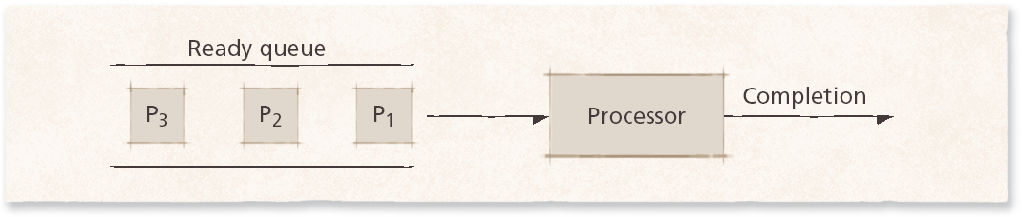
First-come First-served (FCFS) Scheduling
FCFS scheduling
  simplest scheme
  dispatched according to arrival time
  nonpreemptible
  rarely used as primary scheduling algorithm

Slide 10
First-Come First-Served (FCFS) Scheduling
Process Burst Time
P₁ 24
P₂ 3
P₃ 3
Suppose that the processes arrive in the order: P₁ , P₂ , P₃
The Gantt Chart for the schedule is:
Waiting time for P₁ = 0; P₂ = 24; P₃ = 27
Average waiting time: (0 + 24 + 27)/3 = 17
P₁
P₂
P₃
0
24
27
30

Slide 11
First-Come First-Served (FCFS) Scheduling
Suppose that the processes arrive in the order
P₂ , P₃ , P₁
The Gantt chart for the schedule is:
Waiting time for P₁ = 6; P₂ = 0; P₃ = 3
Average waiting time: (6 + 0 + 3)/3 = 3
Much better than previous case
Convoy effect short process behind long process
P₂
P₃
P₁
0
3
6
30

Slide 12
Shortest-Job-First (SJF) Scheduling
Associate with each process the length of its next CPU burst.
Use these lengths to schedule the process with the shortest time.
Two schemes:
  nonpreemptive
  once CPU given to the process it cannot be preempted until completes its CPU burst
  preemptive
  if a new process arrives with CPU burst length less than remaining time of current executing process, preempt. This scheme is know as the Shortest-Remaining-Time-First (SRTF)
SJF is optimal – gives minimum average waiting time for a given set of processes

Slide 13
Example of Non-Preemptive SJF
Process Arrival Time Burst Time
P₁ 0.0 7
P₂ 2.0 4
P₃ 4.0 1
P₄ 5.0 4
SJF (non-preemptive)
Average waiting time = (0 + 6 + 3 + 7)/4 = 4
P₁
P₃
P₂
P₄
0
3
7
8
12
16

Slide 14
Example of Preemptive SJF
Process Arrival Time Burst Time
P₁ 0.0 7
P₂ 2.0 4
P₃ 4.0 1
P₄ 5.0 4
SJF (Preemptive)
Average waiting time = (9 + 1 + 0 +2)/4 = 3
P₁
P₂
P₃
P₂
P₄
P₁
0
2
4
5
7
11
16

Slide 15

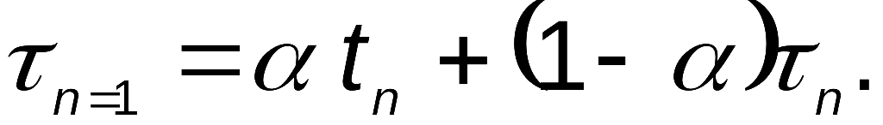
Approximate SJF
Determining Length of Next CPU Burst:
can only estimate the length
can be done by using the length of previous CPU bursts, using exponential averaging

Slide 16

Prediction of the Length of the Next CPU Burst
α = ½ and τ₀ = 10

Slide 17
Exponential Averaging
α =0
  τ_{n+1} = τ_{n}
  Recent history does not count
α =1
  τ_{n+1} = α t_{n}
  Only the actual last CPU burst counts
If we expand the formula, we get:
    τ_{n+1} = α t_{n}+(1 - α)α t_{n} -1 + …
    +(1 - α )^{j} α t_{n} _{-j} + …
    +(1 - α )^{n +1} τ₀
Since both α and (1 - α) are less than or equal to 1, each successive term has less weight than its predecessor

Slide 18
Priority Scheduling
A priority number (integer) is associated with each process
The CPU is allocated to the process with the highest priority (smallest integer => highest priority)
  preemptive
  nonpreemptive
SJF is a priority scheduling where priority is the predicted next CPU burst time
Problem ≡ Starvation – low priority processes may never execute
Solution ≡ Aging – as time progresses, increase the priority of the process

Slide 19
Round Robin (RR)
Each process gets a small unit of CPU time (time quantum), usually 10-100 milliseconds. After this time has elapsed, the process is preempted and added to the end of the ready queue.
If there are n processes in the ready queue and the time quantum is q, then each process gets 1/n of the CPU time in chunks of at most q time units at once. No process waits more than (n-1)q time units.
Performance
  q large ⇒ FIFO
  q small ⇒ q must be large with respect to context switch, otherwise overhead is too high

Slide 20
Time Quantum
Time slice too large
  FIFO behavior
  Poor response time
Time slice too small
  Too many context switches (overheads)
  Inefficient CPU utilization
Heuristic:
  70-80% of jobs block within time-slice
Typical time-slice
  10 to 100 ms
Time spent in system depends on size of job.

Slide 21
Example of RR with Time Quantum = 20
Process Burst Time
P₁ 53
P₂ 17
P₃ 68
P₄ 24
The Gantt chart is:
Typically, higher average turnaround than SJF, but better response
P₁
P₂
P₃
P₄
P₁
P₃
P₄
P₁
P₃
P₃
0
20
37
57
77
97
117
121
134
154
162

Slide 22

Time Quantum and Context Switch Time

Slide 23

Turnaround Time varies with the
Time Quantum

Slide 24
Multilevel Queue
Ready queue is partitioned into separate queues:
foreground (interactive)
background (batch)
Each queue has its own scheduling algorithm
  foreground – RR
  background – FCFS
Scheduling must be done between the queues
  Fixed priority scheduling; (i.e., serve all from foreground then from background). Possibility of starvation.
  Time slice – each queue gets a certain amount of CPU time which it can schedule amongst its processes; i.e., 80% to foreground in RR
  20% to background in FCFS

Slide 25

Multilevel Queue

Slide 26
Multilevel Feedback Queue
A process can move between the various queues;
aging can be implemented this way
Multilevel-feedback-queue scheduler defined by the following parameters:
  number of queues
  scheduling algorithms for each queue
  method used to determine when to upgrade a process
  method used to determine when to demote a process
  method used to determine which queue a process will enter when that process needs service

Slide 27
Example of Multilevel Feedback Queue
Three queues:
  Q₀ – RR with time quantum 8 milliseconds
  Q₁ – RR time quantum 16 milliseconds
  Q₂ – FCFS
Scheduling
  A new job enters queue Q₀ which is served FCFS. When it gains CPU, job receives 8 milliseconds. If it does not finish in 8 milliseconds, job is moved to queue Q₁.
  At Q₁ job is again served FCFS and receives 16 additional milliseconds. If it still does not complete, it is preempted and moved to queue Q₂.

Slide 28

Example of Multilevel Feedback Queue

Slide 29
Multilevel Feedback Queue
Discussions:
  Favors I/O bound processes to achieve good device utilization
  Separates processes into categories based on their CPU need
  Each time a process leaves the queue it is stamped with the identity of the lowest level queue in which it last resided.
  When the process reenters the fray for CPU, it is sent directly to the queue where it last completed its execution.
  (the past behavior is a good indicator of the future behavior)
  If the process changes its characteristics from CPU bound to I/O bound,
  1) the process is stamped with the time spent last time on
  the CPU.
  2) if a process voluntarily relinquishes the CPU, it may be
  moved up to the next level queue.

Slide 30
Selfish Round Robin (SRR)
Objective :
  To give better service to processes that have been executing for a while than to newcomers.
Implementation :
  Processes in the ready list are partitioned into two lists: new and accepted.
  new processes wait.
  accepted processes are serviced by RR.
  priority of a new process increases at rate a.
  priority of an accepted process increases at rate b .

Slide 31
Selfish Round Robin (SRR)
Implementation :
  a and b are parameters to tune the method.
  When the priority of a new process reaches the priority of an accepted process, that new process becomes accepted.
  If all accepted processes finish, the highest priority new process is accepted.

Slide 32
Selfish Round Robin (SRR)
Implementation :
  Assume that there are no ready processes, when the first one, A, arrives. It has priority 0 to begin with. Since there are no other accepted processes, A is accepted immediately.
  After a while another process, B, arrives. As long as b / a < 1, B’s priority will eventually catch up to A’s, so it is accepted; now both A and B have the same priority.
  All accepted processes share a common priority (which rises at rate b ); that makes this policy easy to implement.
  Even if b / a > 1, A will eventually finish, and then B can be accepted.

Slide 33
Selfish Round Robin (SRR)
Adjusting the parameters a and b :
  If b / a >= 1, a new process is not accepted until all the accepted processes have finished, so SRR becomes FCFS.
  If b / a = 0, all processes are accepted immediately, so SRR becomes RR.
  If 0 < b / a < 1, accepted processes are selfish, but not completely.

Slide 34
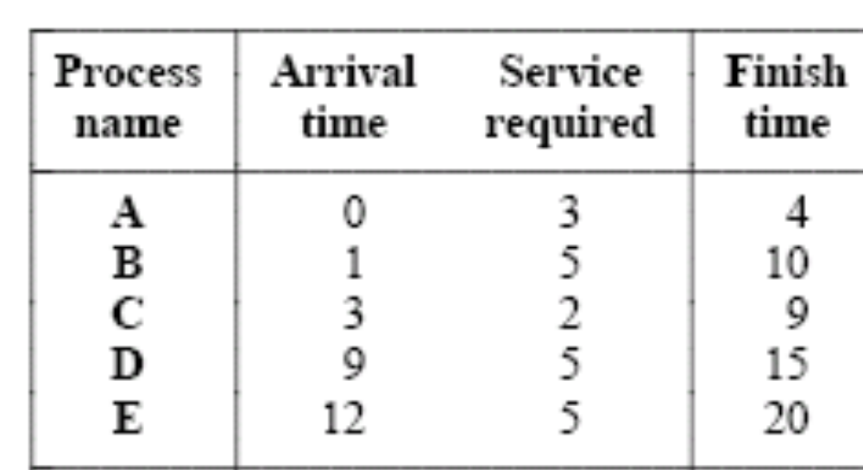
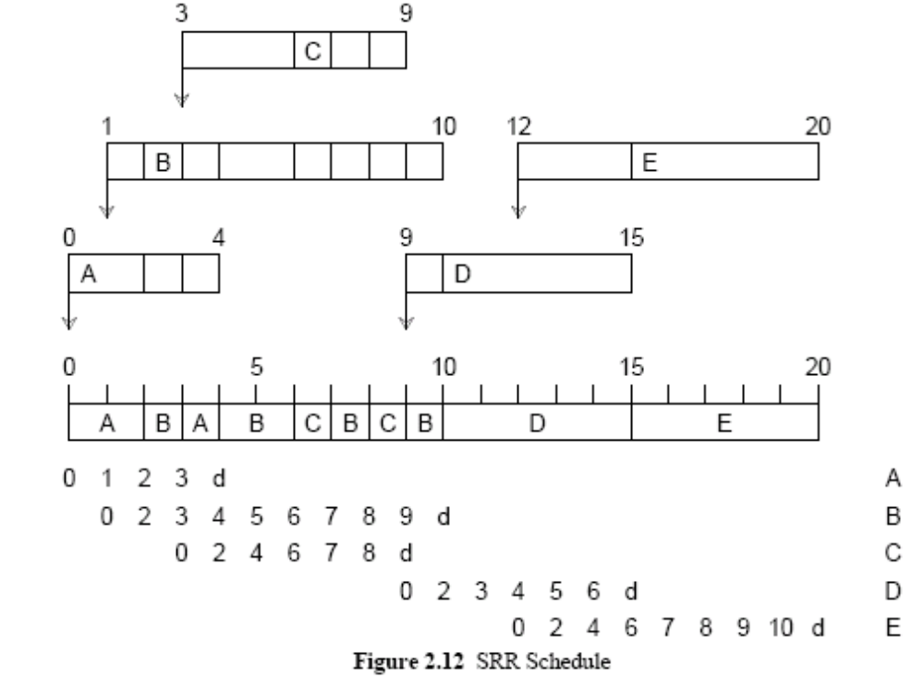
Demonstration a = 2 and b=1

Slide 35
Selfish Round Robin (SRR)
Demonstration a = 2 and b=1

Slide 36
Lottery Scheduling: Flexible Proportional-Share Resource Management
Carl A. Waldspurger 􀀀 William E. Weihl 􀀀
MIT Laboratory for Computer Science, 1994
Novelty :
  Lottery scheduling provides efficient, responsive control over the relative execution rates of computations.
  Such control is beyond the capabilities of conventional schedulers.
  Desirable in systems that service requests of varying importance, such as databases, media-based applications, and networks.

Slide 37
Lottery Scheduling: Flexible Proportional-Share Resource Management
Lottery Scheduling:
  Lottery scheduling is a randomized resource allocation mechanism.
  Resource rights are represented by lottery tickets.
  Each allocation is determined by holding a lottery; the resource is granted to the client with the winning
  ticket.
  This effectively allocates resources to competing
  clients in proportion to the number of tickets that they hold.

Slide 38
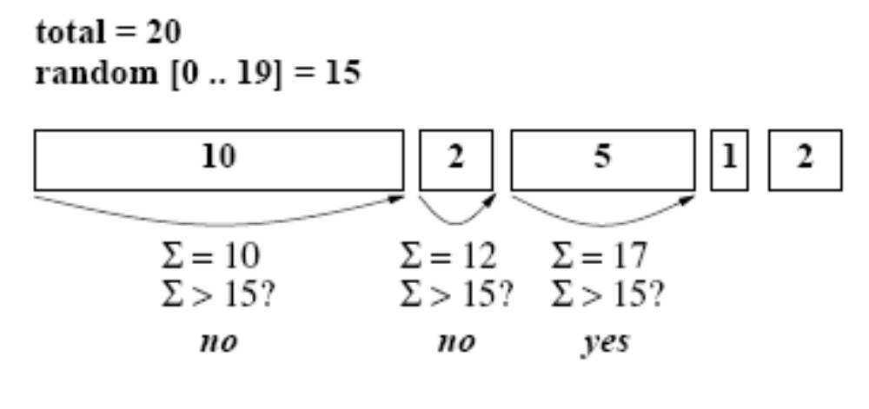
Lottery Scheduling: Flexible Proportional-Share Resource Management
Demonstration:

Slide 39
Lottery Scheduling: Flexible Proportional-Share Resource Management
Resource Rights:
  Lottery tickets encapsulate resource rights that are abstract, relative, and uniform.
  abstract:
  They quantify resource rights independently of machine details.
  relative:
  since the fraction of a resource that they represent varies dynamically in proportion to the contention for that resource. Thus, a client will obtain more of a lightly contended resource than one that is highly contended.
  uniform:
  because rights for heterogeneous resources can be homogeneously represented as tickets.

Slide 40
Lottery Scheduling: Flexible Proportional-Share Resource Management
Lotteries:
  Scheduling by lottery is probabilistically fair. The expected allocation of resources to clients is proportional to the number of tickets that they hold.
  Since the scheduling algorithm is randomized, the actual allocated proportions are not guaranteed to match the expected proportions exactly.
  However, the disparity between them decreases as the number of allocations increases.

Slide 41
Lottery Scheduling: Flexible Proportional-Share Resource Management
Lotteries:
  The number of lotteries won by a client has a binomial distribution.
  Probability p that a client holding t tickets will win a given lottery with total T tickets is given by: p = t / T.
  After n identical lotteries, the expected number of wins w is given by: E[w] = np with variance σ_{w}² = n.p.(1-p).

Slide 42

Lottery Scheduling: Flexible Proportional-Share Resource Management
Lotteries:
  The coefficient of variation for the observed proportion of wins is
  σ_{w} / E[w] =
  Thus, a client’s throughput is proportional to its ticket allocation, with accuracy that improves with √n.

Slide 43
Lottery Scheduling: Flexible Proportional-Share Resource Management
Lotteries:
  The number of lotteries required for a client’s first win has a geometric distribution.
  The expected number of lotteries n that a client must wait before its first win is given by:
E[n] = 1/p
with variance σ_{n}² = (1-p) / p² .
  So, a clients average response time is inversely proportional to ticket allocation.

Slide 44
Lottery Scheduling: Flexible Proportional-Share Resource Management
Lotteries:
  Since any client with a non-zero number of tickets will eventually win a lottery, the conventional problem of starvation does not exist.
  The lottery mechanism also operates fairly when the number of clients or tickets varies dynamically.
  For each allocation, every client is given a fair chance of winning proportional to its share of the total number of tickets. Since any changes to relative ticket allocations are immediately reflected in the next allocation decision, lottery scheduling is extremely responsive.

Slide 45
Lottery Scheduling: Flexible Proportional-Share Resource Management
Resource Management Policies:
Ticket Transfer:
  Ticket transfers are explicit transfers of tickets from one client to another.
  Ticket transfers can be used in any situation where a client blocks due to some dependency.
  For example, when a client needs to block pending a reply from an RPC, it can temporarily transfer its tickets to the server on which it is waiting.
  Clients also have the ability to divide ticket transfers across multiple servers on which they may be waiting.

Slide 46
Lottery Scheduling: Flexible Proportional-Share Resource Management
Resource Management Policies:
Ticket Inflation:
  Ticket inflation is an alternative to explicit ticket transfers in which a client can escalate its resource rights by creating more lottery tickets.
  In general, such inflation should be disallowed, since it violates desirable modularity and load insulation properties.
  For example, a single client could easily monopolize a resource by creating a large number of lottery tickets. However, ticket inflation can be very useful among mutually trusting clients; inflation and deflation can be used to adjust resource allocations without explicit communications.

Slide 47
Lottery Scheduling: Flexible Proportional-Share Resource Management
Resource Management Policies:
Compensation tickets:
  A client which consumes only a fraction f of its allocated resource quantum can be granted a compensation ticket that inflates its value by 1/f until the client starts its next quantum.
  This ensures that each client’s resource consumption, equal to f times its per-lottery win probability p , is adjusted by 1/f to match its allocated share p .
  Without compensation tickets, a client that does not consume its entire allocated quantum would receive less than its entitled share of the processor.

Slide 48
Case study: Solaris 2
Solaris uses priority based scheduling
Four classes of scheduling in order of priority
1) real time 2) system 3) time sharing 4) interactive
Each class has different priority and different scheduling algorithms.
A process starts as a LWP and can create more LWPs.
Default scheduling class for a process is time sharing.
Scheduling policy for time sharing dynamically adjusts priorities and assigns time slices of different lengths using multilevel feedback queue.

Slide 49
Case study: Solaris 2
The higher the priority the smaller the time slice
Interactive processes have a higher priority
CPU bound processes have a lower priority
Gives
  Good response time for interactive processes
  Good throughput for CPU bound processes
Interactive class uses same scheduling policy as the time sharing class but gives more priority for windowing applications.

Slide 50
Case study: Solaris 2
System class designates the kernel processes
(scheduling and paging daemon for example)
Priority of a system process does not change
User processes running in kernel mode are not in the system class
A system class thread runs until it either blocks or is preempted by a higher priority thread.

Slide 51
Case study: Solaris 2
Real time threads are given the highest priority amongst all classes
A real time process will run before a process in any other class

Slide 52
Case study: Solaris 2
Each scheduling class has a priority and the scheduler converts class-specific priorities into global priorities
Thread with the highest global priority is selected for CPU.
A thread runs until:
  it blocks
  uses the time slice ( if not a system thread)
  it is preempted by a higher priority thread
If there are multiple threads with same priority, round robin is used.

Slide 53
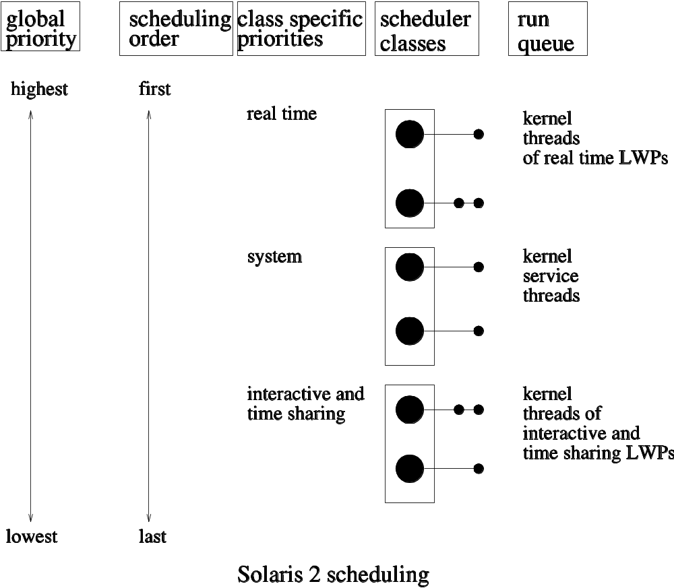

Slide 54
Case study: Windows 2000
Priority based preemptive scheduling
A thread selected by the dispatcher will run until
    preempted by a higher priority thread or
    it terminates, or
    its time quantum ends, or
    it calls a blocking system call (for I/O etc.)
If a higher real time thread is ready, the lower priority thread will be preempted

Slide 55
Case study: Windows 2000
Windows dispatcher uses 32-level priority to determine the order of thread execution
Priorities are divided into two classes:
  Variable class – threads with priorities from 1 to 15
  Real-time class – with priorities from 16 to 31
A thread running at priority 0 used for memory management
Dispatcher uses a queue for each scheduling priority, and traverses the set of queues from highest to lowest priority until finds a thread ready to run.
If no ready thread is found, it runs a special thread called idle thread

Slide 56
Case study: Windows 2000
A process may belong to several
priority classes:
1. REALTIME_PRIORITY_CLASS
2. HIGH_PRIORITY_CLASS
3. ABOVE_NORMAL_PRIORITY_CLASS
4. NORMAL_PRIORITY_CLASS
5. BELOW_NORMAL_PRIORITY_CLASS
6. IDLE_PRIORITY_CLASS
All priority classes except REALTIME_PRIORITY_CLASS are variable class properties.
Within each of these priority
classes there is a relative priority:
1. TIME_CRITICAL
2. HIGHEST
3. ABOVE_NORMAL
4. NORMAL
5. BELOW_NORMAL
6. LOWEST
7. IDLE
The priority of each thread is based upon the priority class it belongs to and the relative priority within the class.

Slide 57
Case study: Windows 2000
PRIORITY CLASSES
 | Real-time | High | Above Normal | Normal | Below normal | Idle priority
Time-critical | 31 | 15 | 15 | 15 | 15 | 15
Highest | 26 | 15 | 12 | 10 | 8 | 6
Above normal | 25 | 14 | 11 | 9 | 7 | 5
Normal | 24 | 13 | 10 | 8 | 6 | 4
Below normal | 23 | 12 | 9 | 7 | 5 | 3
Lowest | 22 | 11 | 8 | 6 | 4 | 2
Idle | 16 | 1 | 1 | 1 | 1 | 1
RELATIVE PRIORITY
BASE
PRIORITY

Slide 58
Case study: Windows 2000
Processes are typically members of the NORMAL_PRIORITY_CLASS unless the parent was of IDLE_PRIORITY_CLASS or another class was specified when the process was created.
Initial priority of the thread is typically the base priority of the process the thread belongs to.
If thread’s time quantum runs out, the thread is interrupted and if the thread is in variable priority class (not in real_time_priority_class), the priority is lowered.
Aim is to limit CPU consumption of compute-bound jobs

Slide 59
Case study: Windows 2000
When a variable priority thread is released from a wait operation, the dispatcher boosts priority:
  large boost for threads which had been waiting for key-board input
  moderate – for disk operation
Aim is to give good response time to interactive threads using key-board, mouse and windows, to keep the I/O devices busy.
Compute bound threads use the spare CPU cycles.
The current window gets a priority boost to enhance response time.

Slide 60
Case study: Windows 2000
Windows 2000 selects the foreground process (the window which is currently selected) and gives it typically thrice the time quantum for better results.

Slide 61
Case study: Linux
Linux uses two separate scheduling algorithms:
  time sharing algorithm for fair preemptive scheduling among multiple processes
  for real-time tasks with absolute priorities where priorities are more important than fairness

Slide 62
Case study: Linux
Linux allows only the processes running in user mode to be preempted.
A process may not be preempted while running in kernel mode even if a real time process with higher priority is available to run.

Slide 63
Case study: Linux
Time sharing scheduling class:
  uses a prioritized, credit-based algorithm
Each process has a certain number of scheduling credits, the process with the most credits is selected by the dispatcher
Every time a timer interrupt occurs, the process loses one scheduling credit, if the credit reaches zero, it is suspended.

Slide 64
Case study: Linux
If no runnable process have any credits, then recrediting is done.
Adds credits to all the processes (not only the runnable ones) in the system as per the following rule:
credit = credits / 2 + priority
Mixes the process’ history and its priority.
Half of the credits still held by the process is counted.

Slide 65
Case study: Linux
Processes running all the time,
  tend to exhaust their credits
  while the interactive processes accumulate credits over multiple recrediting operations,
  finally getting higher priority leading to rapid response.

Slide 66
Case study: Linux
Including the process priority while recrediting,
Linux forces the background batch jobs (having lower priority) to get less scheduling credits than the interactive jobs (with higher priority),
eventually forcing them spend less time on CPU.

Slide 67
Case study: Linux
Linux real time scheduling:
  The scheduler always runs the process with the highest priority
  If priorities are equal, it selects the one which has been waiting longest.
The above principles are implemented in two different paradigms:
1) FCFS 2) RR
This is soft real time scheduling
Scheduler maintains strict relative priority
Linux kernel code is never preempted
If kernel executes on behalf of another process, the “waken up” real time process may have to wait for the system call to complete or block.

Slide 68
Case study: Linux
SCHED_FIFO Scheduling
Any SCHED_FIFO task on a system will preempt any other tasks and run for as long as it wants to.
SCHED_FIFO tasks do not have timeslices.
Multiple SCHED_FIFO tasks are scheduled by priority - higher priority SCHED_FIFO tasks will preempt lower priority SCHED_FIFO tasks.
SCHED_RR Scheduling
SCHED_RR tasks have timeslices and are always preempted by SCHED_FIFO tasks.
SCHED_RR tasks are scheduled by priority, and within a certain priority they are scheduled in a round-robin fashion.
Each SCHED_RR task within a certain priority runs for its allotted timeslice, and then returns to the bottom of the list in its priority array queue.

Slide 69
End of Session 4

