Slide 1
Operating Systems
A Biswas
IT IIEST Shibpur

Slide 2
Deadlocks

Slide 3
Deadlock
In a multiprogramming environment, several processes may compete for a finite number of resources. A process requests resources; if the resources are not available at that time, the process enters a wait state. Waiting processes may never again change state, because the resources they have requested are held by other waiting processes. This situation is called deadlock.

Slide 4
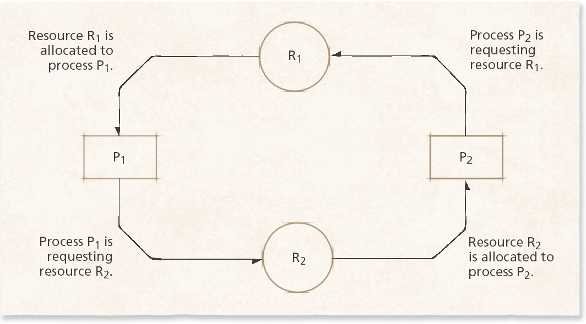

Slide 5
The Deadlock Problem
A set of blocked processes each holding a resource and waiting to acquire a resource held by another process in the set.
Example
  System has 2 disk drives.
  P₁ and P₂ each hold one disk drive and each needs another one.
Example
  semaphores A and B, initialized to 1
        P₀ P₁
        wait (A); wait(B)
        wait (B); wait(A)

Slide 6
System Model
Resource types R₁, R₂, . . ., R_{m}
    CPU cycles, memory space, I/O devices
Each resource type R_{i} has W_{i} instances.
Each process utilizes a resource as follows:
  request : waits until it acquires the resource
  use : can operate on the resource
  release : relinquish it

Slide 7
Deadlock Characterization
Deadlock can arise if four conditions hold simultaneously.
Mutual exclusion: only one process at a time can use a resource.

Slide 8
Deadlock Characterization
Deadlock can arise if four conditions hold simultaneously.
Hold and wait: a process holding at least one resource is waiting to acquire additional resources held by other processes.

Slide 9
Deadlock Characterization
Deadlock can arise if four conditions hold simultaneously.
No preemption: a resource can be released only voluntarily by the process holding it, after that process has completed its task.

Slide 10
Deadlock Characterization
Deadlock can arise if four conditions hold simultaneously.
Circular wait: there exists a set {P₀, P₁, …, P_{n}} of waiting processes such that P₀ is waiting for a resource that is held by P₁, P₁ is waiting for a resource that is held by P₂, …, P_{n–1} is waiting for a resource that is held by P_{n}, and P_{n} is waiting for a resource that is held by P₀.

Slide 11
Deadlock Characterization
Deadlock can arise if four conditions hold simultaneously.
Mutual exclusion: only one process at a time can use a resource.
Hold and wait: a process holding at least one resource is waiting to acquire additional resources held by other processes.
No preemption: a resource can be released only voluntarily by the process holding it, after that process has completed its task.
Circular wait: there exists a set {P₀, P₁, …, P_{n}} of waiting processes such that P₀ is waiting for a resource that is held by P₁, P₁ is waiting for a resource that is held by P₂, …, P_{n–1} is waiting for a resource that is held by P_{n}, and P_{n} is waiting for a resource that is held by P₀.

Slide 12
Resource-Allocation Graph
Consists of a set of vertices V and a set of edges E.
V is partitioned into two types:
  P = {P₁, P₂, …, P_{n}}, the set consisting of all the processes in the system.
  R = {R₁, R₂, …, R_{m}}, the set consisting of all resource types in the system.
request edge – directed edge P_{i} → R_{j}
assignment edge – directed edge R_{j} → P_{i}

Slide 13
Resource-Allocation Graph (Cont.)
Process
Resource Type with 4 instances
P_{i} requests instance of R_{j}
P_{i} is holding an instance of R_{j}
P_{i}
R_{j}
P_{i}
R_{j}

Slide 14

Example of a Resource Allocation Graph

Slide 15

Resource Allocation Graph With A Deadlock
If cycle involves resource types, each of which has single instance, then a cycle
implies deadlock.

Slide 16

Graph With A Cycle But No Deadlock
If each resource type has
several instances, a cycle
does not necessarily imply a deadlock.
Cycle is a necessary condition but not a sufficient condition for a deadlock to occur.

Slide 17
Basic Facts
If graph contains no cycles ⇒ no deadlock.
If graph contains a cycle ⇒
  if only one instance per resource type, then deadlock.
  if several instances per resource type, possibility of deadlock.

Slide 18
Methods for Handling Deadlocks
Ensure that the system will never enter a deadlock state.
Allow the system to enter a deadlock state and then recover.
Ignore the problem and pretend that deadlocks never occur in the system; used by most operating systems, including UNIX.

Slide 19


Slide 20


Slide 21
The Ostrich Algorithm
Guess: what is implemented in Linux?
Don’t do anything, simply restart the system (stick your head into the sand, pretend there is no problem at all).
Rationale:
  make the common path faster and more reliable
  Deadlock prevention, avoidance or detection/recovery algorithms are expensive
  if deadlock occurs only rarely, it is not worth the overhead to implement any of these algorithms.

Slide 22
Deadlock Prevention
Restrain the ways request can be made.
Deny at least one deadlock characterization condition.
Mutual Exclusion – not required for sharable resources; must hold for nonsharable resources.
Mutual-exclusion cannot be denied as some resources are intrinsically non-sharable.

Slide 23
Deadlock Prevention
Restrain the ways request can be made.
Deny at least one deadlock characterization condition.
Hold and Wait – must guarantee that whenever a process requests a resource, it does not hold any other resources.
  Require process to request and be allocated all its resources before it begins execution, or allow process to request resources only when the process has none.
  Low resource utilization; starvation possible.

Slide 24
Deadlock Prevention (cont.)
No Preemption –
  If a process that is holding some resources requests another resource that cannot be immediately allocated to it, then all resources currently being held are released.
  Preempted resources are added to the list of resources for which the process is waiting.
  Process will be restarted only when it can regain its old resources, as well as the new ones that it is requesting.

Slide 25
Deadlock Prevention (cont.)
Circular Wait – impose a total ordering of all resource types, and require that each process requests resources in an increasing order of enumeration.
Or, to acquire a resource type, relinquish all resources occurring later in the order. Proof

Slide 26
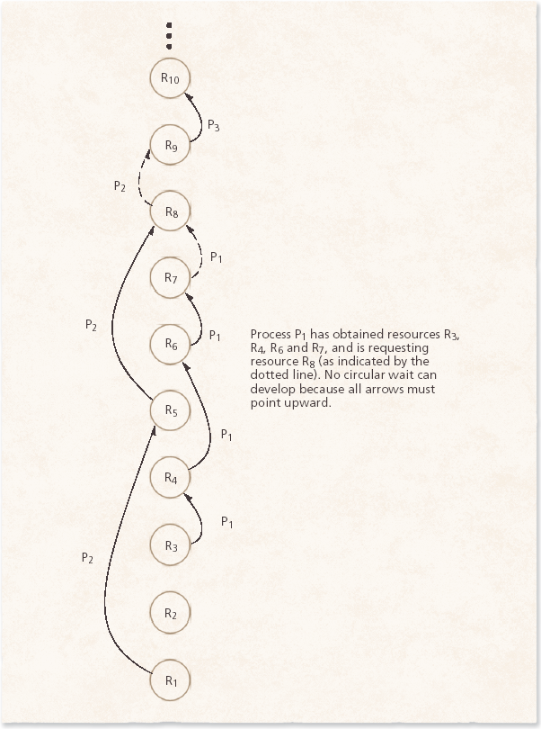

Slide 27
Deadlock Avoidance
Requires that the system has some additional a priori information available.
1. Each process declare the maximum number of resources of each type that it may need.

Slide 28
Deadlock Avoidance
Requires that the system has some additional a priori information available.
2. The deadlock-avoidance algorithm dynamically examines the resource-allocation state to ensure that there can never be a circular-wait condition.

Slide 29
Deadlock Avoidance
Requires that the system has some additional a priori information available.
3. Resource-allocation state is defined by the number of available and allocated resources, and the maximum demands of the processes.

Slide 30
Safe State
When a process requests an available resource, system must decide if immediate allocation leaves the system in a safe state.

Slide 31
Safe State
System is in safe state if there exists a safe sequence <P₁, P₂, …, P_{n}> of ALL the processes in the system such that for each P_{i}, the resources that P_{i} can still request can be satisfied by currently available resources + resources held by all the P_{j}, with j < i.

Slide 32
Safe State
That is:
  If P_{i} resource needs are not immediately available, then P_{i} can wait until all P_{j} have finished.
  When P_{j} is finished, P_{i} can obtain needed resources, execute, return allocated resources, and terminate.
  When P_{i} terminates, P_{i +1} can obtain its needed resources, and so on.

Slide 33
Basic Facts
If a system is in safe state ⇒ no deadlocks.
If a system is in unsafe state ⇒ possibility of deadlock.
Avoidance ⇒ ensure that a system will never enter an unsafe state.

Slide 34

Safe, Unsafe, Deadlock State

Slide 35
Avoidance algorithms
Two variations:
Single instance of a resource type
- use a resource-allocation graph
Multiple instances of a resource type - use the banker’s algorithm

Slide 36
Resource-Allocation Graph Scheme
Claim edge:
P_{i} → R_{j} indicated that process P_{j} may request resource R_{j}; represented by a dashed line.

Slide 37
Resource-Allocation Graph Scheme
Request edge:
when a process requests a resource –
claim edge → request edge

Slide 38
Resource-Allocation Graph Scheme
Assignment Edge:
when the resource is allocated to the process
request edge → assignment edge

Slide 39
Resource-Allocation Graph Scheme
When a resource is released by a process, assignment edge reconverts to a claim edge.
Resources must be claimed a priori in the system.

Slide 40
Resource-Allocation Graph Scheme
Claim edge: P_{i} → R_{j} indicated that process P_{j} may request resource R_{j}; represented by a dashed line.
Request edge: Claim edge converts to request edge when a process requests a resource.
Assignment Edge: Request edge converted to an assignment edge when the resource is allocated to the process.
When a resource is released by a process, assignment edge reconverts to a claim edge.
Resources must be claimed a priori in the system.

Slide 41


Resource-Allocation Graph
Suppose, P2 requests R2.
Cannot be granted because that creates
a cycle in the graph.

Slide 42
Resource-Allocation Graph Algorithm
Suppose that process P_{i} requests a resource R_{j}
Convert the request edge to assignment
If it results in a cycle in the RAG
The request cannot be granted.

Slide 43
Banker’s Algorithm
Multiple instances of resources.
Each process must declare an a priori claim of maximum use.
When a process requests a resource, it may have to wait.
When a process gets all its resources it must return them in a finite amount of time.

Slide 44
Data Structures for the Banker’s Algorithm
Let n = number of processes, and
m = number of resources types.
Available: Vector of length m.
If available [j] = k, there are k instances of resource type R_{j} available.

Slide 45
Data Structures for the Banker’s Algorithm
Let n = number of processes, and
m = number of resources types.
Max: n x m matrix.
If Max [i,j] = k, then process P_{i} may request at most k instances of resource type R_{j}.

Slide 46
Data Structures for the Banker’s Algorithm
Let n = number of processes, and
m = number of resources types.
Allocation: n x m matrix.
If Allocation[i,j] = k then P_{i} is currently allocated k instances of R_{j.}

Slide 47
Data Structures for the Banker’s Algorithm
Let n = number of processes, and
m = number of resources types.
Need: n x m matrix.
If Need[i,j] = k, then P_{i} may need k more instances of R_{j} to complete its task.
    Need [i,j]= Max[i,j]–Allocation[i,j].

Slide 48
Data Structures for the Banker’s Algorithm
Let n = number of processes, and
m = number of resources types.
Available: Vector of length m. If available [j] = k, there are k instances of resource type R_{j} available.
Max: n x m matrix. If Max [i,j] = k, then process P_{i} may request at most k instances of resource type R_{j}.
Allocation: n x m matrix. If Allocation[i,j] = k then P_{i} is currently allocated k instances of R_{j.}
Need: n x m matrix. If Need[i,j] = k, then P_{i} may need k more instances of R_{j} to complete its task.
    Need [i,j] = Max[i,j] – Allocation [i,j].

Slide 49
Safety Algorithm
TO FIND WHETHER THE SYSTEM IS IN SAFE STATE OR NOT.
1. Let Work and Finish be vectors of length m and n, respectively. Initialize:
      Work = Available
      Finish [i] = false for i = 0, 1, …, n- 1.
2. Find an i such that both:
  (a) Finish [i] = false
  (b) Need_{i} ≤ Work
  If no such i exists, go to step 4.
3. Work = Work + Allocation_{i}
Finish[i] = true
go to step 2.
4. If Finish [i] == true for all i, then the system is in a safe state.

Slide 50
Resource-Request Algorithm for Process P_{i}
A request can be granted or not?
Request = request vector for process P_{i}.
If Request_{i} [j] = k then process P_{i} wants k instances of resource type R_{j.}
  1. If Request_{i} ≤ Need_{i} go to step 2. Otherwise, raise error condition, since process has exceeded its maximum claim.
  2. If Request_{i} ≤ Available, go to step 3. Otherwise P_{i} must wait, since resources are not available.
  3. Pretend to allocate requested resources to P_{i} by modifying the state as follows:
      Available = Available – Request;
      Allocation_{i} = Allocation_{i} + Request_{i};
      Need_{i} = Need_{i} – Request_{i};
    If the resulting state is safe ⇒
    the resources are allocated to Pi.
    If unsafe ⇒ Pi must wait, and the old resource-allocation state is restored

Slide 51
Example of Banker’s Algorithm
5 processes P₀ through P₄;
3 resource types:
A (10 instances), B (5 instances), and C (7 instances).
Snapshot at time T₀:
Allocation Max Available
A B C A B C A B C
P₀ 0 1 0 7 5 3 3 3 2
P₁ 2 0 0 3 2 2
P₂ 3 0 2 9 0 2
P₃ 2 1 1 2 2 2
P₄ 0 0 2 4 3 3

Slide 52
Example (Cont.)
The content of the matrix Need is defined to be Max – Allocation.
Need
A B C
P₀ 7 4 3
P₁ 1 2 2
P₂ 6 0 0
P₃ 0 1 1
P₄ 4 3 1
The system is in a safe state since the sequence < P₁, P₃, P₄, P₂, P₀> satisfies safety criteria.

Slide 53
Example: P₁ Request (1,0,2)
Check that Request ≤ Available (that is, (1,0,2) ≤ (3,3,2) ⇒ true.
Allocation Need Available
A B C A B C A B C
P₀ 0 1 0 7 4 3 2 3 0
P₁ 3 0 2 0 2 0
P₂ 3 0 1 6 0 0
P₃ 2 1 1 0 1 1
P₄ 0 0 2 4 3 1
Executing safety algorithm shows that sequence < P₁, P₃, P₄, P₀, P₂> satisfies safety requirement.
Can request for (3,3,0) by P₄ be granted?
Can request for (0,2,0) by P₀ be granted?

Slide 54
Deadlock Detection
Allow system to enter deadlock state
Detection algorithm
Recovery scheme

Slide 55
Single Instance of Each Resource Type
Maintain wait-for graph
  Nodes are processes.
  P_{i} → P_{j} if P_{i} is waiting for P_{j} to release resources needed by P_{i}.
Periodically invoke an algorithm that searches for a cycle in the graph. If there is a cycle, there exists a deadlock.
An algorithm to detect a cycle in the wait-for graph requires an order of n² operations, where n is the number of vertices in the graph.

Slide 56

Resource-Allocation Graph and Wait-for Graph
Resource-Allocation Graph
Corresponding wait-for graph

Slide 57
Several Instances of a Resource Type
Available: A vector of length m indicates the number of available resources of each type.
Allocation: An n x m matrix defines the number of resources of each type currently allocated to each process.
Request: An n x m matrix indicates the current request of each process. If Request [i_{j}] = k, then process P_{i} is requesting k more instances of resource type R_{j}.

Slide 58
Detection Algorithm (cont.)
Let Work and Finish be vectors of length m and n
(a) Work = Available
  (b) For i = 1,2, …, n,
  if Allocation_{i} ≠ 0, then
  Finish[i] = false;
  otherwise,
  Finish[i] = true.
2. Find an index i such that both:
  (a) Finish[i] == false
  Request_{i} ≤ Work
  If no such i exists, go to step 4.
3. Work = Work + Allocation_{i}
Finish[i] = true
go to step 2.
if Finish[i] == false,
for some i, 1 ≤ i ≤ n, then
system is in deadlock state.
moreover,
if Finish[i] == false, then
P_{i} is deadlocked.
Algorithm requires an order of O(m x n²⁾ operations

Slide 59
Example of Detection Algorithm
Five processes P₀ through P₄; three resource types
A (7 instances), B (2 instances), and C (6 instances).
Snapshot at time T₀:
Allocation Request Available
A B C A B C A B C
P₀ 0 1 0 0 0 0 0 0 0
P₁ 2 0 0 2 0 2
P₂ 3 0 3 0 0 0
P₃ 2 1 1 1 0 0
P₄ 0 0 2 0 0 2
Sequence <P₀, P₂, P₃, P₁, P₄> will result in Finish[i] = true for all i.

Slide 60
Example (cont.)
P₂ requests an additional instance of type C.
Request
A B C
P₀ 0 0 0
P₁ 2 0 1
P₂ 0 0 1
P₃ 1 0 0
P₄ 0 0 2
State of system?
  Can reclaim resources held by process P₀, but insufficient resources to fulfill other processes; requests.
  Deadlock exists, consisting of processes P₁, P₂, P₃, and P₄.

Slide 61
Detection-Algorithm Usage
When, and how often, to invoke depends on:
  How often a deadlock is likely to occur?
  How many processes will need to be rolled back?
    one for each disjoint cycle
If detection algorithm is invoked arbitrarily, there may be many cycles in the resource graph and so we would not be able to tell which of the many deadlocked processes “caused” the deadlock.

Slide 62
Recovery from Deadlock: Process Termination
Abort all deadlocked processes.
Abort one process at a time until the deadlock cycle is eliminated.
In which order should we choose to abort?
  Priority of the process.
  How long process has computed, and how much longer to completion.
  Resources the process has used.
  Resources process needs to complete.
  How many processes will need to be terminated.
  Is process interactive or batch?

Slide 63
Recovery from Deadlock: Resource Preemption
Selecting a victim – minimize cost.
Rollback – return to some safe state, restart process for that state.
Starvation – same process may always be picked as victim, include number of rollback in cost factor.

Slide 64
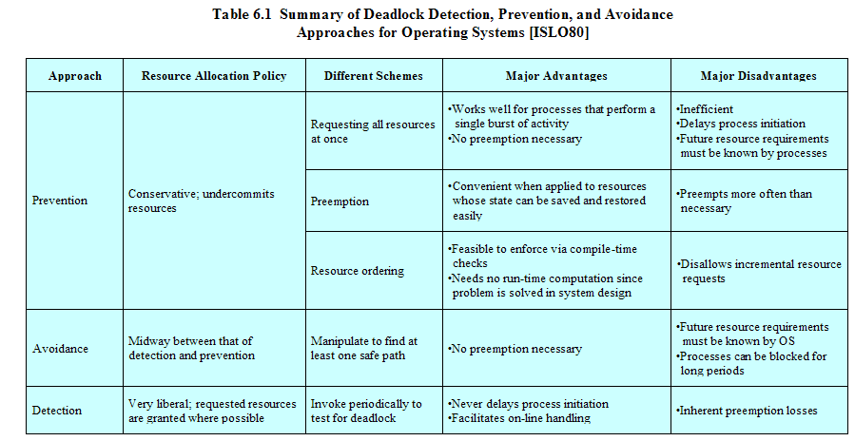

Slide 65
End of Session 6

