Slide 1
Operating Systems
Session 9
File System Interface

Slide 2
File System Interface

Slide 3
File System Interface
File – a named collection of data
Directory Structure – organizes and provides information about all the files in the system
Partitions – separates physically or logically large collection of directories
File protection – when multiple users need access to the files

Slide 4
File Concept
File – a logical storage unit
OS maps the files onto storage devices
File is the smallest allotment of logical secondary storage i.e. data cannot be written to secondary storage unless they are within a file.
Files represent program ( source and object ) and data ( numeric, alphabetic, alpha numeric or binary ).

Slide 5
File Concept
Structure of a file is defined and interpreted by the file’s creator and user. Hence, the concept of file is extremely general.
Examples:
  text files – a sequence of characters
  source – routines and subroutines etc.
  executable – series of code sections

Slide 6
File Attributes
Name – symbolic name in human readable form
Identifier - a unique tag that identifies the file within the file system
Type – different types.
Location – pointer to a device and the location inside that device.
Size – bytes or words or blocks.
Protection – access control info, who is eligible to read, write or execute
Time, date and user identification – creation, last modification, and last use.

Slide 7
File Operations
Creating a file – find space in the file system; make an entry for the new file in the directory
Writing a file – a system call searches the file from the directory; a write pointer is maintained.
Reading a file – read pointer is maintained.
Repositioning within a file – repositioning within a file.

Slide 8
File Operations
Deleting a file – deletes the file and the associated directory entry.
Truncating a file – erase the contents but keep the attributes
Appending, renaming etc.

Slide 9
File Open and Close
Requires two levels of internal tables:
1. per-process table 2. system wide table
Per process table: stores the information about the use of the file by the process. Current file pointer etc.
System wide table: contains process independent information : location of the file on disk, access dates and file size.

Slide 10
File Open and Close
File pointer: the last read-write location, the current file position pointer. Unique to each process operating on the file
File open count: each open increases the count and each close decreases the count.
Disk location : information needed to locate the file on disk.
Access rights: Each process opens a file in the access mode, this is stored in per-process table.

Slide 11
File Types
Executable
Object
Source code
Batch
Text
Library
Archive
Multimedia

Slide 12


Slide 13


Slide 14
Access Methods
Sequential Access: One record after the other – editor , compilers etc. Read next, write next etc.
Direct Access (or Relative Access): The file is made up of fixed length logical records and it allows to read or write in no particular order. Example: databases
A direct access file allows arbitrary blocks to be read or written.

Slide 15
Access Methods
Sequential Access
read next
write next
reset
no read after last write
(rewrite)
Direct Access
read n
write n
position to n
read next
write next
rewrite n
n = relative block number

Slide 16
Access Methods
Indexed systems:
1. Construct an index for the file.
2. First search the index.
3. Use the pointer from there to access the file directly and find the desired record.

Slide 17
Access Methods
Indexed systems:
With large files, the index will be too large.
Create an index for the index file.
Primary index file contain the pointer to the secondary index files.
The secondary index files point to the actual data items.

Slide 18

Example of Index and Relative Files

Slide 19
Access Methods
ISAM (Indexed Sequential Access Method) IBM:
1. A small master index pointing to blocks of secondary index.
2. Secondary index points to actual file blocks.
3. The file is kept sorted on a defined key.

Slide 20
Access Methods
ISAM (Indexed Sequential Access Method) IBM:
Steps:
Binary search on primary index
→ block number of secondary index
Binary search on secondary index
→ points to block of the file
3. Search the file block sequentially.

Slide 21
Directory Structure
Disks are split into one or two partitions.
(known as volumes, minidisks etc.)
Each partition contains information about the files inside it. These information are kept in device directory or volume table contents.
A device directory entry may contain
< name, location, size and type>
A directory translates the file names into their directory entries.

Slide 22

A Typical File-system Organization

Slide 23
Directory Structure
Operations on directory structure:
Search for a file
Create a file
Delete a file
List a directory
Rename a file

Slide 24

Single-Level Directory
A single directory for all users
All files are contained are contained in the same directory
Easy to support and understand
Issues: 1. Naming 2. Grouping

Slide 25

Two-Level Directory
Separate directory for each user
One master file directory
Each user has a user file directory
Path name
Can have the same file name for different user
Efficient searching
No grouping capability

Slide 26

Tree-Structured Directories

Slide 27
Tree-Structured Directories
Efficient searching
Grouping Capability
Current directory (working directory)
  cd /spell/mail/prog
  type list

Slide 28
Tree-Structured Directories
Absolute or relative path name
Creating a new file is done in current directory
Delete a file
rm <file-name>
Creating a new subdirectory is done in current directory
  mkdir <dir-name>
Example: if in current directory /mail
mkdir count
mail
prog
copy
prt
exp
count
Deleting “mail” ⇒ deleting the entire subtree rooted by “mail”

Slide 29

Acyclic-Graph Directories
Have shared subdirectories and files

Slide 30
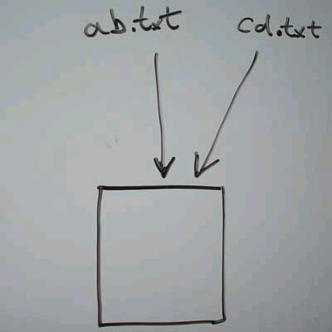
Acyclic-Graph Directories
A Hard Link is where a file has two names which are both on an equal weighting, and both of the file names in the "inode table" point directly to the blocks on the disc that contain the data.

Slide 31
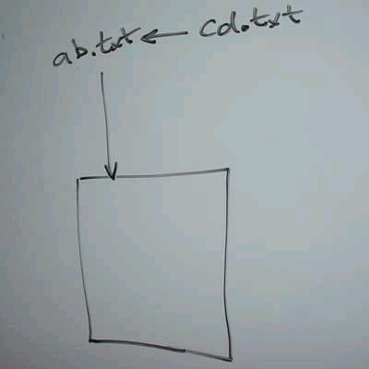
Acyclic-Graph Directories
A Symbolic Link is where a file has one main name, but there's an extra entry in the file name table that refers any accesses back to the main name.

Slide 32
Acyclic-Graph Directories
Item | Hard Link | Symbolic Link
Name resolution | Faster. A hard link contains a direct reference to the object. | Slower. A symbolic link contains a path name to the object, which must be resolved to find the object.
Object existence | Required. An object must exist in order to create a hard link to it. | Optional. A symbolic link can be created when the object it refers to does not exist.
Object deletion | Restricted. All hard links to an object must be unlinked (removed) to delete the object. | Unrestricted. An object can be deleted even if there are symbolic links referring to it.

Slide 33
Item | Hard Link | Symbolic Link
Dynamic objects (attributes change) | Slower. Many of the attributes of an object are stored in each hard link. Changes to a dynamic object, therefore, are slower as the number of hard links to the object increases. | Faster. Changes to a dynamic object are not affected by symbolic links.
Static objects (attributes do not change) | Faster. For a static object, name resolution is the primary performance concern. Name resolution is faster when hard links are used. | Slower. Name resolution is slower when symbolic links are used.
Scope | Restricted. Hard links cannot cross file systems. | Unrestricted. Symbolic links can cross file systems.

Slide 34
Acyclic-Graph Directories
Two different names (aliasing)
If dict deletes list ⇒ dangling pointer
Solutions:
  Backpointers, so we can delete all pointers
  Variable size records a problem
New directory entry type
  Link – another name (pointer) to an existing file
  Resolve the link – follow pointer to locate the file

Slide 35

General Graph Directory

Slide 36
General Graph Directory
How do we guarantee no cycles?
  Allow only links to file not subdirectories
  Garbage collection
  Every time a new link is added use a cycle detection algorithm to determine whether it is acyclic (expensive)

Slide 37
File System Mounting
A file system must be mounted before it can be accessed by processes on the system
A unmounted file system (i.e. Fig. 11-11(b)) is mounted at a mount point

Slide 38

(a) Existing (b) Unmounted Partition

Slide 39
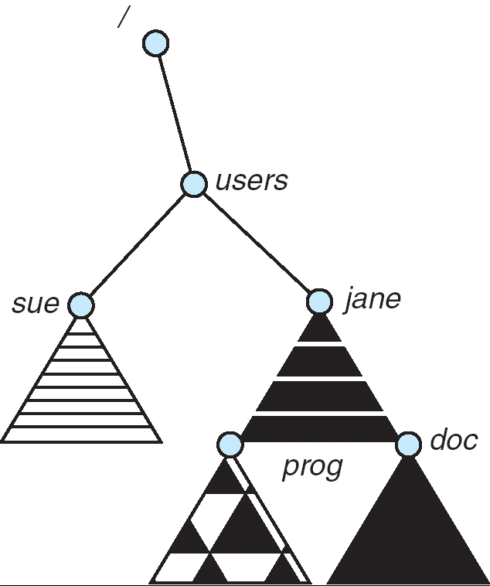
Mount Point

Slide 40
File System Mounting
A mount point is typically empty directory
Steps:
  OS is given the name of the device and the mount point
  OS verifies that the device contains a valid file system by reading the device directory, if in specified format
  OS takes note that a file system has been mounted at a mount point by incorporating it in the directory structure

Slide 41
File System Mounting
Notes:
  A system may disallow mounting at a point which contains files
  May obscure the existing files until the file system is unmounted
  Examples:
  Macintosh- automatically mounts the device at the root level
  Windows- two level, a drive letter, all devices are mounted automatically
  UNIX- mount is explicit system call, a system configuration file contains the list of devices and the mount points, other mounts are executed manually

Slide 42
File Sharing
Sharing of files on multi-user systems is desirable
Sharing may be done through a protection scheme
On distributed systems, files may be shared across a network
Network File System (NFS) is a common distributed file-sharing method

Slide 43
File Sharing – Multiple Users
User IDs identify users, allowing permissions and protections to be per-user
Group IDs allow users to be in groups, permitting group access rights

Slide 44
File sharing Remote File Systems
Uses networking to allow file system access between systems
  Manually via programs like FTP
  Automatically, seamlessly using distributed file systems
  Semi automatically via the world wide web

Slide 45
File sharing Remote File Systems
  - Client-server model allows clients to mount remote file systems from servers
  Server can serve multiple clients
  Client and user-on-client identification is insecure or complicated
  NFS is standard UNIX client-server file sharing protocol
  CIFS is standard Windows protocol (Common Internet File System)
  Standard operating system file calls are translated into remote calls

Slide 46
File sharing Remote File Systems
Distributed Information Systems (distributed naming services) such as LDAP, DNS, NIS, Active Directory implement unified access to information needed for remote computing
LDAP – Lightweight Directory Access Protocol
DNS – Domain Name Service
NIS – Network Information System

Slide 47
Protection
File owner/creator should be able to control:
  what can be done
  by whom
Types of access
  Read
  Write
  Execute
  Append
  Delete
  List

Slide 48
Access Lists and Groups
Mode of access: read, write, execute
Three classes of users
RWX
a) owner access 7 ⇒ 1 1 1
RWX
b) group access 6 ⇒ 1 1 0
RWX
c) public access 1 ⇒ 0 0 1
Ask manager to create a group (unique name), say G, and add some users to the group.
For a particular file (say game) or subdirectory, define an appropriate access.
owner
group
public
chmod
761
game
Attach a group to a file
chgrp G game

Slide 49

Windows ACL Management

Slide 50

A sample UNIX directory Listing

Slide 51
End of Session 10

