Slide 1
Asset Management

Slide 2
Asset Management
Philosophy
WHA Asset Managers will work diligently to maximize your property’s fullest value potential.
The relationship between Asset Manager and Hotel Property is critically important in today’s turbulent and increasingly competitive market place. From Acquisition through Exit our Asset Management division is there to provide expert oversight and strategic positioning to drive the highest and best value for our respected hotel clients and partners.
Thorough Transition Due Diligence
Professional Oversight and Strategic Planning
Creative Solutions to Enhance Value
Persistent Evaluation of Exit Alternatives

Slide 3
Asset Management
Services
WHA offers the following Asset Management Services:
Transition Due Diligence
Operating Manager RFPs
Budget Analysis
Operating Reviews
Capital Improvement Strategies
Financial Analysis and Underwriting
Staffing Reviews
Sales and Marketing Initiatives
ADR & Occupancy Reviews
Market Penetration Analysis
On Line Review Monitoring
Smith Travel Report Analysis
Vendor Credit Checks
Turn Around Planning
Exit Strategies

Slide 4
Hotel Management

Slide 5
Hotel Management
Philosophy
WHA Hotel Managers will drive the highest level of guest satisfaction possible while meticulously caring for and protecting your physical asset.
Hotel operations management is the backbone of the highest and best value goals placed on a hospitality asset. The key components of operating a successful hotel are a superior marketing and sales strategy paired with a comprehensive staff training program. Well trained service providers embrace marketing initiatives and work cohesively to provide high levels of Guest Satisfaction. Guest Satisfaction sets the foundation for building greater than 100% Rev Par market penetration.
Comprehensive Staff Training Procedures
Diligent Marketing and Sales Initiatives
Driving Guest Satisfaction
Superior RevPar Market Penetration

Slide 6
Hotel Management
Services
WHA offers the following Hotel Management Services:
Pre Opening Initiatives
Staff Selection and Training
Guest Services
Reservations / GDS
Engineering
House Keeping
Front Office / Rooms
Sales and Marketing
Property Improvement
Food & Beverage
Banquet and Events
Entertainment / Night Life
Meeting / Conference Centers
Spa Management
Concierge Services

Slide 7
Receivership

Slide 8
Receivership
Philosophy
WHA Receivers will uphold their fiduciary responsibilities and protect all appropriate parties when analyzing and executing proper work out strategies.
It is a current reality that many Hotel Owners and Lenders are facing unsupportable Rev PAR corrections due to the poor socio-economic conditions that are plaguing the hospitality industry. In these circumstances, WHA stands ready to support their valued clients and partners through court appointed Receivership in order to expeditiously reposition or close existing hotel assets.
Detailed Analysis of Operations
Strategic Negotiations with Respective Parties
Creative Solutions to Enhance Value
Appropriate Repositioning or Close Out

Slide 9
Receivership
Services
WHA offers the following Receivership Services
Forensic Due Diligence
Existing Document Analysis
Property Inspection
Property Improvement Plan Review
Hotel Management Review
Operating Department Review
Hotel Brand Interface
Union Negotiations
Third Party Creditor Work Outs
Sales and Marketing Initiatives
Repositioning Strategies
Court / Owner / Lender Reporting
Close Out Budget and Schedule
Close Out Facilities Preparation
Asset Monitoring

Slide 10
Development & Construction

Slide 11
Development & Construction
Philosophy
Walsh has a deep history in the development and construction of hospitality/commercial assets with over 8 million square feet of new development and over 15 million square feet of redevelopment completed.
Walsh provides project management, construction management and development services throughout the Boston/New York/Washington DC corridor with a 2008 general construction volume of approximately $28 million and project management volume of approximately $280 million.
Pre-Construction Services
Project Management Services
Development Management Services
Construction Management Services

Slide 12
Development & Construction
Services
WHA offers the following Development & Construction Services
Site Due Diligence
Vision Planning
Pre Construction
Public Outreach
Brand Development
Government Entitlements
A&E Coordination
Budgeting
Interior Design
Project Management
Construction Management
Historic Restoration
Property Improvement Plans
FF&E / OS&E Purchasing
FF&E / OS&E Installation

Slide 13
Project Summaries

Slide 14
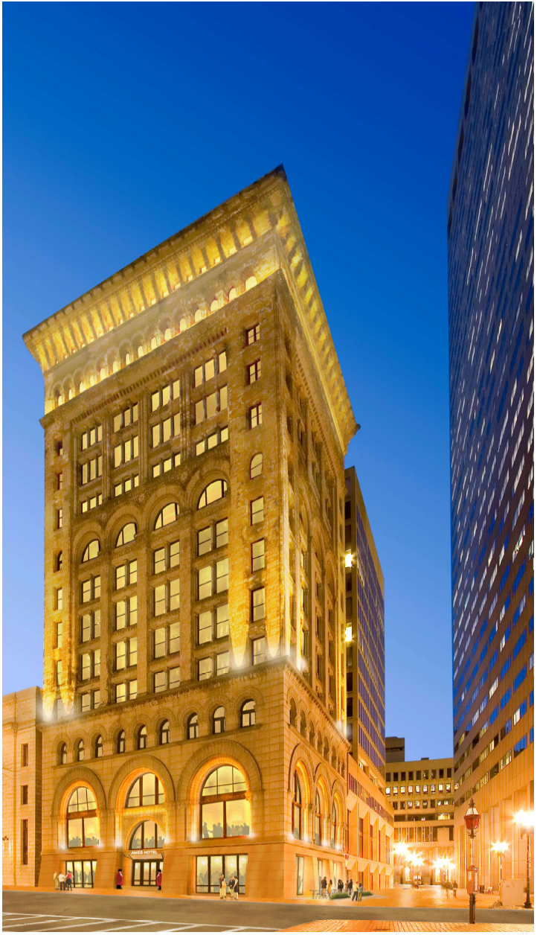
Project Summaries
The Ames Hotel
Client:
Normandy Real Estate Partners/Morgans Hotel Group
Location:
1 Court Street
Boston, MA
Property Information:
14 stories, 113 luxury guest rooms
Full service restaurant
Bar / Nightlife Experience
Private Dining
Entertainment Suites
Scope:
Led Historic Restoration of the Ames Building, a 120,000 sq. ft. Financial District sky scraper into a 4 star full service hotel. Asset Management responsibilities overseeing Rockwell Design and Morgans Hotel Group in full scopes of work.
14
[…]

Slide 15
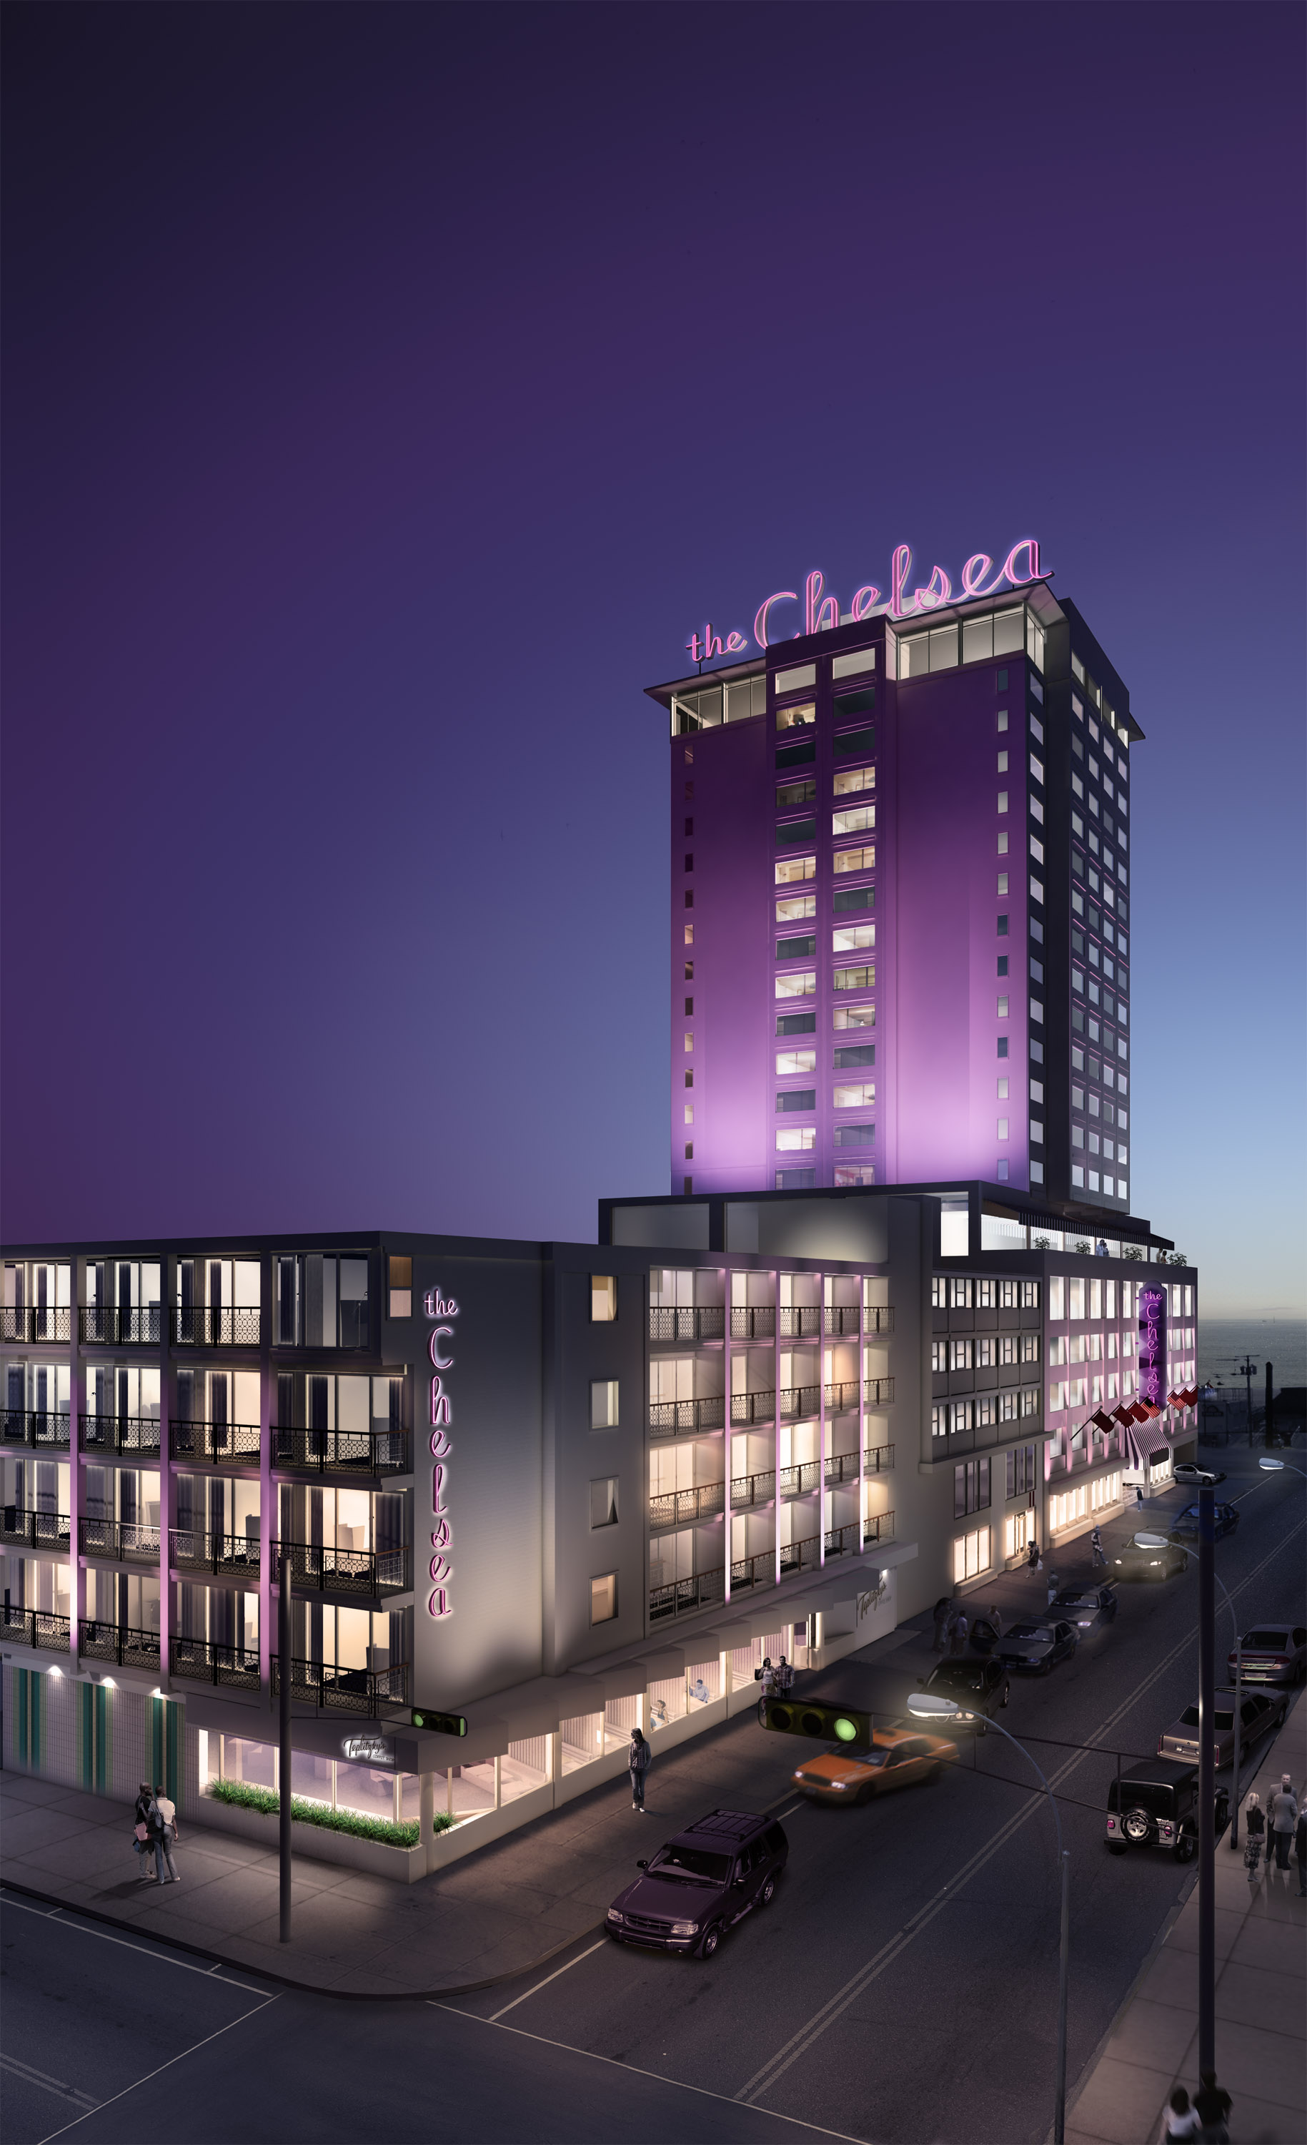
Project Summaries
The Chelsea Hotel
Client:
Normandy Real Estate Partners/Cape Advisers
Location:
111 South Chelsea Avenue
Atlantic City, NJ
Property Information:
330 luxury guest rooms
State of the art fitness center
Seasonally heated outdoor saltwater pool
Rooftop swimming pool with private cabana service
Full service rooftop bar
Luxury spa
Retail store
2 signature Stephen Starr restaurants
Scope:
Led turnkey renovation of Atlantic City’s fist non gaming boutique from a 2 star property into a 4 star, full service hotel. Asset Management responsibilities overseeing full scopes of work including market leading nightlife venue.
[…]

Slide 16
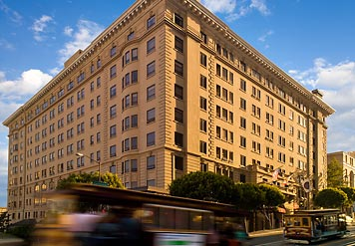
Project Summaries
The Stanford Court Renaissance
Client:
Barclays Bank, CMBS Division, NYC
Location:
905 California Street.- Nob Hill
San Francisco, CA
Property Information:
8 Floors, 367 guest rooms, 26 suites
12 meeting rooms, 13,000 SF total meeting space
Fitness center
Restaurant & lounge
Scope:
Rapid Response Asset Management analysis and report with recommendations.
Current Capitalization $1.8 billion (2 Assets) (Normandy investment in green)
[…]

Slide 17
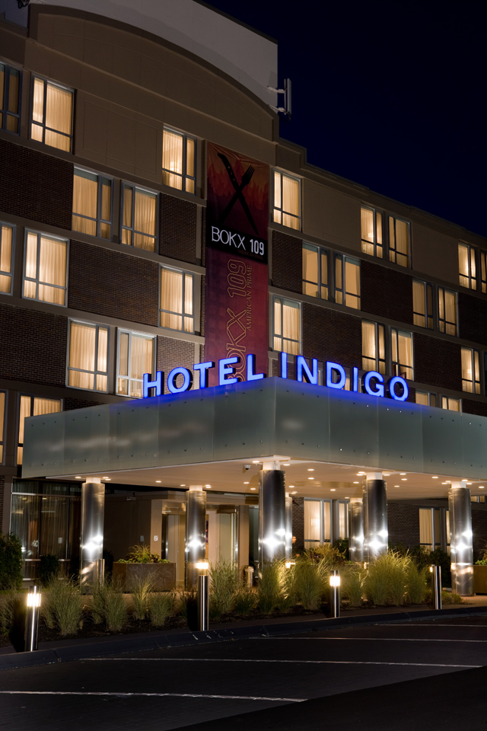
Project Summaries
The Hotel Indigo
Client:
Normandy Real Estate Partners/Pyramid Hotel Group
Location:
399 Grove Street
Newton, MA
Property Information:
191 guest rooms, 1 executive suite
State of the art fitness center
5 modern meeting rooms
Seasonal outdoor pool
Business center
Full Service Restaurant
Scope:
Conversion of a new lifestyle branded 4 star, full service hotel. Asset Management responsibilities overseeing full scopes of work including market leading upscale restaurant.
[…]

Slide 18
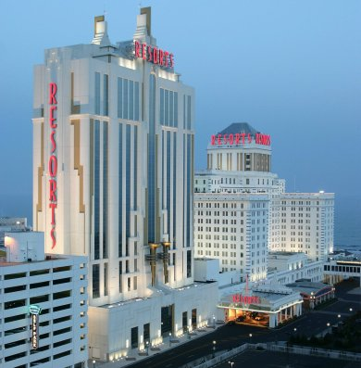
Project Summaries
The Resorts International Tower
Client:
Colony Capital
Location:
1133 Boardwalk
Atlantic City, NJ
Property Information:
27 Stories, 462 guest rooms, 58 suites
Health club & spa
indoor/outdoor pool
Full service salon
Lounge
Scope:
Owner’s Representative on the new construction of a 31 story, high rise tower with full casino floor, multiple restaurant venues and luxury salon/spa.
18
[…]

Slide 19
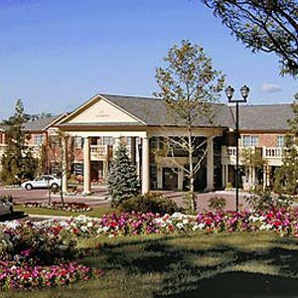
Project Summaries
The Residence Inn At The Manor
Client:
Marriott International
Location:
107 Prospect Avenue
West Orange, NJ
Property Information:
3 Floors, 128 suites (with fully equipped kitchens)
2 meeting rooms, 1,000 SF total meeting space
Fitness center
Indoor pool
Scope:
Construction Manager of the award winning Marriott Residence Inn in West Orange, NJ. Utilized cutting edge modular technology to complete project under budget and schedule.
19
[…]

Slide 20
Principal Bios

Slide 21
Appendix
Principal Biographies
Edward S. Walsh., Managing Principal.
Ed is responsible business development as well as overseeing all phases of Project Management, Construction, and Development related services. With over nineteen years of construction experience including feasibility studies, budget estimates and financial performance, Ed is recognized throughout the industry for his thorough understanding of the demands associated with real estate development and construction. In addition to his extensive experience in the areas of construction and development, Ed has vast knowledge of critical path scheduling and due diligence requirements ensuring that projects are completed on time and within budget. Prior to starting The Walsh Company, Ed served as Senior Vice President for The Gale Construction Company for ten years. Ed is a graduate of Villanova University with a Bachelor of Science degree in Civil Engineering. He is a registered licensed Professional Engineer in the state of New Jersey.
Joseph R. Bezzone, Jr., Managing Principal.
Joe is responsible for the the day-to-day operations of the company with a special focus on Asset Management and Development. Joe has 20 years of hotel experience in all facets of an assets lifecycle working as a top consultant to some of the industry’s most notable owners and projects. His tested knowledge of technology and sustainability drives the Walsh team to the cutting edge and his experience in the construction, PIP and FF&E fields proves invaluable when facing day-to-day challenges in the hospitality industry. With an entertainment and culinary background, Joe brings an applied understanding of what separates a good hotel experience from a great one and is equally comfortable discussing design options as he is analyzing RevPar. Joe is a graduate of the George Washington University School of Business with a Bachelor of Science degree in Finance.

Slide 22
Appendix
Principal Biographies (cont’d)
Gavin I. Evans, Principal.
Gavin is responsible for Business Development and Financial Management. Gavin was the former Director for Westbrook Partners in New York City, where he was an integral member of the acquisitions team that completed numerous hospitality transactions in the United States and Europe. Prior to joining Westbrook, Gavin worked for two years as a Financial Analyst at First Union, where he worked in the corporate banking and capital markets groups. At First Union, he was involved in a variety of debt financings, distressed credit workouts, mergers, acquisitions, and private placements. Gavin. Evans received a Bachelor of Science degree from The Pennsylvania State University.
Wes Lang, Principal,
Wes is responsible for Business Development and Business Management. Wes was the former Managing Director of GSO Capital Partners, an investment firm that specialized in all aspects of leveraged finance with over $10 billion in capital under management. Prior to GSO, Wes was with Valence Capital Management, a middle market private equity investment advisor to Moore Capital Management, LLC. Prior to Valence Capital Management, Wes worked at Weiss, Peck & Greer (“WPG”), a nationally recognized investment management firm with over $18 billion under management at the time of its sale in 1998. Prior to joining WPG, Mr. Lang was a commercial banker at Manufacturers Hanover Trust Company where he specialized in acquisition financing. Mr. Lang currently serves on the board of directors of Aurora Diagnostics LLC, and is on the Advisory Board of York Street Capital Partners, a mezzanine investment firm. Mr. Lang received a Bachelor of Arts degree from Bucknell University.

