Slide 1
Restaurants in New York, NY
Bryan J. Hernandez
May 17, 2020

Slide 2
General information
Description
The location is in New York, NY. The problem is to analyze the market within New York city. Specifically to focus on the Italian restaurants and the higher end of the venues.
Audience
The target audience of this presentation is for either an owner trying to expand into a new market or a market researcher analyzing the climate of the venues within New York city.

Slide 3
Data acquisition and cleaning
Data Acquisition: Foursquare API
Base dataset
Location data for Italian venues within a 25-mile radius of New York City
Includes longitude and latitude, distance and category
Additional dataset
Adding features such as
Distance
Rating
Likes
Tier
Tips
Data Cleaning
Cleaning out features with null values, na values and non applicable categories

Slide 4
Exploratory Data Analysis
The methods to analysis the datasets included
Histograms
Scatterplots
Pearson’s Correlation test

Slide 5
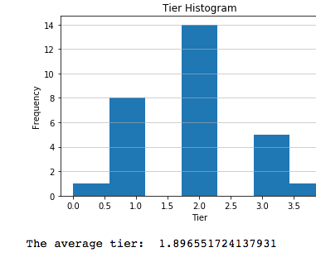
Frequency by Tier
The distribution of the tiers is centered around 2 suggesting that the majority of the locations are of a low-mid tier rating.
This implies that the market is open for a higher tier restaurant to come into the market.

Slide 6
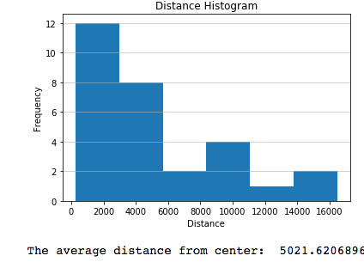
Frequency by distance
This histogram shows that there is an increased amount of restaurants that are above 3.5 miles from the epicenter.
This might be an opportunity for a Italian restaurant within a closer proximity

Slide 7
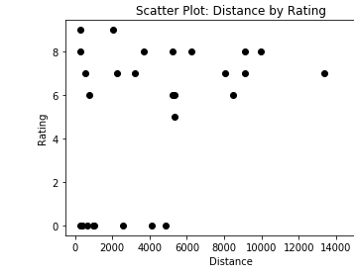
Rating by distance
This locations within a distance of 3.5 miles are varying between 6-8 rating.
This might be an indication of consumers being open to new restaurants as there aren’t many high rated restaurants in the close- proximity

Slide 8
Conclusion
In conclusion the location of New York, NY has an opportunity for the following restaurants
High Tier
< 3.5 miles
Further analysis
More information that would supplement the dataset and add a lot more value to the analysis would be
Rent dataset
Consumer traffic dataset
Market capture projection dataset

