Slide 1
Intro and Bootstrap to Geb
Bob Herrmann
Grails / Web Developer at Innocentive.com

Slide 2
Geb
What is it?
How do I use it?
How do I code it?

Slide 3
Geb: What is the problem?
Testing web applications is hard
Browsers are complicated (HTML, CSS, images, Javascript)
A web page is a horrid scary mess
Who can understand a web page? Chrome/Firefox/IE/Safari
aka Google/Microsoft/Apple (not you)

Slide 4
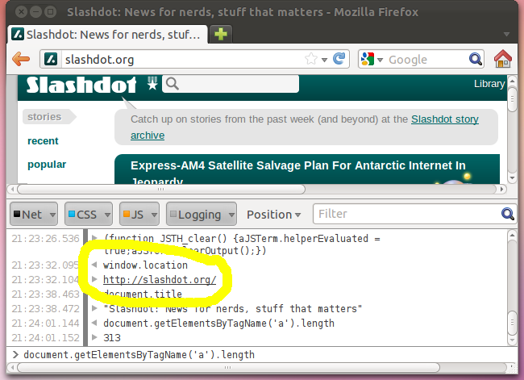
Geb: An idea

Slide 5
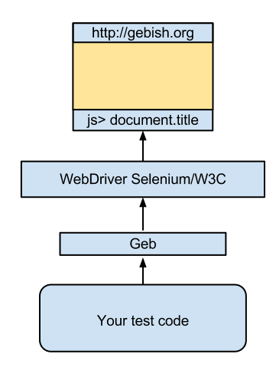
Geb: Architecture

