Slide 1
Intro and Bootstrap to Geb
Bob Herrmann
Grails / Web Developer at Innocentive.com

Slide 2
Geb
What is the problem?
What is the solution?
Demo
Extras

Slide 3
Geb: What is the problem?
Testing web applications is hard
Browsers are complicated (HTML, CSS, images, Javascript)
A web page is a horrid scary mess
Who can understand a web page? Chrome/Firefox/IE/Safari
aka Google/Microsoft/Apple (not you)

Slide 4
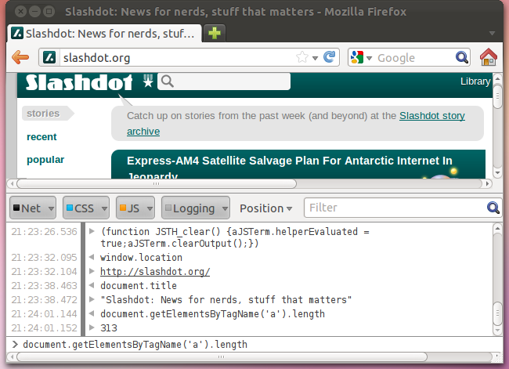
Geb: An idea

Slide 5
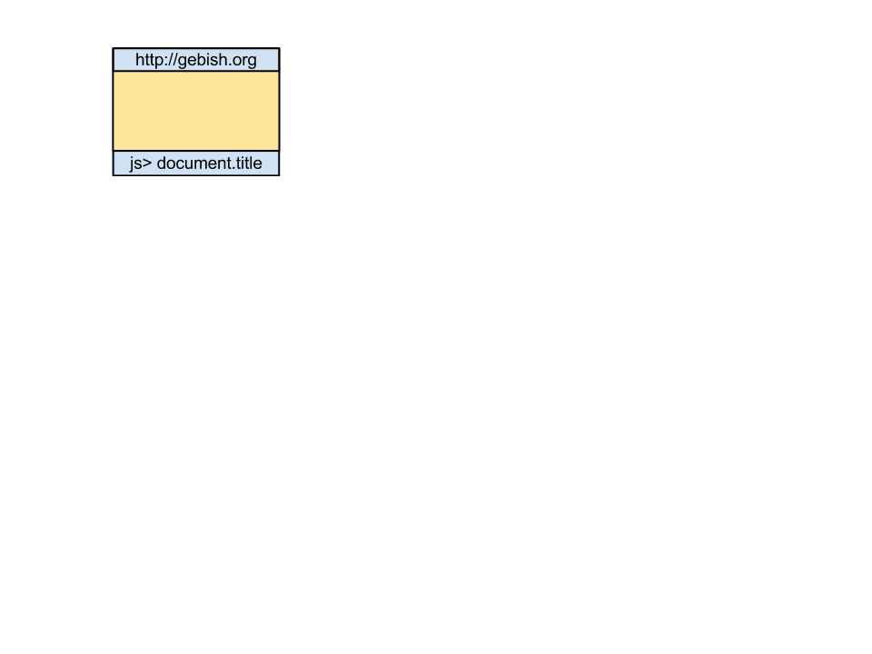
Geb: Architecture

Slide 6
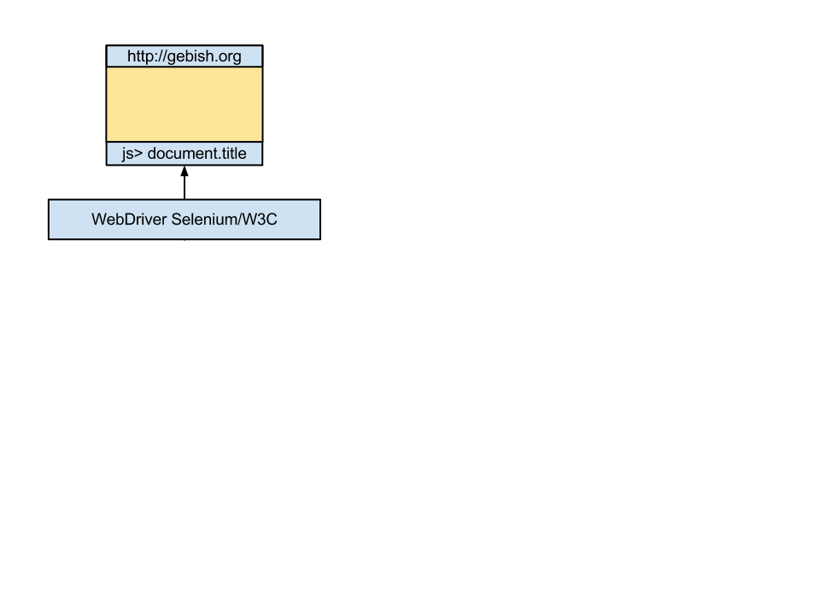
Geb: Architecture

Slide 7
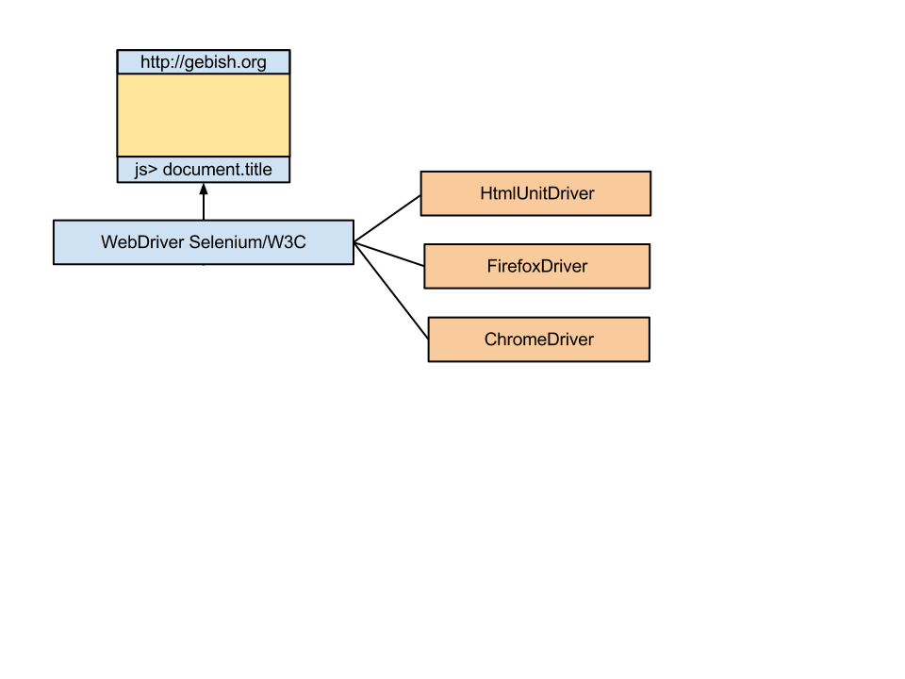
Geb: Architecture

Slide 8

Geb: Architecture

Slide 9
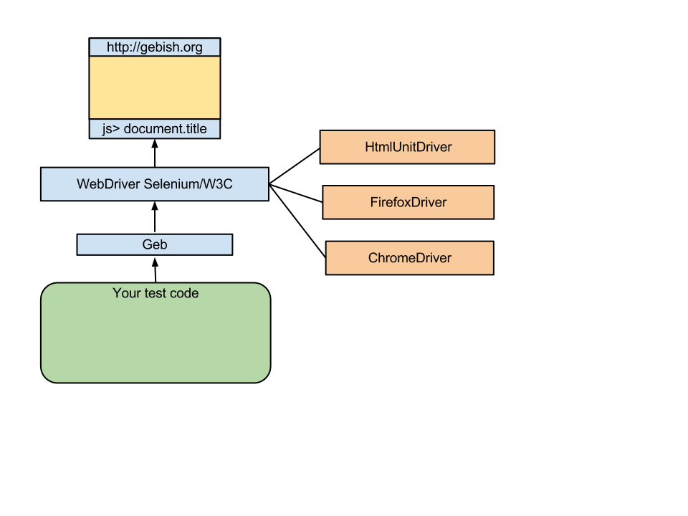
Geb: Architecture

Slide 10
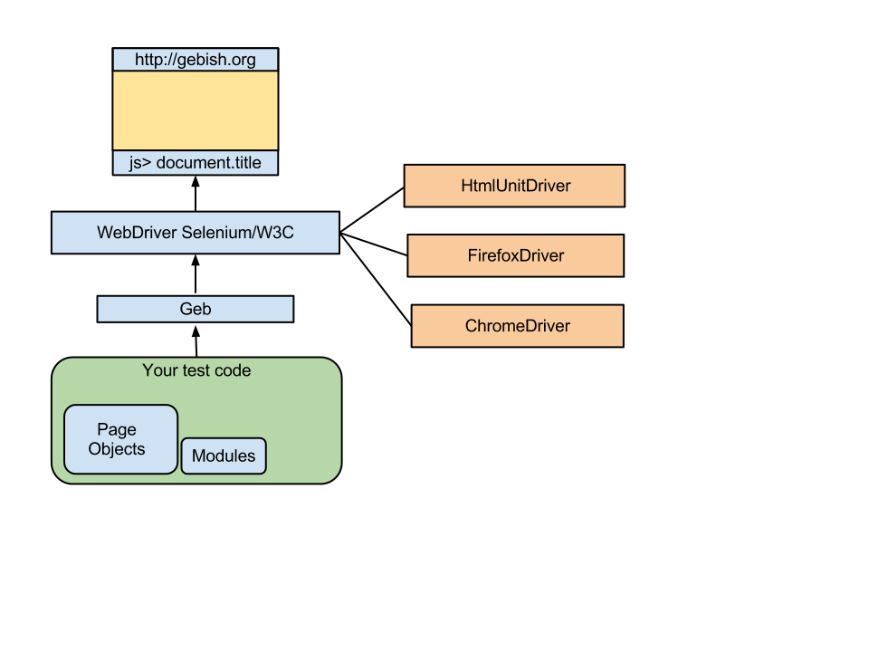
Geb: Architecture

Slide 11
Geb is...
Geb is a browser automation solution.
WebDriver
Jquery content selection,
Page Object modeling
Groovy
scripting, scraping, functional/web/acceptance testing solution
Spock, JUnit & TestNG.
See “The Book of Geb” http://gebish.org

Slide 12
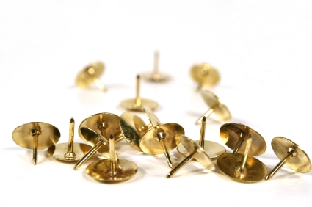
Anatomy of a Geb Test

Slide 13
Anatomy of a Geb Test
@RunWith(JUnit4)
class SimpleTest extends GebReportingTest {
@Test
void testSimple() {
}
}

Slide 14
Anatomy of a Geb Test
@RunWith(JUnit4)
class SimpleTest extends GebReportingTest {
@Test
void testSimple() {
// Start browser
// verify right page (Look at page)
// Enter or click on stuff (click or type)
// verify right thing happens
}
}

Slide 15
Anatomy of a Geb Test
@RunWith(JUnit4)
class SimpleTest extends GebReportingTest {
@Test
void testSimple() {
go 'http://localhost:8080/s/login'
assert $('title').text() == 'Taco Login'
$('input[name=username]').value('bob')
$('input[name=password]').value('taco4me')
$('input[type=submit]').click()
assert title == 'Welcome back'
assert $('img').size() == 2
}
}

Slide 16
Anatomy of a Geb Test
@RunWith(JUnit4)
class SimpleTest extends GebReportingTest {
@Test
void testSimple() {
go 'http://localhost:8080/s/login'
assert $('title').text() == 'Taco Login'
$('input[name=username]').value('bob')
$('input[name=password]').value('taco4me')
$('input[type=submit]').click()
assert title == 'Welcome Back'
assert $('img').size() == 2
}
}

Slide 17
Anatomy of a Geb Test
@RunWith(JUnit4)
class SimpleTest extends GebReportingTest {
@Test
void testSimple() {
go 'http://localhost:8080/s/login'
assert $('title').text() == 'Taco Login'
$('input[name=username]').value('bob')
$('input[name=password]').value('taco4me')
$('input[type=submit]').click()
assert title == 'Welcome Back'
assert $('img').size() == 2
}
}

Slide 18
Geb's JQuery-like API
Syntax
$(«css selector», «index or range», «attribute / text matchers»)
Examples
$('#myId')
$("a", text: "All about Geb")
$("div.some-class p:first[title='something']")
$("h1", 2, class: "heading")
$("p", name: "description")
$("ul.things li", 2)
$("p", text: contains("Geb"))
$("input", value: ~/\d{3,}-\d{3,}-\d{3,}/)

Slide 19
Geb's JQuery like selectors
You found the element, now what?
$().click()
$().text()
$().tag()
$().@attribute
$().value()
$().value('something')

Slide 20
Anatomy of a Geb Test
@RunWith(JUnit4)
class SimpleTest extends GebReportingTest {
@Test
void testSimple() {
go 'http://localhost:8080/s/login'
assert $('title').text() == 'Taco Login'
$('input[name=username]').value('bob')
$('input[name=password]').value('taco4me')
$('input[type=submit]').click()
assert title == 'Welcome Back'
assert $('img').size() == 2
}
}

Slide 21
Anatomy of a Geb Test
@RunWith(JUnit4)
class SimpleTest extends GebReportingTest {
@Test
void testSimple() {
go 'http://localhost:8080/s/login'
assert $('title').text() == 'Taco Login'
$('input[name=username]').value('bob')
$('input[name=password]').value('taco4me')
$('input[type=submit]').click()
assert title == 'Welcome Back'
assert $('img').size() == 2
}
}

Slide 22
Anatomy of a Geb Test
@RunWith(JUnit4)
class SimpleTest extends GebReportingTest {
@Test
void testSimple() {
go 'http://localhost:8080/s/login'
assert $('title').text() == 'Taco Login'
$('input[name=username]').value('bob')
$('input[name=password]').value('taco4me')
$('input[type=submit]').click()
assert title == 'Welcome Back'
assert $('img').size() == 2
}
}

Slide 23
Anatomy of a Geb Test
@RunWith(JUnit4)
class SimpleTest extends GebReportingTest {
@Test
void testSimple() {
go 'http://localhost:8080/s/login'
assert $('title').text() == 'Taco Login'
$('input[name=username]').value('bob')
$('input[name=password]').value('taco4me')
$('input[type=submit]').click()
assert title == 'Welcome Back'
assert $('img').size() == 2
}
}

Slide 24
Anatomy of a Geb Test
Demo

Slide 25
Simple-Geb Quick Start
# quick getting started guide
$ wget https://github.com/bherrmann7/simple-geb/zipball/master
or
$ git clone git://github.com/bherrmann7/simple-geb.git
$ cd simple-geb
$ ./gradlew test # (or gradlew.bat)
$ ./gradlew idea # (or gradlew eclipse) - can use free idea
# when running test add -Dgeb.build.reports

Slide 26
Geb Dangers
go 'cnn.com'; $('a').size
Wobbly – network, server responses
Browser strangeness
Development enormous time sync
Running tests consume wall clock time
Flash / Applets / third party controls
Mitigate dangers by on ramping slowly

Slide 27
More Geb
https://dvcs.w3.org/hg/webdriver/shortlog
Ajax
  waitFor(timeoutSeconds, intervalSeconds, Closure condition)
  waitFor(timeoutSeconds, Closure condition)
  waitFor(Closure condition)
js.execute()
  js.execute('document.title = “Bow Wow”')
Page Objects
Modules

