Slide 1

Cooking App
Bishal Heuju

Slide 2
Features
View Recipes
Search
Filter
Signup / Login
Create, Edit and Delete Recipes
Favourite Recipes
Notes:
Additional Features:
ReturnUrl

Slide 3
MVC Architecture
Model
DB
Recipe
User
Controller
View
Home
Recipe
Account
Home – (Index)
Recipe – (View, Create, Delete, Edit)
Account – (Login, Signup, Dashboard)
User

Slide 4
Objects
Users – Holds users data
Recipe – Holds recipe data
Food
Drinks

Slide 5
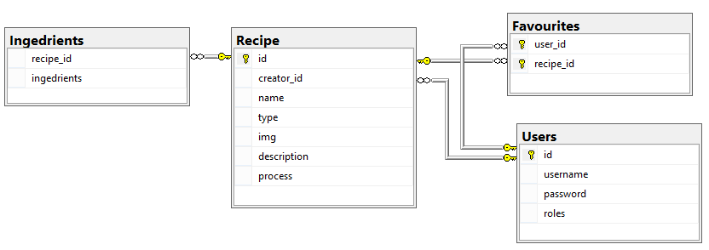
Database Diagram

Slide 6
Data Access Classes
RecipeAccess - Singleton
getRecipe(id)
getRecipeList()
UserAccess - Singleton
getUser()
SqlConnect
Retrieve data
Execute stored procedures

Slide 7
Limitations
Forceful use of inheritance
No control for user management
No password recovery
No admin control

