Slide 1
Transient implementation of BHM
Application to transient thermal problem
May 25, 2012

Slide 2
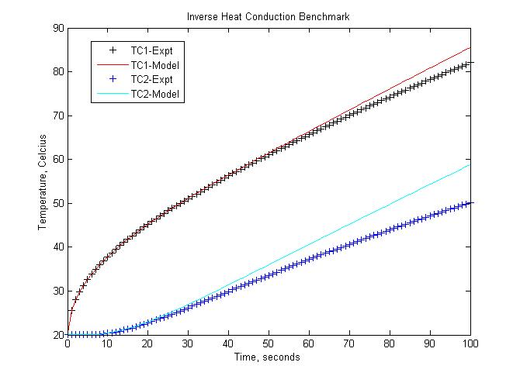
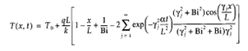
Benchmark Problem
TC1
TC2
h = 0.1 (Model)
h = 0.5 (Data)
Heat Flux = ?
(Truth = 50)
Initial Temperature = ?
(Truth = 20)
X = 0
X = L
Reference – Inverse Engineering Handbook
(Woodbury et. al, 2003)
Can we estimate heat flux and initial temperature in the presence of a modeling error ?
1D Inverse Heat Transfer Benchmark with a “Modeling Error”

Slide 3
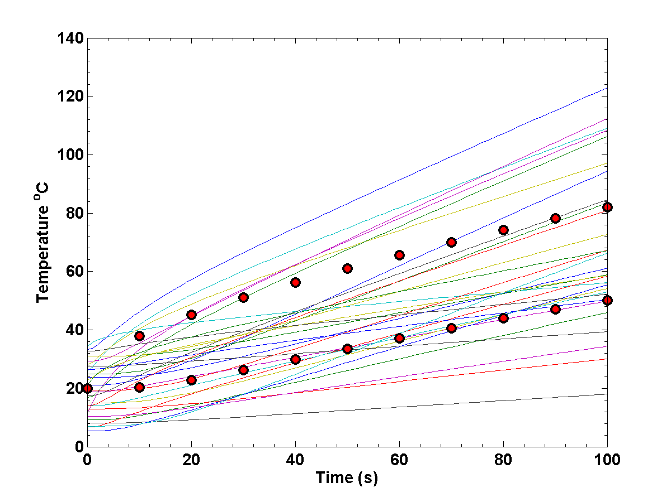
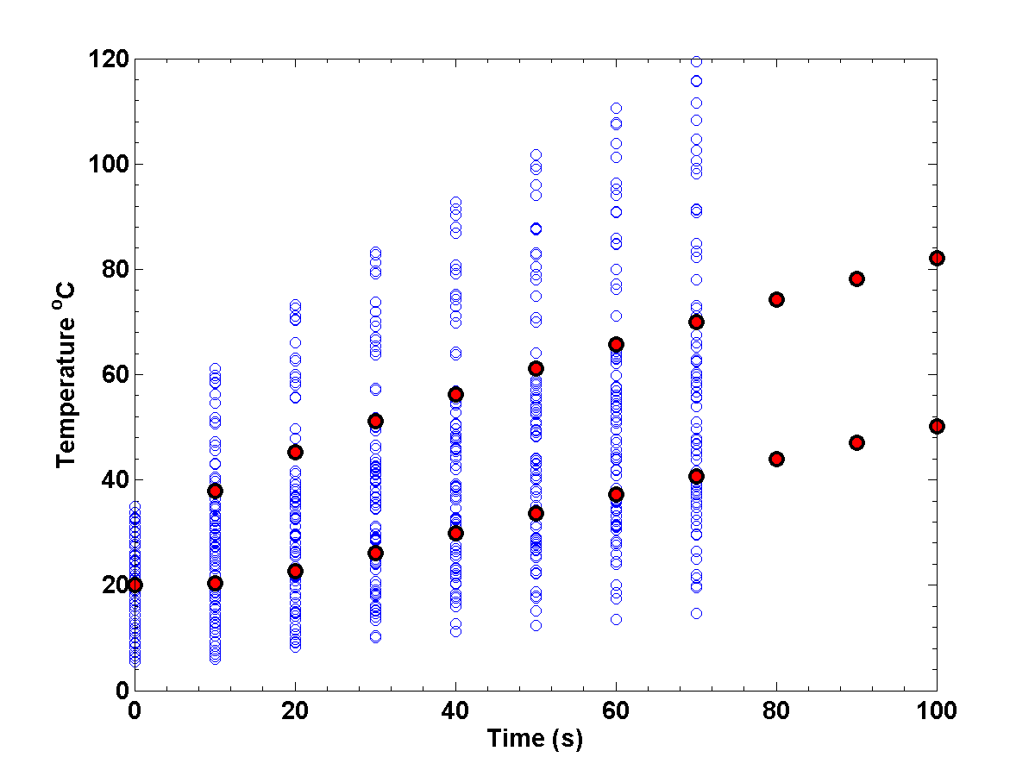
Method
Srikkanth used the non-transient implementation
Brute-force approach to deal with transient problems - consider TIME as x (design variable), reduce DoE data by sampling data at specific TIME points, some loss of the time dependence in the GP model
Transient implementation retains time (or any other non-random parameter) dependence

Slide 4
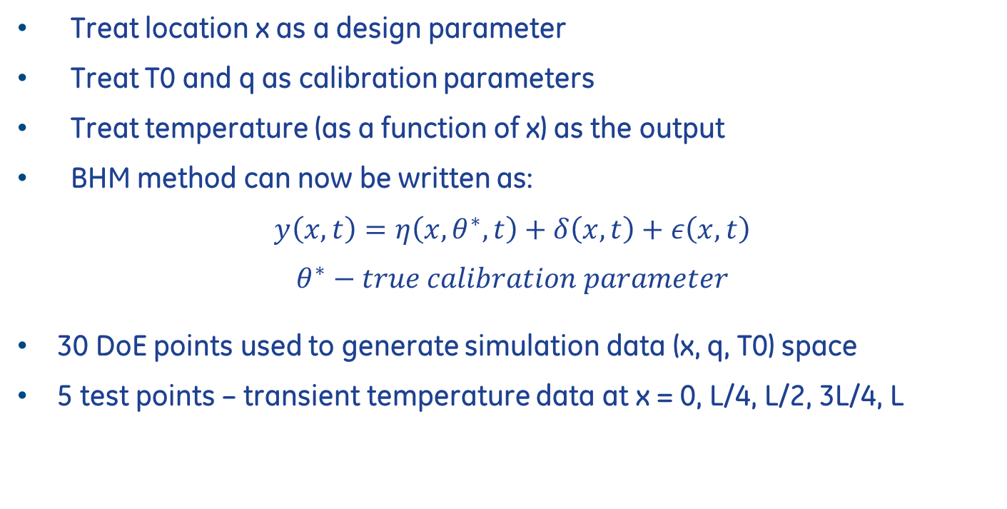
Method
Treat location x as a design parameter
Treat T0 and q as calibration parameters
Treat temperature (as a function of x) as the output
BHM method can now be written as:
$$y\left(x,t\right)=η\left(x,θ^{∗},t\right)+δ\left(x,t\right)+ε\left(x,t\right)$$
$$θ^{∗}−true calibration parameter$$
30 DoE points used to generate simulation data (x, q, T0) space
5 test points – transient temperature data at x = 0, L/4, L/2, 3L/4, L

Slide 5
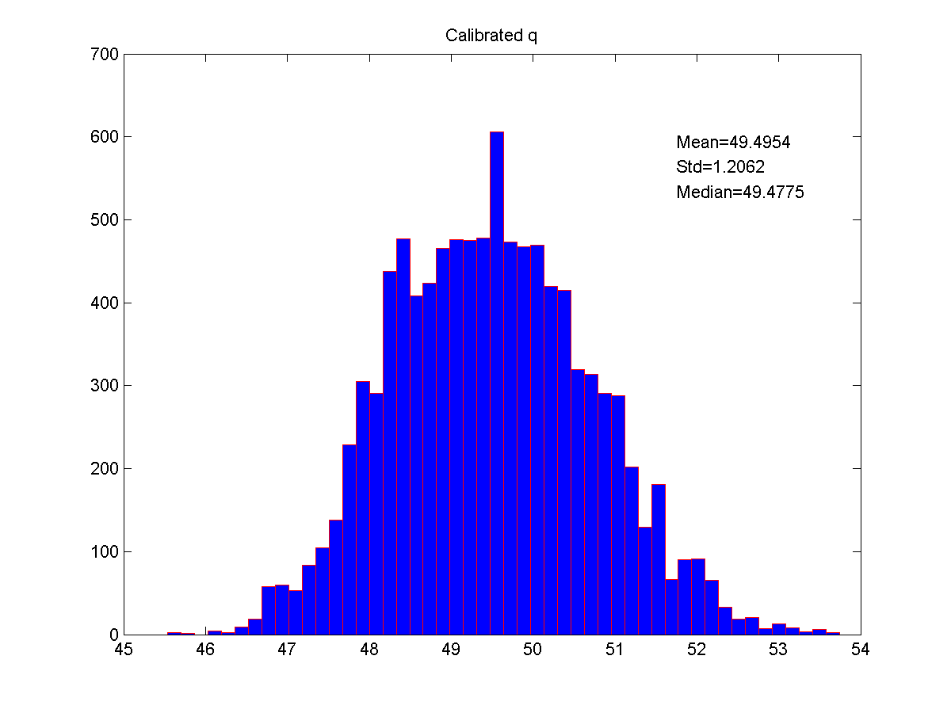
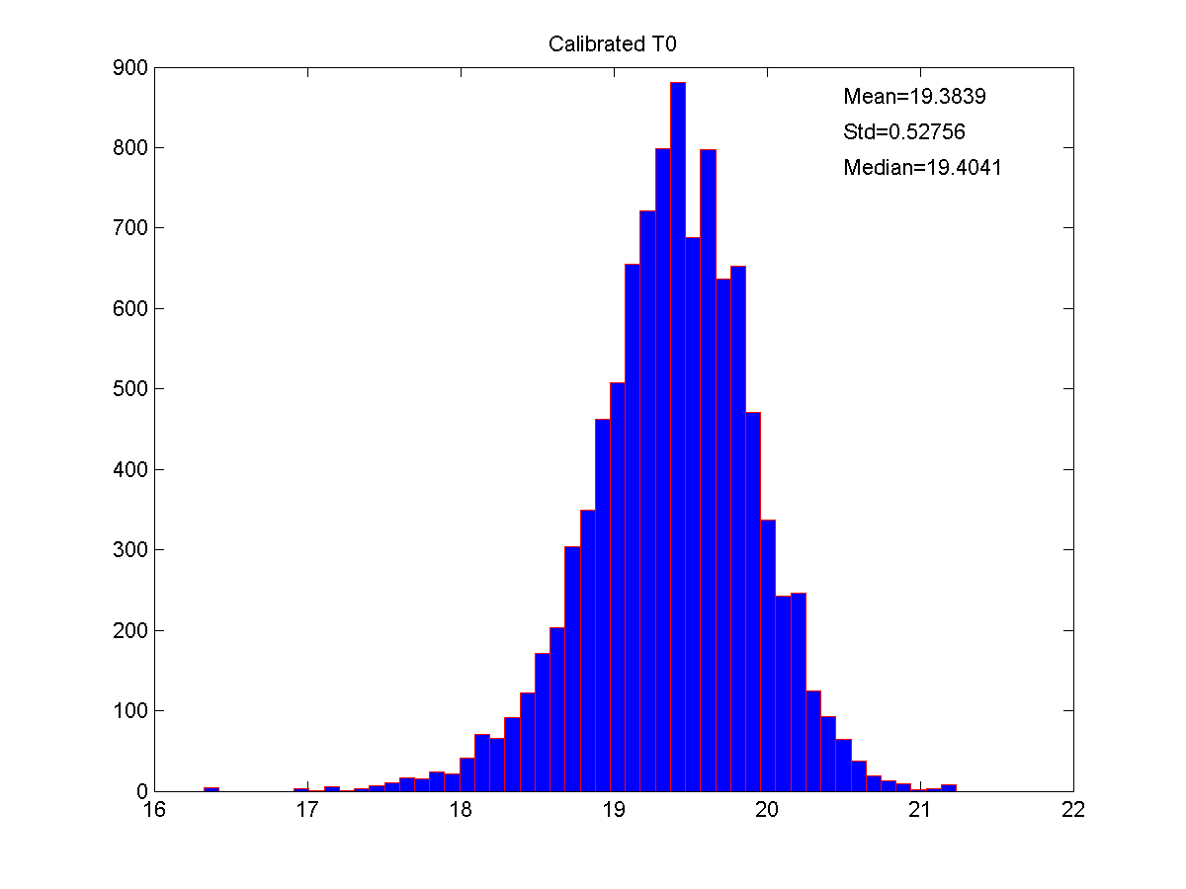
Transient calibration
Mean = 49.954
Std = 1.206
True value = 50
Mean = 19.38
Std = 0.528
True value = 20

Slide 6
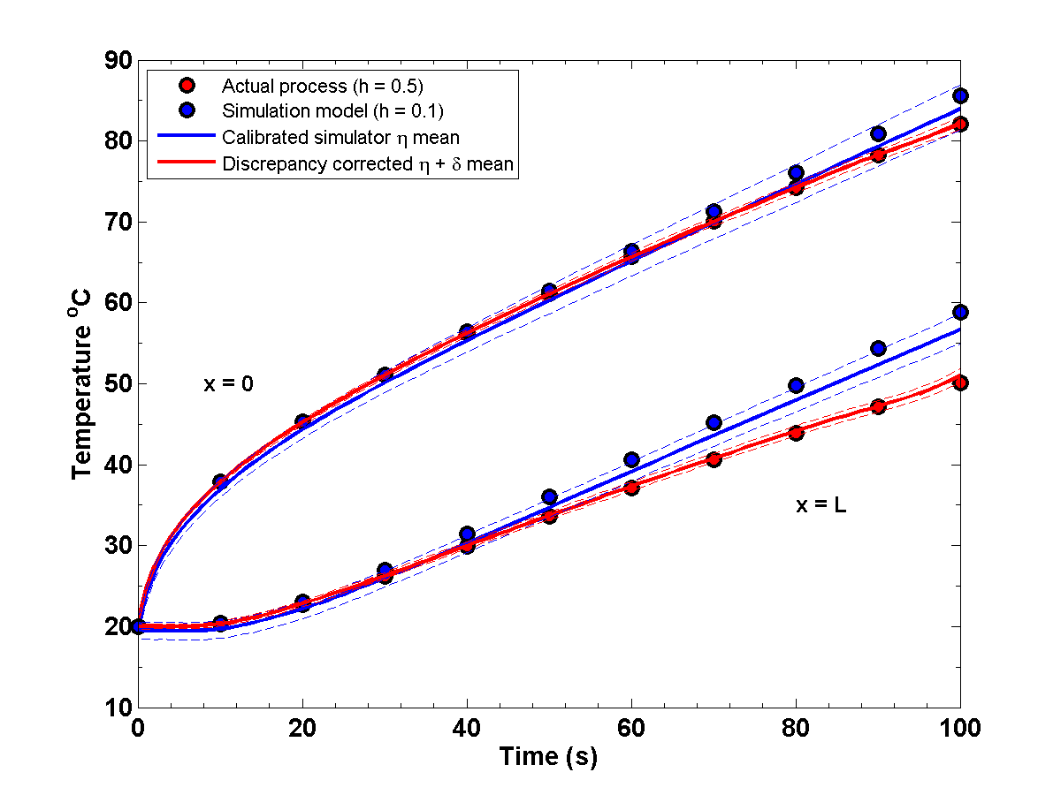
Transient - Prediction
y1
y2
Dashed lines – 95% confidence bounds

Slide 7
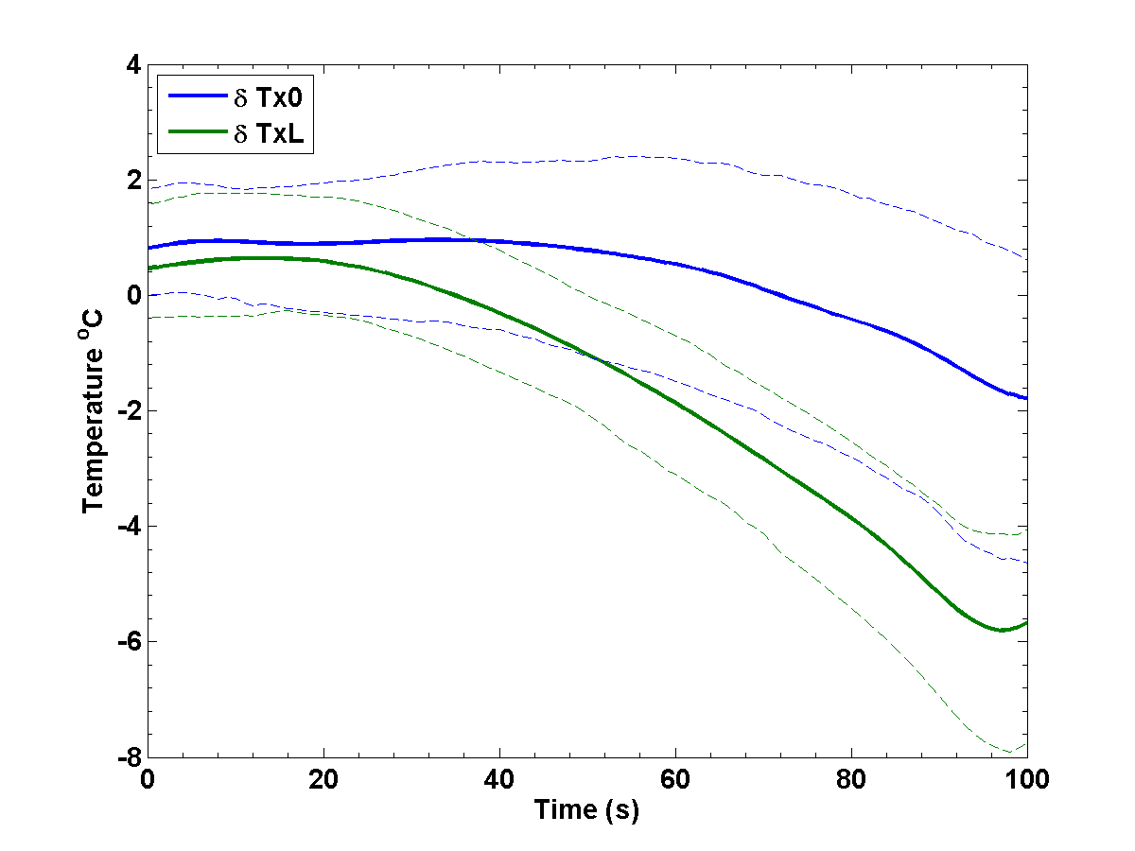
Transient – Delta Prediction
y1
y2
Dashed lines – 95% confidence bounds

Slide 8
Summary
Calibrated theta from BHM very close to “True” values
Transient implementation is very effective in dealing with data dependent on non-random parameters
Multiple ys can also be handled
Step in resolving parameter identifiability issue – problem definition is key

Slide 10
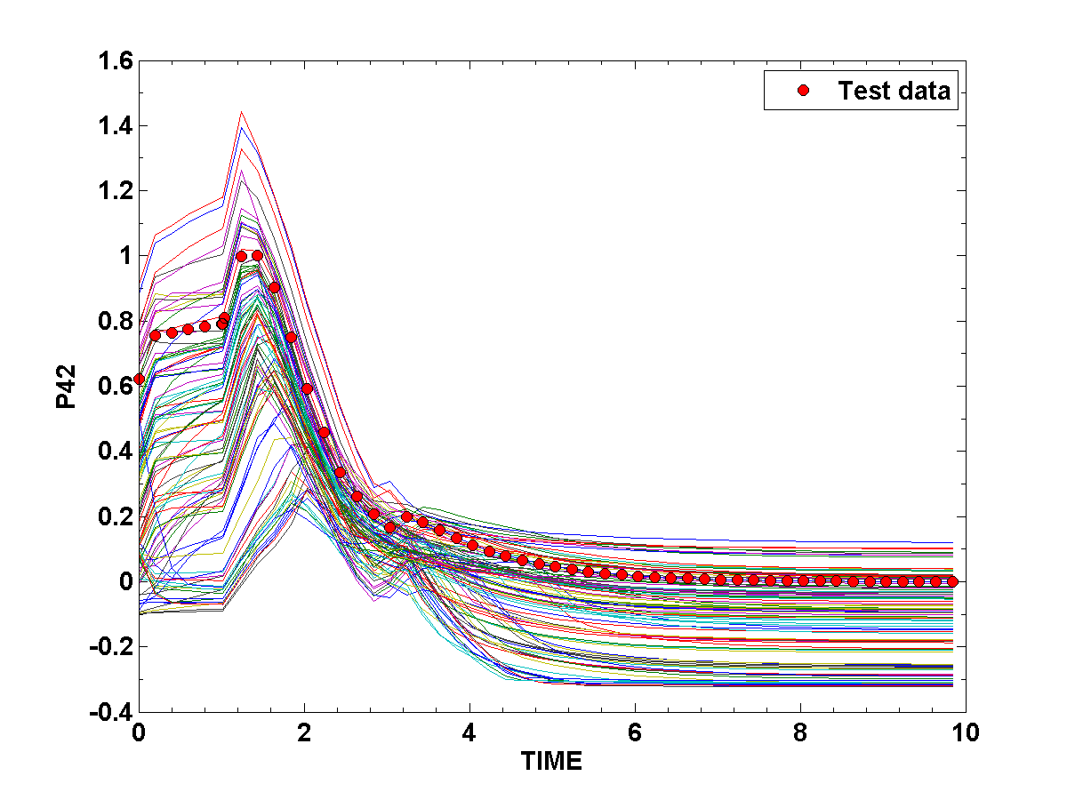
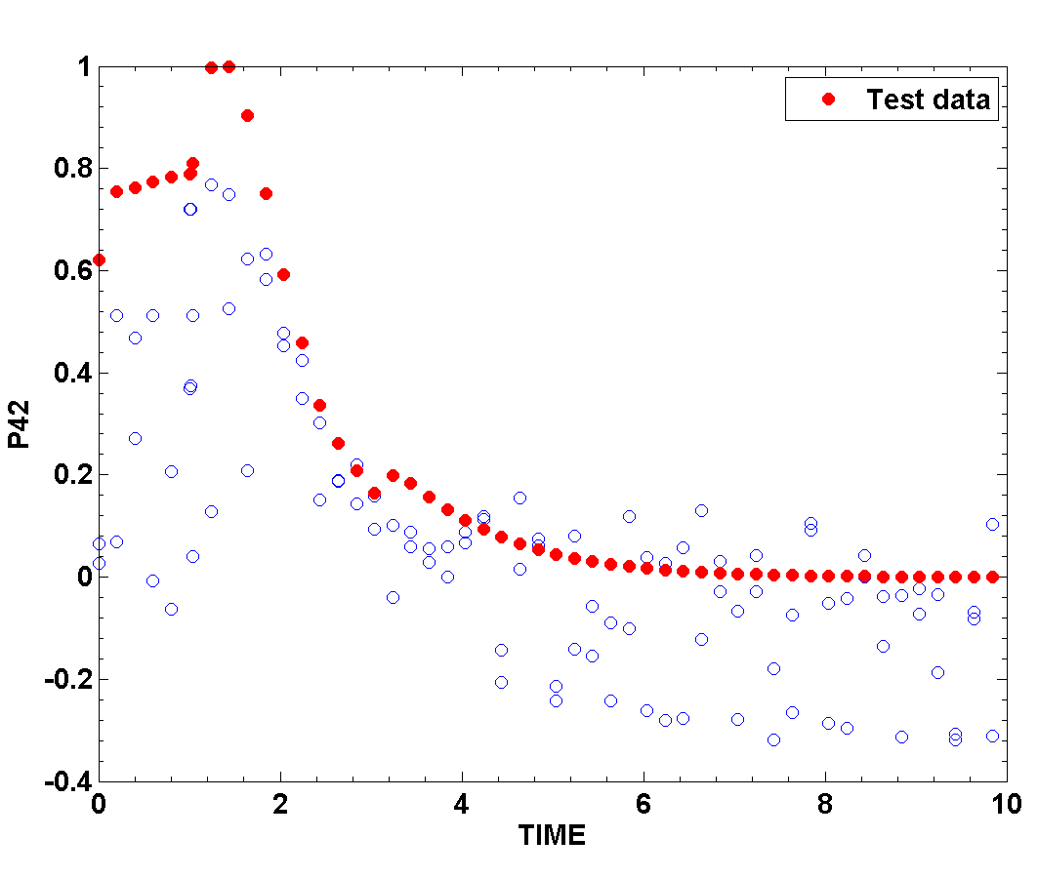
Transient problem
AIR benchmark problem – 100 DoE points
6 calibration parameters
6 output responses – only P42 considered
Brute force approach – consider TIME as x (design variable), reduce DoE data by sampling data at specific TIME points

Slide 11
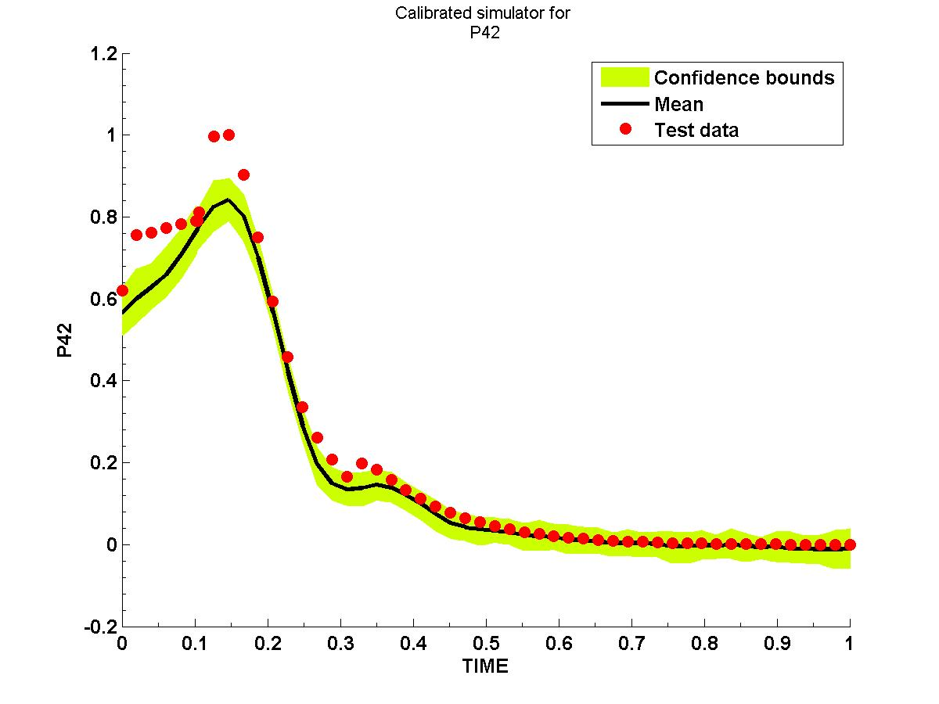
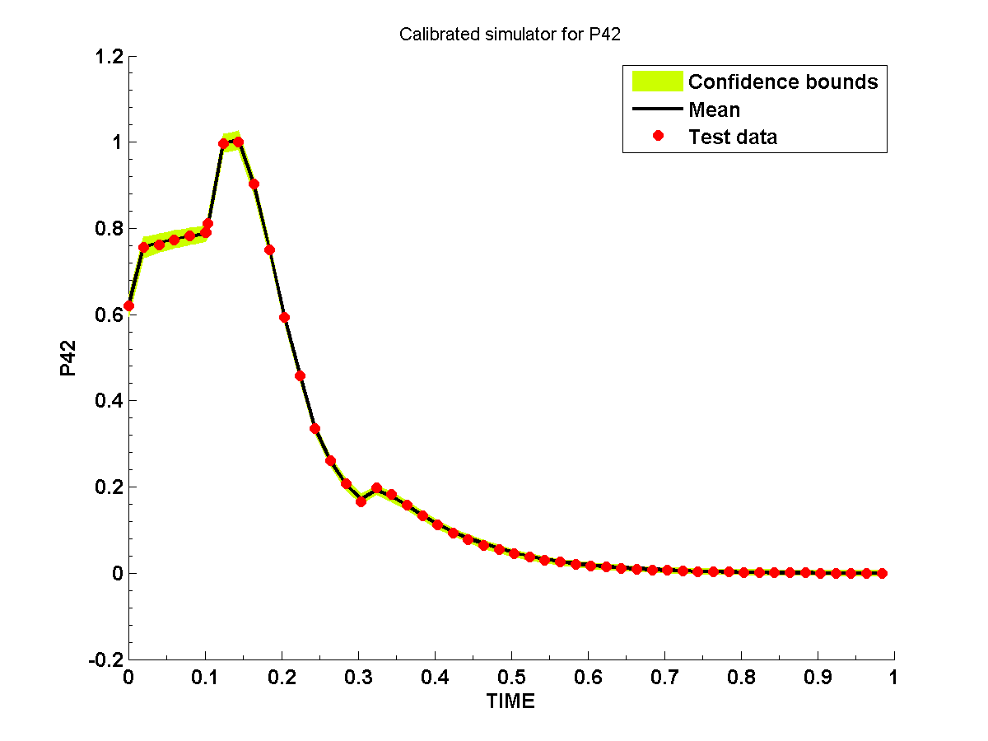
Transient problem
Brute force approach
Treat time as X
Modified approach
Time not treated as random
Updated the framework to read in transient data
Reduced amount of simulation data through POD
Setup Gaussian kernels to accurately model discrepancy

Slide 12
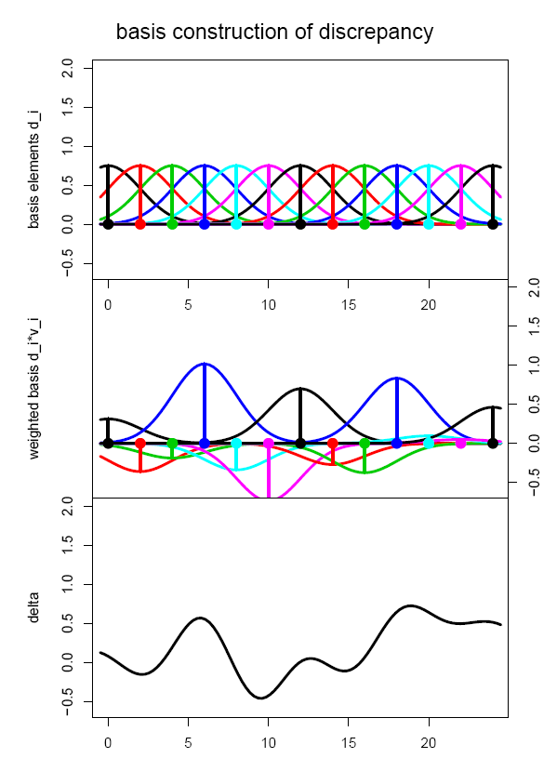
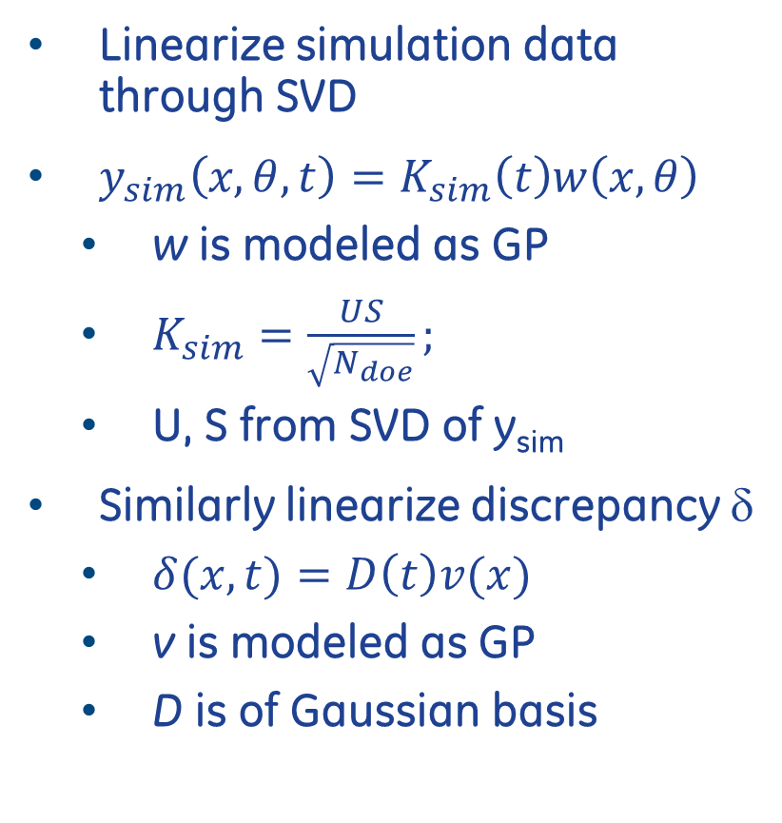
Details on transient implementation
Linearize simulation data through SVD
$y_{sim}\left(x,θ,t\right)=K_{sim}\left(t\right)w\left(x,θ\right)$
w is modeled as GP
$K_{sim}=\frac{US}{\sqrt{N_{doe}}};$
U, S from SVD of y_{sim}
Similarly linearize discrepancy δ
$δ(x,t)=D\left(t\right)v(x)$
v is modeled as GP
D is of Gaussian basis

