Slide 1
Email Security
Jitendra Kumar
Joint Director CDAC Bangalore

Slide 2
What is email security?
Process of preventing email-based cyber attacks and protecting against unwanted communications. It may comprise the following
Protecting inboxes from takeover
Protecting domains from spoofing
Stopping phishing attacks
Preventing fraud
Blocking malware delivery
Filtering spam
Use of encryption to protect the contents of emails from unauthorized access.
Includes the techniques and technologies used to protect email accounts and communications.
Email has the organization’s largest attack surface
Primary target of phishing attacks
Can be used to spread malware

Slide 3
Major concern with email
Security and privacy were not built at the time it was first invented
still not built into email by default
Open format can be read on any device without decryption once it is intercepted.
Normally message contents are not secured
Can be read/modified either in transit or at destination by the attacker
E-mail service is like postcard service
just pick it up and read it
Major attack vector for organizations large and small, and for individual people as well.

Slide 4
Major concern with email contd..
Email is a top threat vector because it is a ubiquitous tool that everyone in an organization uses.
Does not go straight to the recipient before landing in an inbox
Travels between networks and servers
Some may be vulnerable and unsecured.
Some may even be compromised even though the individual computer is secured.
Cyber criminals can easily impersonate a sender
Can manipulate email content body, attachments, Uniform Resource Locators (URLs), or a sender’s email address.
Can manipulate the email headers containing information about the sender and recipients
Can change the metadata and forged email may give the impression of mail coming from a reputable entity

Slide 5
What kinds of attacks occur via email?
Fraud
Aim to trick large enterprise accounting departments into transferring money to illegitimate accounts.
With the use of domain spoofing the attacker can easily vouch for a legitimate person or entity
Phishing
A phishing is an attempt to steal sensitive information, for example, username, password, etc.
Direct users to a fake webpage that collects credentials
Create urgency and pressure to send the information to an email address secretly controlled by the attacker.
Domain spoofing is also common in such attacks
Malware
Malicious code delivered over email include spyware, scareware, adware, and ransomware, among others.
For example, through an email attachment that contains malicious code

Slide 6
What kinds of attacks occur via email? contd..
Account takeover for malicious purposes
such as monitoring their messages
stealing information
To forward malware attacks and spam to their contacts.
Email interception
To steal the information
To carry out on-path attacks in which attackers impersonate both sides of a conversation to each other.
Generally done using monitoring network data packets on LANs.
Spoofing
Spoofing involves fooling the recipient into thinking the email is coming from someone other than the apparent sender.

Slide 7
Email domain spoofing
Allows attackers to send messages from legitimate-seeming addresses.
Allows attackers to send an email with a forged "from" address
For example, an attacker can forge the “From” address that represent a trustable entity

Slide 8
What is a phishing attack?
Phishing is an attempt to steal sensitive data
Usernames, passwords, other important account information, etc.
Phisher can use them to take over the user's accounts with their password or sells the stolen information.
Attackers disguise themselves as a reputable entity.
Bait the victims with an enticing or seemingly urgent request
Attacker lures the victim into providing information, just as a person uses bait while fishing.
Phishers trick people into emailing sensitive information directly
Or through links to a webpage, they control

Slide 9
There are several types of phishing:
Spear phishing is highly targeted and often personalized to be more convincing.
Whaling targets important or influential persons within an organization, such as executives.
Non-email phishing attacks include vishing (phishing via phone call), smishing (phishing via text message), and social media phishing.

Slide 10
Blocking phishing attacks
Email security solutions can
Filter out emails from known bad IP addresses.
Block or remove links embedded within emails
Use DNS filtering to block phishing webpage
An organization's employees should receive training on how to recognize a phishing email.
Many email providers have some built-in phishing protection
However, phishing emails still regularly sneak into user inboxes.
Many organizations employ additional phishing protection to better defend their users and networks.

Slide 11
How are email attachments used in attacks?
Attaching the malicious software as an exe file, then tricking the recipient into opening the attachment.
Common approach is to conceal malicious code within an innocent-seeming document, like a PDF or a Word file.
Both these file types support the inclusion of code such as macros
Many ransomware infections in recent years have started with an email attachment
Ryuk ransomware often enters a network through a TrickBot or Emotet infection through attachments
Maze ransomware
Petya ransomware

Slide 12
What is spam and how to tackle it?
Spam is a term for unwanted or inappropriate email messages, sent without the recipient's permission.
Almost all email providers offer some degree of spam filtering.
Still some spam messages still reach user inboxes.
Individuals and organizations can take several approaches to cut down on the spam they receive.
Reduce or eliminate public listings of their email addresses.
Can implement a third-party spam filter on top of the filtering provided by their email service.
Consistently mark spam emails as spam, in order to better train the filtering
If a large percentage of a sender’s emails are unopened or marked as spam or bounce too much
ISPs and email services downgrade email sender reputation

Slide 13
Email accounts takeover
Attackers can use several methods to break into an email account:
Purchasing lists of previously stolen credentials
Brute force attacks: The attacker loads a login page and uses a bot to rapidly guess a user's credentials.
limits on password entry can effectively stop such attacks.
Phishing attacks
Web browser infections
Spyware
Using multi-factor authentication (MFA) instead of single-factor password authentication is one way to protect inboxes from compromise.
Usage of single sign-on (SSO) service instead of logging directly into email.

Slide 14
How do DNS records help prevent email attacks?
The Domain Name System (DNS) stores public records about a domain, including that domain's IP address.
There are specialized types of DNS records that help ensure emails are from a legitimate source, not an impersonator: SPF records, DKIM records, and DMARC records.
Email service providers check emails against all three of these records to see if they are from the place they claim to be from and have not been altered in transit.

Slide 15
Email Security Best Practices
Spam filter
Email Encryption
Antivirus protection
Secure email gateway (SEG)
Multi-factor authentication (MFA)
Employee education
Educate the to recognize social engineering, phishing, and other types of attacks

Slide 16
Do
ALWAYS… check the email “from” field to validate the sender.
This “from” address can be easily spoofed
ALWAYS… check for files with a “double extension”. Although a text file named “safe.txt” is safe, a file called “safe.txt.exe” is not.
ALWAYS… report suspicious emails to your Information Technology support(ITS) team, or engage them for guidance before proceeding
ALWAYS… look closely at website addresses (URL) that are included in an email

Slide 17
DON’T
DO NOT… open any email attachments that end with .exe, .scr, .bat, .com, or other executable files that you do not recognize.
Be very cautious about opening MS Word, MS Excel, and Adobe PDF files.
DO NOT… ever click embedded hyperlinks within email messages without first hovering your mouse over them to see where they will take you
DO NOT… respond or reply to spam in any way.
Instead mark the email as “SPAM” or “junk” in their email client
Else work with your IT department to adjust your SPAM filter to capture emails from this sender in the future.
DO NOT… “unsubscribe” – it’s easier to mark the email as “SPAM” or “Junk” than deal with the security risks associated with clicking on the “unsubscribe” link or responding to an email.

Slide 18
5 REASONS WHY UNSUBSCRIBING IS A BAD IDEA:
By clicking the link or responding via email you have confirmed to the sender that your email address is both valid and in active use.
By responding to the email, you have positively confirmed that you have opened and read it
may be slightly interested in the subject matter
By clicking unsubscribe and responding you are confirming that your email is active and information about email software too.
If the response opens in a browser window and by visiting the spammer’s website, you may end up sharing your geographic location ( calculated based on IP address), OS, and browser information.
if you visit a website owned by a spammer, you’re giving them a chance to install malware on your computer, even if you don’t click anything.

Slide 19
AI/ML Based Email Safeness Scorer
Email Safeness Scorer
A privacy-preserving machine learning-based client-side tool to provide a safeness score of an email for alerting the user about possible phishing, scam, etc.
AI-based aggregated global model for alerting users about unsafe emails and work non intrusively i.e., available as a plug-in for the Mozilla Thunderbird
Available at https://coednssecurity.in/#resources
EMAIL SAFENESS SCORER
Phishing Detection
Spam Detection
Malicious URL Detection
AI- based Continuous Learning
Personalized Learning

Slide 20
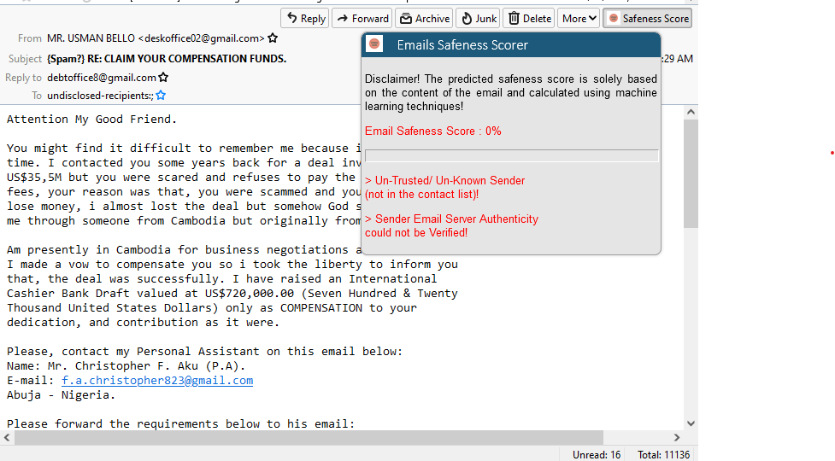
A screenshot

Slide 21
Thank You

