Slide 1
Mobile Plan Finder
INFO 6150 Final Project

Slide 2
Purpose
Mobile Plan Finder is the easiest way to save on your cellular bill. Based on your wireless needs and budget, you'll be able to determine which family package is right for you. Our app lets you to connect with the owner of the plan. Our application helps owners of the family plan to fill the vacant spot by posting the request in our application.

Slide 3











Techstack
Programming languages
Other
Data Storage
JavaScript Framework
API
JavaScript
Socket.io
JWT token
react-bootstrap
Mobile Plan Finder
React

Slide 4
Features
Chat using Socket.io
Payment using Stripe API
NodeMailer for sending OTP
Lottie files for Animation
JWT Token for Authentication
1
2
3
4
5

Slide 5
Let’s have a look at demo!

Slide 6
Screenshots

Slide 7


Slide 8


Slide 9
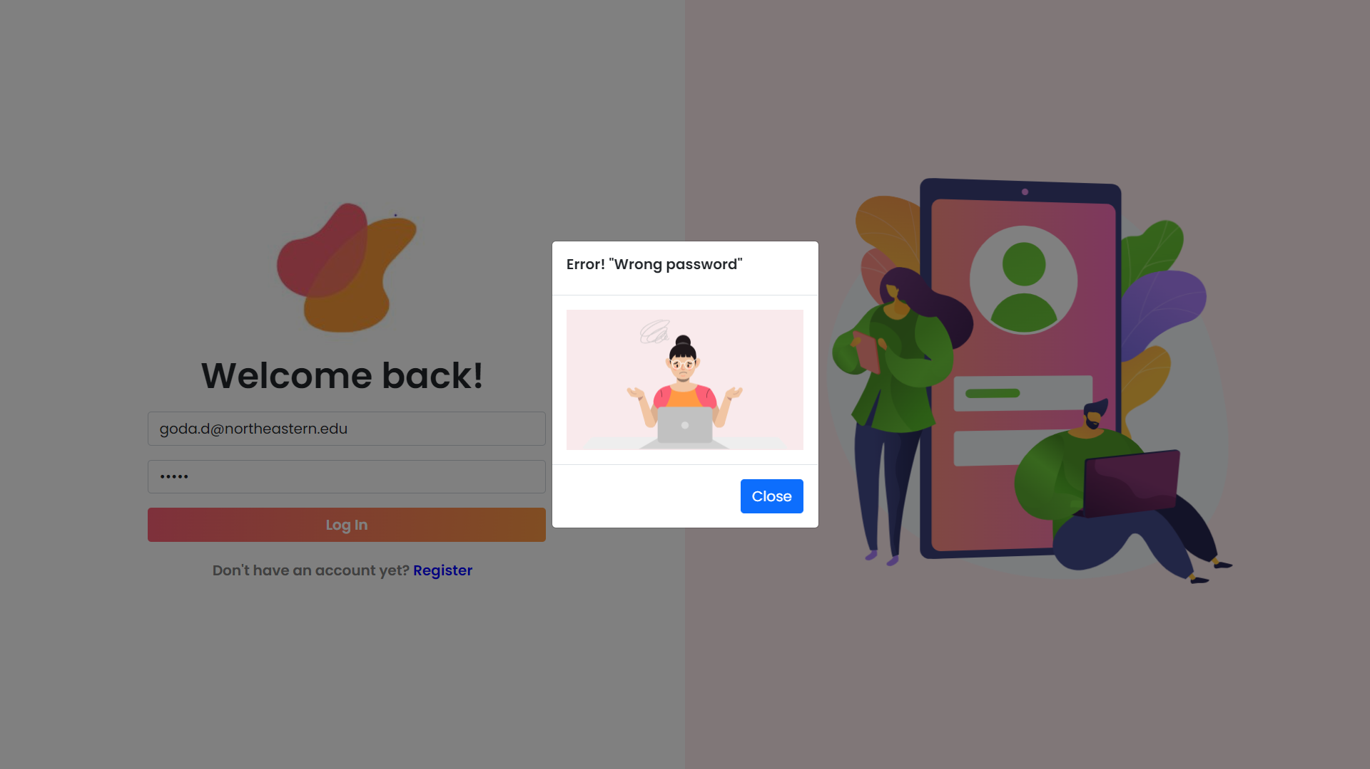

Slide 10
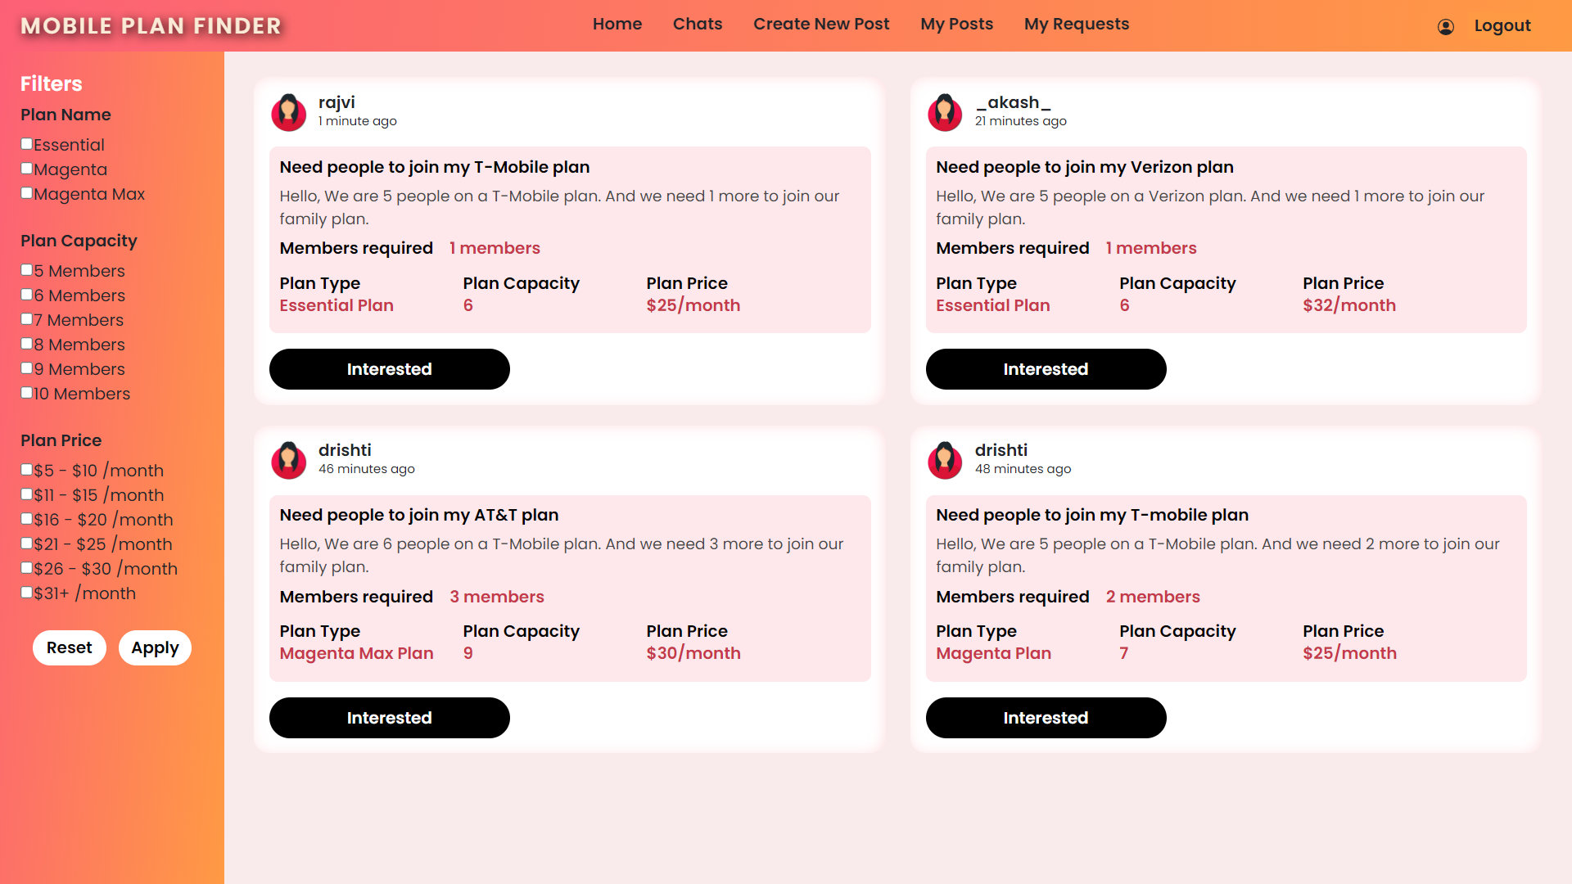

Slide 11
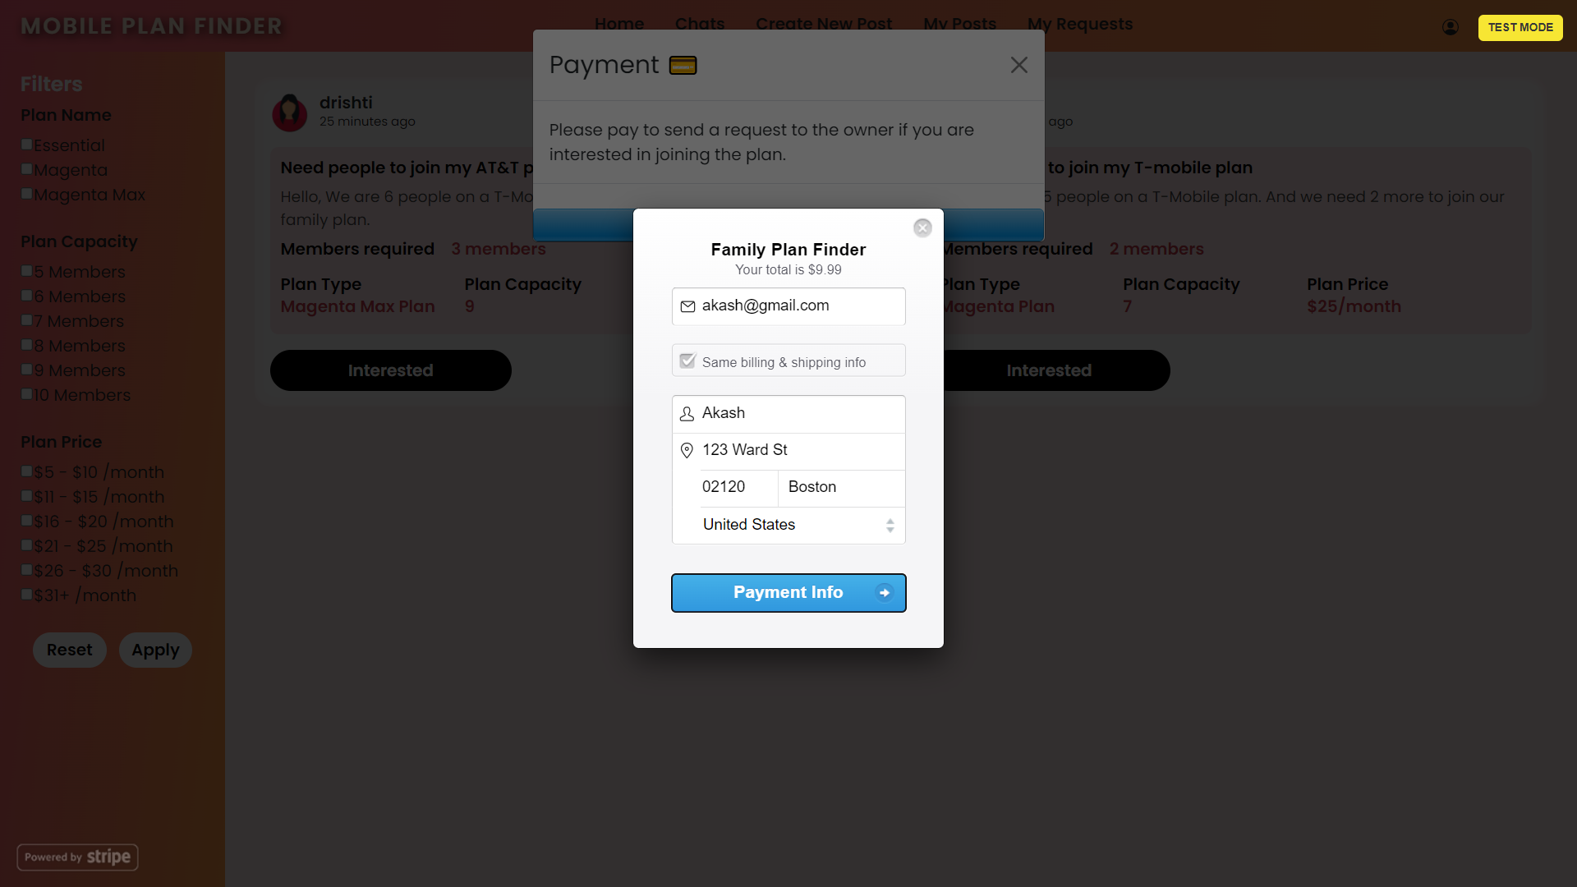

Slide 12
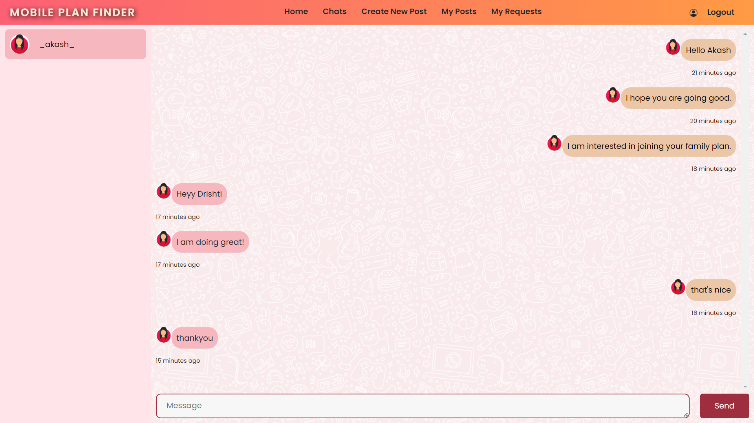

Slide 13
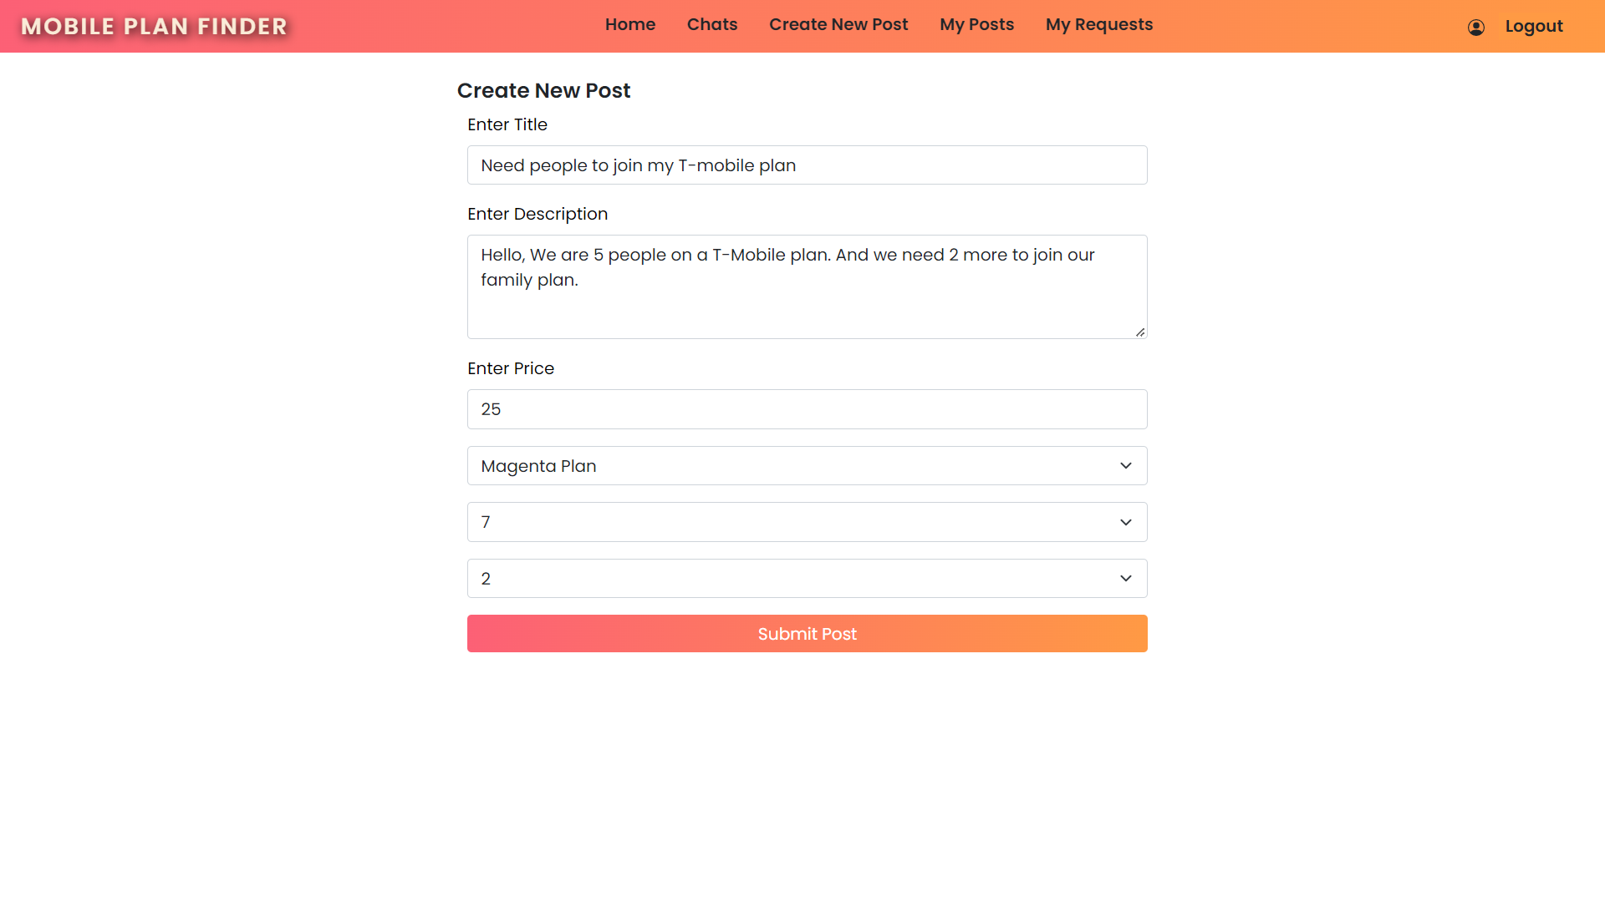

Slide 14
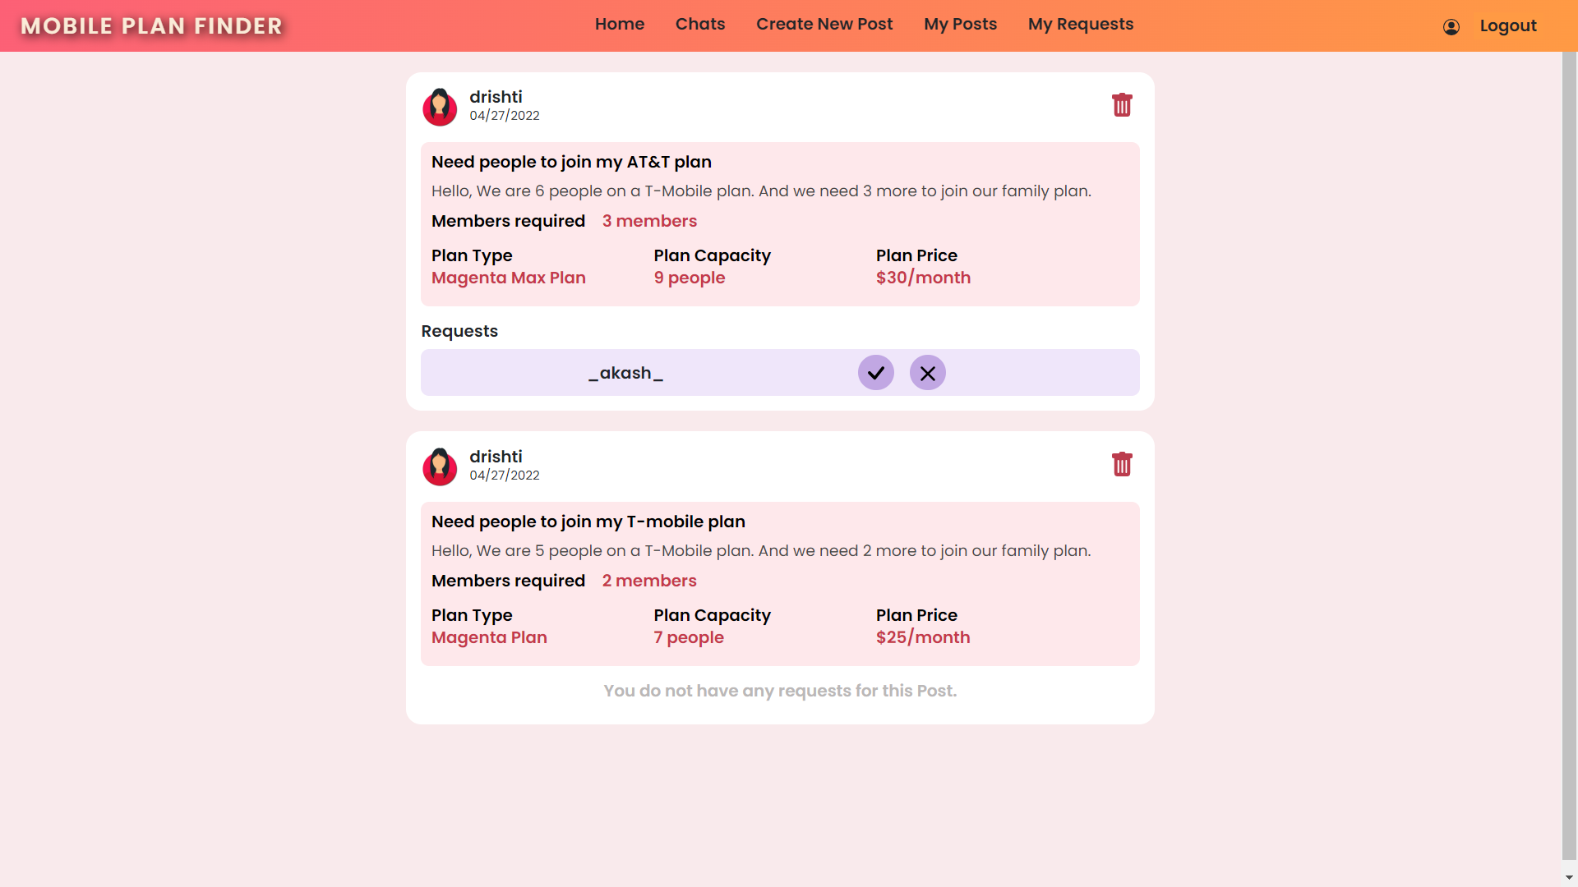

Slide 15
