Slide 1

24CS330 - DATA STRUCTURES
Dr. M S Sunitha Patel
Assistant Professor, Dept. of CSE
From C programming → organizing data → efficient problem solving
1

Slide 2
Course Syllabus

Slide 3
Before Diving In: Recap Key C Concepts
You have already learned the building blocks—we will reuse them
Control Structures
if-else, loops (for, while, do-while), switch-case
Arrays
Variables & Data Types
int, float, char, etc.
Collection of same-type elements
Functions
Pointers
Dynamic Memory
Reusable operations
Store memory addresses
malloc(), calloc(), free()
Structures
Group related fields
3

Slide 4
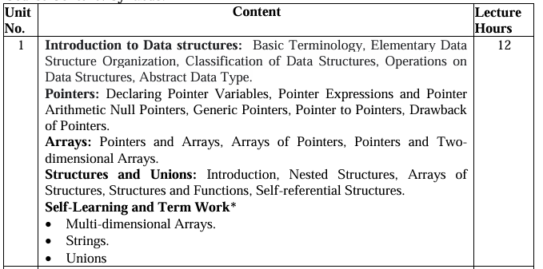

Slide 5
Introduction to Data Structures & Algorithms
Chapter 1 • Basic Terminology, Classification, Operations & ADT

Slide 6
What Is a Data Structure?
DATA
ORGANIZATION
OPERATIONS
Values we need to store
marks • names • IDs • sensor readings
How the values are arranged
sequential • linked • hierarchical • network
What we want to do
insert • delete • search • update • traverse
A data structure is a systematic way of organizing and storing data so that operations on it can be performed efficiently.
5

Slide 7
Why Do We Need Data Structures?
Good Program
Runs correctly
Easy to read and understand
Efficient Program
Minimum execution time
Minimum memory usage
Data Management
Collect → Organize → Maintain
A data structure groups data elements under one name and defines how data is stored and organized.
The appropriate structure can improve the speed and resource efficiency of a program.

Slide 8
Importance of Data Structures
A good structure can change the cost of a solution
Efficient Access
Fast Searching
Easy Updates
Retrieve required data quickly.
Reduce unnecessary comparisons.
Insert/delete data systematically.
Memory Management
Scalability
Better Algorithms
Use memory appropriately.
Handle increasing input sizes.
Provide the foundation for efficient algorithms.
7

Slide 9
Selecting an Appropriate Data Structure
Analyse the problem
What operations are required?
(e.g., insert, delete, search)
Quantify resources
What are the time and space constraints?
1
2
3
Select the structure
Choose the structure that best meets the requirements.
Key idea: data and its required operations come first; representation and implementation follow.
Using a familiar structure is not enough—the structure must suit the problem.

Slide 10
Elementary Data Organization
Data
A value or set of values.
Example: marks, name, address.
Data Item
A single item or a group item
with subordinate items.
Record
A collection of related data items.
File
A collection of related records.
Example: Student Record
Roll No. • Name • Address • Course • Marks
Roll number can uniquely identify the record.
Primary Key
A data item whose value uniquely identifies a record.
Key values: K₁, K₂, …

Slide 11
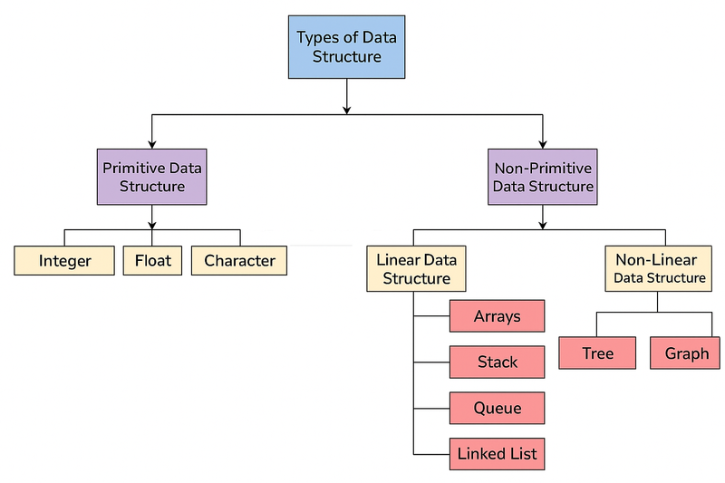
Classification of Data Structures

Slide 12
Arrays
Collection of similar data elements of the same data type.
Elements are stored in consecutive memory locations.
Elements are referenced using an index (subscript).
C syntax: type name[size]; Example: int marks[10];
Index starts at 0; therefore marks[0] is the first element and marks[9] is the tenth.
m0
m1
m2
m3
m4
m5
m6
m7
m8
m9
[0]
[1]
[2]
[3]
[4]
[5]
[6]
[7]
[8]
[9]
Limitations
Fixed size • Requires contiguous memory • Insert/delete may require shifting

Slide 13
Linked Lists
A flexible, dynamic structure in which elements (nodes) form a sequential list.
Memory for each node is allocated as it is added.
Each node contains data and a link/pointer to the next node.
The last node contains a NULL pointer.
1
2
3
4
NULL
Advantage
Easier insertion and deletion
Disadvantages
Slower search; requires extra memory for links

Slide 14
Stacks — LIFO
Linear structure where insertion and deletion occur at only one end: TOP.
LIFO = Last-In, First-Out.
Implemented using arrays or linked lists.
Basic operations: PUSH, POP and PEEP.
Overflow: insertion attempted when the stack is full.
Underflow: deletion attempted when the stack is empty.
Think of a stack of plates
The last plate placed is the first plate removed.
TOP
D
C
B
A

Slide 15
Queues — FIFO
FIFO = First-In, First-Out.
Elements are inserted at the REAR and removed from the FRONT.
Implemented using arrays or linked lists.
FRONT and REAR variables identify deletion and insertion positions.
Overflow: queue is full (rear = MAX−1 in the array representation).
Underflow: deletion attempted when the queue is empty.
12
9
7
18
14
36
FRONT
REAR
Insertion → REAR
Deletion ← FRONT

Slide 16
Trees — Hierarchical, Non-linear Structure
A tree is a collection of nodes arranged in a hierarchical order.
One node is designated as the ROOT.
A binary tree has a root and left and right sub-trees.
Each binary-tree node can contain data, a left pointer and a right pointer.
If root = NULL, the tree is empty.
1
2
3
4
5
6
7

Slide 17
Graphs — Modeling Complex Relationships
B
A graph is a non-linear structure consisting of vertices (nodes) and edges.
Unlike a tree, a graph has no root and does not require a parent–child hierarchy.
Nodes can represent cities, computers, people, etc.; edges can represent roads, network links or other relationships.
Common graph tasks include searching and finding shortest paths.
A
C
D
E
Example
Computer network: nodes = workstations; edges = network connections.

Slide 18
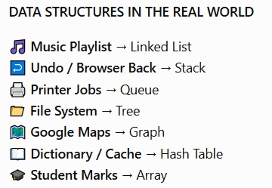
.
Applications of Data Structures
Students see Data Structures everywhere—often without realizing it
STACK
QUEUE
LINKED LIST
Undo/Redo • Browser history • Function calls
Printer queue • CPU scheduling • Network buffering
Playlists • Dynamic memory structures
TREE
GRAPH
File systems • Organization hierarchy • Search structures
Google Maps • Social networks • Computer networks
9

Slide 19
Common Operations on Data Structures
Traversing
Access each data item exactly once for processing.
Searching
Find data items that satisfy a given condition.
Inserting
Add a new data item.
Deleting
Remove a particular data item.
Sorting
Arrange items in ascending/descending order.
Merging
Combine two sorted lists into one sorted list.

Slide 20
Abstract Data Type (ADT)
ADT focuses on WHAT
What data and operations are available?
Implementation details are hidden.
Example: Stack
Operations: push(), pop(), peep()
Can be implemented using an array or linked list.
Example: Queue
Operations are defined by the ADT;
implementation can vary.
User
Calls available operations
ADT
Implementation
Array / Linked List
Benefit: separates the use of a data structure from its implementation, making future changes easier.

Slide 21
Quick Recap
Data Structure
Organizes data so it can be used efficiently.
Classification
Primitive / Non-primitive → Linear / Non-linear.
Linear
Array, Linked List, Stack, Queue.
Non-linear
Tree, Graph.
Operations
Traverse, Search, Insert, Delete, Sort, Merge.
ADT
Describes data + operations while hiding implementation.

Slide 22
Arrays

Slide 23
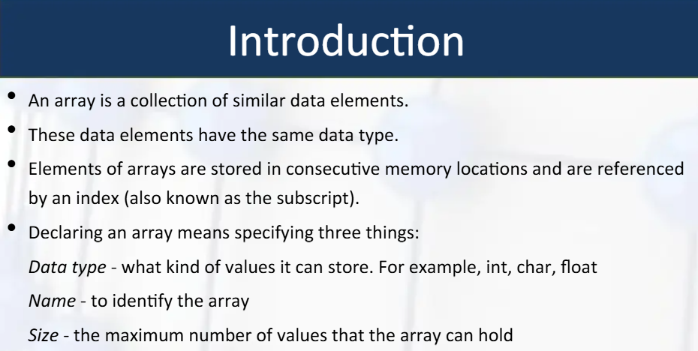
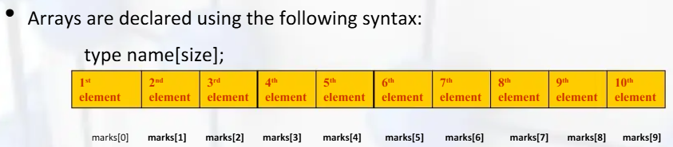
Memory representation of an array of 10 elements

Slide 24
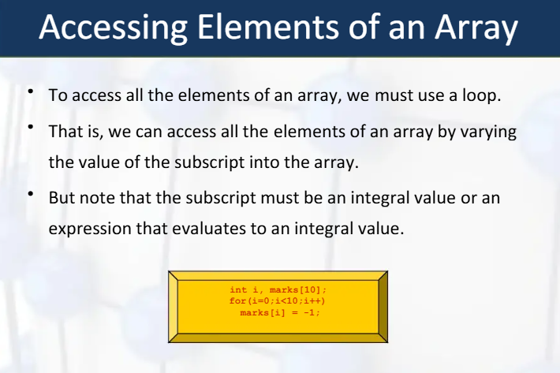

Slide 25
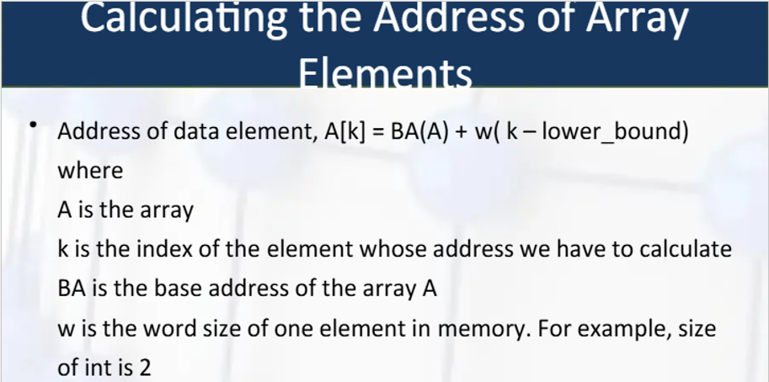
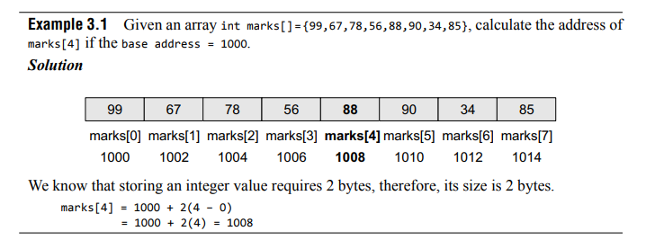

Slide 26
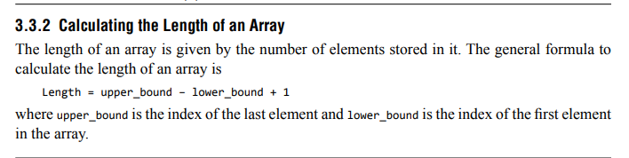
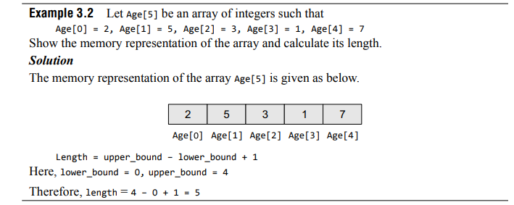

Slide 27
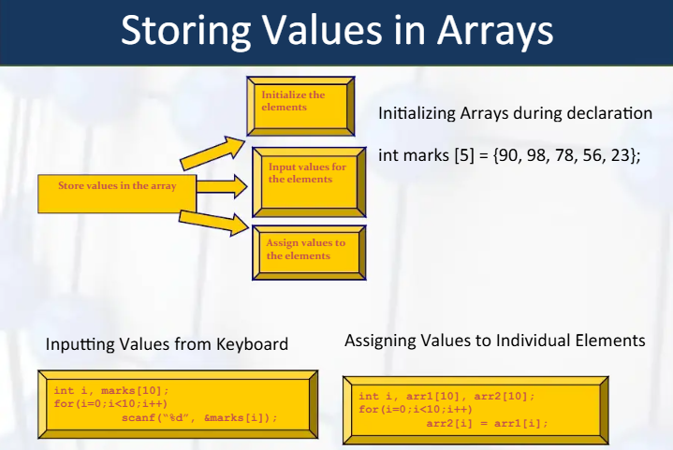

Slide 28
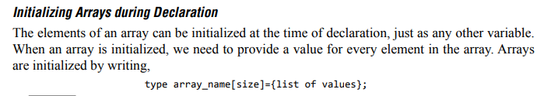
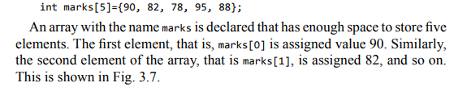
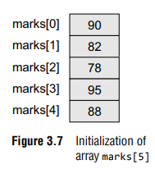
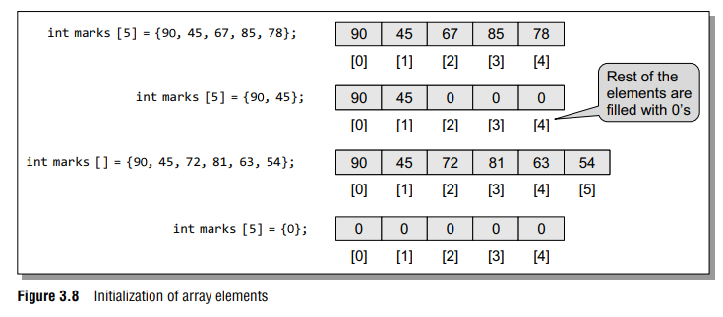

Slide 29
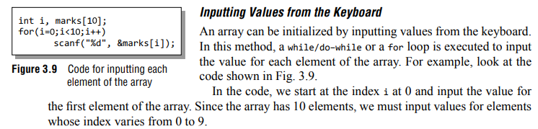

Slide 30
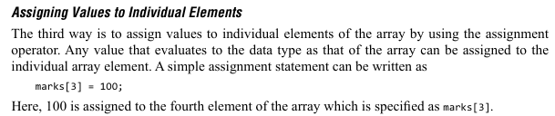
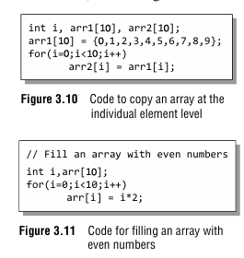

Slide 31
Array Operations
There are a number of operations that can be preformed on arrays. These operations include:
Traversing an array
Inserting an element in an array
Searching an element in an array
Deleting an element from an array
Merging two arrays
Sorting an array in ascending or descending order

Slide 32
1) Traversing an Array
Traversing an array means accessing each and every element of the array for a specific purpose.
Traversing the data elements of an array A can include printing every element, counting the total number of elements, or performing any process on these elements.
Since, array is a linear data structure (because all its elements form a sequence), traversing its elements is very simple and straightforward.
The algorithm for array traversal is given in Fig. 3.12.

Slide 33
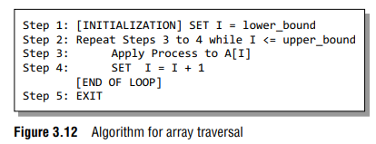
In Step 1, we initialize the index to the lower bound of the array.
In Step 2, a while loop is executed.
Step 3 processes the individual array element as specified by the array name and index value.
Step 4 increments the index value so that the next array element could be processed. The while loop in Step 2 is executed until all the elements in the array are processed, i.e., until I is less than or equal to the upper bound of the array.

Slide 34
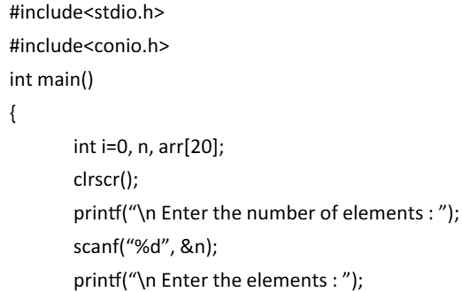
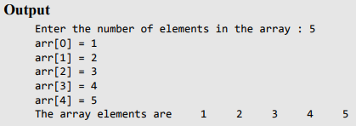
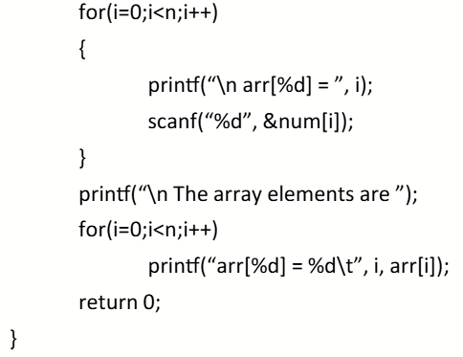
Write a program to read and display n numbers using an array

Slide 35
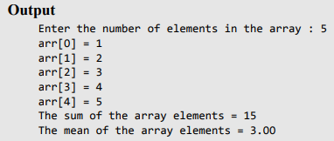

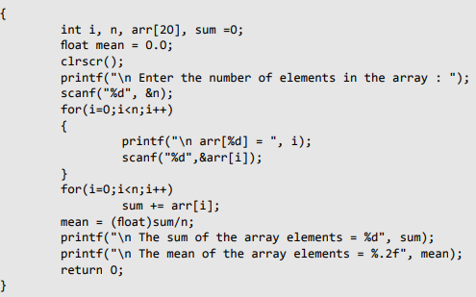
Write a program to find the mean of n numbers using arrays.

Slide 36
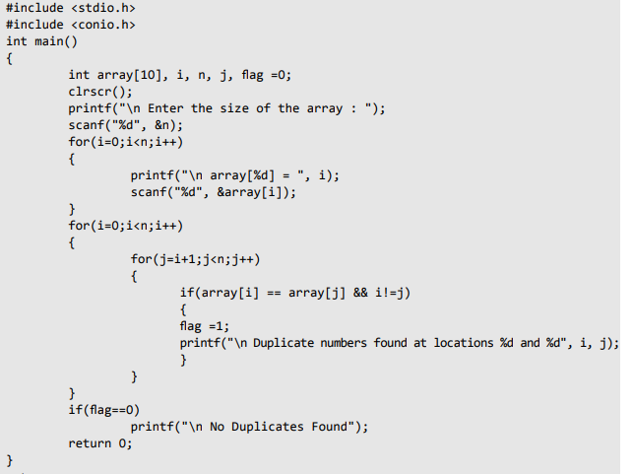
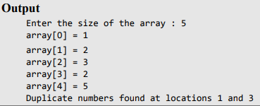
Write a program to find whether the array of integers contains a duplicate number.

Slide 37

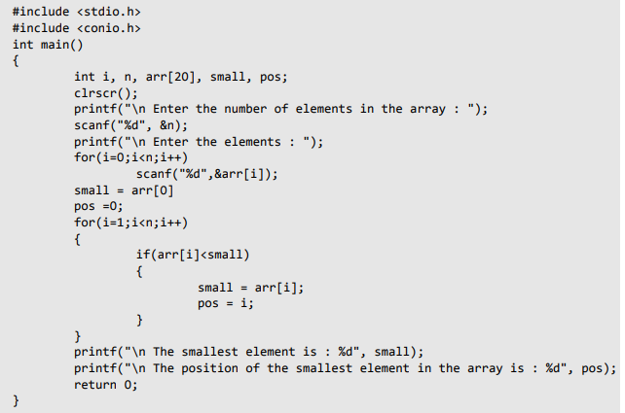
Write a program to print the position of the smallest number of n numbers using arrays.

Slide 38
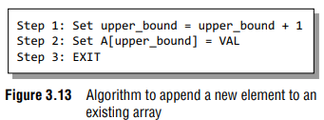
Inserting an Element in an Array
If an element has to be inserted at the end of an existing array, then the task of insertion is quite simple.
We just have to add 1 to the upper_ bound and assign the value.
Here, we assume that the memory space allocated for the array is still available.
For example, if an array is declared to contain 10 elements, but currently it has only 8 elements, then obviously there is space to accommodate two more elements.
But if it already has 10 elements, then we will not be able to add another element to it

Slide 39
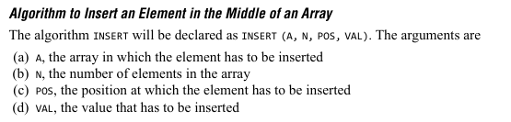
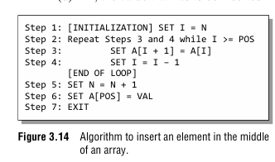
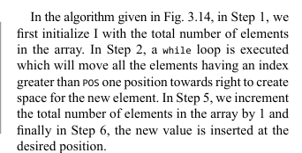
- 1

Slide 40
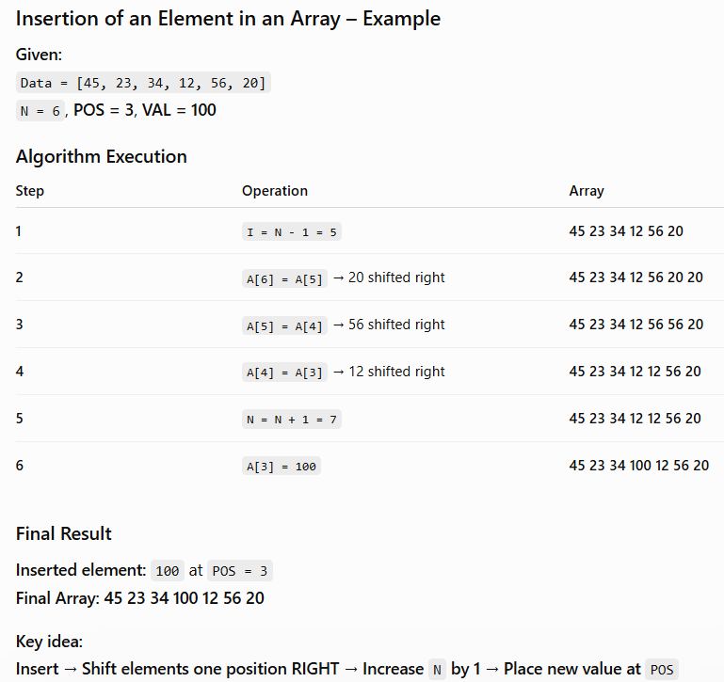

Slide 41
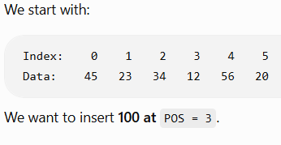
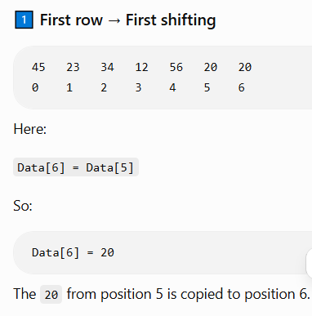
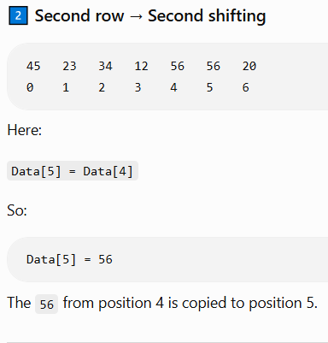
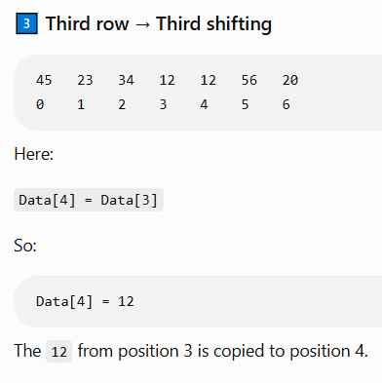

Slide 42
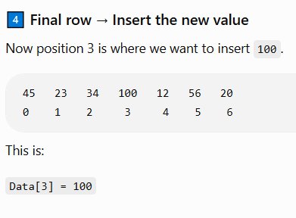
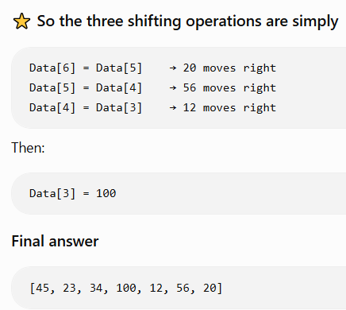
The important thing to notice: We do not move 45, 23, or 34 because they are before the insertion position 3. Only the elements from position 3 onward are shifted right.

Slide 43
#include <stdio.h>
int main()
{
int A[100], N, POS, VAL, I;
printf("Enter number of elements: ");
scanf("%d", &N);
printf("Enter the elements:\n");
for (I = 0; I < N; I++)
scanf("%d", &A[I]);
printf("Enter the position: ");
scanf("%d", &POS);
printf("Enter the number to insert: ");
scanf("%d", &VAL);
/* Shift elements to the right */
for (I = N - 1; I >= POS; I--)
A[I + 1] = A[I];
/* Insert the new number */
A[POS] = VAL;
N = N + 1;
printf("Array after insertion:\n");
for (I = 0; I < N; I++)
printf("%d ", A[I]);
return 0;
}
Write a program to insert a number at a given location in an array.

Slide 44
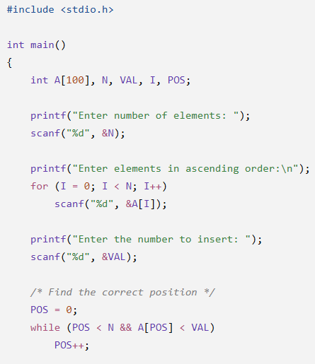
Write a program to insert a number in an array that is already sorted in ascending order.

Slide 45
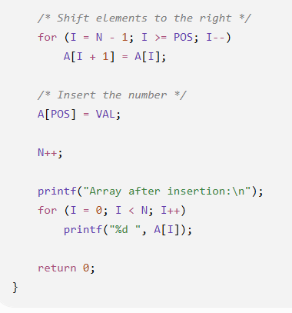

Slide 46
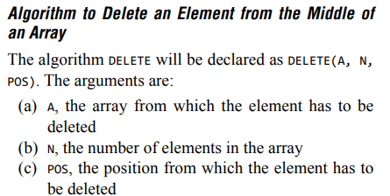
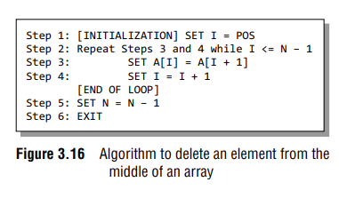
Figure 3.16 shows the algorithm in which we first initialize I with the position from which the element has to be deleted.
In Step 2, a while loop is executed which will move all the elements having an index greater than POS one space towards left to occupy the space vacated by the deleted element. When we say that we are deleting an element, actually we are overwriting the element with the value of its successive element.
In Step 5, we decrement the total number of elements in the array by 1.

Slide 47
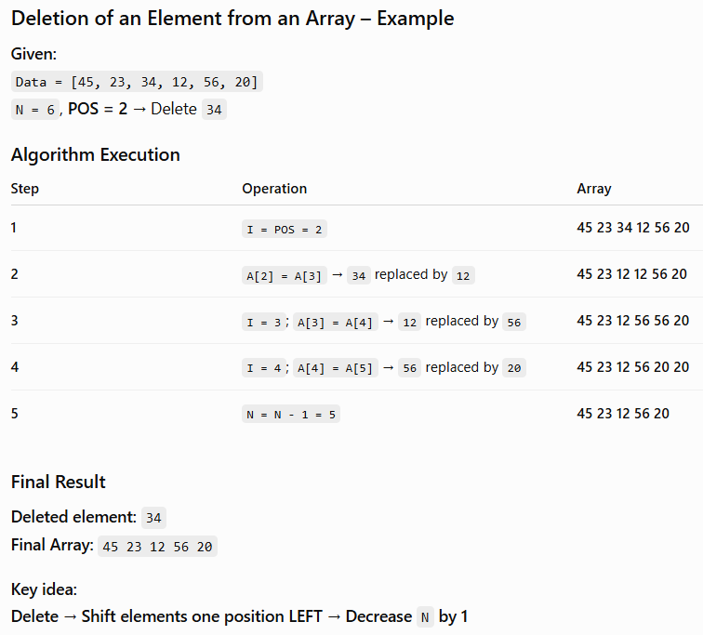

Slide 48
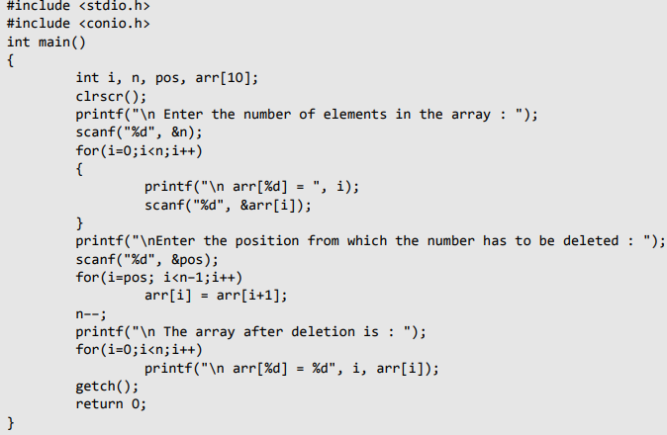
Write a program to delete a number from a given location in an array

Slide 49
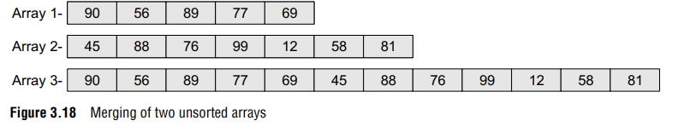
Merging Two Arrays
Merging two arrays in a third array means first copying the contents of the first array into the third array and then copying the contents of the second array into the third array.
Hence, the merged array contains the contents of the first array followed by the contents of the second array. If the arrays are unsorted, then merging the arrays is very simple, as one just needs to copy the contents of one array into another.
But merging is not a trivial task when the two arrays are sorted and the merged array also needs to be sorted.
Let us first discuss the merge operation on unsorted arrays. This operation is shown in Fig 3.18.

Slide 50
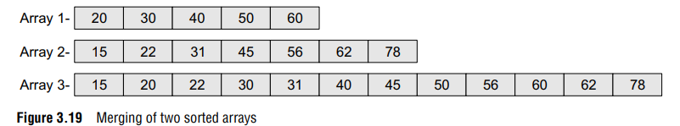
If we have two sorted arrays and the resultant merged array also needs to be a sorted one, then the task of merging the arrays becomes a little difficult. The task of merging can be explained using Fig. 3.19.

Slide 51
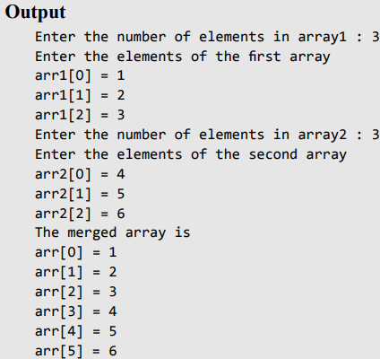
Write a program to merge two unsorted arrays.

Slide 52
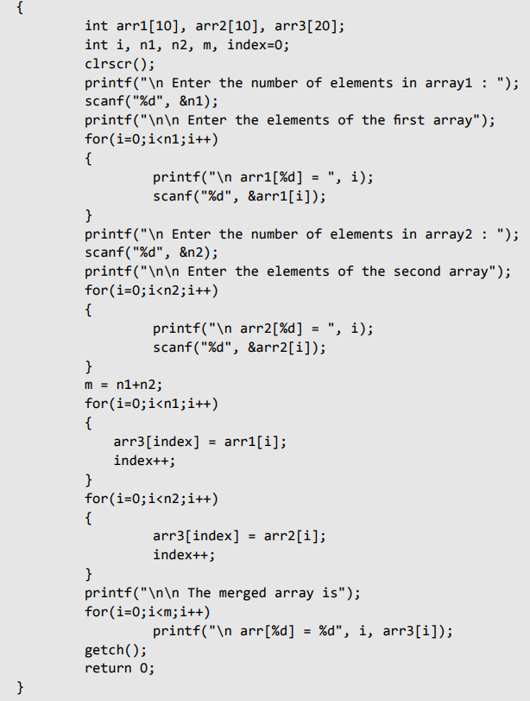

Slide 53
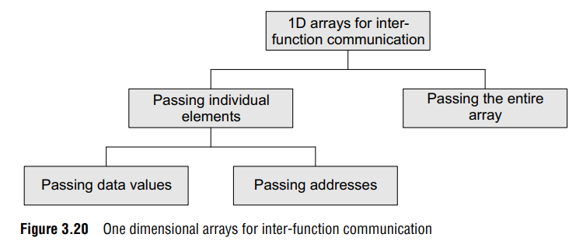
PASSING ARRAYS TO FUNCTIONS
Like variables of other data types, we can also pass an array to a function. In some situations, you may want to pass individual elements of the array; while in other situations, you may want to pass the entire array. In this section, we will discuss both the cases. Look at Fig. 3.20 which will help you understand the concept.

Slide 54
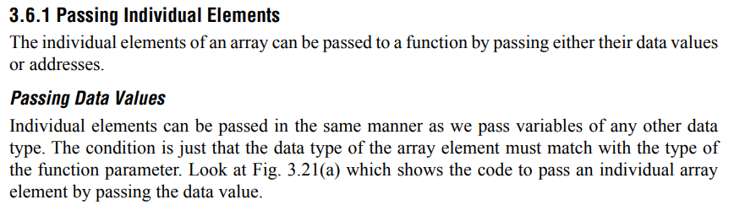

In the above example, only one element of the array is passed to the called function.
This is done by using the index expression. Here, arr[3] evaluates to a single integer value.
The called function hardly bothers whether a normal integer variable is passed to it or an array value is passed.

Slide 55



Slide 56



Slide 57


Write a program to read an array of n numbers and then find the smallest number using functions

Slide 58


Slide 59



Write a program to interchange the largest and the smallest number in an array

Slide 60



Slide 61



Slide 62


Slide 63


Program to modify the contents of an array using a pointer to an array.
A[ ] = 1 2 3 4 5

Slide 64

Write a program to display an array of given numbers using pointers

Slide 65

int *ptr[10];
int p = 10, q = 20, r = 30, s = 40, t = 50;
ptr[0] = &p;
ptr[1] = &q;
ptr[2] = &r;
ptr[3] = &s;
ptr[4] = &t;
Can you tell what will be the output of the following statement?
printf("\n %d", *ptr[3]);

Slide 66


The output will be 40 because ptr[3] stores the address of integer variable s, and
*ptr[3] will therefore print the value of s that is 40
Now look at another code in which we store the address of three individual arrays in the array of pointers:

Slide 67


Program to store the address of three individual arrays in the array of pointers
In the for loop, parr[0] stores the base address of arr1 (or, &arr1[0]). So writing *parr[0] will print the value stored at &arr1[0]. Same is the case with *parr[1] and *parr[2]

Slide 68

Three Integer Arrays
Array of Pointers
int arr1[] = {1,2,3,4,5};
int arr2[] = {0,2,4,6,8};
int arr3[] = {1,3,5,7,9};
int *parr[3] = {arr1, arr2, arr3};
arr1 → 1 2 3 4 5
↑
arr1[0]
arr2 → 0 2 4 6 8
↑
arr2[0]
arr3 → 1 3 5 7 9
↑
arr3[0]
for(i = 0; i < 3; i++)
printf("%d", *parr[i]);
i | parr[i] points to | *parr[i] | Output
0 | arr1 | 1 | 1
1 | arr2 | 0 | 0
2 | arr3 | 1 | 1

Slide 69


Slide 70


Slide 71


Slide 72


Slide 73


Slide 74



Slide 75


Slide 76

Passing a Row
A row of a two-dimensional array can be passed by indexing the array name with the row number. Look at Fig. 3.32 which illustrates how a single row of a two-dimensional array can be passed to the called function.

Slide 77

Passing the Entire 2D Array
To pass a two-dimensional array to a function, we use the array name as the actual parameter (the way we did in case of a 1D array).
However, the parameter in the called function must indicate that the array has two dimensions. Look at the following program which passes entire 2D array to a function
Write a program to fill a square matrix with value zero on the diagonals, 1 on the upper right triangle, and –1 on the lower left triangle.

Slide 78




Slide 79


Slide 80
Pointers and Two Dimensional Arrays
A 2D array can be accessed using pointers in a few ways:
  a pointer to an array or
  an array of pointers.
A pointer to an array is a pointer that points to a whole 1D array (a row) within the 2D array,
while an array of pointers is an array where each element is a pointer pointing to another element, often used for dynamically allocated 2D arrays.
Both methods allow for direct memory manipulation, which can be more efficient than using double subscripts in some cases.

Slide 81


Slide 82



Slide 83

Important difference between “pointer to an array” and “array of pointers” in C.

Slide 84


Slide 85


Pointers and Two Dimensional Arrays
program to demonstrate how a pointer to an array is used to access a 2-D array.

Slide 86



Slide 87



Slide 88

Pointers and Two Dimensional Arrays

Slide 89
Lab Program 1
Write programs for the following to illustrate the use of pointers.
Create 3 pointers called P1, P2, P3 and an integer variable X where P1 points to P2, P2 points to P3 and P3 points to X. Demonstrate how to read and retrieve the value of X using P1, P2 and P3.
Crate a pointer to an integer array, Read and display the contents using pointer and also display the contents in reverse order using pointer.
Create a pointer to an integer array and pass this as parameter to a function called Reverse which reverses the array contents using pointer. Write different functions called Read (P) to read the array elements using pointer P and Display (P) to display the array contents using P before and after reverse.
Create a pointer to two-dimensional array of integers. Write functions Read (P) and Display (P) to read and display the contents using pointer.
Create two pointers called PS1 and PS2 to two strings, Read the contents using pointers and also write a function StrCat (PS1, PS2) which concatenates second string to the end of first string using pointers PS1 and PS2.

Slide 90



1.d. Write a program to read and display a 3 * 3 matrix using pointers.(lab program)

Slide 91
1.e. Create two pointers called PS1 and PS2 to two strings, Read the contents using pointers and also write a function StrCat (PS1, PS2) which concatenates second string to the end of first string using pointers PS1 and PS2.

Slide 92
Dynamic Memory Allocation
The process of reserving memory is called allocation. The way to allocate memory depends on the type of memory.
C has two types of memory: Static memory and dynamic memory.
Static Memory
Static memory is memory that is reserved for variables before the program runs.
Allocation of static memory is also known as compile time memory allocation.
C automatically allocates memory for every variable when the program is compiled.
For example, if you create an integer array of 20 students, C will reserve space for 20 elements which is typically 80 bytes of memory (20 * 4):

Slide 93
But when the semester starts, it turns out that only 12 students are attending. Then you have wasted the space of 8 unused elements.
Since you are not able to change the size of the array, you are left with unnecessary reserved memory.
Note that the program will still run, and it is not damaged in any way.
But if your program contains a lot of this kind of code, it may run slower than it optimally could.
If you want better control of allocated memory, then Dynamic Memory allocation has to be used.

Slide 94
Dynamic Memory
Dynamic memory is memory that is allocated after the program starts running.
Allocation of dynamic memory can also be referred to as runtime memory allocation.
Unlike with static memory, you have full control over how much memory is being used at any time.
You can write code to determine how much memory you need and allocate it.
Dynamic memory does not belong to a variable, it can only be accessed with pointers.
Dynamic memory allocation techniques give programmer control of memory when to allocate, how much to allocate and when to de-allocate.

Slide 95

The sizeof operator in C is a compile-time unary operator used to determine the size, in bytes, of a data type or variable. It is a fundamental tool for understanding memory usage and is crucial for tasks like dynamic memory allocation and buffer management.

Slide 96
Dynamic memory allocation is possible in C by using the following 4 library functions provided by <stdlib.h> library:
malloc()
The malloc() (stands for memory allocation) function is used to allocate a single block of contiguous memory on the heap at runtime.
The memory allocated by malloc() is uninitialized, meaning it contains garbage values.

Slide 97



Slide 98


malloc()

Slide 99

malloc()
In the above malloc call, we hardcoded the number of bytes we need to store 5 integers. But we know that the size of the integer in C depends on the architecture. So, it is better to use the sizeof operator to find the size of type you want to store.

Slide 100


malloc()
Moreover, if there is no memory available, the malloc will fail and return NULL.
So, it is recommended to check for failure by comparing the ptr to NULL.

Slide 101


malloc()

Slide 102


where n is the number of elements and size is the size of each element in bytes.
This function also returns a void pointer to the allocated memory that is converted to the pointer of required type to be usable. If allocation fails, it returns NULL pointer.

Slide 103

calloc()

Slide 104


calloc()

Slide 105

free()
The memory allocated using functions malloc() and calloc() is not de-allocated on their own.
The free() function is used to release dynamically allocated memory back to the operating system. It is essential to free memory that is no longer needed to avoid memory leaks.
After calling free(), it is a good practice to set the pointer to NULL to avoid using a "dangling pointer," which points to a memory location that has been deallocated.

Slide 106

free()

Slide 107

#include <stdio.h>
#include <stdlib.h>
int main() {
int *ptr = (int *)calloc(5, sizeof(int));
// Do some operations.....
for (int i = 0; i < 5; i++)
printf("%d ", ptr[i]);
// Free the memory after completing
// operations
free(ptr);
return 0;
}
free()

Slide 108
realloc()
realloc() function is used to resize a previously allocated memory block. It allows you to change the size of an existing memory allocation without needing to free the old memory and allocate a new block.
Suppose we initially allocate memory for 5 integers but later need to expand the array to hold 10 integers. We can use realloc() to resize the memory block:
#include <stdio.h>
#include <stdlib.h>
int main() {
int *ptr = (int *)malloc(5 * sizeof(int));
// Resize the memory block to hold 10 integers
ptr = (int *)realloc(ptr, 10 * sizeof(int));
// Check for allocation failure
if (ptr == NULL) {
printf("Memory Reallocation Failed");
exit(0);
}
return 0;
}

Slide 109

realloc()

Slide 110


Slide 111


Example 1: malloc() and free()

Slide 112


Slide 113


Example 2: calloc() and free()

Slide 114

Write a program to display the following output

Slide 115

Example 3: realloc()

Slide 116
Structures and Unions

Slide 117

Structures
Structure is basically a user-defined data type that can store related information (even of different data types) together.
The major difference between a structure and an array is that an array can store only information of same data type.
A structure is therefore a collection of variables under a single name.
The variables within a structure are of different data types and each has a name that is used to select it from the structure.
For example, if we have to define a structure for a student, then the related information for a student probably would be: roll_number, name, course, and fees. This structure can be declared as:

Slide 118


Each variable name declared within a structure is called a member of the structure.
The structure declaration, however, does not allocate any memory or consume storage space.
It just gives a template that conveys to the C compiler how the structure would be laid out in the memory and also gives the details of member names.
Like any other data type, memory is allocated for the structure when we declare a variable of the structure. For example, we can define a variable of student by :
struct student stud1;
Here, struct student is a data type and stud1 is a variable.

Slide 119



Slide 120


Slide 121

Memory is allocated only when we declare the variables of the structure. In other words, the memory is allocated only when we instantiate the structure. In the absence of any variable, structure definition is just a template that will be used to reserve memory when a variable of type struct is declared.

Slide 122

Copying and Comparing Structures
This statement initializes the members of stud2 with the values of members of stud1. Therefore, now the values of stud1 and stud2 can be given as shown in Fig. 5.3.

Slide 123



Write a program using structures to read and display the information about a student.

Slide 124
NESTED STRUCTURES
A structure can be placed within another structure, i.e., a structure may contain another structure as its member.
A structure that contains another structure as its member is called a nested structure.
Although it is possible to declare a nested structure with one declaration, it is not recommended.
The easier and clearer way is to declare the structures separately and then group them in the higher level structure.
When you do this, take care to check that nesting must be done from inside out (from lowest level to the most inclusive level), i.e., declare the innermost structure, then the next level structure, working towards the outer (most inclusive) structure.

Slide 125



typedef struct
{
int rollno;
char name[20];
} Student;
Student s1;
Now Student becomes an alias for the structure type, so you can simply write: Student s1;
struct Student
{
int rollno;
char name[20];
};
struct Student s1;
Here, you must write struct Student every time you declare a variable.

Slide 126

Write a program to read and display the information of a student using a nested structure

Slide 127



Slide 128


ARRAYS OF STRUCTURES

Slide 129


ARRAYS OF STRUCTURES

Slide 130

STRUCTURES AND FUNCTIONS

Slide 131

Passing Individual Members
To pass any individual member of a structure to a function, we must use the direct selection operator to refer to the individual members. The called program does not know if a variable is an ordinary variable or a structured member. Look at the code given below which illustrates this concept.

Slide 132


Passing the Entire Structure

Slide 133

Passing Structures through Pointers
Passing large structures to functions using the call by value method is very inefficient.
Therefore, it is preferred to pass structures through pointers.
It is possible to create a pointer to almost any type in C, including the user-defined types. It is extremely common to create pointers to structures.
The syntax to declare a pointer to a structure can be given as,

Slide 134
For the student structure, we can declare a pointer variable by writing
struct student *ptr_stud, stud;
The next thing to do is to assign the address of stud to the pointer using the address operator (&), as we would do in case of any other pointer. So to assign the address, we will write
ptr_stud = &stud;
To access the members of a structure, we can write
/* get the structure, then select a member */
(*ptr_stud).roll_no;
C introduces a new operator to do the same task. This operator is known as ‘pointing-to’ operator (->). It can be used as:
/* ptr_stud points to the roll_no in the structure */
ptr_stud -> roll_no = 01;
This statement is far easier than its alternative.

Slide 135


Write a program to initialize the members of a structure by using a pointer to the structure.

Slide 136





Write a program, using an array of pointers to a structure, to read and display the data of students.

Slide 137

SELF-REFERENTIAL STRUCTURES
Self-referential structures are those structures that contain a reference to the data of its same type.
That is, a self-referential structure, in addition to other data, contains a pointer to a data that is of the same type as that of the structure.
A self-referential structure is a structure that contains a pointer member which points to another structure of the same type.
For example, consider the structure node given below.
Here, the structure node will contain two types of data: an integer val and a pointer next.
Actually, self-referential structure is the foundation of other data structures.

Slide 138


Slide 139



Slide 140


Slide 141
#include <stdio.h>
#include <stdlib.h>
struct Node
{
int data;
struct Node *next;
};
int main()
{
struct Node *head = NULL;
struct Node *second = NULL;
head = malloc(sizeof(struct Node));
second = malloc(sizeof(struct Node));
head->data = 10;
head->next = second;
second->data = 20;
second->next = NULL;
printf("First node data: %d\n", head->data);
printf("Second node data: %d\n", head->next->data);
free(head);
free(second);
return 0;
}

Slide 142
Lab Program 2

Slide 143
End of Unit-1

Slide 144
Pointers and Two Dimensional Arrays
Pointer to an array
A 2D array, such as int arr[3][4], is fundamentally a collection of 1D arrays.
To create a pointer that points to a row of the 2D array, declare a pointer to an array of the correct size. For int arr[3][4], you would use int (*p)[4].
The array name itself (arr) can be implicitly cast to a pointer to its first row.
p + i will move the pointer to the i-th row (which is a 1D array of 4 integers).
*(p + i) or p[i] accesses the i-th row.
To access an individual element arr[i][j], you can use *(*(p + i) + j).

Slide 145
Pointers and Two Dimensional Arrays
Array of pointers
This method is useful for dynamically creating a 2D array where rows are allocated separately.
Declare an array where each element is a pointer, such as int *arr[3][4].
You can initialize each element arr[i][j] to point to another variable or an element in a different array, for example
arr[i][j] = &some_other_variable.
To access arr[i][j] using double pointers, use *(*(arr + i) + j)

Slide 146
Pointers and Two Dimensional Arrays
Other considerations
The 2D array name arr in C is a constant pointer that points to the base address of the first row (&arr[0]).
Using arr + i points to the i-th row, while *(arr + i) accesses the i-th row.
*(arr + i) + j gives you the memory address of the element at row i and column j.
*(*(arr + i) + j) dereferences that address to get the value of the element arr[i][j].

