Slide 1
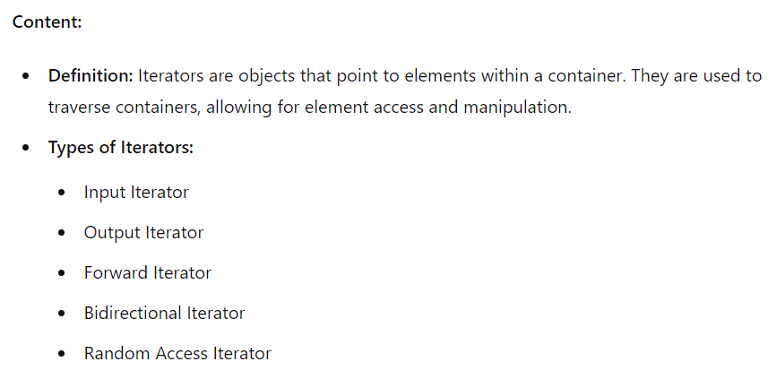
Introduction to Iterators

Slide 2
Basic Iterator Usage
#include <vector>
#include <iostream>
int main() {
std::vector<int> vec = {1, 2, 3, 4, 5};
for (std::vector<int>::iterator it = vec.begin(); it != vec.end(); ++it) {
std::cout << *it << ' ';
}
return 0;
}

Slide 3
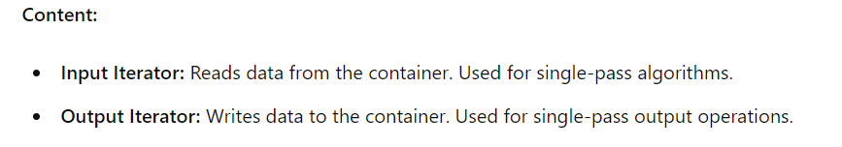
Input and Output Iterators
#include <iostream>
#include <iterator>
#include <vector>
int main() {
std::vector<int> vec = {1, 2, 3, 4, 5};
// Using Input Iterator
for (std::istream_iterator<int> it(std::cin), end; it != end; ++it) {
std::cout << *it << ' ';
}
// Using Output Iterator
std::copy(vec.begin(), vec.end(), std::ostream_iterator<int>(std::cout, " "));
return 0;
}

Slide 4
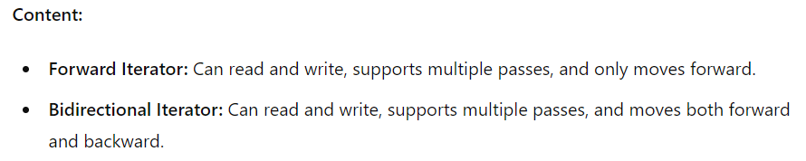
Forward and Bidirectional Iterators

Slide 5
#include <list>
#include <iostream>
int main() {
std::list<int> lst = {1, 2, 3, 4, 5};
// Using Forward Iterator
for (std::list<int>::iterator it = lst.begin(); it != lst.end(); ++it) {
std::cout << *it << ' ';
}
// Using Bidirectional Iterator
for (std::list<int>::reverse_iterator rit = lst.rbegin(); rit != lst.rend(); ++rit) {
std::cout << *rit << ' ';
}
return 0;
}

Slide 6
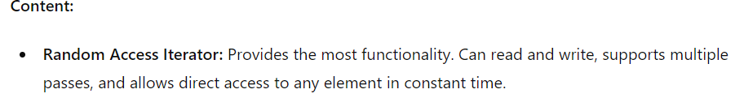
Random Access Iterators
int main() {
std::vector<int> vec = {1, 2, 3, 4, 5};
// Using Random Access Iterator
for (std::vector<int>::iterator it = vec.begin(); it != vec.end(); ++it) {
std::cout << *it << ' ';
}
// Direct access using Random Access Iterator
std::vector<int>::iterator it = vec.begin();
std::advance(it, 2); // Move iterator to the 3rd element
std::cout << *it << std::endl; // Output: 3
return 0;
}

Slide 7
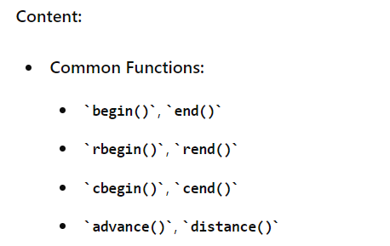
Iterator Functions and Algorithms

Slide 8
#include <vector>
#include <iostream>
#include <algorithm>
#include <iterator>
int main() {
std::vector<int> vec = {1, 2, 3, 4, 5};
// Using begin() and end()
for (auto it = vec.begin(); it != vec.end(); ++it) {
std::cout << *it << ' ';
}
// Using rbegin() and rend()
for (auto rit = vec.rbegin(); rit != vec.rend(); ++rit) {
std::cout << *rit << ' ';
}
// Using advance() and distance()
auto it = vec.begin();
std::advance(it, 3); // Move iterator to the 4th element
std::cout << *it << std::endl; // Output: 4
auto dist = std::distance(vec.begin(), it);
// Output: 3
std::cout << "Distance: " << dist << std::endl;
return 0;
}

