Slide 1
Object Oriented Programming in C++
Presented by Bhimashankar T
E-Mail: bhima.t@gmail.com
PhNo:+91 9980156833 / 6363863430

Slide 2
DAY 01

Slide 3
OOPS Concept
Objects
Classes
Abstraction
Encapsulation
Inheritance
Overloading
Exception Handling

Slide 4
Introduction
C++ is a statically typed, compiled, general-purpose, case-sensitive, free-form programming language that supports procedural, object-oriented, and generic programming.
C++ is regarded as a middle-level language, as it comprises a combination of both high-level and low-level language features.
C++ was developed by Bjarne Stroustrup starting in 1979 at Bell Labs in Murray Hill, New Jersey, as an enhancement to the C language and originally named C with Classes but later it was renamed C++ in 1983.
C++ is a superset of C, and that virtually any legal C program is a legal C++ program.
Note: A programming language is said to use static typing when type checking is performed during compile-time as opposed to run-time.

Slide 5
Difference between Static typing and Dynamic typing
Static Typing
Static typing is a typing system where variables are bound to a data type during compilation. Once a variable is assigned a data type it remains unchanged throughout the programs execution. This binding promotes type safety and detects errors at an early stage.
Examples of Statically Typed Languages are C++, Java, Rust
Dynamic Typing
Dynamic typing allows variables to be bound to data types at runtime instead of during compilation. This flexibility enables concise code and ease of use. It compromises on type safety as a trade-off..
Examples of Statically Typed Languages are Python, JS, Ruby

Slide 6
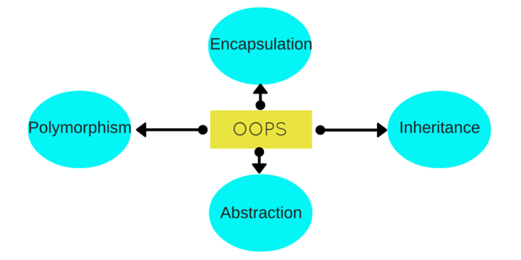
Object Oriented Programming
Object Oriented programming is a programming style that is associated with the concept of Class, Objects and various other concepts revolving around these two, like Inheritance, Polymorphism, Abstraction, Encapsulation etc.

Slide 7
OOPS Concept Definitions
Objects
Objects are the basic unit of OOP. They are instances of class, which have data members and uses various member functions to perform tasks.
Class
It is similar to structures in C language. Class can also be defined as user defined data type but it also contains functions in it. So, class is basically a blueprint for object. It declare & defines what data variables the object will have and what operations can be performed on the class's object.
Abstraction
Abstraction refers to showing only the essential features of the application and hiding the details. In C++, classes can provide methods to the outside world to access & use the data variables, keeping the variables hidden from direct access, or classes can even declare everything accessible to everyone, or maybe just to the classes inheriting it. This can be done using access specifiers.

Slide 8
OOPS Concept Definitions
Encapsulation
It can also be said data binding. Encapsulation is all about binding the data variables and functions together in class.
Inheritance
Inheritance is a way to reuse once written code again and again. The class which is inherited is called the Base class & the class which inherits is called the Derived class. They are also called parent and child class.
So when, a derived class inherits a base class, the derived class can use all the functions which are defined in base class, hence making code reusable.
Polymorphism
It is a feature, which lets us create functions with same name but different arguments, which will perform different actions. That means, functions with same name, but functioning in different ways. Or, it also allows us to redefine a function to provide it with a completely new definition.

Slide 9
OOPS Concept Definitions
Exception Handling
Exception handling is a feature of OOP, to handle unresolved exceptions or errors produced at runtime.

Slide 10
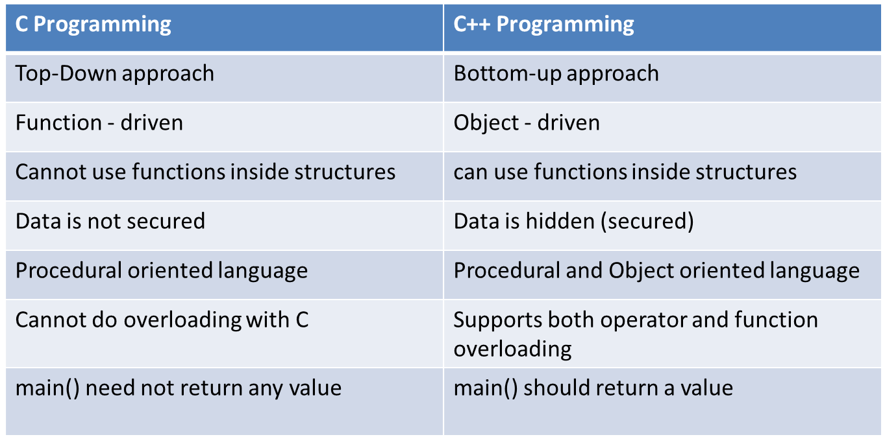
Comparison between C and C++

Slide 11
C++ Basic Syntax
C++ program can be defined as a collection of objects that communicate via invoking each other's methods.
Let us now briefly look into what do class, object, methods and instant variables mean.
Object - Objects have states and behaviors. Example: A dog has states - color, name, breed as well as behaviors - wagging, barking, eating. An object is an instance of a class.
Class - A class can be defined as a template/blueprint that describes the behaviors/states that object of its type support.
Methods - A method is basically a behavior. A class can contain many methods. It is in methods where the logics are written, data is manipulated and all the actions are executed.
Instant Variables - Each object has its unique set of instant variables. An object's state is created by the values assigned to these instant variables.

Slide 12
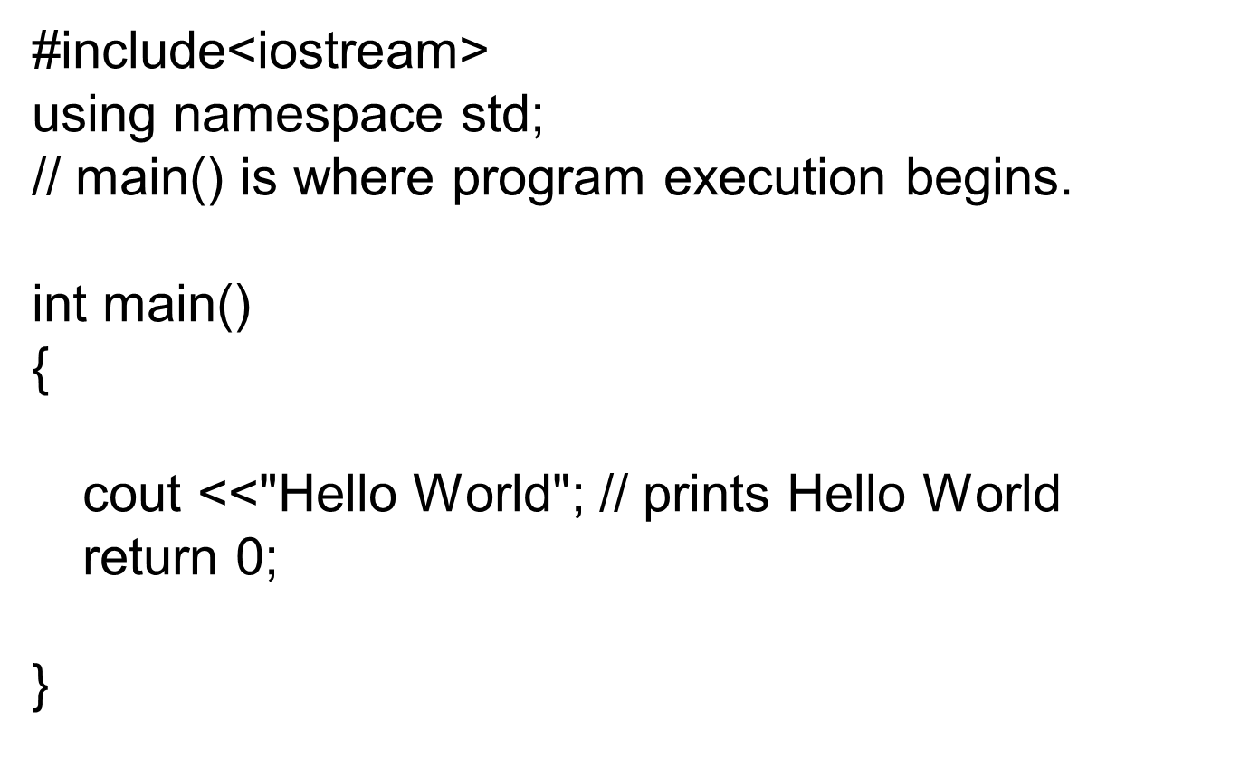
C++ Program Structure

Slide 13
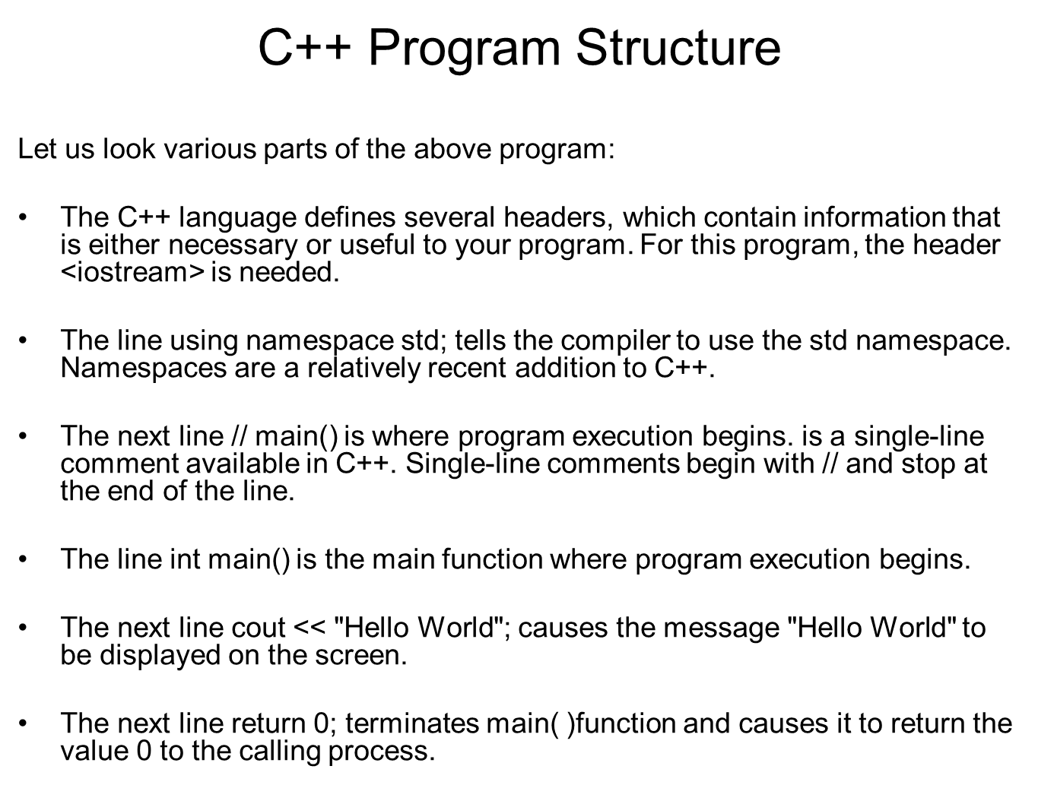

Slide 14
C++ Identifiers:
A C++ identifier is a name used to identify a variable, function, class, module, or any other user-defined item. An identifier starts with a letter A to Z or a to z or an underscore (_) followed by zero or more letters, underscores, and digits (0 to 9).
C++ does not allow punctuation characters such as @, $, and % within identifiers. C++ is a case-sensitive programming language. Thus, Manpower and manpower are two different identifiers in C++.

Slide 15
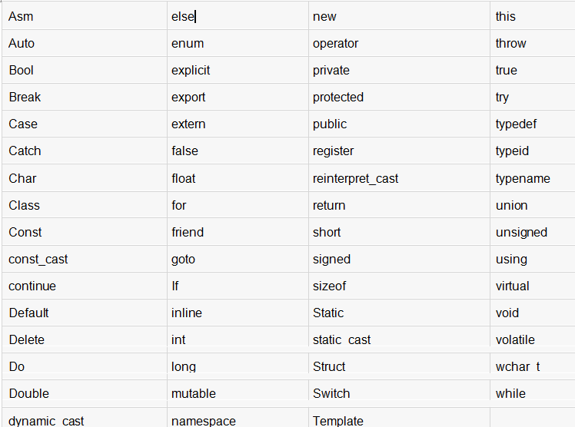
C++ Keywords:
The following list shows the reserved words in C++. These reserved words may not be used as constant or variable or any other identifier names.

Slide 16
Data Types in C++
Already we have seen in C language. But some additional types are,
bool | Boolean ( True or False )
void | Without any Value
wchar_t | Wide Character

Slide 17
Wide char and library functions in C++
Wide char is similar to char data type, except that wide char take up twice the space and can take on much larger values as a result. char can take 256 values which corresponds to entries in the ASCII table. On the other hand, wide char can take on 65536 values which corresponds to UNICODE values which is a recent international standard which allows for the encoding of characters for virtually all languages and commonly used symbols.
Just like the type for character constants is char, the type for wide character is wchar_t.
This data type occupies 2 or 4 bytes depending on the compiler being used.
Mostly the wchar_t datatype is used when international languages like Japanese are used.
// An example C++ program to demonstrate use of wchar_t
int main()
{
wchar_t w = L'A';
cout << "Wide character value:: " << w << endl ;
cout << "Size of the wide char is:: " << sizeof(w);
return 0;
}

Slide 18
// An example C++ program to demonstrate use
// of wchar_t in array
#include <iostream>
using namespace std;
int main()
{
// char type array string
char caname[] = "geeksforgeeks" ;
cout << caname << endl ;
// wide-char type array string
wchar_t waname[] = L"geeksforgeeks" ;
wcout << waname << endl;
return 0;
}
// An example C++ program to demonstrate use
// of wcslen()
#include <iostream>
#include<cwchar>
using namespace std;
int main()
{
// wide-char type array string
wchar_t waname[] = L"geeksforgeeks" ;
wcout << L"The length of '" << waname
<< L"' is " << wcslen(waname) << endl;
return 0;
}

Slide 19
// An example C++ program to demonstrate use
// of wcscpy()
#include <iostream>
#include<cwchar>
using namespace std;
int main()
{
wchar_t waname[] = L"geeksforgeeks" ;
wchar_t wacopy[14];
wcscpy(wacopy, waname);
wcout << L"Original = " << waname
<< L"\nCopy = " << wacopy << endl;
return 0;
}
// An example C++ program to demonstrate use
// of wcscat()
#include <iostream>
#include<cwchar>
using namespace std;
int main()
{
wchar_t string1[] = L"geeksforgeeks" ;
wchar_t string2[] = L" is for Geeks" ;
wcscat(string1, string2);
wcout << L"Concatenated wide string is = "
<< string1 << endl;
return 0;
}

Slide 20
Data Types in C++
Enum as Data type
Enumerated type declares a new type-name and a sequence of value containing identifiers which has values starting from 0 and incrementing by 1 every time.
For Example :
enum day(mon, tues, wed, thurs, fri) d;
Here an enumeration of days is defined with variable d. mon will hold value 0, tue will have 1 and so on. We can also explicitly assign values, like, enum day(mon, tue=7, wed);. Here, mon will be 0, tue is assigned 7, so wed will have value 8.

Slide 21
Data Types in C++
Modifiers
Specifiers modify the meanings of the predefined built-in data types and expand them to a much larger set. There are four data type modifiers in C++, they are :
long
short
signed
unsigned

Slide 22
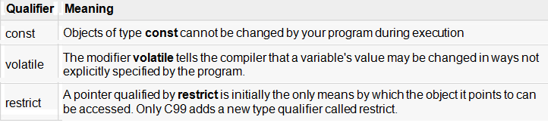
Type Qualifiers in C++
The type qualifiers provide additional information about the variables they precede.

Slide 23
Some special types of variable
There are also some special keywords, to impart unique characteristics to the variables in the program. Following two are mostly used, we will discuss them in details later.
Final - Once initialized, its value cant be changed.
Static - These variables holds their value between function calls.
Example :
#include <iostream.h>
using namespace std;
int main()
{
final int i=10;
static int y=20;
}

Slide 24
Operators
These we have already learnt in C language
typedef and Pointers
typedef can be used to give an alias name to pointers also. Here we have a case in which use of typedef is beneficial during pointer declaration.
In Pointers * binds to the right and not the left.
int* x, y ;
By this declaration statement, we are actually declaring x as a pointer of type int, whereas y will be declared as a plain integer.
typedef int* IntPtr ;
IntPtr x, y, z;
But if we use typedef like in above example, we can declare any number of pointers in a single statement.

Slide 25
Branching and Looping Statements
Simple if statement
If....else statement
Nested if....else statement
else if statement
goto statement
Looping Statements
while loop
for loop
do-while loop

Slide 26
Storage Classes in C++
These are basically divided into 5 different types :
Global variables
Local variables
Register variables
Static variables
Extern variables
Mutable

Slide 27
Storage Classes in C++
Static Variables
void fun()
{
static int i = 10;
i++;
cout << i;
}
int main()
{
fun(); // Output = 11
fun(); // Output = 12
fun(); // Output = 13
}

Slide 28
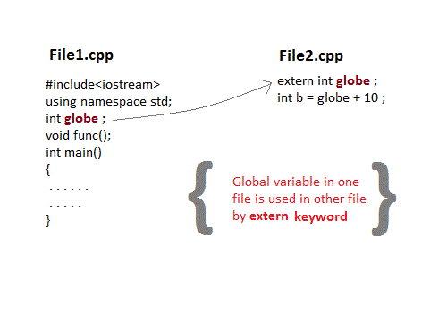
Storage Classes in C++
Extern Variables
This keyword is used to access variable in a file which is declared & defined in some other file, that is the existence of a global variable in one file is declared using extern keyword in another file.

Slide 29
Mutable storage class in C++
The mutable specifier applies only to class objects, which are discussed later in this tutorial. It allows a member of an object to override constness. That is, a mutable member can be modified by a const member function

Slide 30
IO Streaming

Slide 31
Functions in C++
Calling a Function
Functions are called by their names. If the function is without argument, it can be called directly using its name. But for functions with arguments, we have two ways to call them,
Call by Value
Call by Pointer
Call by Reference

Slide 32
Function - Call by value
#include <iostream>
using namespace std;
// function declaration
int max(int num1, int num2);
int main ()
{
local variable declaration:
int a = 100;
int b = 200; int ret;
//calling a function to get max value.
ret = max(a, b);
cout << "Max value is : " << ret << endl;
return 0;
}
// function returning the max between two numbers
int max(int num1, int num2)
{
// local variable declaration
int result;
if (num1 > num2)
result = num1;
else
result = num2;
return result;
}

Slide 33
Functions in C++
Call by Pointer
void calc(int *p);
int main()
{
int x = 10;
calc(&x); // passing address of x as argument
printf("%d", x);
}
void calc(int *p)
{
*p = *p + 10;
}
Output : 20

Slide 34
Functions in C++
#include <iostream>
using namespace std;
// function declaration
void swap(int &x, int &y);
int main ()
{
// local variable declaration:
int a = 100;
int b = 200;
cout << "Before swap, value of a :" << a << endl;
cout << "Before swap, value of b :" << b << endl;
// calling a function to swap the values.
swap(a, b);
cout << "After swap, value of a :" << a << endl;
cout << "After swap, value of b :" << b << endl;
return 0;
}
Call by Reference
Call by reference :
void swap(int &x, int &y)
{
int temp;
temp = x; /* save the value of x */
x = y; /* put y into x */
y = temp; /* put x into y */
}

Slide 35
Functions in C++: Default Values for Parameters :
#include <iostream>
using namespace std;
int sum(int a, int b=20)
{
int result;
result = a + b;
return (result);
}
int main ()
{
// local variable declaration:
int a = 100;
int b = 200;
int result;
// calling a function to add the values.
result = sum(a, b);
cout << "Total value is :" << result << endl;
// calling a function again as follows.
result = sum(a);
cout << "Total value is :" << result << endl;
return 0;
}

Slide 36
Introduction to Classes and Objects
The classes are the most important feature of C++ that leads to Object Oriented programming. Class is a user defined data type, which holds its own data members and member functions, which can be accessed and used by creating instance of that class.
The variables inside class definition are called as data members and the functions are called member functions.

Slide 37
Introduction to Classes and Objects
Class name must start with an uppercase letter(Although this is not mandatory). If class name is made of more than one word, then first letter of each word must be in uppercase. Example, class Study, class StudyTonight etc
Classes contain, data members and member functions, and the access of these data members and variable depends on the access specifiers (discussed in next section).
Class's member functions can be defined inside the class definition or outside the class definition.
Class in C++ are similar to structures in C, the only difference being, class defaults to private access control, where as structure defaults to public.
All the features of OOPS, revolve around classes in C++. Inheritance, Encapsulation, Abstraction etc.
Objects of class holds separate copies of data members. We can create as many objects of a class as we need.
Classes do posses more characteristics, like we can create abstract classes, immutable classes, all this we will study later.

Slide 38
Introduction to Classes and Objects
Objects
Each object has different data variables. Objects are initialised using special class functions called Constructors. We will study about constructors later.
And whenever the object is out of its scope, another special class member function called Destructor is called, to release the memory reserved by the object. C++ doesn't have Automatic Garbage Collector like in JAVA, in C++ Destructor performs this task.
class Abc
{
int x;
void display(){} //empty function
};
in main()
{
Abc obj; // Object of class Abc created
}

Slide 39
Access Control in Classes
Access specifiers in C++ class defines the access control rules. C++ has 3 new keywords introduced, namely,
public
private
protected
Protected, is the last access specifier, and it is similar to private, it makes class member inaccessible outside the class. But they can be accessed by any subclass of that class. (If class A is inherited by class B, then class B is subclass of class A.
class ProtectedAccess
{
protected: // protected access
int x; // Data Member
void display(); // Member Function
}

Slide 40
Defining Class and Declaring Objects
class ClassName
{
Access specifier:
Data members;
Member Functions(){}
};
class Student
{
public:
int rollno;
string name;
};
class Student
{
public:
int rollno;
string name;
}A,B;

Slide 41
Accessing Data Members of Class
class Student
{
public:
int rollno;
string name;
};
int main()
{
Student A;
Student B;
A.rollno=1;
A.name="Adam";
B.rollno=2;
B.name="Bella";
cout <<"Name and Roll no of A is :"<< A.name << A.rollno;
cout <<"Name and Roll no of B is :"<< B.name << B.rollno;
}

Slide 42
Accessing Data Members of Class
Accessing Private Data Members
class Student
{
private: // private data member
int rollno;
public: // public accessor and mutator functions
int getRollno()
{
return rollno;
}
void setRollno(int i)
{
rollno=i;
}
};
int main()
{
Student A;
A.rollono=1; //Compile time error
cout<< A.rollno; //Compile time error
A.setRollno(1); //Rollno initialized to 1
cout<< A.getRollno(); //Output will be 1
}

Slide 43
Constructors
Constructors are of three types :
Default Constructor
Parametrized Constructor
Copy Constructor
class Cube
{
public:
int side;
Cube(int x)
{
side=x;
}
};
int main()
{
Cube c1(10);
Cube c2(20);
Cube c3(30);
cout << c1.side;
cout << c2.side;
cout << c3.side;
} // OUTPUT : 10 20 30
class Cube
{
int side;
public:
Cube()
{
side=10;
}
};
int main()
{
Cube c;
cout << c.side;
} // Output : 10
Default
Parameterized

Slide 44
Constructors
Copy Constructor
class Samplecopyconstructor
{
private:
int x, y; // data members
public:
Samplecopyconstructor(int x1, int y1)
{
x = x1;
y = y1;
}
// Copy constructor
Samplecopyconstructor (const Samplecopyconstructor &sam)
{
x = sam.x;
y = sam.y;
}
void display()
{
cout<<x<<" "<<y<<endl;
}
};
int main()
{
Samplecopyconstructor obj1(10, 15); // Normal constructor
Samplecopyconstructor obj2 = obj1; // Copy constructor
cout<<"Normal constructor : ";
obj1.display();
cout<<"Copy constructor : ";
obj2.display();
return 0;
}
Output:
Normal constructor : 10 15
Copy constructor : 10 15

Slide 45
Constructors
Constructor Overloading
class Student
{
int rollno;
string name;
public:
Student(int x)
{
rollno=x;
name="None";
}
Student(int x, string str)
{
rollno=x ;
name=str ;
}
};
int main()
{
Student A(10);
Student B(11,"Ram");
}
Note: Whenever we are using para.. constructor… without default constructor then we can declare like
Student S;
it will lead to a compile time error, because we haven't defined default constructor, and compiler will not provide its default constructor because we have defined other parameterized constructors.

Slide 46
Destructors
class A
{
A()
{
cout << "Constructor called";
}
~A()
{
cout << "Destructor called";
}
};
int main()
{
A obj1; // Constructor Called
int x=1;
if(x)
{
A obj2; // Constructor Called
} // Destructor Called for obj2
} // Destructor called for obj1.

Slide 47
Types of Member Functions
Simple functions
Static functions
Const functions
Inline functions
Friend functions
Static Function
class X
{
public:
static void f(){};
};
int main()
{
X::f(); // calling member function directly with class name
}
These functions cannot access ordinary data members and member functions, but only static data members and static member functions.
It doesn't have any "this" keyword which is the reason it cannot access ordinary members
Const Member functions
When used with member function, such member functions can never modify the object or its related data members.
//Basic Syntax of const Member Function
void fun() const {}
Inline functions
All the member functions defined inside the class definition are by default declared as Inline

Slide 48
Types of Member Functions
Friend functions
Friend functions are actually not class member function. Friend functions are made to give private access to non-class functions.
You can declare a global function as friend, or a member function of other class as friend.
class WithFriend
{
int i;
public:
friend void fun(); // Global function as friend
};
void fun()
{
WithFriend wf;
wf.i=10; // Access to private data member
cout << wf.i;
}
int main()
{
fun(); //Can be called directly
}
We can also make an entire class as friend class
class Other
{
void fun();
};
class WithFriend
{
private:
int i;
public:
void getdata(); // Member function of class WithFriend
friend void Other::fun(); // making function of class Other as friend here
friend class Other; // making the complete class as friend
};
When we make a class as friend, all its member functions automatically become friend functions.
Friend Functions is a reason, why C++ is not called as a pure Object Oriented language. Because it violates the concept of Encapsulation.

