Slide 1
Object Oriented Programming in C++
Presented by Bhimashankar T
E-Mail: bhima.t@gmail.com
PhNo:+91 9980156833 / 6363863430

Slide 2
DAY 02

Slide 3
OOPS Concept
Objects
Classes
Abstraction
Encapsulation
Inheritance
Overloading
Exception Handling

Slide 4
OOPS Concept Definitions
Objects
Objects are the basic unit of OOP. They are instances of class, which have data members and uses various member functions to perform tasks.
Class
It is similar to structures in C language. Class can also be defined as user defined data type but it also contains functions in it. So, class is basically a blueprint for object. It declare & defines what data variables the object will have and what operations can be performed on the class's object.
Abstraction
Abstraction refers to showing only the essential features of the application and hiding the details. In C++, classes can provide methods to the outside world to access & use the data variables, keeping the variables hidden from direct access, or classes can even declare everything accessible to everyone, or maybe just to the classes inheriting it. This can be done using access specifiers.

Slide 5
OOPS Concept Definitions
Encapsulation
It can also be said data binding. Encapsulation is all about binding the data variables and functions together in class.
Inheritance
Inheritance is a way to reuse once written code again and again. The class which is inherited is called the Base class & the class which inherits is called the Derived class. They are also called parent and child class.
So when, a derived class inherits a base class, the derived class can use all the functions which are defined in base class, hence making code reusable.
Polymorphism
It is a feature, which lets us create functions with same name but different arguments, which will perform different actions. That means, functions with same name, but functioning in different ways. Or, it also allows us to redefine a function to provide it with a completely new definition.

Slide 6
OOPS Concept Definitions
Exception Handling
Exception handling is a feature of OOP, to handle unresolved exceptions or errors produced at runtime.

Slide 7
Introduction to Classes and Objects
Objects
Each object has different data variables. Objects are initialised using special class functions called Constructors. We will study about constructors later.
And whenever the object is out of its scope, another special class member function called Destructor is called, to release the memory reserved by the object. C++ doesn't have Automatic Garbage Collector like in JAVA, in C++ Destructor performs this task.
class Abc
{
int x;
void display(){} //empty function
};
in main()
{
Abc obj; // Object of class Abc created
}

Slide 8
Access Control in Classes
Access specifiers in C++ class defines the access control rules. C++ has 3 new keywords introduced, namely,
public
private
protected
Protected, is the last access specifier, and it is similar to private, it makes class member inaccessible outside the class. But they can be accessed by any subclass of that class. (If class A is inherited by class B, then class B is subclass of class A.
class ProtectedAccess
{
protected: // protected access
int x; // Data Member
void display(); // Member Function
}

Slide 9
Defining Class and Declaring Objects
class ClassName
{
Access specifier:
Data members;
Member Functions(){}
};
class Student
{
public:
int rollno;
string name;
};
class Student
{
public:
int rollno;
string name;
}A,B;

Slide 10
Accessing Data Members of Class
class Student
{
public:
int rollno;
string name;
};
int main()
{
Student A;
Student B;
A.rollno=1;
A.name="Adam";
B.rollno=2;
B.name="Bella";
cout <<"Name and Roll no of A is :"<< A.name << A.rollno;
cout <<"Name and Roll no of B is :"<< B.name << B.rollno;
}

Slide 11
Accessing Data Members of Class
Accessing Private Data Members
class Student
{
private: // private data member
int rollno;
public: // public accessor and mutator functions
int getRollno()
{
return rollno;
}
void setRollno(int i)
{
rollno=i;
}
};
int main()
{
Student A;
A.rollono=1; //Compile time error
cout<< A.rollno; //Compile time error
A.setRollno(1); //Rollno initialized to 1
cout<< A.getRollno(); //Output will be 1
}

Slide 12
Constructors
Constructors are of three types :
Default Constructor
Parametrized Constructor
Copy Constructor
class Cube
{
public:
int side;
Cube(int x)
{
side=x;
}
};
int main()
{
Cube c1(10);
Cube c2(20);
Cube c3(30);
cout << c1.side;
cout << c2.side;
cout << c3.side;
} // OUTPUT : 10 20 30
class Cube
{
int side;
public:
Cube()
{
side=10;
}
};
int main()
{
Cube c;
cout << c.side;
} // Output : 10
Default
Parameterized

Slide 13
Constructors
Copy Constructor
class Samplecopyconstructor
{
private:
int x, y; // data members
public:
Samplecopyconstructor(int x1, int y1)
{
x = x1;
y = y1;
}
// Copy constructor
Samplecopyconstructor (const Samplecopyconstructor &sam)
{
x = sam.x;
y = sam.y;
}
void display()
{
cout<<x<<" "<<y<<endl;
}
};
int main()
{
Samplecopyconstructor obj1(10, 15); // Normal constructor
Samplecopyconstructor obj2 = obj1; // Copy constructor
cout<<"Normal constructor : ";
obj1.display();
cout<<"Copy constructor : ";
obj2.display();
return 0;
}
Output:
Normal constructor : 10 15
Copy constructor : 10 15

Slide 14
Constructors
Constructor Overloading
class Student
{
int rollno;
string name;
public:
Student(int x)
{
rollno=x;
name="None";
}
Student(int x, string str)
{
rollno=x ;
name=str ;
}
};
int main()
{
Student A(10);
Student B(11,"Ram");
}
Note: Whenever we are using para.. constructor… without default constructor then we can declare like
Student S;
it will lead to a compile time error, because we haven't defined default constructor, and compiler will not provide its default constructor because we have defined other parameterized constructors.

Slide 15
Destructors
class A
{
A()
{
cout << "Constructor called";
}
~A()
{
cout << "Destructor called";
}
};
int main()
{
A obj1; // Constructor Called
int x=1;
if(x)
{
A obj2; // Constructor Called
} // Destructor Called for obj2
} // Destructor called for obj1.

Slide 16
References in C++
int main()
{ int y=10;
int &r = y; // r is a reference to int y
cout << r;
}
Output :10
Difference between Reference and Pointer
References | Pointers
Reference must be initialized when it is created. | Pointers can be initialized any time.
Once initialized, we cannot reinitialize a reference. | Pointers can be reinitialized any number of time.
You can never have a NULL reference. | Pointers can be NULL.
Reference is automatically dereferenced. | * is used to dereference a pointer.

Slide 17
C++ Static Data Members
Static data members are class members that are declared using static keywords. A static member has certain special characteristics which are as follows:
Only one copy of that member is created for the entire class and is shared by all the objects of that class, no matter how many objects are created.
It is initialized before any object of this class is created, even before the main starts.
It is visible only within the class, but its lifetime is the entire program.
Syntax:
static data_type data_member_name;
class X {
static int n;
};
// declaration (uses 'static’)
int X::n = 1; // definition (does not use 'static')

Slide 18
C++ Static Data Members
// C++ program to illustrate non-static data members
using namespace std;
#include <iostream>
// Class
class Test {
private:
// Created a static variable
static int count;
public:
// Member function to increment
// value of count
void set_count()
{
count++;
}
// Member function to access the
// private members of this class
void show_count()
{
// print the count variable
cout << count << '\n';
}
};
int Test::count = 0; //defining static members
// Driver Code
int main()
{
// Objects of class Test
Test S1, S2, S3;
// Increment count variable
// by 1 for each object
S1.set_count();
S2.set_count();
S3.set_count();
// Function to display count
// for each object
S1.show_count();
S2.show_count();
S3.show_count();
return 0;
}
Output: 3 3 3

Slide 19
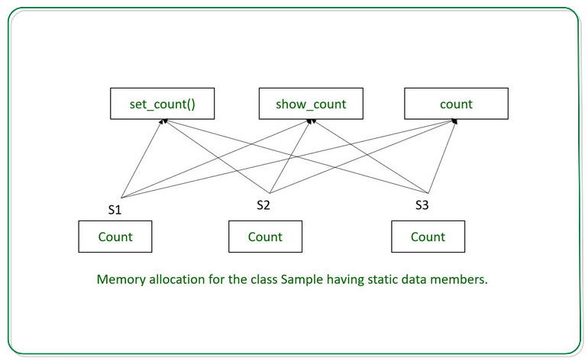
Below is the illustration of memory allocation for the above program:

Slide 20
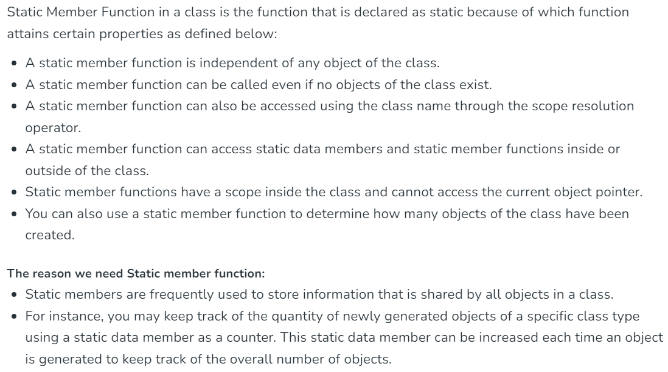
C++ Member Function in C++

Slide 21
C++ Member Function in C++
// C++ Program to show the working of static member functions
#include <iostream>
using namespace std;
class Box
{
private:
static int length;
static int breadth;
static int height;
public:
static void print()
{
cout << "The value of the length is: " << length << endl;
cout << "The value of the breadth is: " << breadth << endl;
cout << "The value of the height is: " << height << endl;
}
};
// initialize the static data members
int Box :: length = 10;
int Box :: breadth = 20;
int Box :: height = 30;
// Driver Code
int main()
{
Box b;
cout << "Static member function is called through Object name: \n" << endl;
b.print();
cout << "\nStatic member function is called through Class name: \n" << endl;
Box::print();
return 0;
}

Slide 22
C++ Member Function in C++
Output:
Static member function is called through Object name:
The value of the length is: 10
The value of the breadth is: 20
The value of the height is: 30
Static member function is called through Class name:
The value of the length is: 10
The value of the breadth is: 20
The value of the height is: 30

Slide 23
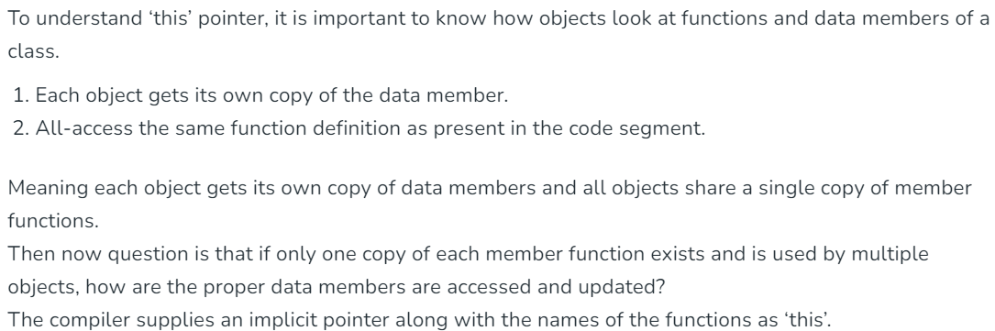
‘this’ pointer in C++

Slide 24
‘this’ pointer in C++

Slide 25
‘this’ pointer in C++
Following are the situations where ‘this’ pointer is used:
1) When local variable’s name is same as member’s name
/* local variable is same as a member's name */
class Test
{
private:
int x;
public:
void setX (int x)
{
// The 'this' pointer is used to retrieve the object's x
// hidden by the local variable 'x'
this->x = x;
}
void print() { cout << "x = " << x << endl; }
};
int main()
{
Test obj;
int x = 20;
obj.setX(x);
obj.print();
return 0;
}
Output: 20
Note: For constructors, initializer list can also be used when parameter name is same as member’s name.

Slide 26
‘this’ pointer in C++
class Test
{
private:
int x;
int y;
public:
Test(int x = 0, int y = 0) { this->x = x; this->y = y; }
Test &setX(int a) { x = a; return *this; }
Test &setY(int b) { y = b; return *this; }
void print() { cout << "x = " << x << " y = " << y << endl; }
};
2) To return reference to the calling object
/* Reference to the calling object can be returned */
Test& Test::func ()
{
// Some processing
return *this;
}
When a reference to a local object is returned, the returned reference can be used to chain function calls on a single object.
int main()
{
Test obj1(5, 5);
// Chained function calls. All calls modify the same object
// as the same object is returned by reference
obj1.setX(10).setY(20);
obj1.print();
return 0;
}
Output: x = 10 y = 20

Slide 27
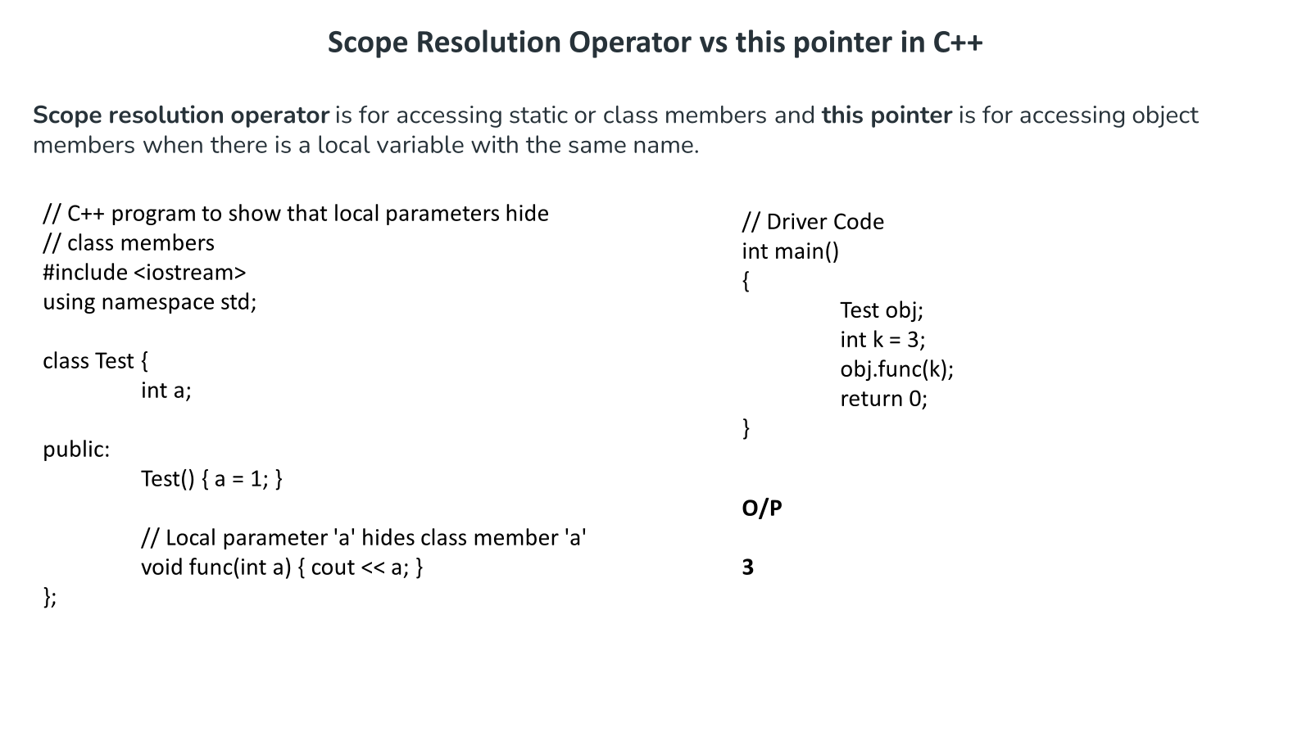

Slide 28
class Test {
int a;
public:
Test() { a = 1; }
// Local parameter 'a' hides object's member
// 'a', but we can access it using this.
void func(int a) { cout << this->a; }
};
// Driver code
int main()
{
Test obj;
int k = 3;
obj.func(k);
return 0;
}
Output: 1

Slide 29
// C++ program to show that scope resolution operator can be
// used to access static members when there is a local
// variable with same name
class Test {
static int a;
public:
// Local parameter 'a' hides class member
// 'a', but we can access it using ::
void func(int a) { cout << Test::a; }
};
// In C++, static members must be explicitly defined
// like this
int Test::a = 1;
// Driver code
int main()
{
Test obj;
int k = 3;
obj.func(k);
return 0;
}
Output: 1

Slide 30
References in C++
References in Funtions
int* first (int* x)
{ (*x++);
return x; // SAFE, x is outside this scope
}
int& second (int& x)
{ x++;
return x; // SAFE, x is outside this scope
}
int& third ()
{ int q;
return q; // ERROR, scope of q ends here
}
int& fourth ()
{ static int x;
return x; // SAFE, x is static, hence lives till the end.
}
int main()
{
int a=0;
first(&a); // UGLY and explicit
second(a); // CLEAN and hidden
}

Slide 31
Pointers to class members
Defining a pointer of class type
class Simple
{
public:
int a;
};
int main()
{
Simple obj;
Simple* ptr; // Pointer of class type
ptr = &obj;
cout << obj.a;
cout << ptr->a; // Accessing member with pointer
}
Pointer to Data Members of class
Syntax for Declaration :
datatype class_name :: *pointer_name ;
Syntax for Assignment :
pointer_name = &class_name :: datamember_name ;
Both declaration and assignment can be done in a single statement too.
datatype class_name::*pointer_name = &class_name::datamember_name;

Slide 32
Pointers to class members
Pointer to Data Members of class
class Data
{
public:
int a;
void print() { cout << "a is "<< a; }
};
int main()
{
Data d, *dp;
dp = &d; // pointer to object
int Data::*ptr=&Data::a; // pointer to data member 'a'
d.*ptr=10;
d.print();
dp->*ptr=20;
dp->print();
}
Output :
a is 10 a is 20

Slide 33
Types of Member Functions
Simple functions
Static functions
Const functions
Inline functions
Friend functions
Static Function
class X
{
public:
static void f(){};
};
int main()
{
X::f(); // calling member function directly with class name
}
These functions cannot access ordinary data members and member functions, but only static data members and static member functions.
It doesn't have any "this" keyword which is the reason it cannot access ordinary members
Const Member functions
When used with member function, such member functions can never modify the object or its related data members.
//Basic Syntax of const Member Function
void fun() const {}
Inline functions
All the member functions defined inside the class definition are by default declared as Inline

Slide 34
Const member functions in C++
Constant member functions are those functions that are denied permission to change the values of the data members of their class. To make a member function constant, the keyword const is appended to the function prototype and also to the function definition header.
Important Points
When a function is declared as const, it can be called on any type of object, const object as well as non-const objects.
Whenever an object is declared as const, it needs to be initialized at the time of declaration. however, the object initialization while declaring is possible only with the help of constructors.
A function becomes const when the const keyword is used in the function’s declaration. The idea of const functions is not to allow them to modify the object on which they are called.
It is recommended practice to make as many functions const as possible so that accidental changes to objects are avoided.

Slide 35
Types of Member Functions
Friend functions
Friend functions are actually not class member function. Friend functions are made to give private access to non-class functions.
You can declare a global function as friend, or a member function of other class as friend.
class WithFriend
{
int i;
public:
friend void fun(); // Global function as friend
};
void fun()
{
WithFriend wf;
wf.i=10; // Access to private data member
cout << wf.i;
}
int main()
{
fun(); //Can be called directly
}
We can also make an entire class as friend class
class Other
{
void fun();
};
class WithFriend
{
private:
int i;
public:
void getdata(); // Member function of class WithFriend
friend void Other::fun(); // making function of class Other as friend here
friend class Other; // making the complete class as friend
};
When we make a class as friend, all its member functions automatically become friend functions.
Friend Functions is a reason, why C++ is not called as a pure Object Oriented language. Because it violates the concept of Encapsulation.

Slide 36
Types of Member Functions
Friend functions
Friend functions are actually not class member function. Friend functions are made to give private access to non-class functions.
You can declare a global function as friend, or a member function of other class as friend.
class WithFriend
{
int i;
public:
friend void fun(); // Global function as friend
};
void fun()
{
WithFriend wf;
wf.i=10; // Access to private data member
cout << wf.i;
}
int main()
{
fun(); //Can be called directly
}
We can also make an entire class as friend class
class Other
{
void fun();
};
class WithFriend
{
private:
int i;
public:
void getdata(); // Member function of class WithFriend
friend void Other::fun(); // making function of class Other as friend here
friend class Other; // making the complete class as friend
};
When we make a class as friend, all its member functions automatically become friend functions.
Friend Functions is a reason, why C++ is not called as a pure Object Oriented language. Because it violates the concept of Encapsulation.

Slide 37
Function Overloading
If any class have multiple functions with same names but different parameters then they are said to be overloaded. Function overloading allows you to use the same name for different functions, to perform, either same or different functions in the same class.
Function overloading is usually used to enhance the readability of the program. If you have to perform one single operation but with different number or types of arguments, then you can simply overload the function.
Ways to overload a function
By changing number of Arguments.
By having different types of argument.
int sum (int x, int y)
{
cout << x+y;
}
int sum(int x, int y, int z)
{
cout << x+y+z;
}
int main()
{
sum (10,20); // sum() with 2 parameter will be called
sum(10,20,30); //sum() with 3 parameter will be called
}
int sum(int x,int y)
{
cout<< x+y;
}
double sum(double x,double y)
{
cout << x+y;
}
int main()
{
sum (10,20);
sum(10.5,20.5);
}

Slide 38
Function Overloading
Default Arguments
sum(int x,int y=0)
{
cout << x+y;
}
int main()
{
sum(10);
sum(10,0);
sum(10,10);
}

Slide 39
Inheritance
Inheritance is the capability of one class to acquire properties and characteristics from another class.
The class whose properties are inherited by other class is called the Parent or Base or Super class.
And, the class which inherits properties of other class is called Child or Derived or Sub class.
Inheritance makes the code reusable. When we inherit an existing class, all its methods and fields become available in the new class, hence code is reused.
NOTE : All members of a class except Private, are inherited

Slide 40
Purpose of Inheritance
1. Code Reusability
2. Method Overriding (Hence, Runtime Polymorphism.)
3. Use of Virtual Keyword
Basic Syntax of Inheritance
class Subclass_name : access_mode Superclass_name
While defining a subclass like this, the super class must be already defined or at least declared before the subclass declaration.
Access Mode is used to specify, the mode in which the properties of superclass will be inherited into subclass, public, privtate or protected.

Slide 41
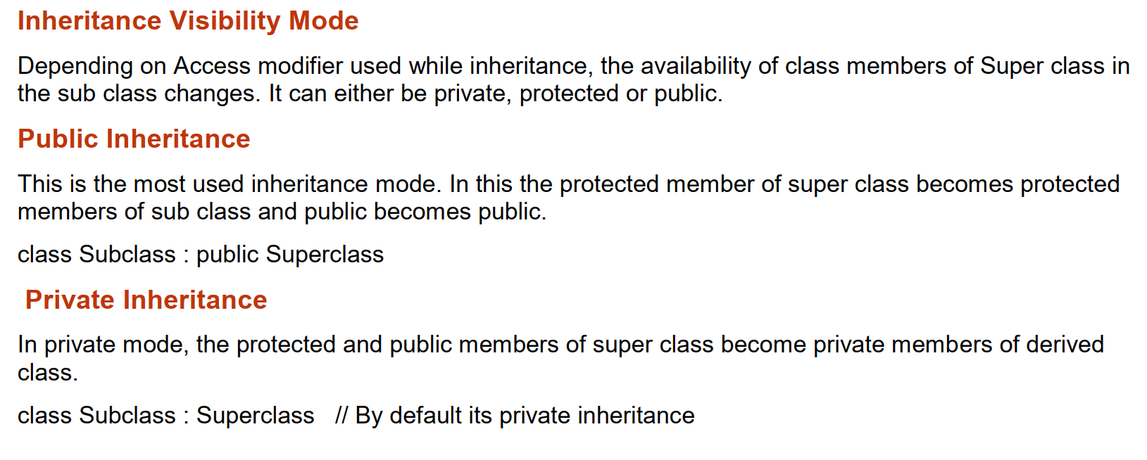
Inheritance

Slide 42
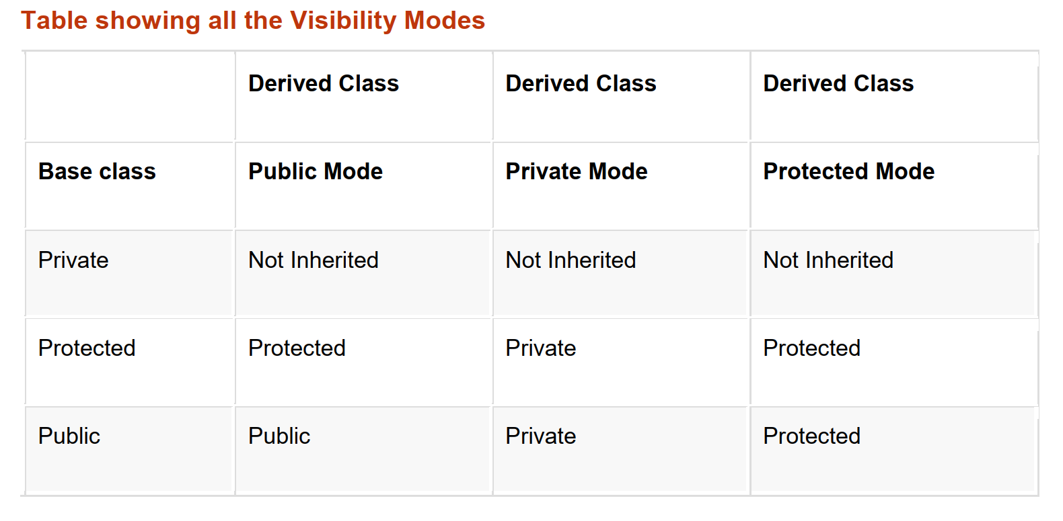
Inheritance

Slide 43
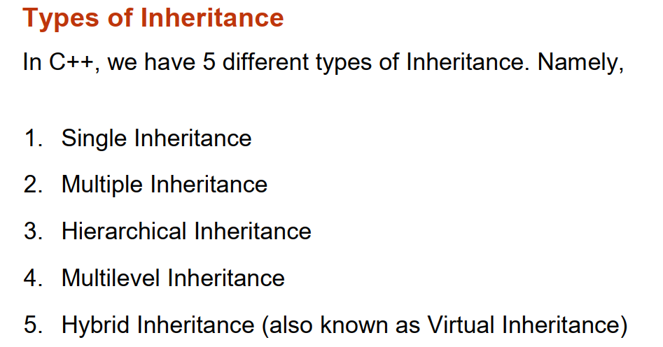
Inheritance

Slide 44
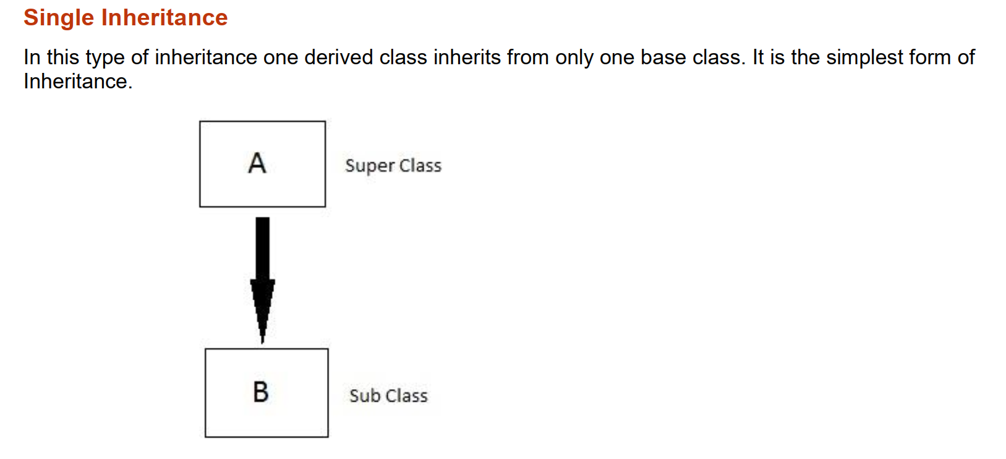
Inheritance

Slide 45
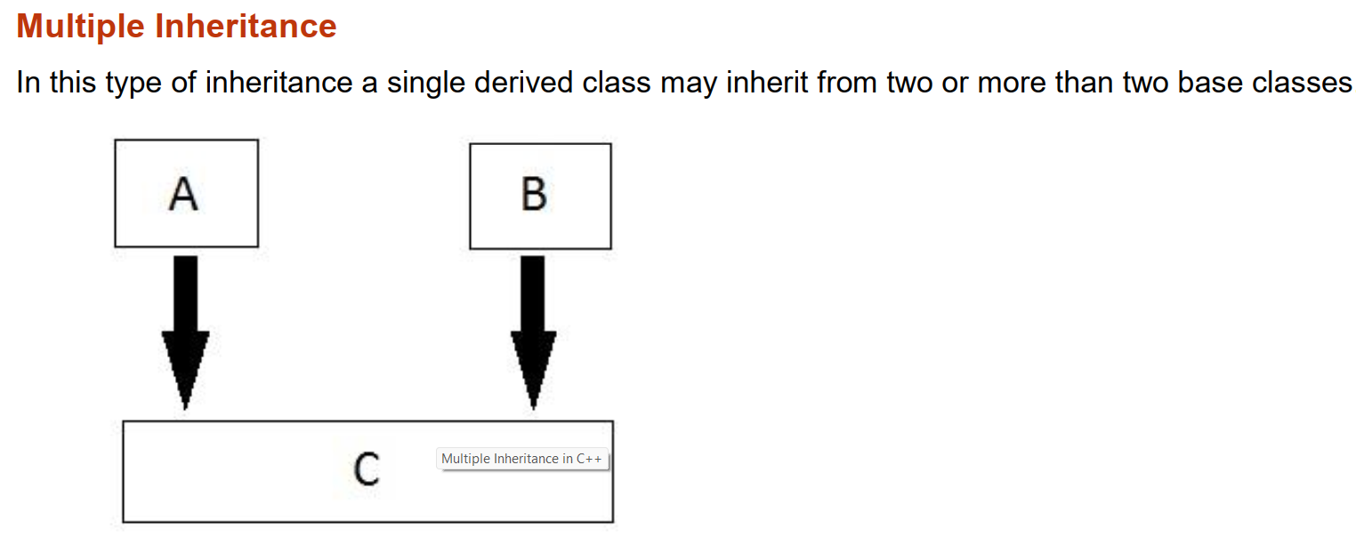
Inheritance

Slide 46
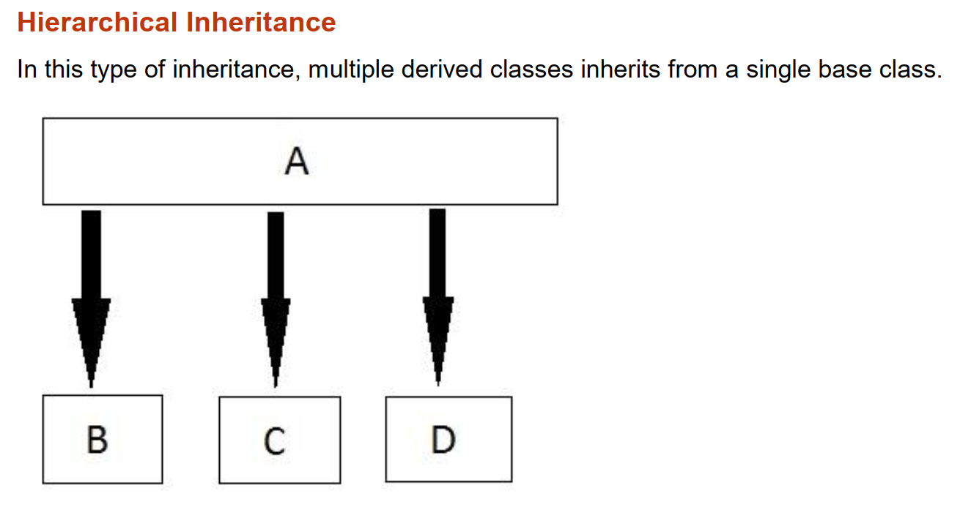
Inheritance

Slide 47
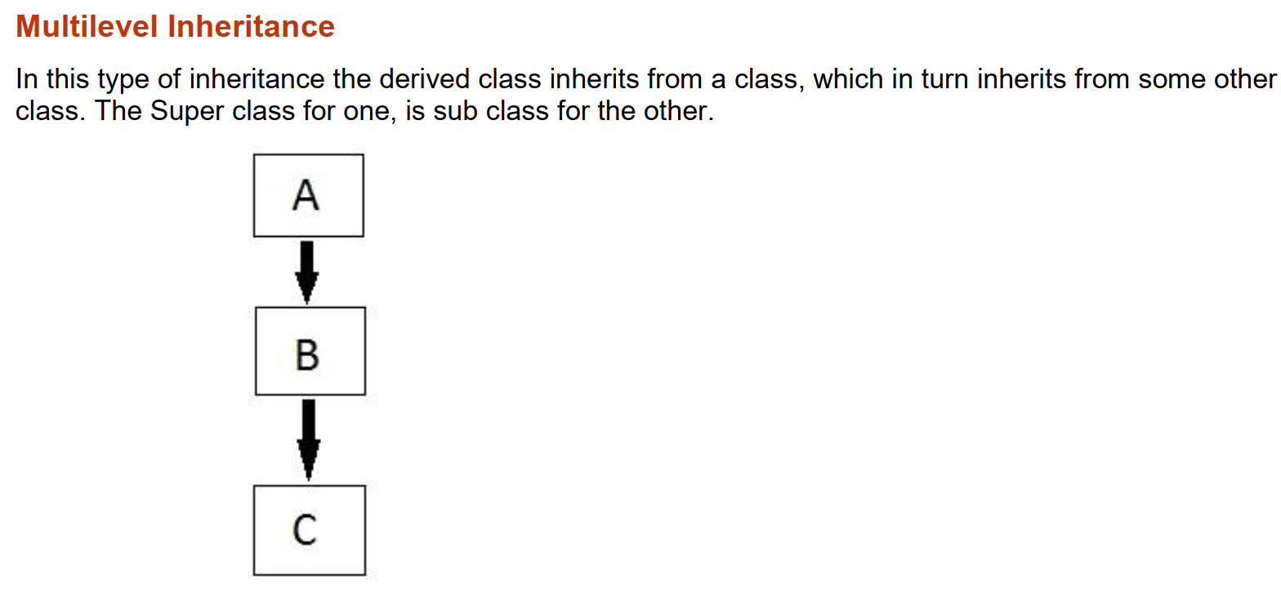
Inheritance

Slide 48
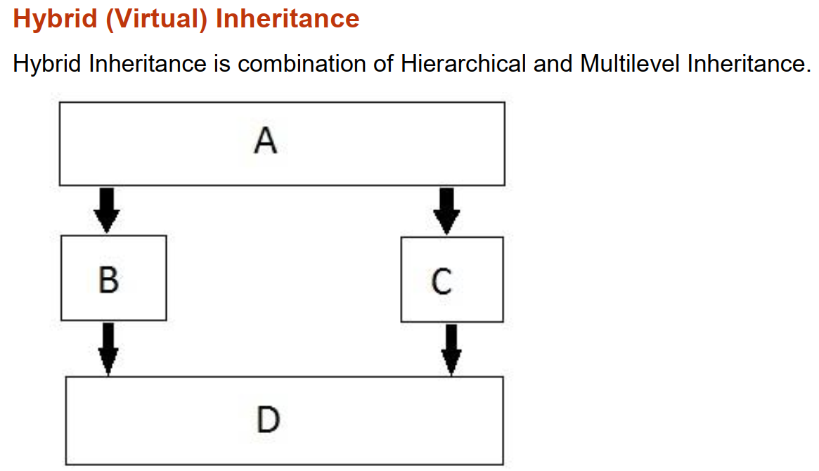
Inheritance

Slide 49
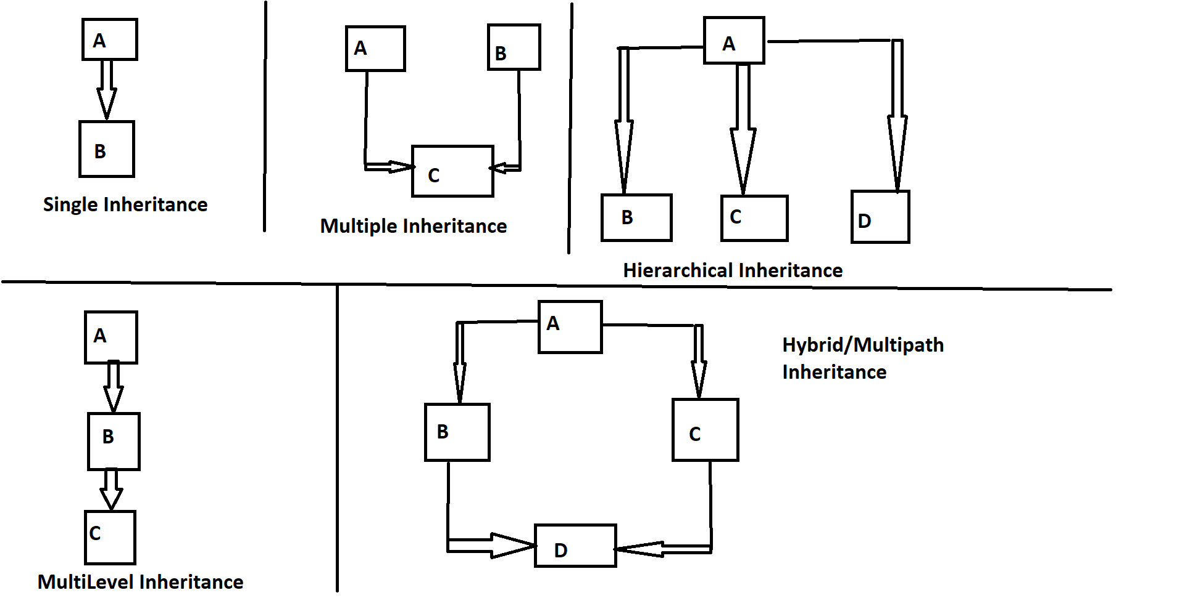

Slide 51
Class Hierarchy (Example)
University Member
Single Inheritance
Employee
Student
Alumnus

Slide 52
Class Hierarchy (Example)
University Member
Single Inheritance
Multilevel Inheritance
Employee
Employee
Student
Alumnus
Administrator
Professor

Slide 53
Class Hierarchy (Example)
University Member
Employee
Administrator
Professor
Multiple
Inheritance
H.O.D

Slide 54
Class Hierarchy (Example)
University Member
Employee
Administrator
Professor
Multipath
Inheritance
Multiple
Inheritance
H.O.D

Slide 55
Class Hierarchy (Example)
University Member
Single Inheritance
Multilevel Inheritance
Employee
Student
Alumnus
Administrator
Professor
Multipath
Inheritance
Multiple
Inheritance
H.O.D

Slide 56
Example - 1
class B //base class
{
int x;
protected:
int y;
public:
int z;
};
Class D : public B
{
public:
D()
{
x = 5;
y = 6;
z = 7;
}
void myfunc ()
{
cout<<y<<z<<endl;
}
};
void main
{
D objD;
objD.myfunc ();
}
//Error
Q: Point out the errors, if any?
A: Compiler Error: Cannot access private member declared in class B

Slide 57
Inheritance & Member accessibility
Public Inheritance
class A : public B
{ // Class A now inherits the members of Class B
// with no change in the “access specifier” for
// the inherited members
}
public base class (B)
public members
protected members
private members
derived class (A)
public
protected
Not Inherited

Slide 58
Example - 2
class B //base class
{
protected:
int y;
public:
int z;
};
Class D : protected B
{
public:
D()
{
y = 6;
z = 7;
}
void myfunc ()
{
cout<<y<<z<<endl;
}
};
void main()
{
D objD;
objD.myfunc ();
}
Q: What is the output?
A: 67

Slide 59
Inheritance & Member accessibility
Protected Inheritance
class A : protected B
{ // Class A now inherits the members of Class B
// with public members “converted” to protected
} // but no other changes to the inherited members
public base class (B)
public members
protected members
private members
derived class (A)
protected
protected
Not Inherited

Slide 60
Example - 3
class B //base class
{
int x;
protected:
int y;
void myfunc ()
{
cout<<x;
}
public:
int z;
B()
{
x = 5;
}
};
Class D : private B
{
public:
D()
{
y = 6;
z = 7;
}
void myfunc ()
{
B::myfunc();
cout<<y<<z<<endl;
}
};
void main()
{
D objD;
objD.myfunc ();
}
Q: What is the output?
A: 567

Slide 61
Inheritance & Member accessibility
Private Inheritance
class A : private B
{ // Class A now inherits the members of Class B
// with public & protected members “converted” to
} // private
public base class (B)
public members
protected members
private members
derived class (A)
private
private
Not Inherited

Slide 62
Q - 01
class A //base class
{
public:
int i;
};
class B : private A
{
public:
B()
{
i = 277246;
}
};
class C : public B
{
}c;
void main ()
{
cout<<c.i;
}
Q: Point out the Errors, if any?
A: 'i' not accessible because 'B' uses 'private' to inherit from 'A'
//Error

Slide 63
Q - 02
class B //base class
{
int x;
protected:
int y;
public:
int z;
B():x(2),y(3),z(4){}
void myfunc()
{
cout<<x<<y<<z;
}
};
class D: private B
{
public:
int x;
private:
int y;
protected:
int z;
Public:
D():x(5),y(6),z(7){}
void myfunc()
{
B::myfunc();
cout<<x<<y<<z;
}
};
Q: What is the output?
A: 234567
int main ()
{
D objD;
objD.myfunc ();
}

Slide 64
Problem Statement - 1
class B //base class
{
int privateB;
protected:
int protectedB;
public:
int publicB;
int getBPrivate()
{
return privateB;
}
};
Class D : B
{
public:
int publicD;
void myfunc()
{
int a;
a = privateB;
a = getBprivate();
a = protectedB;
a = publicB;
}
};
void main()
{
D objd;
int a;
a = objd.publicB;
a = objd.protectedB;
}
Q: Point out the errors, if any?
Notes:
Note that “private:” is the default
a = privateB; //Error: B::privateB is not accessible
a = getBPrivate(); // OK, inherited member accesses private data
a = protectedB; // OK
a = publicB; //OK
a = objd.publicB; //Error: B::publicB is not accessible
a = objd.protectedB; // Error: B::protectedB is not accessible

Slide 65
Problem Statement - 1
class B //base class
{
int privateB;
protected:
int protectedB;
public:
int publicB;
int getBPrivate()
{
return privateB;
}
};
Class D : B
{
public:
int publicD;
void myfunc()
{
int a;
a = privateB;
a = getBprivate();
a = protectedB;
a = publicB;
}
};
void main
{
D objd;
int a;
a = objd.publicB;
a = objd.protectedB;
}
//Error
//Error
//Error
Notes:
Note that “private:” is the default
a = privateB; //Error: B::privateB is not accessible
a = getBPrivate(); // OK, inherited member accesses private data
a = protectedB; // OK
a = publicB; //OK
a = objd.publicB; //Error: B::publicB is not accessible
a = objd.protectedB; // Error: B::protectedB is not accessible

Slide 66
Conclusion
The base class must have a default constructor
Defining a default constructor is always a good practice
If the base class does not have a default constructor and has an parameterised constructor, they must be explicitly invoked, otherwise compiler generates an error

Slide 67
Example
class A
{
public:
void func()
{
cout<<“A::func()”;
}
};
class B : public A
{
};
class C : public A
{
};
class D : public B, public C
{
};
void main ()
{
D objd;
objd.func();
}
Q: Is there any problem with this program?
A: D::func1() is ambiguous

Slide 68
Example – (Contd...)
class A
{
public:
void func()
{
cout<<“A::func()”;
}
};
class B : public virtual A
{
//body of class B
};
class C : public virtual A
{
//body of class C
};
class D : public B, public C
{
//body of class D
};
void main ()
{
D objd;
objd.func();
}

